Slide 1
MARQUIS TECHNOLOGIES
Drive Route for Airtel, Vodafone, Jio4G & Idea (Mumbai)

Slide 2
Basic Information
Country | India
City | Mumbai/Maharashtra
Time Zone | GMT +5:30
International Dialing Code | +91
Currency | INR
Project | Topaz
DUT | Topaz_19531
REF Devices | 18531 & VIVO 1725 (X21)

Slide 3
Operator Information
Operator | MCC | MNC | Bands (MHz)
Airtel | 404 | 92 | GSM 900/1800, W-CDMA 2100, LTE 1800/2300
Vodafone | 404 | 20 | GSM 900/1800, W-CDMA 2100, LTE 1800/2300
JIO4G | 405 | 874 | LTE 850/1800/2300
Idea | 405 | 799 | GSM 900/1800, LTE 1800/2100

Slide 4
USSD Codes for Operators
Operator | USSD Codes | Function | Comments
Airtel | *121# | To check Main menu
 | *123# | To check Main Balance
 | *121# | To Check Best Offers
 | *282# | To check own no.
Vodafone | *111# | To check Main menu
 | *141# or *111# | To check Main Balance
 | *121# | To Check Best Offers
 | *111*2# | To check own no.
JIO4G | Dial 1991 | To check the available data balance. | JIO4G does not support USSD Codes.
Idea | *121*4# | To check Main menu
 | *125# | To check Main Balance
 | *121# | To Check Best Offers
 | *131*1# | To check own no.
MTNL | *444# or *123# | To check Main menu
 | *446# | MTNL 3G Internet Data Balance Check code (Data volume, Minutes, SMS)
 | *8888# | To check own no.

Slide 5
Attached is a sheet which has Manual APN Settings for all operators in Mumbai, India.

Slide 6
Service Supported by Operators
Operator | Features/Services | Supports(Yes/No)
JIO4G | Band Handover | Yes
 | VoLTE/VT | Yes/Yes
 | SMS/MMS | Yes/NA
 | CSFB | NA
 | Redirection | NA
Vodafone | Band Handover | Yes
 | VoLTE/VT | Yes/NA
 | SMS/MMS | Yes/Yes
 | CSFB | Yes
 | Redirection | Yes
Airtel | Band Handover | Yes
 | VoLTE/VT | Yes/NA
 | SMS/MMS | Yes/Yes
 | CSFB | Yes
 | Redirection | Yes
Idea | Band Handover | NA
 | VoLTE/VT | NA/NA
 | SMS/MMS | Yes/Yes
 | CSFB | Yes
 | Redirection | Yes

Slide 7
RSRP Criteria
Near Cell :-Stationary: RSRP : -50dbm to -70dbm
Cell Edge :-Stationary: RSRP : -90dbm to -105dbm
Mixed :-Mobility: RSRP : -70dbm to -90dbm

Slide 8
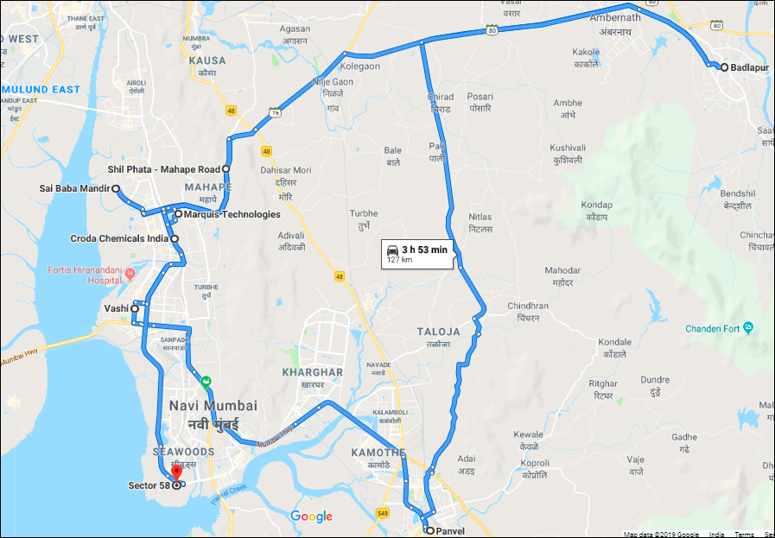
Drive Route & Network Information for Airtel

Slide 9
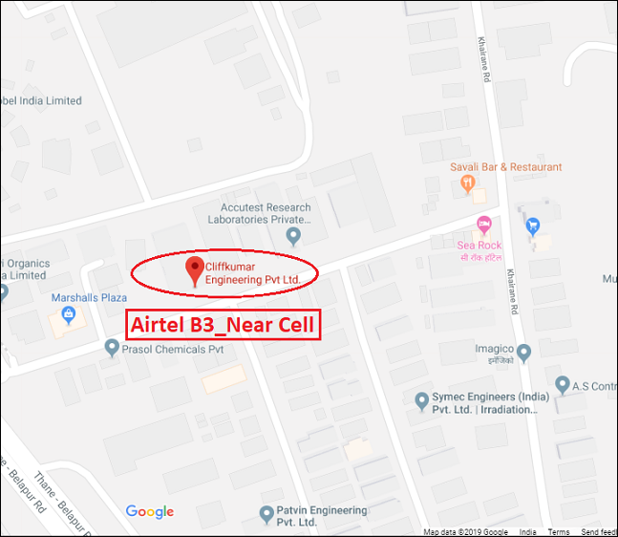
Airtel Band 03 (Near Cell):- Cliff Kumar Engg. Pvt Ltd ,Croda
Operator: Airtel
RSRP: -60dBm to -70dBm
Lat: 19.0991579
Long: 73.0162555
BAND: 03
E-ARFCN: 1425
PCI: 08

Slide 10
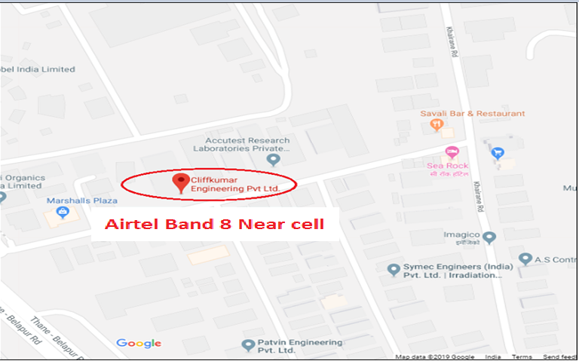
Airtel Band 03 (Near Cell):- Cliff Kumar Engg. Pvt Ltd ,Croda

Slide 11
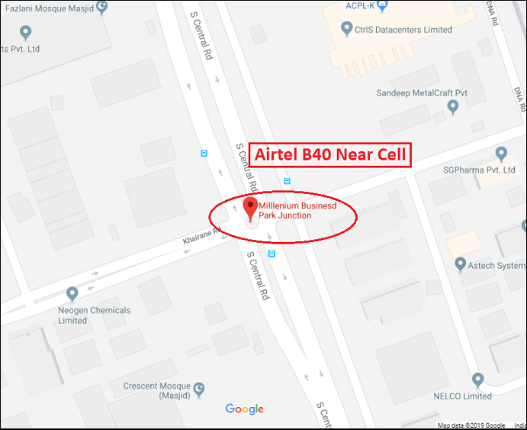
Airtel Band 40 (Near Cell):- MBP Junction, MIDC Area
Operator: Airtel
RSRP: -60dBm to -75dBm
Lat: 19.1070826
Long: 73.0228892
BAND: 40
E-ARFCN: 39050
PCI: 368

Slide 12
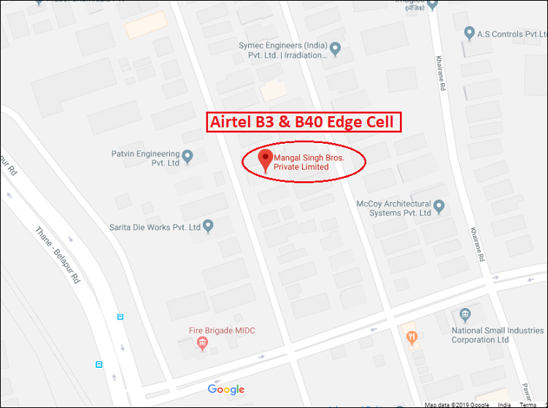
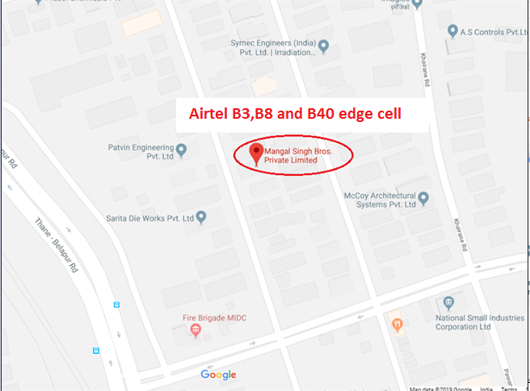
Airtel Band 03,08 & B40(Edge Cell): Mangal Singh Bros Pvt Ltd.
Operator: Airtel
RSRP: -90dBm to -115dBm
Lat: 19.0967109
Long: 73.017629
BAND: 03,08 & B40
PCI: 15 + 15

Slide 13
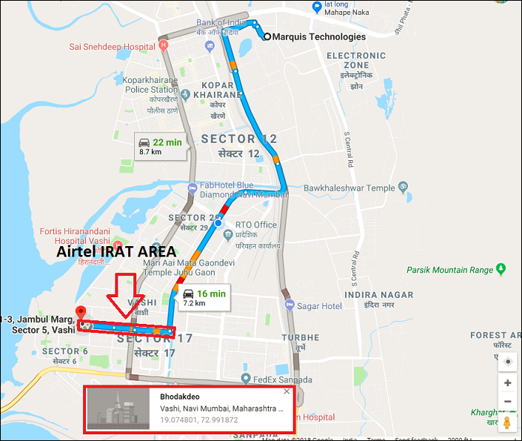
Airtel IRAT: LTE→WCDMA→GSM
Operator: Airtel
Lat: 19.074801
Long: 72.991872

Slide 14
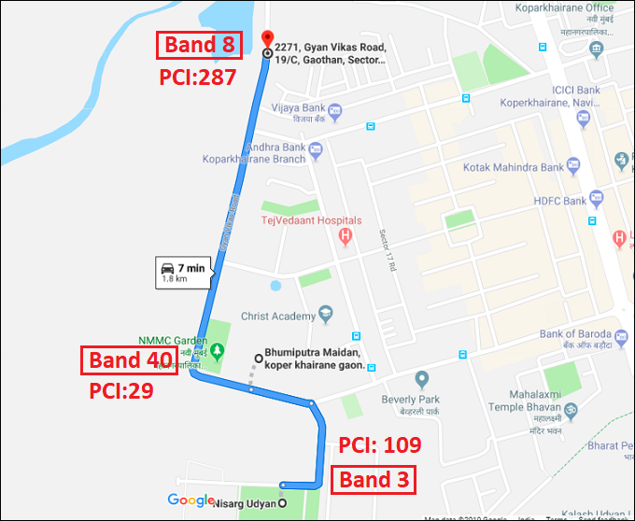
Airtel Band HO B8>>B40>>B3
Operator: Airtel
Lat: 19.1003867/19.1003867
Long: 72.9951049/ 72.9951049
Cell ID: 287(B8)>>29(B40)>>109(B3)
Location: Gyan Vikas Road

Slide 15
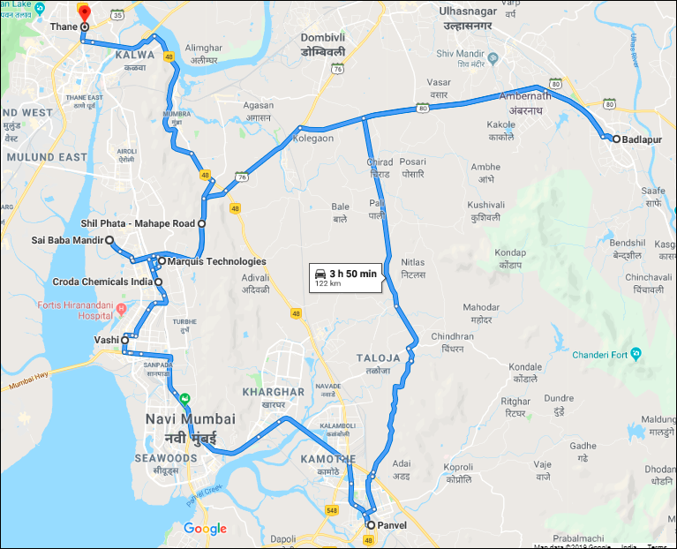
Vodafone Drive Route:

Slide 16
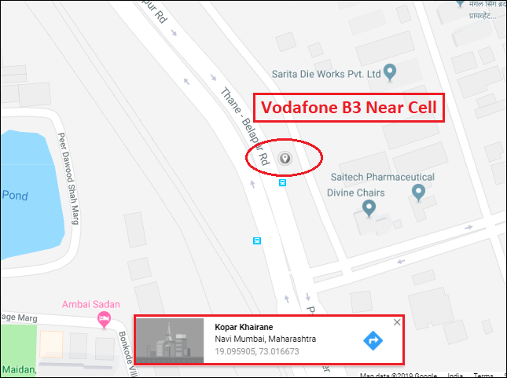
Vodafone Band 03(Near Cell): (Near White House, Croda)
Operator: Vodafone
RSRP: -60dBm to -70dBm
Lat: 19.0960745
Long: 73.015481
Band: 03

Slide 17
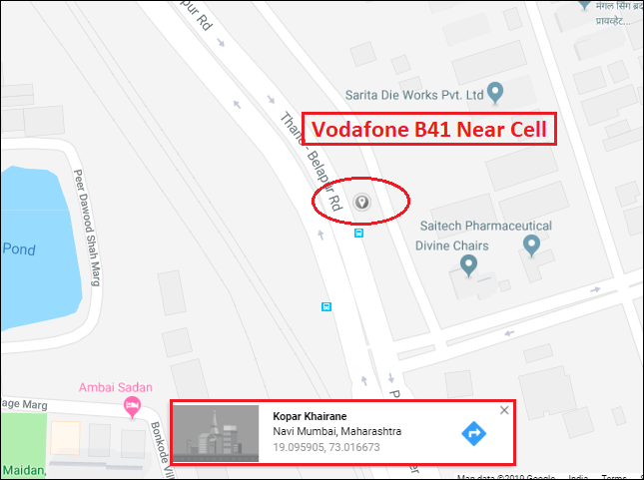
Vodafone Band 41(Near Cell): (Near White House, Croda)
Operator: Vodafone
RSRP: -65dBm to -75dBm
Lat: 19.0966481
Long: 73.017929
Band: 41

Slide 18
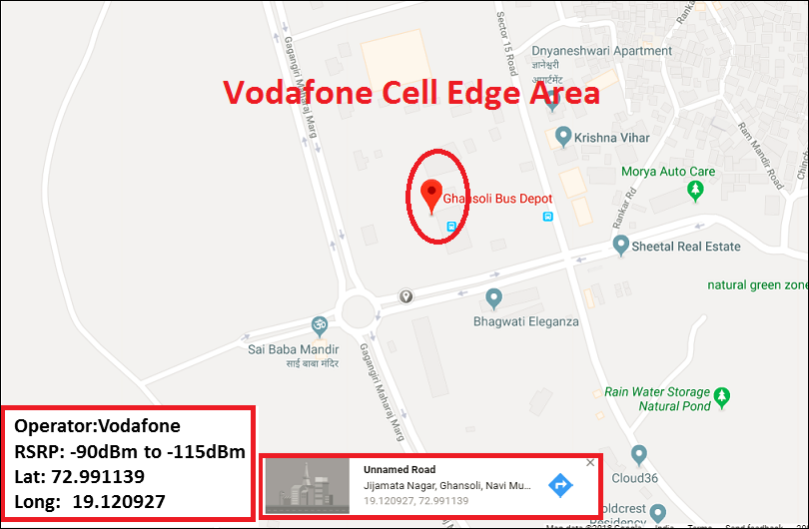
Vodafone Band 03 & B41 (Edge Cell):
Operator: Vodafone
RSRP: -90dBm to -105dBm
Lat: 19.120927
Long: 72.991139
BAND: 03 & 41

Slide 19
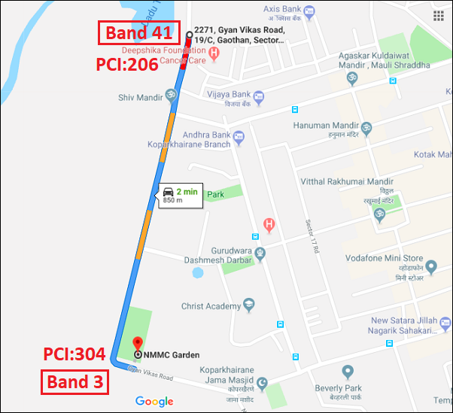
Vodafone Band HO 41>>B3
Operator: Vodafone
Lat: 19.1003867/19.1048373
Long: 72.9951049/ 72.9968212
Cell ID: 206(B41)>>304(B3)
Location: Gyan Vikas Road

Slide 20
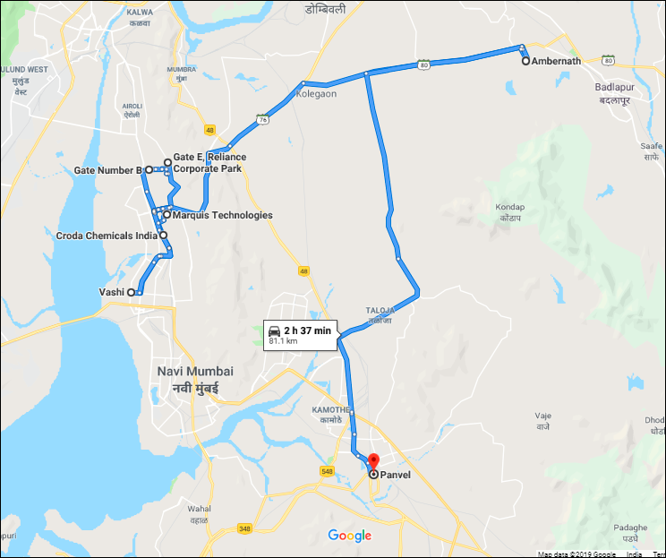
JIO4G Drive Route:

Slide 21
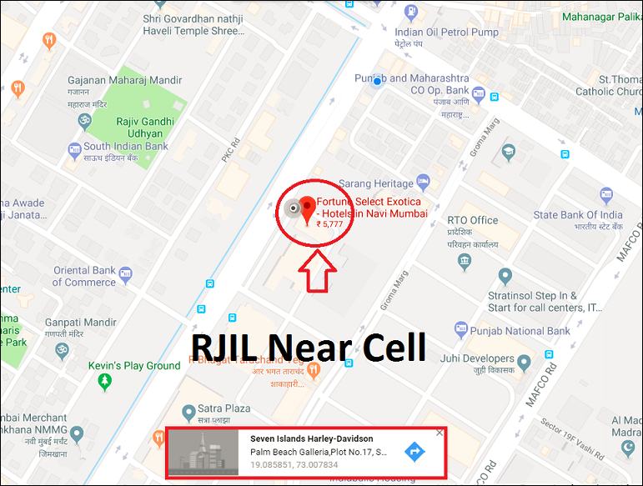
JIO4G Band 3(Near Cell): Fortune Hotel
Operator: JIO4G
RSRP: -50 dBm to -65dBm
Lat: 19.085851
Long: 73.007834
E-ARFCN: 1234

Slide 22
JIO4G Band 5(Near Cell): Fortune Hotel
Operator: RJIL
RSRP: -50 dBm to -65dBm
Lat: 19.085851
Long: 73.007834
E-ARFCN: 2539

Slide 23
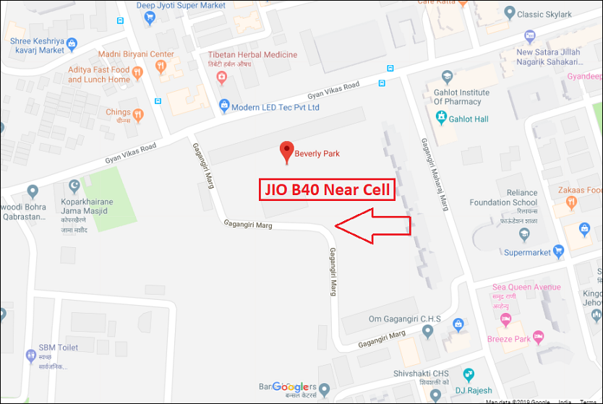
JIO4G Band 40(Near Cell): Near Beverly Park
Operator: JIO4G
RSRP: -65dBm to -75dBm
Lat: 19.0972751
Long: 73.000348
E-ARFCN: 38850
PCI: 303

Slide 24
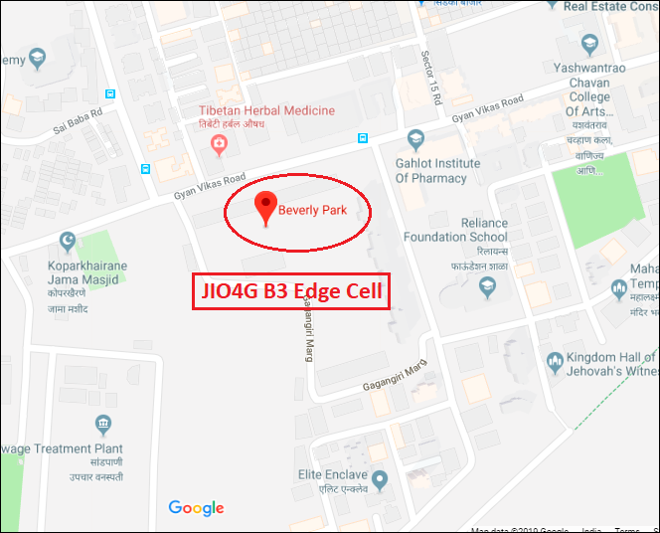
JIO4G B3(Edge Cell): Beverly Park
Operator: JIO4G
RSRP: -85dBm to -95dBm
Lat: 19.0976142
Long: 72.9996544
Band: 3

Slide 25
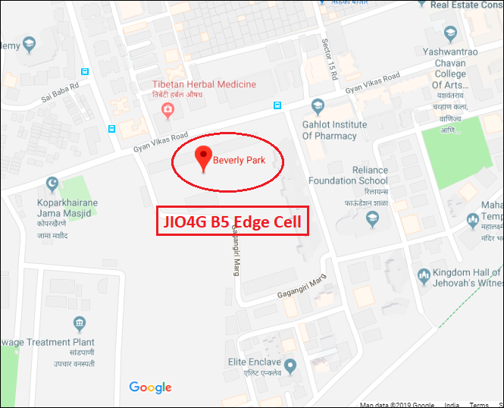
JIO4G B5(Edge Cell): Beverly Park
Operator: JIO4G
RSRP: -85dBm to -95dBm
Lat: 19.0976142
Long: 72.9996544
Band: 5

Slide 26
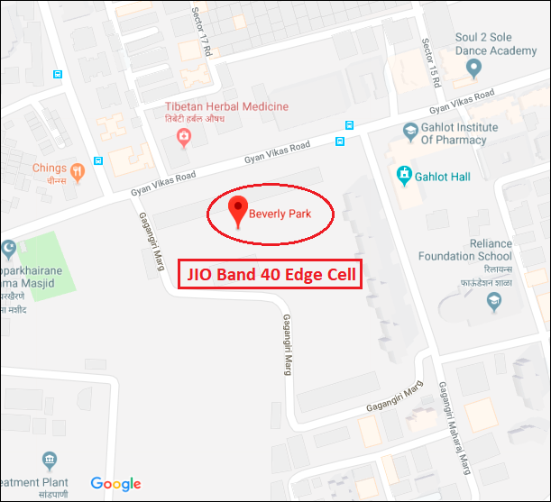
JIO4G B40(Edge Cell): Beverly Park
Operator: JIO4G
RSRP: -90dBm to -105dBm
Lat: 19.0976142
Long: 72.9996544
Band: 40

Slide 27
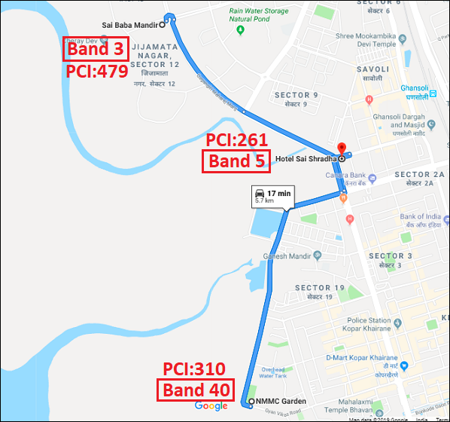
JIO Band HO(B40 >> B5 >> B3)
Operator: JIO4G
Lat: 19.0978626/19.1094235
Long: 72.9940834/72.9871849
Band: B5 >> B5 >> B3
Location : NMMC garden to Sai Baba Mandir

Slide 28
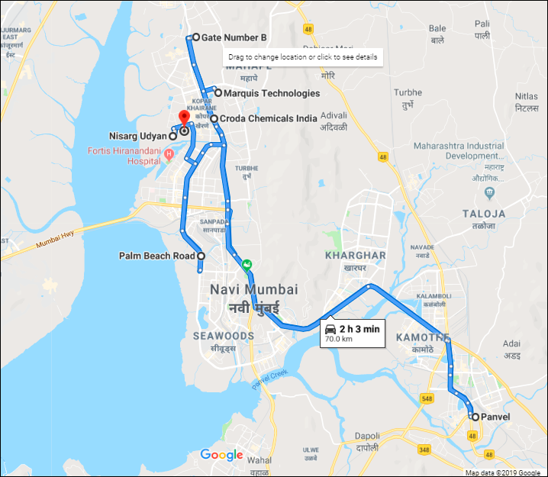
IDEA Drive Route

Slide 29
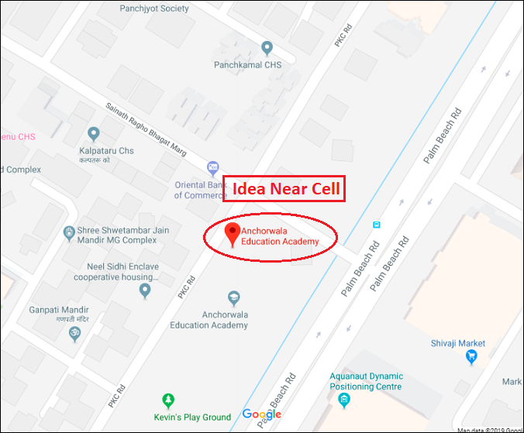
Idea (Near Cell): Anchorwala Edu. Academy
Operator: Idea
RSRP: -55dBm to -65dBm
Lat: 19.0845189
Long: 73.0056965
Band: 1

Slide 30
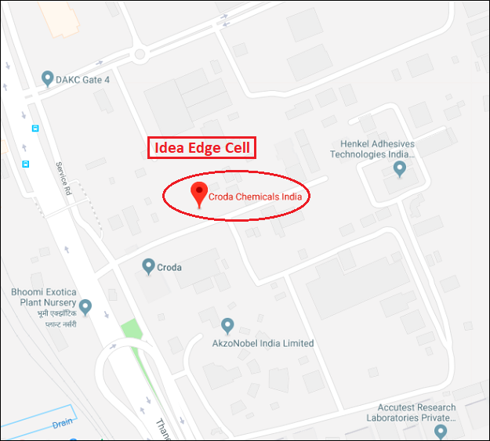
Idea (Edge Cell): Croda Chemicals
Operator: Idea
RSRP: -90dBm to -105dBm
Lat: 19.1018426
Long: 73.0130362
Band: 1

Slide 31
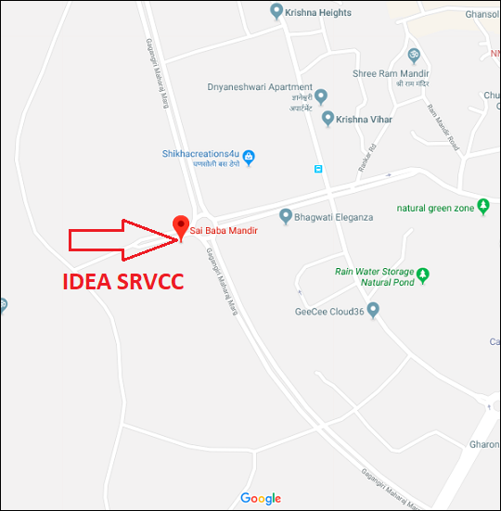
Idea SRVCC: Sai Baba Mandir, Ghansoli drive
Operator: Idea
Lat: 19.1201233
Long: 72.9916972
Band: 1

Slide 32
Emergency No. Used
Sr. No. | Emergency number Used for | Number
1 | General Emergency No. | 112
2 | General Emergency No. | 911
3 | Police | 100
4 | Fire | 101
5 | Ambulance | 102

Slide 33
THANK YOU
MARQUIS TECHNOLOGIES
www.marquistech.com

