Slide 1
DRIVE ROUTE- South Korea
Operator’s in South Korea:
KT
SKT
LGU+

Slide 2
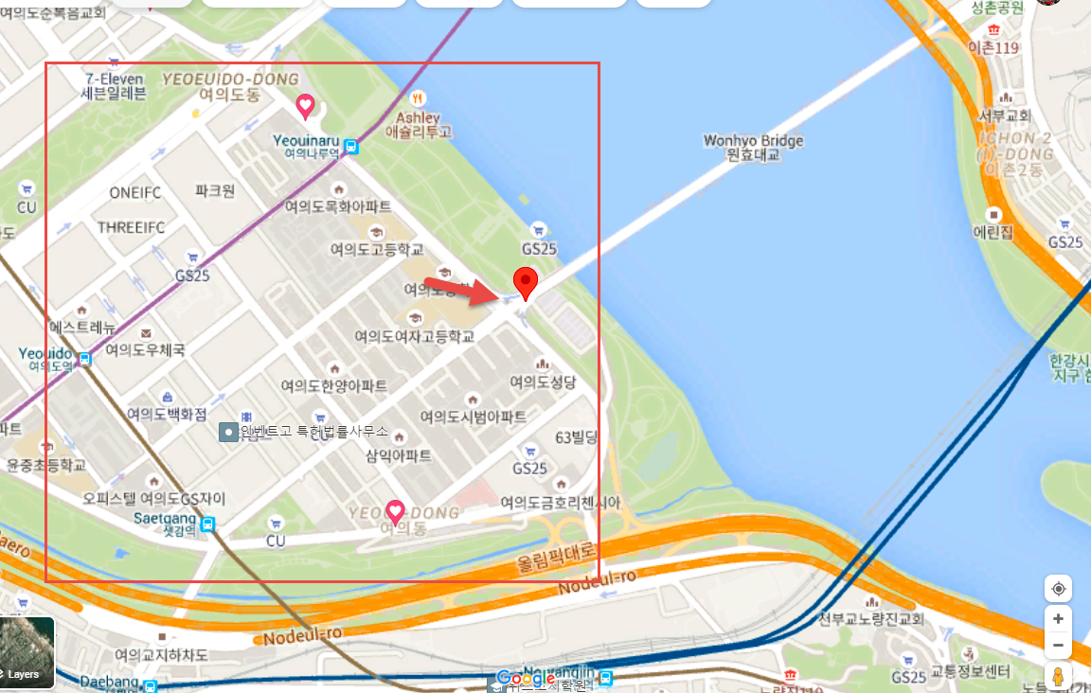
CA Location for All operator’s
CA Location for all the operator’s at:
Yeouidong-ro, Yeoeuido-dong, Yeongdeungpo-gu, Seoul

Slide 3
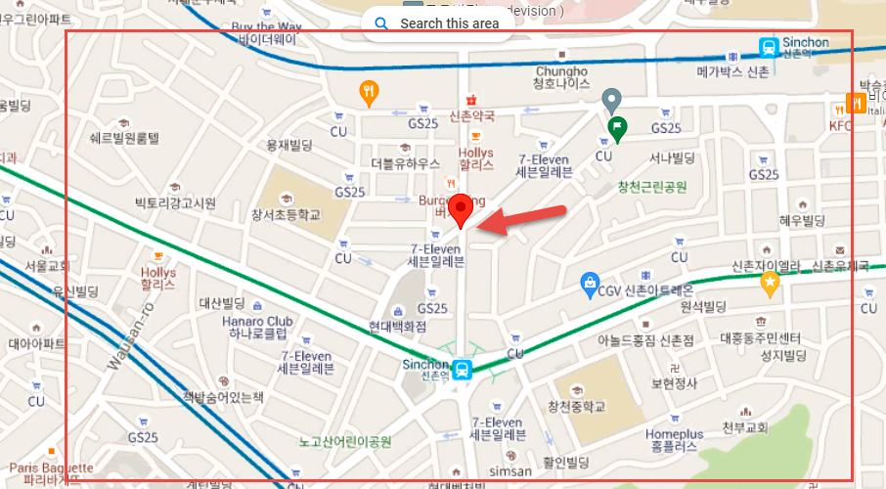
KT 5G NR Largest Location in Seoul
5G NR largest Location (Main Test location): (Changcheon-dong, Seodaemun-gu, Seoul)
KT 5G NR is already commercial we can find anywhere in Seoul.
For official NR Network Map visit : https://nqi.kt.com/KTCVRG/coverage

Slide 4
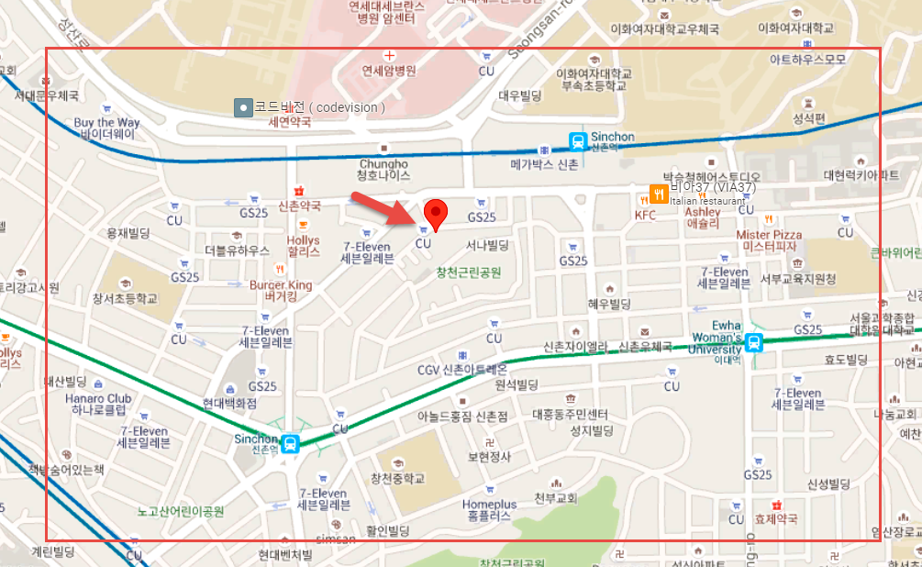
SKT 5G NR Largest Location in Seoul
5G NR largest Location(Main Test location): 5-70 Changcheon-dong, Seodaemun-gu, Seoul.
SKT 5G NR is already commercial we can find anywhere in Seoul.
For official NR Network Map visit : https://sktcoverage.com/map?TYPE=FIVEG

Slide 5
LGU+ 5G NR Largest Location in Seoul
5G NR largest Location(Main Test location): 5-70 Changcheon-dong, Seodaemun-gu, Seoul.
LGU+ 5G NR is already commercial we can find anywhere in Seoul.
For official NR Network Map visit : http://www.uplus.co.kr/css/iner/RetrieveCoverMapNoneSSL.hpi

Slide 6
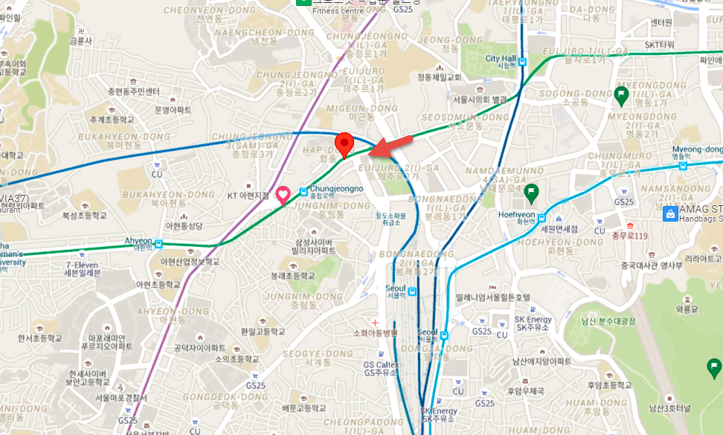
KT 4G TAC CHANGE
TAC change Location: 21-9 Chunghyeon-dong, Seodaemun-gu, Seoul

Slide 7
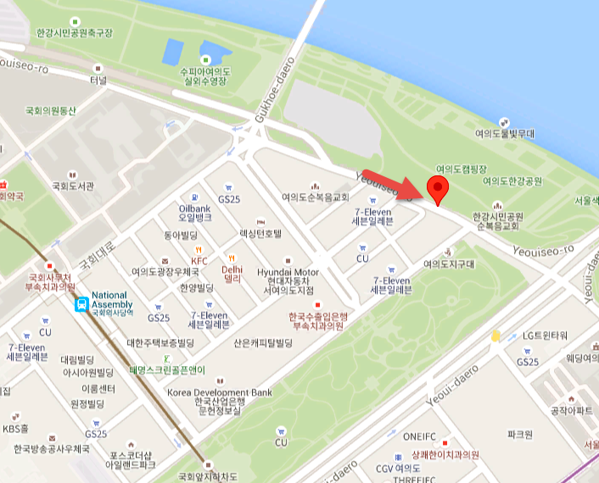
SKT 4G TAC CHANGE
TAC change Location: Yeoeuido-dong, Yeongdeungpo-gu, Seoul

Slide 8
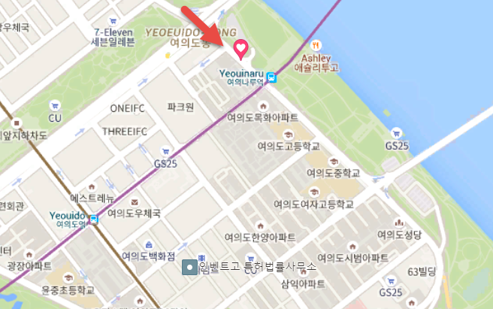
LGU 4G TAC CHANGE
TAC change Location: Yeouiseo-ro, Yeoeuido-dong, Yeongdeungpo-gu, Seoul

Slide 9
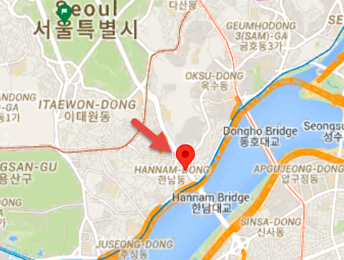
KT 5G NR TAC CHANGE
TAC change location: 167-1 Hannam-dong, Yongsan-gu, Seoul

Slide 10
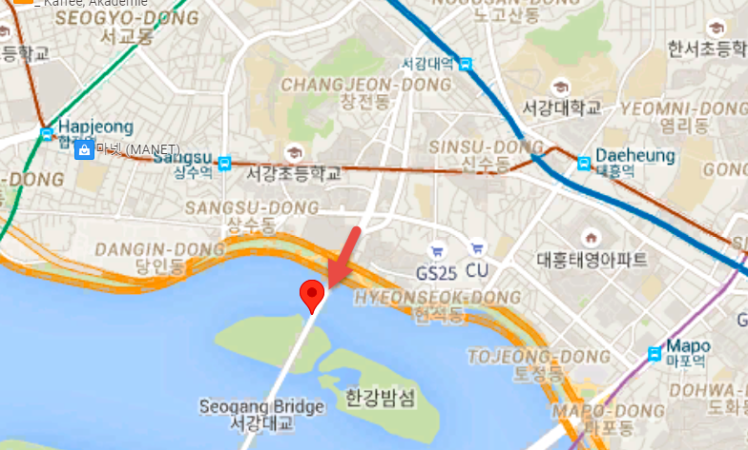
SKT 5G NR TAC CHANGE
TAC change location: Seogang Bridge, Hajung-dong, Mapo-gu, Seoul

Slide 11
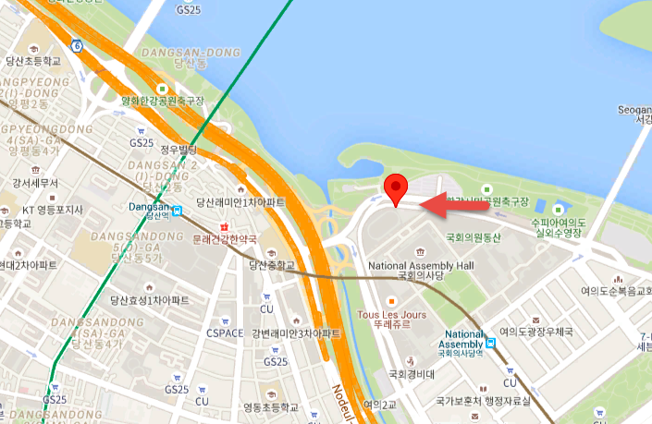
LGU 5G NR TAC CHANGE
TAC change location: Yeoeuido-dong, Yeongdeungpo-gu, SeoulHelsinki

Slide 12
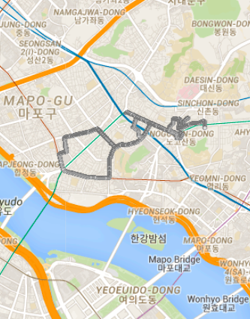
KT 5G NR HANDOVER TEST LOCATION
NR handover location: Emha Women University to Hongik University to Hapjeong Station
[All NR handover (LTE#1+NR#1 → LTE#2+NR#2; LTE#1+NR#1 → LTE#1+NR#2; LTE#1+NR#1 → LTE#2+NR#1)
5G is commercially available so no LTE only coverage area observed while testing
As per logs analysis, handover test cases can be cover from above route.

Slide 13
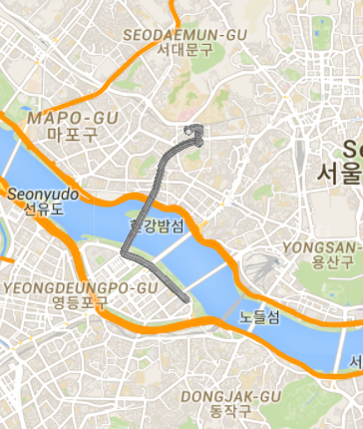
SKT 5G NR HANDOVER TEST LOCATION
NR handover location: Drive from
Changcheon-dong, Seodaemun-gu to Emha Women University to Han River
[All NR handover (LTE#1+NR#1 → LTE#2+NR#2; LTE#1+NR#1 → LTE#1+NR#2; LTE#1+NR#1 → LTE#2+NR#1)
5G is commercially available so no LTE only coverage area observed while testing
As per logs analysis, handover test cases can be cover from above route.

Slide 14
LGU 5G NR HANDOVER TEST LOCATION
NR handover location: Drive : Emha Women University to Hongik University to Hapjeong Station
[All NR handover (LTE#1+NR#1 → LTE#2+NR#2; LTE#1+NR#1 → LTE#1+NR#2; LTE#1+NR#1 → LTE#2+NR#1)
5G is commercially available so no LTE only coverage area observed while testing
As per logs analysis, handover test cases can be cover from above route.

Slide 15
KT AND SKT 4x4 MIMO LOCATION (4_CA)
Location : 5-70 Changcheon-dong, Seodaemun-gu, Seoul.
KT Band Combination (B8+B1+B3+B3), (B3+B1+B8+B3), (B1+ B3+B8+B3) SKT Band Combination : (B5+B7+B1+B3), (B3+B7+B7+B1), (B3+B1+B5+B7)

Slide 16
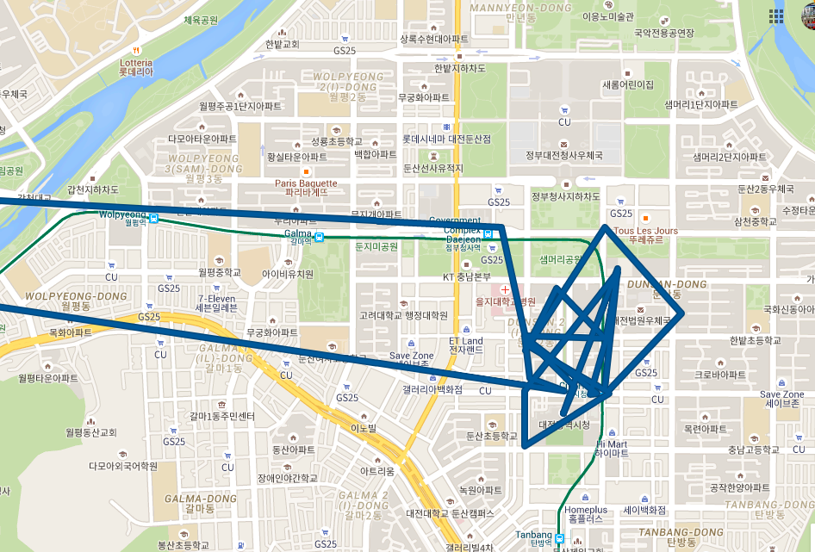
KT Drive Route City Daejeon
For Mobility 5G SA KT Operator in Daejeon
We can perform in Dunsanbuk-ro
Lat : 36.3553642 , Long: 127.3895787

Slide 17
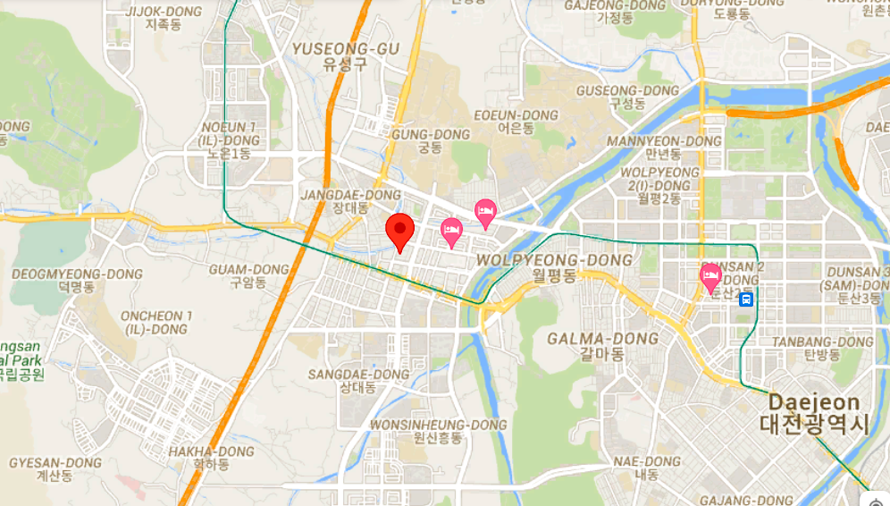
KT Drive Route City Daejeon
For Stationary 5G SA KT Operator in Daejeon
We can perform in Namoo Hotel Daejeon
Lat : 36.35706603, Long: 127.3400020

Slide 18
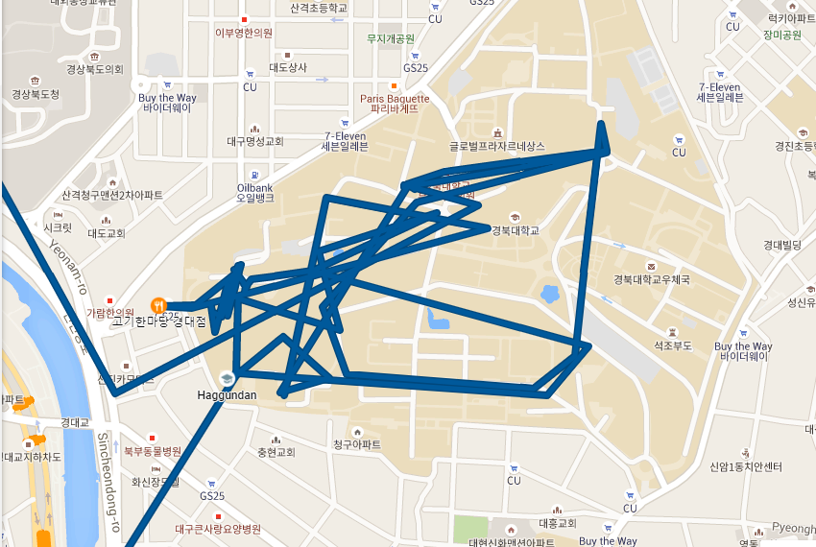
KT Drive Route City Daegu
For Mobility 5G SA KT Operator in Daegu
We can perform in Kyungpook National University Daegu Campus
Lat : 35.889341 , Long: 128.610053

Slide 19
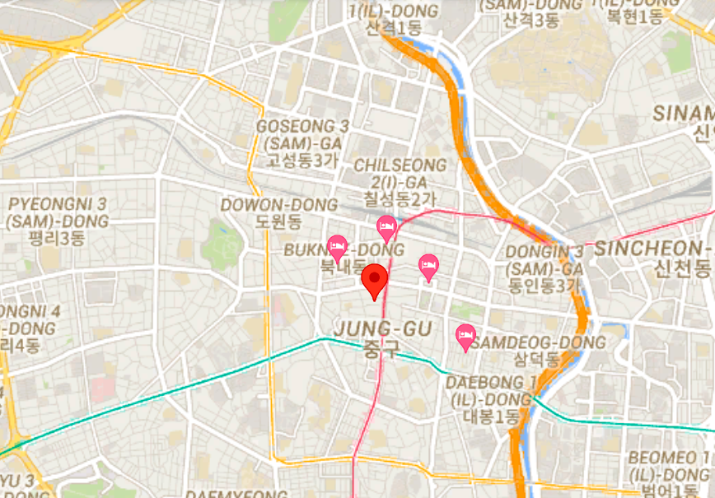
KT Drive Route City Daegu
For Stationary 5G SA KT Operator in Daegu
We can perform in February Hotel Dongseongro
Lat : 35.87033166, Long: 128.59254704
Please request to Network condition before check in. Preferred Room 706 or 809

Slide 20
Thank You

