Slide 1
MARQUIS TECHNOLOGIES
Drive Route Saudi arabia RIYADH

Slide 2
(Location Name)
Country | Saudi Arabia
Continent | Middle East
City | Riyadh
Time Zone | GMT + 01:00 Hour PM GMT + 06:00 PM

Slide 3
Operators in Location
MCC | MNC | Operator
01 | 420 | STC
01 | 420 | ZAIN
01 | 420 | Mobily
STC operator Network Info
RAT | Band | Comment
5G | N78
4G | B1(2100MHz,B3 (1800MHz),B28 (9310MHz
3G | 900MHz
2G | 900(E-GSM)
Zain operator Network Info
RAT | Band | Comment
5G | N78
4G | B1 (2100MHz) B3(1800MHz,B20 (6200 MHz)
3G | 900MHz
2G | 900(E-GSM)
Mobily operator Network Info
RAT | Band | Comment
5G | N78
4G | B1(2100MHz),B3 (1800MHz) B8(900MHz
3G | 900MHz
2G | 900(E-GSM)

Slide 4
Operators and general Information
STC- Supports 5G,LTE, VoLTE, VoWifi , WCDMA and 2G
ZAIN- Supports 5G, LTE, VoLTE ,VoWifi, WCDMA and 2G
MOBILY Supports 5G , LTE, VoLTE, VoWIFI, WCDMA and 2G

Slide 5
RSRP Criteria
Poor coverage :-Stationary: RSRP: -75dbm to -95dbm
Mixed :-Mobility: RSRP : -75dbm to -95dbm
SRVCC :-Stationary: RSRP : -95dbm to -115dbm

Slide 6
Operator

Slide 7
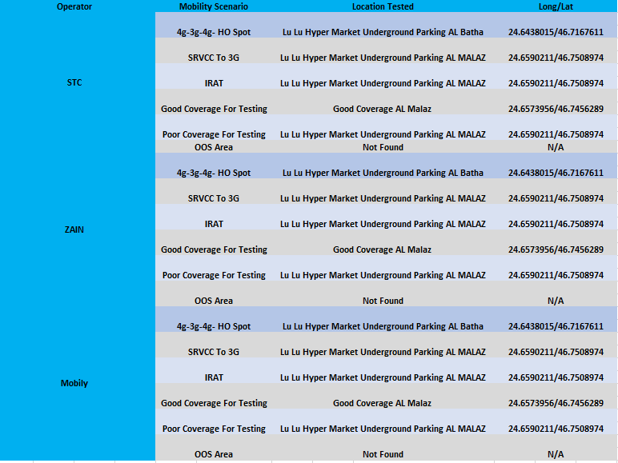

Slide 8
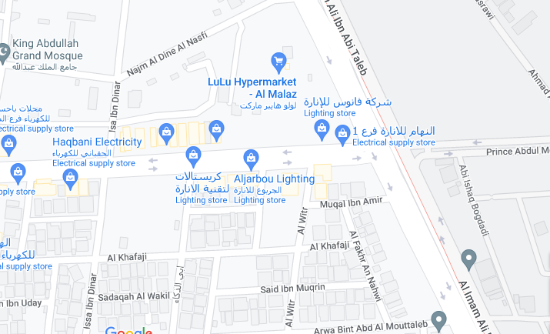
Poor Coverage for testing SRVCC to 3G

Slide 9
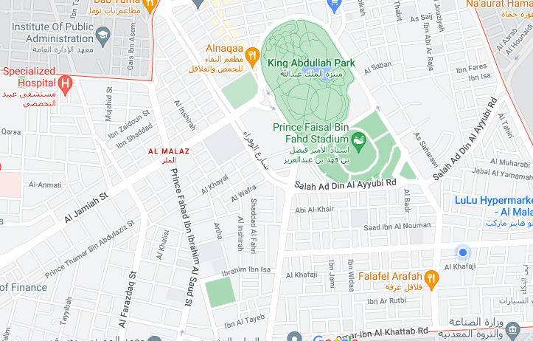
4G-3G-4G HO SPOT SRVCC-3G

Slide 10
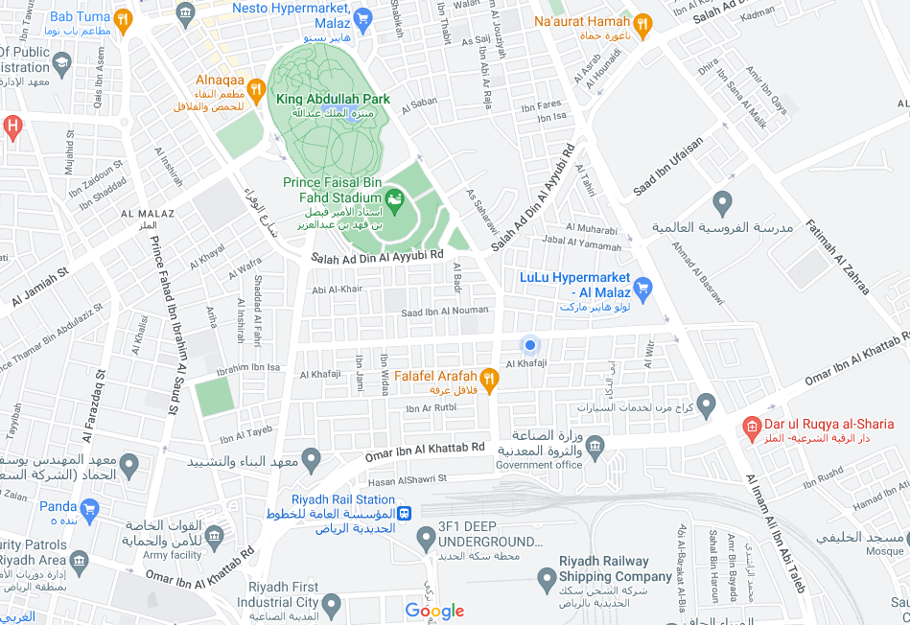
( Mixed Mobility Area) screenshots

Slide 11
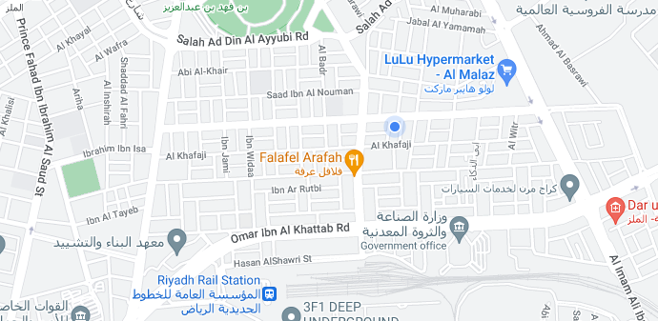
5G STC Drive Route
AL Malaz >>Salah ad din al ayyubi >> Prince fahad ibne ibrahim >> Omar Ibn AL Khetab RD >> AL Farazdaq St.
RSRP: -65dbm to -100dbm Long/Lat: 24.6590211/46.7508974

Slide 12
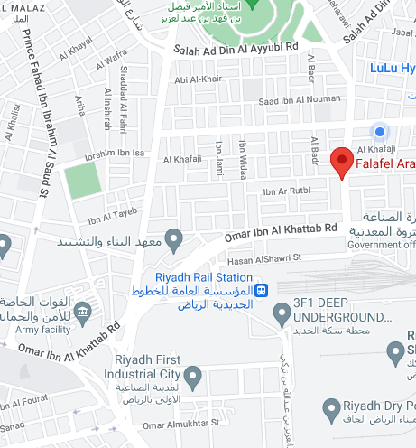
5G ZAIN Drive Route AL Malaz >>Salah ad din al ayyubi >> Prince fahad ibne ibrahim >> Omar Ibn AL Khetab RD >> AL Farazdaq St AL batha. RSRP: -65dbm to -100dbm Long/Lat: 24.6590211/46.7508974

Slide 13
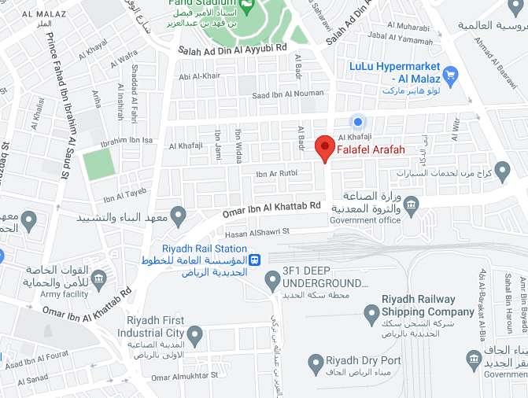
5G ZAIN Drive Route Riyadh first industrial city >> Prince fahad ibne ibrahim >> Al malaz >> Omar Ibn AL Khetab RD >> AL Farazdaq St AL batha. RSRP: -65dbm to -100dbm Long/Lat: 24.6690211/46.7608974

Slide 14
THANK YOU
MARQUIS TECHNOLOGIES
www.marquistech.com

