Slide 1
5G Network Route For Saudi Arabia _MTK FT
Saudi Arabia Location:
Riyadh
Mecca
3. Dammam

Slide 2
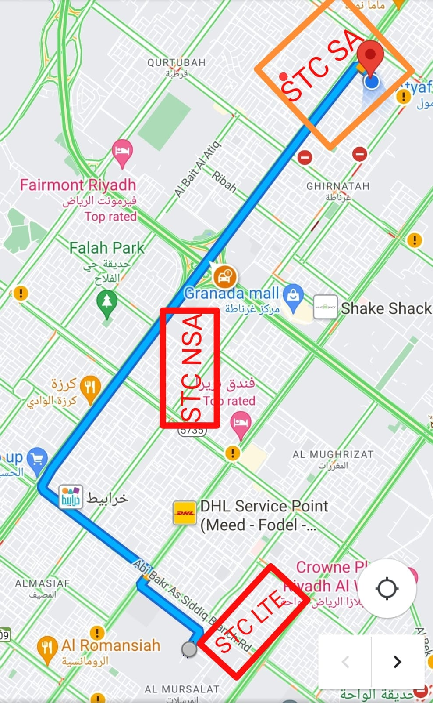
STC SA-NSA-LTE HO
SIM 1 + SIM 2 | STC
NR band / BW (Ex. N71_30) | B3+N78
NR cell ID | 232
NR RSRP | -88
NR SinR | 4
Date | 8/4/2023
Location / GPS | STC Gate 5

Slide 3
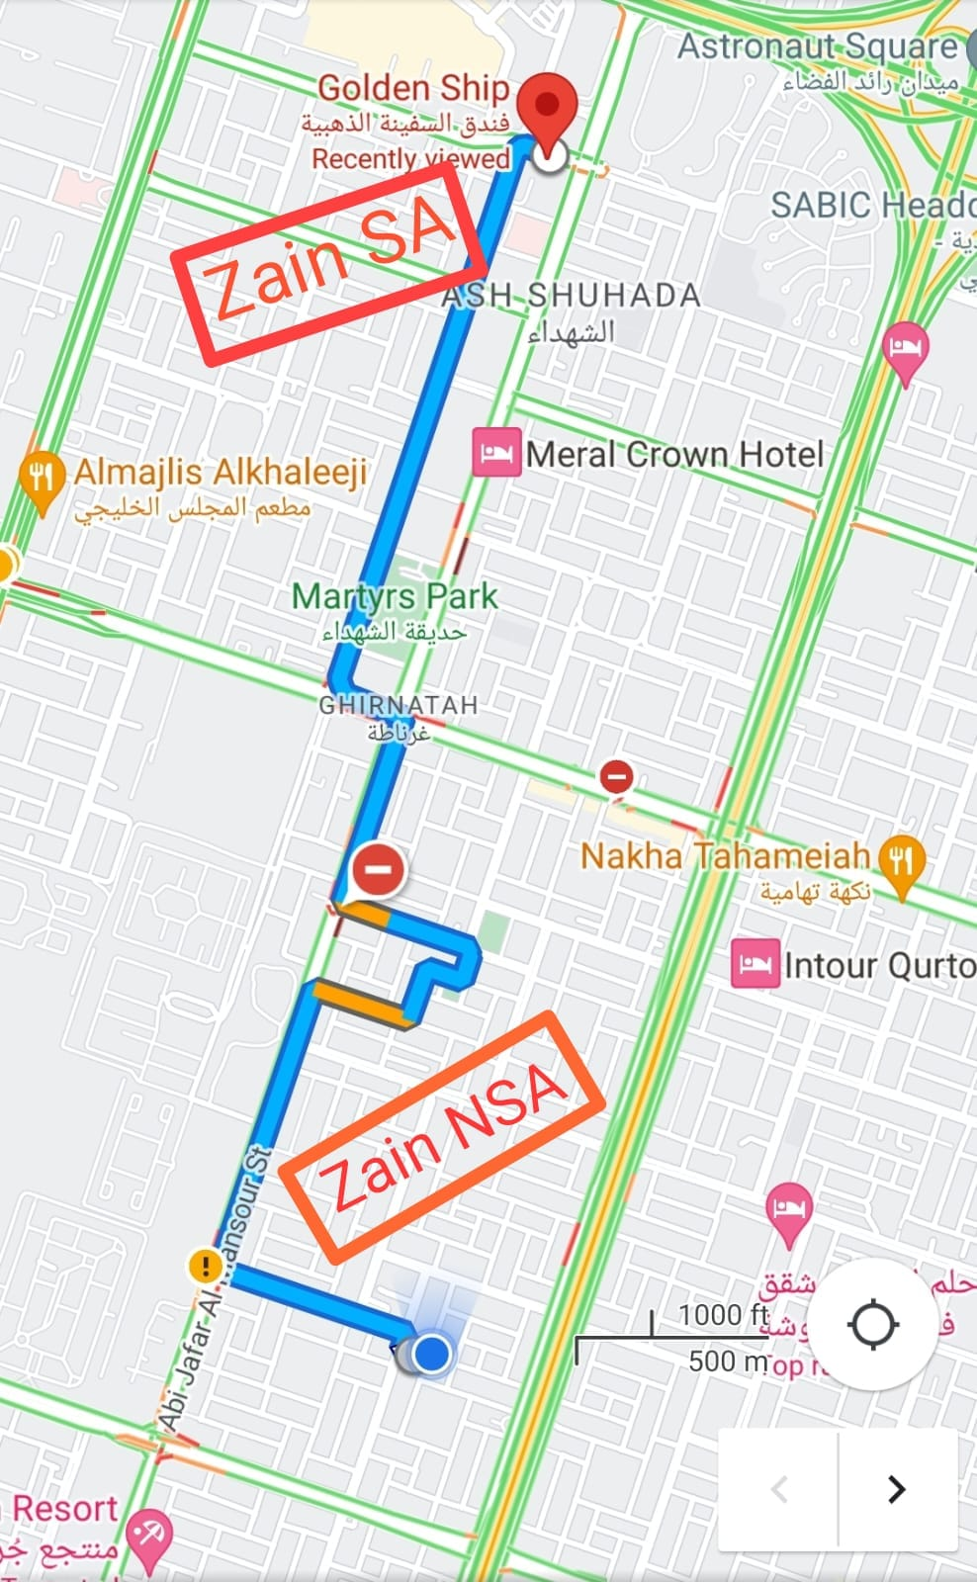
ZAIN SA _ NSA Points
SIM 1 + SIM 2 | ZAIN
Server IP address/Name | ZAIN
Start LTE+NR band / BW | B3+B41+N78
Start LTE+NR cell ID | 210+597
Date | 3/28/2023
Location / GPS / route link | 24.7956487,46.7381793

Slide 4
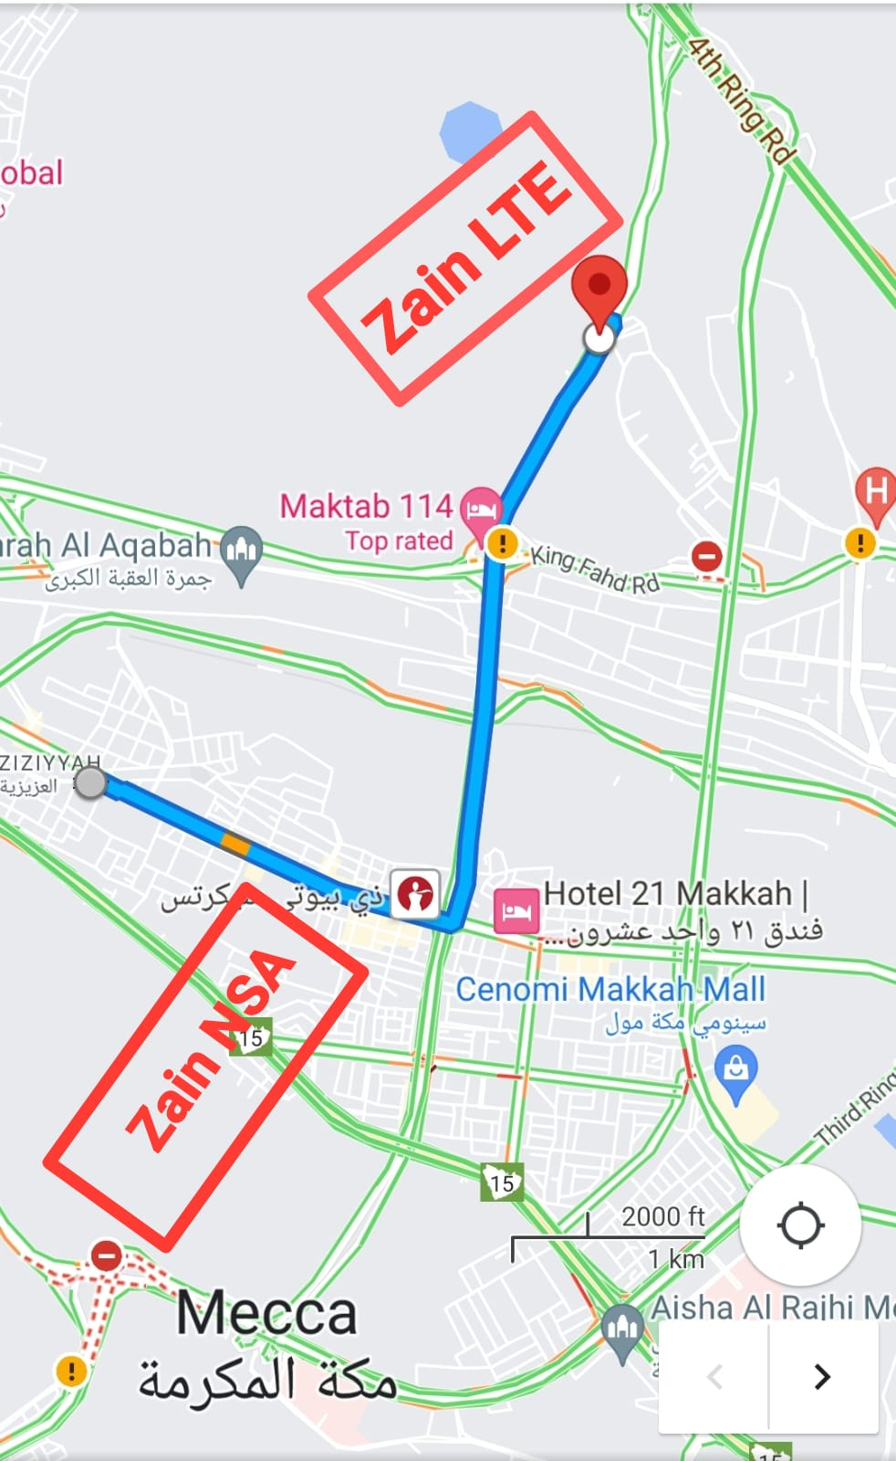
ZAIN NSA-LTE HO
SIM 1 | ZAIN
Server IP address/Name | ZAIN
Start LTE+NR band / BW | B3+N41+N78
Start LTE+NR cell ID | 210+597
Date | 3/28/2023
Location / GPS / route link | 21.426685,39.892026
21.426685,39.892026 Zain LTE

Slide 5
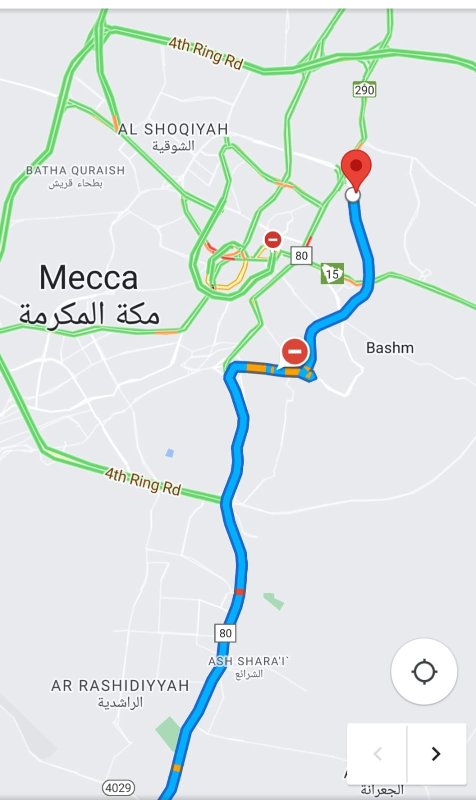
Mobily NSA>>LTE HO
SIM 1 | Mobily
Server IP address/Name | Mobily
Start LTE+NR band / BW | B1+B78
Start LTE+NR cell ID | 56
Date | 3/22/2023
Location / GPS / route link | 21.446457,39.781262
21.446457,39.781262Mobily NSA>>LTE HO

Slide 6
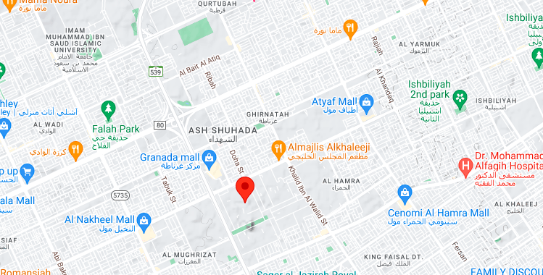
Dammam 5G Pin location
SIM 1 + SIM 2 | MOBILY
LTE/NR/band / BW (Ex. N71_30) | B20/N78
cell ID | 383
RSRP | 75 to 80
SinR | 1 to 5
Date | 4/5/2023
Location / GPS | 24.7862988,46.7287659
SIM 1 + SIM 2 | STC
band / BW (Ex. N71_30) | B1/N78
cell ID | 124
RSRP | 86 to 90
SinR | 1 to 5
Date | 4/5/2023
Location / GPS | 24.7862988,46.7287659
SIM 1 + SIM 2 | ZAIN
band / BW (Ex. N71_30) | B20/N78
cell ID | 281
RSRP | 65 to 70
SinR | 15 to 20
Date | 4/5/2023
Location / GPS | 24.7862988,46.7287659

