Slide 1
MARQUIS TECHNOLOGIES NL
T Mobile, KPN and Vodafone SRVCC, IRAT, HO, Intra Frequency HO Route and 5G small cell location Overview
Vishal B. Dongare
Date :- 18th October 2020

Slide 2
KPN 5G Throughput, SRVCC, IRAT, Intra Frequency HO and 5G to 4G HO Locations

Slide 3
KPN 5G Small cell, Throughput Location details
KPN has Implemented 5G-B28 in Amsterdam
Location: MQT Apartment (@52.3521485,4.8341271)
NR Frequency – 773/718 MHz
NARFCN – 154600
EARFCN - 1300
NR PCI– 315, 369
DL BW – 10MHZ
UL BW – 10MHZ
DL Subcarrier Spacing – 15 kHz
UL Subcarrier Spacing – 15 kHz
SINR– 15-20
DL Data Split Path- DL:NR
UL Data Split path- UL:NR
Modulation type- DL 256QAM
NR SSB Index- 3

Slide 4
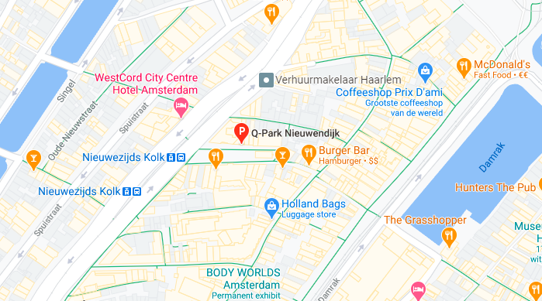
KPN SRVCC and IRAT Location
@52.3764458,4.894485 (Q-Park Nieuwendijk, Nieuwezijds Kolk 18, 1012 PV Amsterdam

Slide 5
Continued
Steps to Know before you start SRVCC or IRAT test
Before driving inside parking DUT will go from 5G to 4G →Drive to entry point
Now take Parking ticket
Go inside and car will go left, keep device ready as now it will go to 3G (During call or IRAT)
Go straight and come to entry point of parking where your device will again camp on 4G (Do not go out of parking if you have another round or test case to do, otherwise you will have to buy another ticket to enter which will cost you 2Euro)
Don’t stop for too long at the entry point as other cars also entering the parking from same entry
While Going out pay and take the receipt

Slide 6
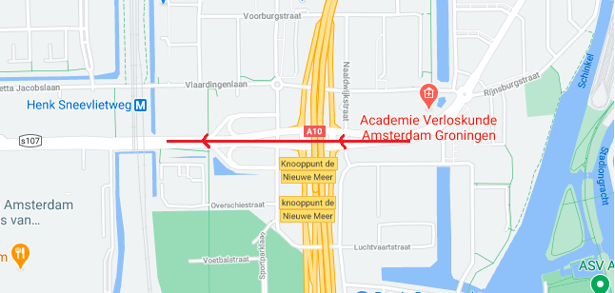
KPN Intra Frequency cell change location
@52.3457923,4.8386877; Street - Henk sneevlietweg

Slide 7
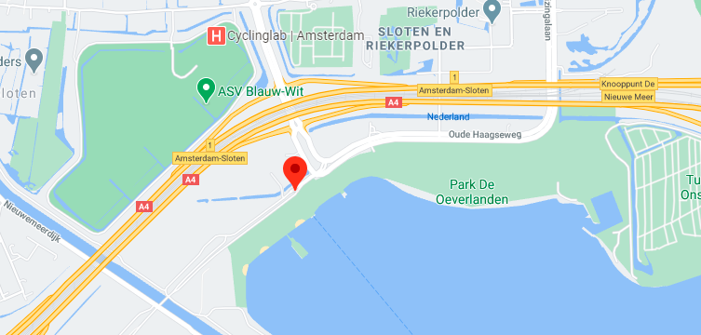
KPN 5G to 4G Handover location
@52.3360556,4.8060909; Street - Oude Haagseweg

Slide 8
T Mobile 5G Throughput, SRVCC, IRAT, Intra Frequency HO and 5G to 4G HO Locations

Slide 9
T Mobile 5G Small cell, Throughput Location details
T Mobile has Implemented 5G-B28 and B3 in Amsterdam
Location: Wimbledonpark, 1185 XJ Amstelveen(@52.2904195,4.8427377)
NR Frequency – 783/729 MHz, Band-N28
EARFCN - 1800
NR PCI– 222
DL BW – 10MHZ
UL BW – 10MHZ
DL Subcarrier Spacing – 15 kHz
UL Subcarrier Spacing – 15 kHz
SINR– 15-20
DL Data Split Path- DL: LTE & NR
UL Data Split path- UL: LTE & NR
Modulation type- DL 256QAM
NR SSB Index- 3

Slide 10
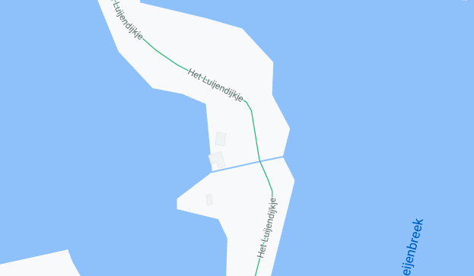
T Mobile SRVCC and IRAT Location
@52.4335049,4.8983948 (Het Twiske)

Slide 11
Continued
Steps to Know before you start SRVCC or IRAT test
T Mobile SRVCC can be easily found anywhere in Amsterdam, Also can be performed if you have RF shield bag or inside lifts
Also can be performed at park mentioned in earlier slide
Take a ticket before entering park and go inside until SRVCC or IRAT happens
While Going out pay and take the receipt

Slide 12
T Mobile Intra Frequency cell change location
@52.3457923,4.8386877; Street - Henk sneevlietweg

Slide 13
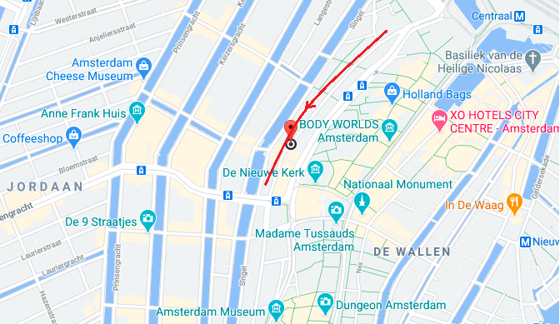
T Mobile 5G to 4G Handover location
@52.3747844,4.820562; Street - Spuistraat 100-122, 1012 VA Amsterdam

Slide 14
Vodafone 5G Throughput, SRVCC, IRAT, Intra Frequency HO and 5G to 4G HO Locations

Slide 15
KPN 5G Small cell, Throughput Location details
KPN has Implemented 5G-B28 in Amsterdam
Location: Professor R. Casimirstraat (@52.3522881,4.8067299)
NR Frequency – 806/847 MHz
EARFCN - 6300
NR PCI– 403
DL BW – 20MHZ
UL BW – 20MHZ
DL Subcarrier Spacing – 15 kHz
UL Subcarrier Spacing – 15 kHz
SINR– 15-20
DL Data Split Path- DL:LTE & NR
UL Data Split path- UL:LTE & NR
Modulation type- DL 256QAM
NR SSB Index- 2

Slide 16
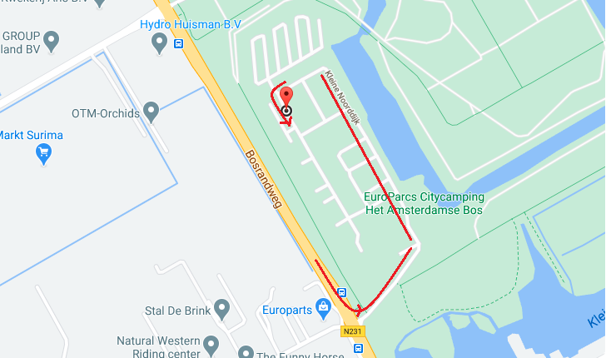
Vodafone SRVCC and IRAT Location
@52.2941344,4.8160739(Kleine Noorddijk 134, 1187 NZ Amstelveen)

Slide 17
Continued
Steps to Know before you start SRVCC or IRAT test
Vodafone does not support 3G, because of which SRVCC will be performed from 5G to 2G directly if NR device, or from 4G to 2G
Need to follow exact route shown in picture as this is Private property
It’s a camping site need to tell at the gate if asked that your there to check the site also there are children and people walking on the road, Please ask cab driver to drive slowly and only from the shown route.
When reached at the shown point, stop the cab for 10 seconds and device will perform SRVCC or IRAT from 5G to 2G, 4G to 2G

Slide 18
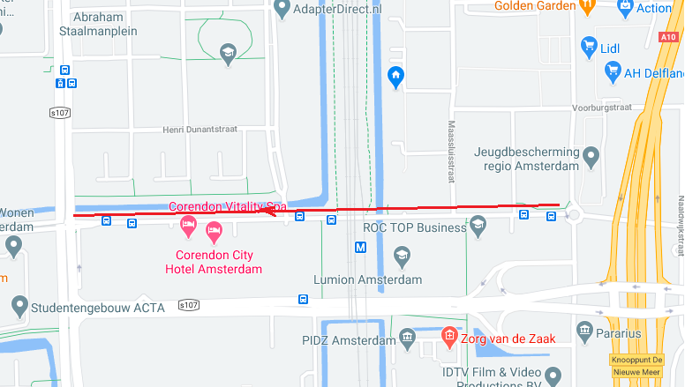
Vodafone 5G to 4G Handover location
@52.3471006,4.8311314; Street - Aletta Jacobslaan 5, 1066 BP Amsterdam

Slide 19
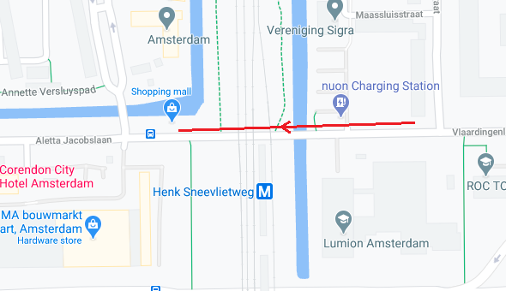
Vodafone Intra Frequency cell change location
@52.3469924,4.8353265; Street - Vlaardingenlaan, 1062 HM Amsterdam

Slide 20
Thank You

