Slide 1
UE KPI Report on BSNL Test Network_Panjab Circle

Slide 2
BSNL Network Info_Panjab Circle
Operator | Band | A-EARFCN | PCI
BSNL | 2100 | 315 | 298
 |  |  | 357
 |  |  | 358
Feature | BSNL
5G Band | Not supported
Dedicate Mode- NSA/SA | Not supported
VONR | Not supported
4G Band | Band 1 (2100 MHz )
4G CA Combination | Not Supported
USSD | *222#
VoLTE Support | Yes
ViLTE Call Support | Yes
CSFB supoort | Yes
VoWiFi Support | NO
Voicemail Services | No
UT /XCAP | NO
Conference Call Support | Yes
Infra vender name | ZTE
Supplementary services | Call Waiting, Call Forwarding, Call Hold, Conference Call

Slide 3
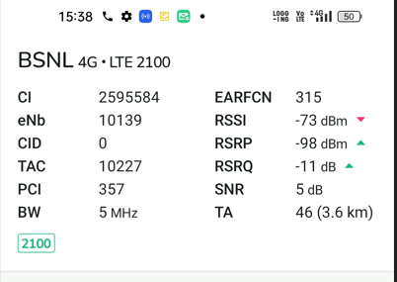
Network Info: MATT Or G Net Track

Slide 4
Test Location
Field trial are conducted in different Cell ID, Pass Fail logs on UE sides are uploaded and shared with Client with Ananlysis.
.
Day No. | Date | Site Covered | Cell ID | Issues Reported | Log Analysis
Day 1 | 15/09/2023 | AMI 008 | 101 | Upload Successful | Shared
Day 2 | 16/09/2023 | AMI 012,AMI 002 | 2, | Upload Successful | shared
Day-3 | 18/09/2023 | AMI 012 | 2,0 | Upload Successful | shared

Slide 5
Reports and Analysis
Bug Details | Log Analysis Conclusion /Failure Reason | Next Action
Issue 01 : [MQT][BSNL][VoLTE] DUT fail to register on 4G network | RACH Failure at Message 4 ( from Network) during registration | Network Team to check the reason for failure of message 4
Issue 02 : [MQT][BSNL][VoLTE] DUT is taking more time as compared to normal time to register on 4G network | Due to Authentication failure at registration process. Cause code=21 ( Sync- Failure) | Network Team to check the reason for failure of message 4
Issue 03 : [MQT][BSNL][VoLTE] Observed voice cracking & call muting while ongoing call & then UE drops the call (12/20) | Call Muted and call drop observed due to RTP inactivity and causing RTP timeout. Packet Loss is the major cause for RTP inactivity (causing RTP timeout). To prevent release of connection from UE, network node performs a method to prevent such activity. When the Network node detects a gap in packet flow, the network node prevents the UE from initiating a release of the connection caused by the gap in the packet flow, by sending a message to the UE, which message forces the UE into a failure. The failure triggers the UE to initiate a Radio Resource Control, RRC, Connection Reestablishment procedure. | Packet Loss need to be check from Network End
Issue 04 : [MQT][BSNL][VoLTE] Observed UE fallback on 2G network during volte call setup in moderate RSRP value and taking time around 35 sec to recamp on 4G after disconnecting the call .(10/20) | Fast return to LTE taking a lot of time. It is a network issue. Need to check at the network end. Observed multiple TA request in the UE logs. Need to Check the TAC / LAC relation in the Core side. Maybe these relations were not properly created. | Need To be check from Network End

