Slide 1


Marquis Technologies
Poland Drive Route

Slide 2

Operator Supporting in Poland:
Plus
Orange
T-Mobile
Play

Slide 3
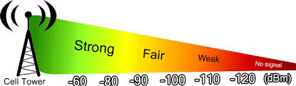
RSRP VALUES :
Near Cell :-Stationary: RSRP: -65dbm to -90dbm
Mixed :-Mobility: RSRP : -75dbm to -100dbm
Cell Edge :-Stationary: RSRP : -95dbm to -120dbm

Slide 4
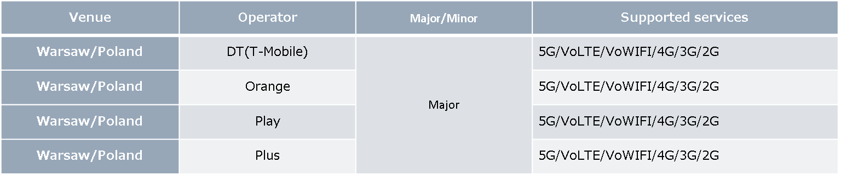
Services supported by operators

Slide 5
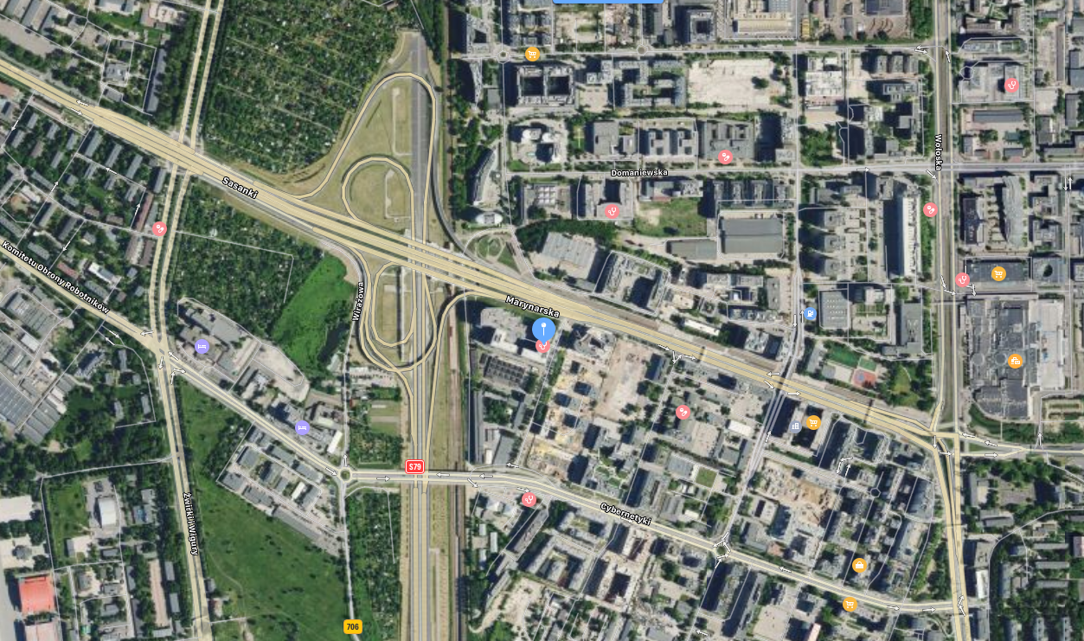
5G Band detail:
Tasmowa 7, Warszawa
52.180001, 20.989798, or 52 ° 10'48 "N 20 ° 59'23" E
RSRP: -65dbm to -95dbm
Band details: 5G Band: N1

Slide 6
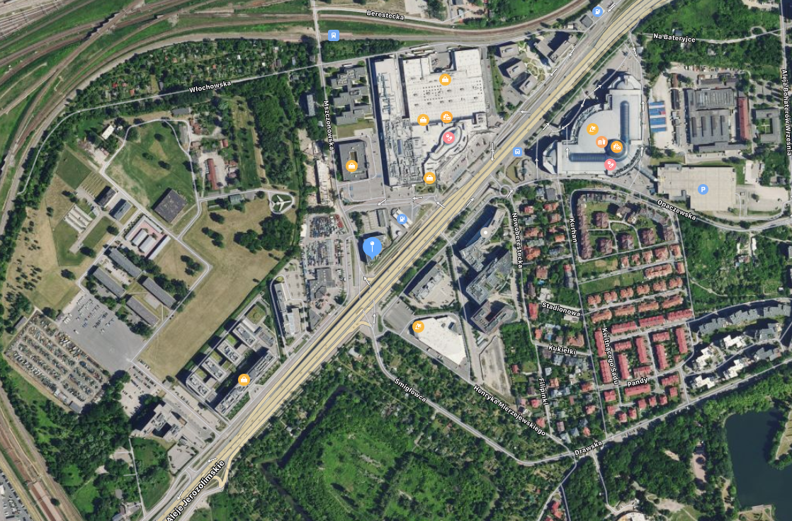
5G Band detail:
Aleje Jerozolimskie 154
52.210710, 20.949383, or 52 ° 12′38 "N 20 ° 56′57" E
RSRP: -65dbm to -95dbm
5G band: N1, N78

Slide 7
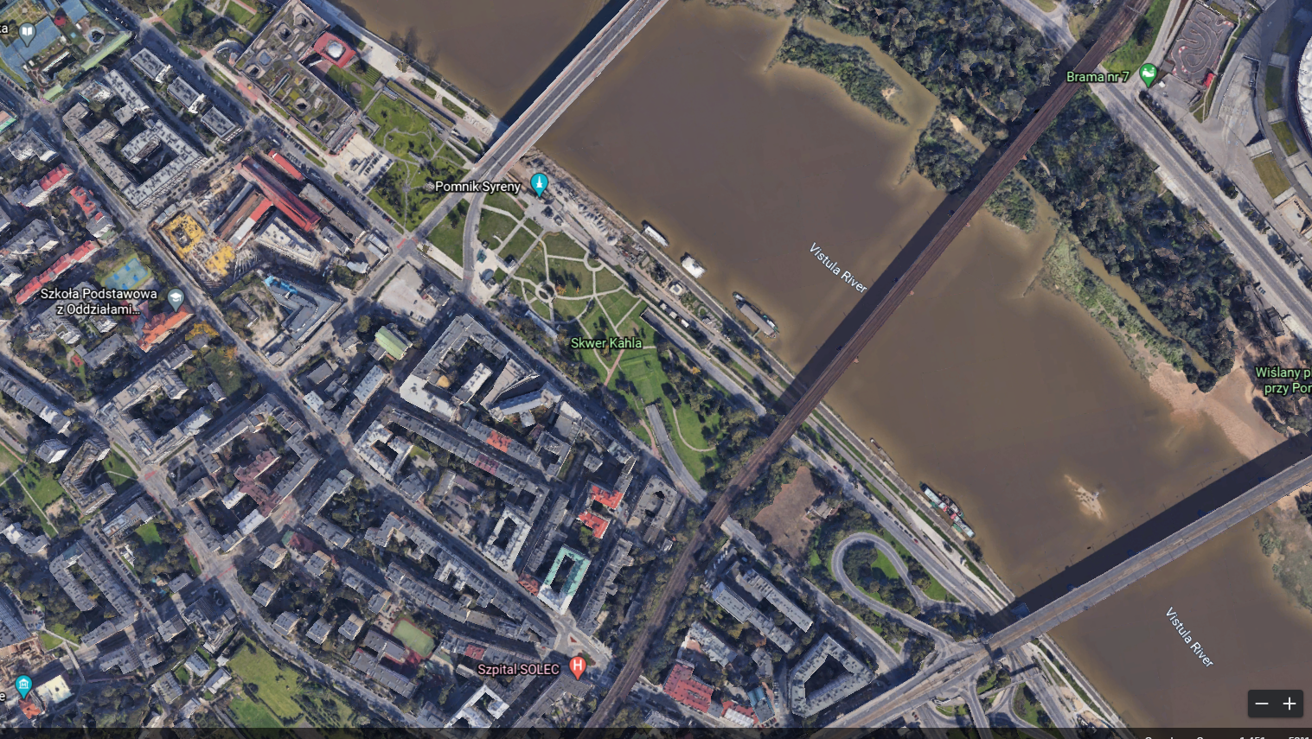
5G Band detail:
Centrum Nauki Kopernik
52.239022, 21.030900, or 52 ° 14'20 "N 21 ° 01'51" E
RSRP: -65dbm to -95dbm
5G band: N41@40MHz + B3@20MHz

Slide 8
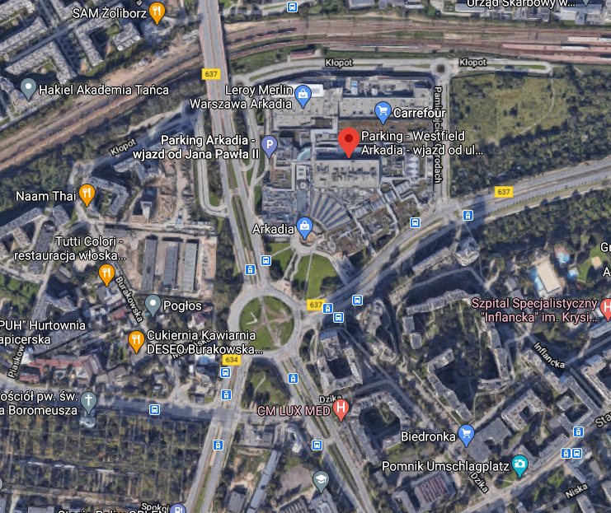
Weak Coverage area for all Operator
wjazd od ul. Jana Pawła II
52.256466, 20.983844, or 52 ° 15'23 "N 20 ° 59'01" E
RSRP value:-116dB≤RSRP≤-110 dB

Slide 9
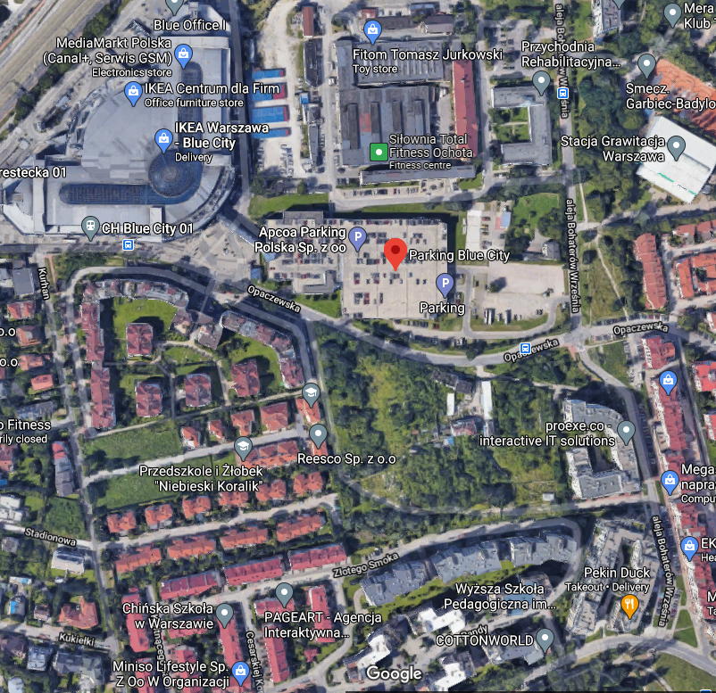
Mixed Coverage area for all Operator
5G-4G-5G
4G-3G-4G area for all operators
Opaczewska 310, 02-368 Warszawa
52.212965, 20.955219, or 52 ° 12'46 "N 20 ° 57'18" E

Slide 10

Thank You

