Slide 1
MARQUIS TECHNOLOGIES
Drive Route

Slide 2
(Pune/India)
Country | India
Continent | Asia
City | Pune
Time Zone | GMT+5:30

Slide 3
Pune/India
Operator Details:
S. No. | Operator |  | Supported Bands | Supported Features by Network
1 | Major | Airtel | LTE FDD B1/B3/B8 & TDD B40/N78 | VoWiFi/VoLTE/4G/2G/5G
2 |  | JIO | LTE FDD B3/B5 & TDD B40/N78/N28 | VoWiFi/VoLTE/4G/5G
3 |  | VI | LTE FDD B3/B8 & TDD B41/N78 | VoWiFi/VoLTE/4G/3G/2G/5G
4 | Minor | BSNL | 2100/900 | 3G/2G

Slide 4
Drive Route operator
Near Cell :-Stationary: RSRP: -60dbm to -75dbm
Mixed :-Mobility: RSRP : -75dbm to -95dbm
Cell Edge :-Stationary: RSRP : -95dbm to -115dbm

Slide 6
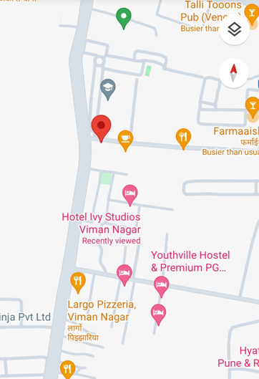
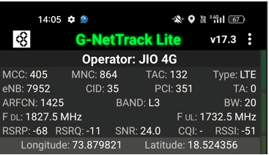
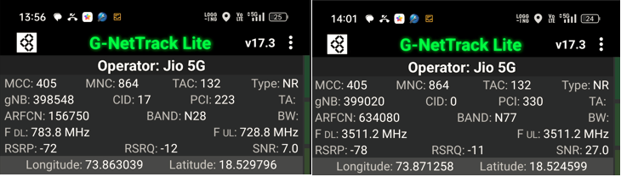
Good Coverage Screenshots
Operator: Jio
Band: B3 | B5 | B40 | N78 | N28

Slide 7
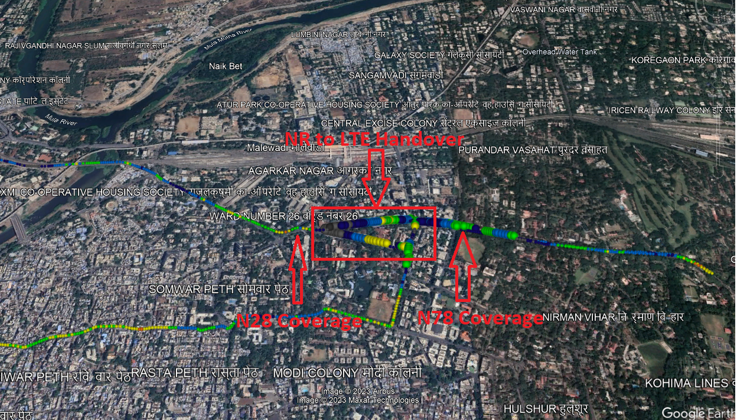
Band Handover – 5G to 4G
Operator: Jio
Band Handover: N78 – B40 – N78

Slide 8
VoNR call on NR to LTE route ,Jio
Lat , Long - NA Location - NA Specification – No Location Found / Not in Scope

Slide 10
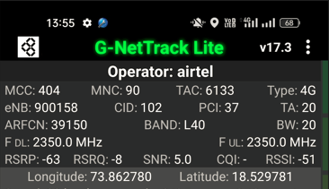
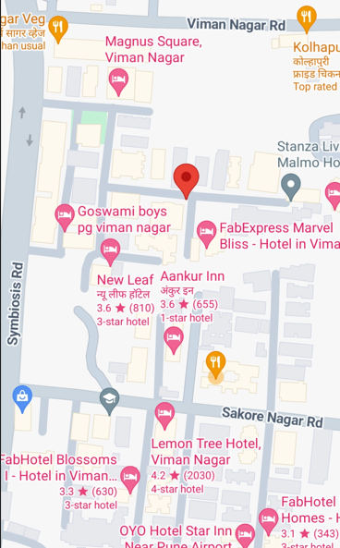
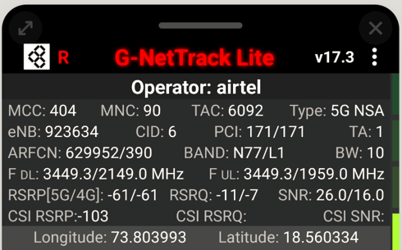
Good Coverage Screenshots
Operator: Airtel
Band : B3 | B8 | B40 | N78

Slide 11
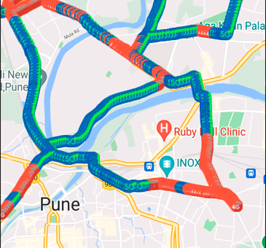
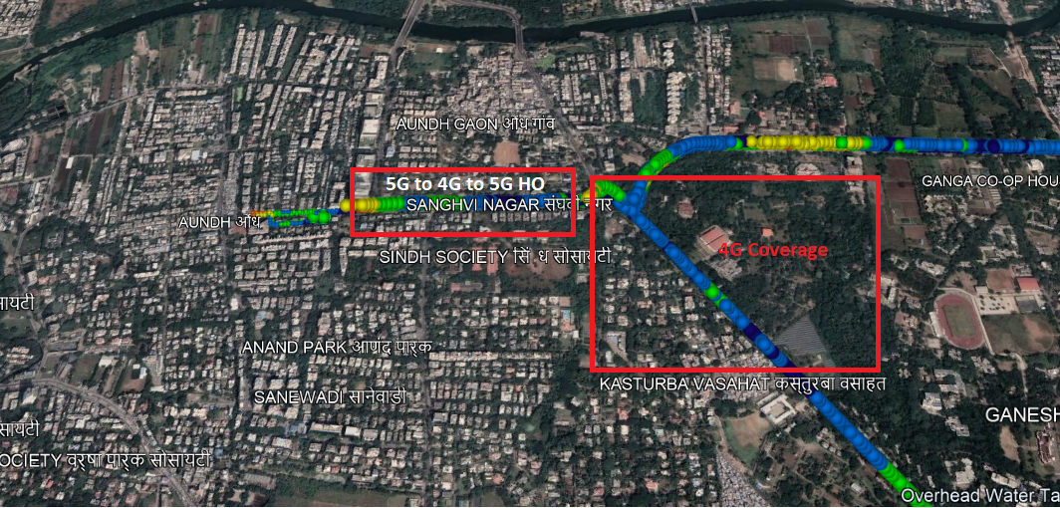
Band Handover – 5G to 4G
Operator: Airtel
HO : NSA to LTE to NSA

Slide 12
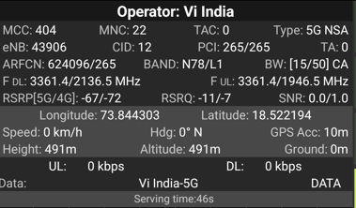
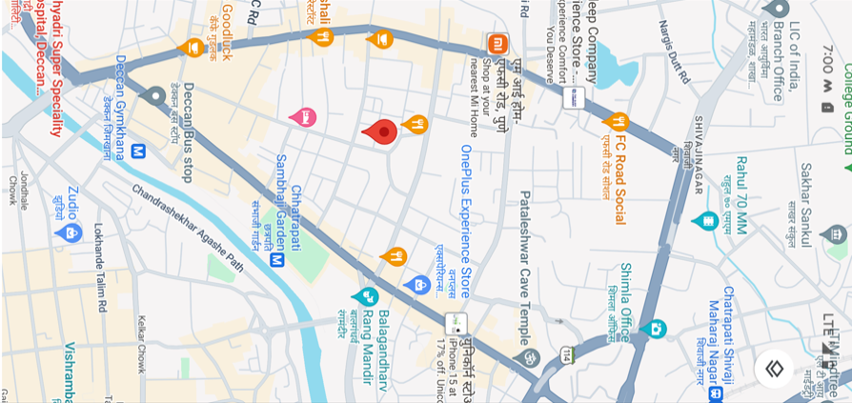
VI 5G
Lat long – 18.522194° N, 73.844303° E Location – Shivaji Nagar, Pune, India Specification –VI 5G limited coverage

Slide 13
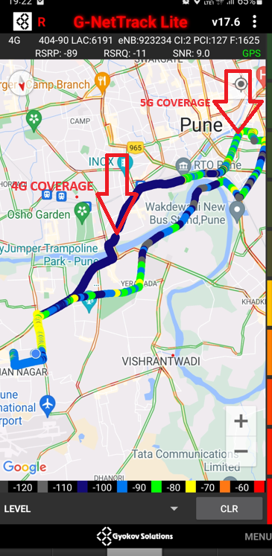
VI 5G to 4G HANDOVER LOCATION Lat – 18.522194° N, Long - 73.844303° E Location–Shivaji Nagar

Slide 14
SRVCC(AIRTEL,VI) and Call drop(Airtel ,Jio ,VI)
Lat Long- NA. Location- NA Specification – No Location Found / Not in Scope

Slide 15
BSNL VOLTE AREA Lat/Long - NA Location – No Location Found
VI ROAMING Lat/Long- NA Location – No Location Found

Slide 16
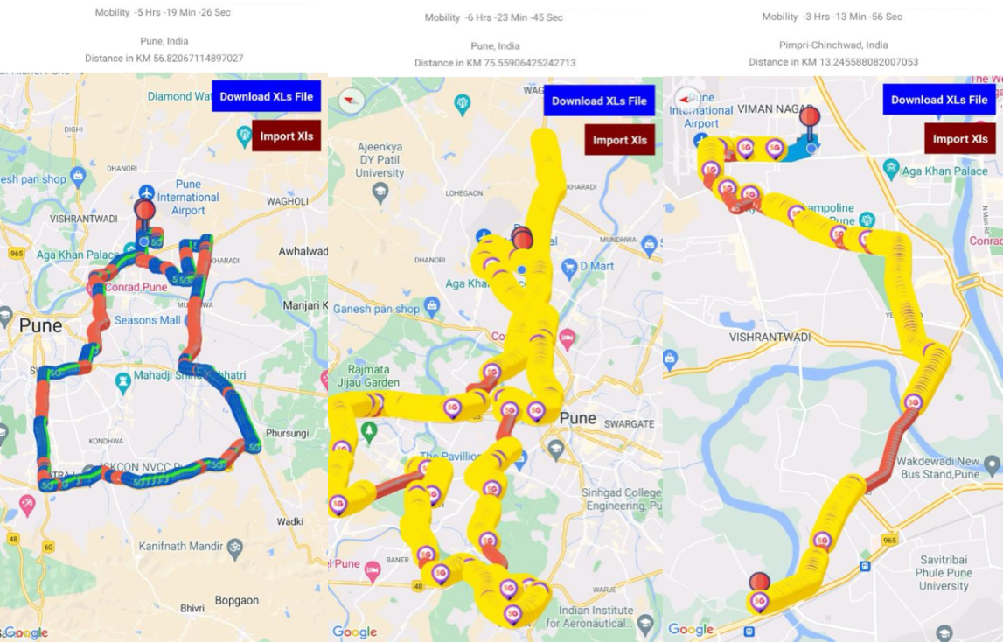
( Drive Route covered during mobility. )

Slide 17
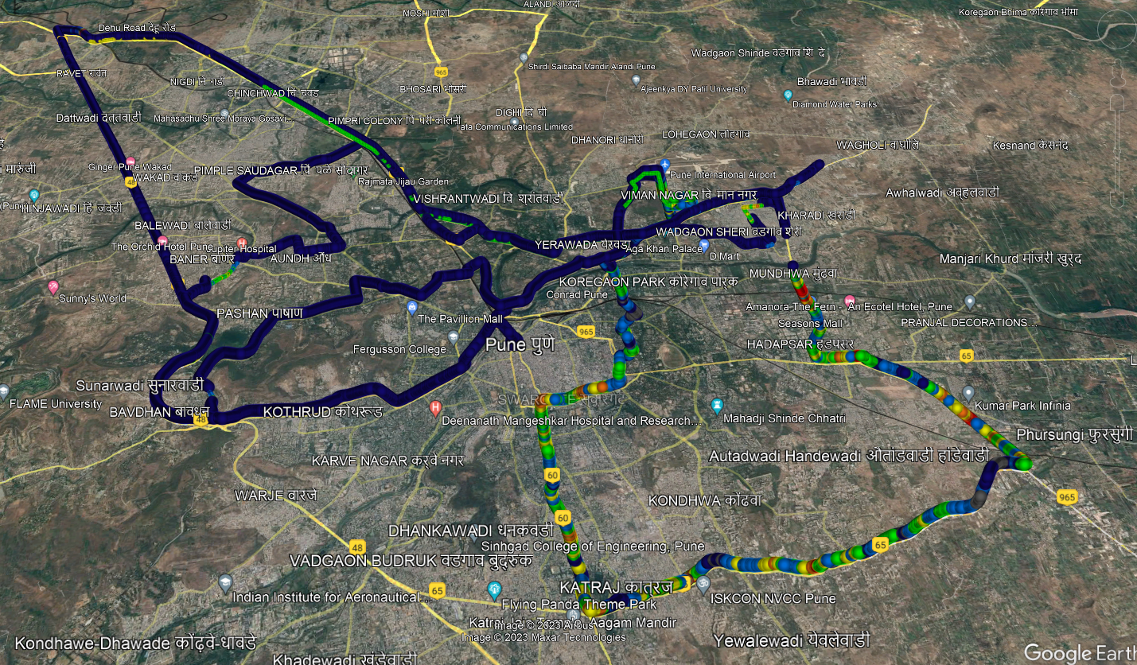
( Drive Route covered during mobility. )

Slide 18
THANK YOU
MARQUIS TECHNOLOGIES
www.marquistech.com

