Slide 1
Drive Rout Coverage
Ayush Tripathi atripathi@marquistech.com

Slide 2
Drive Route Coverage : Telekom

Slide 3
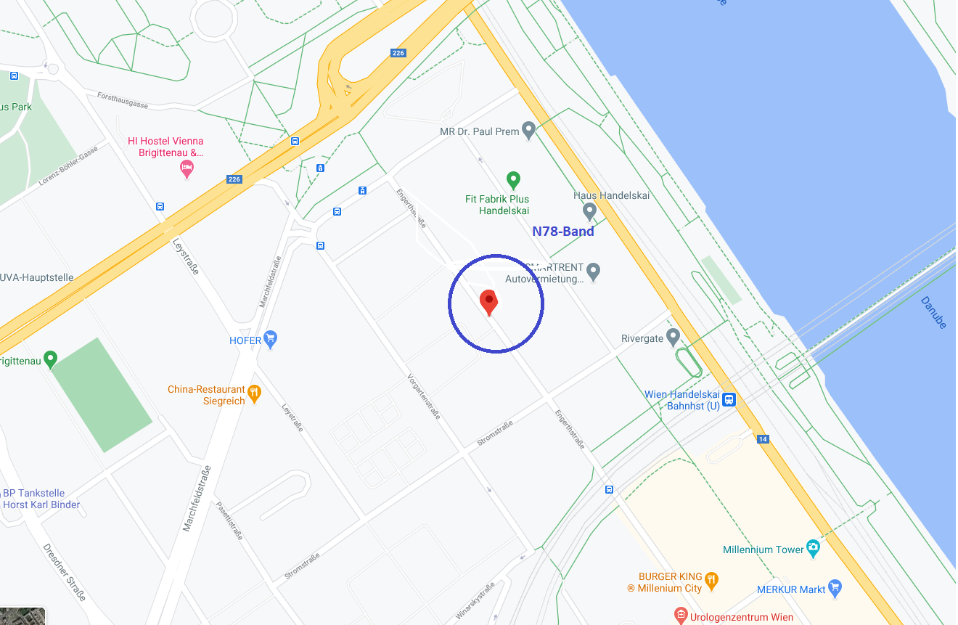
Operator: Tmobile Band: N78
Engerthstr. 51-47, 1200 Wien, Austria, 48.2428055, 16.3820908

Slide 4
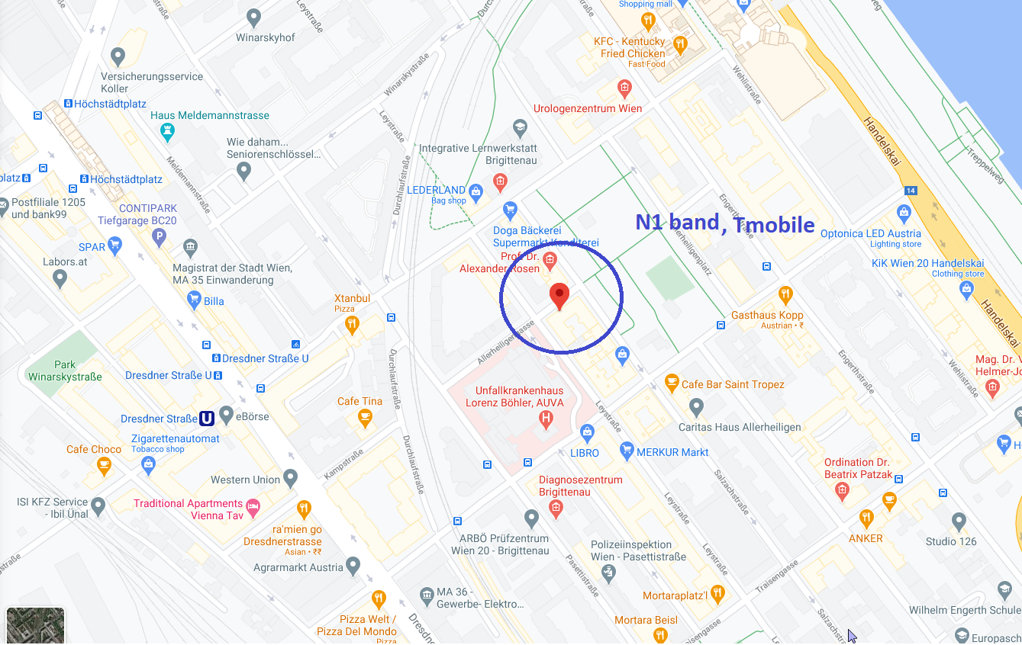
Allerheiligengasse 13-7, 1200 Wien, Austria
Allerheiligengasse 13-7, 1200 Wien, Austria
Operator: Tmobile Band: N1
Allerheiligengasse 13-7, 1200 Wien, Austria, 48.237778 16.384025

Slide 5
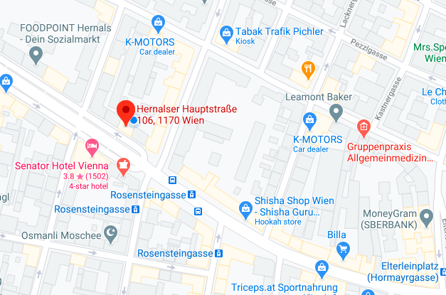
3A and H3G locations Vienna

Slide 6
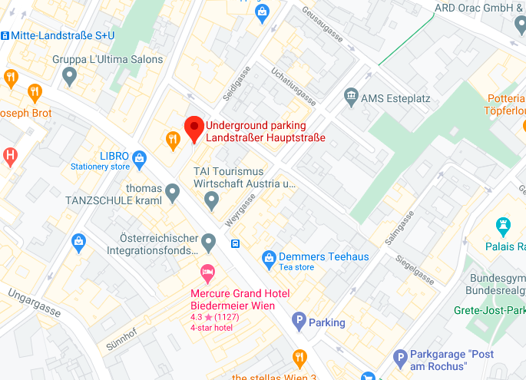

Slide 7
Thank You..!!

