Slide 1
MARQUIS TECHNOLOGIES
Drive Route

Slide 2
(BULGARIA)
Country | Bulgaria
Continent | Europe
City | Sofia
Time Zone | GMT+3

Slide 3
Operators in Location
MCC | MNC | Operator
284 | 05 | Telenor
284 | 03 | Vivacom
Telenor Network Info
RAT | Band | Comment
4G | L3, L7
3G | U1, U8
2G | GSM 900
Vivacom Network Info
RAT | Band | Comment
4G | L7, L3, L1
3G | U1
2G | GSM 900

Slide 4
Drive Route operator
Near Cell :-Stationary: RSRP: -60dbm to -75dbm
Mixed :-Mobility: RSRP : -75dbm to -95dbm
Cell Edge :-Stationary: RSRP : -95dbm to -115dbm

Slide 5
Telenor

Slide 6
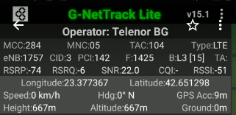
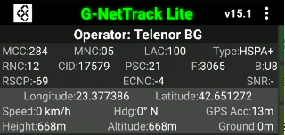
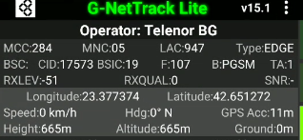
Near Cell screenshot
Operator: Telenor BG
Band: L3
Cell ID: 3
E-ARFCN : 1425
RSRP: -60dBm to -75dBm

Slide 7
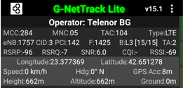
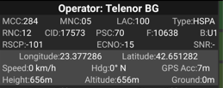
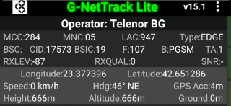
Edge Cell screenshots
Operator: Telenor BG
Band: L3
Cell ID: 3
E-ARFCN : 1425
RSRP: -95dbm to 115dbm

Slide 8
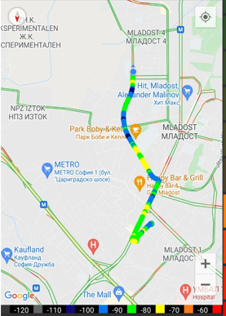
( Mixed Mobility Area) screenshots

Slide 9
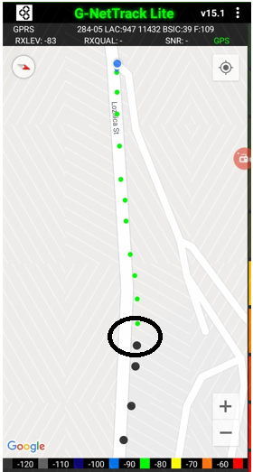
SRVCC screenshot

Slide 10
(Reselection)

Slide 11
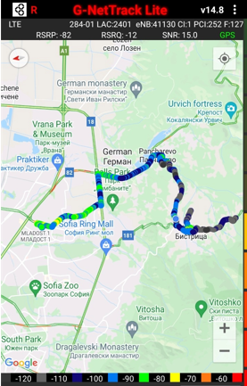
( Drive Route covered during mobility. )

Slide 12
Vivacom

Slide 13
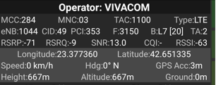
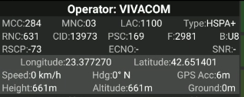
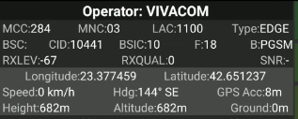
Near Cell screenshot
Operator: Vivacom BG
Band: L7
Cell ID: 49
E-ARFCN : 3150
RSRP: -60dBm to -75dBm

Slide 14
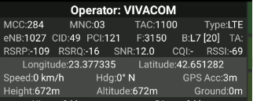
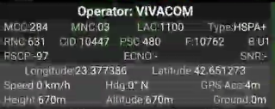
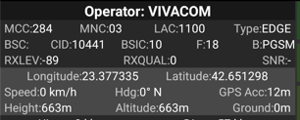
Edge Cell screenshots
Operator: Vivacom BG
Band: L7
Cell ID: 49
E-ARFCN : 3150
RSRP: -95dbm to 115dbm

Slide 15
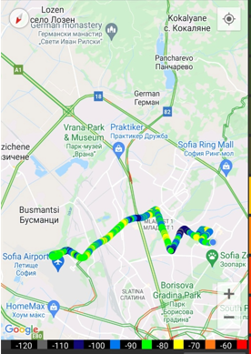
( Mixed Mobility Area) screenshots

Slide 16
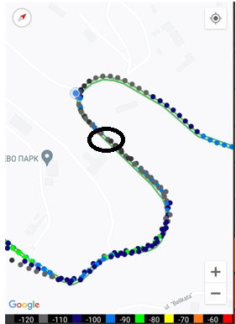
SRVCC screenshot

Slide 17
(Reselection)

Slide 18
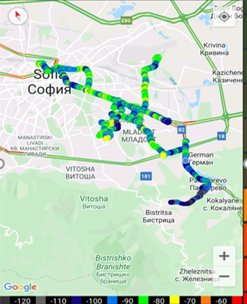
( Drive Route covered during mobility. )

Slide 19
THANK YOU
MARQUIS TECHNOLOGIES
www.marquistech.com

