Slide 1
Kota/Rajasthan Network Information
Kota
(Rajasthan)
S.NO | Operator Name | Service Supported | Band Supported | Band Tested | Endc Combination tested | CA Combination
1 | Airtel | 2G/4G/5G/VoLTE/VoWiFi | 4G BAND 1/3/8/40,5GBand N78 | B1,B40,N78 | N78+B1,N78+B40 | B40+B40,B1+B3
2 | RJIO | 4G/5G/VoLTE/VoWiFi | 4G BAND 3/5/40,5G Band N78/N28 | B40,B3,B5,N78,N28 | NA | NRCA(N78+N28), B40+B40,B5+B40,B3+B40
3 | VI | 2G/4G/VoLTE/VoWiFi | 4G BAND 1/3/8/41 | B3,B8,41 | NA
4 | BSNL | 4G/3G/2G | 4G BAND 28, 3G BAND 1 | B28,B1 | NA | NA

Slide 2
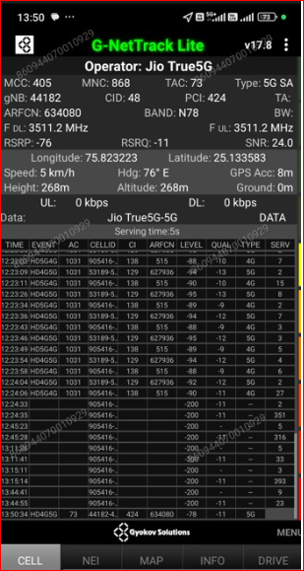
JIO 5G SA Good Coverage Location
Description | Operator | Band | Lat. | Long.
5G SA Good coverage Location | JIO | N78 | 25.133583 | 75.823223

Slide 3
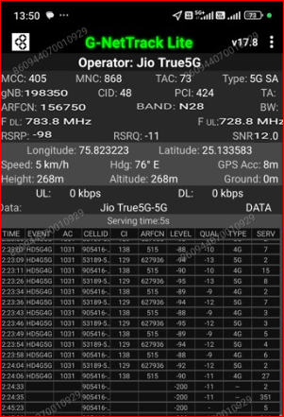
JIO 5G SA N28 Location
Discerption | Operator | Band | Lat. | Long.
5G SA N28 Location | JIO | N28 | 25133583 | 75.823223

Slide 4
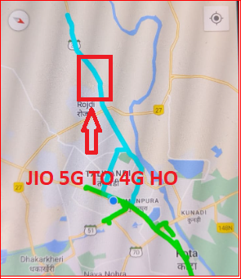
JIO 5G to 4G Handover Location
Discerption | Operator | Technology/ Band | Lat. | Long.
5G to 4G Handover Location | JIO | 5G>>4G>>5G | 25.109969 | 75.782037

Slide 5
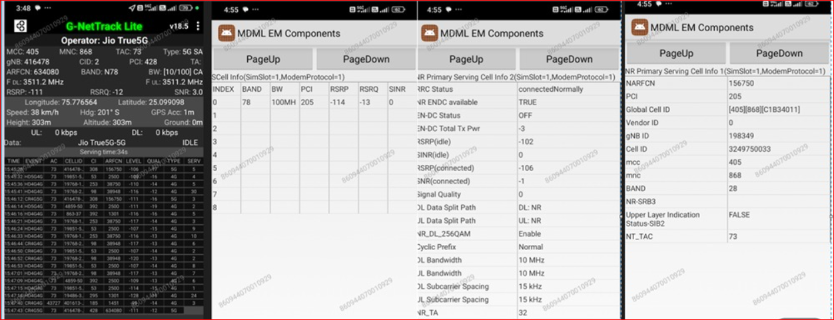
JIO NR CA Location
Discerption | Operator | Technology/ Band | Lat. | Long.
JIO NR CA Location | JIO | 5G>>4G>>5G | 25.099098 | 75.776564

Slide 6
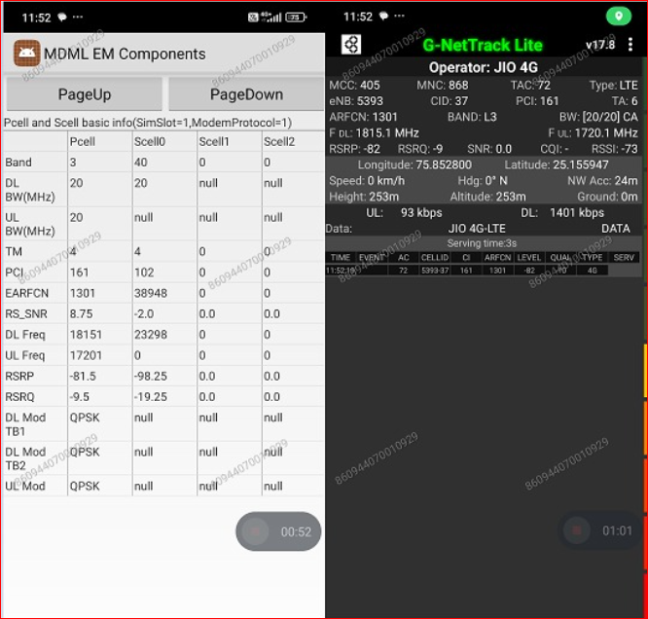
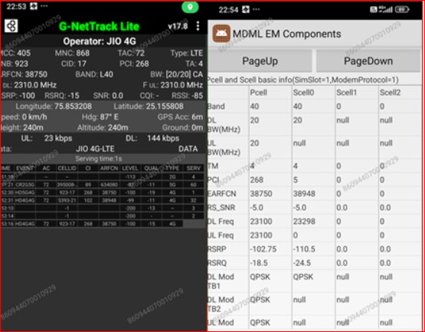
JIO LTE 2CA Location
Discrption | Operator | Band | Lat. | Long.
LTE 2CA Location | JIO | B3+B40 | 25.155947 | 75.852800
 |  | B40+B40 | 25.155808 | 75.853208

Slide 7
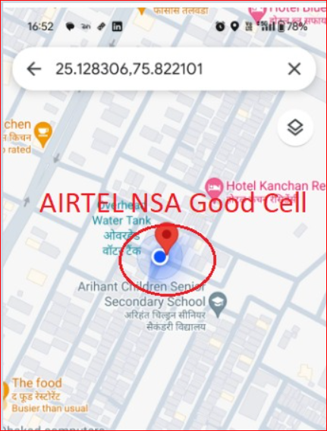
Airtel 5G NSA Good coverage Location
Discerption | Operator | Band | Lat. | Long.
5G NSA Good Coverage Location | Airtel | N78+B1 | 25.128306 | 75.822101

Slide 8
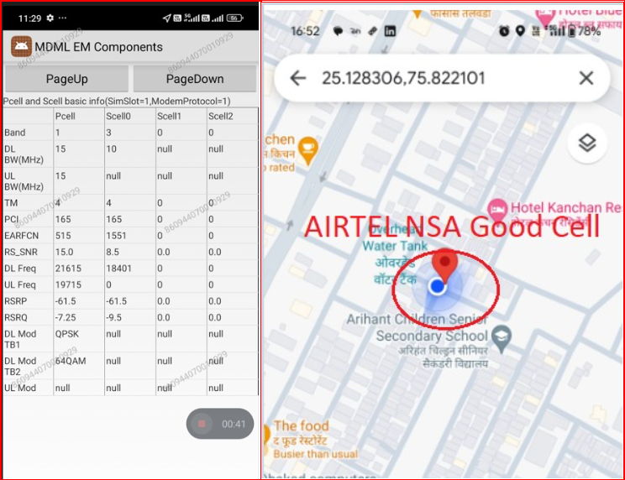
Airtel ENDC Combination
Discerption | Operator | ENDC Combination | Lat. | Long.
Airtel ENDC Combination | Airtel | N78+B1 | 25.128306 | 75.822101

Slide 9
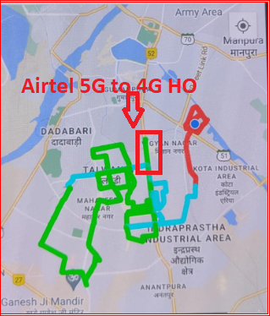
Airtel 5G to 4G Handover Location
Discerption | Operator | Technology/ Band | Lat. | Long.
5G to 4G Handover Location | Airtel | 5G>>4G>>5G | 25.160300 | 75.851989

Slide 10
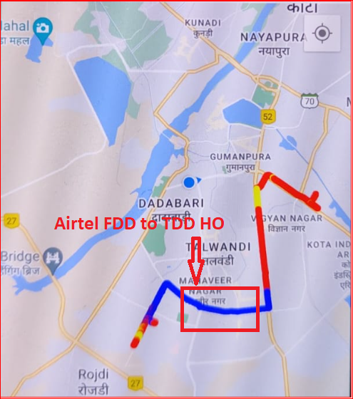
Airtel LTE BAND Handover
Discerption | Operator | BAND | Lat. | Long.
Airtel LTE Band Handover | Airtel | TDD>>FDD>>TDD | 25.131763 | 75.837882

Slide 11
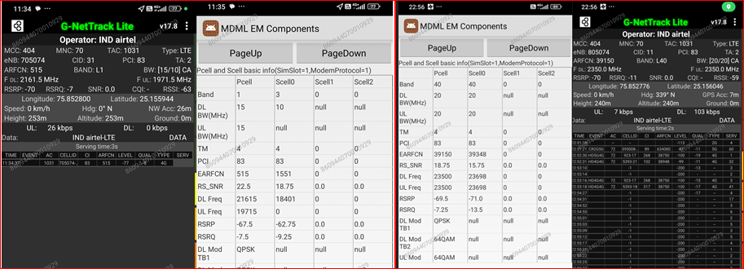
Airtel LTE 2CA Location
Discrption | Operator | Band | Lat | Long
LTE 2CA Location | Airtel | B1+B3 | 25.155944 | 75.852800
 |  | B40+B40 | 25.156046 | 75.852776

Slide 12
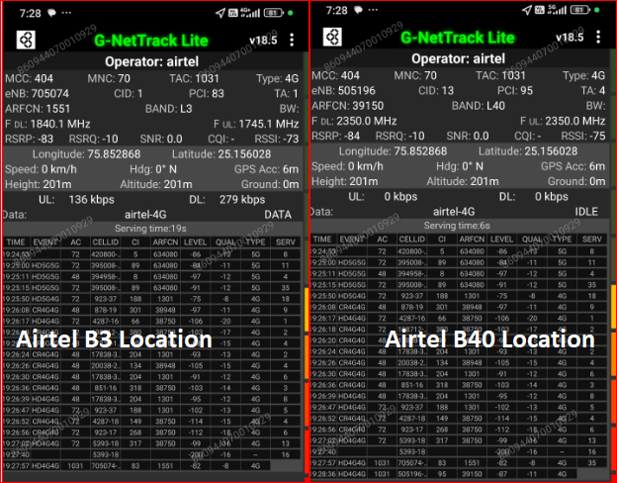
Airtel 4G BAND Location
Discerption | Operator | BAND | Lat | Long
Airtel 4G Band Location | Airtel | B3 | 25.156028 | 75.852868
 |  | B40 | 25.156028 | 75.852868

Slide 13
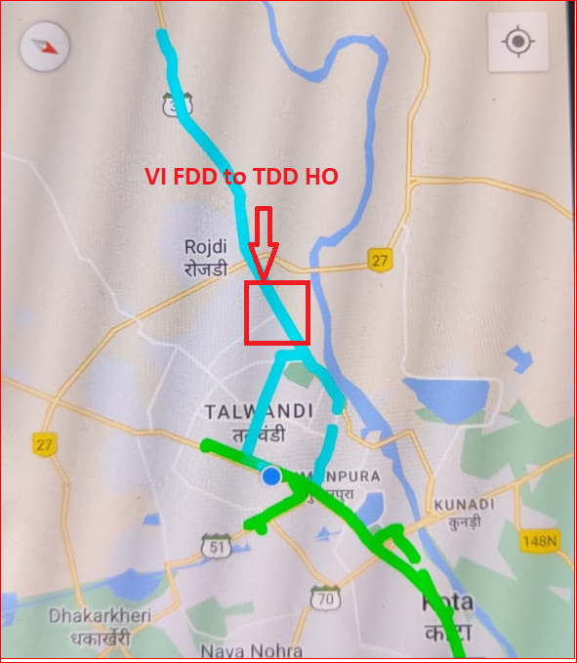
VI LTE BAND Handover
Discerption | Operator | Band | Lat. | Long.
VI LTE Band Handover | VI | TDD>>FDD>>TDD | 25.133318 | 75.806758

Slide 14
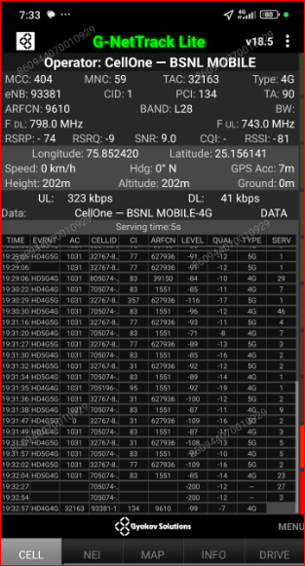
BSNL 4G Good Coverage Location
Discerption | Operator | Band | Lat. | Long.
4G Good coverage Location | BSNL | B28 | 25.156141 | 75.852420

Slide 15

THANK YOU

