Slide 1
MARQUIS TECHNOLOGIES
Drive Route – Ho Chi Minh( Vietnam)

Slide 2
Testing Place – Ho Chi Minh (Vietnam)
Country | Vietnam
Continent | Asia
City | Ho Chi Minh
Time Zone | GMT+7:00
International Dialing Code | +84

Slide 3
RSRP Criteria
Near Cell :-Stationary: RSRP : -55dbm to -85dbm
Cell Edge :-Stationary: RSRP : -95dbm to -110dbm
Mixed :-Mobility: RSRP : -55dbm to -120dbm

Slide 4
Operator Information
MCC | MNC | Operator | LTE Bands
452 | 01 | Mobifone 4G/3G/2G | Band 3
452 | 04 | Viettel 4G/3G/2G | Band 3 & Band 7
452 | 02 | Vinaphone 4G/3G/2G | Band 3
452 | 05 | Vietnamobile 4G/3G/2G | Band 1 and 8

Slide 5
Band details for each operator
4G LTE operators | Mobifone | Viettel |  | Vinaphone | Vietnamobile
 | 4G | 4G |  | 4G | 4G
Band | 3 | 7 | 3 | 3 | 1 | 8
Frequency | 1800+ |  | 1800+ | 1800+ | 2100+ | 900+
UL frequency(MHz) | 1740.1 MHz | 2530 | 1760 | 1717.5 | 2147.6 | 883
DL frequency(MHz) | 1835.1 | 2650 | 1855 | 1812.5 MHz | 1957.6 | 928
(ARFCN/UARFCN/EARFCN) | 1501 | 3050 | 1700 | 1275 | 376 | 3480
MCC | 452 | 452 | 452 | 452 | 452 | 452
MNC | 1 | 4 | 4 | 2 | 5 | 5
APN | m-wap | v-internet | v-internet | m3-world | internet | internet

Slide 6
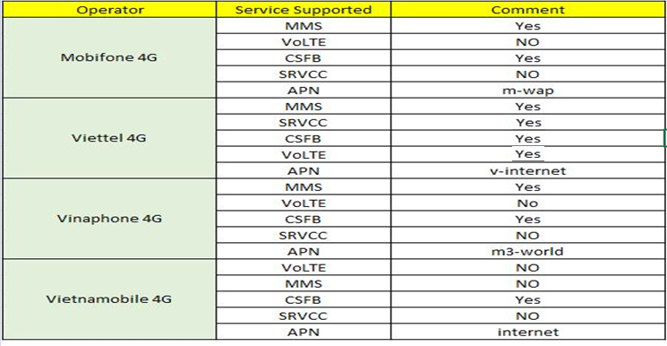
Services Supported by Operators

Slide 7
APN details for all operators
Details include: Mobifone,Viettel,Vinaphone,Vietnamobile

Slide 8
USSD code for Operators
No. | Operator | Balance Check Code | Customer Care
1 | Viettel | *101# & *102# | 18008098
2 | MobiFone | *0# & *101# | 18001090
3 | VinaPhone | *111# ,*101# & *102# | 9192
4 | VietnaMobile | *121# | 366/0922366366

Slide 9
MobiFone Operator
Drive Route – Ho Chi Minh( Vietnam)

Slide 10
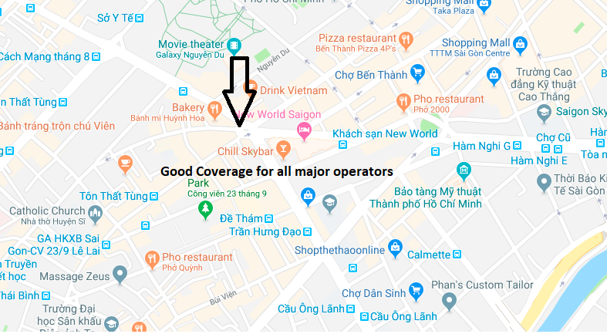
Good coverage to test MobiFone operator
Junction near Chill Skybar
Location 10.771399, 106.693260 RSRP: Near -65 to -75 dBm
AT-Slide : 7

Slide 11
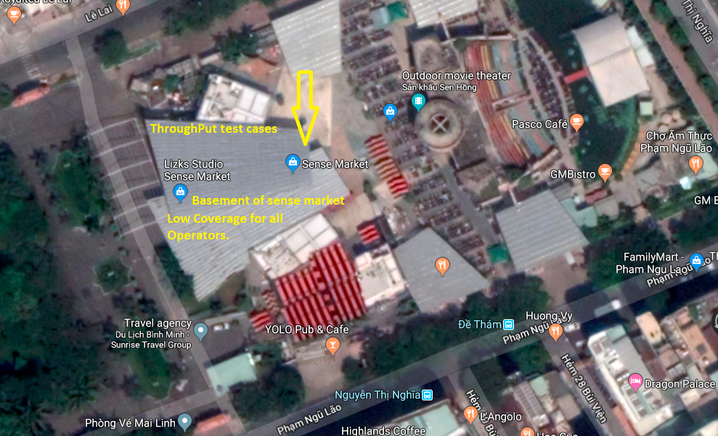
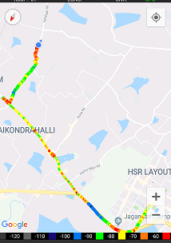
Poor coverage to test MobiFone operator
Basement Market of Sense.
Location : 10.769260, 106.693136 RSRP: -105 dBm
AT-Slide : 14

Slide 12
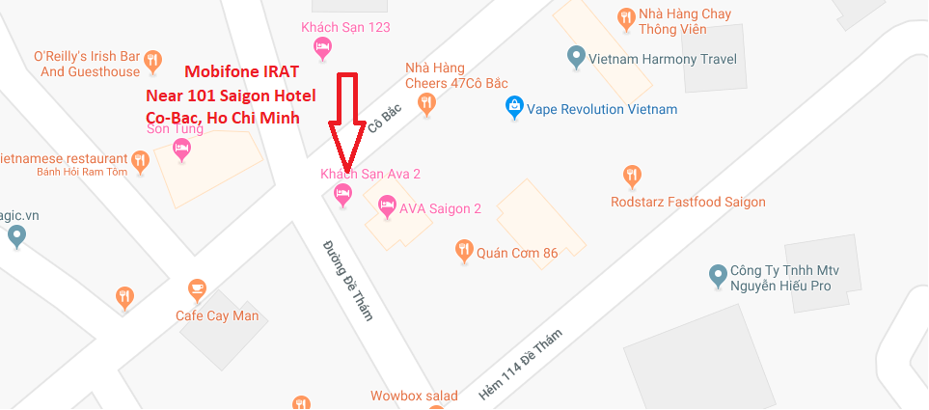
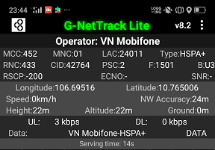
IRAT area for MobiFone Operator
Place : Near 101 Saigon hotel, Co-bac location: 10.765006, 106.69516 , IRAT to HSPA+ network
AT-Slide : 17

Slide 13
Viettel Operator
Drive Route – Ho Chi Minh( Vietnam)

Slide 14
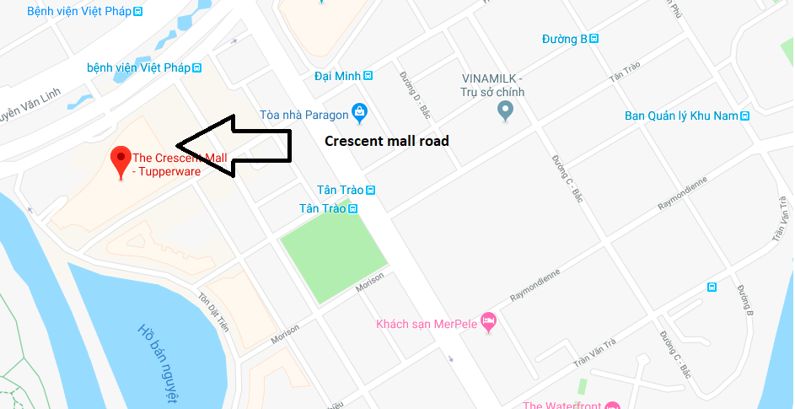
Good coverage to test Viettel operator
Crescent mall road
Location 10.728880, 106.718748 RSRP: Near -65 to -75 dBm ; Band :3
jio-Slide : 5

Slide 15
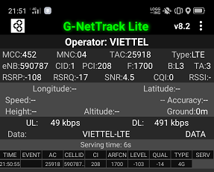
Poor coverage to test Viettel operator
Basement Market of Sense.
Location : 10.769260, 106.693136 RSRP: -108 dBm and Band:3
jio-Slide : 12

Slide 16
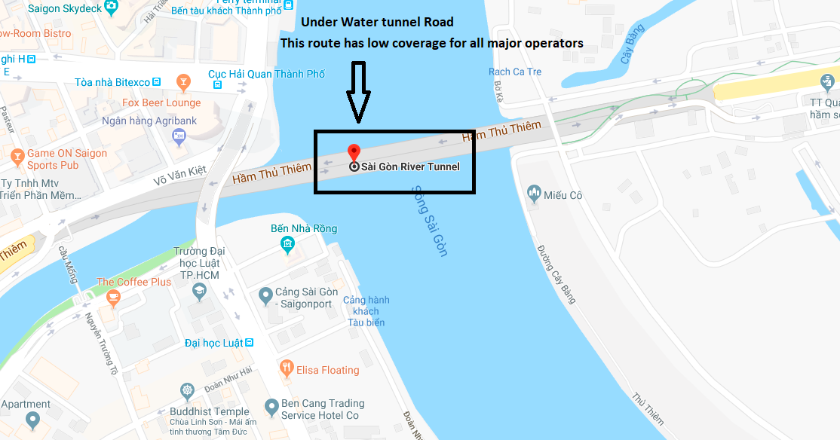
Low coverage area for Viettel Operator
Location: 10.769594, 106.707690
Saigon River Tunnel serves as Low coverage area of all major 4G operators
jio-Slide : 13

Slide 17
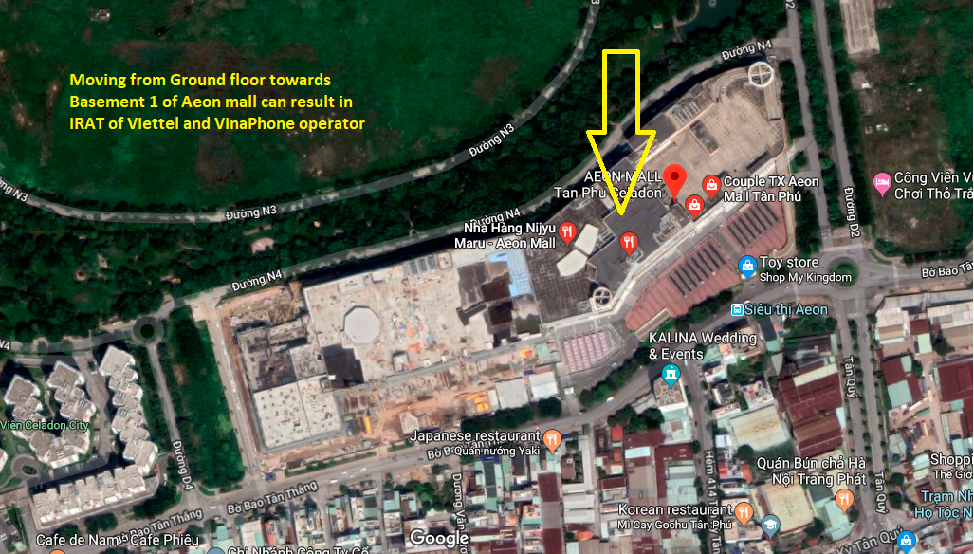
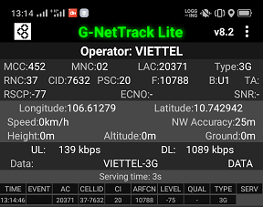
IRAT area for Viettel Operator
Place :Ground Floor to Basement 1 of Aeon mall location: 10.742942, 106.61279 , IRAT to 3G Network

Slide 18
Vinaphone Operator
Drive Route – Ho Chi Minh( Vietnam)

Slide 19
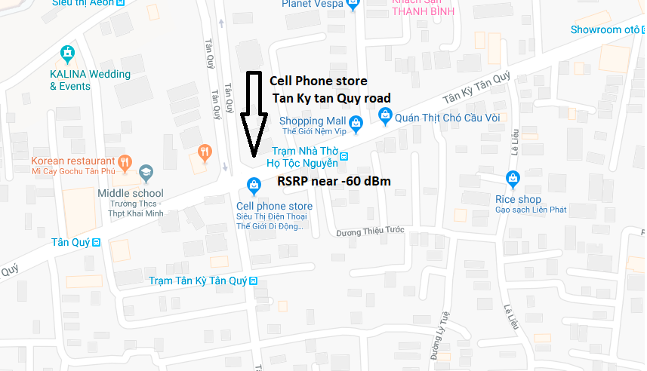
Good coverage to test Vinaphone operator
Location : 10.799551, 106.619298
RSRP: near -60 dBm Band : 3

Slide 20
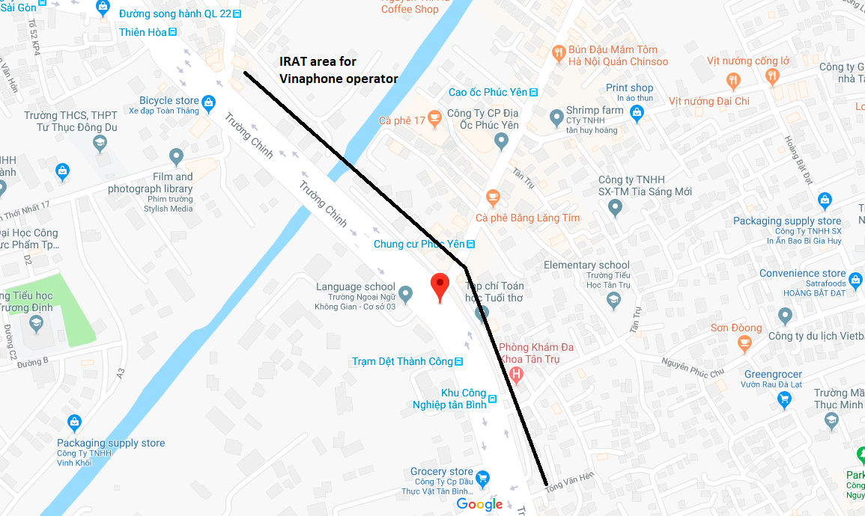
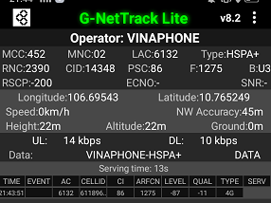
IRAT area for Vinaphone Operator
Place :Near language school location: 10.765249, 106.69543

Slide 21
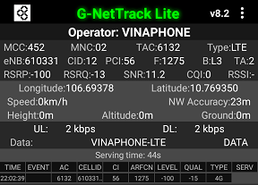
Poor coverage to test Vinaphone operator
Basement Market of Sense.
Location : 10.769350, 106.69378 RSRP: -100 dBm ,Band : 3
AT-Slide : 14

Slide 22
Vietnamobile Operator
Drive Route – Ho Chi Minh( Vietnam)

Slide 23
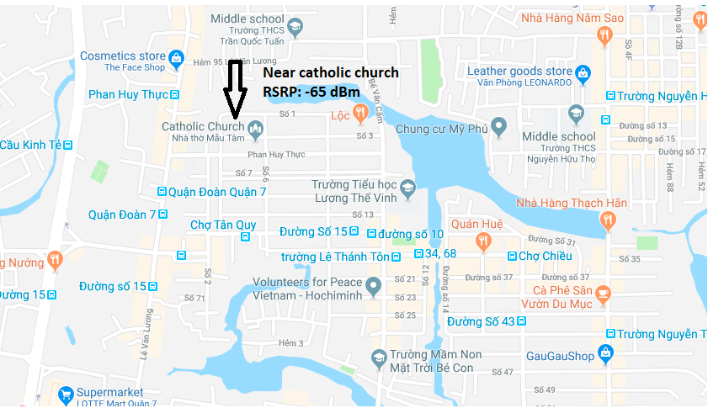
Good coverage to test Vietnamobile operator
Location : 10.747979, 106.706993
RSRP: near -65 dBm Band: 1
Idea-Slide : 1

Slide 24
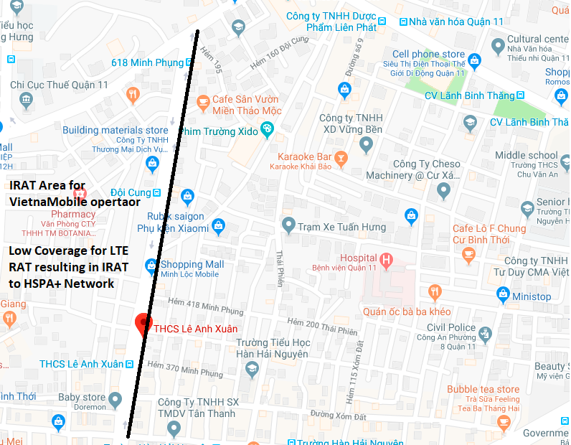
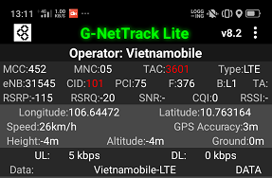
Poor coverage to test Vietnamobile operator
Near THCS Le Anh Xuan Centre
Location : 10.763164, 106.64472 RSRP: -115 dBm Band : 1
Idea-Slide : 3

Slide 25
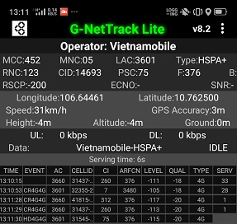
IRAT area for Vietnamobile Operator
Area : From THCS Le Anh Xuan towards 618 Minh Phung location: 10.762500, 106.64461 , IRAT to HSPA+ Network
Idea-Slide : 4

Slide 26
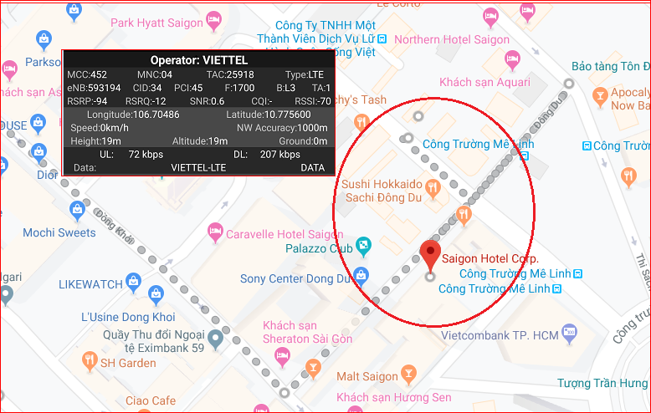
IRAT & CSFB location for all operators
Area : Saigon Hotel
Idea-Slide : 4

Slide 27
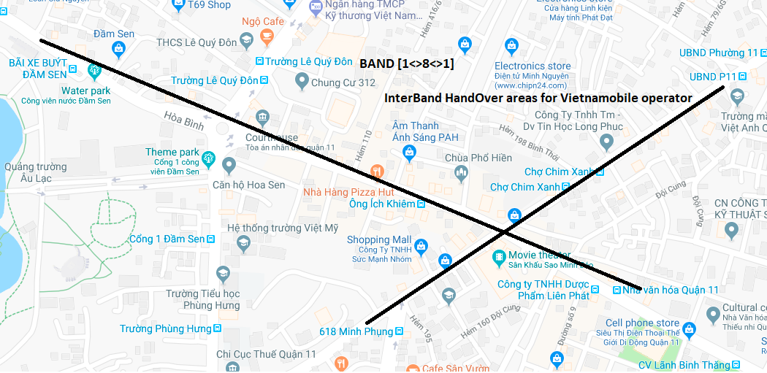
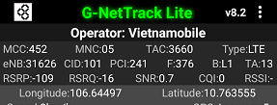
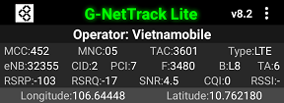
Inter-Band Handover area for Vietnamobile Operator
Area : From THCS Le Anh Xuan towards 618 Minh Phung location:106.64497 10.763555 , Band [1-8-1], CID: 101(B1) to CID:2(B8)

Slide 28
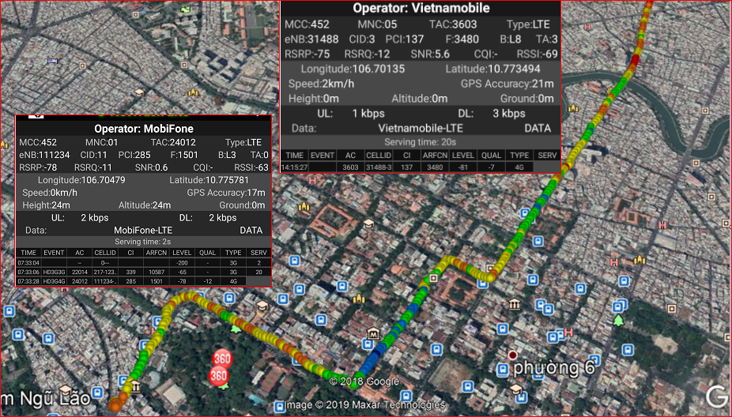
Drive route covered:
Route: Co Bac to - Statue of Phu Dong Thein Vuong-Saigon apartments –BenNghe-Saigon center- Crescent mall road

Slide 29
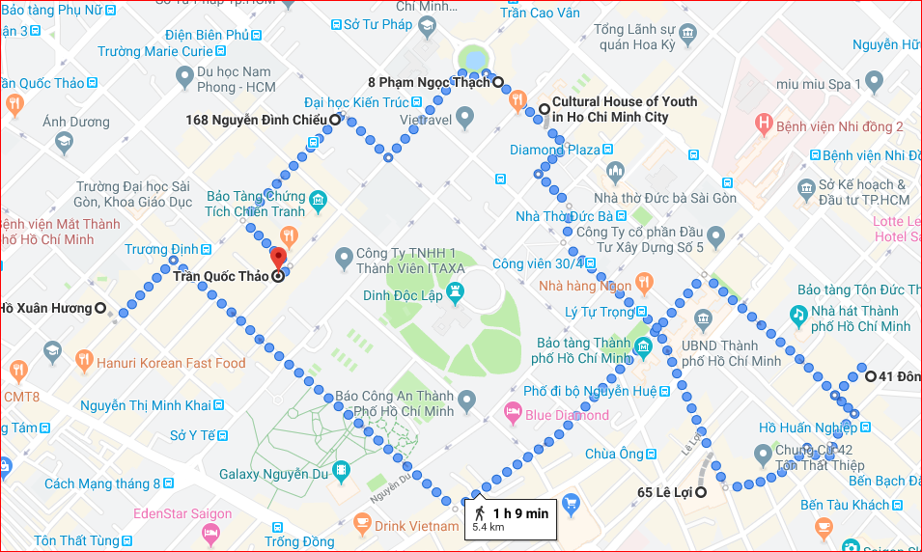
AREA OF HIGH DENSITY OF
CROWD AND TALL BULIDINGS
Location:Tower A to Cultural house of youth to saigon Hotel

Slide 30
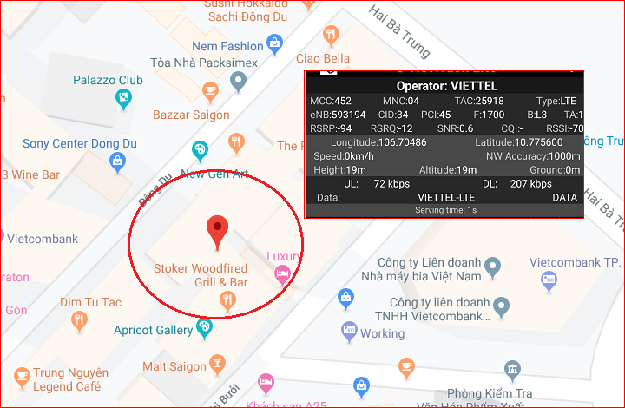
CA Location for Viettel & Vietnamobile operators
Location:Saigon Hotel, District 1

Slide 31
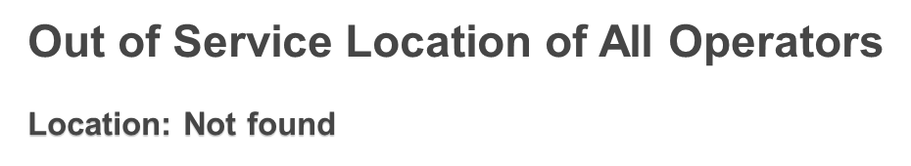

Slide 32
Local EM number used in Ho Chi Minh(Vietnam)
Police | 113
Fire | 114
Ambulance | 115

Slide 33
THANK YOU
MARQUIS TECHNOLOGIES
www.marquistech.com

