Slide 1
Gwalior/Madhya Pradesh Network Information
Gwalior
(Madhya Pradesh)
S.NO | Operator Name | Service Supported | Band Supported | Band Tested | Endc Combination tested | CA Combination
1 | Airtel | 2G/4G/5G/VoLTE/VoWiFi | 4G BAND 1/3/5/40,5GBand N78 | B40,B3,N78 | N78+B3 | B40+B40/B3+B40
2 | RJIO | 4G/5G/VoLTE/VoWiFi | 4G BAND 3/5/40,5G Band N78/N28 | B40,B3,N78,N28 | NA | B40+B40
3 | VI | 2G/4G/VoLTE/VoWiFi | 4G BAND 1/3/8/41 | B3,41 | NA | B3+B41
4 | BSNL | 3G/2G/4G/VoLTE | 4G BAND 1/ L28 | B1, L28 | NA | NA

Slide 2
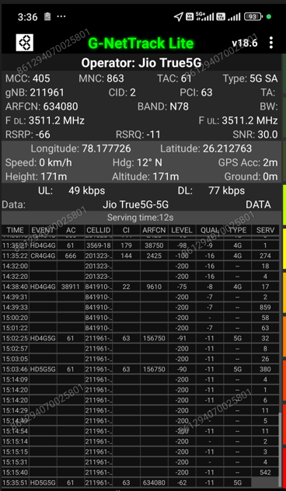
JIO 5G SA Good Coverage Location
Description | Operator | Band | Lat. | Long.
5G SA Good coverage Location | JIO | N78 | 26.212763 | 78.177726

Slide 3
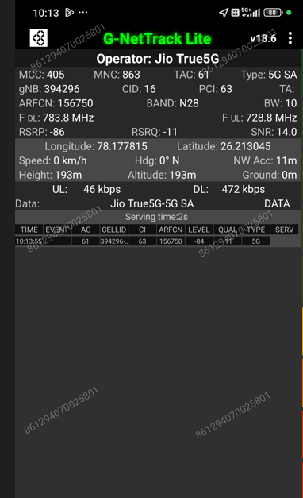
JIO 5G SA N28 Location
Discerption | Operator | Band | Lat. | Long.
5G SA N28 Location | JIO | N28 | 26.213045 | 78.177815

Slide 4
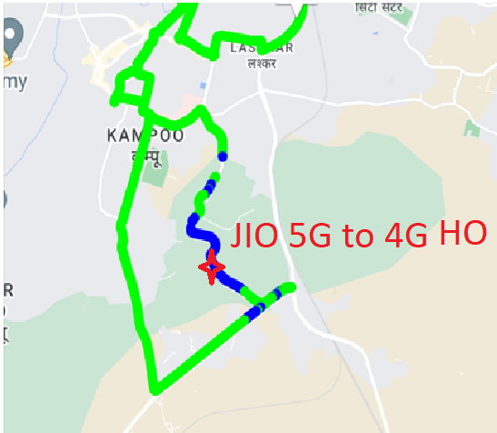
JIO 5G to 4G Handover Location
Discerption | Operator | Technology/ Band | Lat. | Long.
5G to 4G Handover Location | JIO | 5G>>4G>>5G | 26.175366 | 78.162235

Slide 5
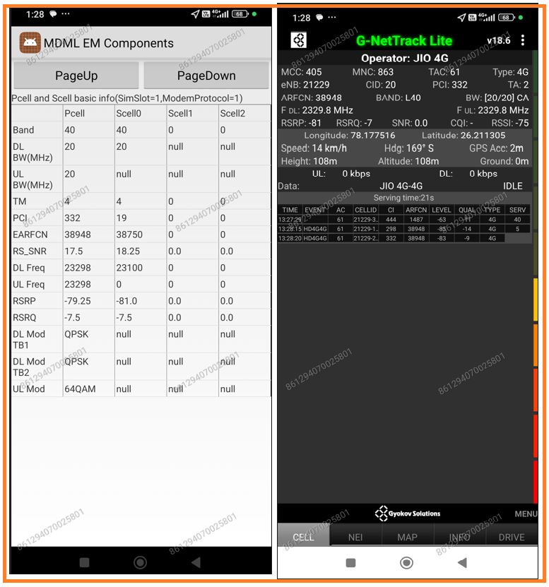
JIO LTE 2CA Location
Discrption | Operator | Band | Lat. | Long.
LTE 2CA Location | JIO | B40+B40 | 26.211305 | 78.177516

Slide 6
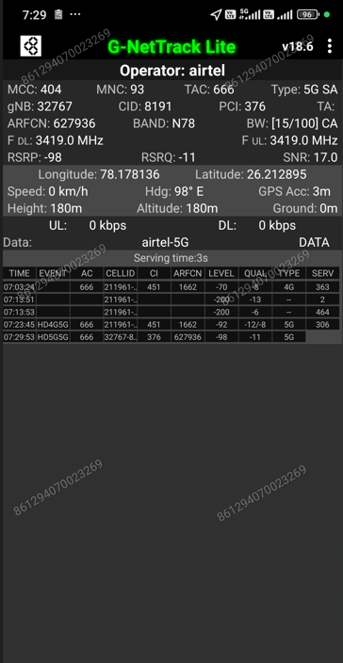
Airtel 5G NSA Good coverage Location
Discerption | Operator | Band | Lat. | Long.
5G NSA Good Coverage Location | Airtel | N78+B3 | 26.212895 | 78.178136

Slide 7
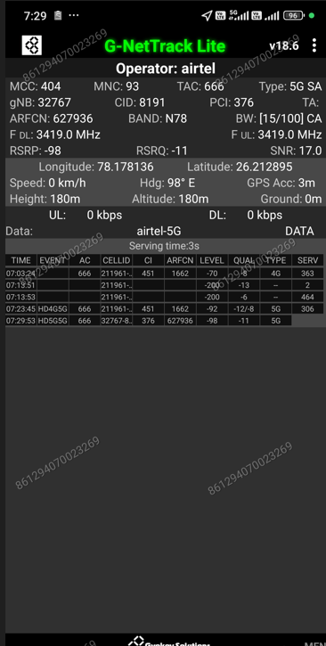
Airtel ENDC Combination
Discerption | Operator | ENDC Combination | Lat. | Long.
Airtel ENDC Combination | Airtel | N78+B3 | 26.212895 | 78.178136

Slide 8
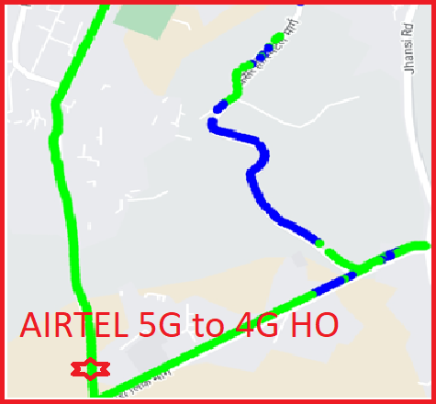
Airtel 5G to 4G Handover Location
Discerption | Operator | Technology/ Band | Lat. | Long.
5G to 4G Handover Location | Airtel | 5G>>4G>>5G | 26.161217 | 78.151895

Slide 9
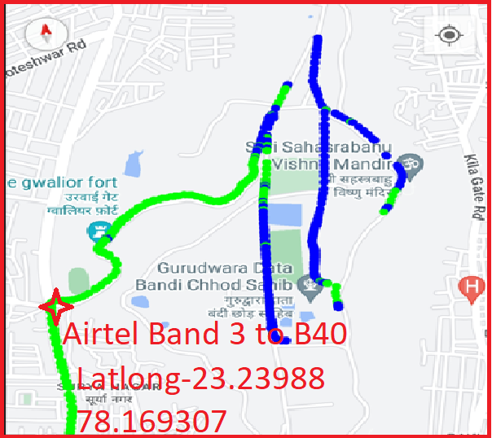
Airtel LTE BAND Handover
Discerption | Operator | BAND | Lat. | Long.
Airtel LTE Band Handover | Airtel | TDD>>FDD>>TDD | 26.230988 | 78.169307

Slide 10
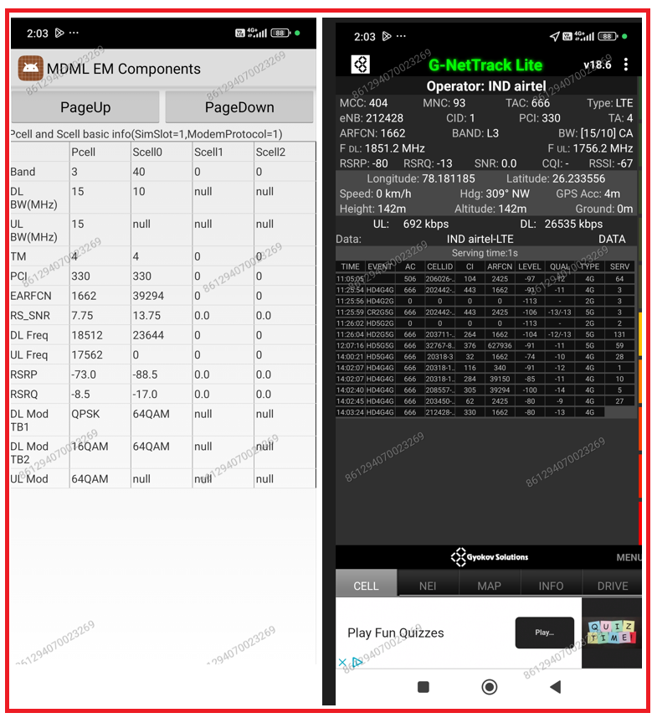
Airtel LTE 2CA Location
Discrption | Operator | Band | Lat | Long
LTE 2CA Location | Airtel | B3+B40 | 26.233555 | 78.181189

Slide 11
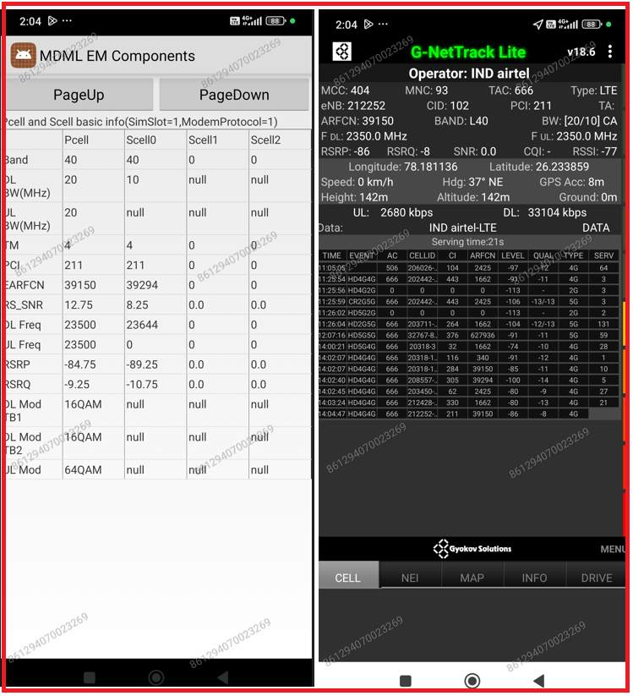
Airtel LTE 2CA Location
Discerption | Operator | Band | Lat. | Long.
LTE 2CA Location | Airtel | B40+B40 | 26.233859 | 78.181136

Slide 12
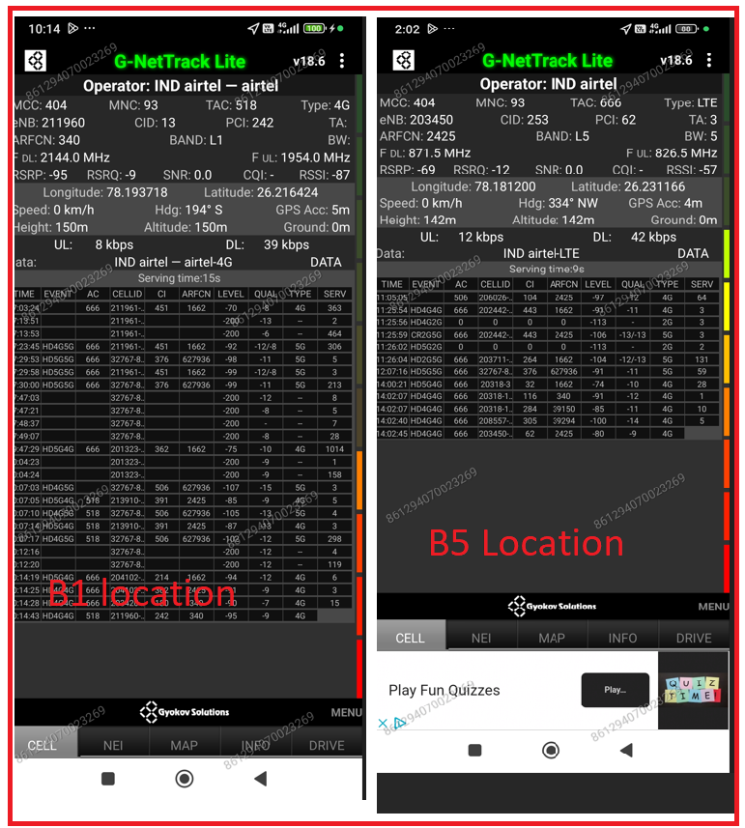
Airtel 4G BAND Location
Discerption | Operator | BAND | Lat | Long
Airtel 4G Band Location | Airtel | B1 | 26.216424 | 78.193718
 |  | B5 | 26.231166 | 78.181200

Slide 13
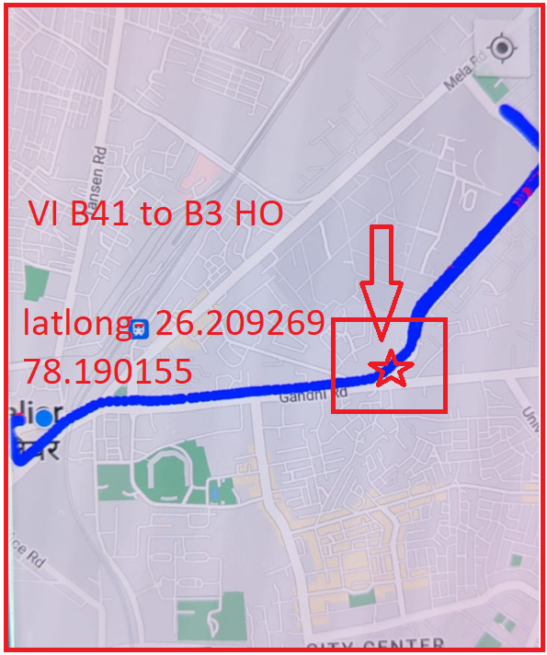
VI LTE BAND Handover
Discerption | Operator | Band | Lat. | Long.
VI LTE Band Handover | VI | TDD>>FDD>>TDD | 26.209269 | 78.190155

Slide 14
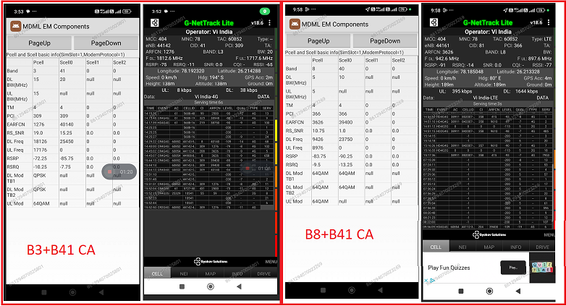
VI LTE 2CA Location
Discerption | Operator | Band | Lat. | Long.
VI LTE 2CA Location | VI | B3+41 | 26.214288 | 78.192320
 |  | B8+B41 | 26.213328 | 78.185048

Slide 15
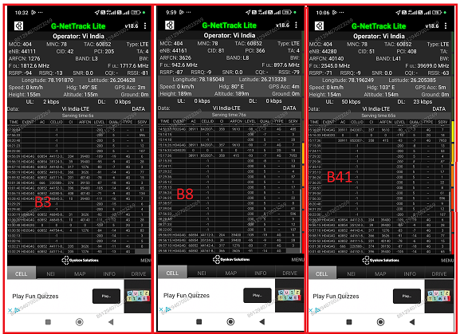
VI 4G BAND Location
Discerption | Operator | Band | Lat. | Long.
VI 4G Band Location | VI | B3 | 26.204628 | 78.191870
 |  | B8 | 26.213328 | 78.185048
 |  | B41 | 26.205385 | 78.196249

Slide 16
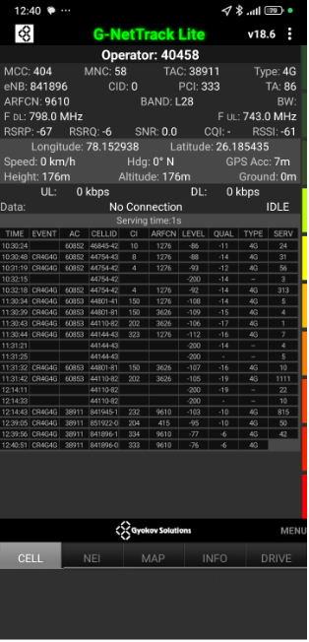
BSNL 4G Good coverage Location
Discerption | Operator | Band | Lat. | Long.
4G Good Location | BSNL | B28 | 26.185435 | 78.152938

Slide 17
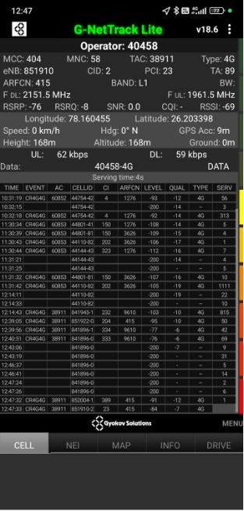
BSNL 4G Good coverage Location
Discerption | Operator | Band | Lat. | Long.
4G Good Location | BSNL | B1 | 26.203398 | 78.160455

Slide 18

THANK YOU

