Slide 1
MARQUIS TECHNOLOGIES
Drive Route –Airtel, Idea, VODAFONE & Reliance JIO (FDD/TDD) LTE

Slide 2
Operator Information:
Operator | JIO 4G
MCC | 405
MNC | 869
APN | Jionet
Operator | Airtel 4G
MCC | 404
MNC | 94
APN | Airtelgprs.com
Operator | VI
MCC | 404
MNC | 43
APN | www

Slide 3
Operator Information 1
Functionality | Airtel
Website: http://www.airtel.com/ WAP APN: airtelgprs.com
Customer care | 199
MNC | 94
Bands supported | Both FDD and TDD
 | LTE 2300 MHz – TDD(Band 40)
 | LTE 2100,1800 MHz – FDD(Band1,3)
USSD | To check MDN: *282#
 | Balance check: *123#
 | Data Balance check: *121*114#
VoLTE | Supported
CSFB | Supported (CSFB to 2G)

Slide 4
Operator Information 2
Functionality | RELIANCE JIO
Website: http://www.jio.com WAP APN: jionet
Customer care | 198
MNC | 869
Bands supported | Both FDD and TDD
 | LTE 2300 MHz –TDD(Band 40)
 | LTE 850 MHz – FDD(Band 5)
 | LTE 1800 MHz –FDD(Band 3)
USSD | NA
 | NA
 | NA
VoLTE | Supported
CSFB | Not Supported

Slide 5
Operator Information 3
Functionality | VI
Website: http://www.myvi.in WAP APN: www
Customer care | 198
MNC | 43
Bands supported | Both FDD and TDD
 | LTE 2300 MHz –TDD(Band 40,41)
 | LTE 2100 MHz – FDD(Band 1)
 | LTE 1800 MHz –FDD(Band 3)
USSD | To check MDN*199#
 | Balance check198
 | Data Balance check: 121
VoLTE | Supported
CSFB | Supported(csfb to 2g)

Slide 6
Drive Route
Near Cell :- Stationary: RSRP : -65dbm to -75dbm
Cell Edge :- Stationary: RSRP : -95dbm to -110dbm
Mixed :- Mobility: RSRP : -65dbm to -110dbm

Slide 7
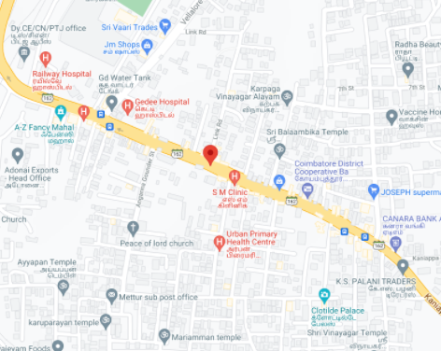
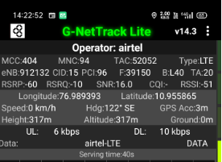
Near Cell (Airtel)
Near cell(NC) | longitude | latitude | RSRP | Cell id | FDD E-ARFCN
1 | 76.989393 | 10.955865 | 60 | 15 | 39150
Sre ayyanar medical,podanur,tamilnadu
RSRP:
-65dbm to 75dbm

Slide 8
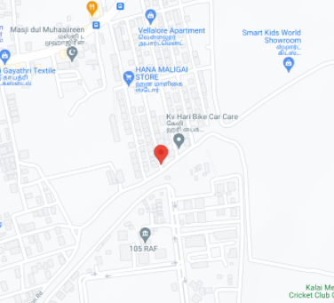
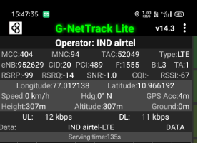
Edge Cell (Airtel)
Edge cell(EC) | longitude | latitude | RSRP | Cell id | TDD E-ARFCN
1 | 77.012138 | 10.966192 | -99 | 20 | 1555
Kovai Mahalingapuram,podanur,tamilnadu
RSRP:
-95dbm to -110dbm

Slide 9
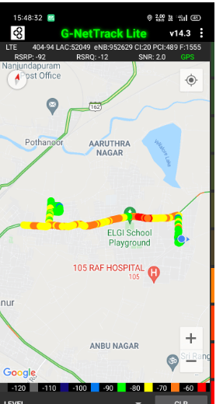
Mixed Mobility:- Coimbatore,tamilnadu.

Slide 10
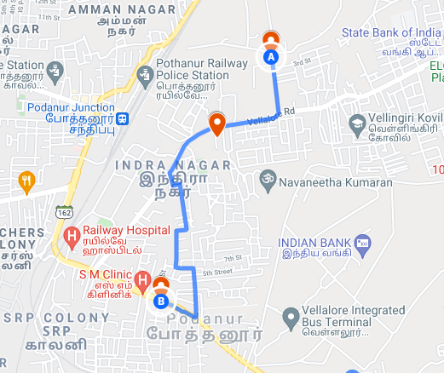
Airtel Band HO

Slide 11
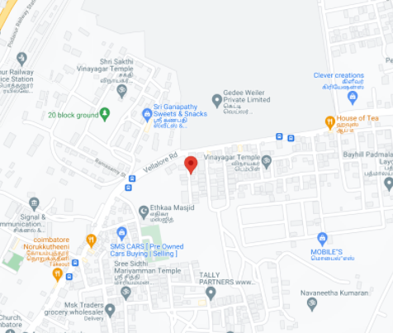
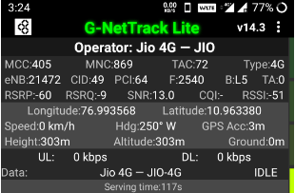
Near Cell (Reliance JIO)
Near cell(NC) | longitude | latitude | RSRP | Cell id | TDD E-ARFCN
1 | 76.993568 | 10.963380 | 60 | 49 | 2540
Sam anna nagar,podanur,Tamilnadu
RSRP:
-65dbm to -75dbm

Slide 12
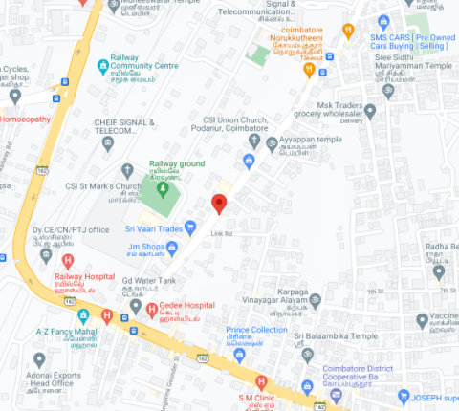
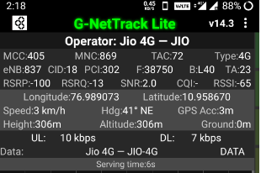
Edge Cell (Reliance JIO)
Edge cell(NC) | longitude | latitude | RSRP | Cell id | TDD E-ARFCN
1 | 76.989073 | 10.958670 | 100 | 18 | 38750
Vellalore road,arulmurgan nagar,cheran nagar,tamilnadu
RSRP:
-95dbm to -110dbm

Slide 13
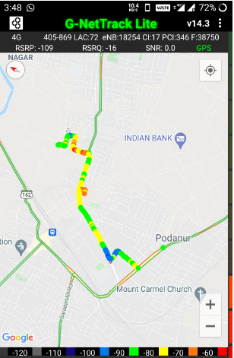
Mixed Mobility:- Coimbatore Tamilnadu
RSRP: -95dbm to -110dbm

Slide 14
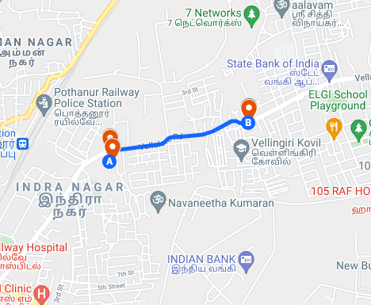
Inter Band Handover (FDD-TDD), JIO 4G

Slide 15
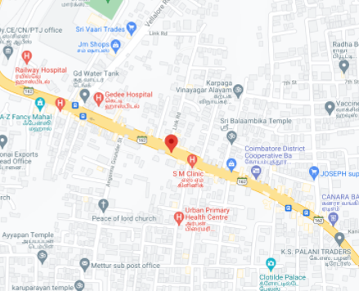
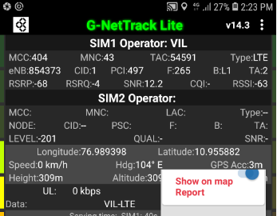
Near Cell VI:
Near cell(NC) | longitude | latitude | RSRP | Cell id | TDD E-ARFCN
1 | 76.989398 | 10.95582 | 68 | 1 | 265
Mettur,Podanur,Tamilnadu
RSRP:
-65dbm to -75dbm

Slide 16
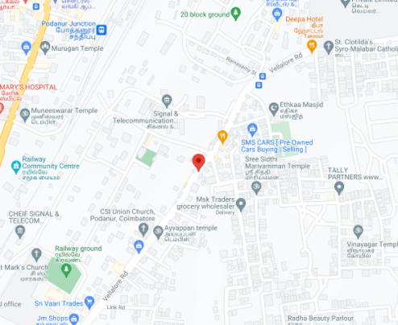
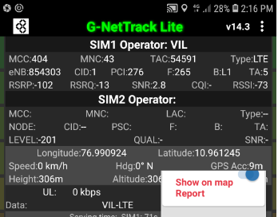
Cell Edge VI:
Edge cell(EC) | longitude | latitude | RSRP | Cell id | TDD E-ARFCN
1 | 76.990924 | 10.961245 | 102 | 1 | 265
Vellalore road,siddannapuram,podanur,tamilnadu
RSRP:
-95dbm to -105dbm

Slide 17
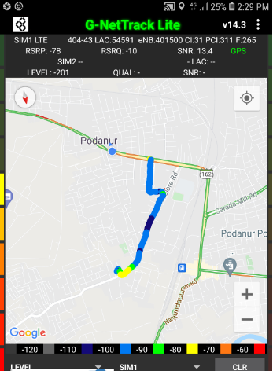
Mixed coverage area Vodafone:

Slide 18
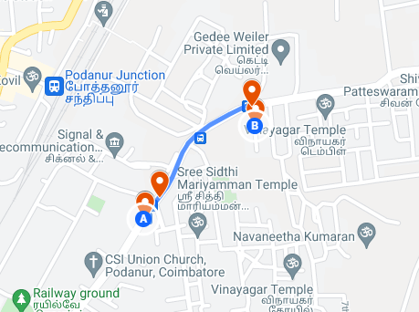
Inter Band Handover (FDD-TDD), VI 4G

Slide 19
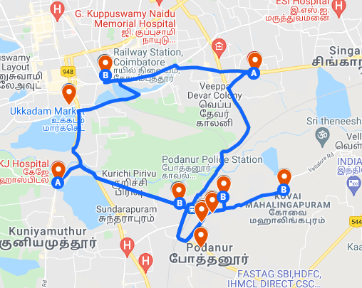
Total Drive Route

Slide 20
THANK YOU
MARQUIS TECHNOLOGIES

