Slide 1
MARQUIS TECHNOLOGIES
Drive Route –Airtel, VI & Reliance JIO (FDD/TDD) LTE
Location : Vadodara

Slide 2
Operator Information:
Operator | JIO 4G
MCC | 405
MNC | 857
APN | JIONET
Operator | Airtel 4G
MCC | 404
MNC | 98
APN | airtelgprs.com
Operator | VI
MCC | 404
MNC | 05
APN | internet
Operator | BSNL
MCC | 404
MNC | 57
APN | Bsnlnet

Slide 3
Operator Information 1
Functionality | Airtel
Website: https://www.airtel.in/ WAP APN: airtelgprs.com
Customer care | 121
MNC | 98
Bands supported | Both FDD and TDD
 | LTE 2300 MHz – TDD(Band 40)
 | LTE 1800 – FDD(Band 3) LTE 2100 – FDD (Band 1)
USSD | To check MDN: *282#
 | Balance check: *123#
 | To check all services: *121#
VoLTE | Supported
VoWiFi | Supported
CSFB | Supported (CSFB to 2G)

Slide 4
Operator Information 2
Functionality | RELIANCE JIO
Website: https://www.jio.com WAP APN: jionet
Customer care | 198
MNC | 857
Bands supported | Both FDD and TDD
 | LTE 2300 MHz –TDD(Band 40)
 | LTE 850 MHz – FDD(Band 5)
 | LTE 1800 MHz –FDD(Band 3)
USSD | NA
 | NA
 | NA
VoLTE | Supported
VoWiFi | Supported
CSFB | Not Supported

Slide 5
Operator Information 3
Functionality | VI
Website: https://www.myvi.in WAP APN: internet
Customer care | 198
MNC | 05
Bands supported | Both FDD and TDD
 | LTE 2100 MHz –FDD(Band 1)
 | LTE 2500 MHz –TDD(Band 41)
 | LTE 1800 MHz –FDD(Band 3) LTE 900Mhz - FDD(Band 8)
USSD | To check MSISDN :*199#
 | Recharge : *199*5#
 | Balance check : *199*2#
VoLTE | Supported
VoWiFi | Supported
CSFB | Supported (CSFB to 2G/3G)

Slide 6
Drive Route
Near Cell : Stationary: RSRP : -65dbm to -75dbm
Edge Cell : Stationary: RSRP : -95dbm to -110dbm
Mixed : Mobility: RSRP : -65dbm to -110dbm

Slide 7
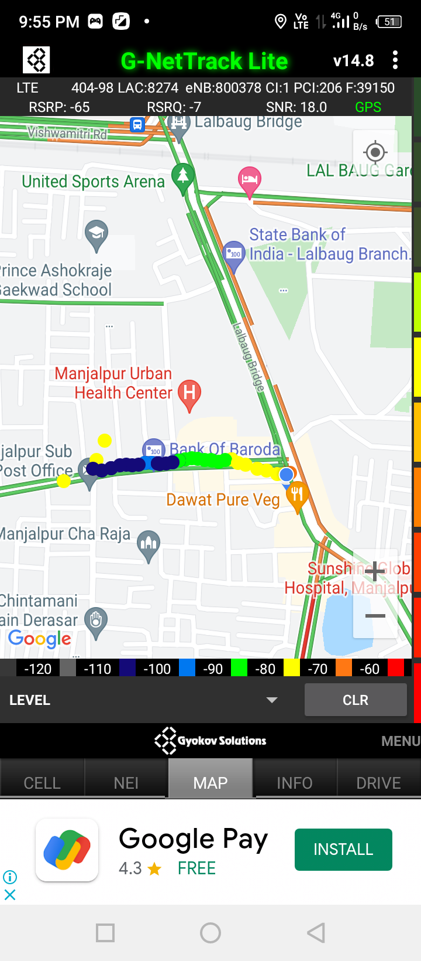
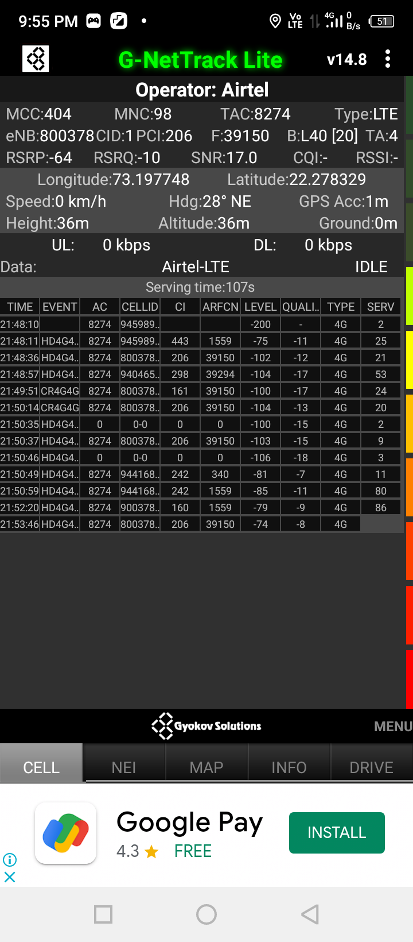
Near Cell (Airtel)
Near cell | longitude | latitude | RSRP (dbm) | Cell id | E-ARFCN
1 | 73.197748 | 22.278329 | -64 | 1 | 39150
RSRP Range for Near Cell :
-65dbm to -75dbm
Bank of Baroda Manjalpur branch Vadodara

Slide 8
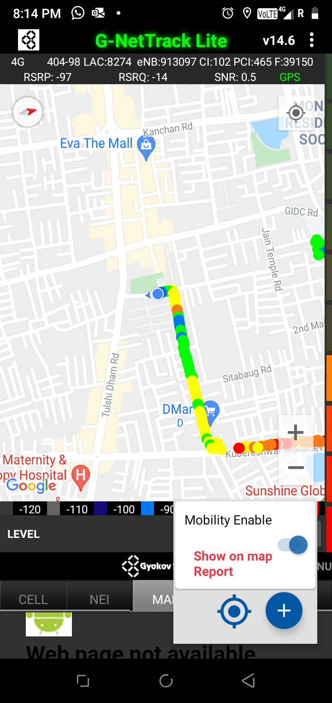
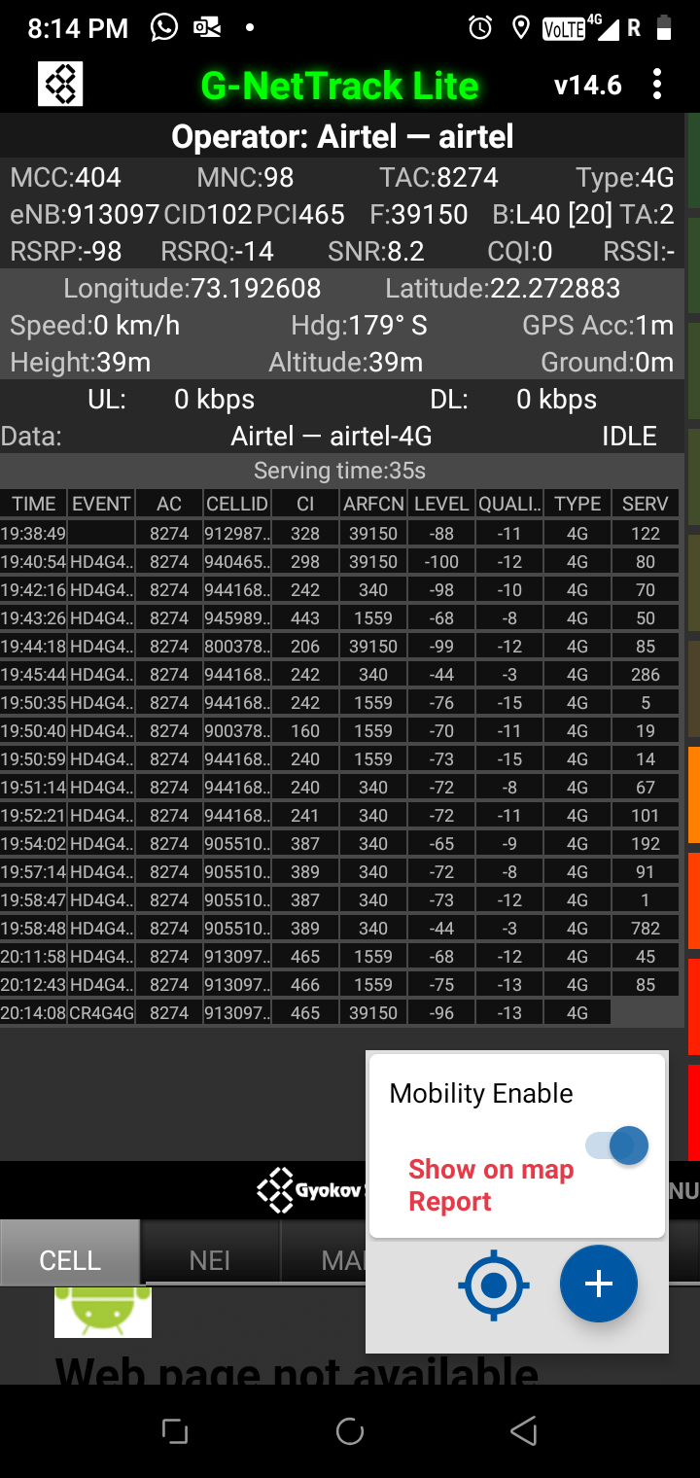
Edge Cell (Airtel)
Edge cell | longitude | latitude | RSRP (dbm) | Cell id | E-ARFCN
1 | 73.192608 | 22.272883 | -98 | 102 | 39150
RSRP Range for Edge Cell :
-95dbm to -110dbm
D-mart majalpur vadodara

Slide 9
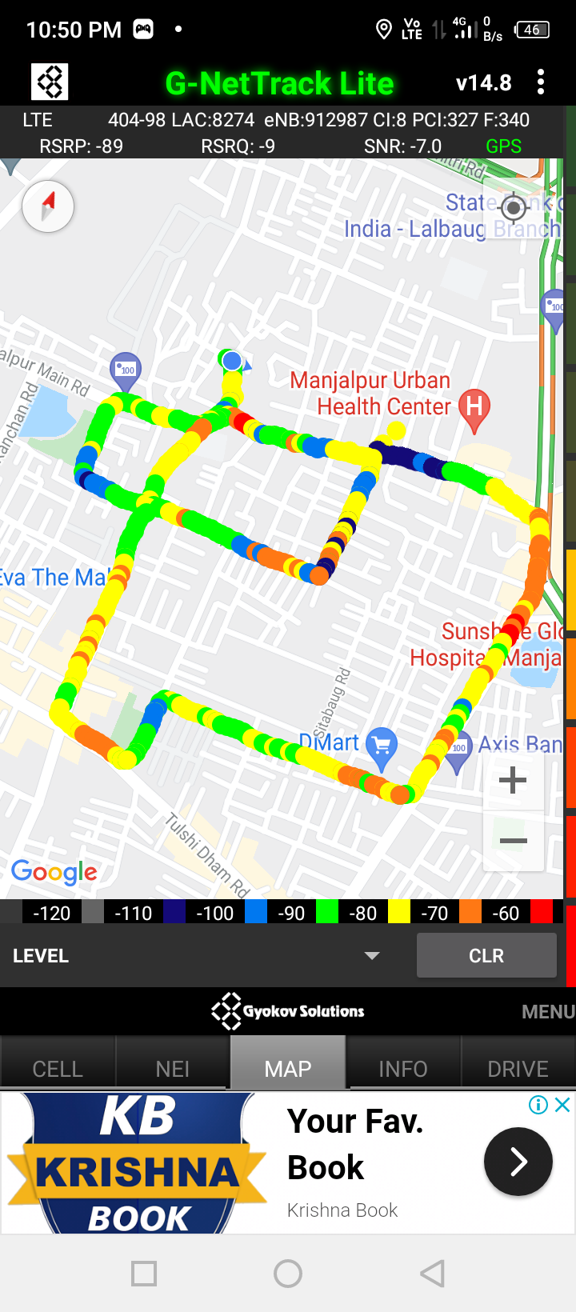
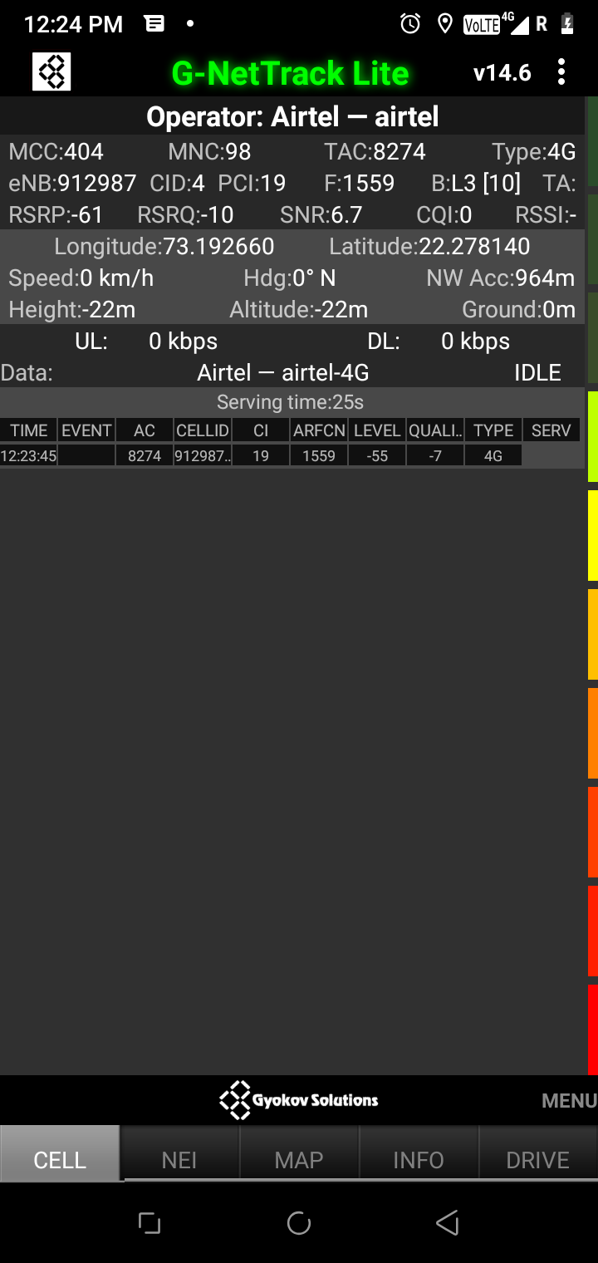
Mixed Coverage Area for Airtel

Slide 10
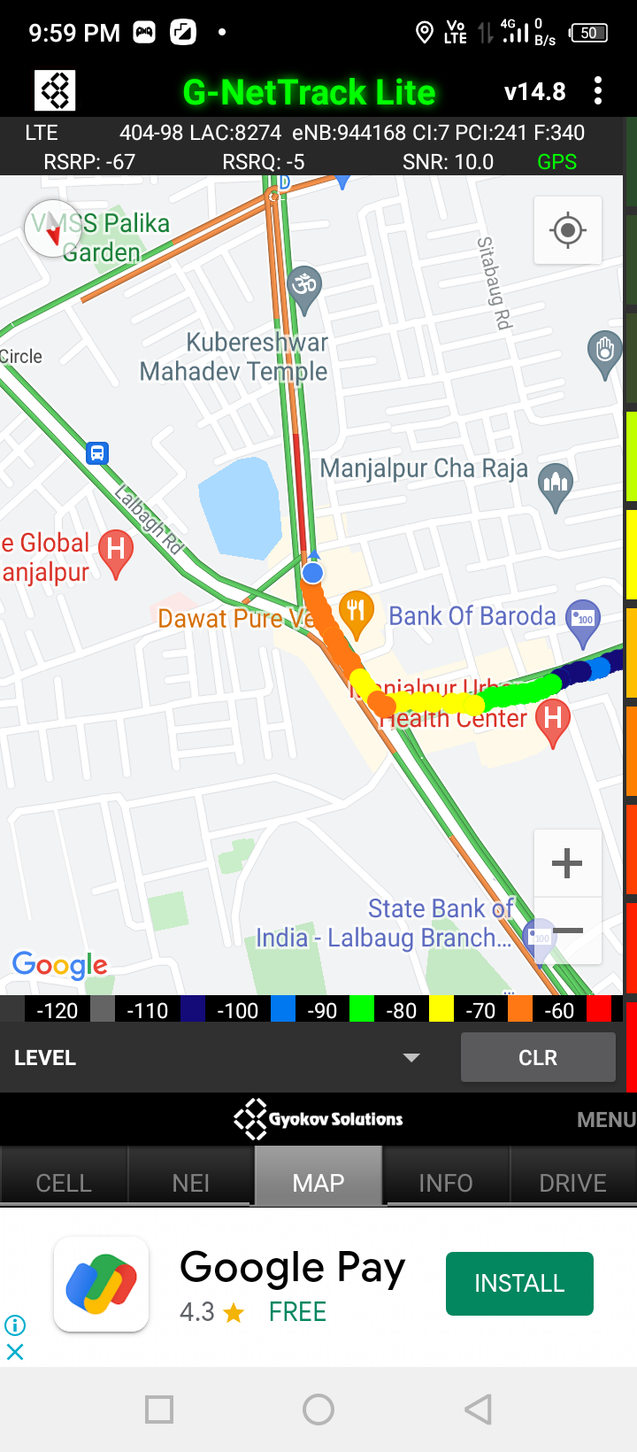
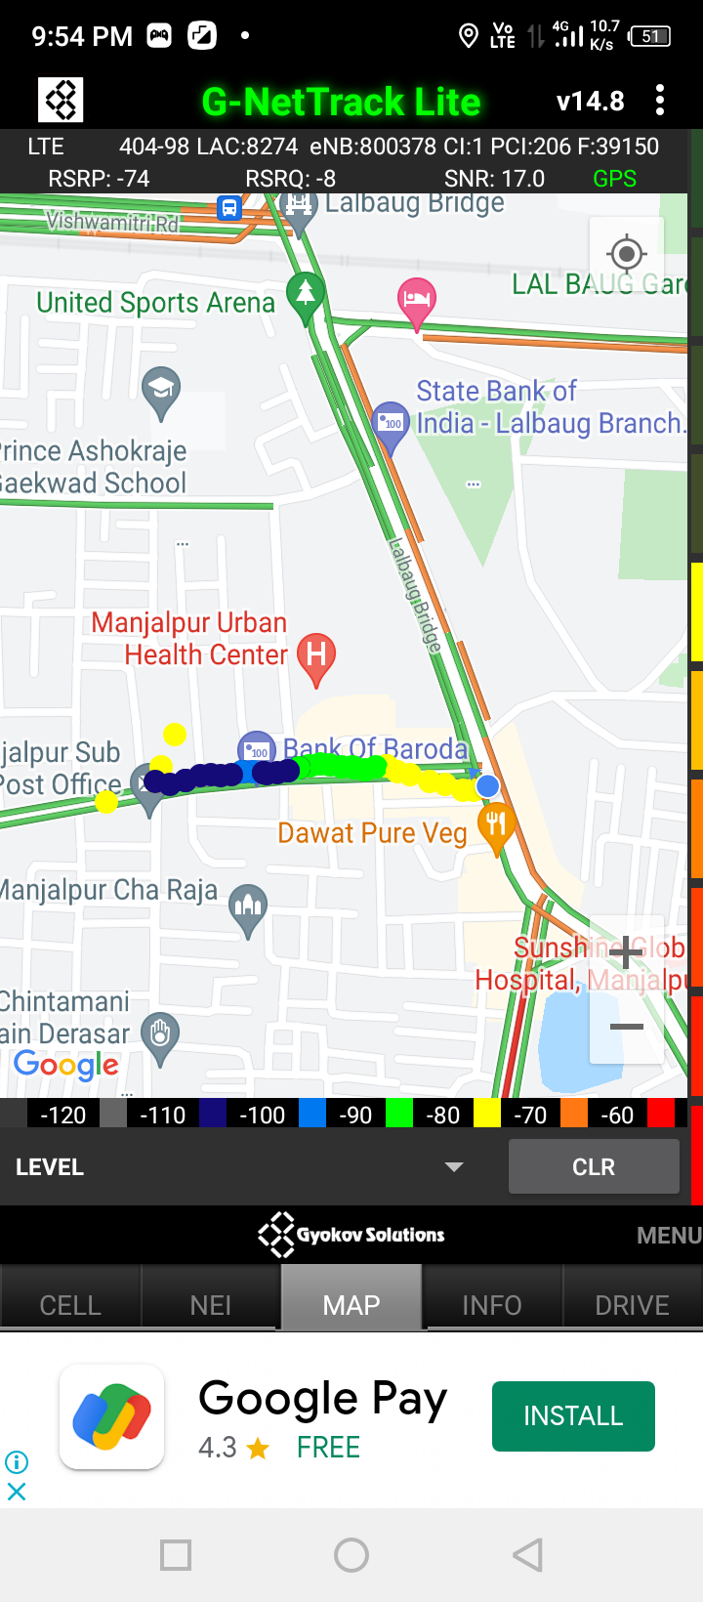
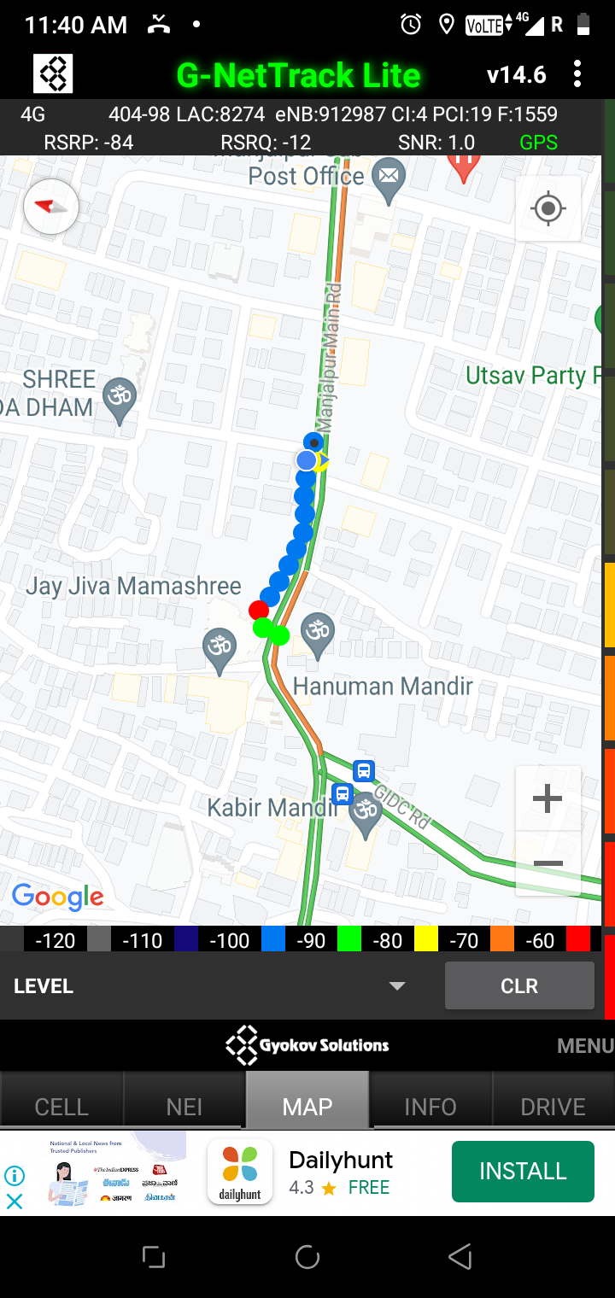
Airtel Inter Band HO
Band 1 BAND 40 BAND 3

Slide 11
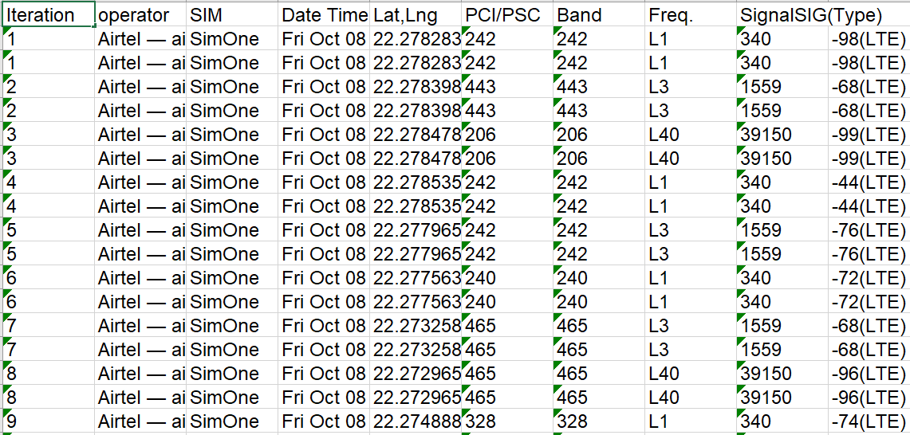
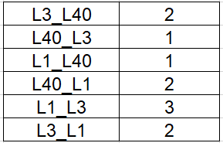
MATT Tool InterBand Handover Results for Airtel

Slide 12
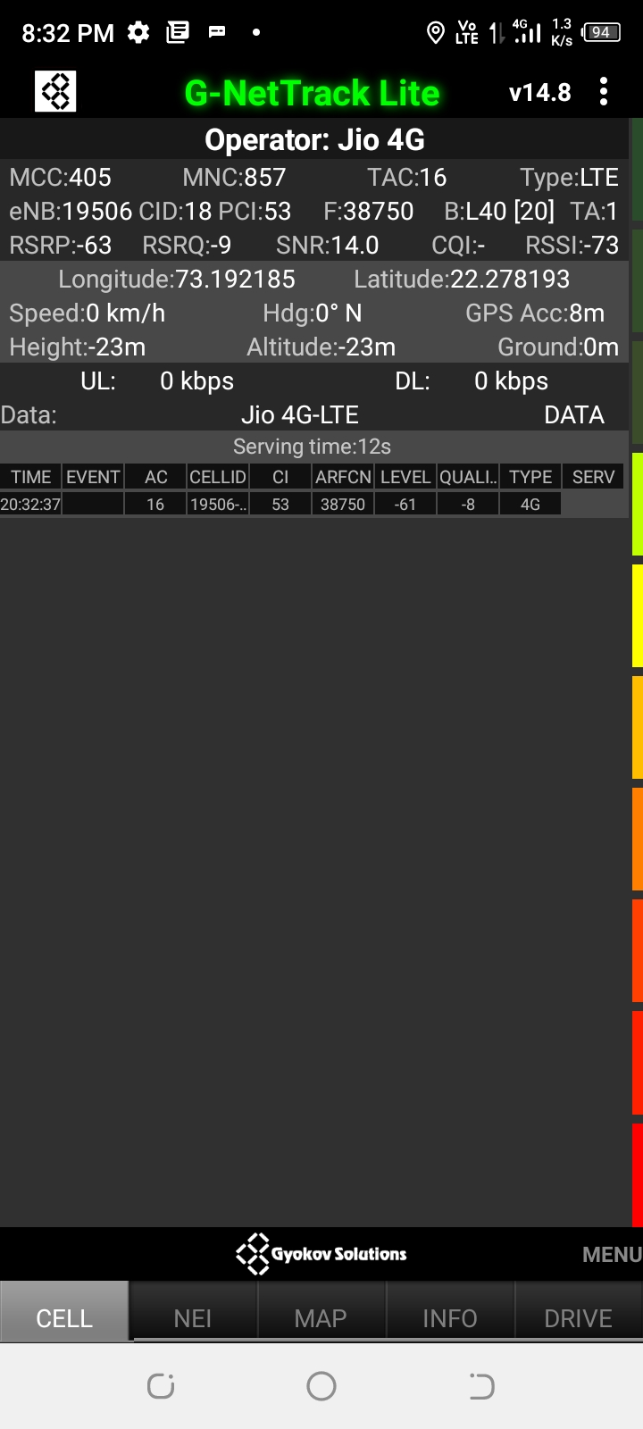
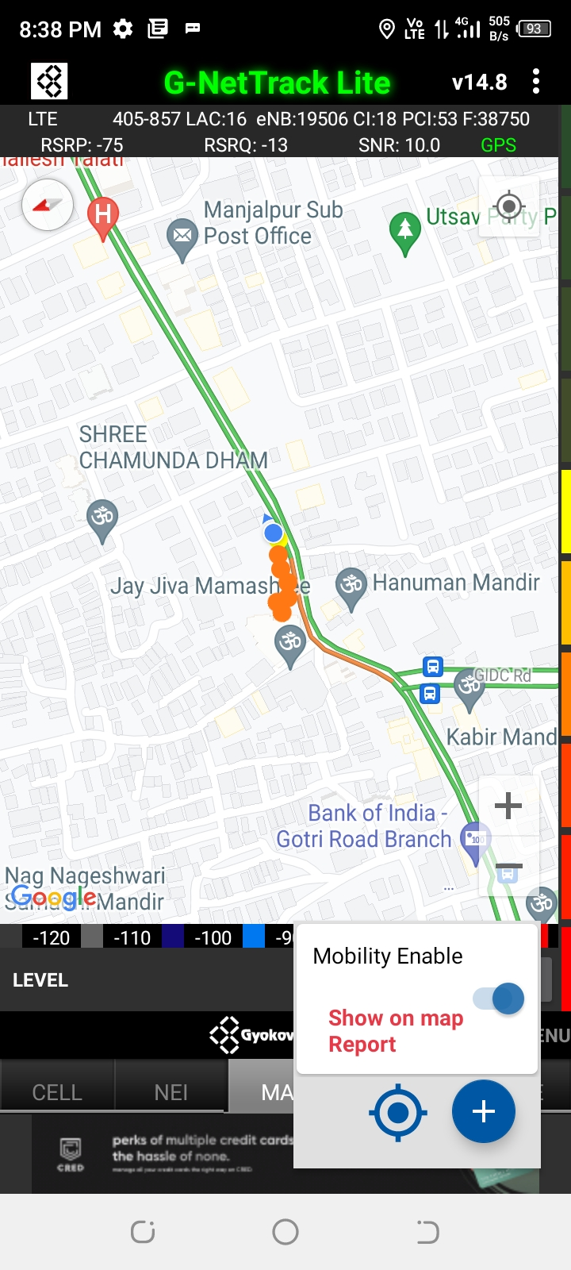
Near Cell (Reliance JIO)
Near cell | longitude | latitude | RSRP (dbm) | Cell id | E-ARFCN
1 | 73.192185 | 22.278193 | -63 | 18 | 38750
RSRP Range for Near Cell : -65dbm to -75dbm
Majalpur main road near Hanuman temple

Slide 13
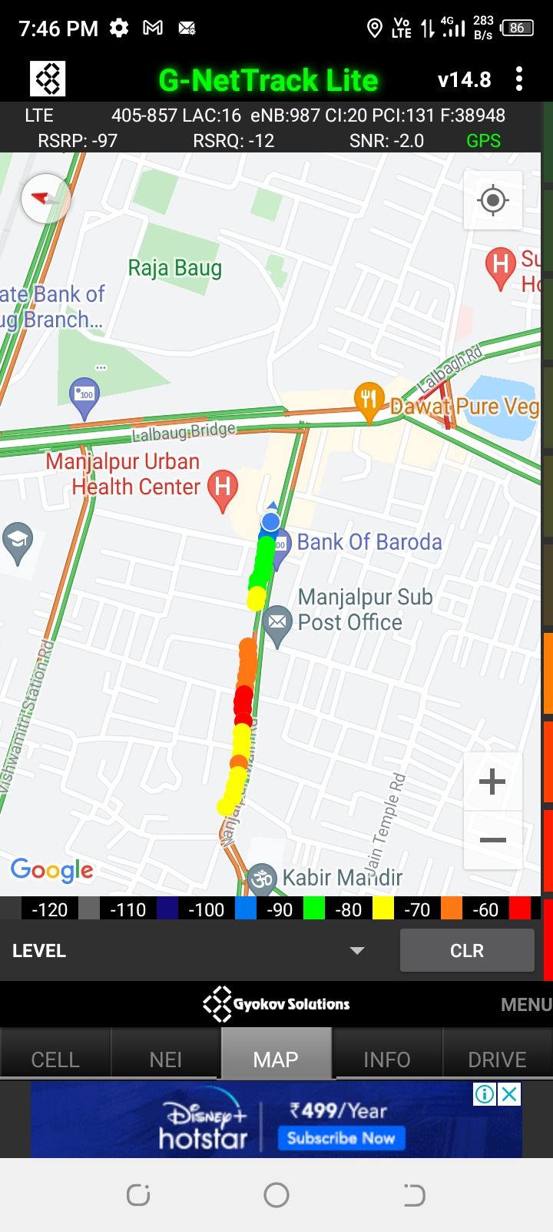
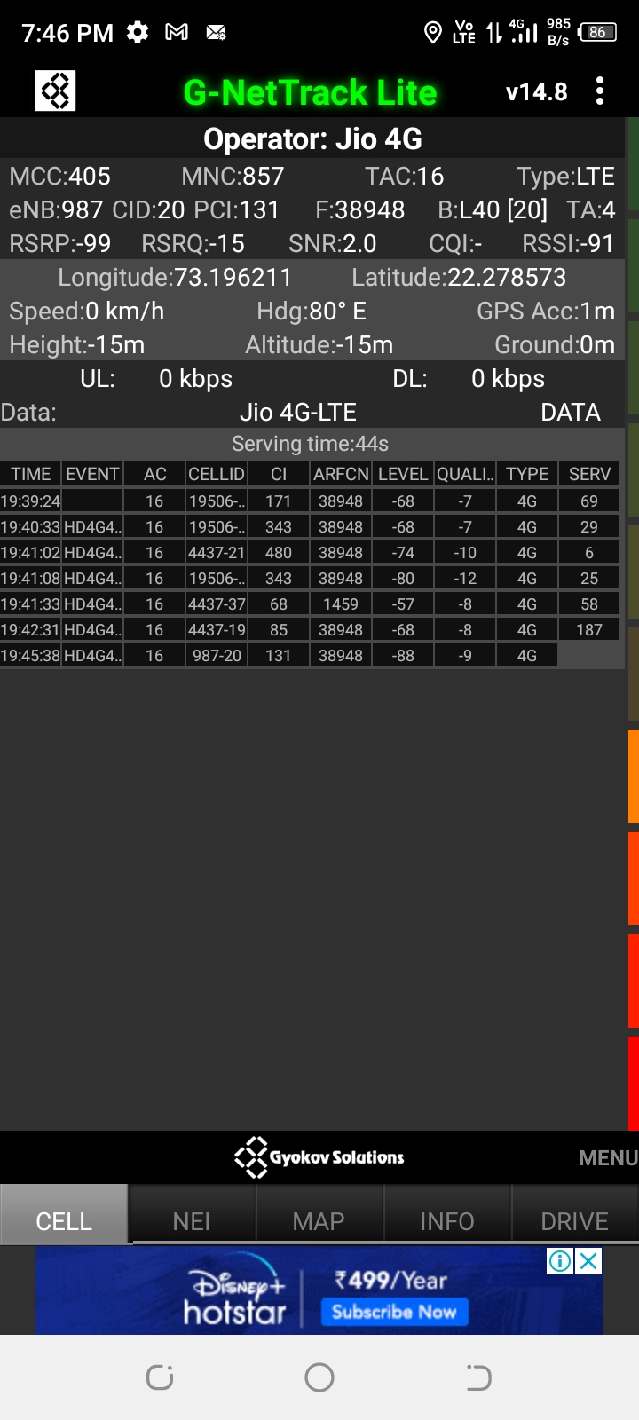
Edge Cell (Reliance JIO)
Edge Cell | longitude | latitude | RSRP (dbm) | Cell id | E-ARFCN
1 | 73.196211 | 22.278573 | -99 | 20 | 38948
RSRP Range for Edge Cell :
-95dbm to -110dbm
Bank of Baroda Manjalpur branch Vadodara

Slide 14
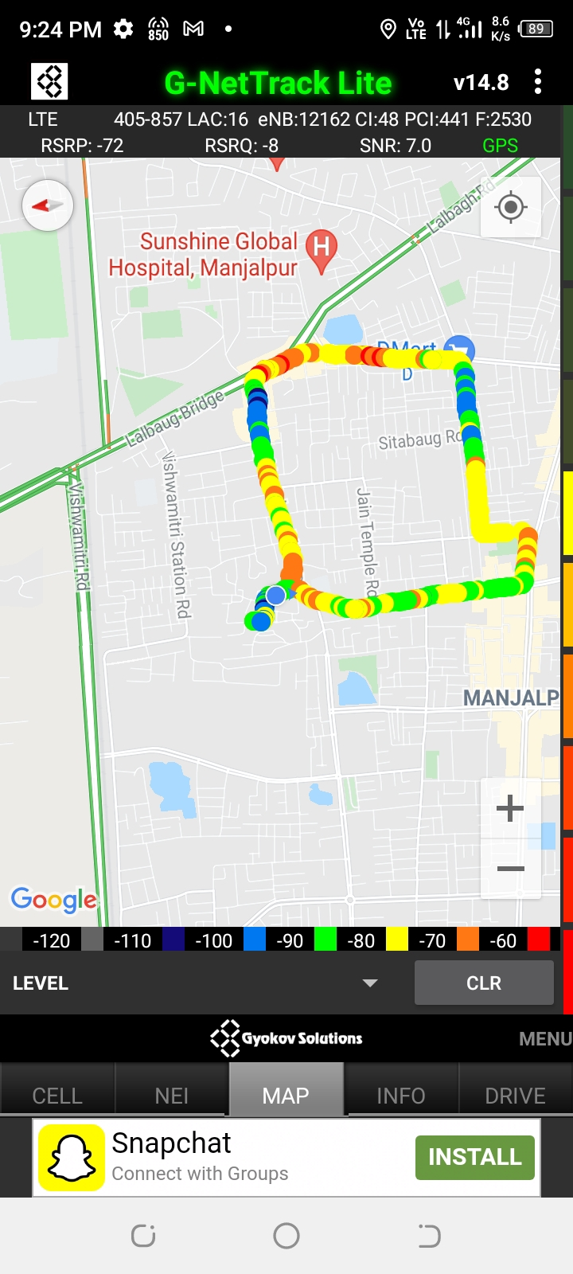
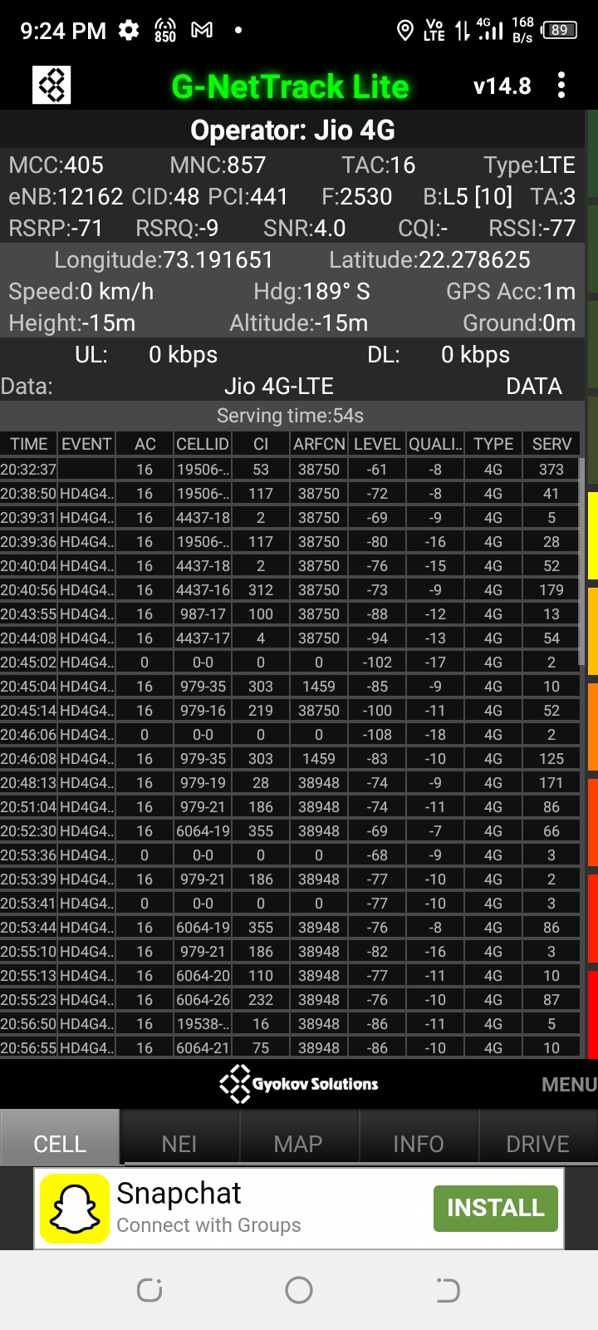
Mixed Coverage Area for Reliance JIO

Slide 15
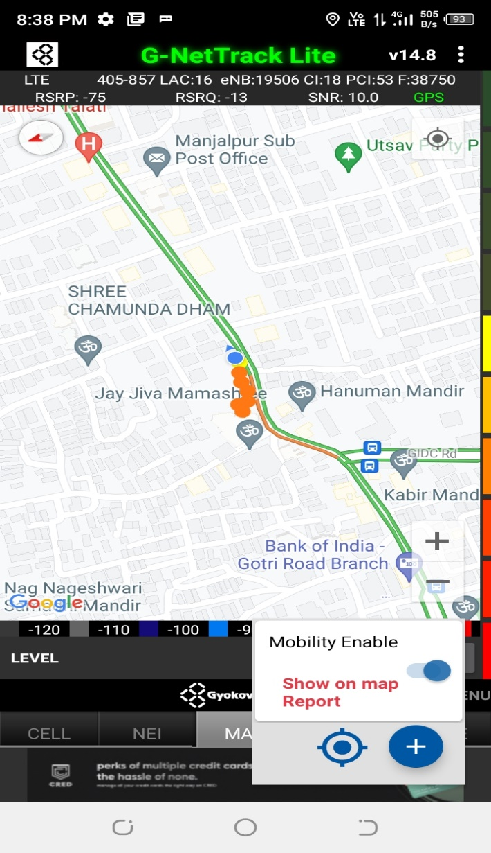

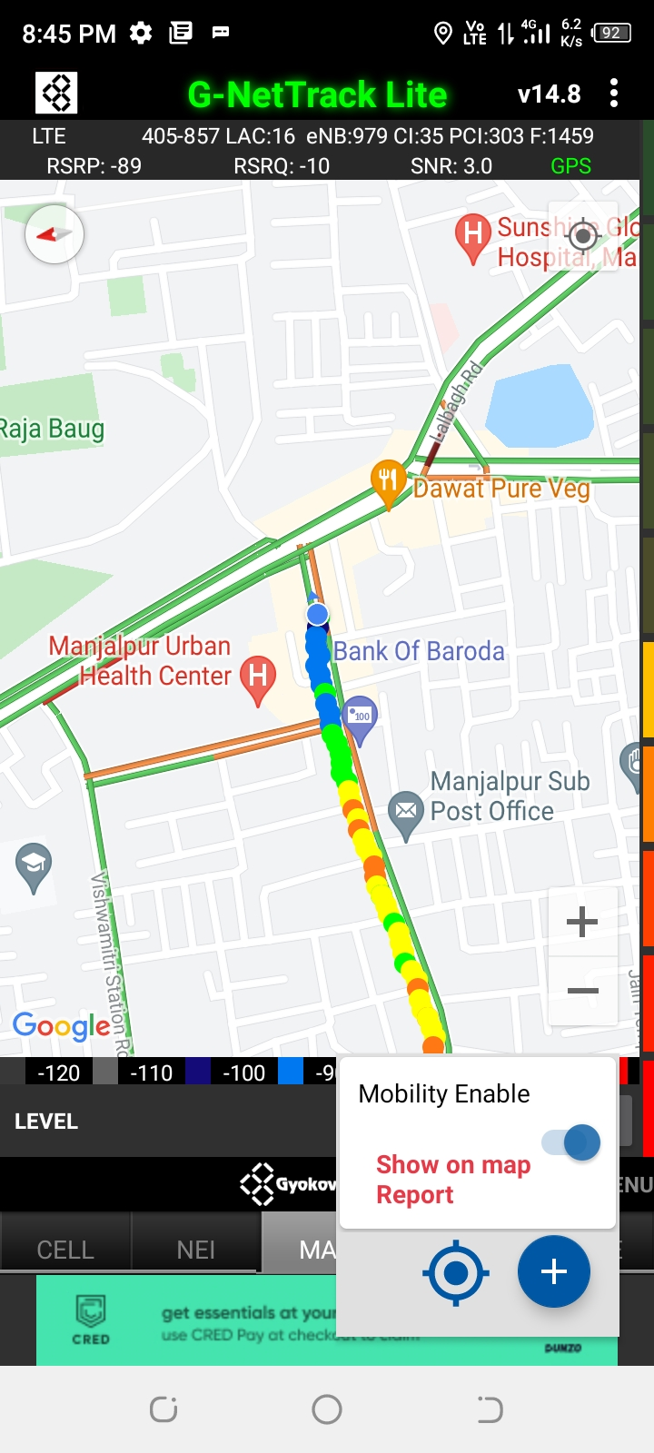
Inter Band Handover (FDD-TDD) for JIO 4G
Band 40 Band 5 Band 3

Slide 16
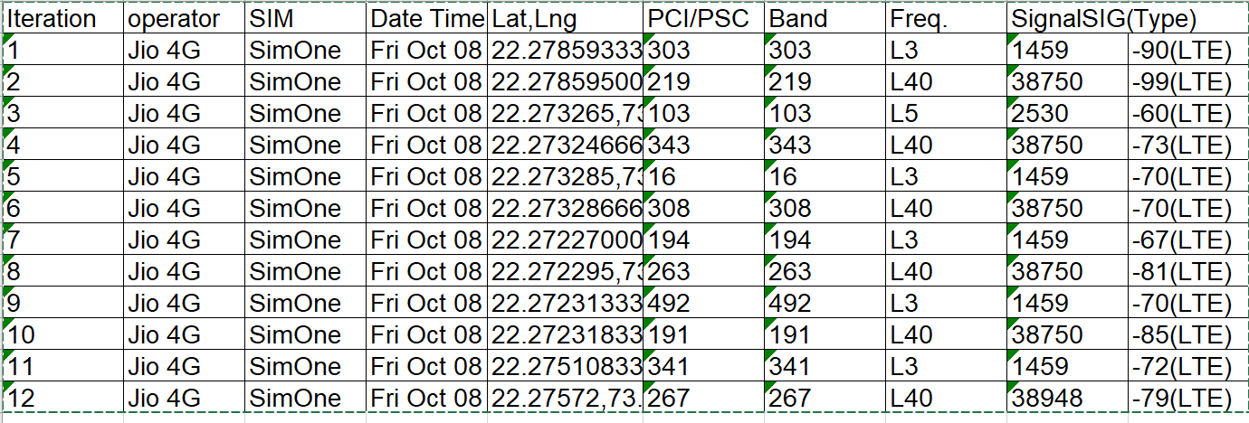
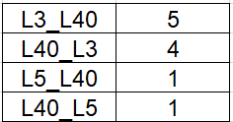
MATT Tool InterBand Handover Results for Jio

Slide 17
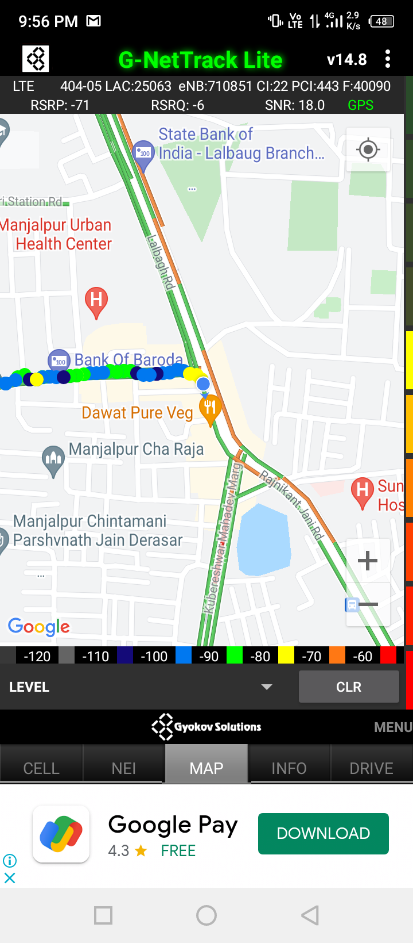
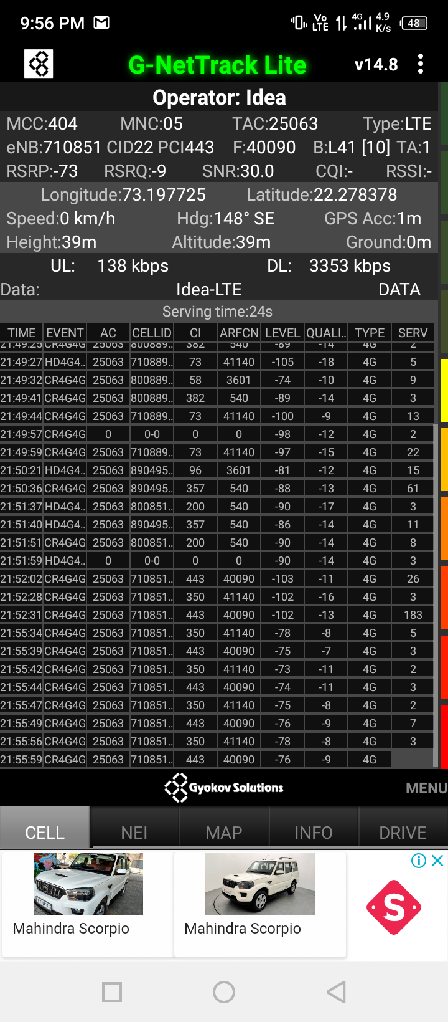
Near Cell for VI:
Near Cell | longitude | latitude | RSRP (dbm) | Cell id | E-ARFCN
1 | 73.197725 | 22.278378 | -73 | 22 | 40090
RSRP Range for Near Cell :
-65dbm to -75dbm
Bank of Baroda Manjalpur branch Vadodara

Slide 18
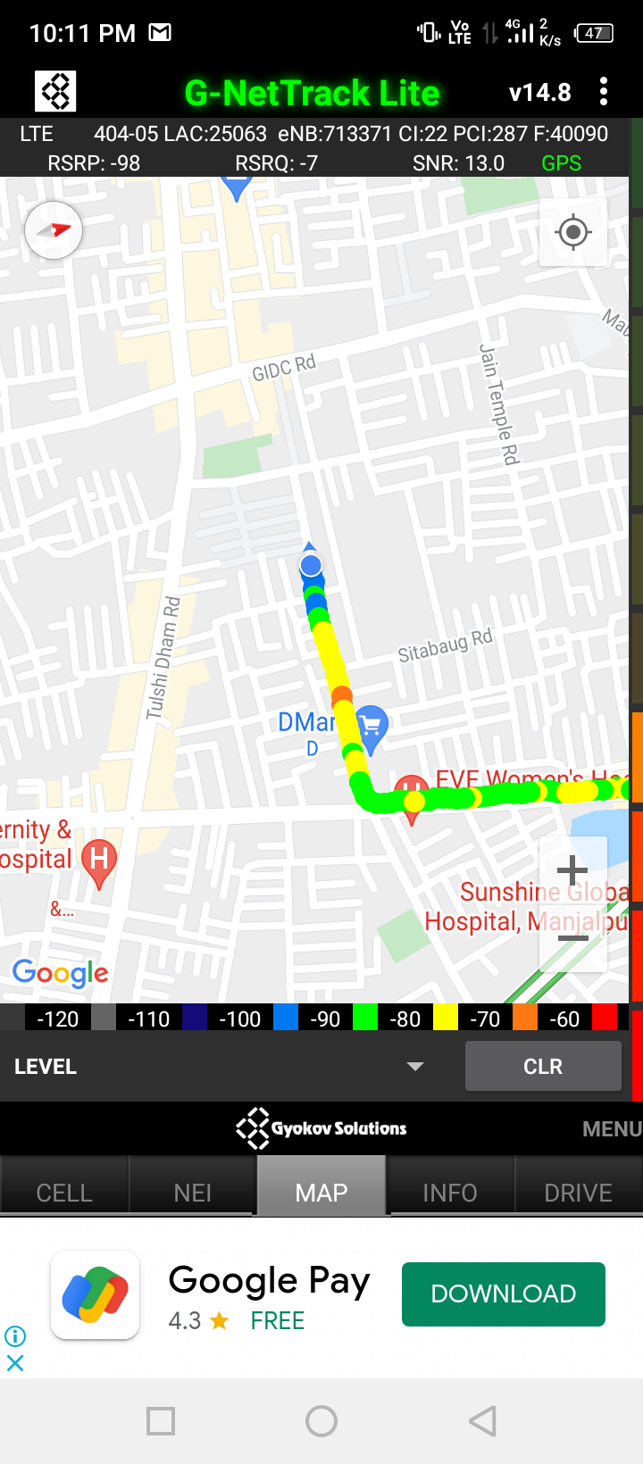
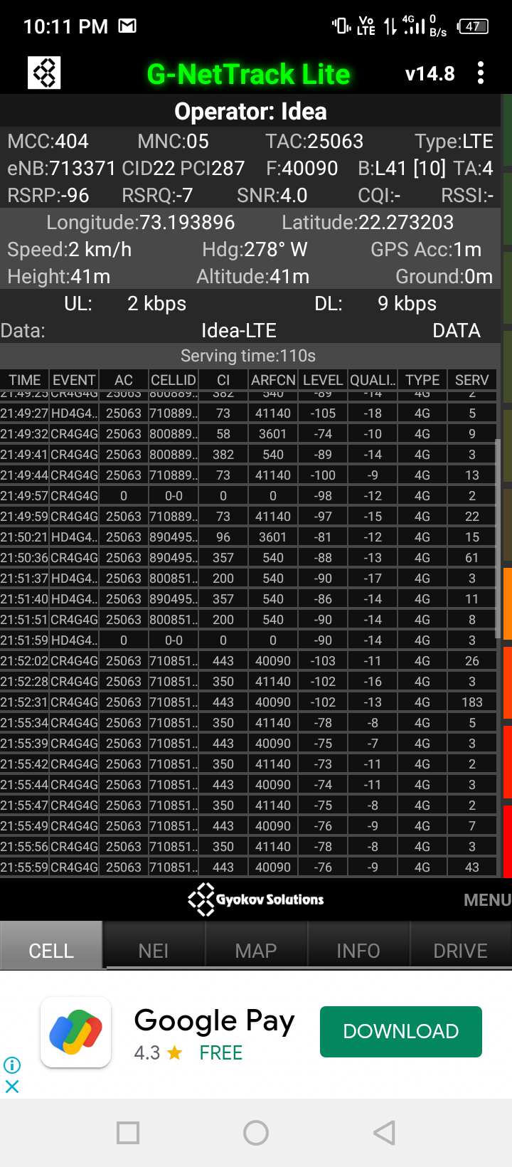
Edge Cell for VI:
Edge cell(EC) | longitude | latitude | RSRP (dbm) | Cell id | E-ARFCN
1 | 73.193896 | 22.273203 | -96 | 22 | 40090
RSRP Range for Edge Cell :
-95dbm to -110dbm
D-mart Majhalpur Vadodara

Slide 19
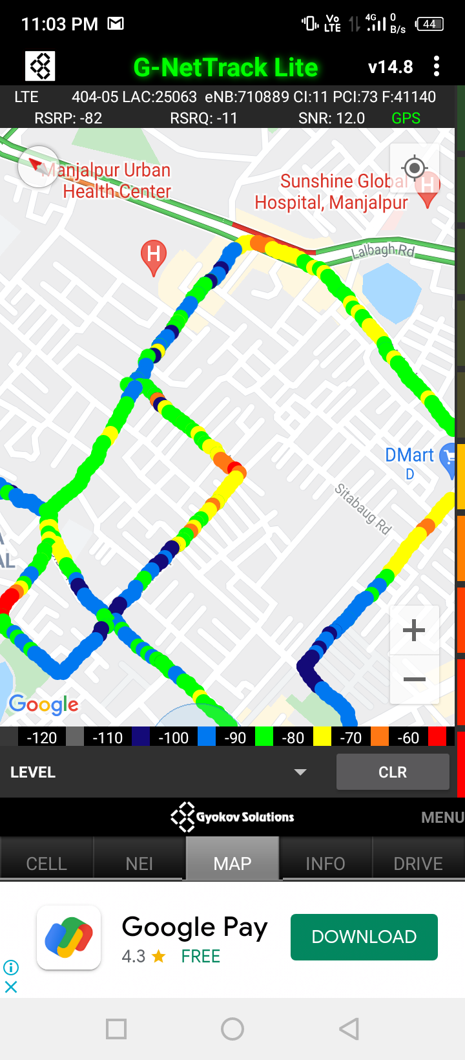
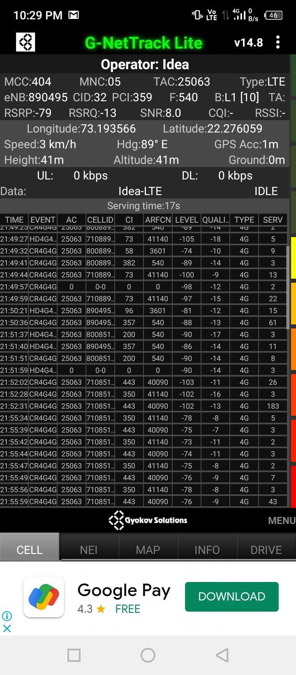
Mixed Coverage Area for VI:

Slide 20
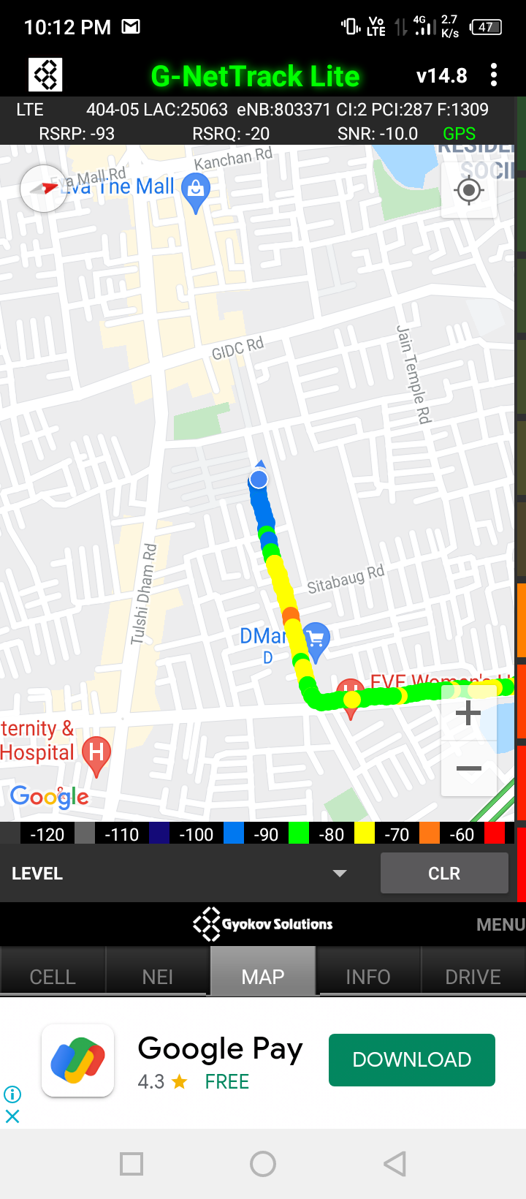
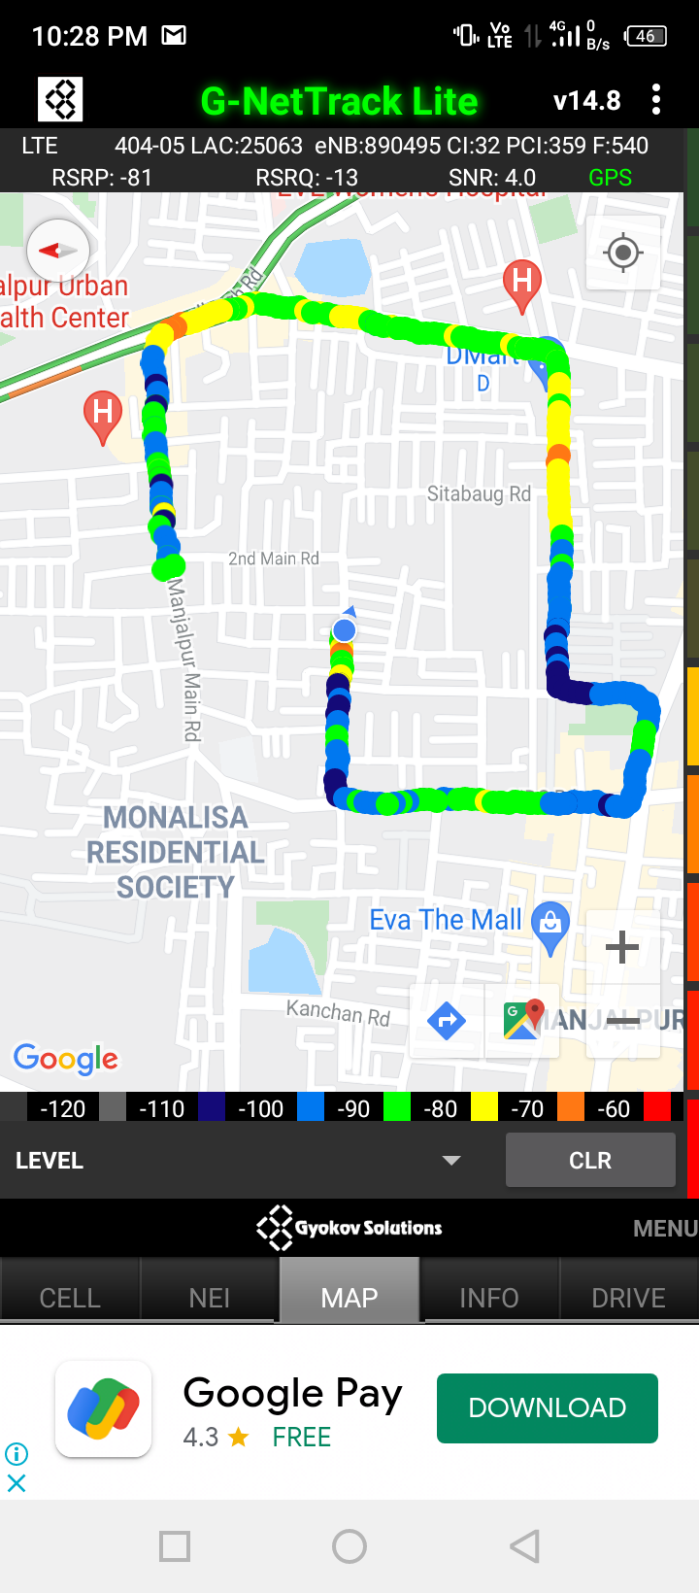
VI Band Handover
Band 3 Band 1 Band 41

Slide 21
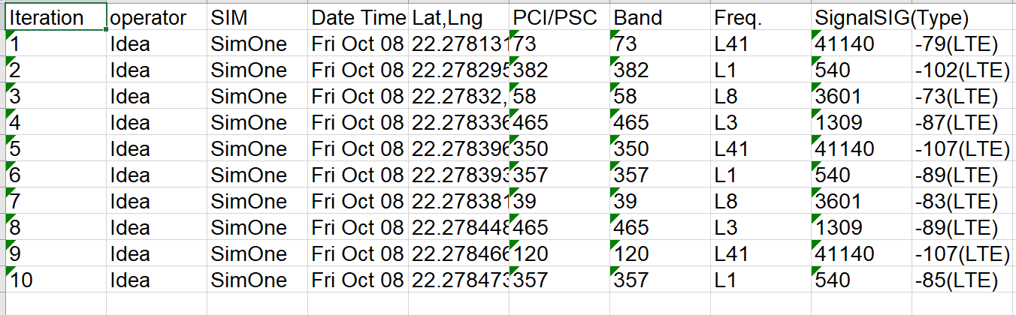
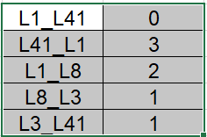
MATT Tool InterBand Handover Results for VI

Slide 22
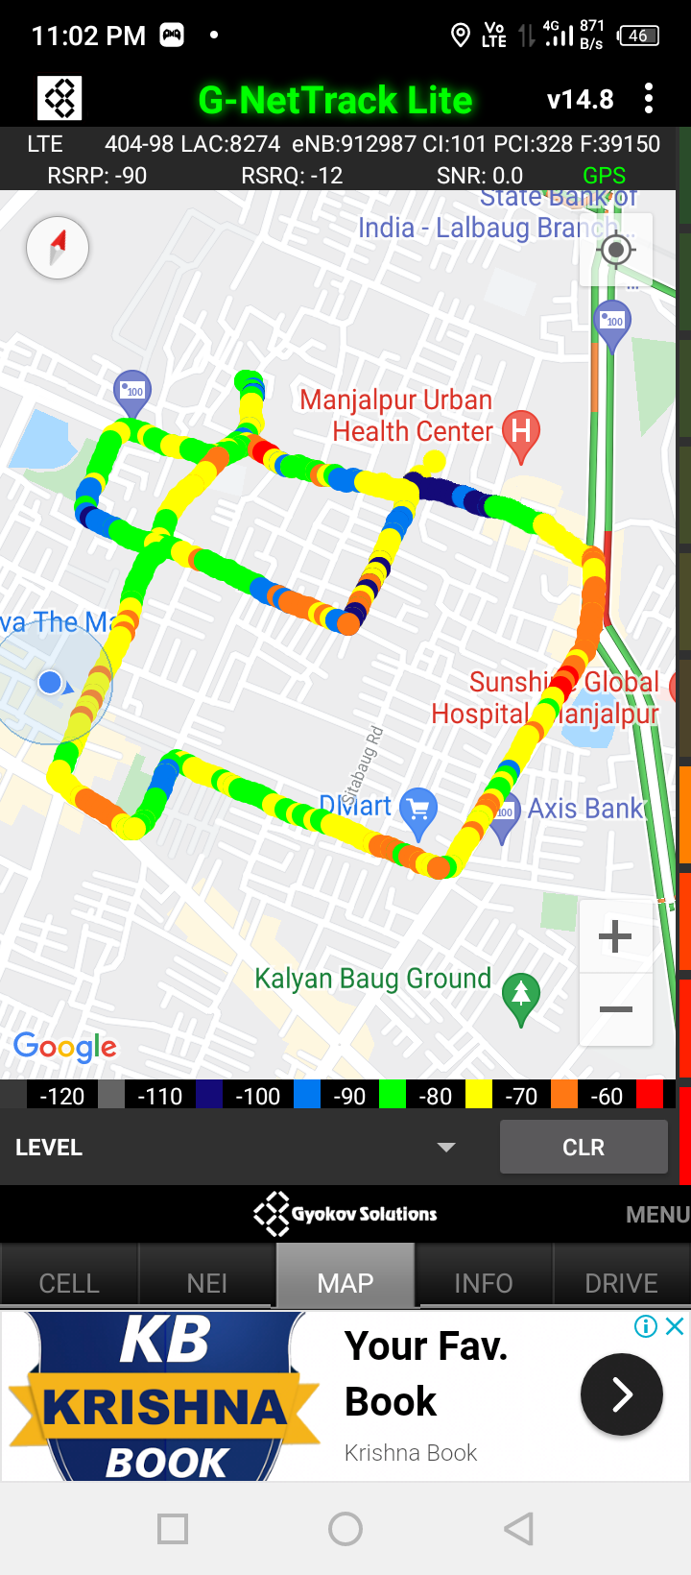
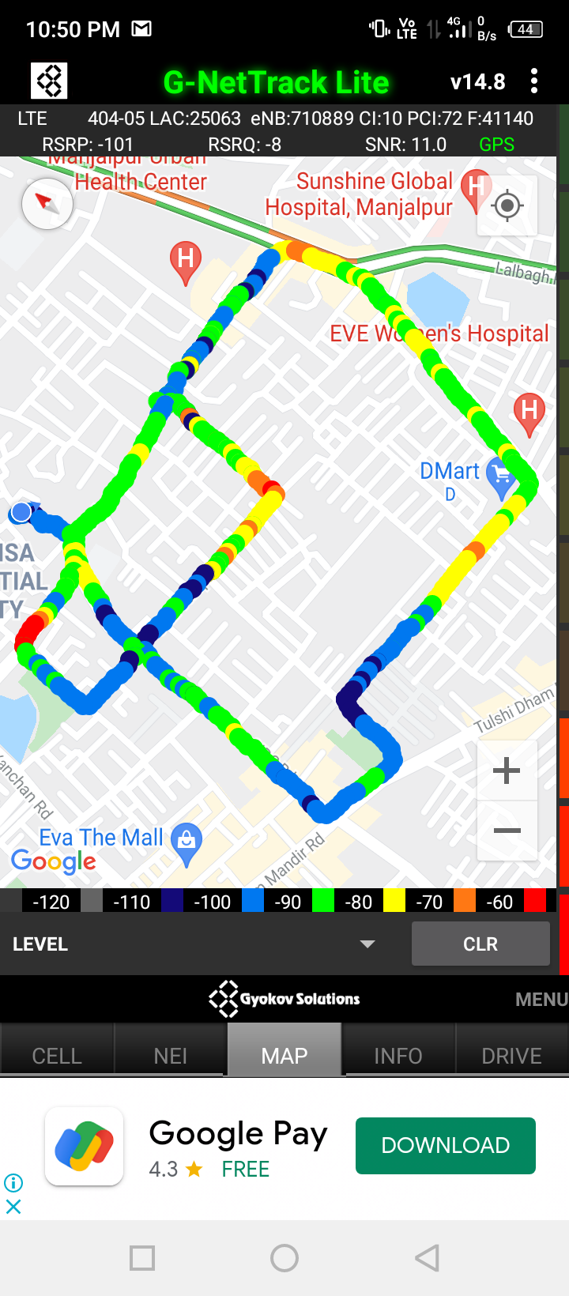
G-net Tracker Drive Route

Slide 23
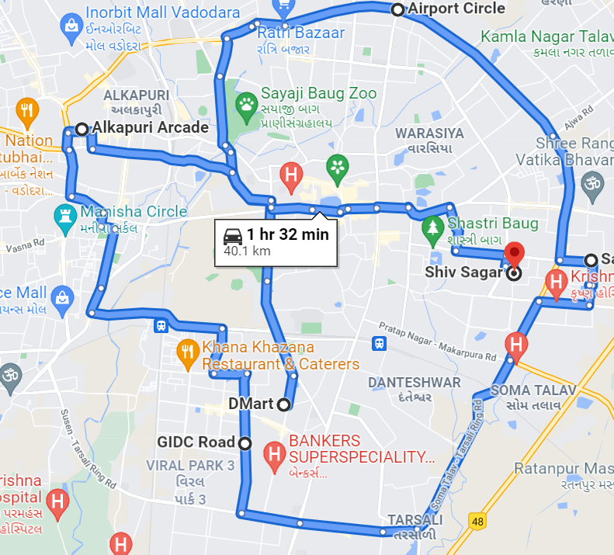
Drive Route

Slide 24
THANK YOU
MARQUIS TECHNOLOGIES

