Slide 1
MARQUIS TECHNOLOGIES
Drive Route – Yangon (Myanmar)

Slide 2
Travel to Hanoi (Vietnam)
Country | Myanmar
Continent | Asia
City | Yangon
Duration of travel from New Delhi | Approx. 14 Hrs.
Time Zone | GMT +6:30
International Dialing Code | +95
VISA | Tourist Visa
VISA Duration | 90 Days , Single Entry
VISA Fees | Contact Nisha Deshpande
VISA Requirements | Need to provide 2 passport size photographs
Yellow Fever Vaccination Certificate | Not Required

Slide 3
Operator Information
MCC | MNC | Operator | Bands (MHz)
414 | 06 | Telenor | GSM 900 / UMTS 2100 / LTE 1800
414 | 01 | MPT | GSM 900 / UMTS 2100 / LTE 1800
414 | 05 | Ooredoo | UMTS 900/2100 LTE 1800/2100

Slide 4
USSD Codes for operators
No. | Operator | Balance Check Code | Customer Care | Voice Mail No.
1 | Telenor | *124# | Call 979 for Prepaid | NA
2 | MPT | *124# | Call 106 for Prepaid | NA
3 | Ooredoo | *124# | Call 234 for Prepaid | NA

Slide 5
Manual APN Settings
Attached is a sheet which has Manual APN Settings for all operators in Yangon (Myanmar)

Slide 6
RSRP Criteria
Near Cell :-Stationary: RSRP : -55dbm to -85dbm
Cell Edge :-Stationary: RSRP : -95dbm to -110dbm
Mixed :-Mobility: RSRP : -55dbm to -120dbm

Slide 7
Services Supported by Operators
Operator | Features/Services | Supports(Yes/No)
Telenor | Reselection | Yes
 | Redirection | Yes
 | MMS | NO
 | CSFB | Yes(3G)
 | VoLTE | No
 | PS Handover | Yes
MPT | Reselection | Yes
 | Redirection | Yes
 | MMS | NO
 | CSFB | Yes(3G)
 | VoLTE | No
 | PS Handover | Yes
Ooredoo | Reselection | Yes
 | Redirection | Yes
 | MMS | NO
 | CSFB | Yes(3G)
 | VoLTE | No
 | PS Handover | Yes

Slide 8
Additional Information
Where to Get SIM cards?
SIM cards are available at Airport and in local operator outlet.
What Documents Required to Purchase SIM?
At Airport passport is required and in City only mobile is required
Best Recharge Option for 8 days Testing?
Recharges are available in all confectionery shops and street kiosks.
Best Hotel to Stay
Best Western Green Hill Hotel
Driver Details for Mobility?
Mob: +959799230125

Slide 9
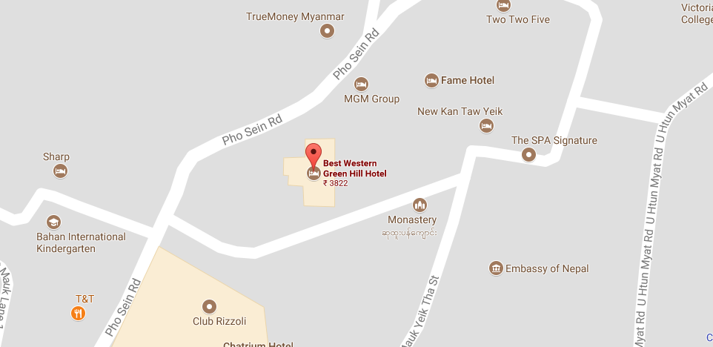
Near Cell Location of Ooredoo Location: Best Western Green Hill Hotel Lat: 16.801417 Long: 96.169480

Slide 10
Edge Cell Location of Ooredoo Location: Best Western Green Hill Hotel Basement Lat: 16.801417 Long: 96.169480

Slide 11
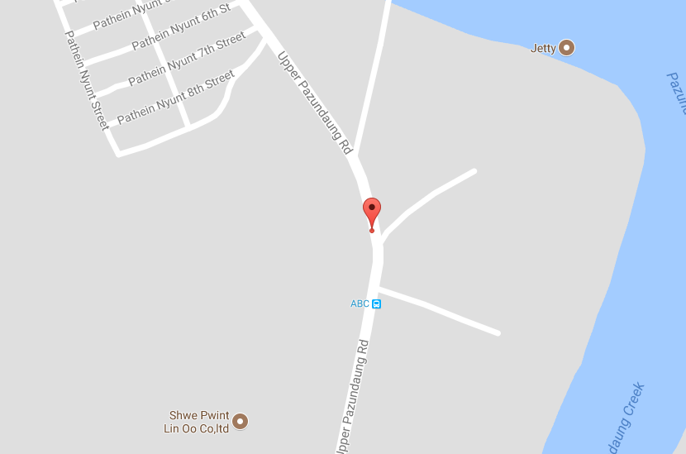
4G to 3G Reselection Location of Ooredoo Location :Upper Pazundaung Lat: 16.800934 Long: 96.186861

Slide 12
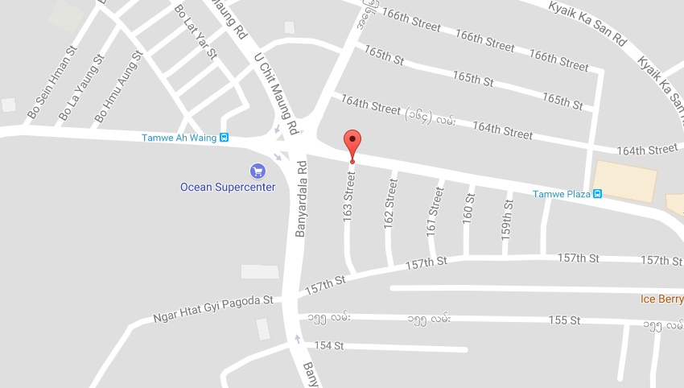
3G to 4G Reselection Location of Ooredoo Location :Near Tamwe Plaza Bus Stop Lat: 16.811348 Long: 96.171841

Slide 13
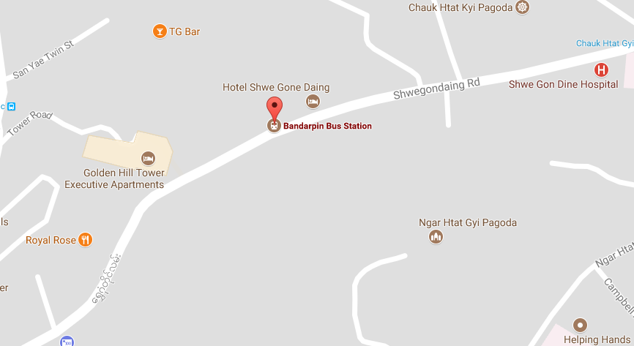
Near Cell Location of MPT Location :Bandarpin Bus Station Lat: 16.809694 Long: 96.159492

Slide 14
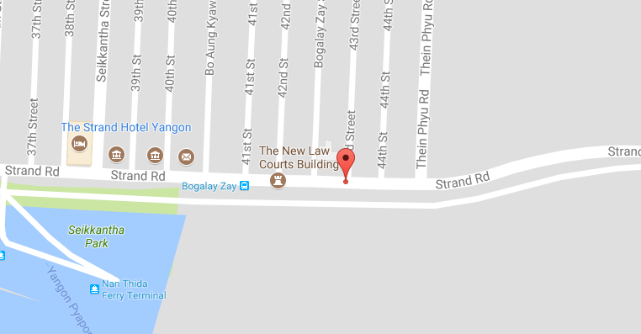
Edge Cell Location of MPT Location : 6th Ward Lat:16.769193 Long:96.166841

Slide 15
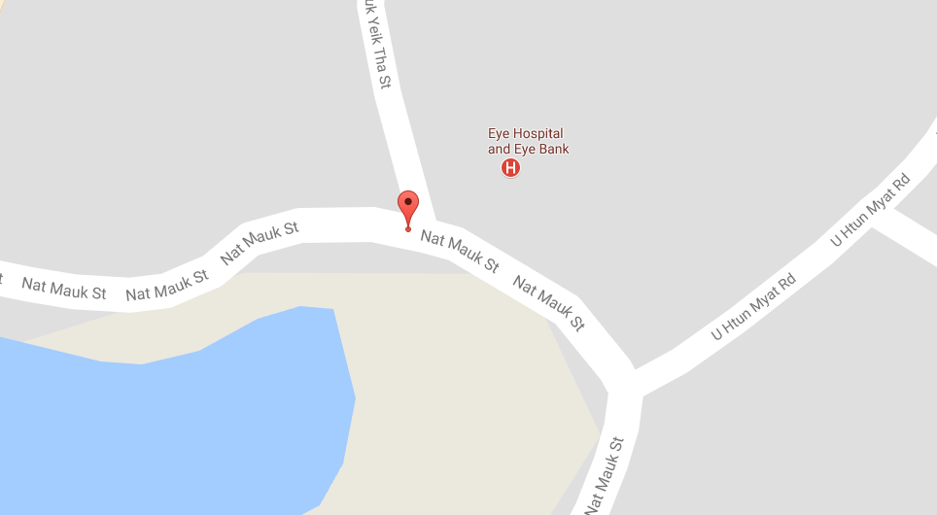
4G to 3G Reselection Location of MPT Location :40 Nat Mauk St Lat: 16.799416 Long: 96.170202

Slide 16
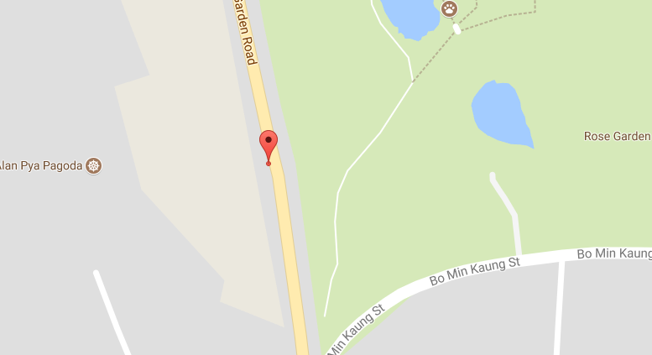
3G to 4G Reselection Location of MPT Location :Zoological Garden Road Lat: 16.790362 Long: 96.157014

Slide 17
Near Cell Location of Telenor Location : Best Western Green Hill Hotel Lat: 16.801417 Long: 96.169480

Slide 18
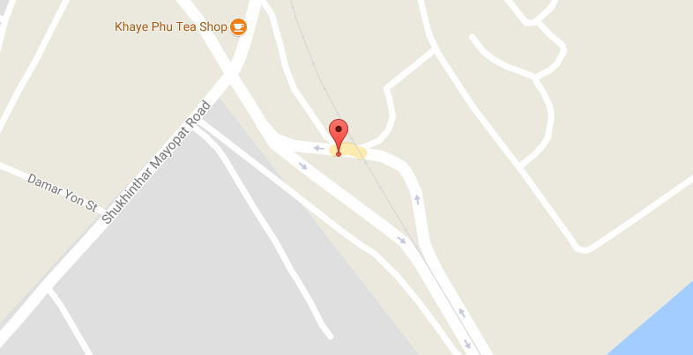
Edge Cell Location of Telenor Location : Thanlyin Ramp Lat: 16.799904 Long:96.227020

Slide 19
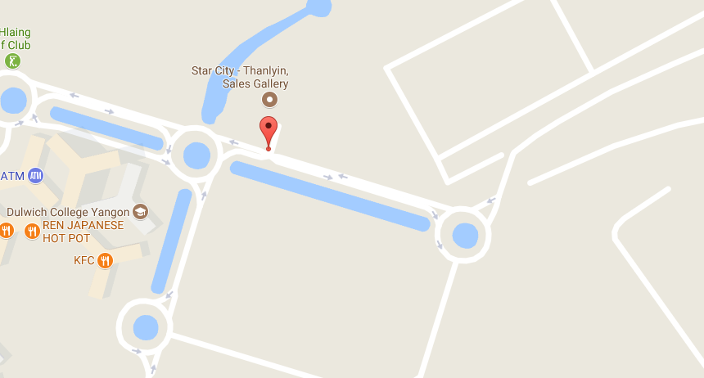
4G to 3G Reselection Location of Telenor Location :Star City Thanlyin Gallery Lat: 16.777409 Long: 96.230947

Slide 20
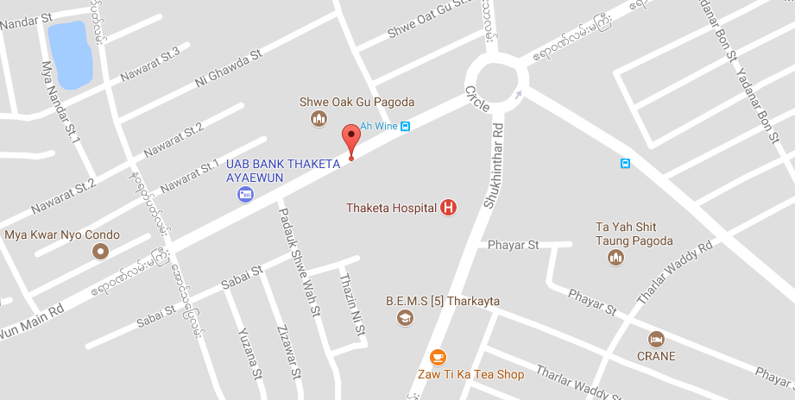
3G to 4G Reselection Location of Telenor Location :Giant Wun Road Lat: 16.806118 Long: 96.216227

Slide 21
Out of Service Location of All Operators Location: Not found

Slide 22
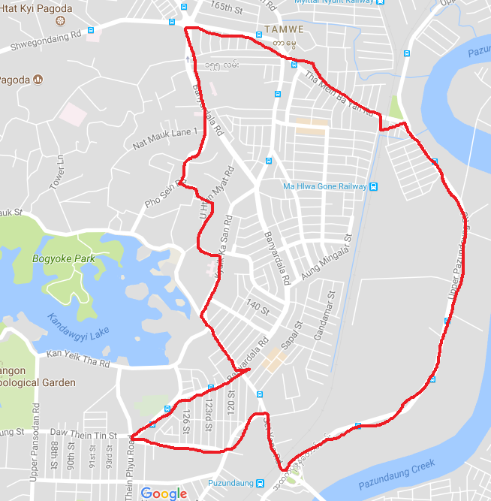
Mobility Route1:4G

Slide 23
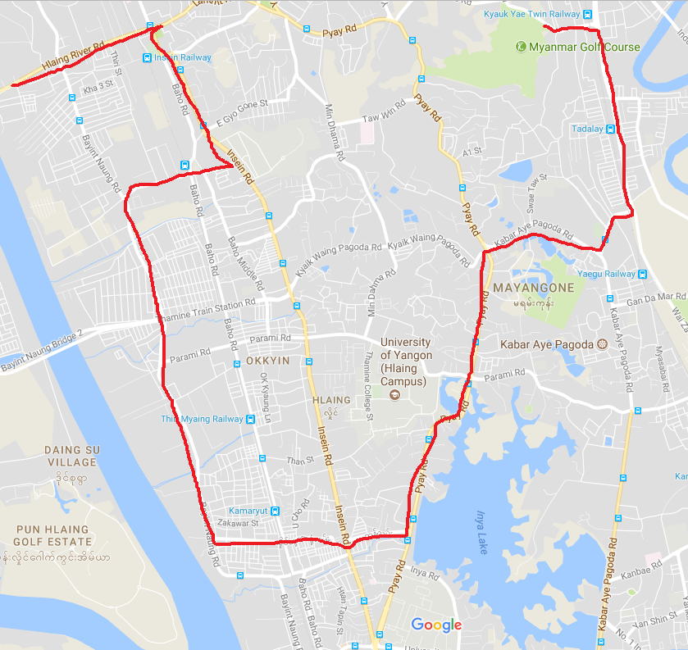
Mobility Route2:4G

Slide 24
Top Most Popular Android Apps used in Vietnam
Facebook
Facebook Messenger
WhatsApp Messenger
Share it
Uber
True caller

Slide 25
Local EM number used in Vietnam(Hanoi)
Police | 199
Ambulance | 192
Fire Bridge | 191

Slide 26
THANK YOU
MARQUIS TECHNOLOGIES
www.marquistech.com

