Slide 1
MARQUIS TECHNOLOGIES
Drive Route –Airtel, Idea, VODAFONE & Reliance JIO (FDD/TDD) LTE

Slide 2
Operator Information:
Operator | JIO 4G
MCC | 405
MNC | 871
APN | Jionet
Operator | Airtel 4G
MCC | 405
MNC | 54
APN | Airtelgprs.com
Operator | VI
MCC | 404
MNC | 15
APN | www

Slide 3
Operator Information 1
Functionality | Airtel
Website: http://www.airtel.com/ WAP APN: airtelgprs.com
Customer care | 121
MNC | 54
Bands supported | Both FDD and TDD
 | LTE 2300 MHz – TDD(Band 40)
 | LTE 1800,850 MHz– FDD(Band 3), FDD(Band 5)
USSD | To check MDN: *282#
 | Balance check: *123#
 | Data Balance check: *121*114#
VoLTE | Supported
CSFB | Supported (CSFB to 2G)

Slide 4
Operator Information 2
Functionality | RELIANCE JIO
Website: https://www.jio.com/ WAP APN: jionet
Customer care | 198
MNC | 871
Bands supported | Both FDD and TDD
 | LTE 2300 MHz –TDD(Band 40)
 | LTE 850 MHz – FDD(Band 5)
 | LTE 1800 MHz –FDD(Band 3)
USSD | NA
 | NA
 | NA
VoLTE | Supported
CSFB | Not Supported

Slide 5
Operator Information 3
Functionality | VI
Website: https://www.vodafoneidea.com/ WAP APN: www
Customer care | 199
MNC | 15
Bands supported | Both FDD and TDD
 | LTE 2500 MHz –TDD(Band 41)
 | LTE 2100 MHz – FDD(Band 1)
 | LTE 1800 MHz –FDD(Band 3)
USSD | To check MDN*199#
 | Balance check*199*2*1#
 | Data Balance check: *199*2*2#
VoLTE | Supported
CSFB | Supported (CSFB to 2G & 3G)

Slide 6
Drive Route
Near Cell :- Stationary: RSRP : -65dbm to -75dbm
Cell Edge :- Stationary: RSRP : -95dbm to -110dbm
Mixed :- Mobility: RSRP : -65dbm to -110dbm

Slide 7
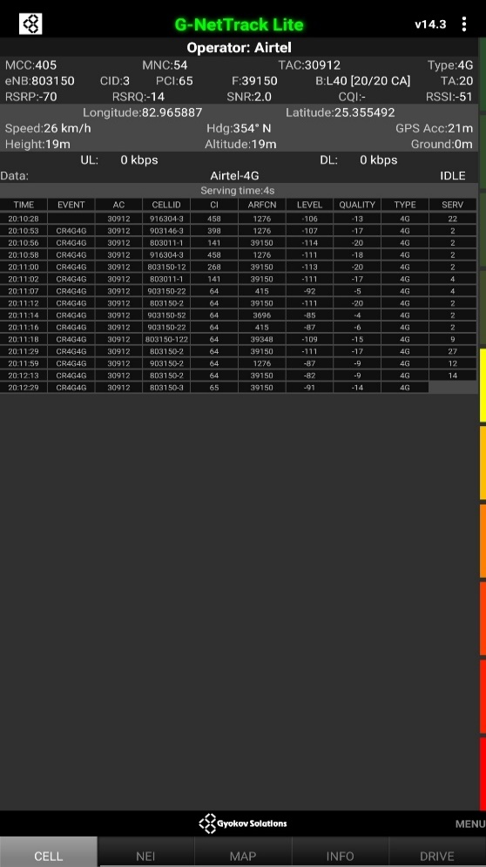
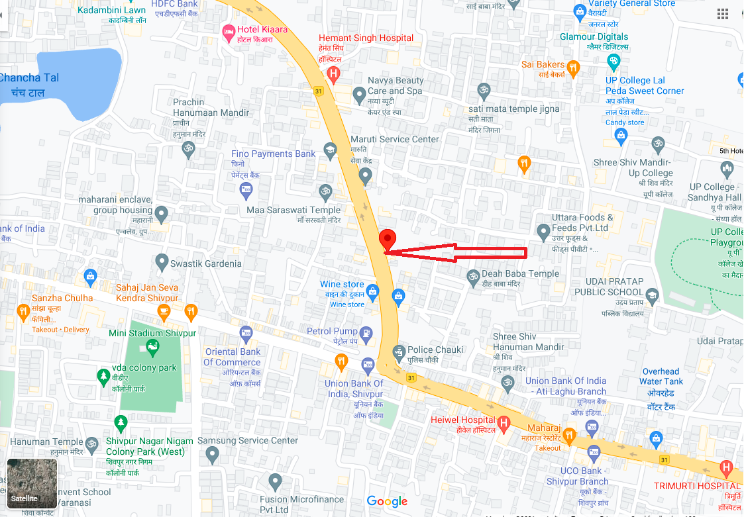
AIRTEL Band 40 Near Cell
Near cell(NC) | Longitude | Latitude | RSRP | Cell id | FDD E-ARFCN
1 | 82.965887 | 25.355492 | 70 | 65 | 39150

Slide 8
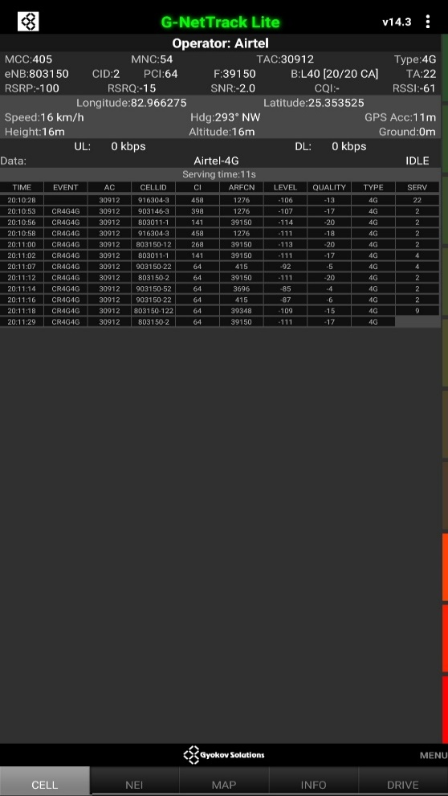
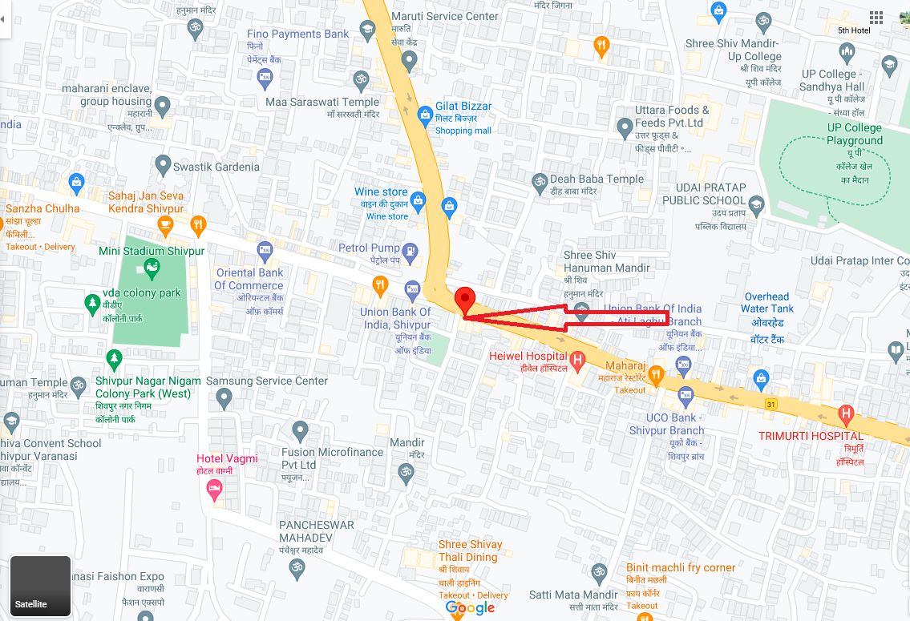
AIRTEL Band 40 Edge Cell
Edge cell(EC) | Longitude | Latitude | RSRP | Cell id | TDD E-ARFCN
1 | 82.966275 | 25.353525 | 100 | 64 | 39150

Slide 9
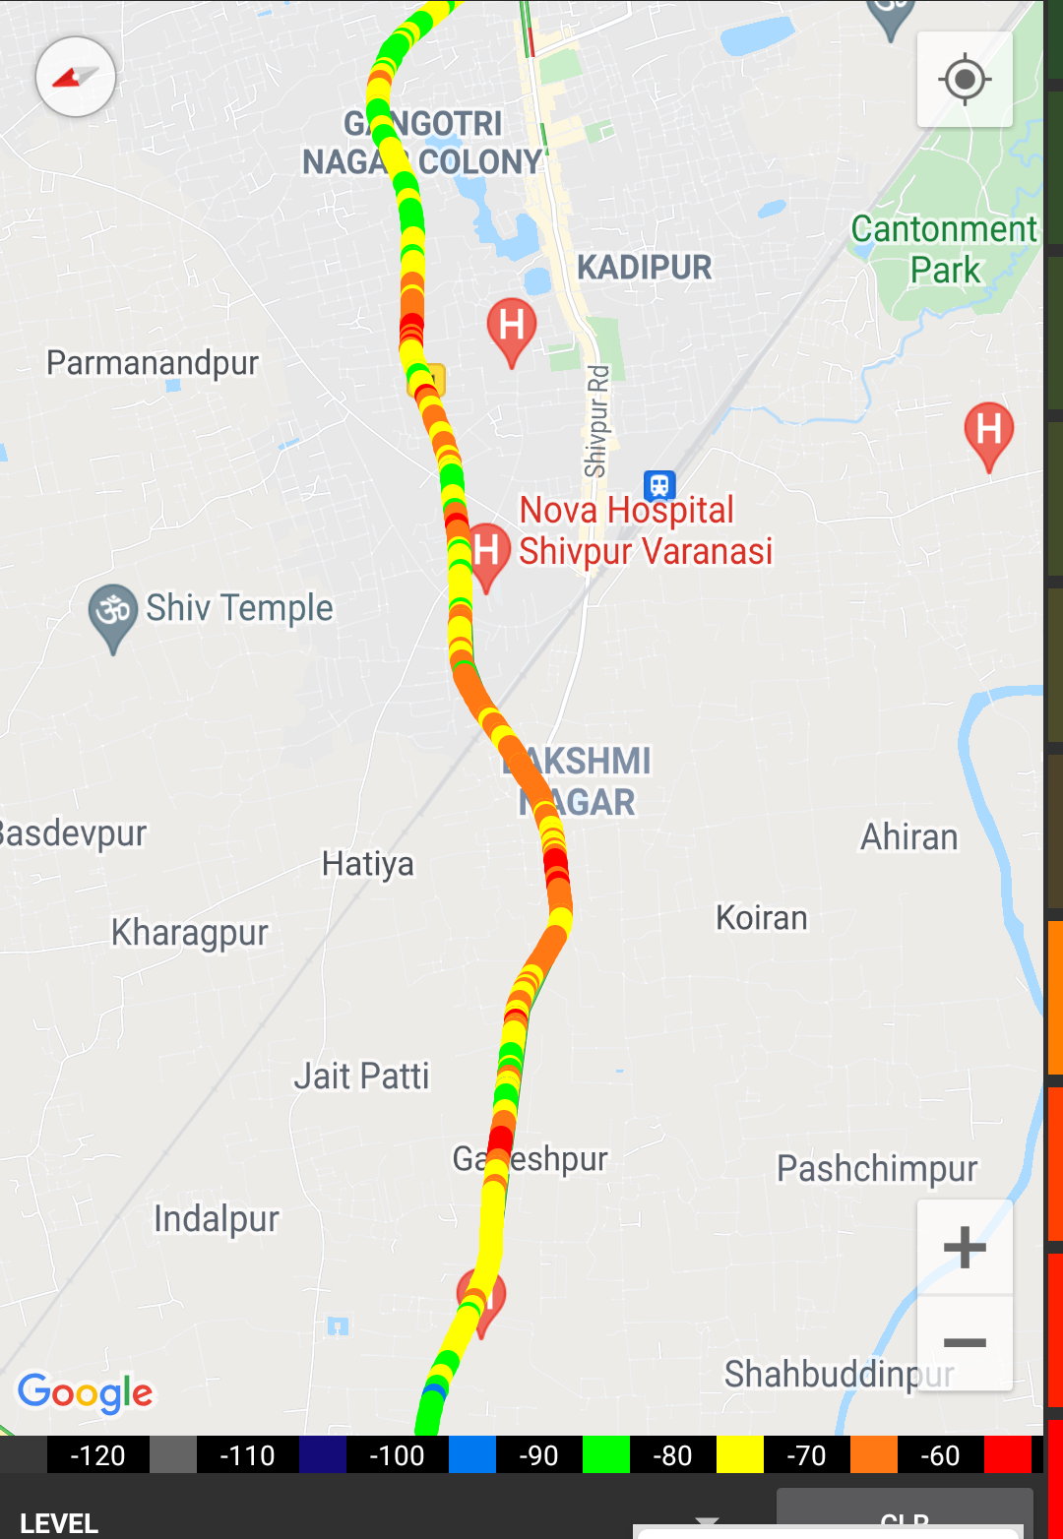
Near Cell (Airtel)
Near cell(NC) | Longitude | Latitude | RSRP | Cell id | FDD E-ARFCN
1 | 82.965887 | 25.355492 | 70 | 65 | 39150
China Town Restaurant Gilat Bazar
RSRP:
-65dbm to 75dbm

Slide 10
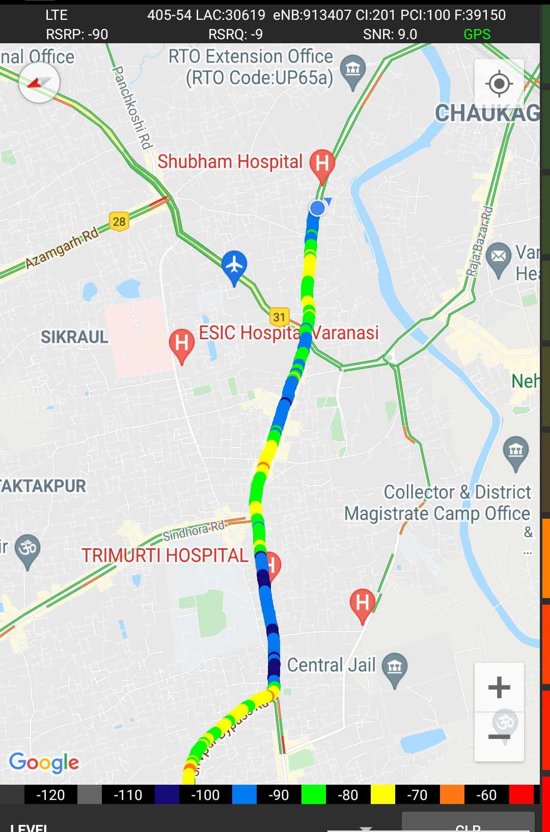
Edge Cell (Airtel)
Edge cell(EC) | Longitude | Latitude | RSRP | Cell id | TDD E-ARFCN
1 | 82.966275 | 25.353525 | 100 | 64 | 39150
V- Mart Shivpur chowk
RSRP:
-95dbm to -110dbm

Slide 11
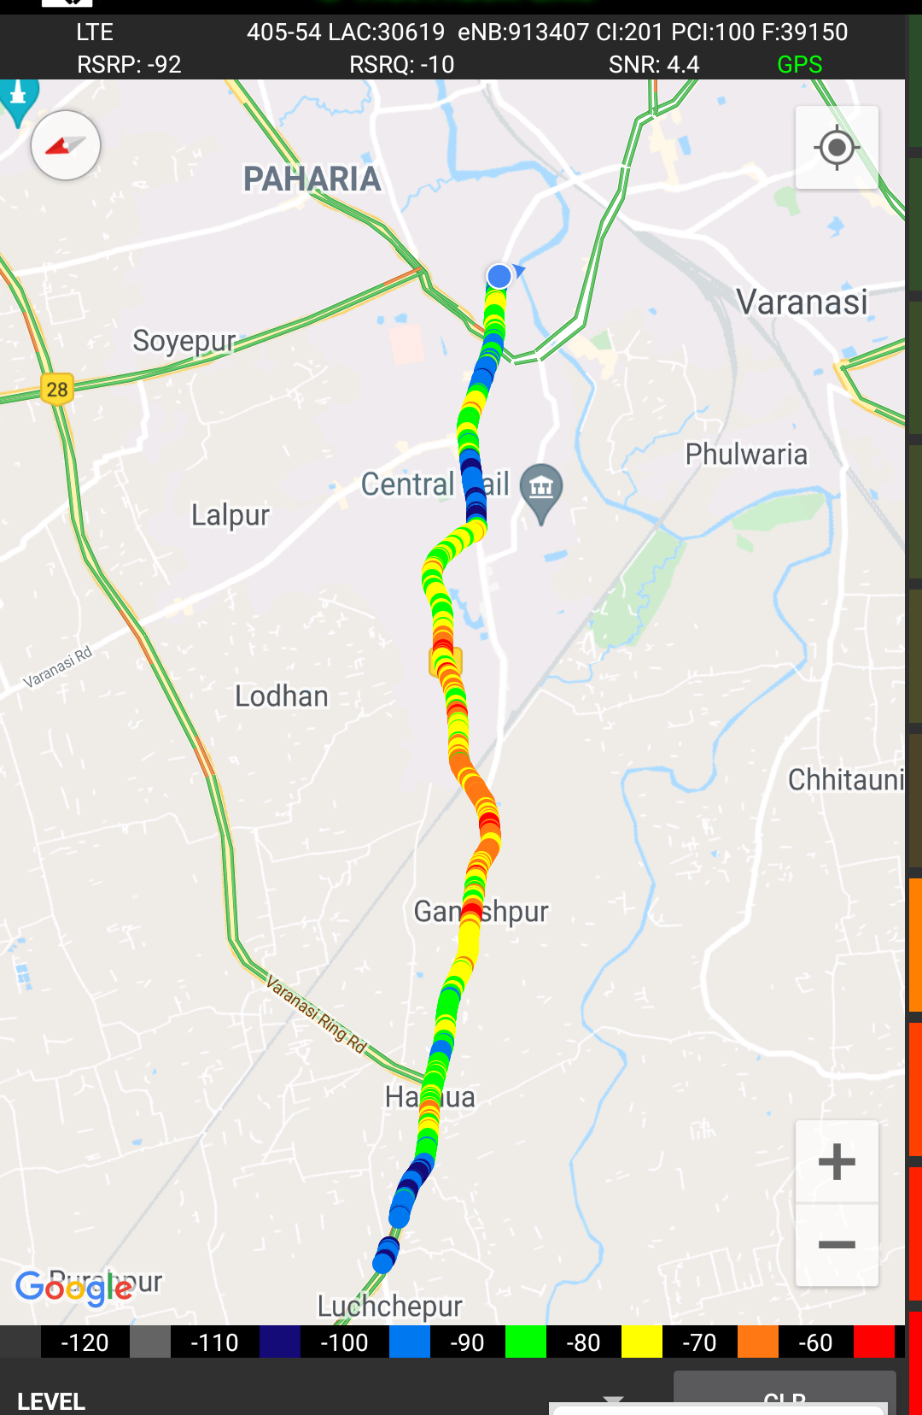
Mixed Mobility:-
Hukulganj to Harhua Varanasi
RSRP: -65dbm to -110dbm

Slide 12

Airtel Band HO
Band Hand Over | Longitude | Latitude | RSRP | Band | Freq.
1 | 82.9613 | 25.35953 | -85 to 105 dBM | L40 | 39150
2 | 82.96884 | 25.35277 | -85 to 105 dBM | L3 | 1276
3 | 82.96794 | 25.35306 | -85 to 105 dBM | L40 | 39348
4 | 82.96949 | 25.35262 | -85 to 105 dBM | L1 | 415
5 | 82.96961 | 25.35262 | -85 to 105 dBM | L3 | 1276
6 | 82.97107 | 25.35237 | -85 to 105 dBM | L40 | 39150
7 | 82.9734 | 25.35184 | -85 to 105 dBM | L3 | 1276
8 | 82.974 | 25.35167 | -85 to 105 dBM | L40 | 39150
9 | 82.97669 | 25.35086 | -85 to 105 dBM | L3 | 1276
10 | 82.97677 | 25.35081 | -85 to 105 dBM | L40 | 39150
11 | 82.98069 | 25.34782 | -85 to 105 dBM | L3 | 1276
12 | 82.98137 | 25.34738 | -85 to 105 dBM | L40 | 39150
13 | 82.98154 | 25.34724 | -85 to 105 dBM | L3 | 1276
14 | 82.98202 | 25.34679 | -85 to 105 dBM | L40 | 39150
15 | 82.98303 | 25.34605 | -85 to 105 dBM | L3 | 1276
16 | 82.98338 | 25.34583 | -85 to 105 dBM | L40 | 39348
Band Details
L1_L40 | 0
L1_L3 | 1
L40_L1 | 1
L40_L3 | 6
L3_L1 | 0
L3_L40 | 7

Slide 13
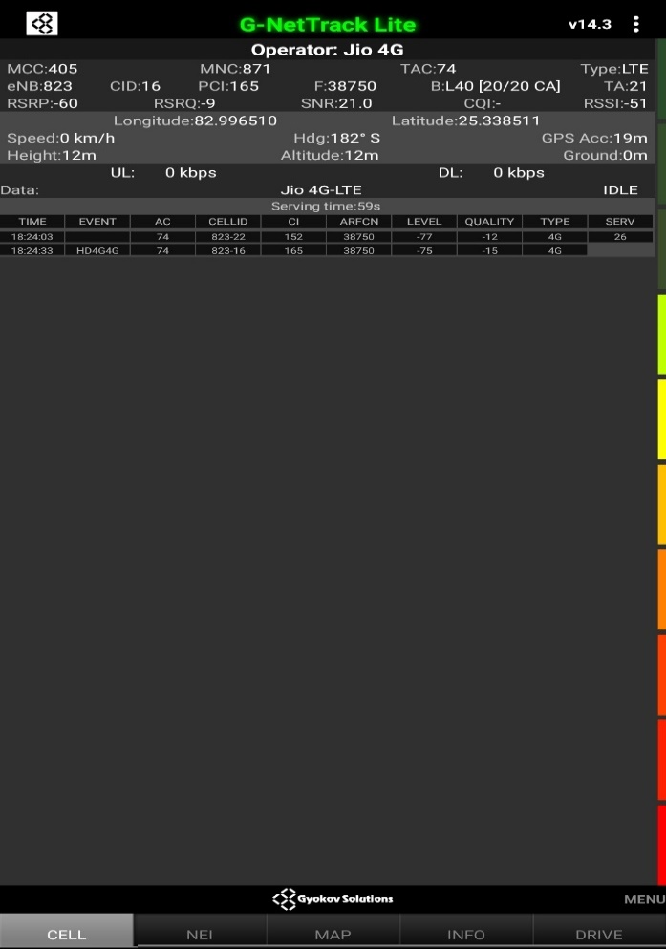
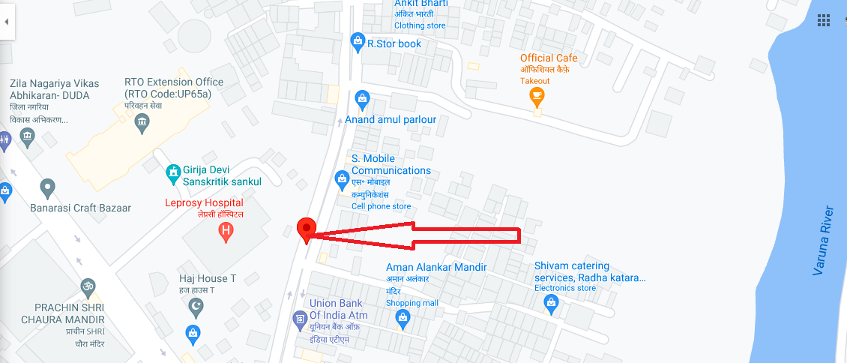
RJIO Band 40 Near Cell
Near cell(NC) | Longitude | Latitude | RSRP | Cell id | TDD E-ARFCN
1 | 82.996510 | 25.338511 | 60 | 165 | 38750

Slide 14
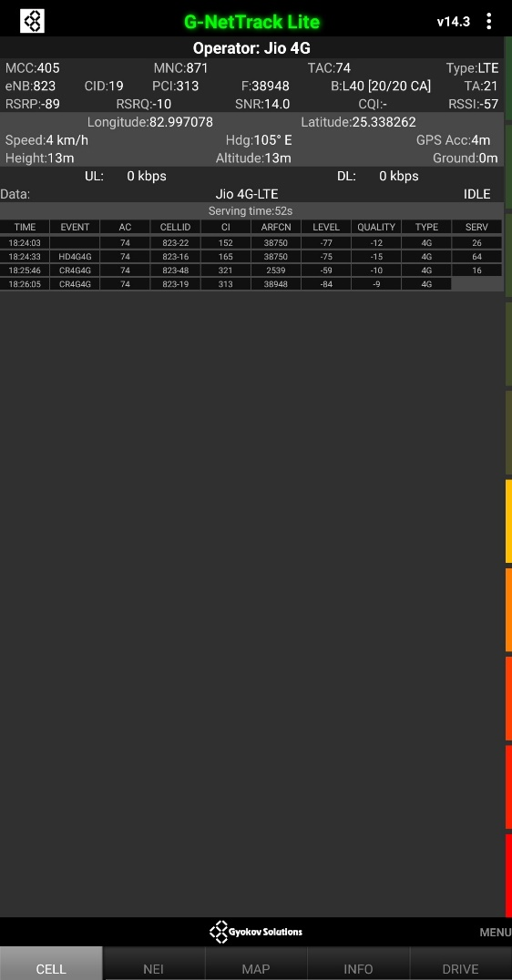
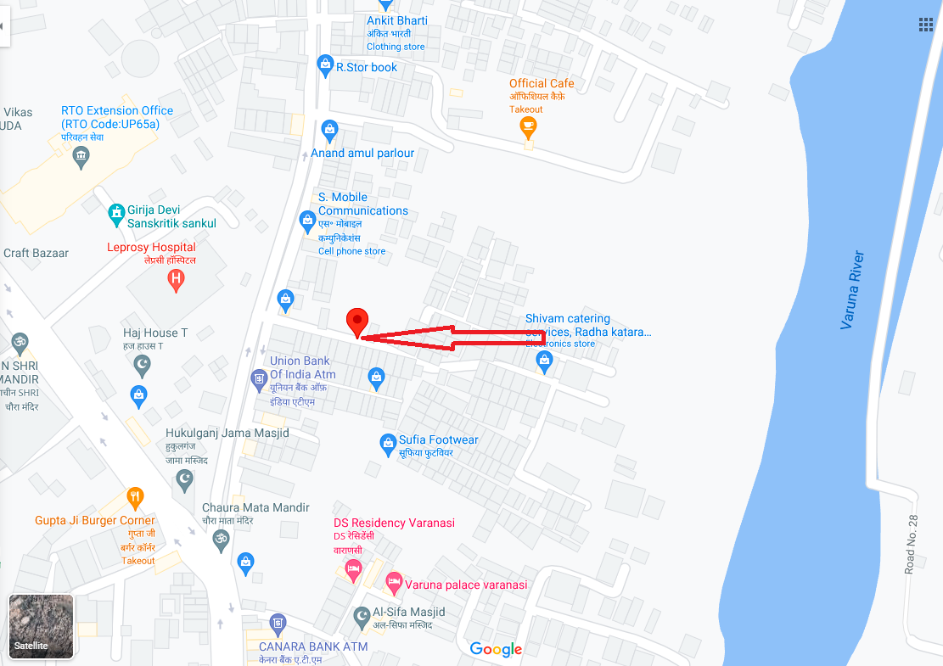
RJIO Band 40 Edge Cell
Edge cell(NC) | Longitude | Latitude | RSRP | Cell id | TDD E-ARFCN
1 | 82.997078 | 25.338262 | 89 | 313 | 38948

Slide 15

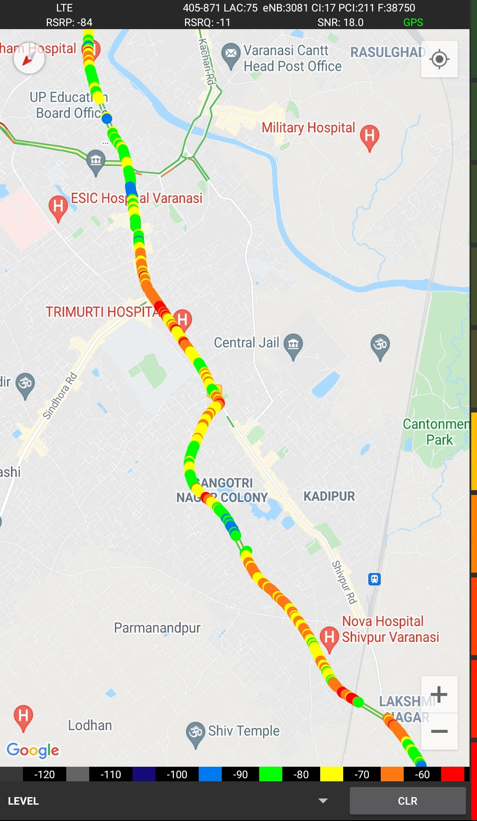
Near Cell (Reliance JIO)
Near cell(NC) | Longitude | Latitude | RSRP | Cell id | TDD E-ARFCN
1 | 82.996510 | 25.338511 | 60 | 165 | 38750
RSRP:
-65dbm to -75dbm
Khajuri Colony Varanasi

Slide 16
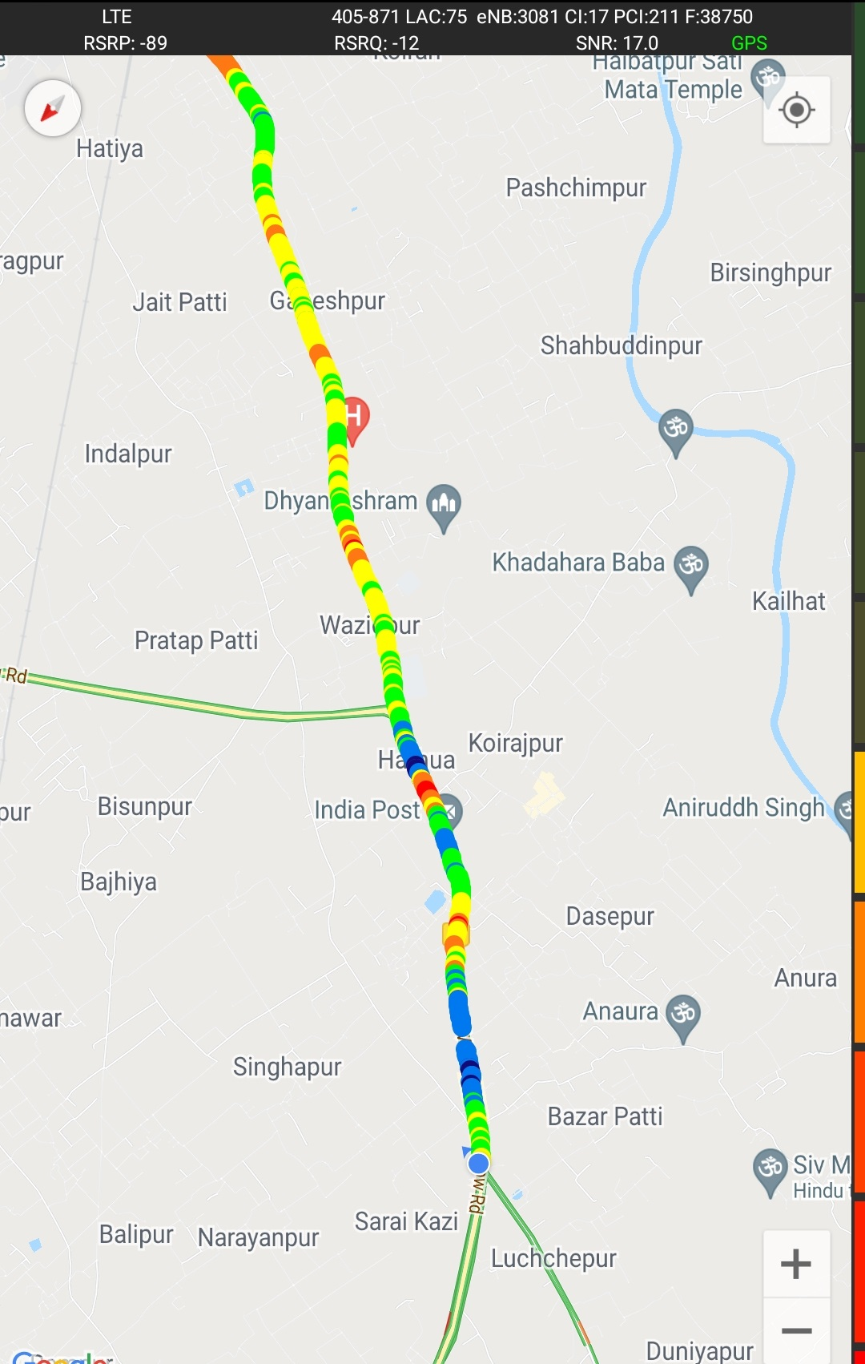
Edge Cell (Reliance JIO)
Edge cell(NC) | Longitude | Latitude | RSRP | Cell id | TDD E-ARFCN
1 | 82.997078 | 25.338262 | 89 | 313 | 38948
RSRP:
-95dbm to -110dbm
Khajuri Colony Varanasi

Slide 17
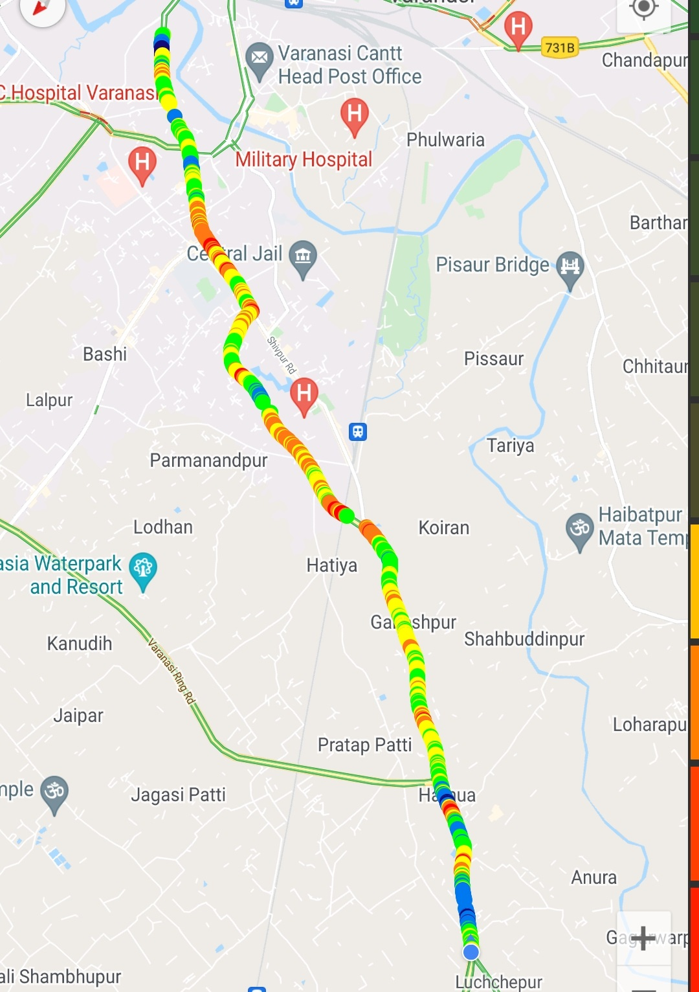
Mixed Mobility:-
Hukulganj to Harhua Varanasi
RSRP: -65dbm to -110dbm

Slide 18
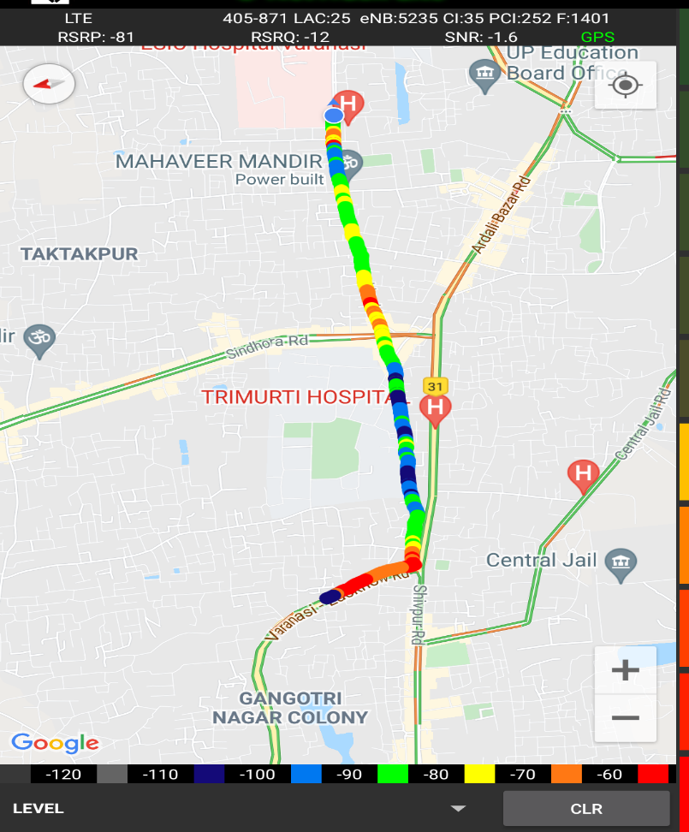
Inter Band Handover (FDD-TDD), JIO 4G
Band Hand Over | Longitude | Latitude | RSRP | Band | Freq.
1 | 82.96545201 | 25.35640413 | -85 to 105 dBM | L3 | 1401
2 | 82.96799835 | 25.3534109 | -85 to 105 dBM | L40 | 38948
3 | 82.96923744 | 25.35339701 | -85 to 105 dBM | L3 | 1401
4 | 82.96936792 | 25.352617 | -85 to 105 dBM | L5 | 2539
5 | 82.96942743 | 25.35337133 | -85 to 105 dBM | L40 | 38750
6 | 82.97324486 | 25.35291274 | -85 to 105 dBM | L3 | 1401
7 | 82.97371487 | 25.35285871 | -85 to 105 dBM | L40 | 38750
8 | 82.97533059 | 25.35285298 | -85 to 105 dBM | L3 | 1401
9 | 82.97540231 | 25.35284739 | -85 to 105 dBM | L40 | 38948
10 | 82.98400846 | 82.98400846 | -85 to 105 dBM | L3 | 1401
Band Details
L40_L5 | 0
L5_L40 | 1
L5_L3 | 0
L3_L5 | 1
L40_L3 | 4
L3_L40 | 3

Slide 19
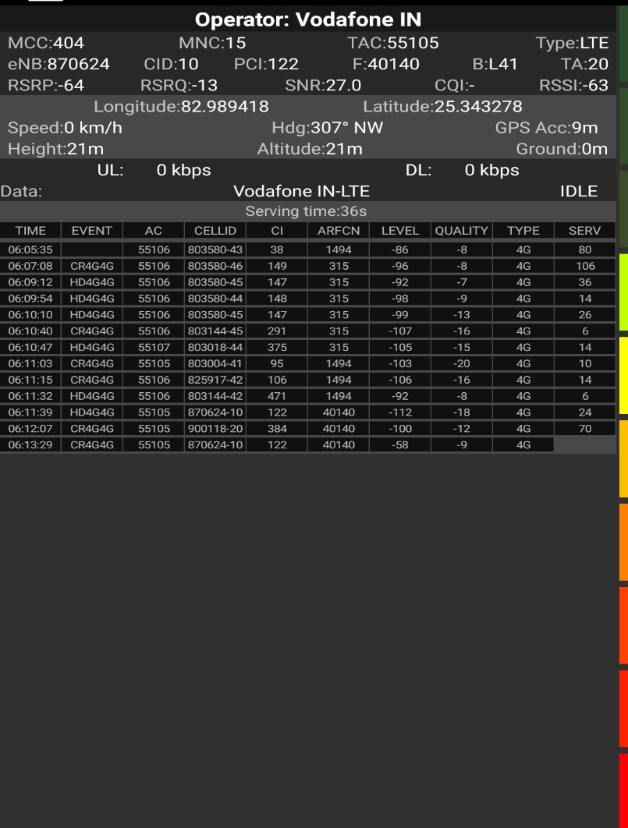
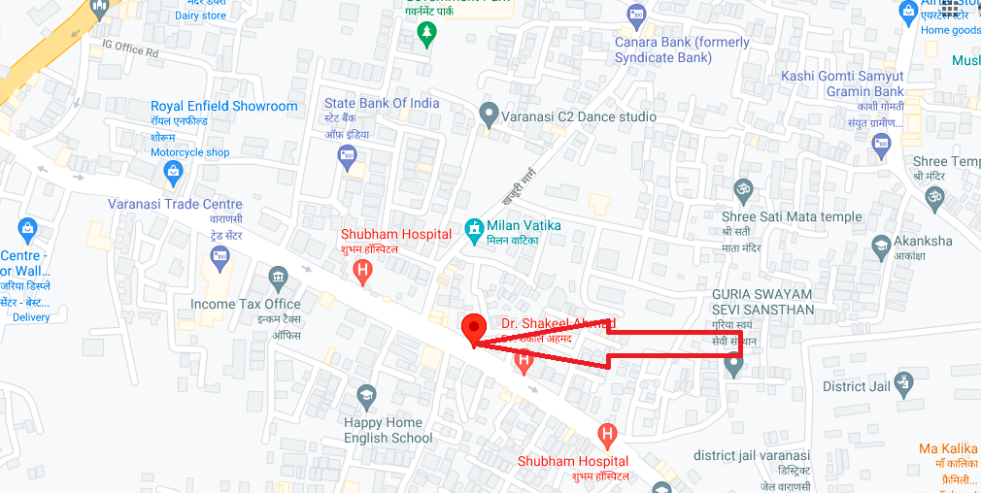
VIL Band 41 Near Cell
Near cell(NC) | Longitude | Latitude | RSRP | Cell id | TDD E-ARFCN
1 | 82.989418 | 25.343278 | 64 | 122 | 40140

Slide 20
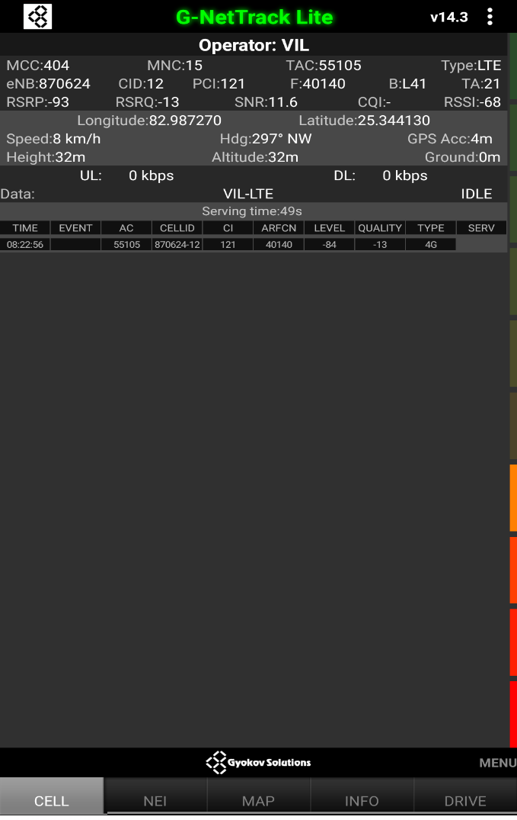
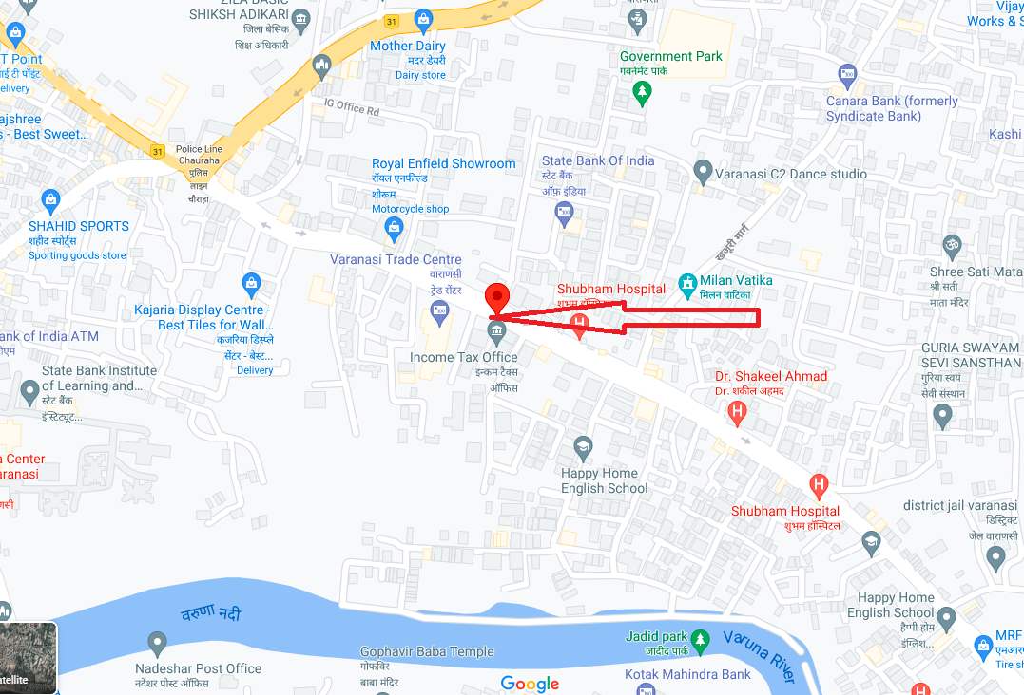
VIL Band 41 Edge Cell
Edge cell(EC) | Longitude | Latitude | RSRP | Cell id | TDD E-ARFCN
1 | 82.987270 | 25.344130 | 93 | 121 | 40140

Slide 21
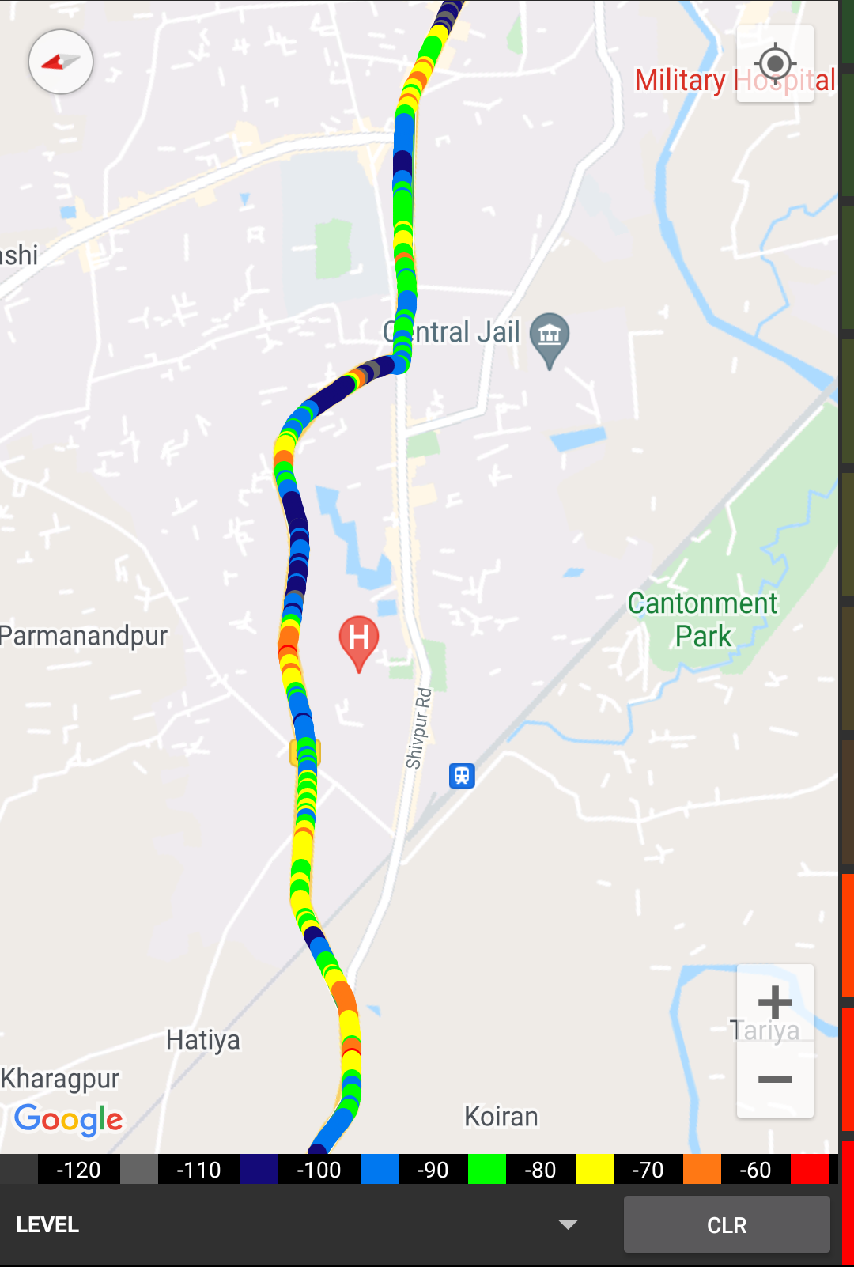
Near Cell VIL
Near cell(NC) | Longitude | Latitude | RSRP | Cell id | TDD E-ARFCN
1 | 82.989418 | 25.343278 | 64 | 122 | 40140
RSRP:
-65dbm to -75dbm
Shubham Hospital Varanasi

Slide 22
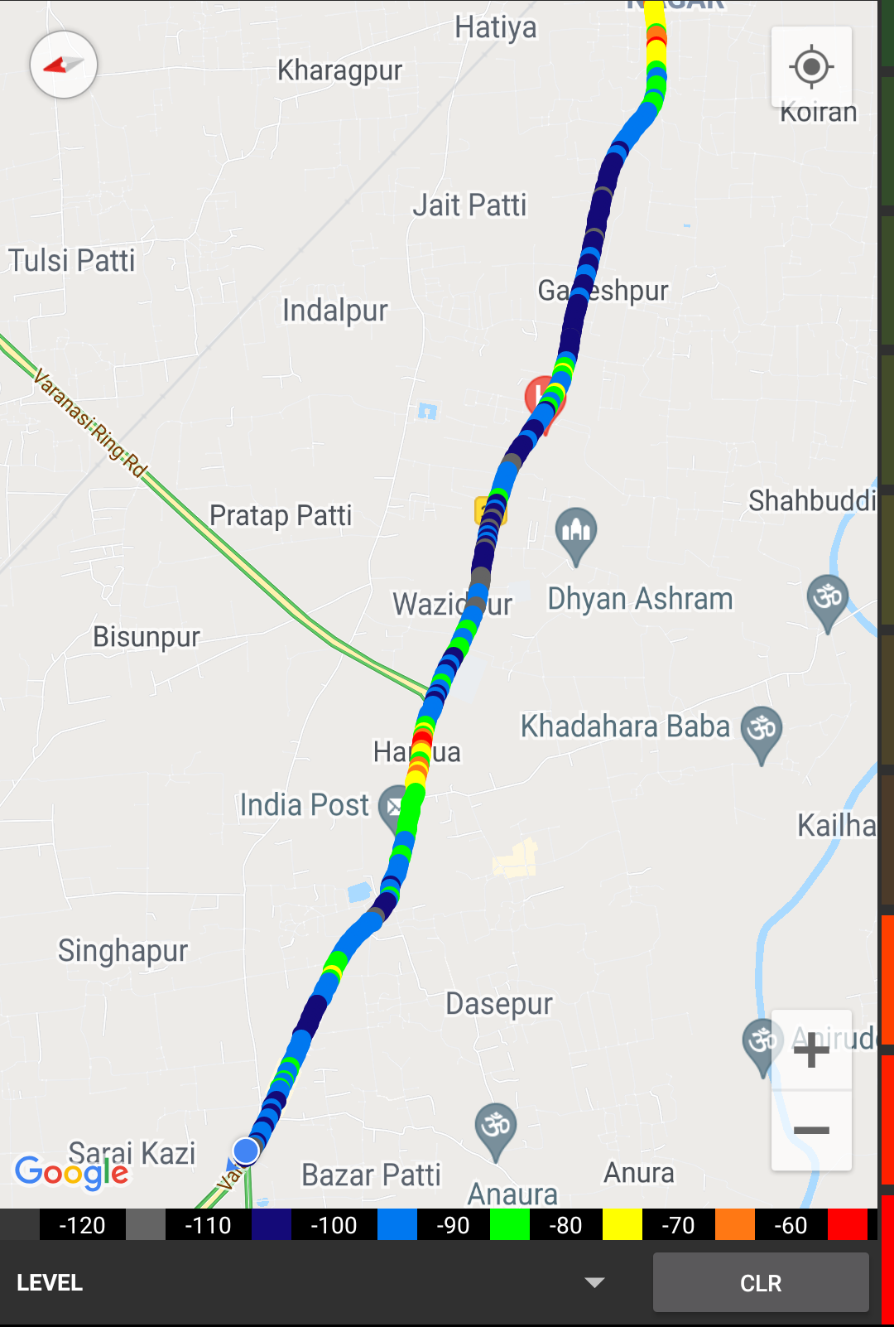
Cell Edge VIL:
Edge cell(EC) | Longitude | Latitude | RSRP | Cell id | TDD E-ARFCN
1 | 82.987270 | 25.344130 | 93 | 121 | 40140
RSRP:
-95dbm to -105dbm
Max Life Insurance Varanasi Trade Center

Slide 23
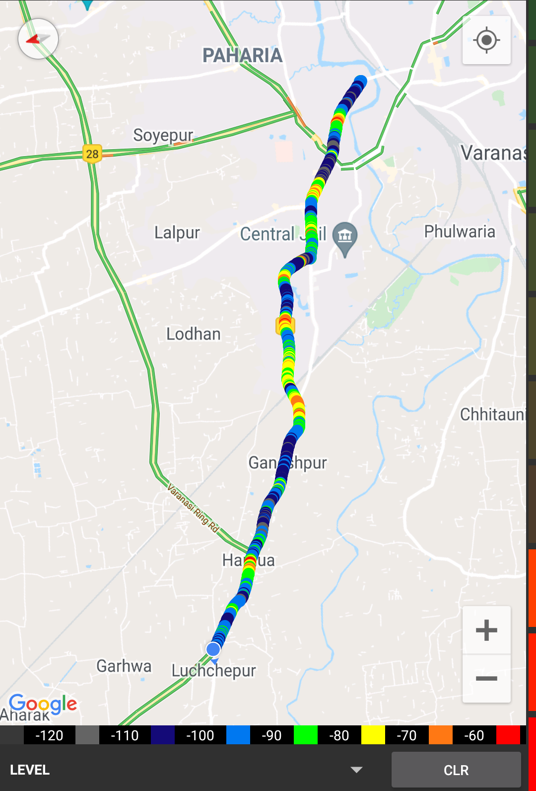
Mixed coverage area VIL:
RSRP: -65dbm to -110dbm

Slide 24
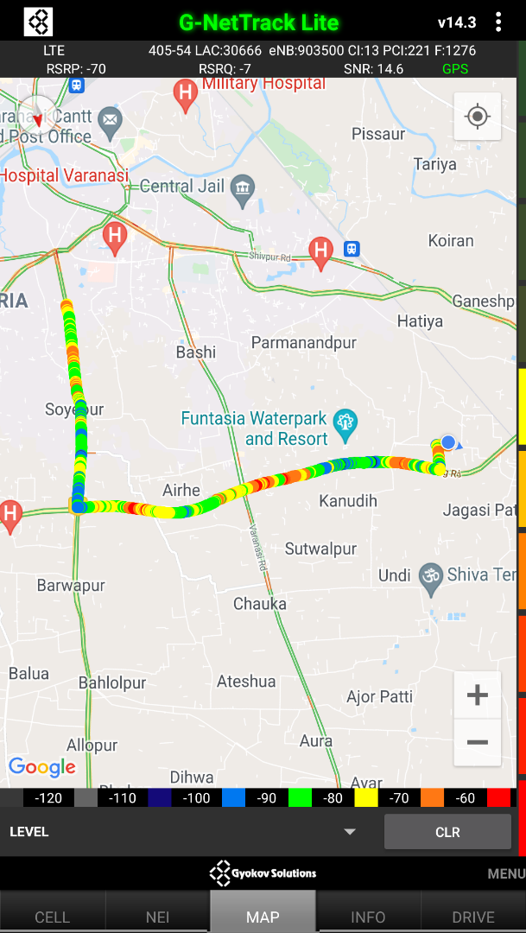
VI Band 1<>3<>41 Handover
Band Hand Over | Longitude | Latitude | RSRP | Band | Freq.
1 | 82.99498191 | 25.38617284 | -85 to 105 dBM | L3 | 1494
2 | 82.9942122 | 25.38627995 | -85 to 105 dBM | L1 | 315
3 | 82.97935644 | 25.38897845 | -85 to 105 dBM | L3 | 1494
4 | 82.97935644 | 25.38897845 | -85 to 105 dBM | L1 | 315
5 | 82.93891957 | 25.3866061 | -85 to 105 dBM | L3 | 1494
Band Details
L3_U1 | 1
L1_L3 | 2
L3_L1 | 2

Slide 25
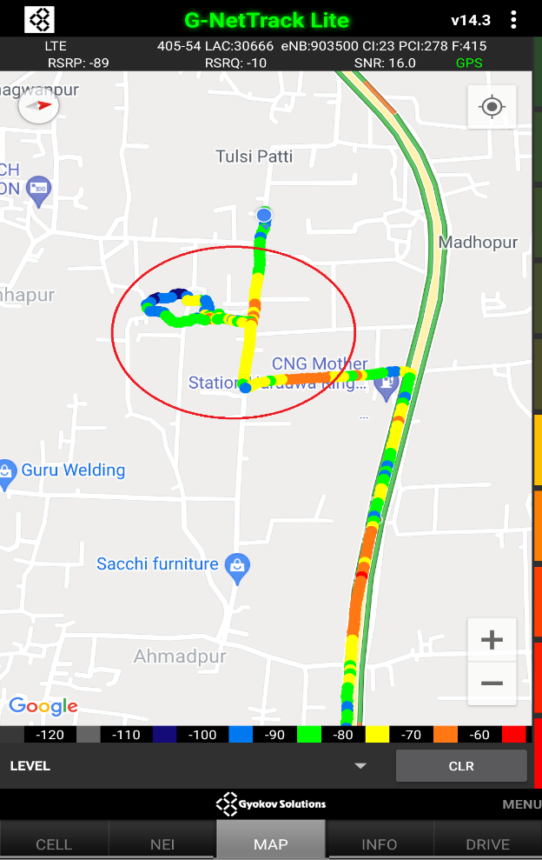
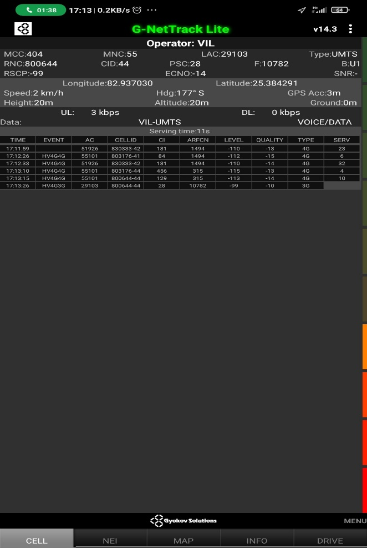
VIL & AIRTEL SRVCC to UTRAN:
Longitude | Latitude
82937030 | 25.384291

Slide 26
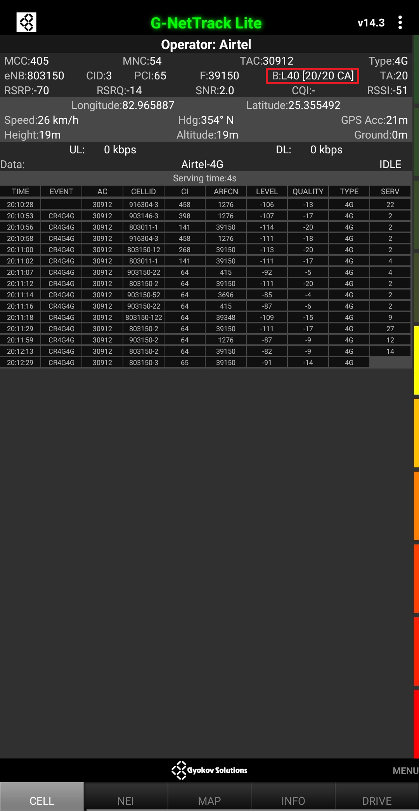
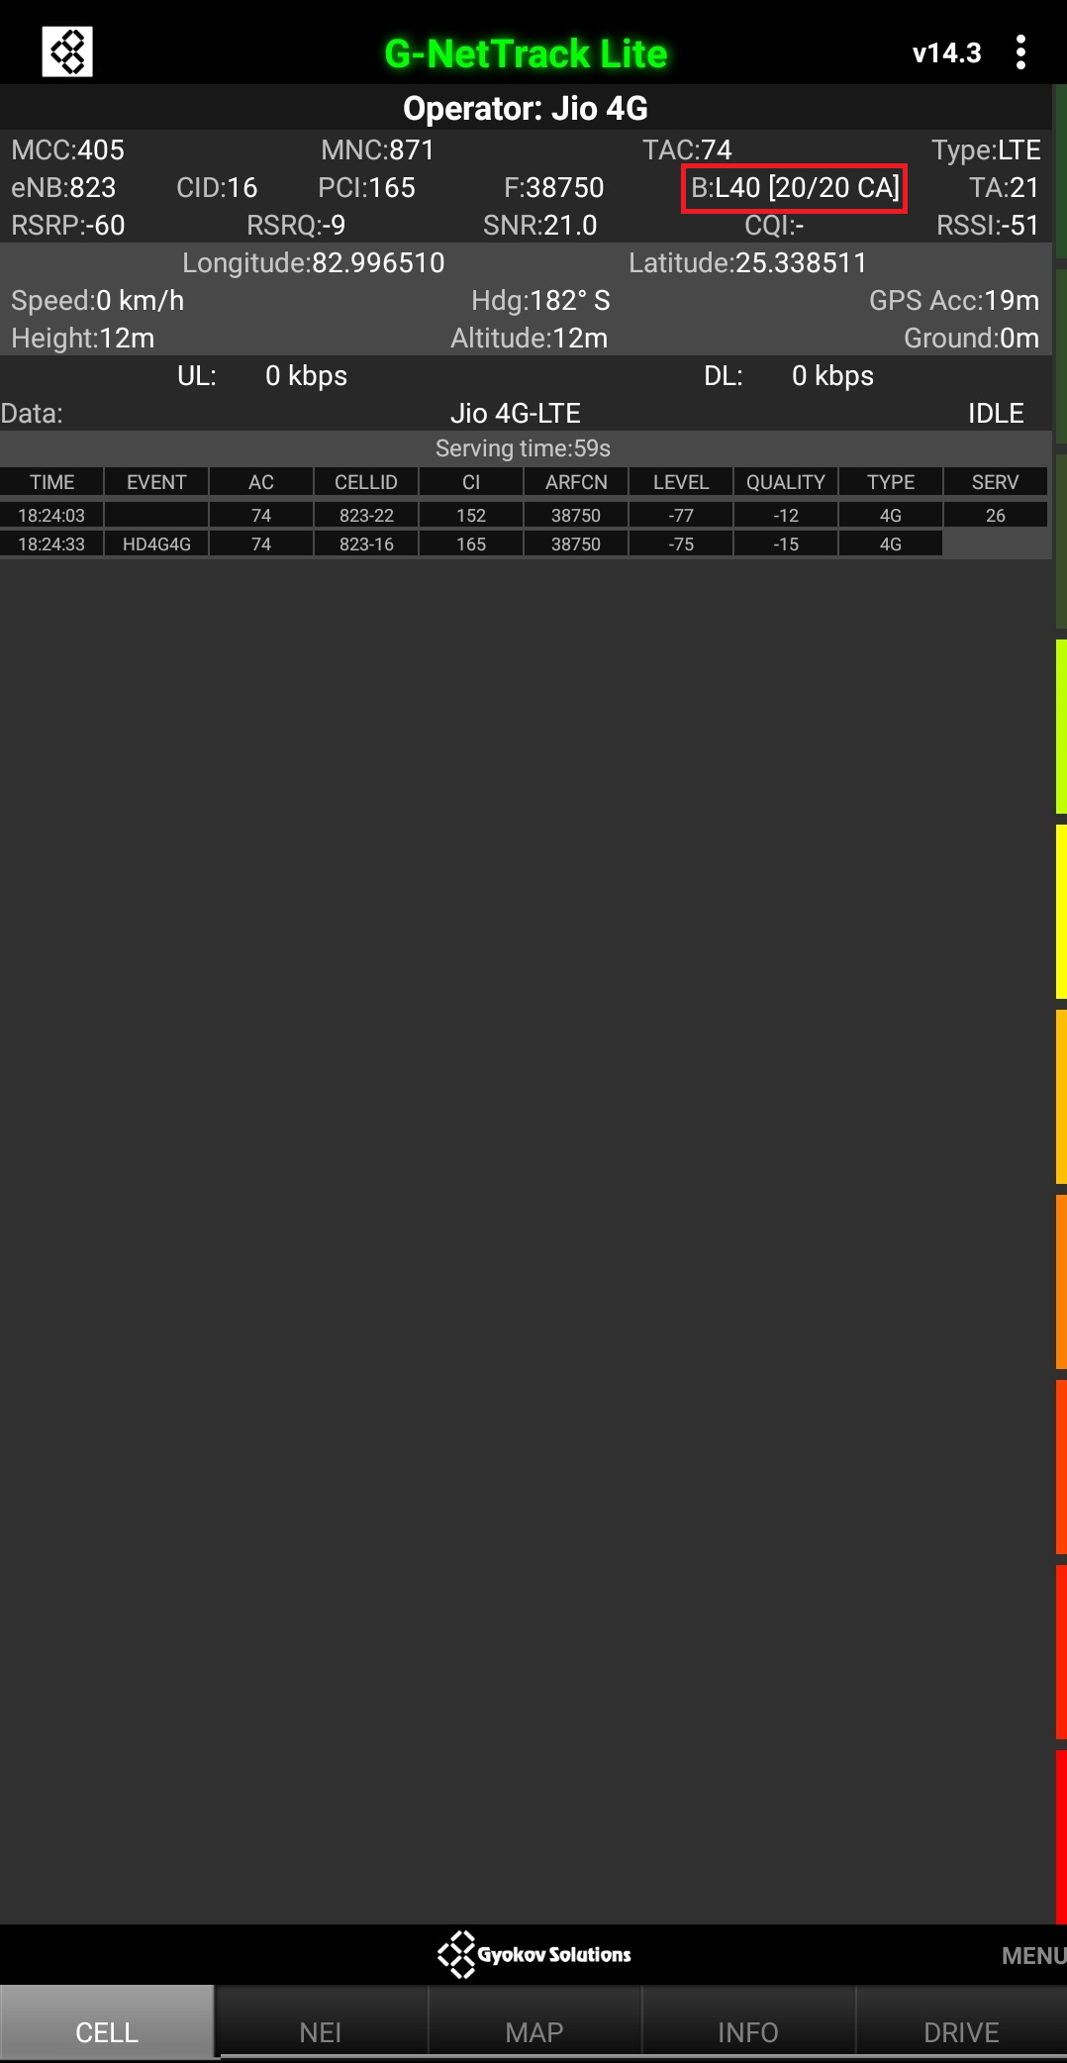
CA

Slide 27
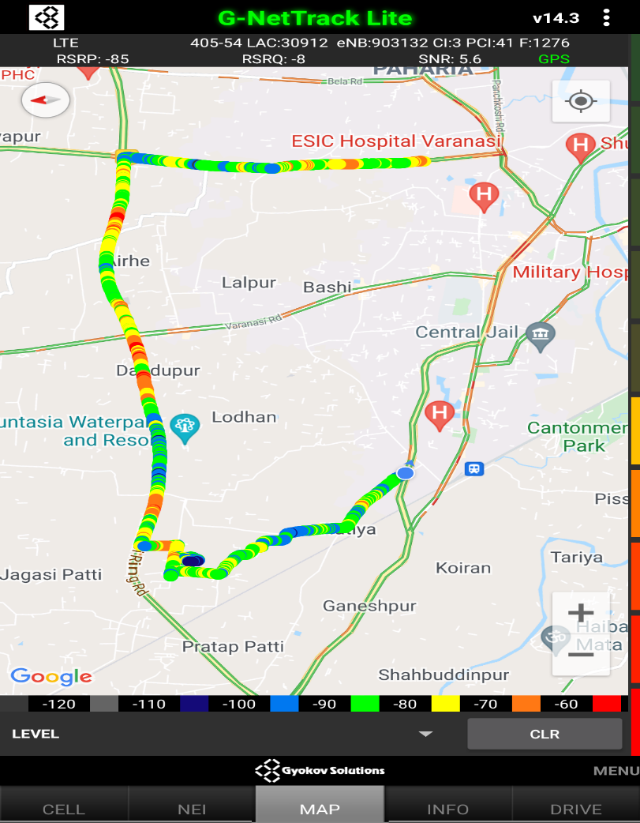

G net Tracker Drive Route

Slide 28
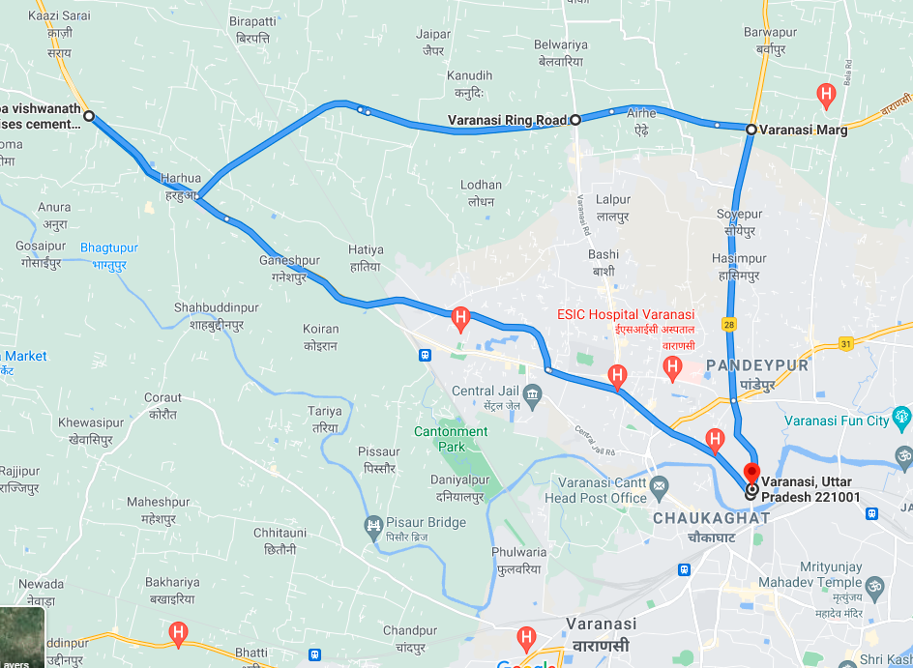
Drive Route

Slide 29
THANK YOU
MARQUIS TECHNOLOGIES

