Slide 1
MARQUIS TECHNOLOGIES
Drive Route – Istanbul(Turkey)

Slide 2
Testing Place - Bangalore (India)
Country | Turkey
Continent | Eurasia(Europe + Asia)
City | Istanbul
Time Zone | GMT +3:00 Hour
International Dialing Code | +90

Slide 3
RSRP Criteria
Near Cell :-Stationary: RSRP : -55dbm to -75dbm
Cell Edge :-Stationary: RSRP : -95dbm to -110dbm
Mixed :-Mobility: RSRP : -76dbm to -90dbm

Slide 4
Operator Information
MCC | MNC | Operator SUPPORT | OPERATOR
286 | 01 | VOWIFI/VIWIFI/VoLTE/VILTE/4G/3G/2G | Turkcell
286 | 02 | VoLTE/VOWIFI/4G/3G/2G | Vodafone
250 | 03 | VoLTE 4G/3G | Turk Telekom

Slide 5
Band Details:
Location | Service Provider | Bands Deployed
 |  | GSM-2G | UMTS-3G | LTE-4G
Istanbul/Turkey | Turkcell | B8 900 | B1 2100 | Band 3 (FDD-1800), Band 7 (FDD-2600), Band 20 (FDD-800), Band 8 (TDD-900) B1 (2100)
 | Turk Telekom | B3 1800 | B1 2100 | Band 8(FDD-900) Band 7(FDD-2600), Band 3 (FDD-1800),B38 (TDD-2600)
 | Vodafone | B8 900 B3 1800 | 2100 | Band 3 (FDD-1800), Band 7 (FDD-2600) B8(TDD-900) B38 (TDD-2600)

Slide 6
TURKCELL Operator
Drive Route – Istanbul(TURKEY)

Slide 7
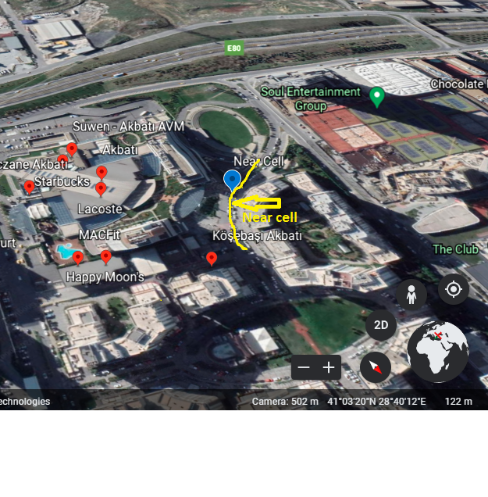
GOOD AREA (NEAR CELL) Operator: Turkcell Location Near Kosebasi Akbati Lat.41.057855, Long 28.667991
AT-Slide : 1

Slide 8
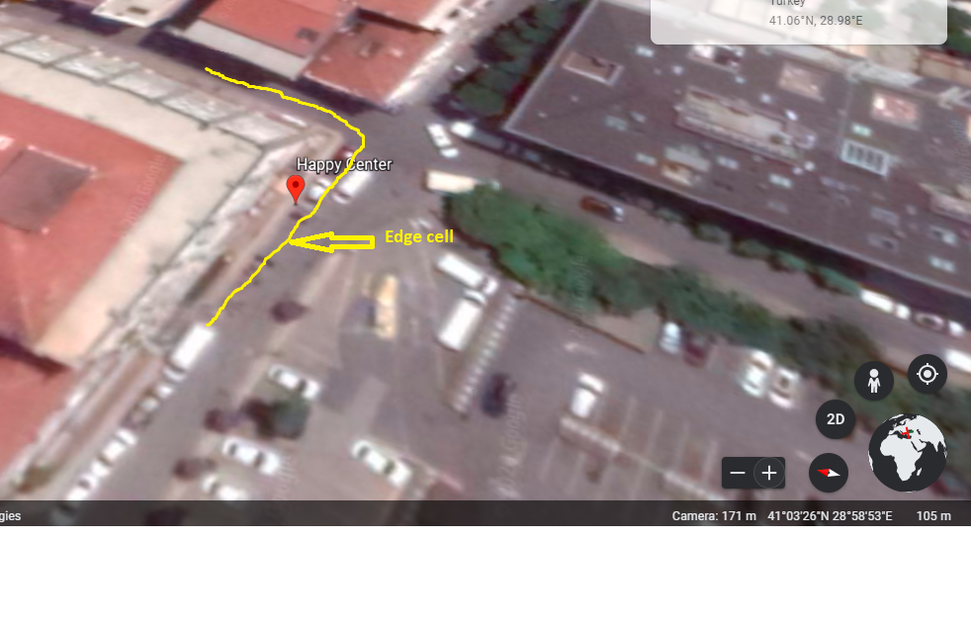
EDGE CELL Operator -Turkcell Location : Happy Center Lat 41.062018, long 28.678681
AT-Slide : 2

Slide 9
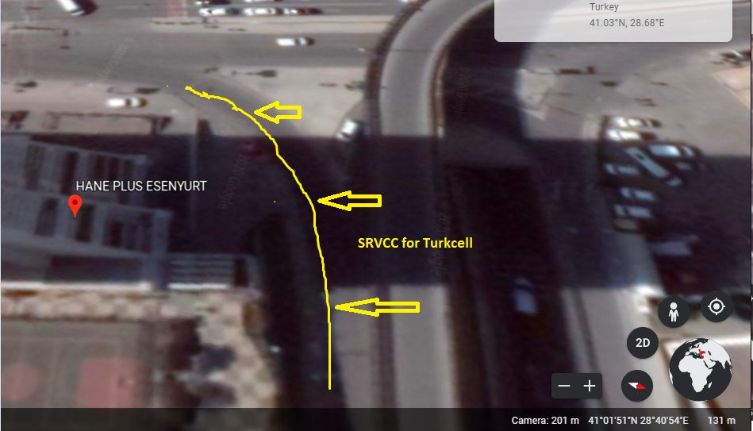
TURKCELL – SRVCC location: Hane plus Lat 41.031365 Long 28.682451

Slide 10
Vodafone Operator
Drive Route – Istanbul(Turkey)

Slide 11
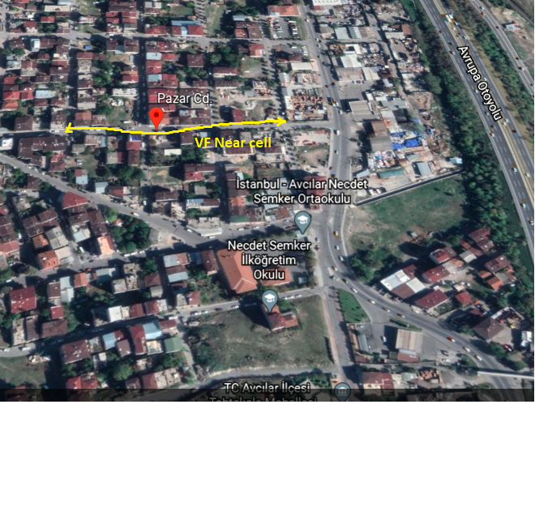
GOOD AREA (NEAR CELL) Operator: Vodafone Location: PAZAR cd lat:41.053951,long 28.89446
AT-Slide : 1

Slide 12
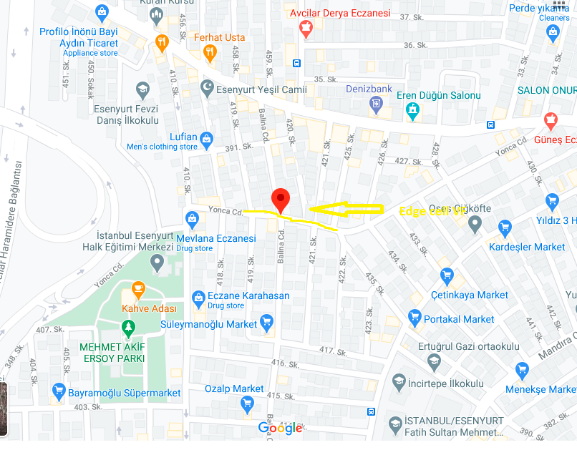
EDGE CELL –VF operator location: Yonca CD lat.41.030624,long 28.690829

Slide 13
SRVCC VF operator location: near HANE PLUS ESENYURT lat: 41.031405, long 28.682430

Slide 14
TurkTelekom Operator
Drive Route – Istanbul(Turkey)

Slide 15
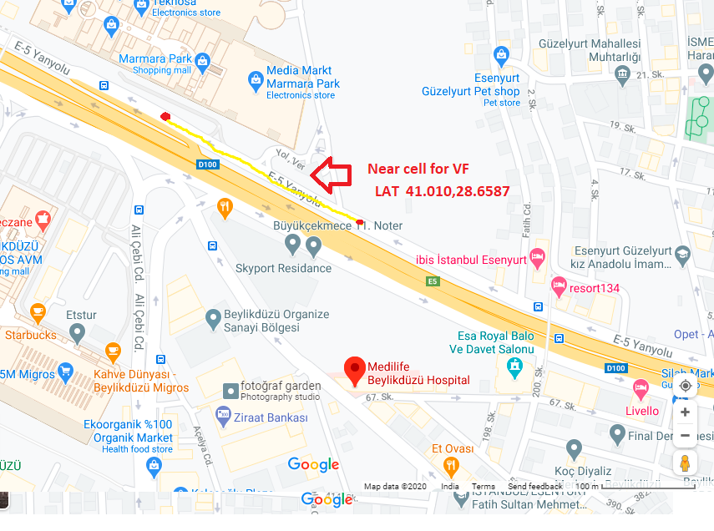
GOOD AREA (NEAR CELL) Operator : Turk Telekom location : Medilife Beylikdüzü lat: 41.00909, long: 28.65897
AT-Slide : 1

Slide 16
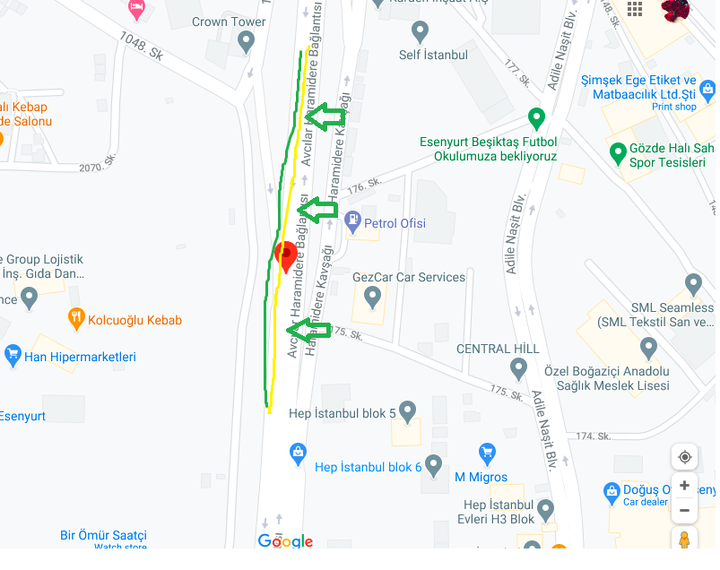
EDGE CELL Operator: TurkTelekom location: Avcılar Haramidere Bağlantısı Lat:41.028097 ,Long: 28.68544

Slide 17
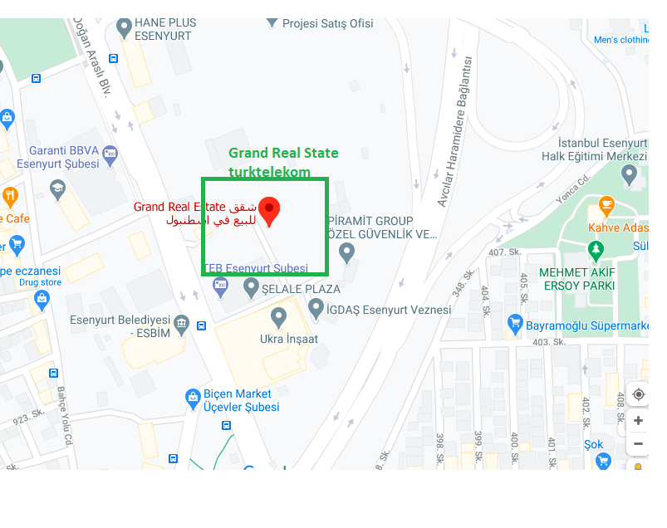
SRVCC LOCATION FOR Turk Telekom location: Grand Real Estate lat: 41.29565, long: 28.684308

Slide 18
THANK YOU
WWW.MARQUISTECH.COM

