Slide 1
MARQUIS TECHNOLOGIES
Drive Route –Airtel & Reliance JIO (FDD/TDD) LTE
Thiruvananthapuram

Slide 2
Operator Information:
Operator | JIO 4G
MCC | 404
MNC | 95
APN | Jionet
Operator | Airtel 4G
MCC | 404
MNC | 95
APN | airtelgprs.com
Operator | VI 4G
MCC | 404
MNC | 19
APN | Internet

Slide 3
Operator Information 1
Functionality | Airtel
Website: http://www.airtel.com/ WAP APN: airtelgprs.com
Customer care | 199
MNC | 95
Bands supported | Both FDD and TDD
 | LTE 2300 MHz – TDD(Band 40)
 | LTE 1800,850 MHz – FDD(Band 3)
USSD | To check MDN: *282#
 | Balance check: *123#
 | Data Balance check: *121*114#
VoLTE | Supported
CSFB | Supported (CSFB to 2G)

Slide 4
Operator Information 2
Functionality | RELIANCE JIO
Website: http://www.jio.com WAP APN: jionet
Customer care | 198
MNC | 862
Bands supported | Both FDD and TDD
 | LTE 2300 MHz –TDD(Band 40)
 | LTE 850 MHz – FDD(Band 5)
 | LTE 1800 MHz –FDD(Band 3)
USSD | NA
 | NA
 | NA
VoLTE | Supported
CSFB | Not Supported

Slide 5
Operator Information 3
Functionality | VI
Website: http://www.jio.com WAP APN: internet
Customer care | 198
MNC | 19
Bands supported | Both FDD and TDD
 | LTE 2300 MHz –TDD(Band 40,41)
 | LTE 850 MHz – FDD(Band 5)
 | LTE 1800 MHz –FDD(Band 3)
USSD | To check MDN*199#
 | Balance check *199#
 | Data Balance check: *199#
VoLTE | Supported
CSFB | Supported

Slide 6
Drive Route
Near Cell :- Stationary: RSRP : -65dbm to -75dbm
Cell Edge :- Stationary: RSRP : -95dbm to -110dbm
Mixed :- Mobility: RSRP : -65dbm to -110dbm

Slide 7
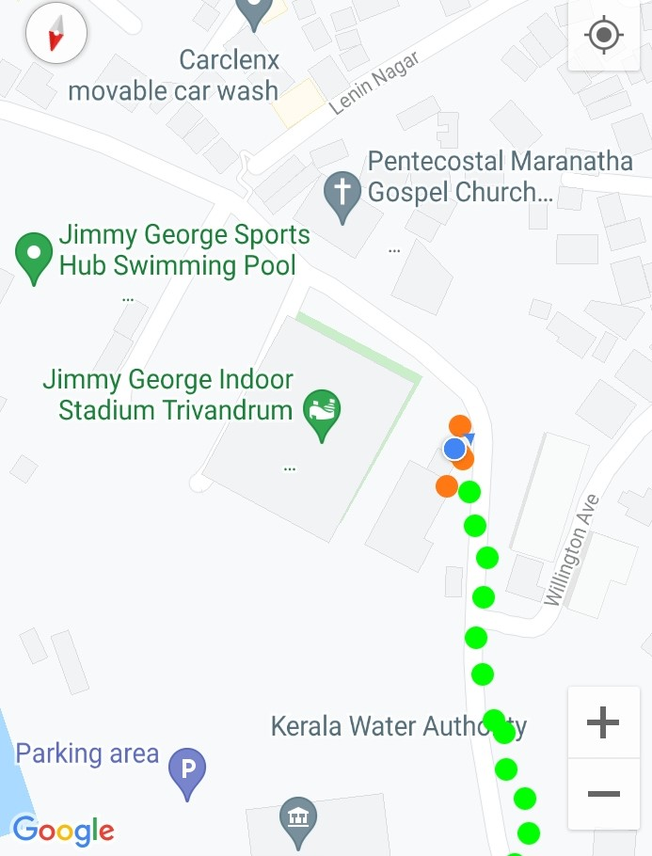
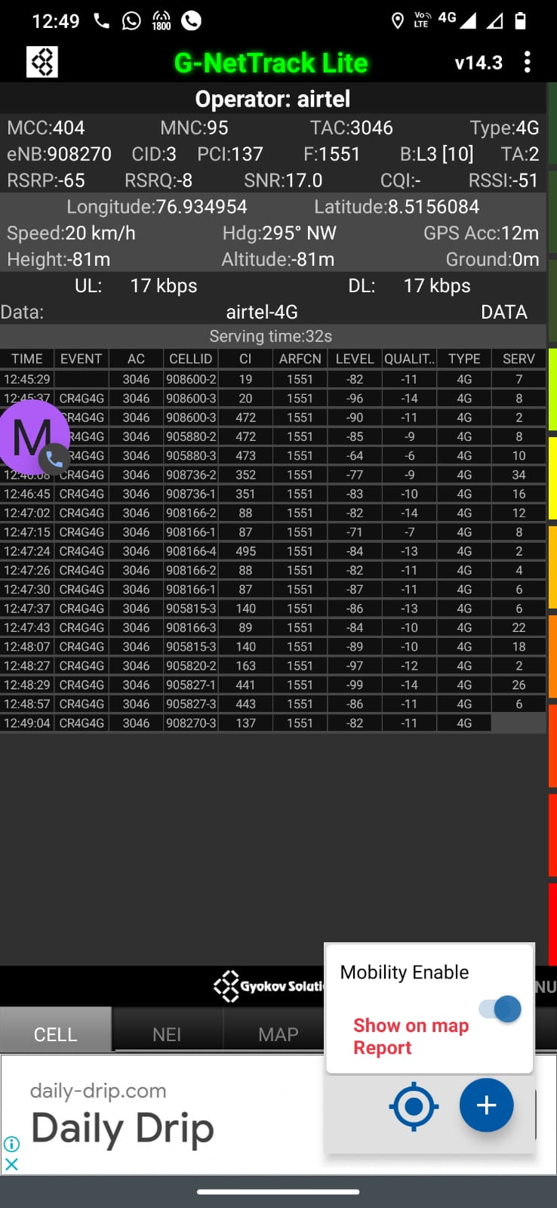
Near Cell (Airtel)
Near cell(NC) | longitude | latitude | RSRP | Cell id | FDD E-ARFCN
1 | 76.934954 | 8.5156084 | 65 | 3 | 1551
Palayam, jimmy indoor stadium Thiruvananthapuram.
RSRP:
-65dbm to 75dbm

Slide 8
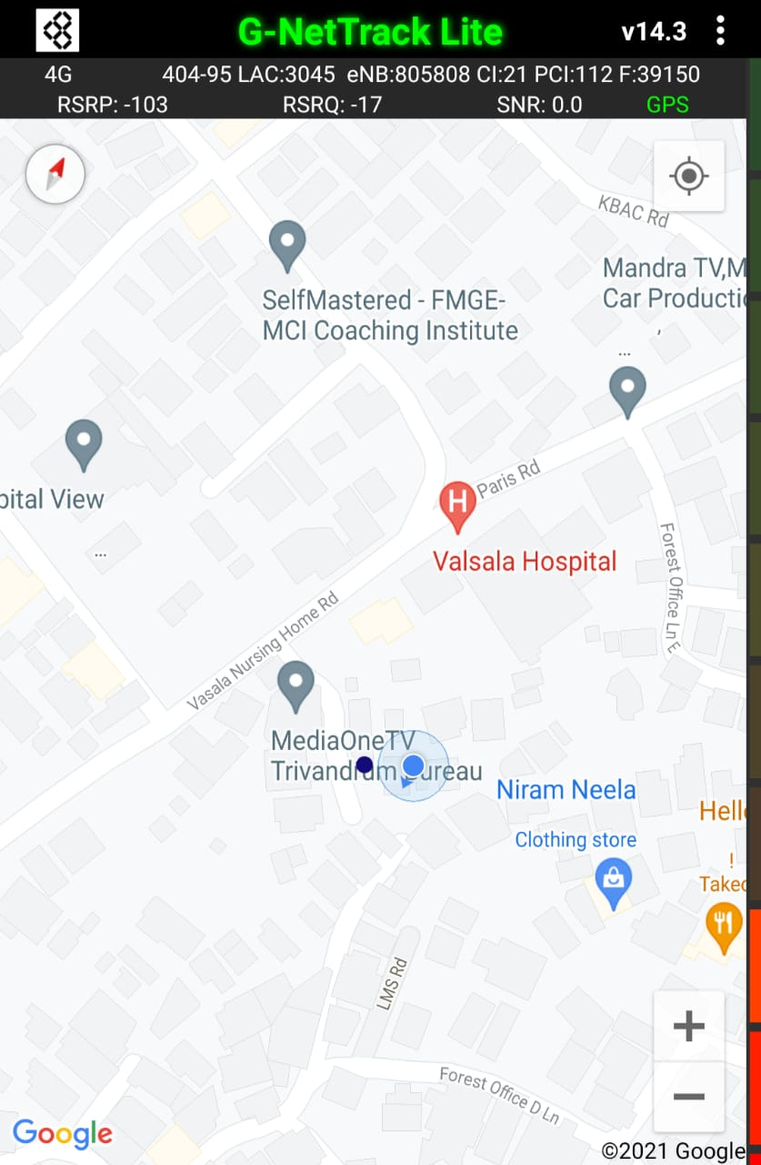
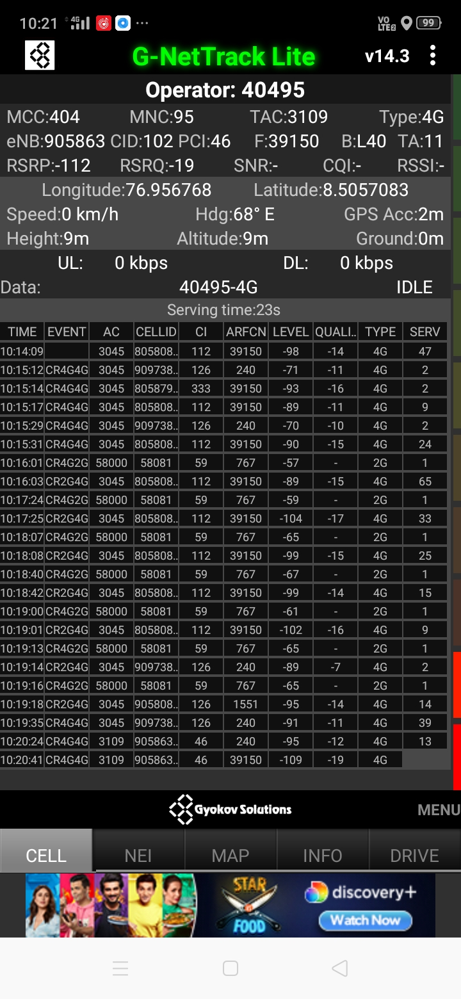
Edge Cell (Airtel)
Edge cell(EC) | longitude | Latitude | RSRP | Cell id | TDD E-ARFCN
1 | 76.956768 | 8.5057083 | 112 | 102 | 39150
Media One TV Office,
Palayam, Thiruvananthapuram.
RSRP:
-95dbm to -110dbm

Slide 9
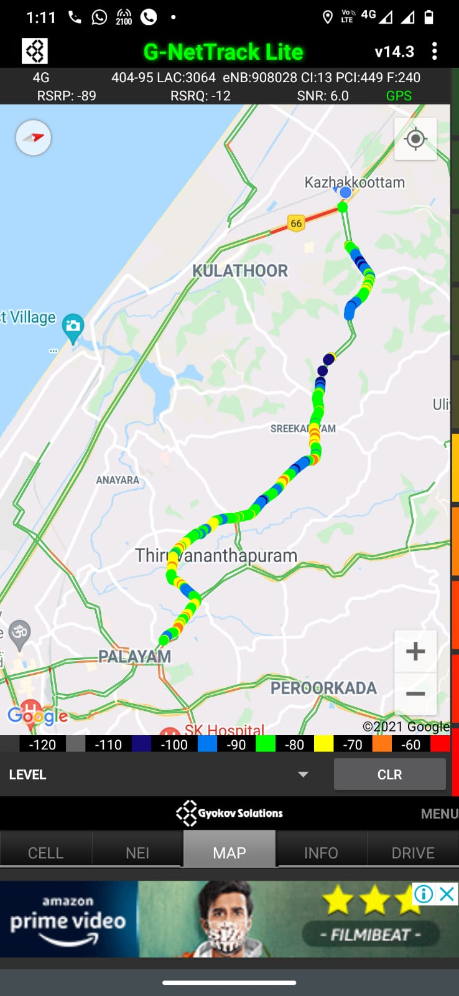
Mixed Mobility:-
RSRP: -65dbm to -110dbm
Thampanoor to kazhakkoottam,
Highway.
Thiruvananthapuram

Slide 10
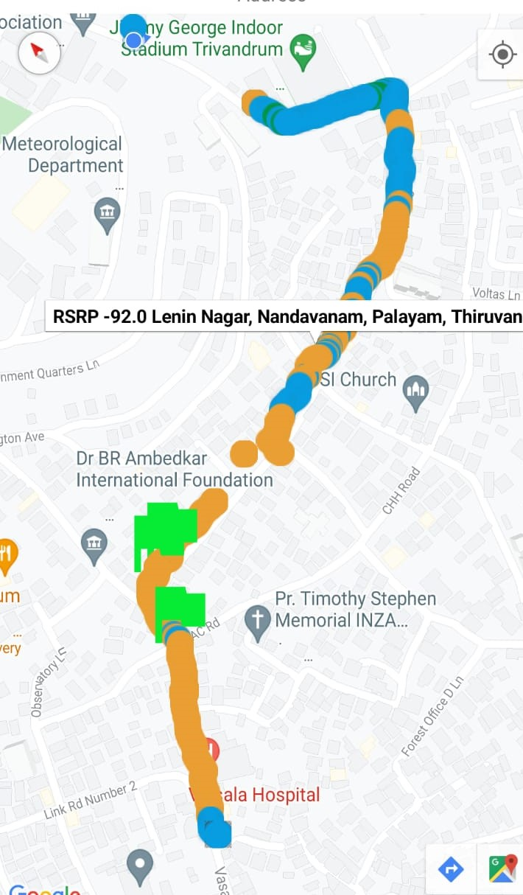
Airtel Band HO
Palayam to Nanthancode
Thiruvananthapuram

Slide 11
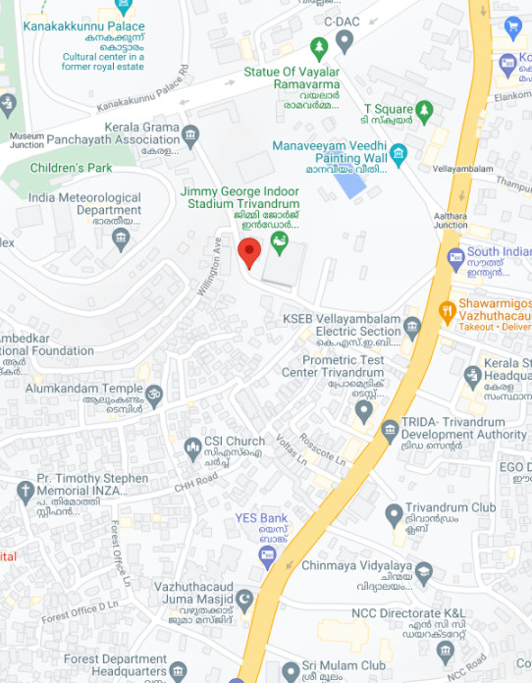
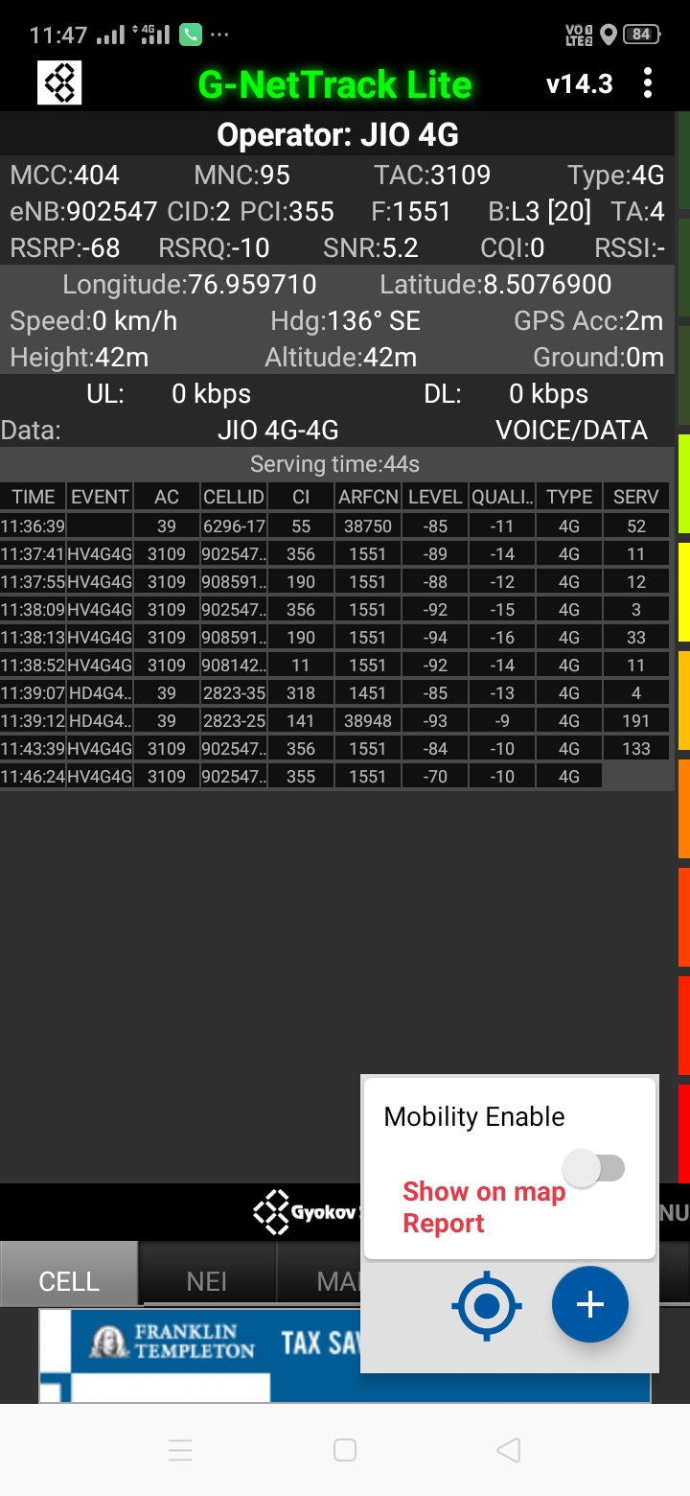
Near Cell (Reliance JIO)
Near cell(NC) | longitude | latitude | RSRP | Cell id | TDD E-ARFCN
1 | 76.959710 | 8.5076900 | 68 | 2 | 38750
Palayam, jimmy indoor stadium Thiruvananthapuram.
RSRP:
-65dbm to -75dbm

Slide 12
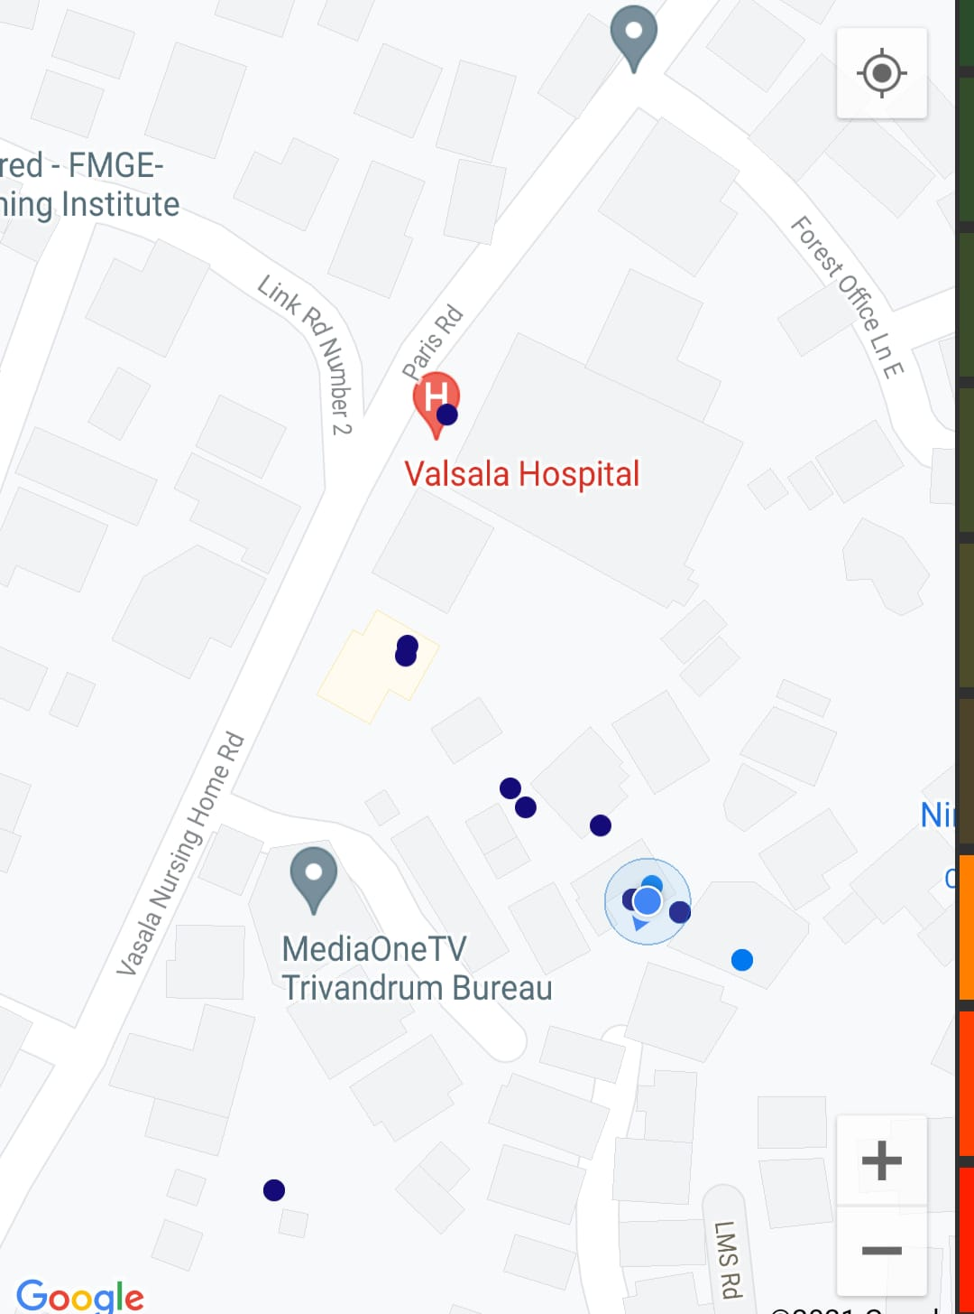
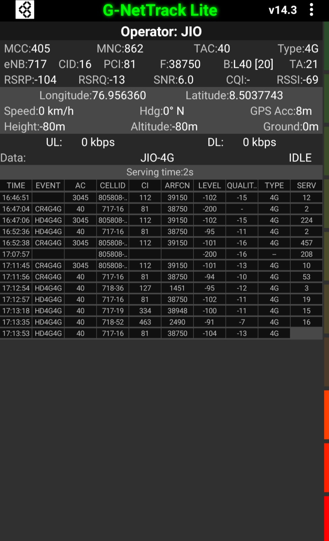
Edge Cell (Reliance JIO)
Edge cell(NC) | longitude | latitude | RSRP | Cell id | TDD E-ARFCN
1 | 76.956360 | 8.5037743 | 104 | 16 | 38750
Reserve bank of India,
medial one street.
RSRP:
-95dbm to -110dbm

Slide 13
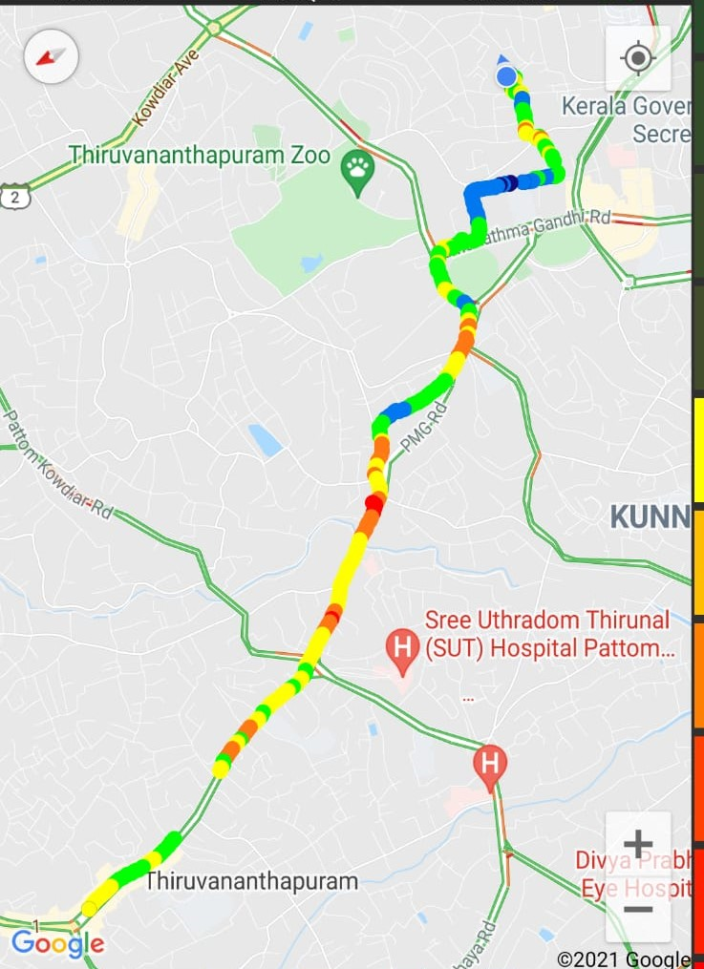
Mixed Mobility:-
Thampanoor to Palayam
Thiruvananthapuram
RSRP: -65dbm to -110dbm

Slide 14
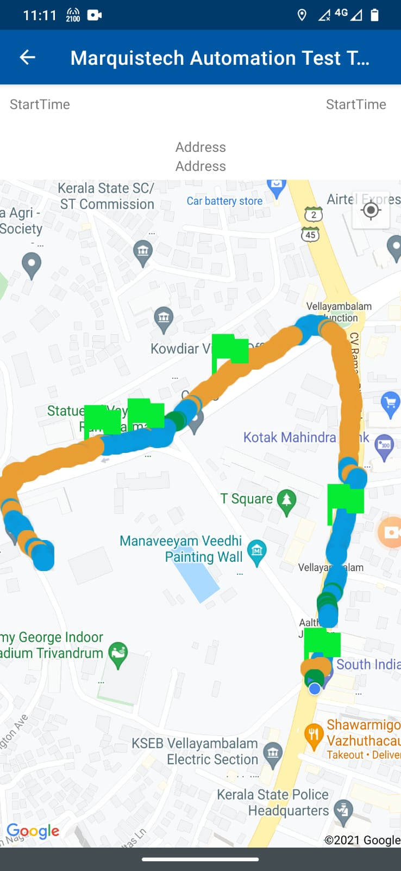
Inter Band Handover (FDD-TDD), JIO 4G
Band Handover | longitude | latitude | RSRP | PCI | FDD E-ARFCN
1 | 8.51005 | 76 .960173 | 93 | 141 | 38948
Vellayambalam to Palayam Thiruvananthapuram.

Slide 15
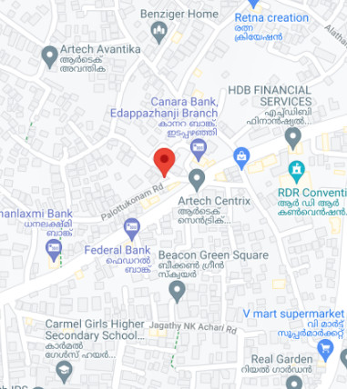
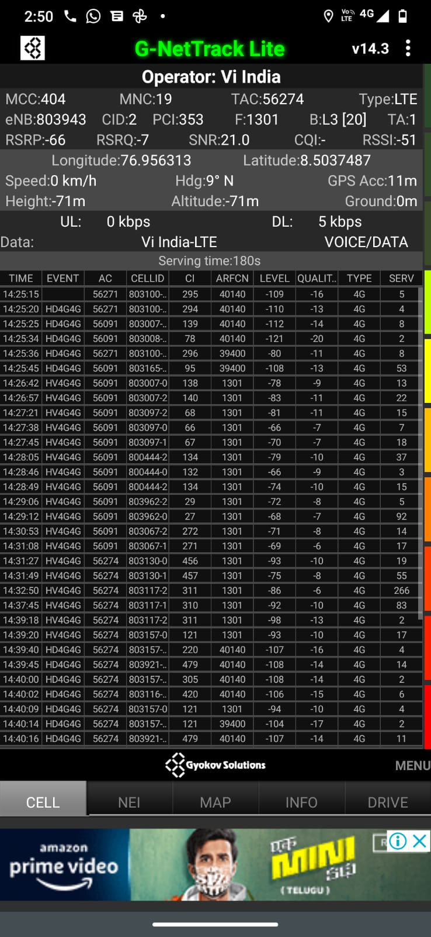
Near Cell VI:
Near cell(NC) | longitude | latitude | RSRP | Cell id | E-ARFCN
1 | 76.966313 | 8.5037487 | 66 | 2 | 40140
Palottukonam road
Thiruvananthapuram
RSRP:
-65dbm to -75dbm

Slide 16
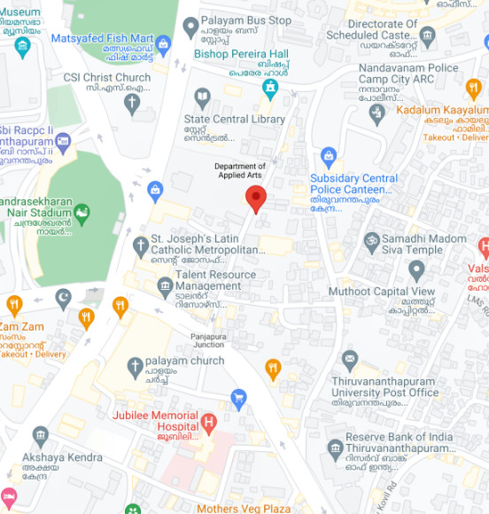
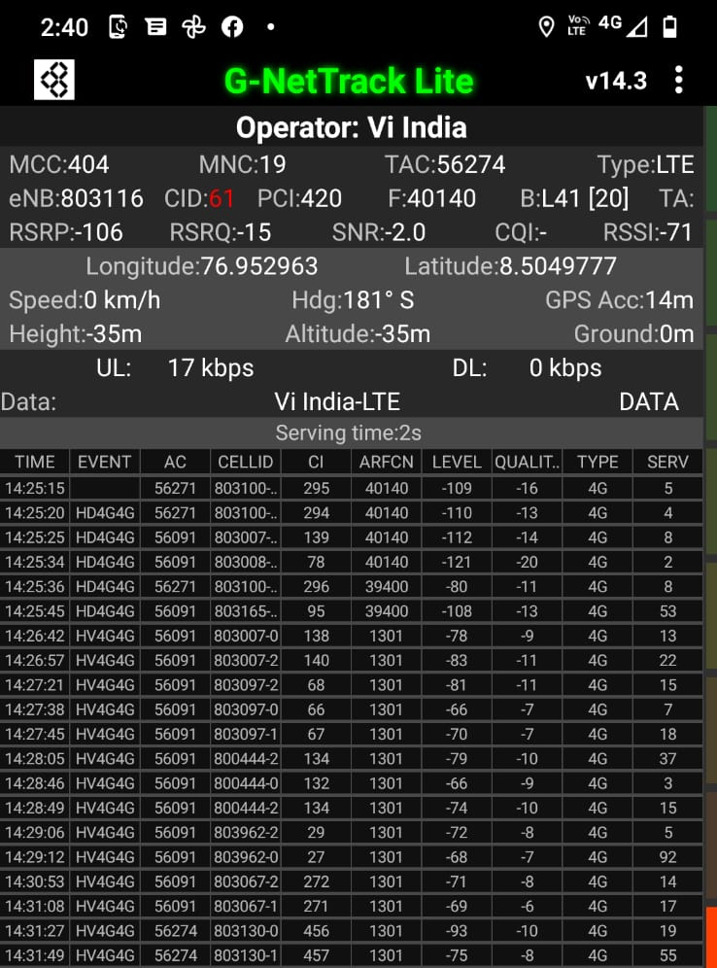
Cell Edge VI:
Edge cell(EC) | longitude | latitude | RSRP | Cell id | E-ARFCN
1 | 76.952963 | 8.5049777 | 106 | 61 | 40140
St. Joseph’s Latin Catholic Metropolitan Cathedral Palayam
RSRP:-95dbm to -110dbm

Slide 17
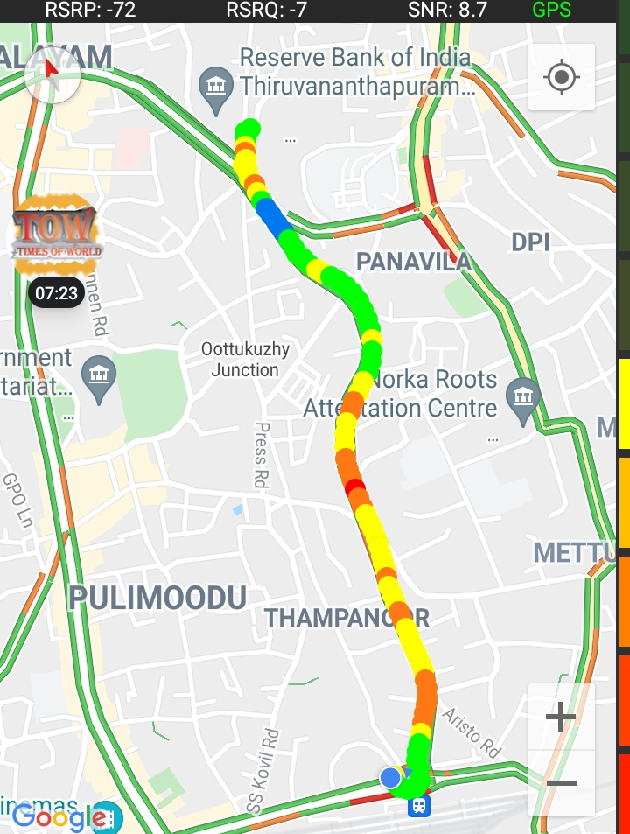
Mixed coverage area vi Thiruvananthapuram:
Thampanoor to Palayam,
Highway.
Thiruvananthapuram
RSRP: -65dbm to -110dbm

Slide 18
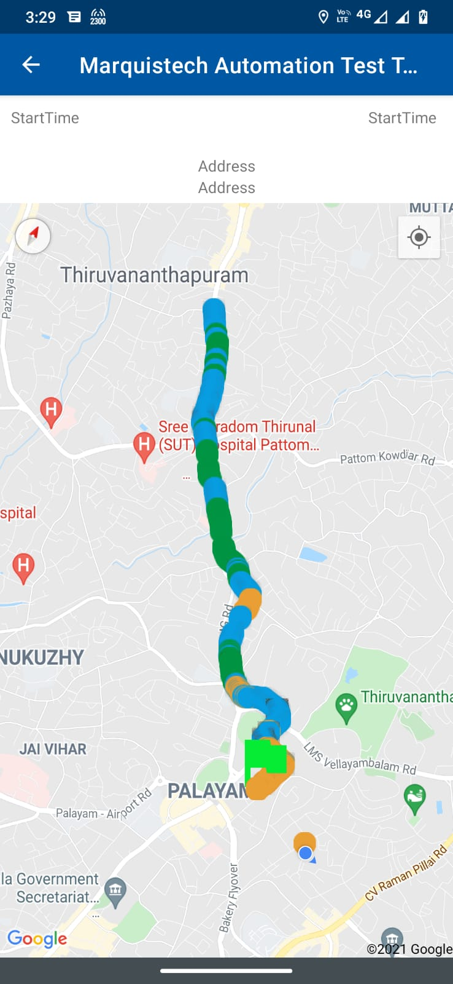
Inter Band Handover (FDD-TDD), vi 4G

Slide 19
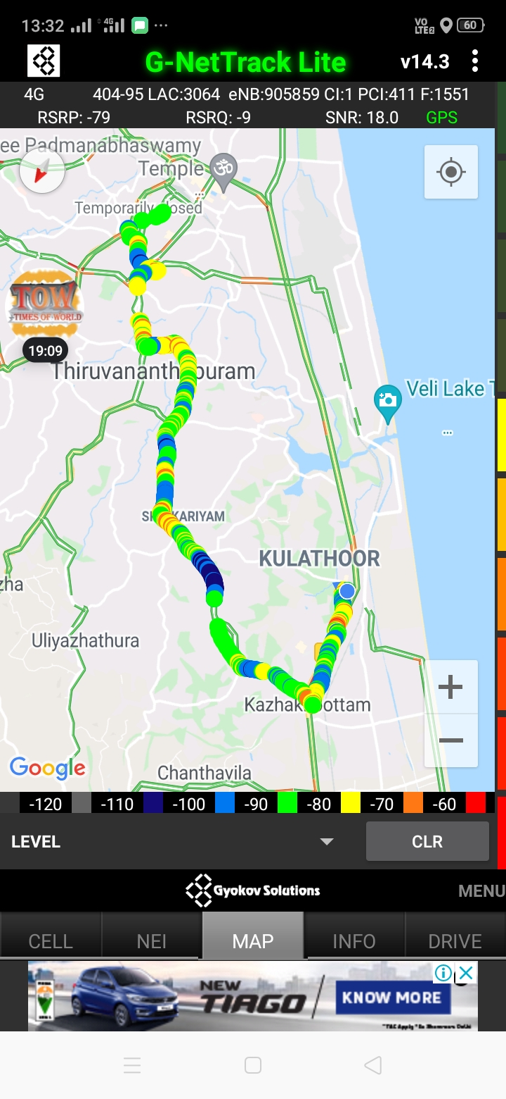
G net Tracker Drive Route

Slide 20
THANK YOU
MARQUIS TECHNOLOGIES

