Slide 1
MARQUIS TECHNOLOGIES
5G Drive Route – Sweden

Slide 2
Drive Route
Near Cell :-Stationary: RSRP: -65dbm to -90dbm
Mixed :-Mobility: RSRP : -75dbm to -100dbm
Cell Edge :-Stationary: RSRP : -95dbm to -120dbm

Slide 3
Major Sweden Operators : Locations for 5G /NR Field Test
Operator | PLMN | 5G Tested Locations | Longitude / Latitude | ENDC combination Tested
Telia | 01 | Radmansgatan | 59.341239603305915, 18.061541513771957 | L20+N78
H3G | 02 | kista | 59.40234119745188, 17.945676298430854 | L7+N78
Tele2 | 07 | Radmansgatan | 59.341239603305915, 18.061541513771957 | L7+N78

Slide 4
Service support by Telia Operator
Services Supported by Telia Operator
Telia 5G/4G/3G/2G | E-GSM (900), 1800(DCS),B1(2100 MHZ) ,B3(1800MHZ), B7(2600MHZ), B20(800MHZ), N78(3400 - 3720 MHz)
OPERATOR | Features /Services | Supported(yes/No)
TELIA (Major) | Reselection | Yes
 | Redirection | Yes
 | MMS /SMS | Yes
 | Volte | Yes
 | vowifi | Yes
 | PS Handover | Yes

Slide 5
Service support by Telia Operator
Services Supported by H3G Operator
H3G5G/4G/3G/2G | E-GSM (900), DCS (1800), B1(2100 MHZ), B8(900MHZ), B7(2600MHZ), B20(800MHZ), B38(TD 2600), N78(3400 - 3720 MHz)
OPERATOR | Features /Services | Supported(yes/No)
H3G (Major) | Reselection | Yes
 | Redirection | Yes
 | MMS /SMS | Yes
 | Volte | Yes
 | vowifi | Yes
 | PS Handover | Yes

Slide 6
Service support by Telia Operator
Services Supported by TELE 2 Operator
Tele2 5G/4G/3G/2G | E-GSM (900), DCS (1800), B1(2100 MHZ), B3(1800MHZ) B7(2600MHZ), B20(800MHZ), B8(900 GSM), N78(3400 - 3720 MHz)
OPERATOR | Features /Services | Supported(yes/No)
TELE 2 (Major) | Reselection | Yes
 | Redirection | Yes
 | MMS /SMS | Yes
 | Volte | Yes
 | vowifi | Yes
 | PS Handover | Yes

Slide 7
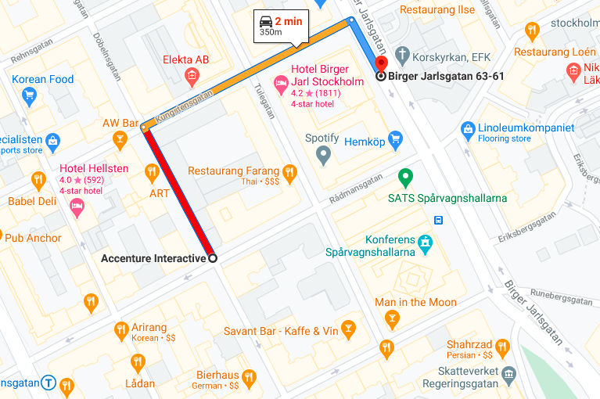
TELIA and TELE 2 5G Good Coverage Area Band L3,L7 AND L20 WITH NR 78 BAND Accenture interactive>> birger jarisgatan >> radmansgatan

Slide 8
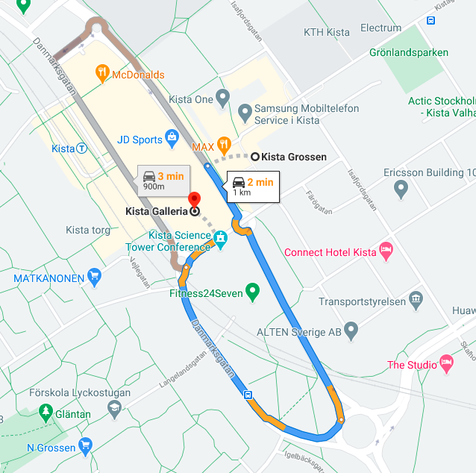
H3G 5G Good Coverage Area Band L3,L7 AND L20 WITH NR 78 BAND Kista grossen>> kista >> kista galleria

Slide 9
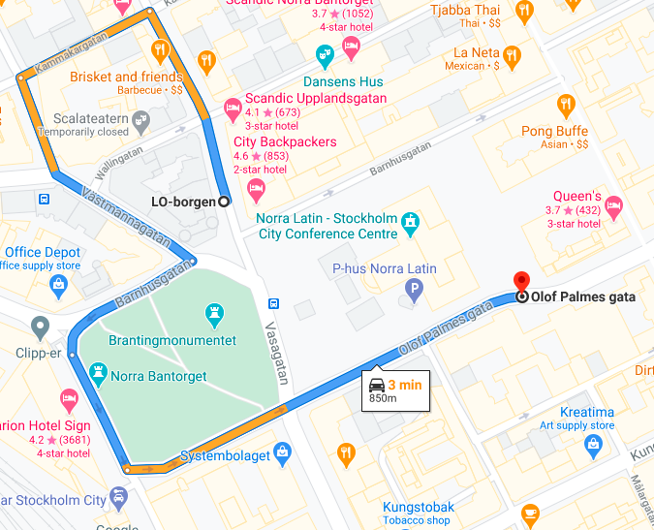
Telia, H3G, Tele 2 5G to Weak Coverage Area Radmansgatan to olof palmes gata

Slide 10
SRVCC 4G to 3G location for Telia, Tele 2, H3G ( mention band detail, location name, Lat/long, RSRP range) Arlanda >> kolstavagen

Slide 11
THANK YOU
MARQUIS TECHNOLOGIES
www.marquistech.com

