Slide 1
MARQUIS TECHNOLOGIES
Drive Route Bratislava, Slovakia

Slide 2
Country | Slovakia
City | Bratislava
MCC | 231
Operator | Orange, 4KA, O2, Telekom
Near Cell | -65dbm to -80dBm
Edge Cell | -95dBm to -115dBm
Currency | Euro

Slide 3
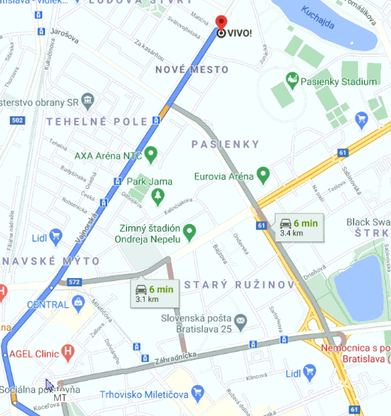
SRVCC Location:

Slide 4
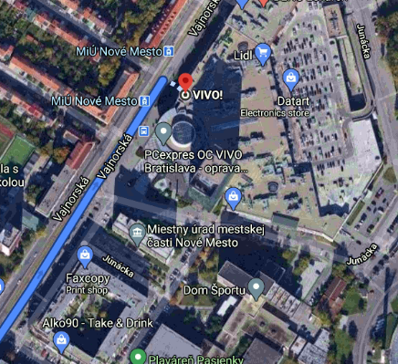
IRAT from 4G to 3G: O2,Orange, Telekom, 4KA

Slide 5
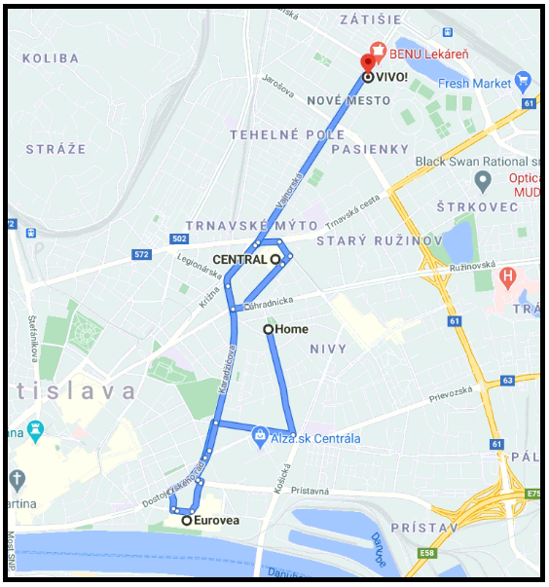
Handover (Orange, O2, 4KA, Telekom ):

Slide 6
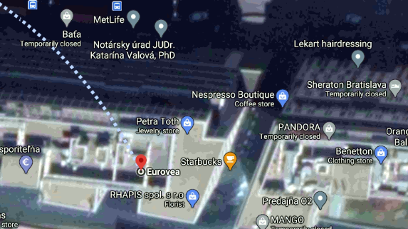
Telekom IRAT from 4G to 3G:

Slide 7
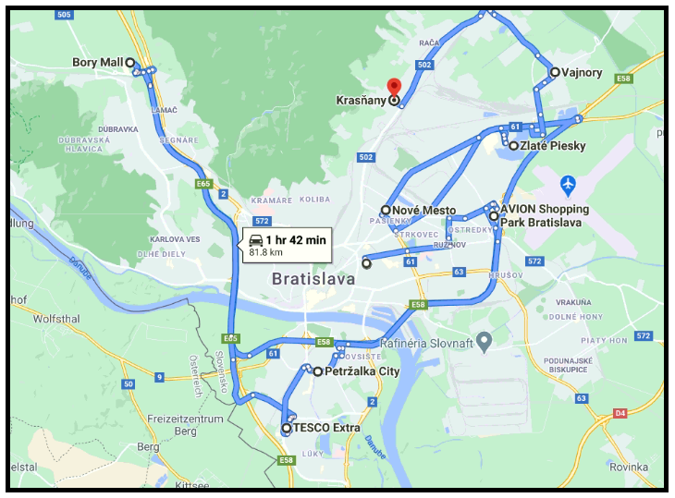
Mobility drive route

Slide 8
THANK YOU
MARQUIS TECHNOLOGIES
www.marquistech.com

