Slide 1
MARQUIS TECHNOLOGIES
Drive Routes - Chile/Santiago

Slide 2
Santiago (Chile)
Country | Chile
Continent | America
City | Santiago
Time Zone | GMT -4 Hour
International Dialing Code | +56
VISA | NO NEED
VISA Duration | 90 days
VISA Fees | TBC
VISA Requirements
Yellow Fever Vaccination Certificate | Not Required

Slide 3
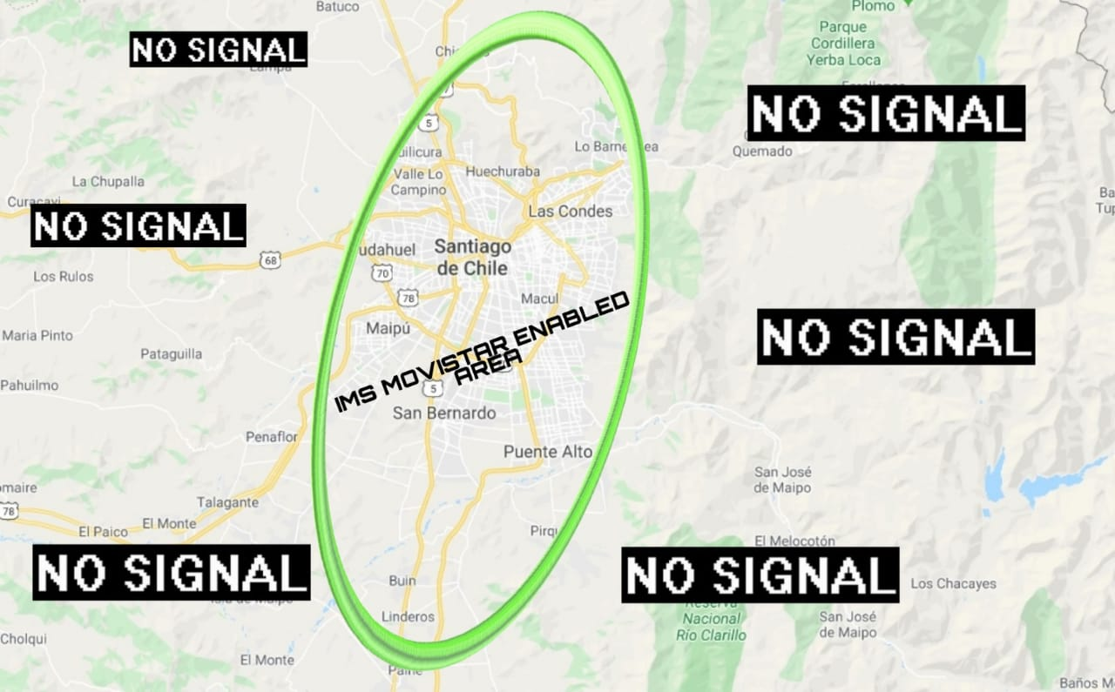
Movistar covered IMS area

Slide 4
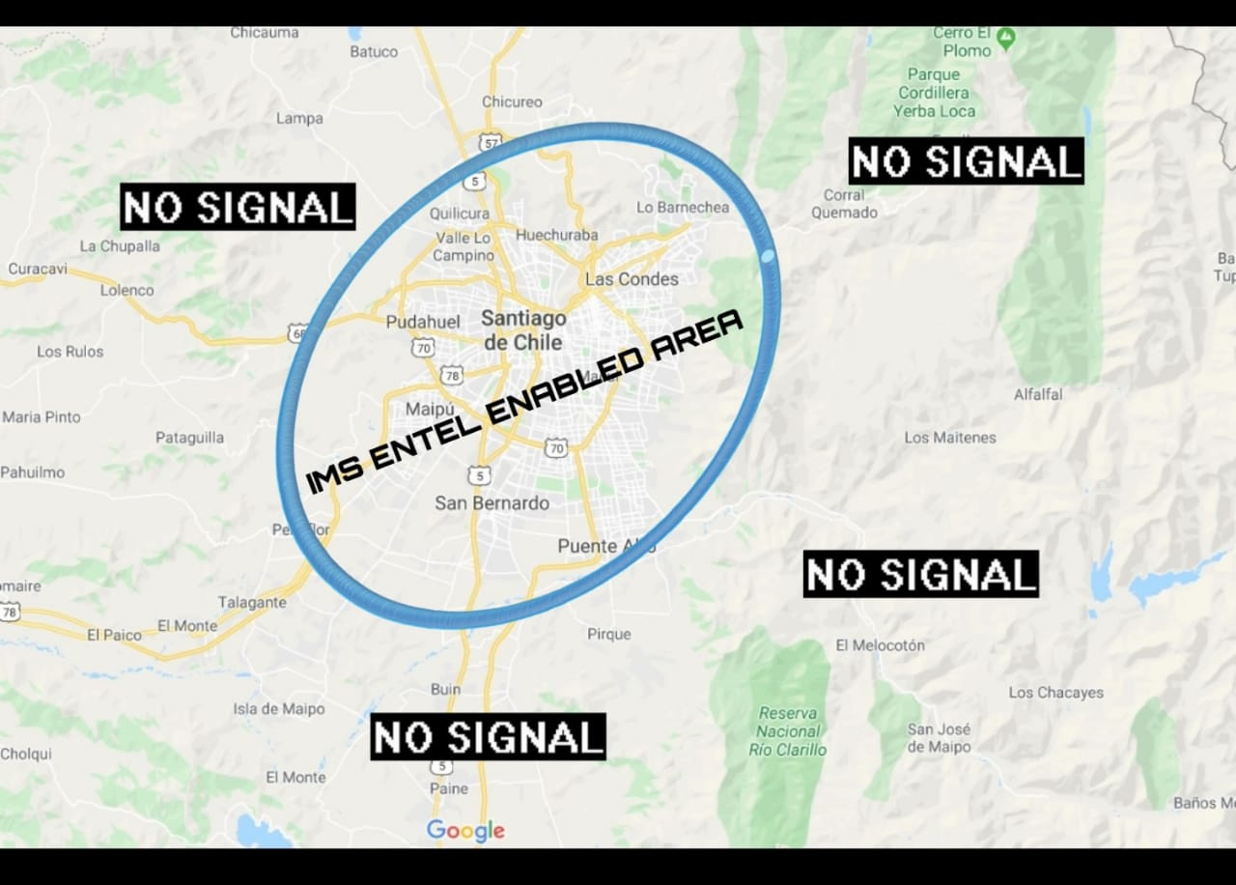
Entel covered IMS area

Slide 5
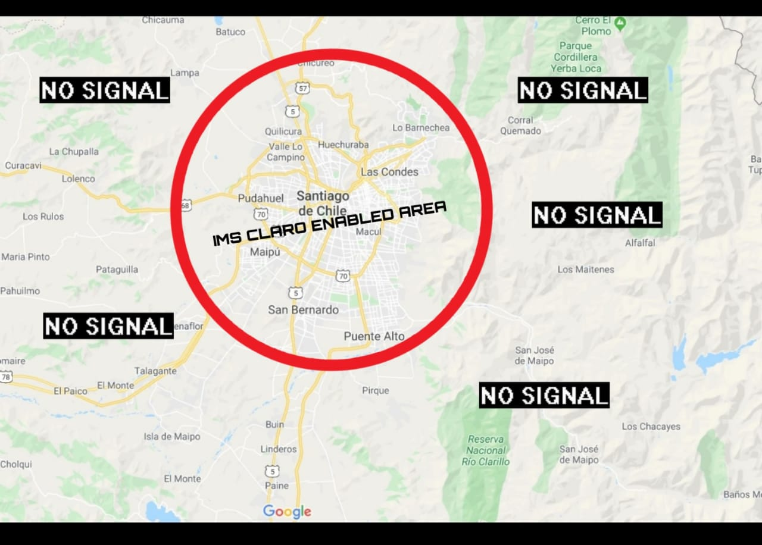
Claro covered IMS area

Slide 6
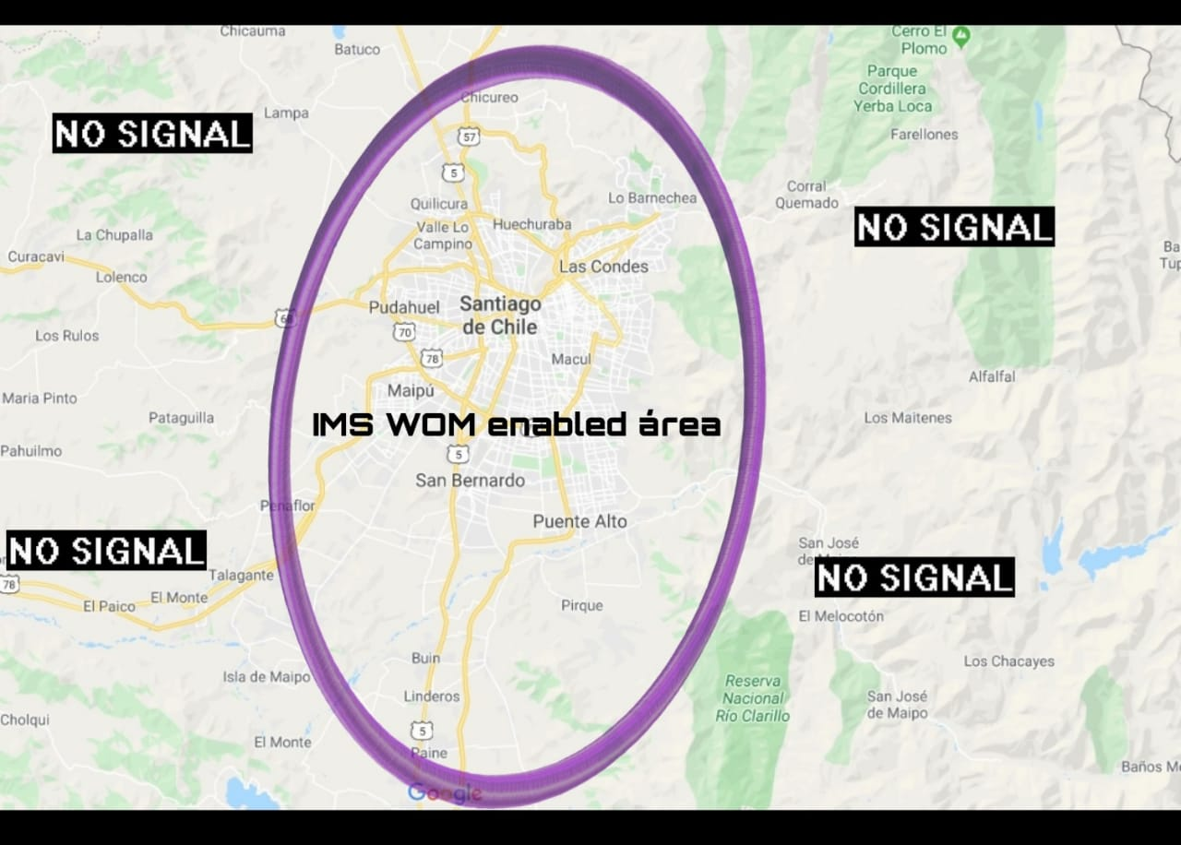
WOM covered IMS area

Slide 7
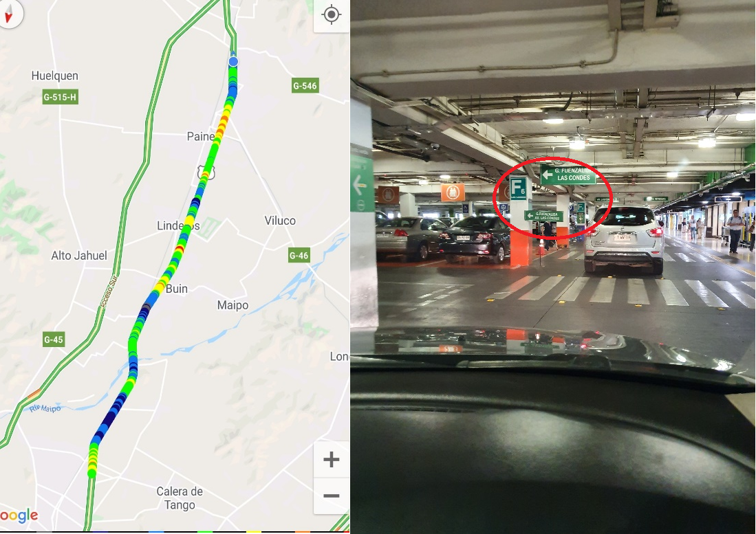
Claro and Entel- SRVCC Location:- Av. Pdte. Kennedy Lateral 9001, Las Condes, Región Metropolitana.Lat:-33.389259;long:-70.546700

Slide 8
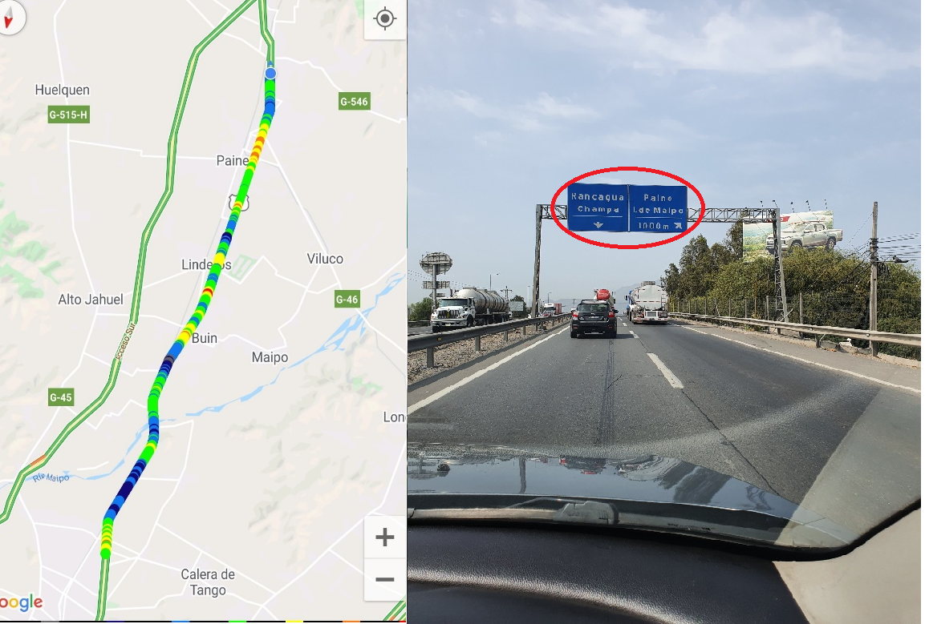
Wom and Movistar- SRVCC Location:- Panamericana Sur Km 67,1 Ruta 5 Oriente, Mostazal, O'Higgins Lat:--34.178280;long: -70.790900

Slide 9
Operators in Chile
MCC | MNC | Operator | Bands (MHz)
730 | 1 | ENTEL | GSM 900/1900, WCDMA 900/1900, LTE 700/2600/1900
730 | 2 | MOVISTAR | GSM 850/1900, WCDMA 850/1900, LTE 700/2600
730 | 3 | CLARO | GSM 850/1900, WCDMA 850/1900, LTE 700/2600/1900
730 | 9 | WOM | GSM 850/1900, WCDMA 850/1900/1700/2100, LTE 700/2600/1700/2100

Slide 10
Operators and Related Information
All the operators are having FDD LTE implementation
ENTEL- Supports VoLTE, VoWifi, LTE, CA, WCDMA and 2G
MOVISTAR- Supports VoLTE, VoWifi, LTE, CA,WCDMA and 2G
CLARO- Supports VoLTE, VoWifi, LTE, CA, WCDMA and 2G
WOM- Supports VoLTE, ViLTE, VoWifi, LTE, WCDMA and 2G
MMS not supported by all operators.

Slide 11
General Info of Operators
Movistar and Entel remain the market leaders, with a similar market share, while Claro accounts for about a quarter of the market
WOM extends roaming agreement with Entel for LTE services.
Movistar and Entel extend LTE-A capabilities.

Slide 12
USSD codes for balance check
All Carrier balance check: *103#

Slide 13

Supplementary Services
ALL carrier support Call forwarding, Call Waiting
Claro doesn’t support call barring.

Slide 14
MCC MNC for Santiago/Chile Operators:-
MCC MNC for Entel 2G/3G/4G: 730 01
MCC MNC for Movistar 2G/3G/4G: 730 02
MCC MNC for Claro 2G/3G/4G: 730 03
MCC MNC for WOM 2G/3G/4G: 730 09

Slide 15
RSRP Criteria
Near Cell :-Stationary: RSRP : -55dbm to -85dbm
Cell Edge :-Stationary: RSRP : -95dbm to -110dbm
Mixed :-Mobility: RSRP : -55dbm to -120dbm

Slide 16
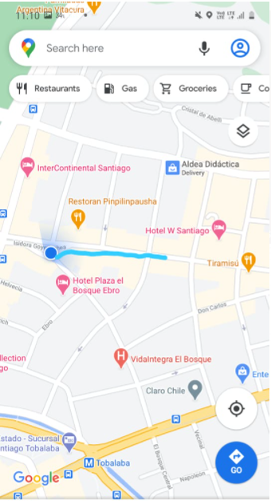
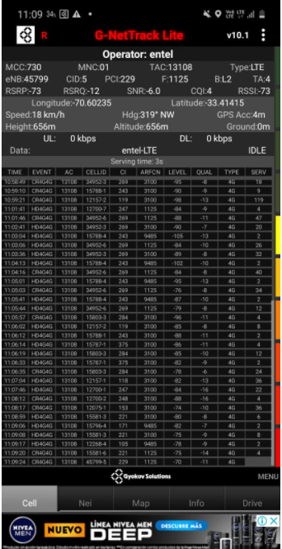
Drive Routes
SRVCC (4G > 3G ) for Entel operator – Parking lot (Don Carlos restaurant) in underground -1 close to the bathroom, need to walk from the stairs.

Slide 17
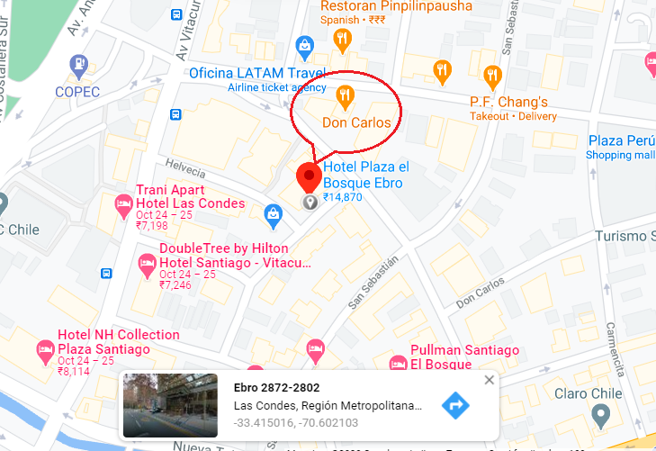
Out of Service location for all operators: Basement of Hotel Plaza el Bosque Ebro:
Lat: -33.415016, Long: -70.602103

Slide 18
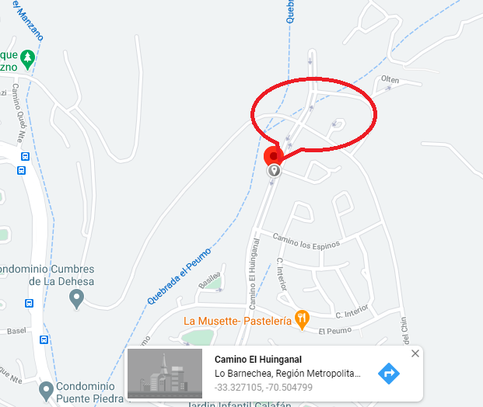
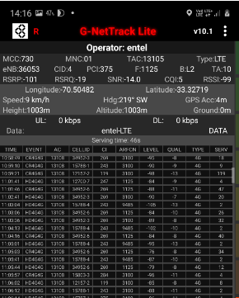
Cell edge location for Entel LTE Band B2 at Lausana Plaza
Lat: -33.327105, Long: -70.504799

Slide 19
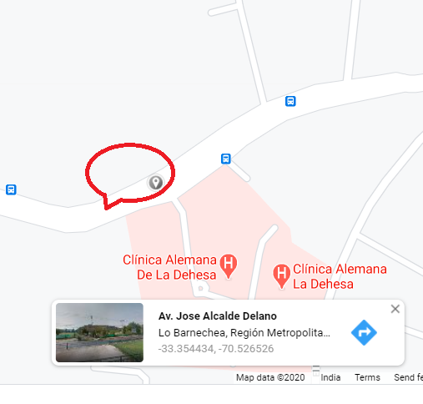
Entel LTE Near Cell for B7, B28
Lat: -33.354434, Long: -70.526526

Slide 20
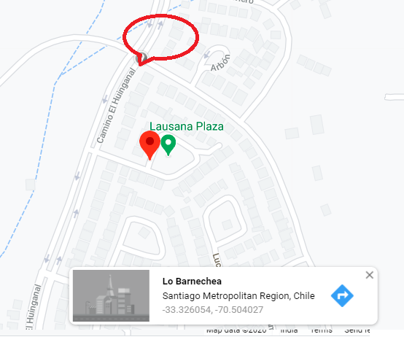
LTE Cell edge location for WOM, Movistar, Claro operator
Lat: -33.326054, Long: -70.504027

Slide 21
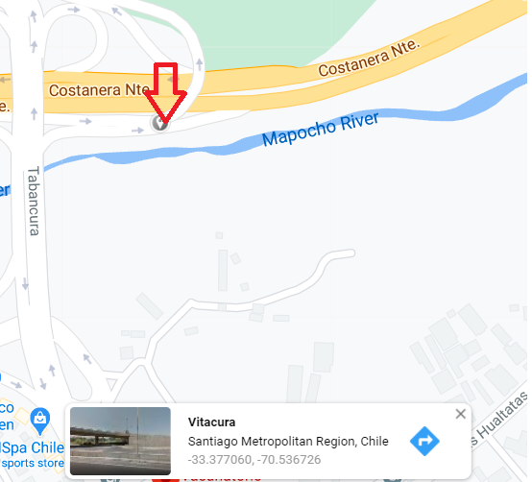
LTE Near cell location for Entel, WOM, Claro and Movistar operator
Lat: -33.377060, Long: -70.536726

Slide 22
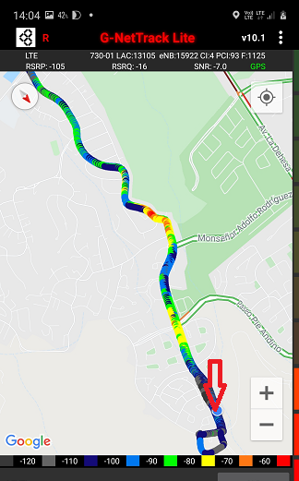
Entel IRAT reselection location LTE > UTRAN

Slide 23
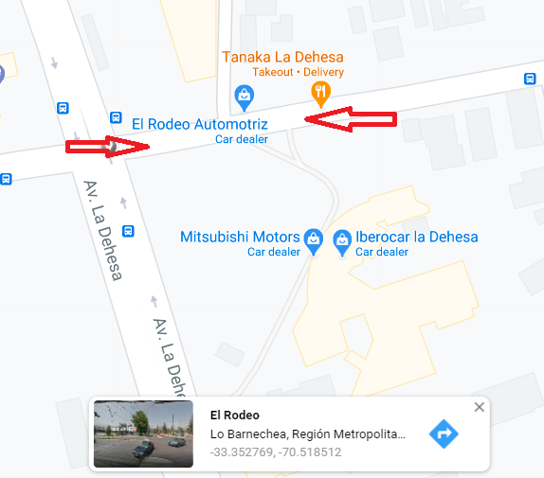
WOM SRVCC to UTRAN cell location
Lat: -33.352769, -70.518512

Slide 24
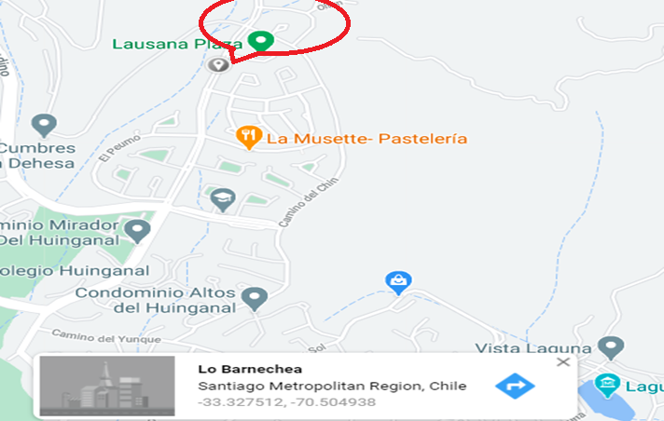
Claro, Movistar SRVCC to UTRAN location at Lausana Plaza –B2
Lat; -33.327512, Long: -70.504938

Slide 25
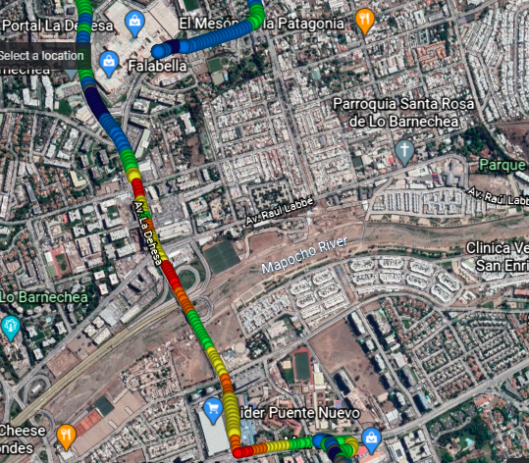
Drive route Mixed coverage
Casa Matriz > Falabella

Slide 26
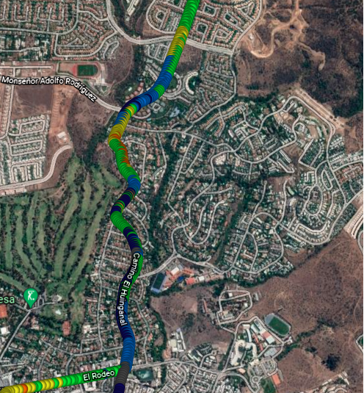
Drive Route Mixed coverage El Rodeo > Lausana Plaza

Slide 27
Thank You

