Slide 1
MARQUIS TECHNOLOGIES
Drive Route – Moscow( RUSSIA)

Slide 2
Testing Place - Bangalore (India)
Country | Russia
Continent | Eurasia(Europe + Asia)
City | Moscow
Time Zone | GMT +3:00 Hour
International Dialing Code | +7

Slide 3
RSRP Criteria
Near Cell :-Stationary: RSRP : -55dbm to -75dbm
Cell Edge :-Stationary: RSRP : -95dbm to -110dbm
Mixed :-Mobility: RSRP : -76dbm to -90dbm

Slide 4
Operator Information
MCC | MNC | Operator SUPPORT | OPERATOR
250 | 01 | VOWIFI/VIWIFI/VoLTE/VILTE/4G/3G/2G | MTS
250 | 2 | VoLTE/VOWIFI/4G/3G/2G | MEGAFON
250 | 20 | VoLTE 4G/3G | TELE2
250 | 99 | VoLTE 4G/3G/2G | BEELINE

Slide 5
Band Details:
Location | Service Provider | Bands Deployed
 |  | GSM-2G | UMTS-3G | LTE-4G
Moscow/ Russia | MTS | 1800 | 2100 | Band 3 (FDD-1800), Band 7 (FDD-2600), Band 20 (FDD-800), Band 38 (TDD-2600)
 | Megafon | 900 | 900 | Band 7(FDD-2600), Band 3 (FDD-1800),
 | Tele2 | NA | 2100 | Band 3 (FDD-1800), Band 20 (FDD-800)
 | Beeline | 1800 | 900 | Band 7(FDD-2600), Band 3 (FDD-1800)

Slide 6
MTS Operator
Drive Route – Moscow( RUSSIA)

Slide 7
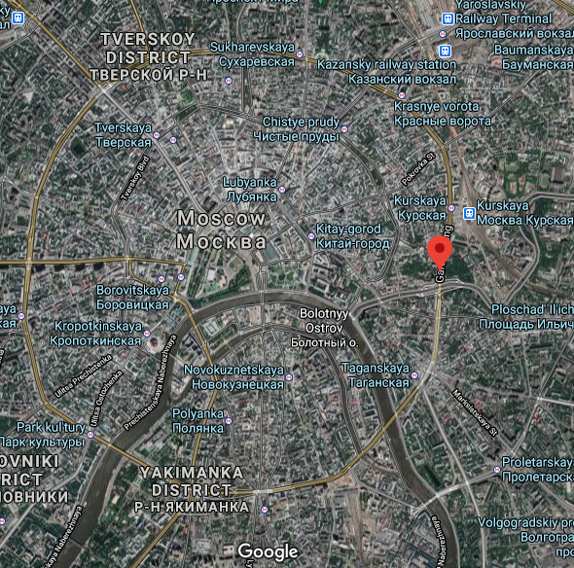
GOOD AREA (NEAR CELL) Operator: MTS location : Garden Ring Road lat :55.756117,long: 37.657311
AT-Slide : 1

Slide 8
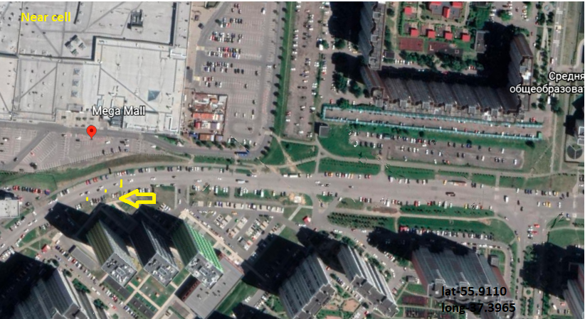
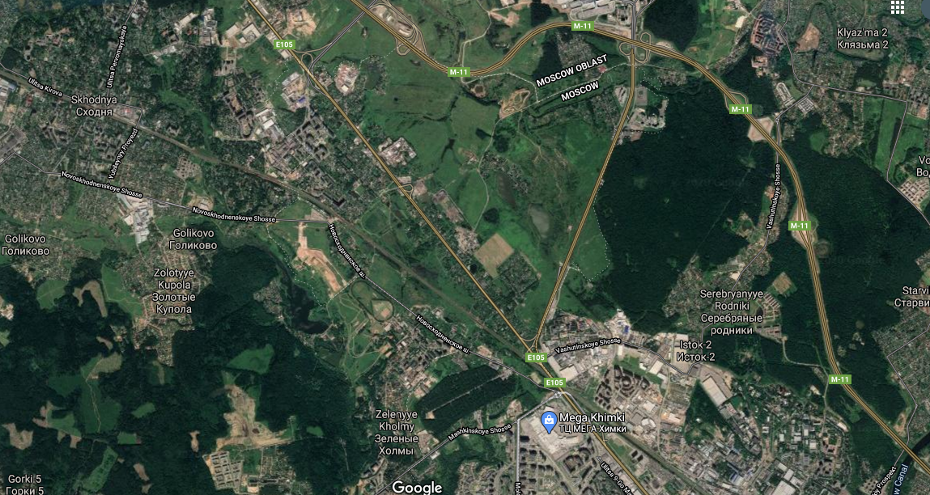
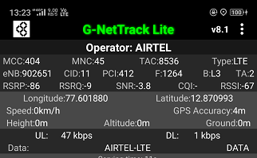
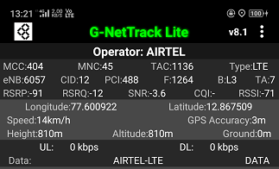
EDGE CELL location : KHIMKI MOSCOW OBLAST lat: 55.908650, long: 37395793
CA Cell ID: 412
NCA Cell ID: 488
AT-Slide : 2

Slide 9
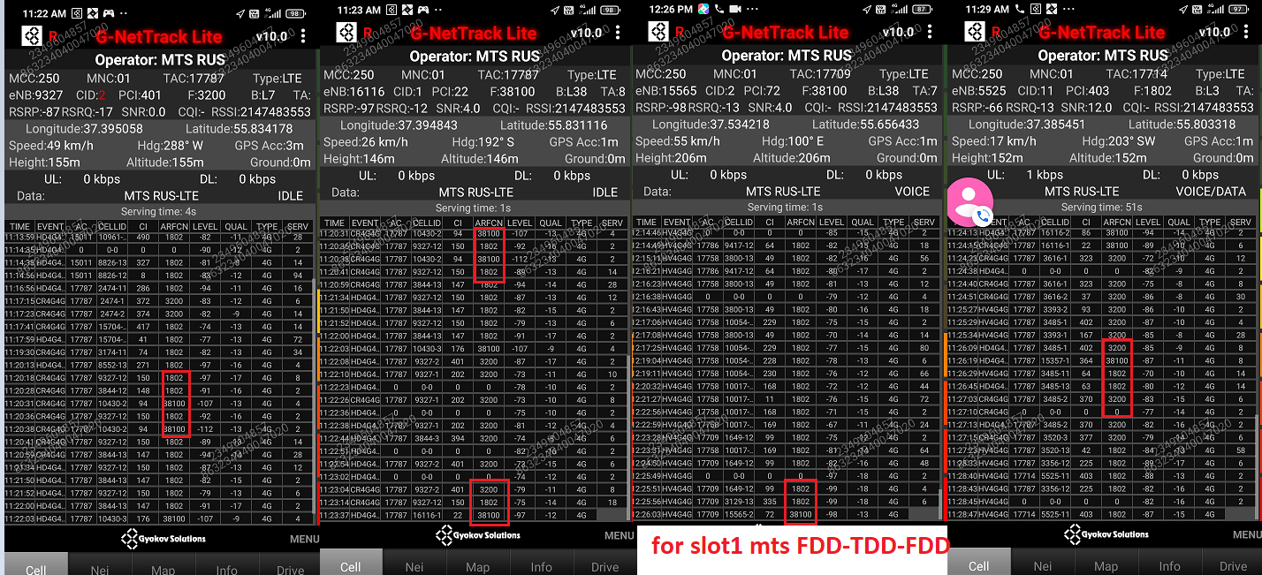
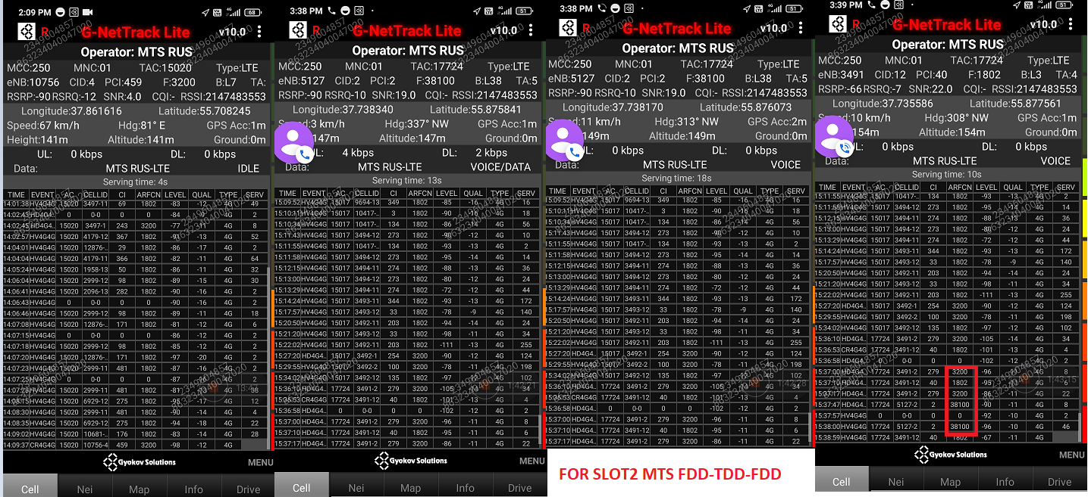
FDD-TDD-FDD 55.831116,37.394843

Slide 10
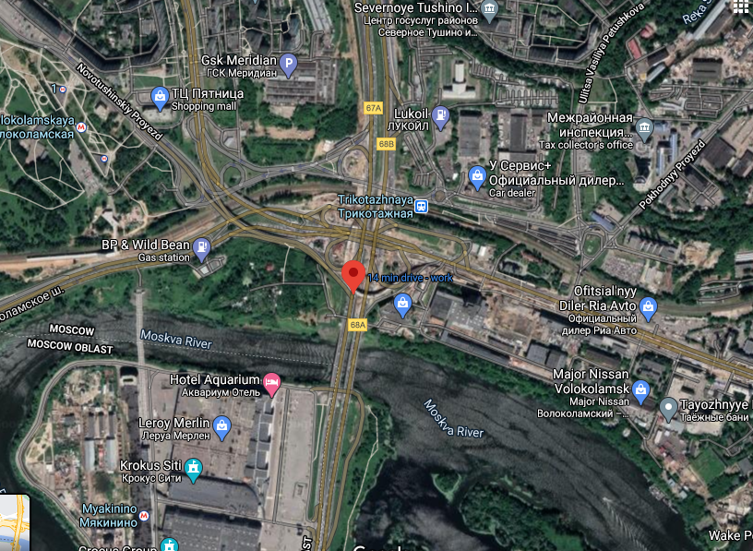
Location :SHEVERNOE TUSHINO lat 55.871724,long 37.413366 Mixed cell coverage

Slide 11
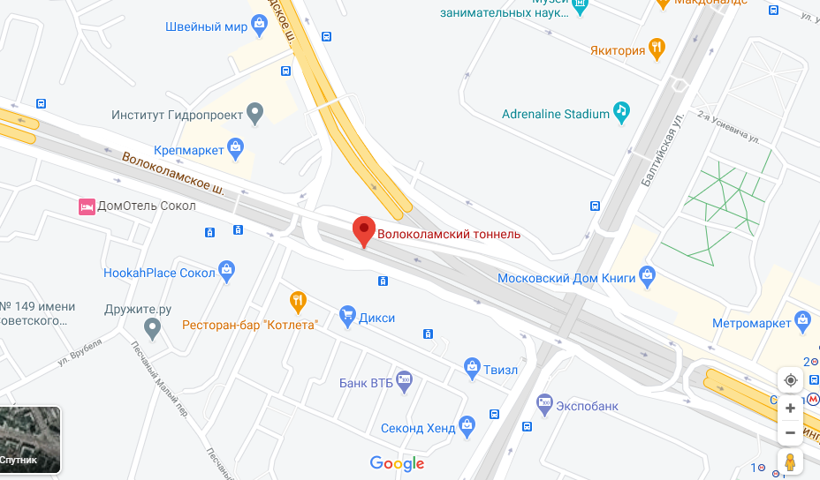
SRVCC LOCATION Location :BOLKOLAMCKY TUNNEL Lat 55.806677 long 37.507518

Slide 12
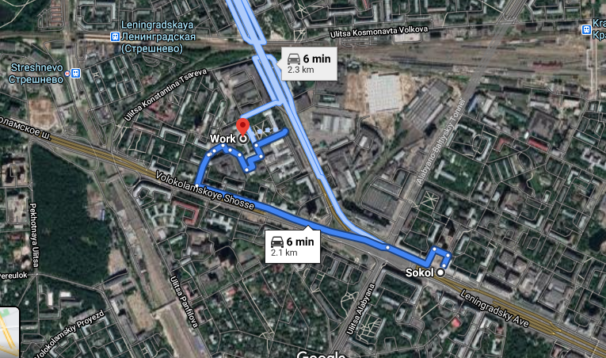
CA LOCATION Location: SOKOL TO MOSCOW AVIATION INSTITUE LAT:55.815713, LONG 37.488376

Slide 13
MEGAFON Operator
Drive Route – Moscow( RUSSIA)

Slide 14
GOOD AREA (NEAR CELL) Operator: MEGAFON GARDEN CIRCLE OF MOSCOW ,CENTRE OF MOSCOW lat :55.756117,long: 37.657311
AT-Slide : 1

Slide 15
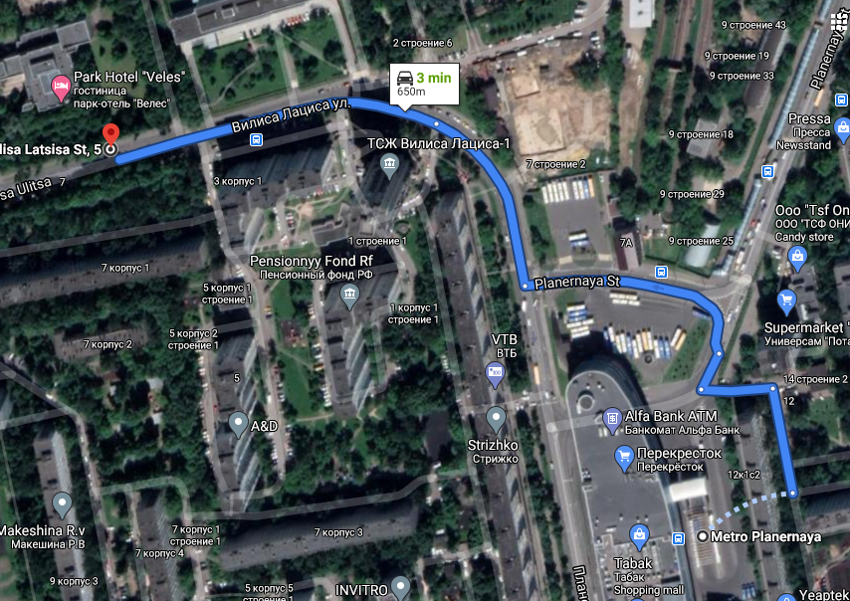
CA LOCATION Location: METRO PLANERNAYA TO VILISA LATSISA St5 lat:55.864983,long:37.429550

Slide 16
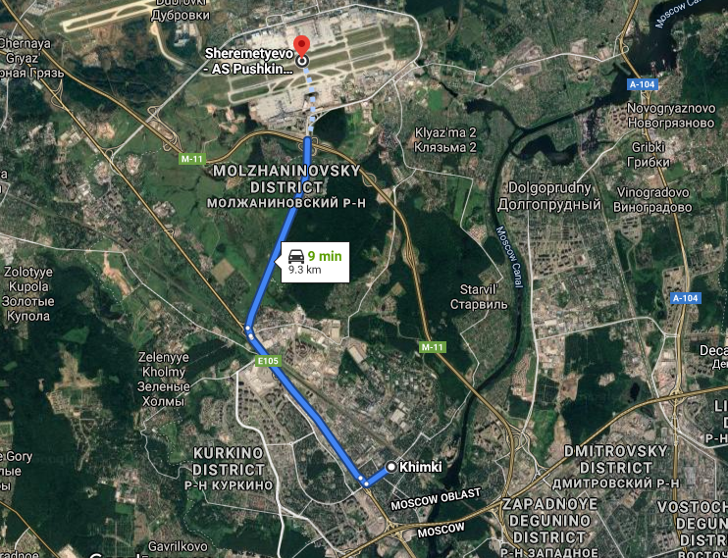
EDGE CELL KHIMKI TO SVO AIRPORT lat: 55.915343,long: 37.400519

Slide 17
SRVCC LOCATION location :BOLKOLAMCKY TUNNEL Lat 55.806677 long 37.507518

Slide 18
TELE2 Operator
Drive Route – Moscow( RUSSIA)

Slide 19
GOOD AREA (NEAR CELL) Operator:TELE2 GARDEN CIRCLE OF MOSCOW ,CENTRE OF MOSCOW lat :55.756117,long: 37.657311
AT-Slide : 1

Slide 20
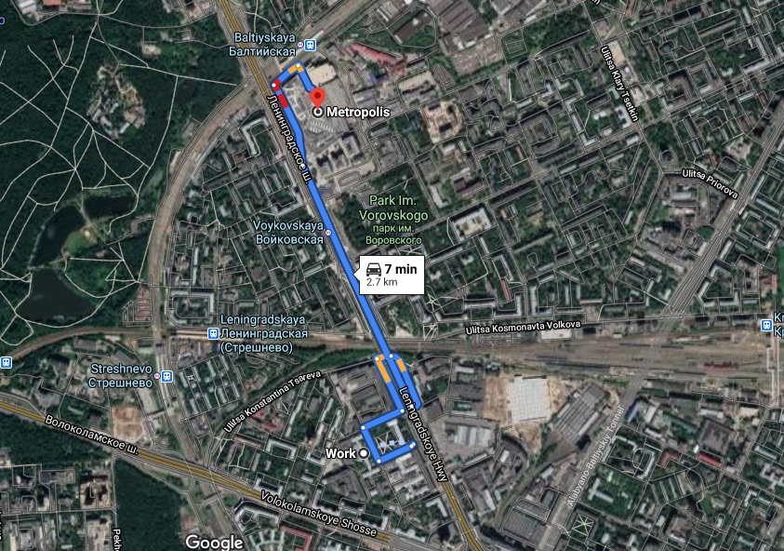
CA LOCATION Location: MAI TO METROPOLIC MALL lat:55.822439 long:37.495392

Slide 21
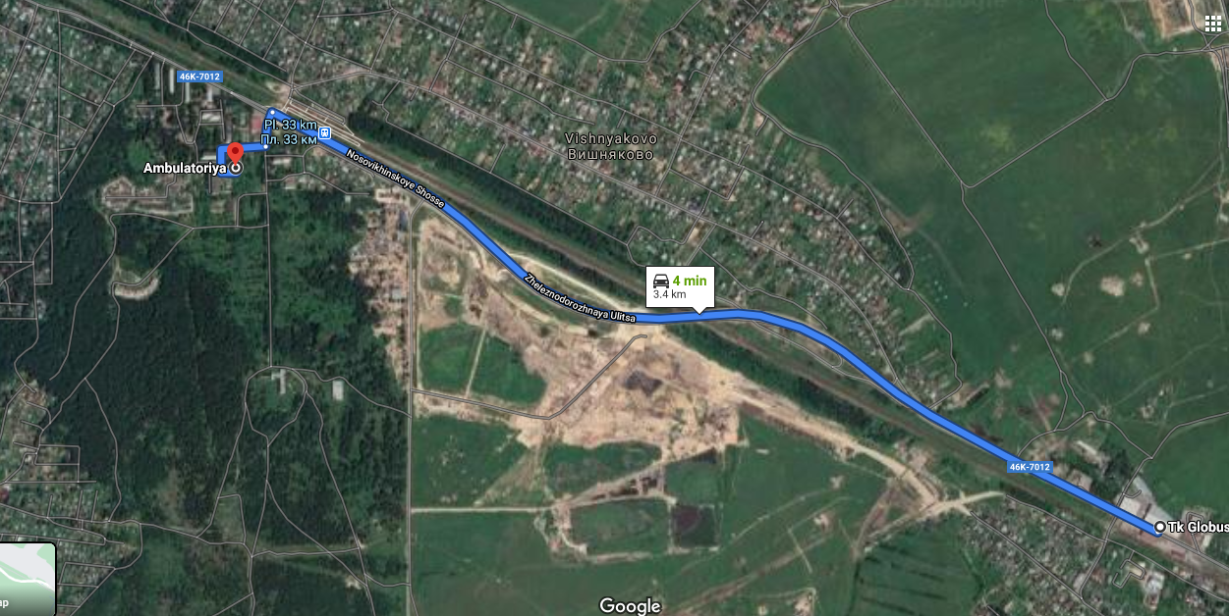
EDGE CELL Location: Ambulatoriya lat: 55.907656 long: 37.475020

Slide 22
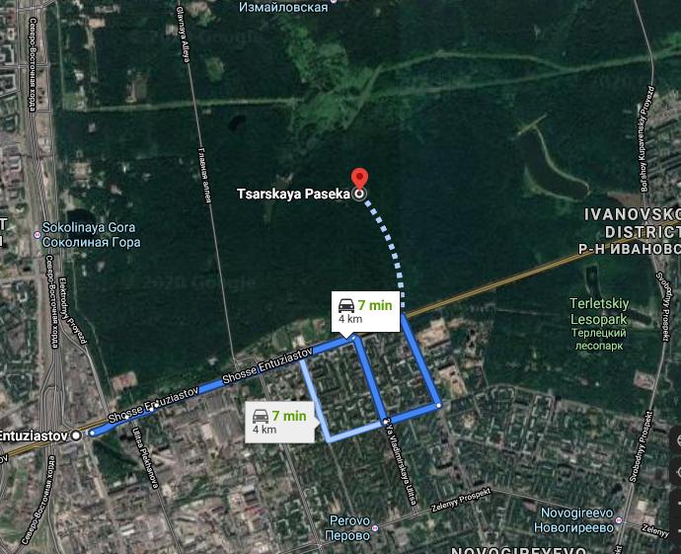
SRVCC LOCATION Location: hosse Entuziastov, 34, Moscow, 105118-Tsarskaya Paseka, 3-Ya lat:55.757717 long: 37.749890

Slide 23
BEELINE Operator
Drive Route – Moscow( RUSSIA)

Slide 24
GOOD AREA (NEAR CELL) Operator: BEELINE Location GARDEN CIRCLE OF MOSCOW ,CENTRE OF MOSCOW lat :55.756117,long: 37.657311
AT-Slide : 1

Slide 25
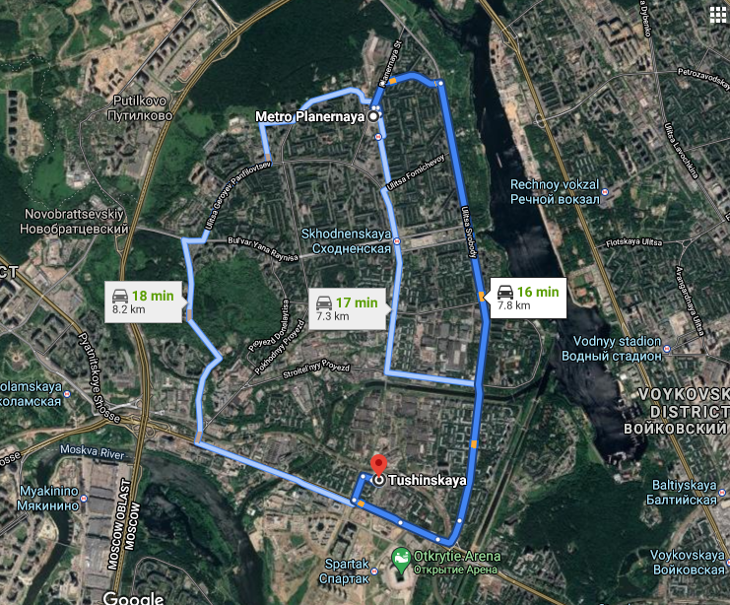
CA LOCATION Location: METRO PLANERNAYA TO METRO TUSHINSKAYA lat:55.864983,long:37.429550

Slide 26
EDGE CELL Location: Ambulatoriya lat: 55.907656 long: 37.475020

Slide 27
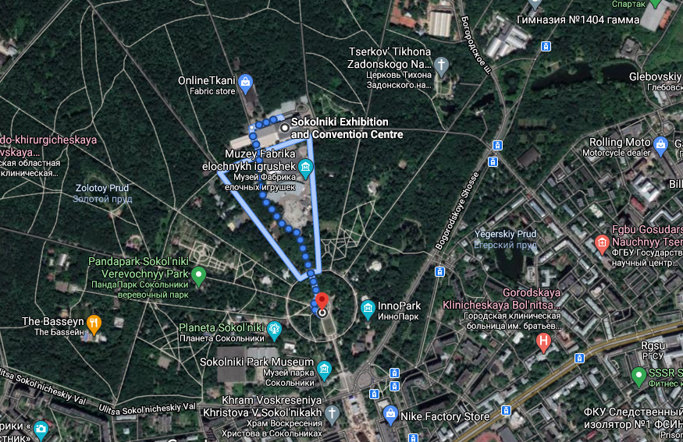
SRVCC LOCATION Location: PARK SOKOLNIKI lat:55.800468, long:37.673601

Slide 28
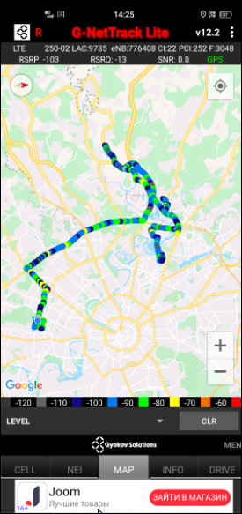
Overall drive route Covering all the Spots

Slide 29
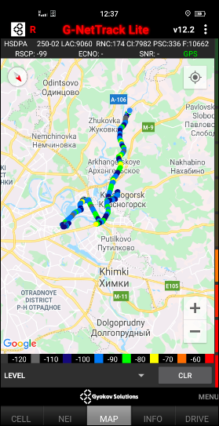

Slide 30
THANK YOU
WWW.MARQUISTECH.COM

