Slide 1
MARQUIS TECHNOLOGIES
Drive Route – Phnom Penh (Cambodia)

Slide 2
Travel to Phnom Penh (Cambodia)
Country | Cambodia
Continent | Asia
City | Phnom Penh
Duration of travel from Mumbai | Approx. 7 Hours
Time Zone | GMT +7
International Dialing Code | +855
VISA | Tourist Visa
VISA Duration | 3 Month , Single Entry
VISA Fees | 30 USD
VISA Requirements | Need to provide 2 passport size photographs, Sufficient funds as per your stay
Yellow Fever Vaccination Certificate | Not Required

Slide 3
Operator Information
MCC | MNC | Operator | Bands (MHz)
456 | 06 | Smart | GSM (900/1800), UMTS (2100), LTE (1800)
456 | 08 | Metfone | GSM (900/1800), UMTS (2100), LTE (1800)
456 | 01 | Cellcard | GSM (900/1800), UMTS (2100)
456 | 04 | QB | GSM (900/1800), UMTS (2100)

Slide 4
USSD Codes for operators
No. | Operator | Balance Check Code | Customer Care | Voice Mail No.
1 | Smart | *888# | Call 888 for Prepaid | 6767
2 | Metfone | 8097# | Call 1777 for Prepaid | 8181
3 | Cellcard | #124# | Call 812 for Prepaid | 766
4 | QB | #132# | Call 333 for Prepaid | 332

Slide 5
RSRP Criteria
Near Cell :-Stationary: RSRP : -55dbm to -85dbm
Cell Edge :-Stationary: RSRP : -95dbm to -110dbm
Mixed :-Mobility: RSRP : -55dbm to -120dbm

Slide 6
Services Supported by 4G Operators
Operator | Features/Services | Supports(Yes/No)
Smart | Reselection | Yes
 | Redirection | Yes
 | MMS | NO
 | CSFB | Yes(3G)
 | VoLTE | No
 | PS Handover | Yes
Metfone | Reselection | Yes
 | Redirection | Yes
 | MMS | NO
 | CSFB | Yes(3G)
 | VoLTE | No
 | PS Handover | Yes

Slide 7
Additional Information
Where to Get SIM cards?
In Operator booth just outside the Phnom Penh Airport and all Operator customer care centers in Phnom Penh.
What Documents Required to Purchase SIM?
Passport ID and Colored Photographs at some shops.
Best Recharge Option for 14 days Testing?
Recharges are available in all confectionery shop and Customer care centers in Phnom Penh.
Best Hotel to Stay
Bougainvillier Hotel Phnom Penh.
Driver Details for Mobility?
Mob: +85512528101

Slide 8
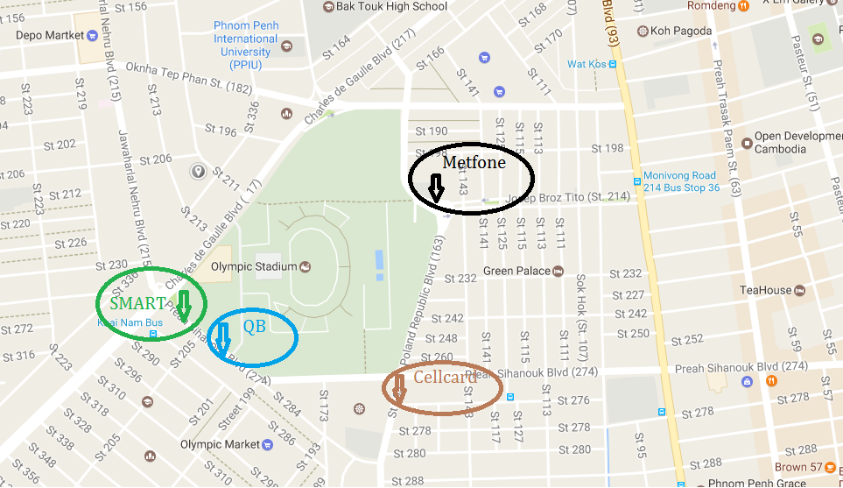
Near Cell Location of Smart/Metfone/Cellcard/QB Location : Charles de Gaulle Blvd (217), Phnom Penh 12253 (around the Olympic Stadium) Coordinates: 11.5611674,104.9107503

Slide 9
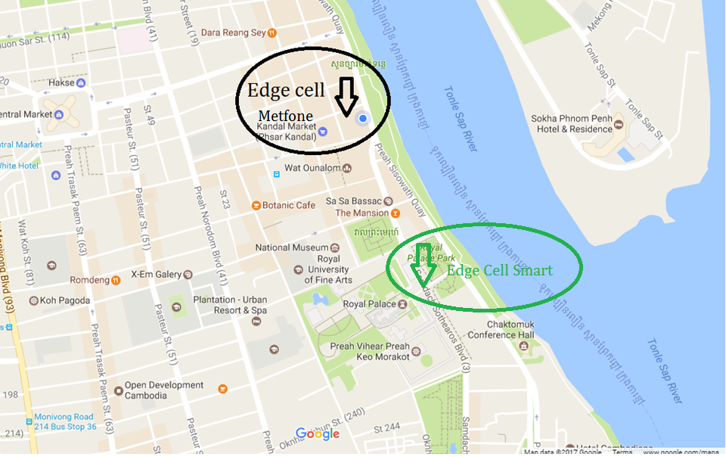
Edge Cell Location of Smart/Metfone/ Location : Preah Sisowath Quay, Phnom Penh Coordinates: 11.5676947,104.9287104

Slide 10
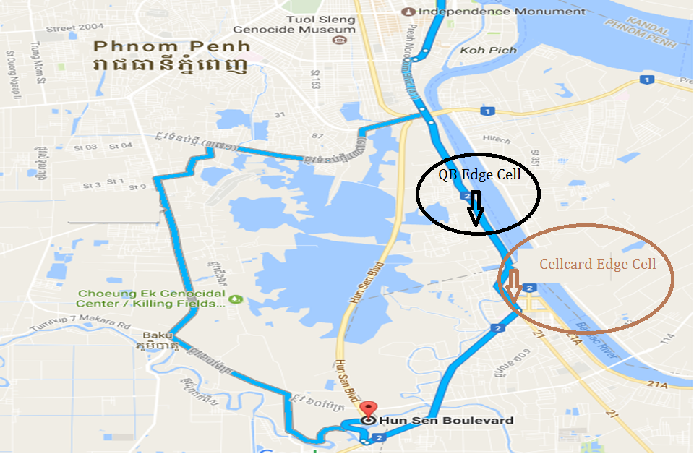
Edge Cell Location of Cellcard/QB Location : National Highway 2, Phnom Penh Coordinates: 11.5676947,104.9287104

Slide 11
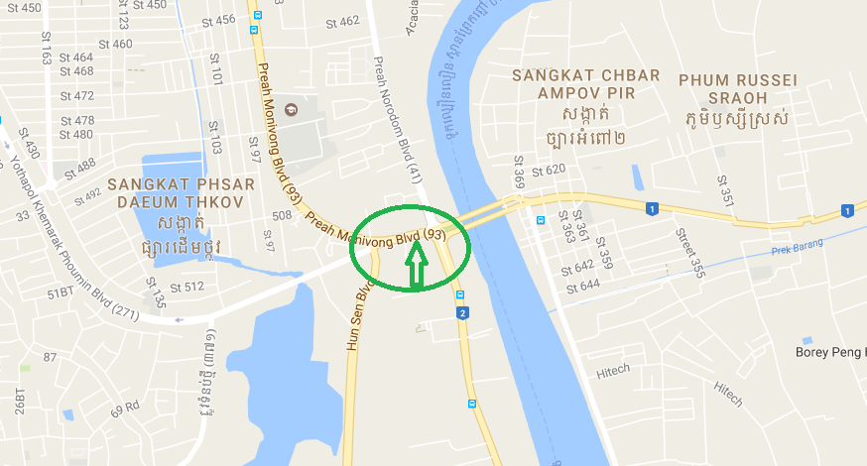
3G to 2G and 2G to 3G Hand Over Location of Smart Location : Preah Monivong Blvd Coordinates: 11.530238,104.929674

Slide 12
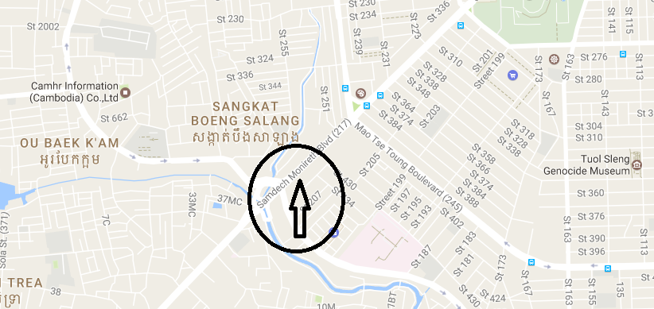
3G to 2G and 2G to 3G Hand Over Location of Metfone Location : Semdech Monireth Blvd Coordinates: 11.548261,104.898557

Slide 13
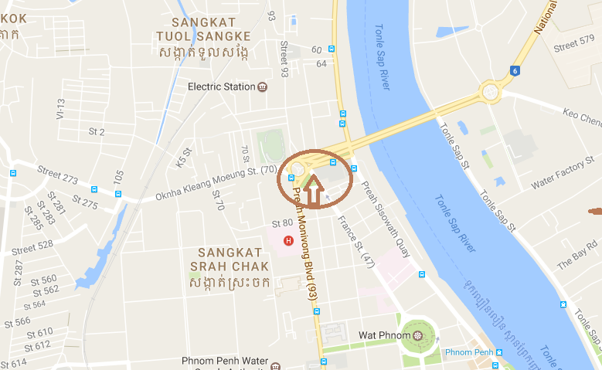
3G to 2G and 2G to 3G Hand Over Location of Cellcard Location : Near Stat Chas Circle Garden Coordinates: 11.585733,104.916288

Slide 14
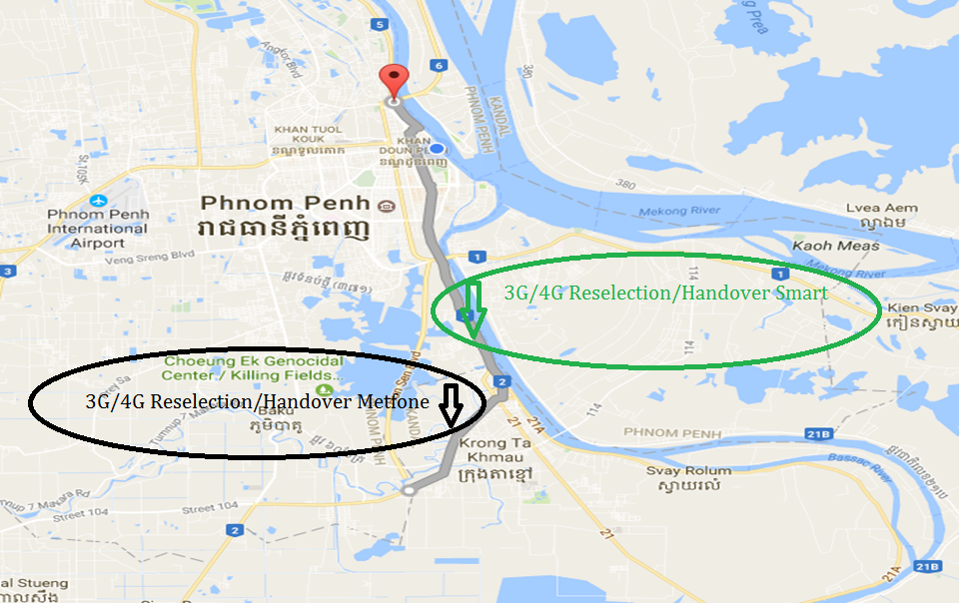
3G to 4G/4G to 3G Reselection Location of Smart/Metfone Location :National High way 5 to NR2

Slide 15
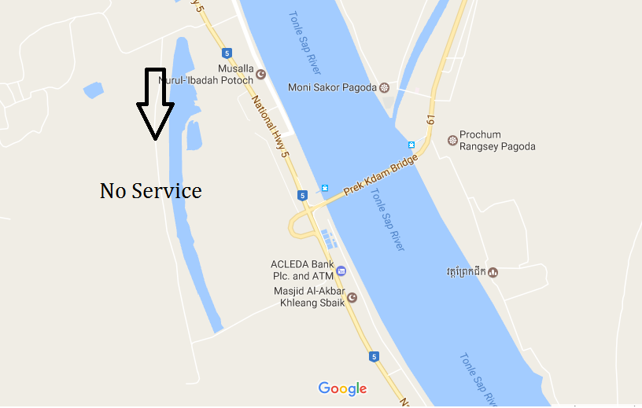
Out of Service Location of All Operators Location :National Hway 5 Coordinates: 11.8191918,104.8064716

Slide 16
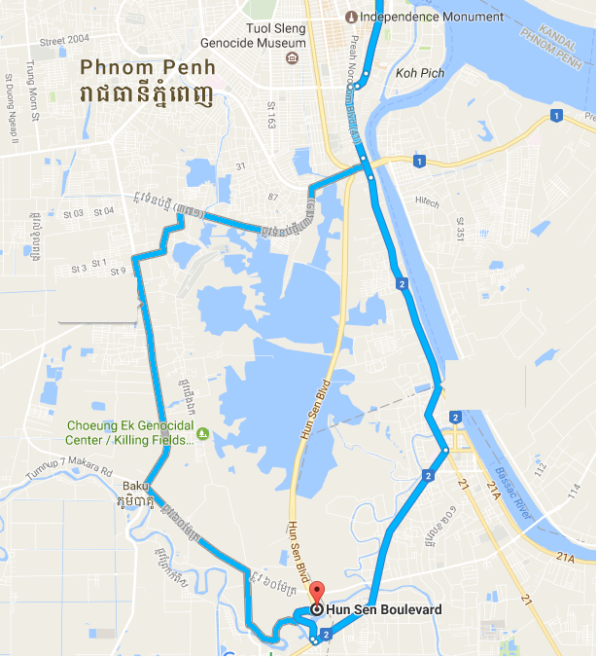
Mobility Route1:4G Route

Slide 17
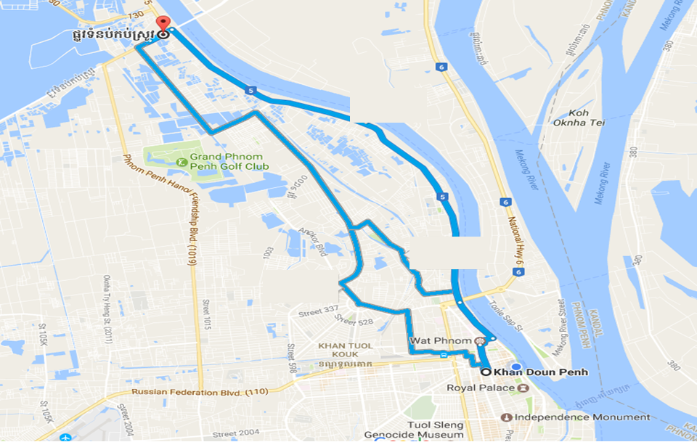
Mobility Route2: Mixed Mobility

Slide 18
Top Most Popular Android Apps used in Cambodia
Facebook
Facebook Messenger
WhatsApp Messenger
Tips Dream League soccer
Khmer Music Box
Clash of Clans
BIGO LIVE
8 Ball Pool
YouTube
Instagram

Slide 19
Local EM number used in Cambodia
Police | 117
Ambulance | 119
Fire Bridge | 118

Slide 20
THANK YOU
MARQUIS TECHNOLOGIES
www.marquistech.com

