Slide 1
MARQUIS TECHNOLOGIES
Drive Route –Airtel, Idea, VODAFONE & Reliance JIO (FDD/TDD) LTE

Slide 2
Operator Information:
Operator | JIO 4G
MCC | 405
MNC | 864
APN | Jionet
Operator | Airtel 4G
MCC | 404
MNC | 90
APN | Airtelgprs.com
Operator | VI
MCC | 404
MNC | 22
APN | www , internet

Slide 3
Operator Information 1
Functionality | Airtel
Website: http://www.airtel.com/ WAP APN: airtelgprs.com
Customer care | 199
MNC | 90
Bands supported | Both FDD and TDD
 | LTE 2300 MHz – TDD(Band 40)
 | LTE 1800,850 MHz – FDD(Band 3)
USSD | To check MDN: *282#
 | Balance check: *123#
 | Data Balance check: *121*114#
VoLTE | Supported
CSFB | Supported (CSFB to 2G)

Slide 4
Operator Information 2
Functionality | RELIANCE JIO
Website: http://www.jio.com WAP APN: jionet
Customer care | 198
MNC | 864
Bands supported | Both FDD and TDD
 | LTE 2300 MHz –TDD(Band 40)
 | LTE 850 MHz – FDD(Band 5)
 | LTE 1800 MHz –FDD(Band 3)
USSD | NA
 | NA
 | NA
VoLTE | Supported
CSFB | Not Supported

Slide 5
Operator Information 2
Functionality | VI
Website: http://www.jio.com WAP APN: jionet
Customer care | 198
MNC | 22
Bands supported | Both FDD and TDD
 | LTE 2300 MHz –TDD(Band 41)
 | LTE 850 MHz – FDD(Band 5)
 | LTE 1800 MHz –FDD(Band 3)
USSD | To check MDN*199#
 | Balance check198
 | Data Balance check: 121
VoLTE | Supported
CSFB | Supported

Slide 6
Drive Route
Near Cell :- Stationary: RSRP : -65dbm to -75dbm
Cell Edge :- Stationary: RSRP : -95dbm to -110dbm
Mixed :- Mobility: RSRP : -65dbm to -110dbm

Slide 7
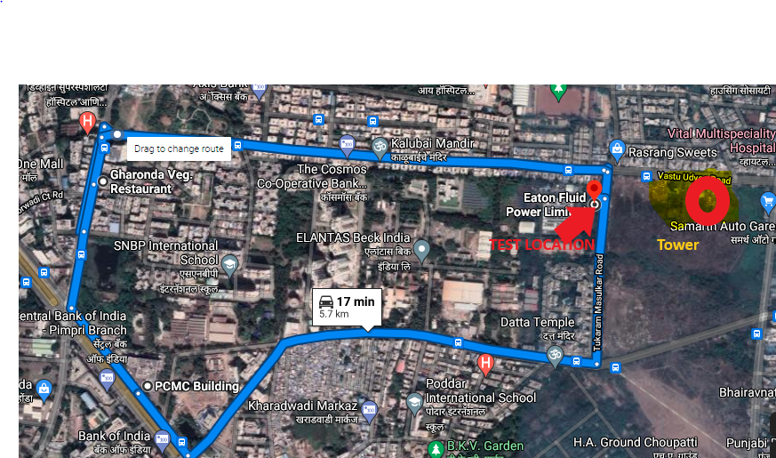
Near Cell (Airtel)
Near cell(NC) | longitude | latitude | RSRP | Cell id | TDD E-ARFCN
1 | 73.81565458 | 18.63223605 | 66 | 425 | 39150
Eaton fluid power ltd,PCMC,PUNE ,INDIA
RSRP:
-65dbm to 75dbm

Slide 8
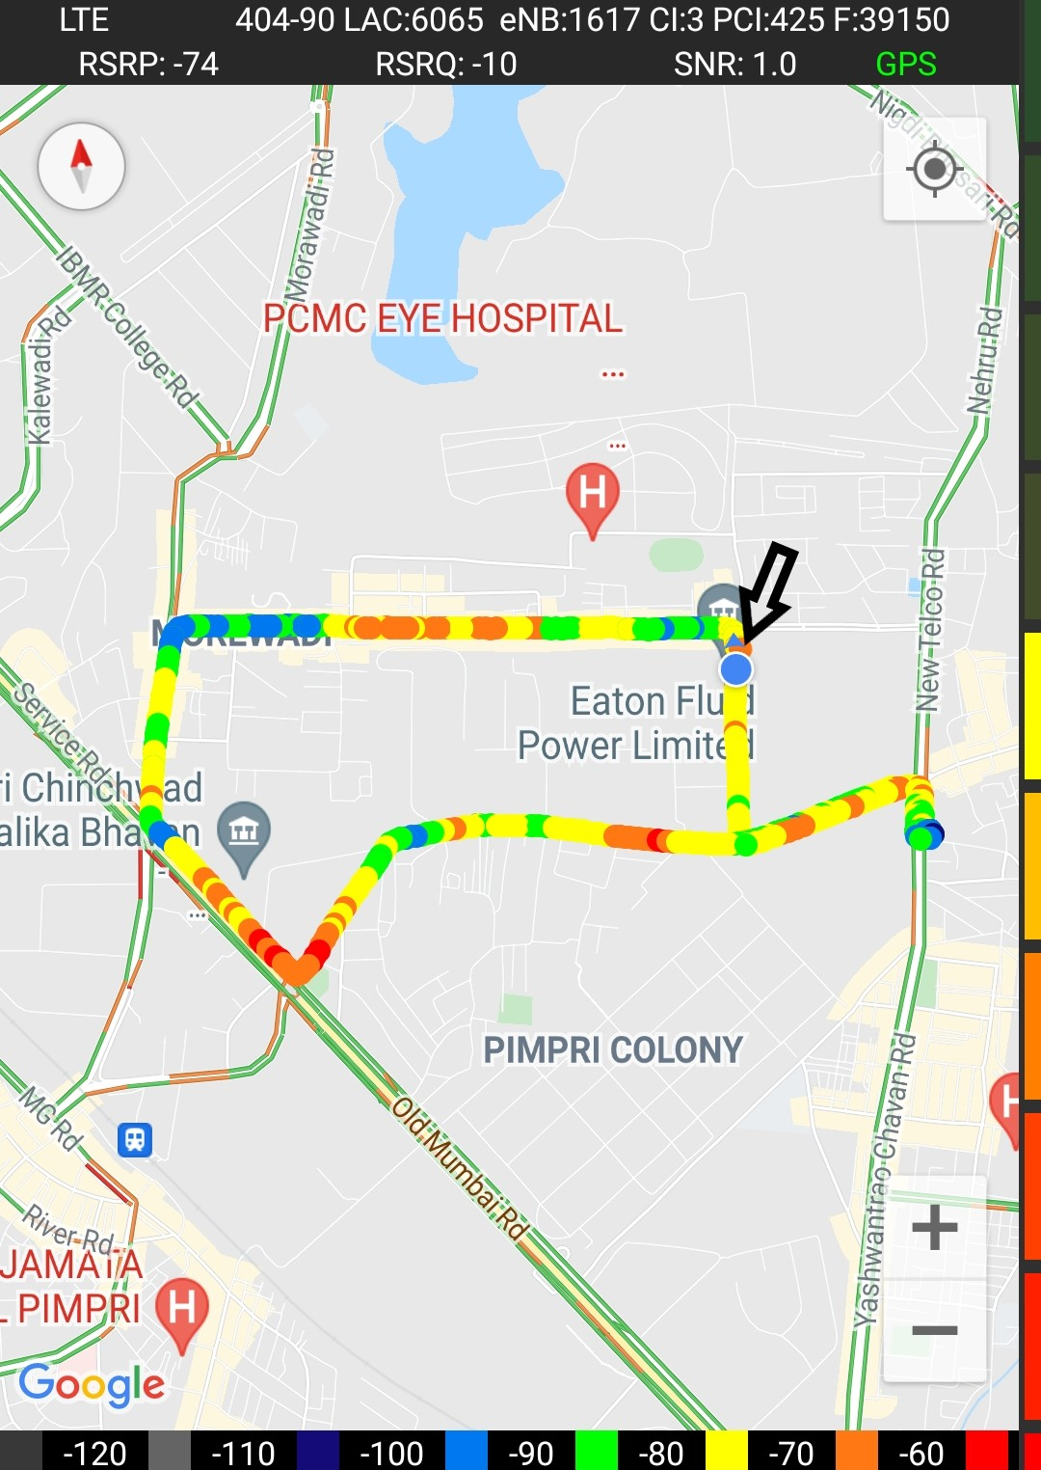
Near Cell (Airtel)

Slide 9
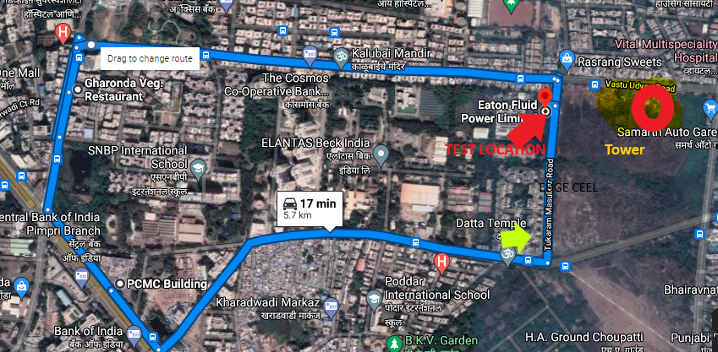
Edge Cell (Airtel)
Edge cell(EC) | longitude | latitude | RSRP | Cell id | TDD E-ARFCN
1 | 73.81554 | 18.62905 | 107 | 412 | 39150
Tukaram Masulkar Road PUNE
RSRP:
-95dbm to -110dbm

Slide 10
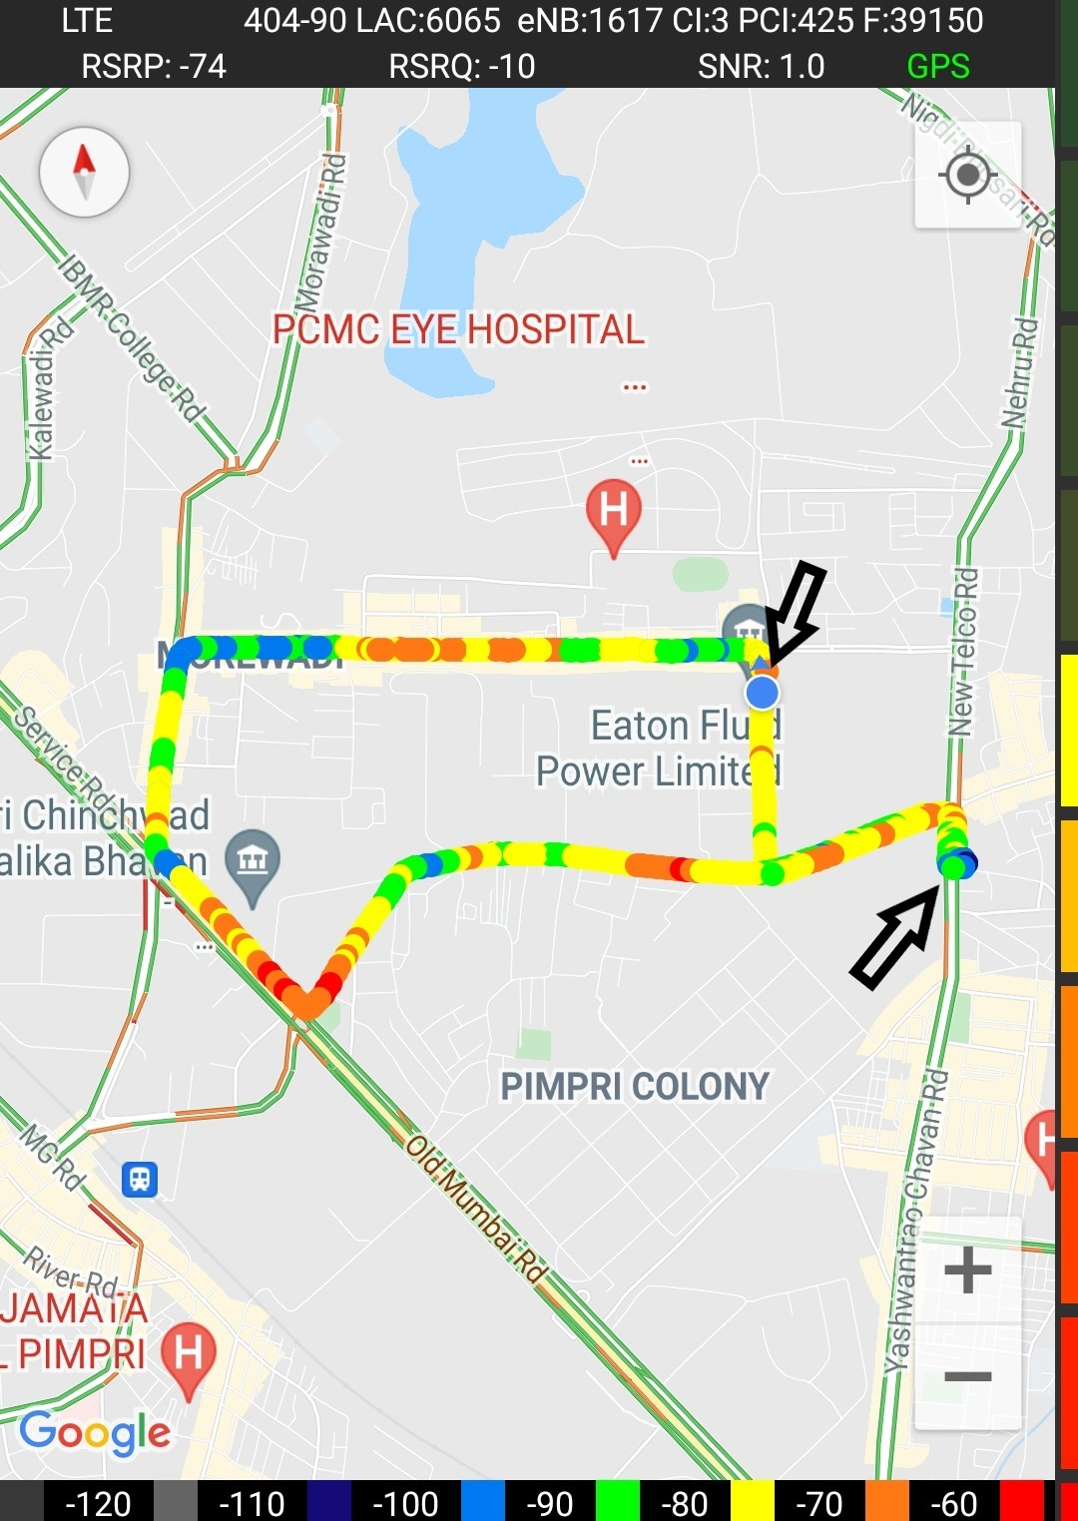
Edge Cell (Airtel)

Slide 11
Mixed Mobility:- Gharonda , PCMC, PUNE
RSRP: -65dbm to -110dbm

Slide 12
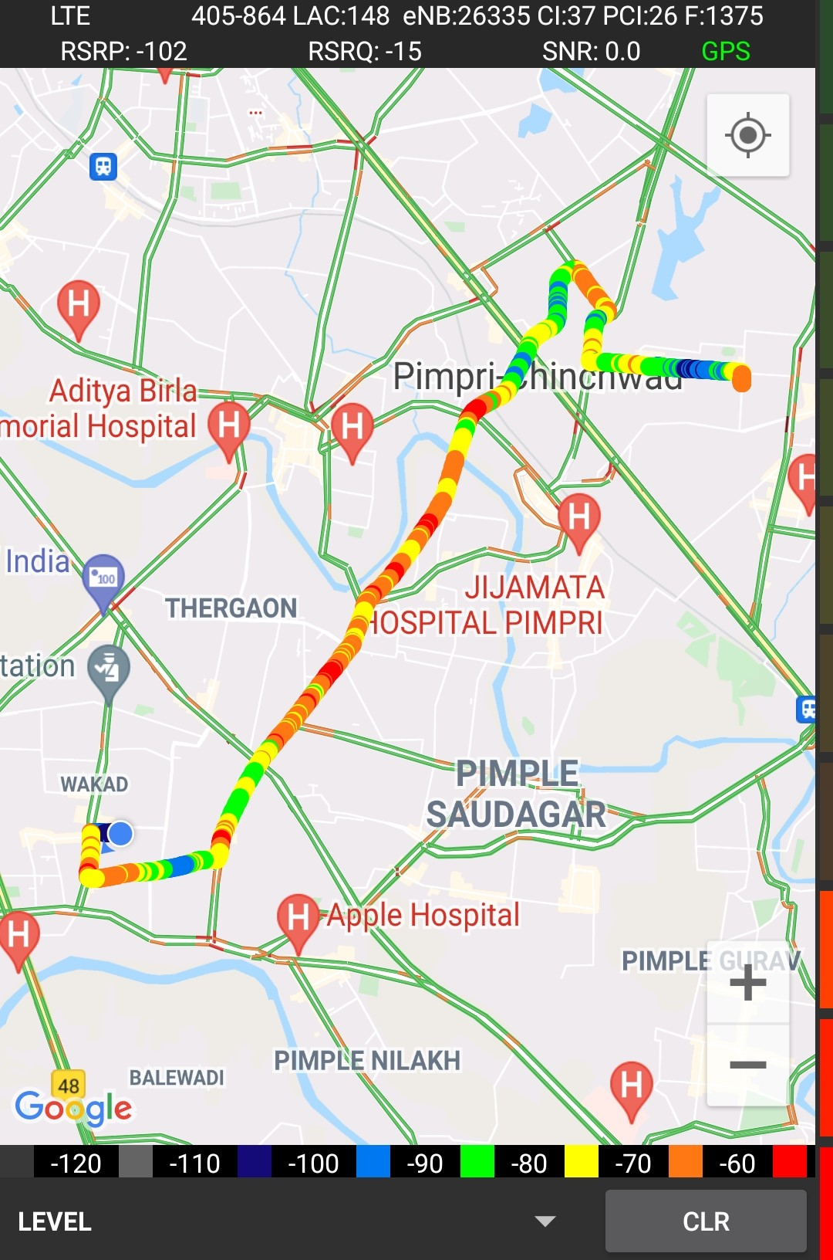
Airtel Band HO
Band Hand Over | longitude | Latitude | RSRP
L1 | 73.81575374 | 18.63291849 | -85 to 105 dBM
L40 | 73.81521047 | 18.63304096 | -90 to -104 dBM
L3 | 73.81508405 | 18.6330518 | -88 to -95 dBM

Slide 13
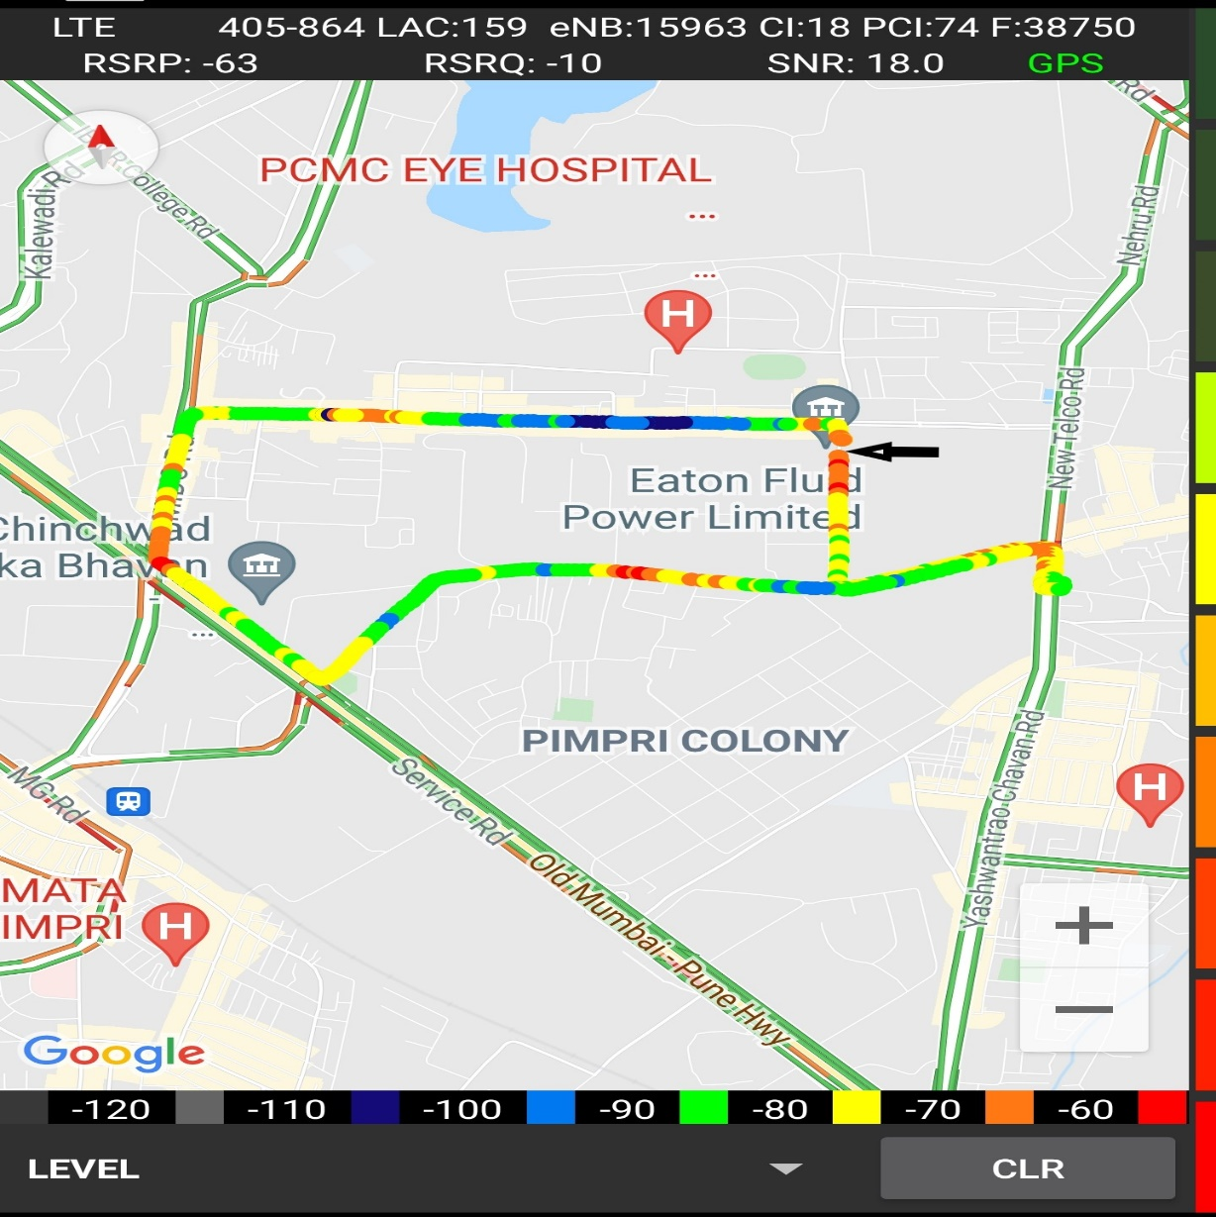
Near Cell (Reliance JIO)
Near cell(NC) | longitude | latitude | RSRP | Cell id | TDD E-ARFCN
1 | 73.81759 | 18.63194 | -62 | 18 | 38948
Eaton power,Pune
RSRP:
-65dbm to -75dbm

Slide 14
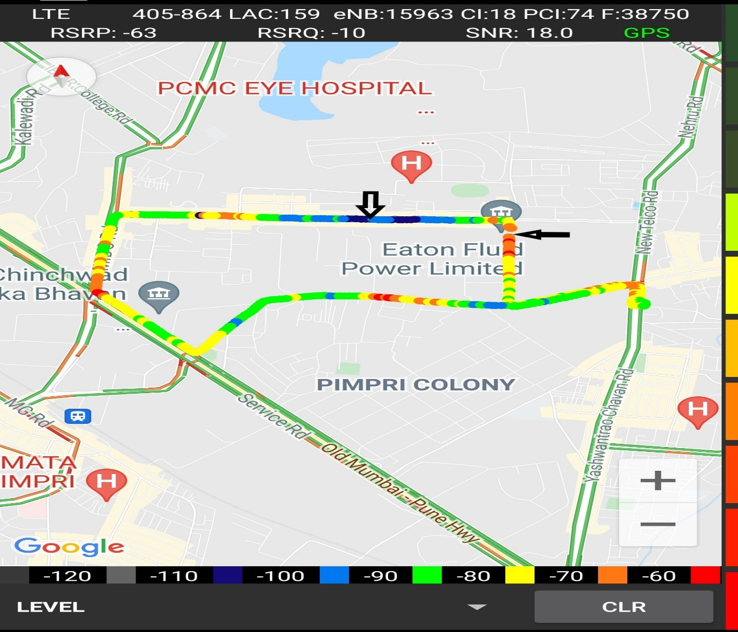
Edge Cell (Reliance JIO)
Edge cell(NC) | longitude | latitude | RSRP | Cell id | TDD E-ARFCN
1 | 73.81066 | 18.63377 | -106 | 16 | 38948
Kalubaiche mandir, PUNE
RSRP:
-95dbm to -110dbm

Slide 15

Mixed Mobility:- Gharonda PCMC PUNE
RSRP: -95dbm to -110dbm

Slide 16
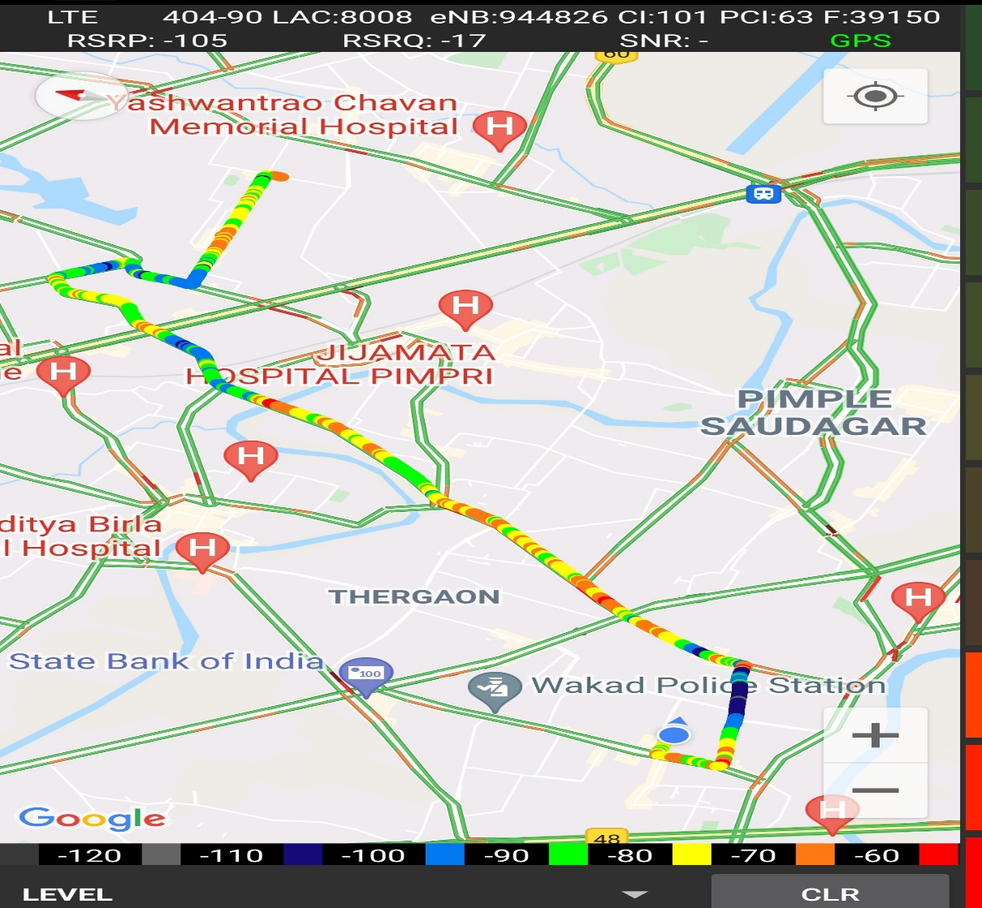
Inter Band Handover (FDD-TDD), JIO 4G
Band Handover | longitude | latitude | RSRP | PCI | TDD E-ARFCN
L3 | 73.76609085 | 18.59816997 | -99 | 26 | 1375
L40 | 73.76609043 | 18.59816918 | -116 | 260 | 38948

Slide 17
RJIO Band 40 Near Cell:

Slide 18
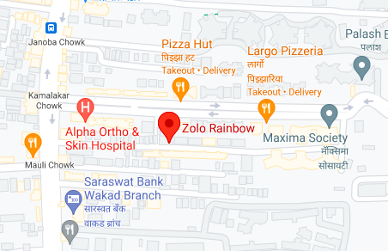
RJIO Band 40 Edge Cell:

Slide 19
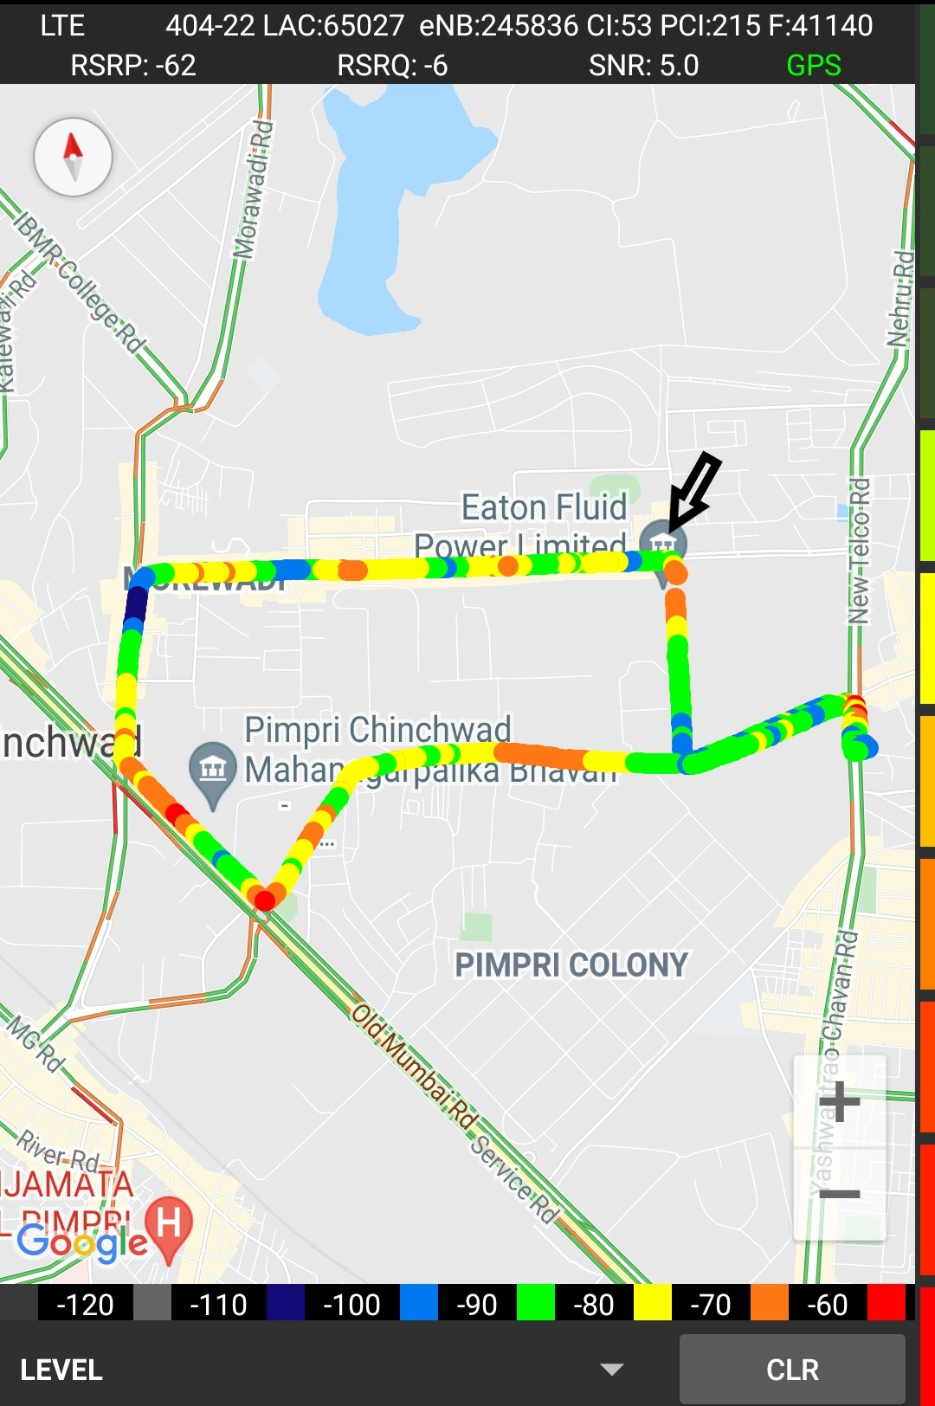
Near Cell VI:
Near cell(NC) | longitude | latitude | RSRP | Cell id | TDD E-ARFCN
1 | 73.81573486 | 18.68151169 | -62 | 215 | 41140
Maradu Cochin , Kerala
RSRP:
-65dbm to -75dbm

Slide 20
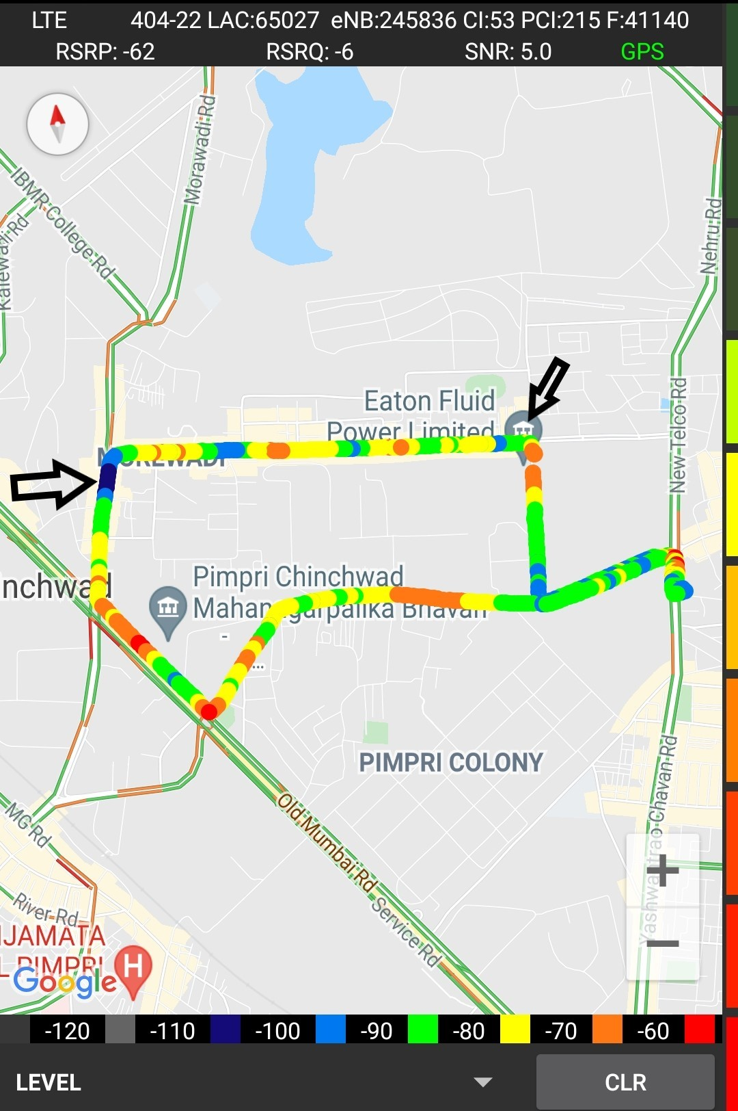
Cell Edge VI:
Edge cell(EC) | longitude | latitude | RSRP | Cell id | TDD E-ARFCN
1 | 73.80358 | 18.63377 | -106 | 214 | 41140
Ajmera Main road Pune
RSRP:
-95dbm to -105dbm

Slide 21
Mixed coverage area Vodafone:

Slide 22
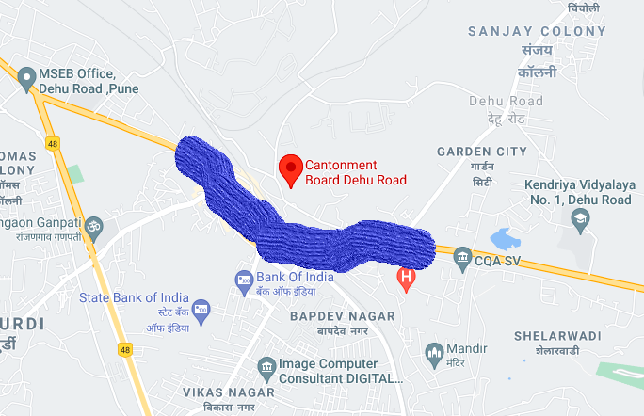
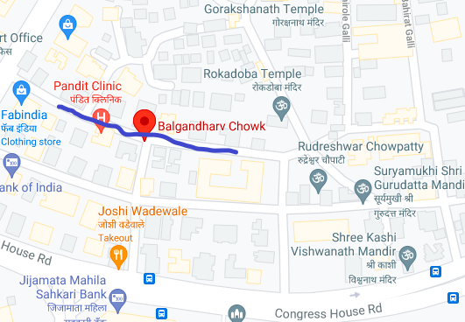
Airtel & VI SRVCC to UTRAN:
SRVCC and OOS
SRVCC

Slide 23
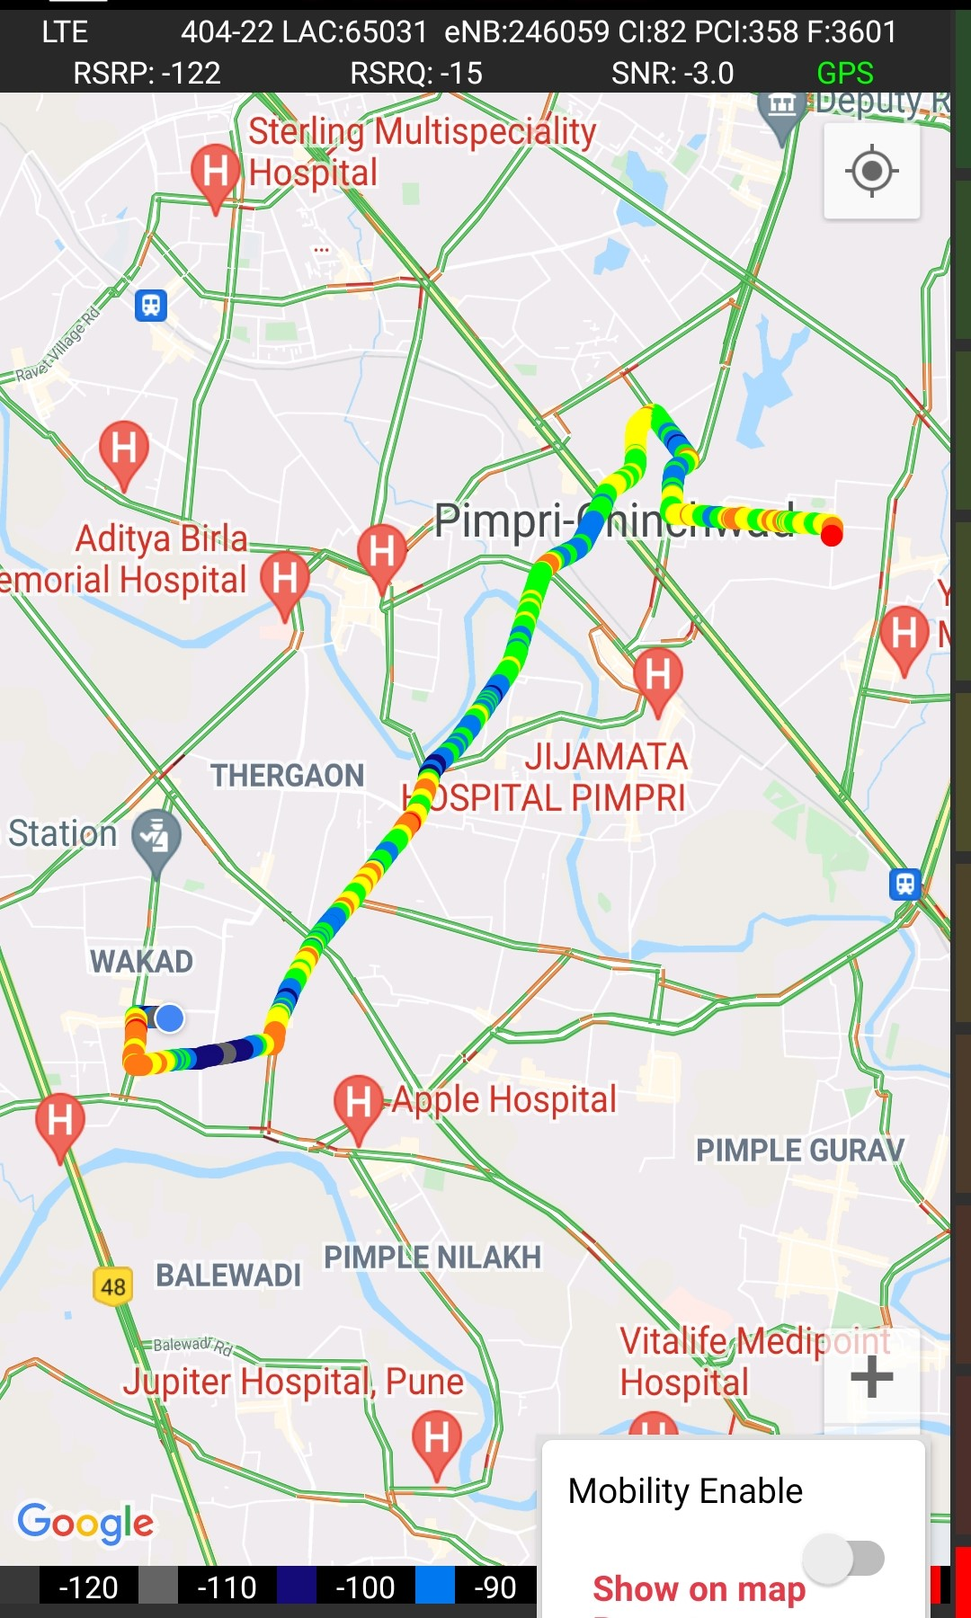
VIBand 3<>5<>40 Handover
Band Handover | longitude | latitude | RSRP | PCI | TDD E-ARFCN
L3 | 73.78554433 | 18.61491389 | -81 | 225 | 1256
L41 | 73.78462002 | 18.61242288 | -78 | 145 | 41140
L8 | 73.76593703 | 18.5980963 | -112 | 358 | 3601

Slide 24
G net Tracker Drive Route JIO AIRTEL Vi(Same Route )

Slide 25
THANK YOU
MARQUIS TECHNOLOGIES

