Slide 1
MARQUIS TECHNOLOGIES
Drive Routes - Nairobi/Kenya

Slide 2
Travel to Nairobi (Kenya)
Country | Kenya
Continent | Africa
City | Nairobi
Time Zone | GMT +3 Hour
International Dialing Code | +254
VISA Requirements | Need to provide 2 passport size photographs
Yellow Fever Vaccination Certificate | Not Required

Slide 3
Operators in Kenya
MCC | MNC | Operator | Bands (MHz)
639 | 2 | Safaricom | 900 (E-GSM), 1800 (DCS),B1 (2100), B3 (1800 +), B20 (800 DD)
639 | 3 | Airtel | 900 (E-GSM), B1 (2100)
639 | 7 | Telkom | 900 (E-GSM), 1800 (DCS), B1 (2100)
639 | 5 | Faiba | B28 (700MHZ)

Slide 4
Operators and Related Information
Safaricom- Supports VoLTE, LTE, WCDMA and 2G
Faiba- Supports VoLTE, LTE
Telkom- Supports LTE, WCDMA and 2G
Airtel- Supports LTE, WCDMA and 2G

Slide 5
General Info of Operators
Safaricom is the strongest network operator in Kenya with a majority share of the market. It's popular because if it's successful mobile money platform M-PESA
Airtel Network is to be ranked second although number of subscribers and network conditions are equally good as that of Safaricom only Volte is not available for Airtel.
Equitel is marked as a finserve network... It is an MVNO under Airtel there has almost similar network as Airtel... Only that it supports 2G and 3G
Faiba has very few users as there is only Volte and 4G is available

Slide 6
USSD codes for balance check
Airtel balance check: *131#
Airtel internet balance check: *544#
Airtel call centre:*100#
Telkom balance check: *123#
Safaricom Self service : *456#
Safaricom M-PESA : *234#
Safaricom Product discription : *100#
Faiba balance check: *131#

Slide 7

Supplementary Services
Safaricom: Call forwarding and Call Waiting supported
Faiba: Call forwarding and Call Waiting supported
Airtel: Call forwarding and Call Waiting supported
Telkom:Call forwarding and Call Waiting supported

Slide 8
RSRP Criteria
Near Cell :-Stationary: RSRP : -55dbm to -85dbm
Cell Edge :-Stationary: RSRP : -95dbm to -110dbm
Mixed :-Mobility: RSRP : -55dbm to -120dbm

Slide 9
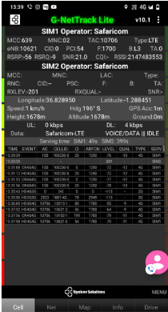
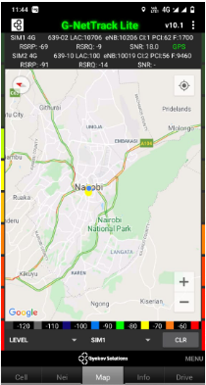
Band 3 Near Cell for Safaricom Operator:- CBD
B3
Maps

Slide 10
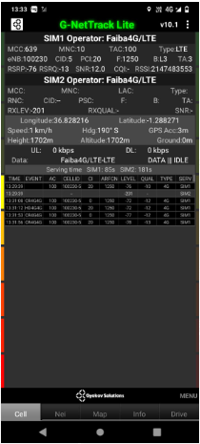
Band Near Cell for Faiba Operator:- CBD
B28
Maps

Slide 11
Local EM number used in Kenya
African general emergency phone number | 999
Local Police | 112
Ambulance | 999
Fire Brigade | 998
Child Helpline | 116

Slide 12
Top Most Popular Android Apps used in Kenya
Barclays Kenya
KCB
KCB Mobile Banking
My Telkom
Bolt (Taxify)
SafeBoda
inDriver — ride app where you offer your fare
Swvl - Bus Booking App
TikTok
Whats app
Facebook

Slide 13
Thank You

