Slide 1
MARQUIS TECHNOLOGIES
Drive Route –Airtel, VI & Reliance JIO (FDD/TDD) LTE
Location : Nagpur

Slide 2
Operator Information:
Operator | JIO 4G
MCC | 405
MNC | 864
APN | jionet
Operator | Airtel 4G
MCC | 404
MNC | 90
APN | airtelgprs.com
Operator | VI
MCC | 404
MNC | 22
APN | internet
Operator | BSNL
MCC | 404
MNC | 66
APN | Bsnlnet

Slide 3
Operator Information 1
Functionality | Airtel
Website: https://www.airtel.in/ WAP APN: airtelgprs.com
Customer care | 121
MNC | 90
Bands supported | Both FDD and TDD
 | LTE 2300 MHz – TDD(Band 40)
 | LTE 1800 – FDD(Band 3) LTE 2100 – FDD (Band 1)
USSD | To check MDN: *282#
 | Balance check: *123#
 | To check all services: *121#
VoLTE | Supported
VoWiFi | Supported
CSFB | Supported (CSFB to 2G)

Slide 4
Operator Information 2
Functionality | RELIANCE JIO
Website: https://www.jio.com WAP APN: jionet
Customer care | 198
MNC | 864
Bands supported | Both FDD and TDD
 | LTE 2300 MHz –TDD(Band 40)
 | LTE 850 MHz – FDD(Band 5)
 | LTE 1800 MHz –FDD(Band 3)
USSD | NA
 | NA
 | NA
VoLTE | Supported
VoWiFi | Supported
CSFB | Not Supported

Slide 5
Operator Information 3
Functionality | VI
Website: https://www.myvi.in WAP APN: internet
Customer care | 198
MNC | 22
Bands supported | Both FDD and TDD
 | LTE 2300 MHz –TDD(Band 40)
 | LTE 2500 MHz –TDD(Band 41)
 | LTE 1800 MHz –FDD(Band 3) LTE 900 MHZ-FDD(Band 8) LTE 2100 MHz-FDD(Band 1)
USSD | To check MSISDN :*199#
 | Recharge : *199*5#
 | Balance check : *199*2#
VoLTE | Supported
VoWiFi | Not Supported
CSFB | Supported (CSFB to 2G)

Slide 6
Drive Route
Near Cell : Stationary: RSRP : -65dbm to -75dbm
Edge Cell : Stationary: RSRP : -95dbm to -110dbm
Mixed : Mobility: RSRP : -65dbm to -110dbm

Slide 7
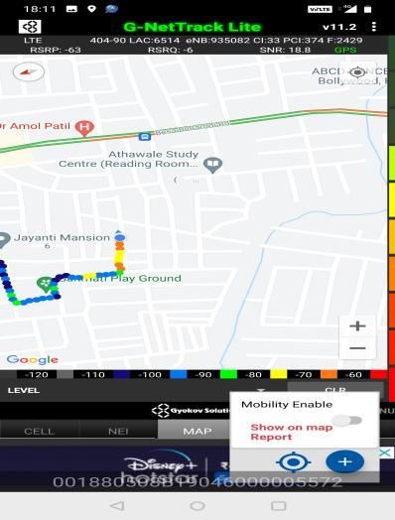
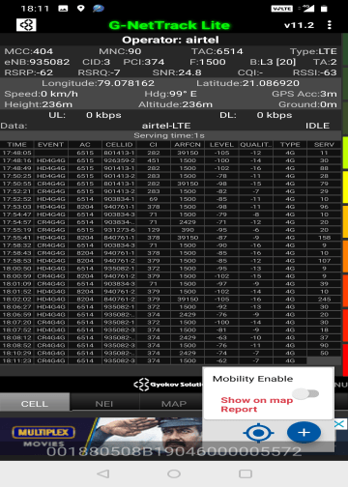
Near Cell (Airtel)
Near cell | longitude | latitude | RSRP (dbm) | Cell id | E-ARFCN
1 | 79.078162 | 21.086920 | -63 | 3 | 1500
RSRP Range for Near Cell :
-65dbm to -75dbm
near Jayanti mansion,
Somalwada
Nagpur

Slide 8
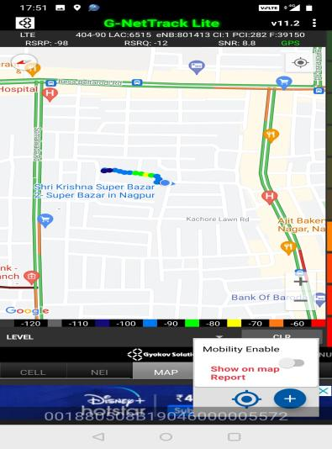
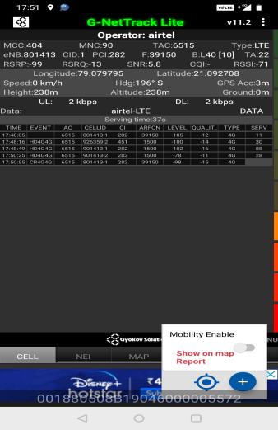
Edge Cell (Airtel)
Edge cell | longitude | latitude | RSRP (dbm) | Cell id | E-ARFCN
1 | 79.079795 | 21.092708 | -99 | 1 | 39150
RSRP Range for Edge Cell :
-95dbm to -110dbm
Manish Nagar,
Nagpur

Slide 9
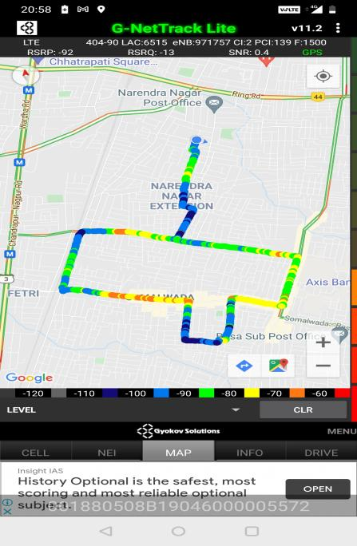
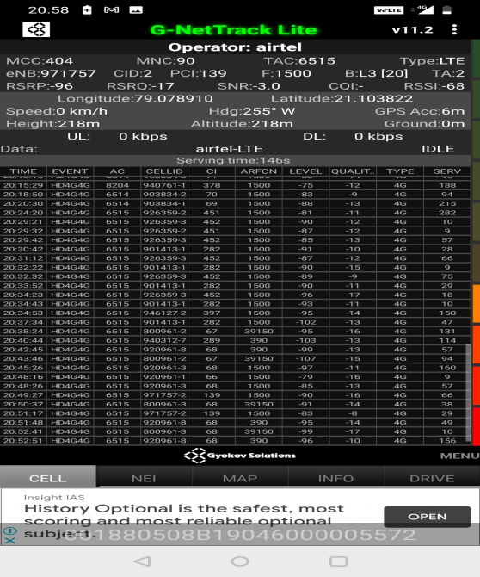
Mixed Coverage Area for Airtel

Slide 10
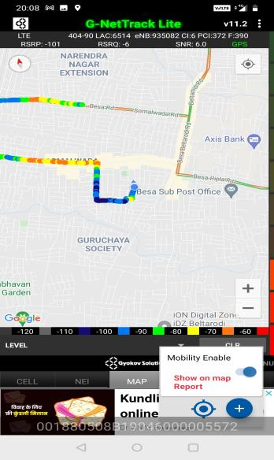
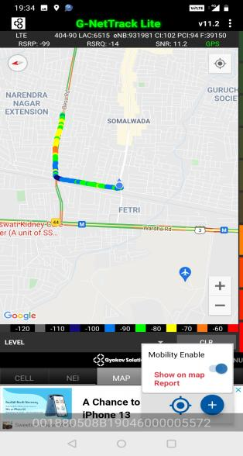
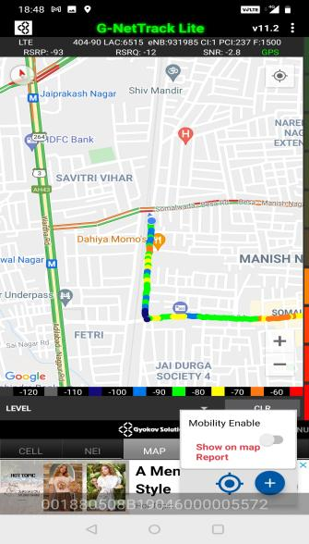
Airtel Inter Band HO
Band 1 BAND 40 BAND 3

Slide 11
MATT Tool InterBand Handover Results for Airtel
L1_L40 :2
L1_L3 : 0
L40_L1: 2
L40_L3 3
L3_ L1: 0
L3_L40: 2

Slide 12
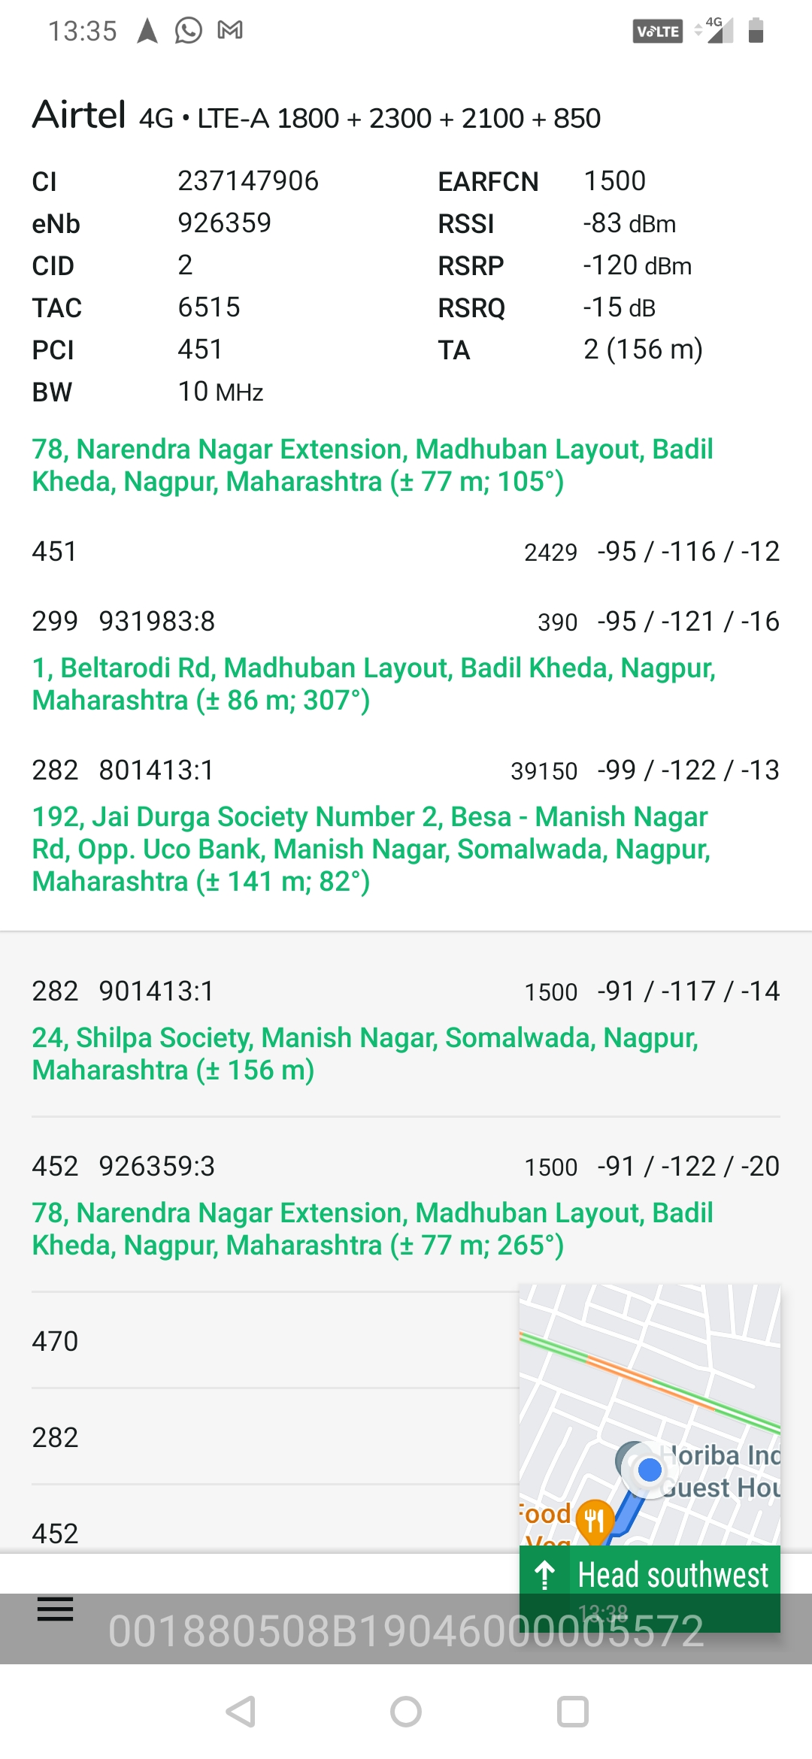
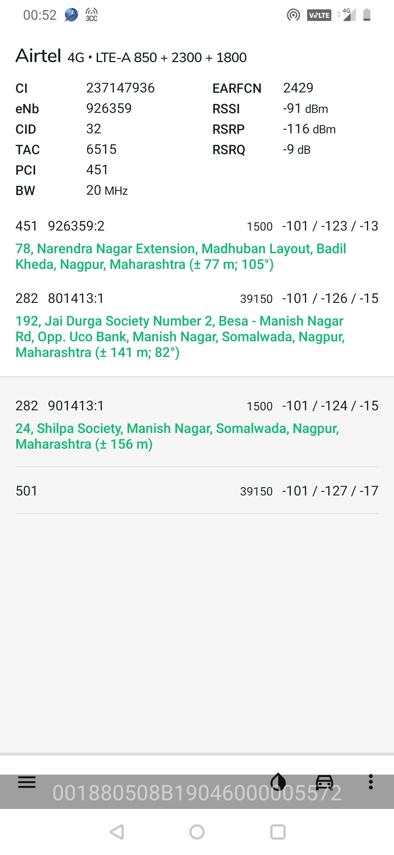
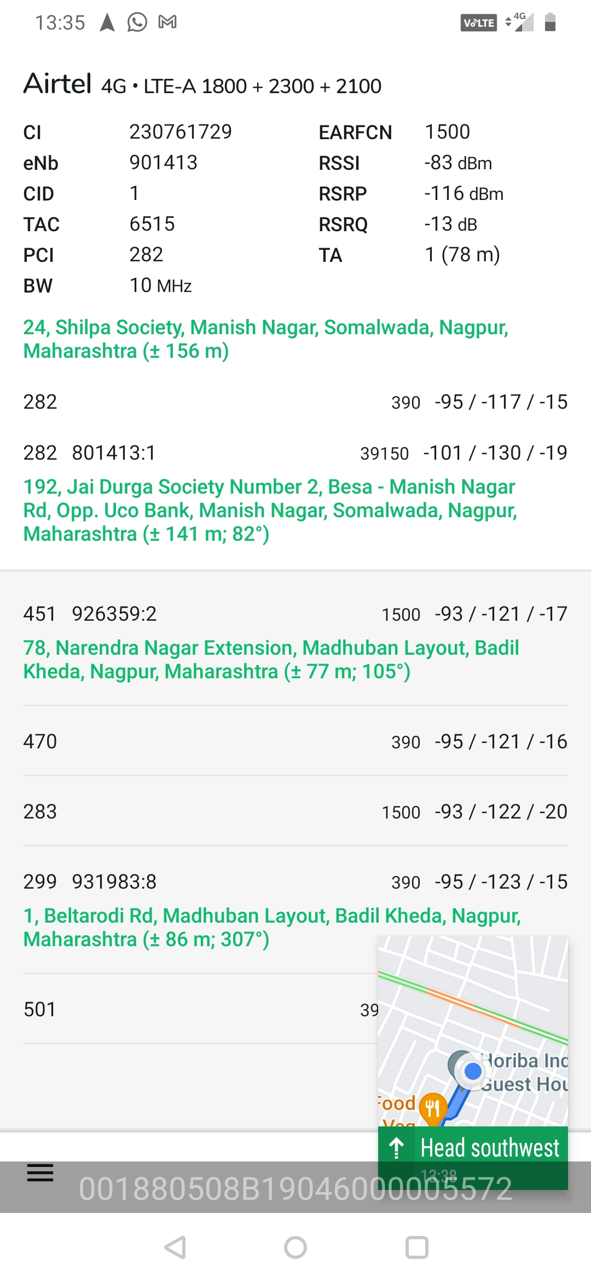
CA Airtel :

Slide 13
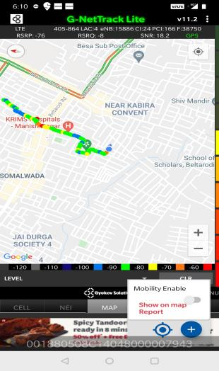
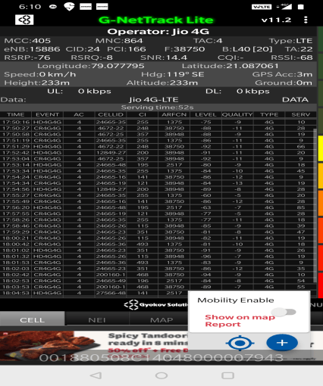
Near Cell (Reliance JIO)
Near cell | longitude | latitude | RSRP (dbm) | Cell id | E-ARFCN
1 | 79.077795 | 21.087061 | -76 | 24 | 38750
RSRP Range for Near Cell : -65dbm to -75dbm
Somalwada,
Nagpur

Slide 14
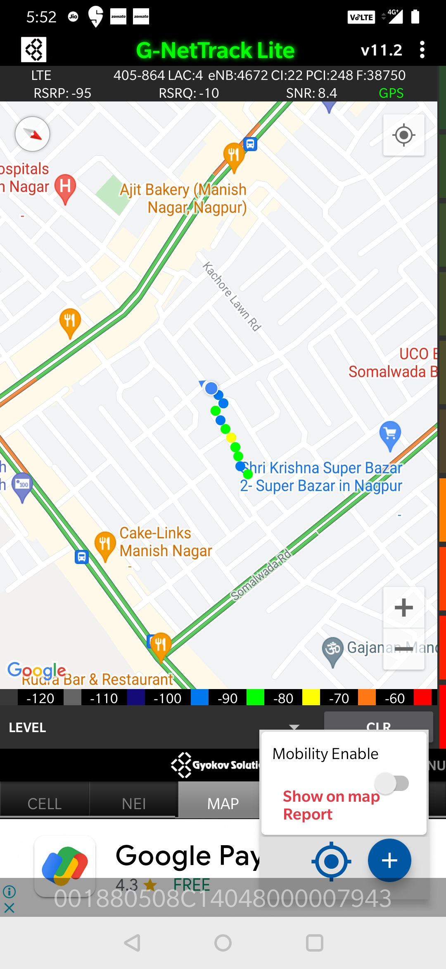
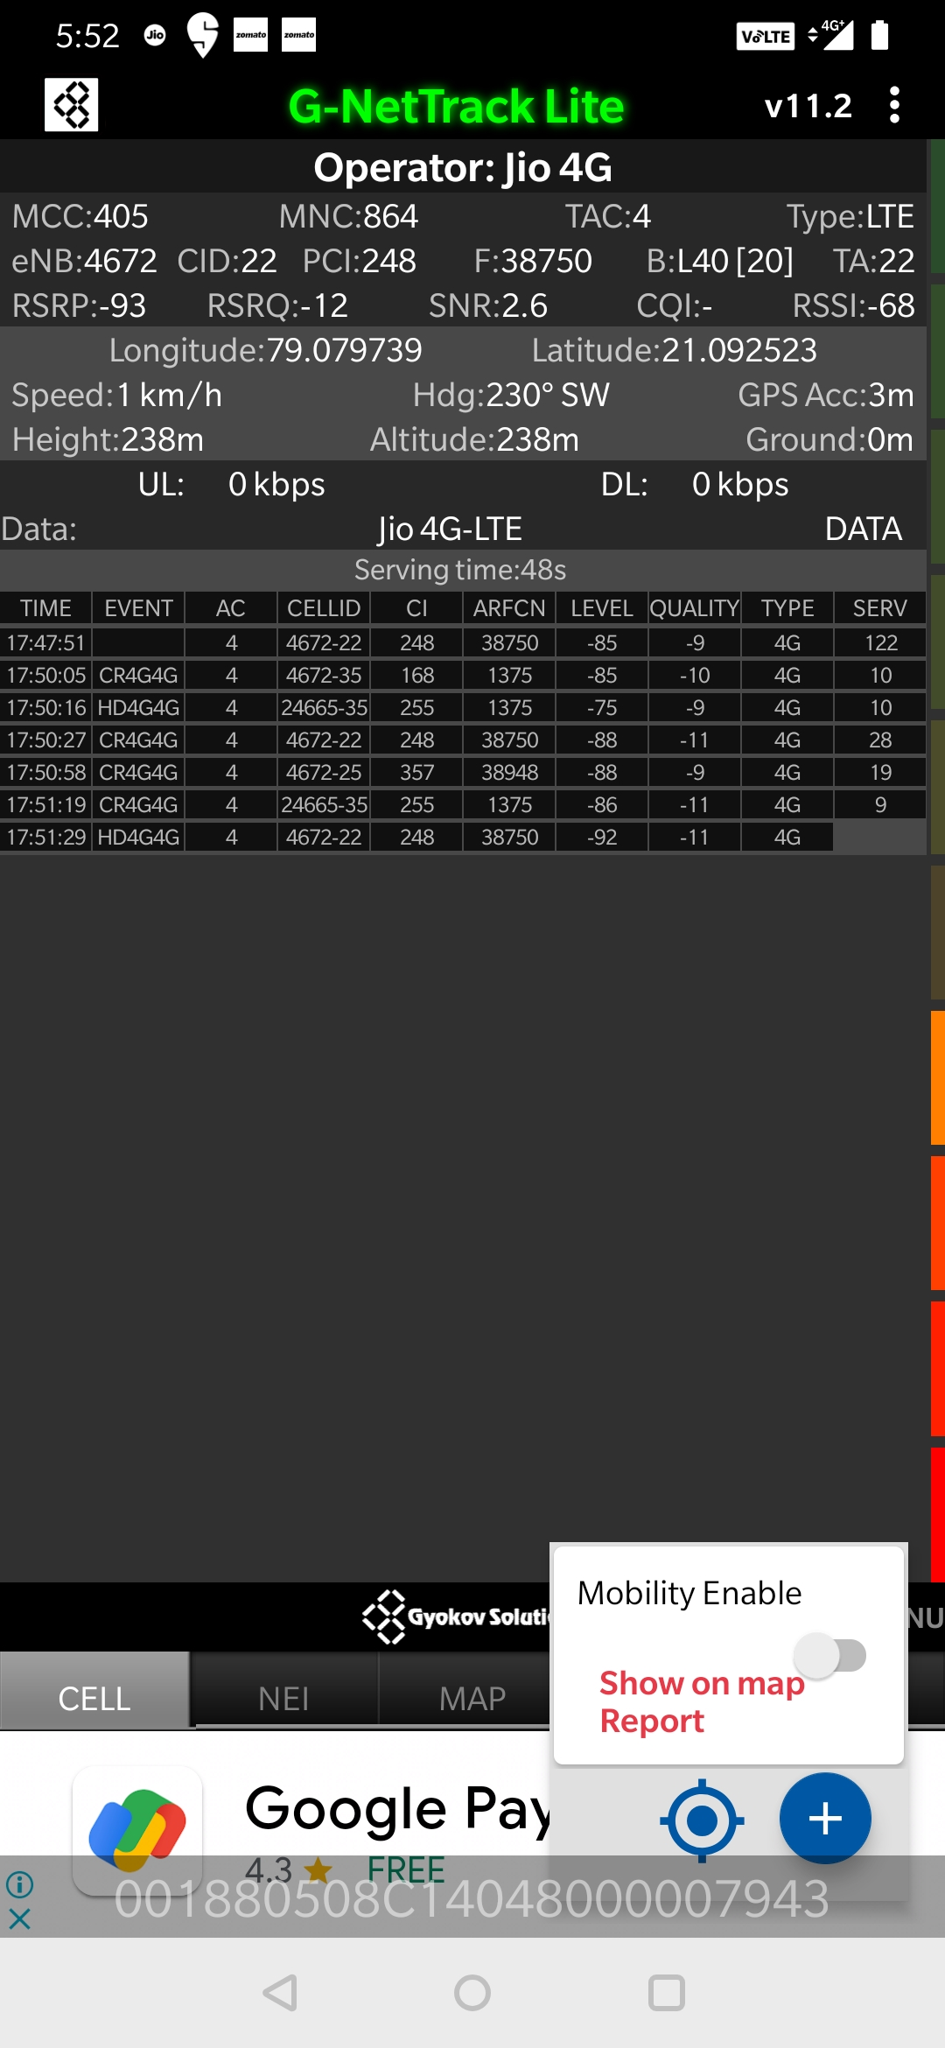
Edge Cell (Reliance JIO)
Edge Cell | longitude | latitude | RSRP (dbm) | Cell id | E-ARFCN
1 | 79.079739 | 21.092523 | -94 | 22 | 38750
RSRP Range for Edge Cell :
-95dbm to -110dbm
Somalwada,
Nagpur

Slide 15
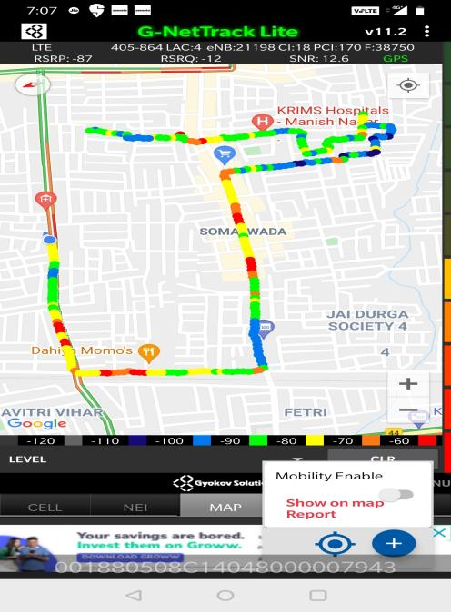
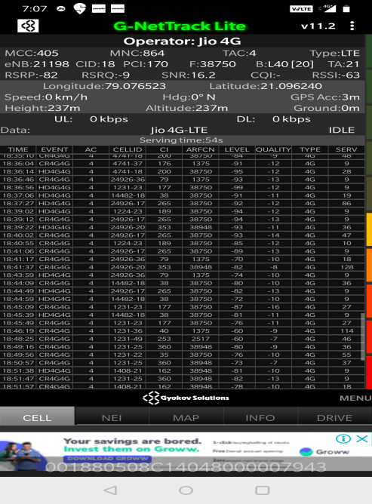
Mixed Coverage Area for Reliance JIO

Slide 16
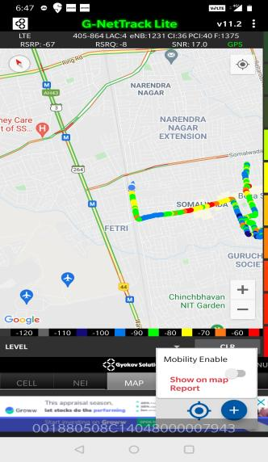
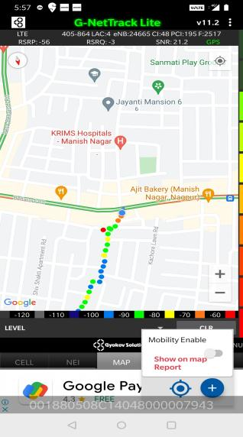
Inter Band Handover (FDD-TDD) for JIO 4G
Band 40 Band 5 Band 3

Slide 17
MATT Tool InterBand Handover Results for Jio
L40_L5 : 1
L5_L3 : 0
L5_L40: 1
L3_L5 : 0
L40_ L3: 1
L3_L40: 0

Slide 18
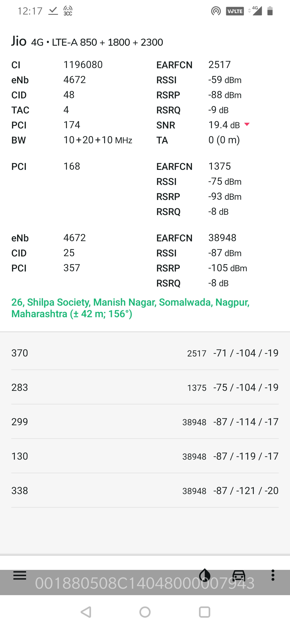
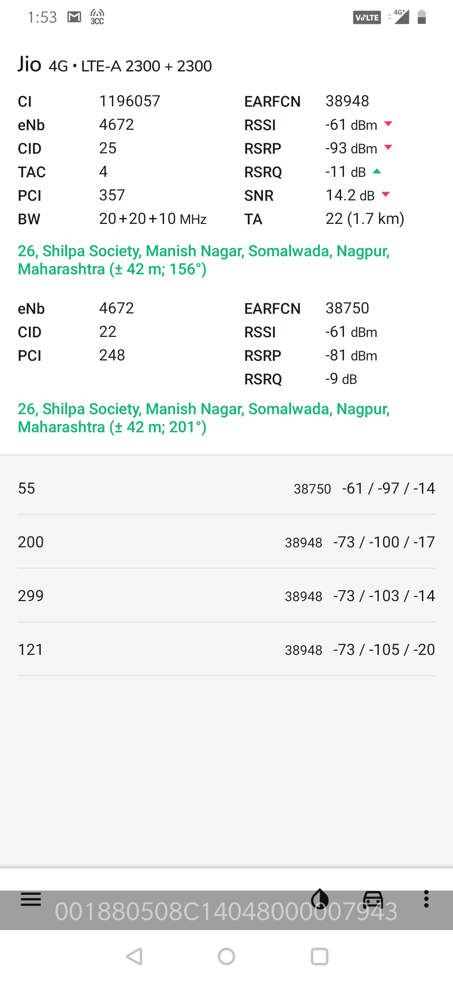
CA Jio :

Slide 19
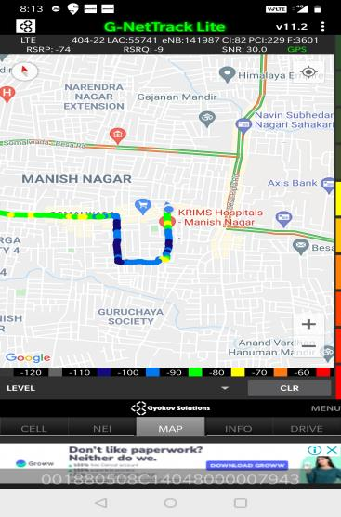
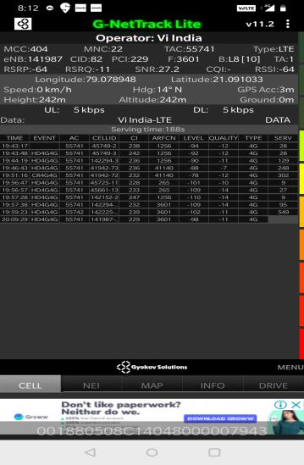
Near Cell for VI:
Near Cell | longitude | latitude | RSRP (dbm) | Cell id | E-ARFCN
1 | 79.078948 | 21.091033 | -64 | 82 | 3601
RSRP Range for Near Cell :
-65dbm to -75dbm
near KRIMS hospital,
Manish Nagar,
Nagpur

Slide 20
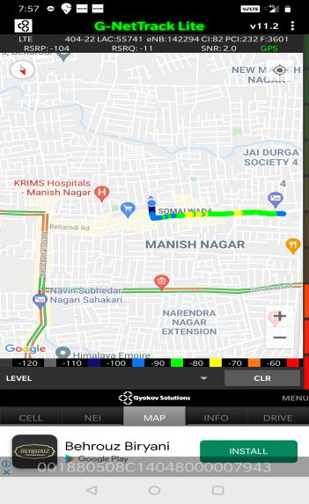
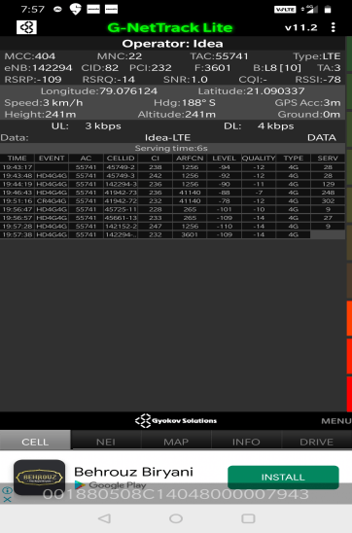
Edge Cell for VI:
Edge cell(EC) | longitude | latitude | RSRP (dbm) | Cell id | E-ARFCN
1 | 79.076124 | 21.7090337 | -109 | 82 | 3601
RSRP Range for Edge Cell :
-95dbm to -110dbm
Somalwada,
Nagpur

Slide 21
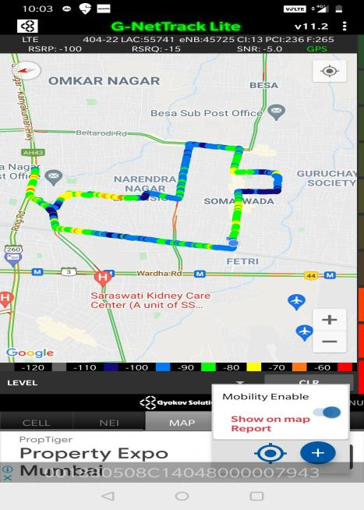
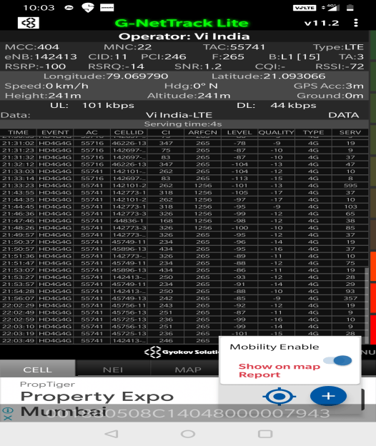
Mixed Coverage Area for VI:

Slide 22
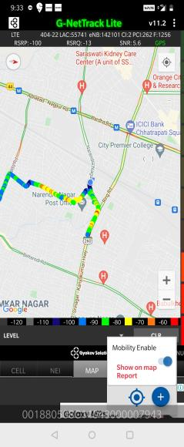
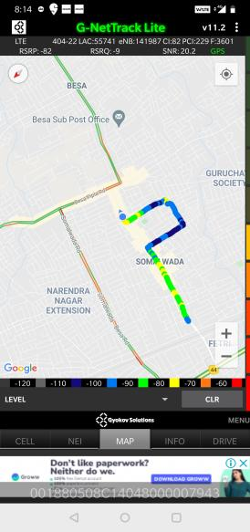
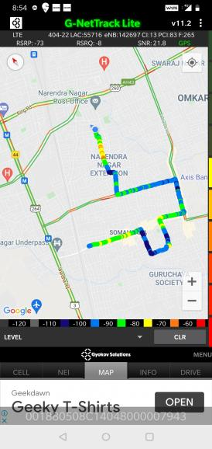
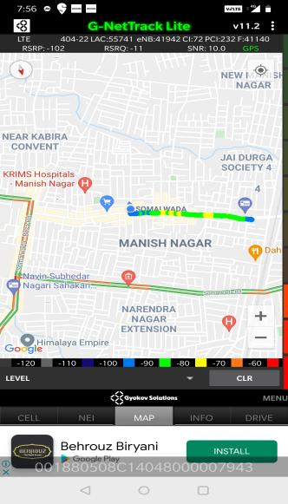
VI Band Handover
Band 3 Band 8 Band 1 Band 41

Slide 23
MATT Tool InterBand Handover Results for VI
L40_L41 : 0
L8_L1 : 1
L1_L41: 1
L3_L1 : 1
L41_ L3: 1
L3_L40: 0

Slide 24
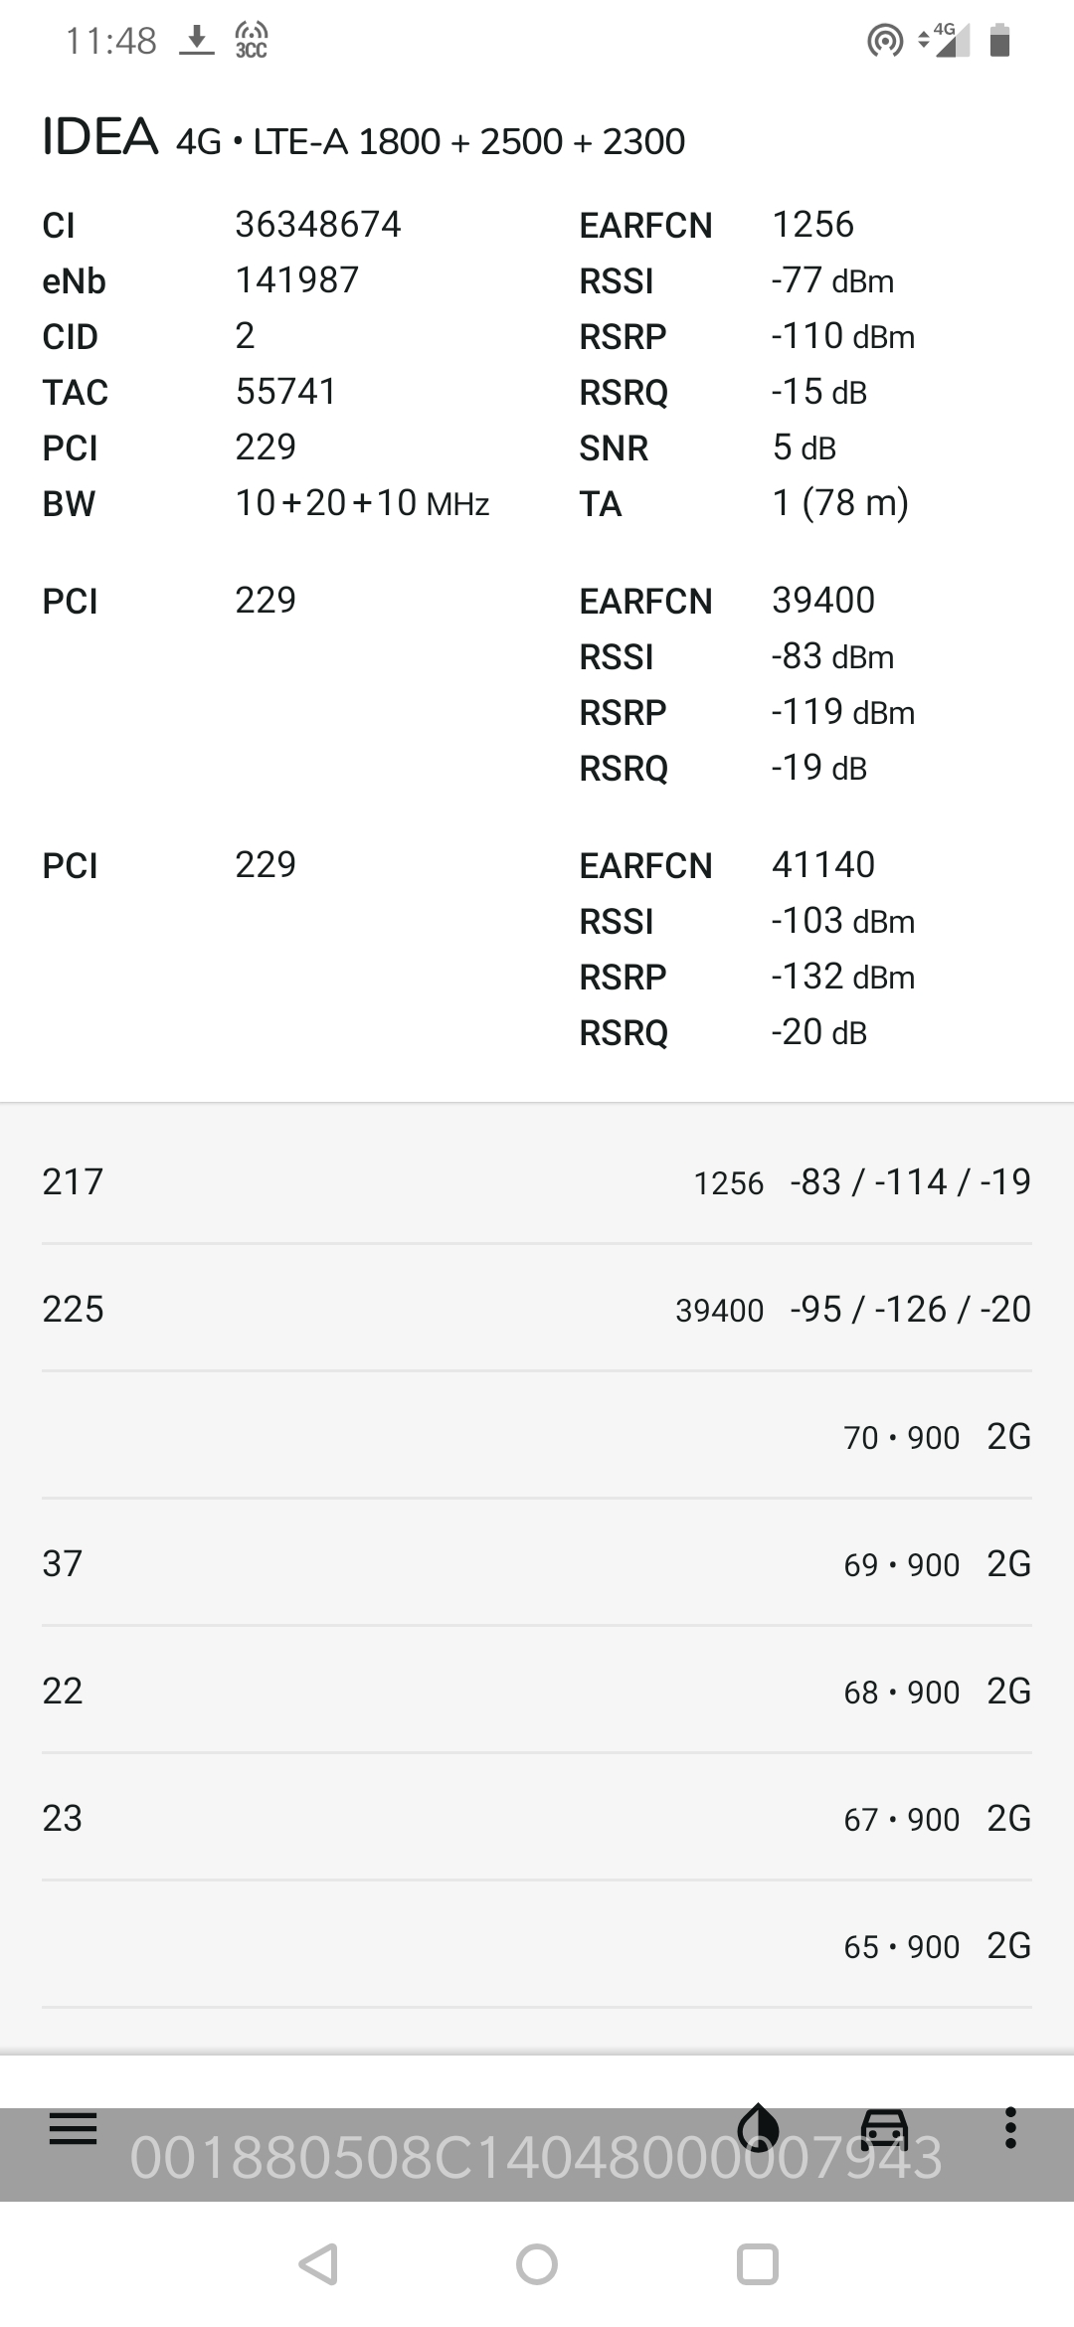
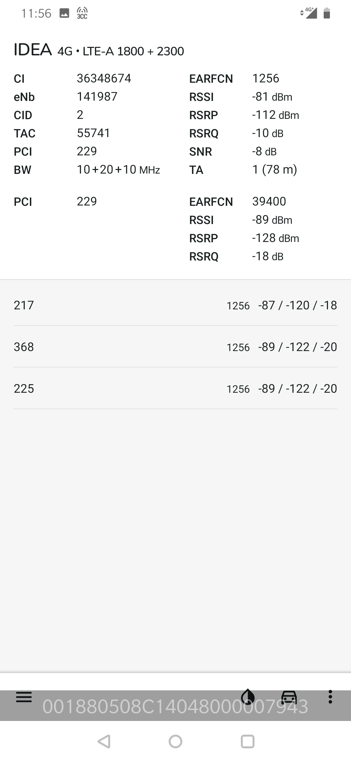
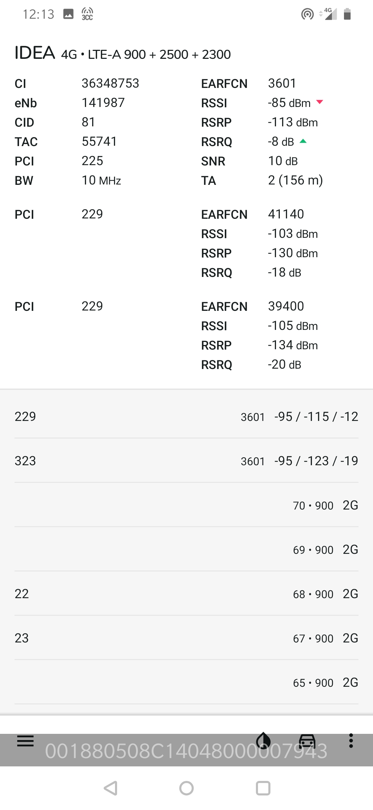
CA VI:

Slide 25
G-net Tracker Drive Route

Slide 26
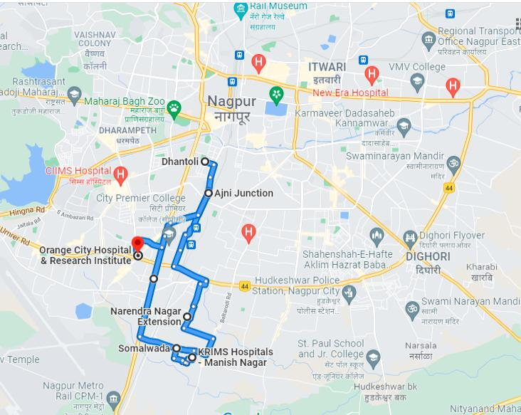
Drive Route

Slide 27
THANK YOU
MARQUIS TECHNOLOGIES

