Slide 1
MARQUIS TECHNOLOGIES
5G Drive Route – Manila, Philippines

Slide 2
Drive Route
Near Cell :-Stationary: RSRP: -65dbm to -90dbm
Mixed :-Mobility: RSRP : -75dbm to -100dbm
Cell Edge :-Stationary: RSRP : -95dbm to -120dbm

Slide 3
Operator | Mobility Scenario | Location Tested | Longitude / Latitude
Globe | SRVCC to 3G | GV barbershop going to Fairlane | 14.7110814,121.0611809
 | SRVCC to 2G | Not supported /Location not Found
 | 4G-3G-4G HO SPOT | GV barbershop going to Fairlane | 14.7110814,121.0611809
 | IRAT | GV barbershop going to Fairlane | 14.7110814,121.0611809
 | Good Coverage for Testing | Bernardino General Hospital 2 | 14.7402265,121.0456221
 | Poor Coverage for testing | North Olympus Subdivision IV | 14.7402265,121.0456221
 | OOS Area | Tower 9 Trees Residences | 14.7369165,121.0658519
Smart | SRVCC to 3G | Beethoven to Novalichez, Quezon City | 14.7387955,121.0456849
 | SRVCC to 2G | Not supported /Location not Found
 | 4G-3G-4G HO SPOT | Beethoven to Novalichez, Quezon City | 14.7387955,121.0456849
 | IRAT | Beethoven to Novalichez, Quezon City | 14.7387955,121.0456849
 | Good Coverage for Testing | Bernardino General Hospital 2 | 14.7402265,121.0456221
 | Poor Coverage for testing | North Olympus Subdivision IV | 14.7402265,121.0456221
 | OOS Area | Tower 9 Trees Residences | 14.7369165,121.0658519

Slide 4
Services Supported by Smart Operator
Smart 5G/4G/3G/2G | GSM-900MHz & 1800MHz, WCDMA - B5(850 MHz), Band 8(900Mhz), B1(2100MHz) LTE - B1(2100MHz), B3(1800MHz), Band 5(850Mhz), Band 28(700mhz), Band 40(2300 MHz - 2400 MHz) 5GNR – N78
OPERATOR | Features /Services | Supported(yes/No)
Smart (Major) | Reselection | Yes
 | Redirection | Yes
 | MMS /SMS | MMS not supported/Yes
 | Volte | Yes
 | Vowifi | Yes
 | PS Handover | Yes

Slide 5
Services Supported by Globe Operator
Globe 5G/4G/3G/2G | GSM-900MHz & 1800MHz, WCDMA - Band 8(900Mhz) LTE - B1(2100MHz), B3(1800MHz), Band 28(700mhz), Band 38 (2570 MHz - 2620 MHz), Band 40(2300 MHz - 2400 MHz), Band 41(2496-2690mhz) 5GNR – N78
OPERATOR | Features /Services | Supported(yes/No)
Globe (Major) | Reselection | Yes
 | Redirection | Yes
 | MMS /SMS | MMS not supported/Yes
 | Volte | Yes
 | Vowifi | Yes
 | PS Handover | Yes

Slide 6
Major Philippines Operators : Locations for 5G /NR Field Test
Operator | PLMN | 5G Tested Locations | Longitude / Latitude | ENDC combination Tested
Smart | 515/03 | 32nd Street, Fort Bonifacio, Taguig | 14.5534459,121.0510334,57 | LTE Band 40 + NR 78
Globe | 515/02 | 32nd Street, Fort Bonifacio, Taguig | 14.5534459,121.0510334,57 | LTE Band 41 + NR 78

Slide 7
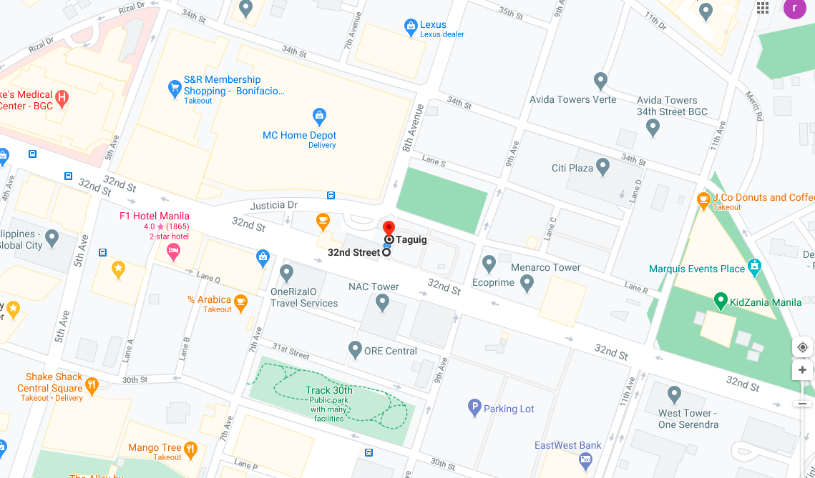
Smart and Globe 5G VoLTE Good Coverage Area NR 78 BAND Route >> 32nd street Taguig area https://www.google.com/maps/dir/14.5535497,121.0514603/Bonifacio+Global+City,+Taguig,+Metro+Manila/@14.5533963,121.050146,17z/data=!4m9!4m8!1m0!1m5!1m1!1s0x3397c8f3f7939247:0x813e60f0060d667f!2m2!1d121.0514897!2d14.5536757!3e2

Slide 8
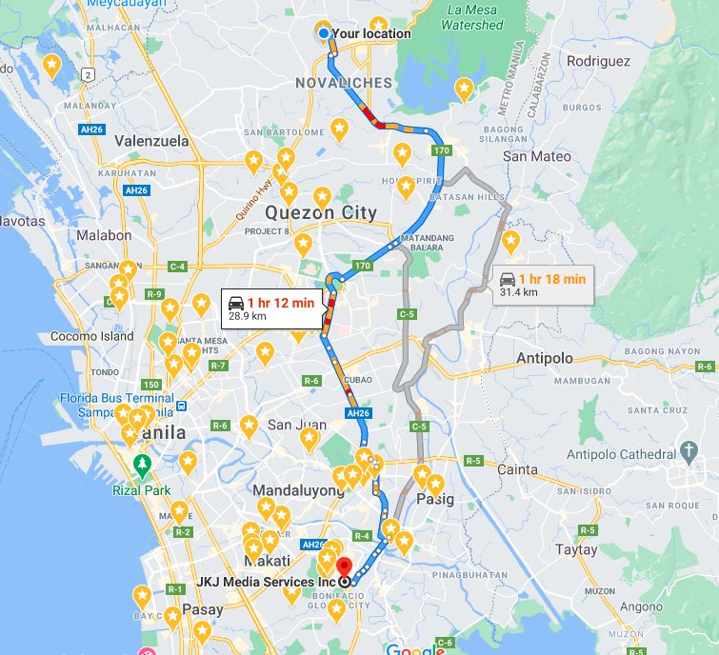
Smart and Globe 5G VoLTE Good Coverage Area going to 5G coverage N78 Route >> Olympus, Novaliches, Quezon City, Metro Manila > JKJ Media Services Inc, Unit 1812 High Street South Corporate Plaza Tower 2 26th Street, cor 11th Ave, Taguig, Metro Manila

Slide 9
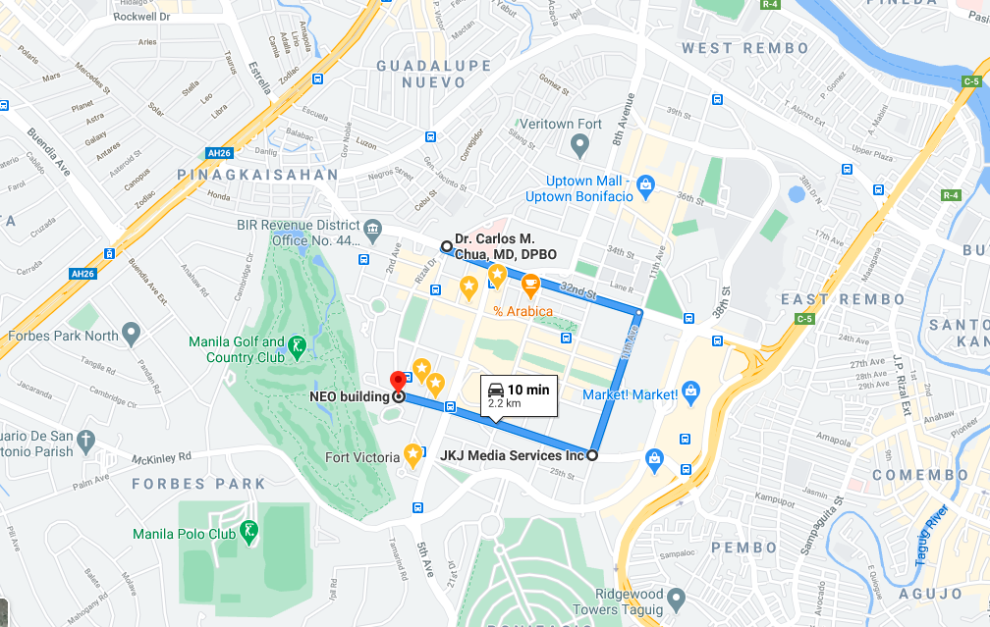
Smart and Globe 5G VoLTE Good Coverage Area Band 40 and Ban 41 with NR 78 BAND Route >> Dr. Carlos M. Chua, MD, DPBO, Rizal Drive, corner 32nd St, Taguig, Metro Manila > JKJ Media Services Inc, Unit 1812 High Street South Corporate Plaza Tower 2 26th Street, cor 11th Ave, Taguig, Metro Manila > NEO building, Taguig, Metro Manila

Slide 10
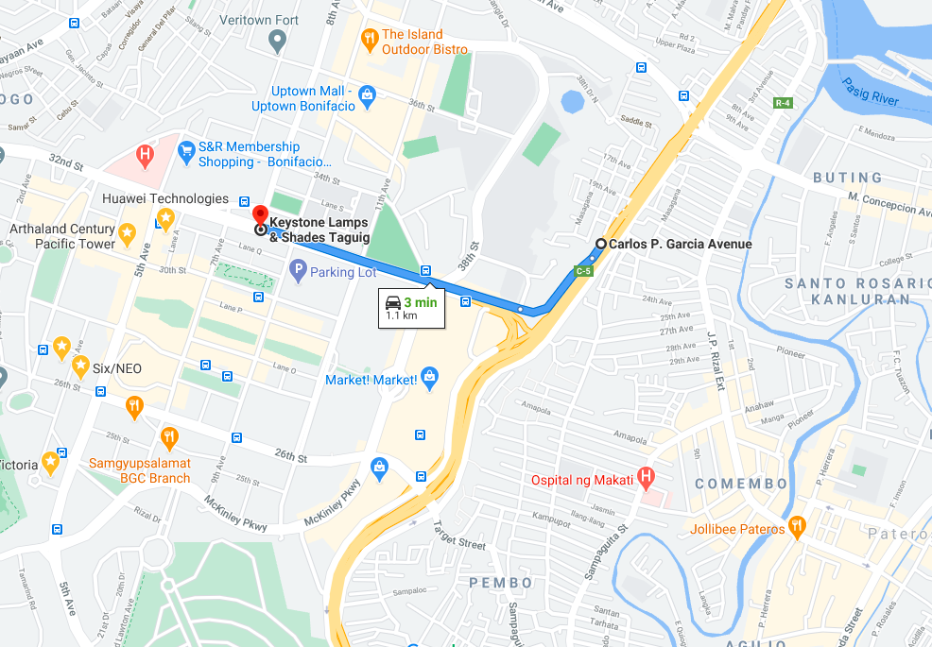
Globe and Smart 5G and 4g VoLTE Mix Coverage Area Route >> 32nd street Taguig going to C5 road https://www.google.com/maps/dir/14.5529989,121.0605362/14.5533721,121.0513419/@14.5512672,121.0508645,15.75z/data=!4m2!4m1!3e0
5g coverage ends here
4g and 5g mixed coverage
5g area

Slide 11
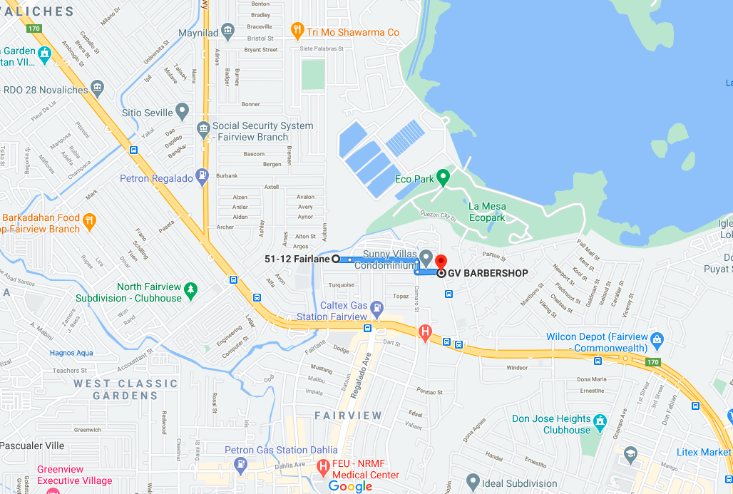
Globe 4G and 3G SRVCC Route >> GV barbershop going to Fairlane https://www.google.com/maps/dir/14.7096571,121.0676063/GV+BARBERSHOP,+157-D+Pearl,+Novaliches,+Quezon+City,+Metro+Manila/@14.7110814,121.0611809,15.29z/data=!4m9!4m8!1m0!1m5!1m1!1s0x3397b1cbeb975f21:0xb6cdc52c5b91823b!2m2!1d121.0727755!2d14.7089709!3e0
SRVCC 4G -3G
3G area
4G area

Slide 12
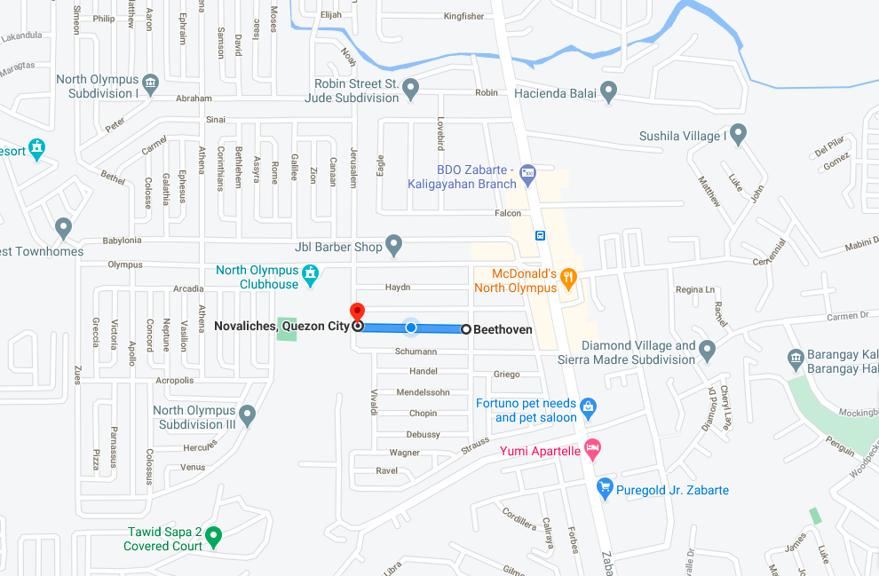
Smart 4G and 3G SRVCC Route >> Beethoven to Novalichez, Quezon City https://www.google.com/maps/dir/14.7387955,121.0456849/14.7388526,121.0439829/@14.7397042,121.041717,16.62z/data=!4m2!4m1!3e0
SRVCC 4G -3G
3G area
4G area

Slide 13
THANK YOU
MARQUIS TECHNOLOGIES
www.marquistech.com

