Slide 1
MARQUIS TECHNOLOGIES
Drive Route – Vilnius( Lithuania)

Slide 2
Travel to Vilnius (Lithuania)
Country | Lithuania
Continent | Europe
City | Vilnius
Time Zone | GMT +2 Hour
International Dialing Code
VISA | Travel Visa
VISA Duration | 3 Month , Multiple Entry
VISA Fees | Contact Nisha Deshpande
VISA Requirements | Need to provide 3 passport size photographs, 6 month bank statement
Yellow Fever Vaccination Certificate | Not Required

Slide 3
Operator Information
MCC | MNC | Operator | Bands (MHz)
246 | 01 | Telia LT | GSM 900/1800, W-CDMA 2100, LTE 800/1800/2100/2600

Slide 4
USSD Codes for operators
No. | Operator | Balance Check Code | Customer Care | Voice Mail No.
1 | Telia LT | *123#

Slide 5
RSRP Criteria
Near Cell :-Stationary: RSRP : -55dbm to -85dbm
Cell Edge :-Stationary: RSRP : -95dbm to -110dbm
Mixed :-Mobility: RSRP : -55dbm to -120dbm

Slide 6
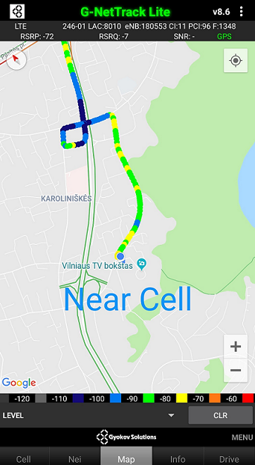
Telia LT Near Cell Location:

Slide 7
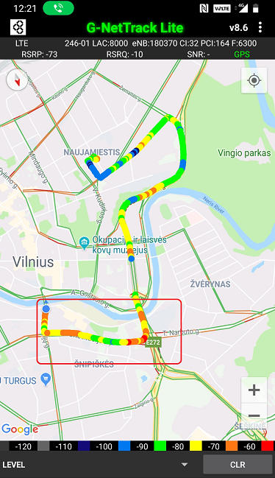
Edge Cell Location: Poor Coverage Mobility Area

Slide 8
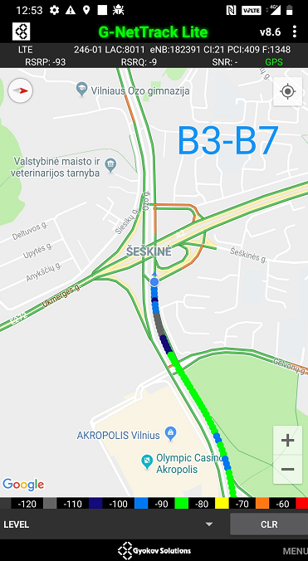
Telia LT InterBand:

Slide 9
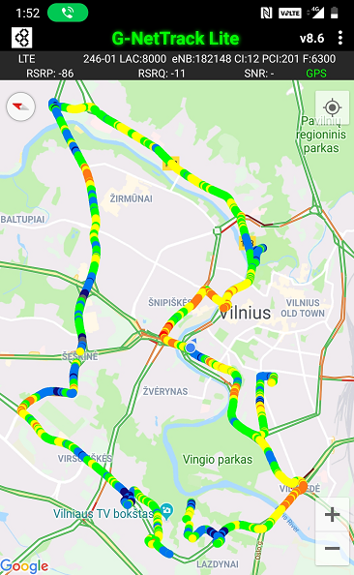
Telia LT Mixed Mobility Coverage:

Slide 10
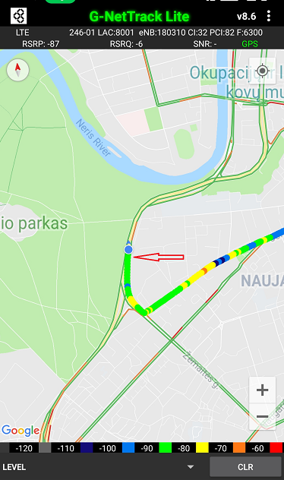
Telia LT SRVCC:

Slide 11
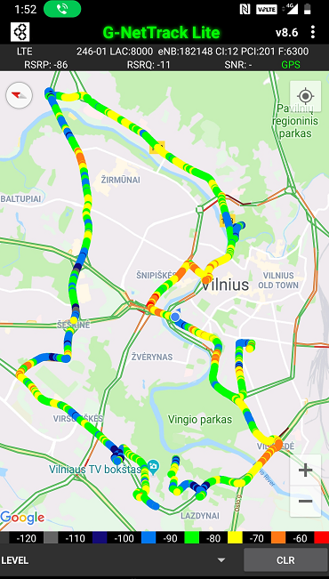
Mobility Route:4G

Slide 12
Top Most Popular Android Apps used in Vilnius
Jak dojade
Gdansk4U
Dictionary Linguee
Duo
Google Translate
Memrise
Phrasebook
Quizlet
Rosetta Stone
Speak Tribe
Mytaxi
Yanosik.pl

Slide 13
Local EM number used in Poland:
European general emergency phone number | 112
Local Police | 997
Ambulance | 999
Fire Brigade | 998
Road Assistance | 981

Slide 14
THANK YOU
MARQUIS TECHNOLOGIES
www.marquistech.com

