Slide 1
MARQUIS TECHNOLOGIES
Drive Route- Kuwait/ Kuwait City

Slide 2
Travel to Kuwait (Kuwait City)
Country | Kuwait
Continent | Western Asia
City | Kuwait City
Time Zone | GMT +03 Arabian Standard Time

Slide 3
Operators in Kuwait:
MCC | MNC | Operator
419 | 03 | Ooredoo
419 | 04 | STC_KW
419 | 02 | Zain_KW
Ooredoo Network Info1
RAT | Band | Comment
5G | N78 (3500 MHz) | NSA
4G | B3 (1800 MHz), B20 (800 MHz)
3G | B8 (900 MHz), B1 (2100 MHz)
2G | 900, 1800Mhz
STC Network Info
RAT | Band | Comment
5G | N78 (3500 MHz) | SA
4G | B3 (1800 MHz),
3G | B1 2100 MHz
2G | 900, 1800Mhz
Zain Network Info
RAT | Band | Comment
5G | N77 (3700 MHz) | SA
4G | B3 (1800 MHz)
3G | B1 2100 MHz
2G | 900 Mhz

Slide 4
Operators and general Information
Ooredoo- Supports 5G,LTE, VoLTE, VoWifi , WCDMA and 2G
STC- Supports 5G, LTE, VoLTE ,VoWifi, WCDMA and 2G
Zain- Supports 5G , LTE, VoLTE, VoWIFI, WCDMA and 2G

Slide 5
RSRP Criteria
Near Cell :-Stationary: RSRP : -65dbm to -85dbm
Cell Edge :-Stationary: RSRP : -95dbm to -110dbm
Mixed :-Mobility: RSRP : -65dbm to -120dbm

Slide 6
Operator | Mobility Scenario | Location Tested | Longitude / Latitude
Ooredoo | 4G-3G-4G HO SPOT | No Location Found | 48.124920/ 29.127284
 | SRVCC to 3G/2G | Block 2, Kuwait | 48.120618, 29.131248
 | IRAT | No Location Found | 48.124920/ 29.127284
 | Good Coverage for Testing | Al Razi St, Kuwait | 48.124920/ 29.127284
 | Poor Coverage for testing | Block 2, Kuwait | 48.120618, 29.131248
 | OOS Area | No Location Found | 48.120618, 29.131248
STC | 4G-3G-4G HO SPOT | No Location Found | 48.127562 ,29.137785
 | SRVCC to 3G/2G | 44J9+RJV Fahad Al Ahmad, Kuwait | 48.119037 , 29.132120
 | IRAT | No Location Found | 48.127562, 29.137785
 | Good Coverage for Testing | Ajran Hassan Al Ajran St, Kuwait | 48.127562, 29.137785
 | Poor Coverage for testing | 44J9+RJV Fahad Al Ahmad, Kuwait | 48.119037 , 29.132120
 | OOS Area | No Location Found | 48.119037, 29.132120
Zain | 4G-3G-4G HO SPOT | No Location Found | 48.125024, 29.140080
 | SRVCC to 3G/2G | Al Mahboula Public Park, Salem Sabah Al Salem Al Sabah St, Kuwait | 48.131237, 29.139626
 | IRAT | No Location Found | 48.125024, 29.140080
 | Good Coverage for Testing | 44RF+3X, Fahad Al Ahmad, Kuwait | 48.125024, 29.140080
 | Poor Coverage for testing | Al Mahboula Public Park, Salem Sabah Al Salem Al Sabah St, Kuwait | 48.131237, 29.139626
 | OOS Area | No Location Found | 48.131237, 29.139626

Slide 7
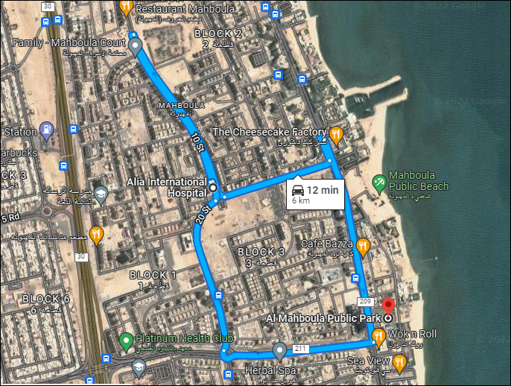
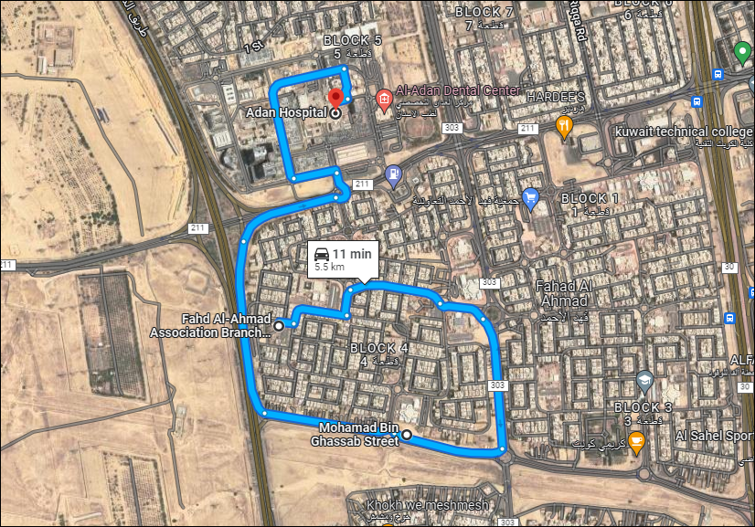
4G-3G-4G HO SPOT SRVCC to 3G 4G-3G-4G HO SPOT SRVCC to 3G 4G-3G-4G HO SPOT SRVCC to 3G 4G-3G-4G HO SPOT, SRVCC-3G/2G
to 3G

Slide 8
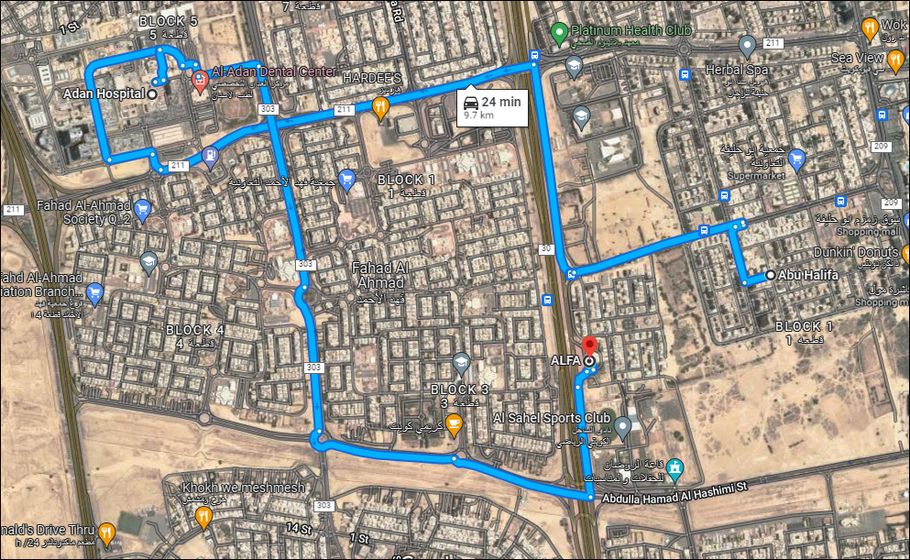
5G Ooredoo Drive Route
Abu Halifa, Kuwait >> Adan Hospital, 43PW+6QF, Hadiya, Kuwait >> ALFA, 44F8+VX2, Fahad Al Ahmad, Kuwait
RSRP: -65dbm to -100dbm Long/Lat: 29.127, 48.124

Slide 9
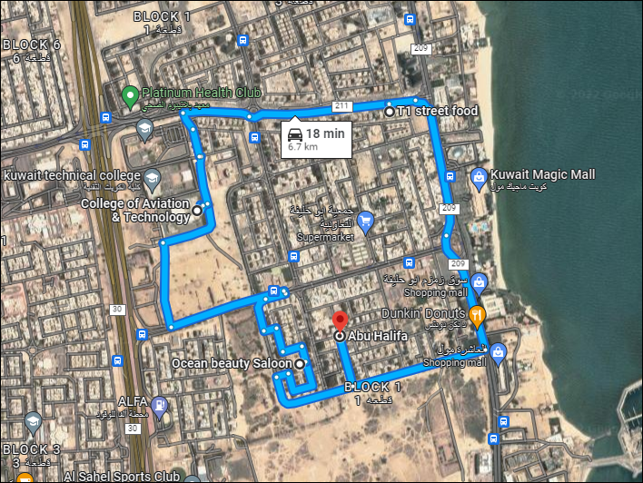
5G STC Drive Route
building 36, Kuwait >> Abu Halifa, Kuwait >> College of Aviation & Technology, Building #69, 34 Walking St, Kuwait >> T1 street food، 211, Mahboula،, Kuwait
RSRP: -65dbm to -120dbm Long/Lat: 29.127, 48.124

Slide 10
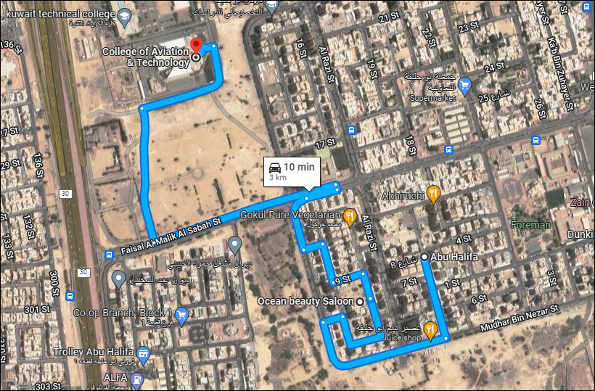
5G Zain Drive Route
building 36, Kuwait> Al Sahel Sports Club, Abdulla Hamad Al Hashimi St, Kuwait> Alia international hospital > block 2 Kuwait
RSRP: -65dbm to -100dbm Long/Lat: 48.096674, 29.100119

Slide 11
THANK YOU
MARQUIS TECHNOLOGIES
www.marquistech.com

