Slide 1
MARQUIS TECHNOLOGIES
Drive Route – Kuala Lumpur (Malaysia)

Slide 2
Travel to Kuala Lumpur (Malaysia)
Country | Malaysia
Continent | Asia
City | Kuala Lumpur
Duration of travel from Delhi | Approx. 5 and 1/2 Hrs.
Time Zone | GMT +8
International Dialing Code | +60
VISA | Travel Visa
VISA Duration | 6 Month , Multiple Entry
VISA Fees | Contact Nisha Deshpande
VISA Requirements | Need to provide 3 passport size photographs, 6 month bank statement
Yellow Fever Vaccination Certificate | Not Required

Slide 3
Operator Information
MCC | MNC | Operator | Bands (MHz)
502 | 12 | Maxis | GSM900/UMTS 2100/B3/B7
502 | 16 | Digi | DCS-1800 / UMTS 2100 /B3/B7
502 | 19 | Celcom | DCS-1800 / UMTS 2100 /B3/B7
502 | 18 | U mobile | GSM-900/DCS-1800/ UMTS 2100 /B7

Slide 4
USSD Codes for operators
No. | Operator | Balance Check Code | Customer Care | Voice Mail No.
1 | Maxis | *122# | 1800 821 123 | 121
2 | Digi | *126# | 016-2211 800 | *128*1*8*1#
3 | Celcom | *124# | 00 60 19-601 1111 | 1313
4 | U mobile | *118# | 018 388 1318 | 018 388 1318

Slide 5
Manual APN Settings
Attached is a sheet which has Manual APN Settings for all operators in Kuala Lumpur (Malaysia)

Slide 6
Services Supported by Operators
Operator | Features/Services | Supports(Yes/No)
Maxis | Reselection | Yes
 | Redirection | Yes
 | MMS | Yes
 | CSFB | Yes(3G)
 | VoLTE | No
 | PS Handover | Yes
Digi | Reselection | Yes
 | Redirection | Yes
 | MMS | Yes
 | CSFB | Yes(3G)
 | VoLTE | No
 | PS Handover | Yes
Celcom | Reselection | Yes
 | Redirection | Yes
 | MMS | Yes
 | CSFB | Yes(3G)
 | VoLTE | No
 | PS Handover | Yes
U Mobile | Reselection | Yes
 | Redirection | Yes
 | MMS | Yes
 | CSFB | Yes(3G)
 | VoLTE | No
 | PS Handover | Yes

Slide 7
RSRP Criteria
Near Cell :-Stationary: RSRP : -55dbm to -85dbm
Cell Edge :-Stationary: RSRP : -95dbm to -110dbm
Mixed :-Mobility: RSRP : -55dbm to -120dbm

Slide 8
Additional Information
Where to Get SIM cards?
7/11 shop and Time Square Mall
What Documents Required to Purchase SIM?
Only Passport ID
Best Recharge Option for 8 days Testing?
Recharges are available in all confectionery shop.
Hotel to Stay
Hotel Beltif
Driver Details for Mobility?
Mob: 0166556630

Slide 9
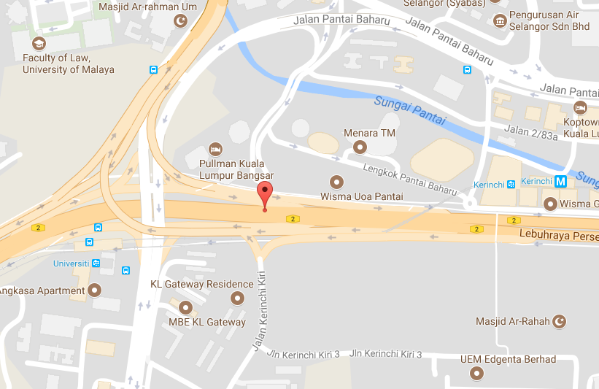
Near Cell Location of Celcom Location : Lebuhraya Persekutuan Lat: 3.1150800 Long:101.66422

Slide 10
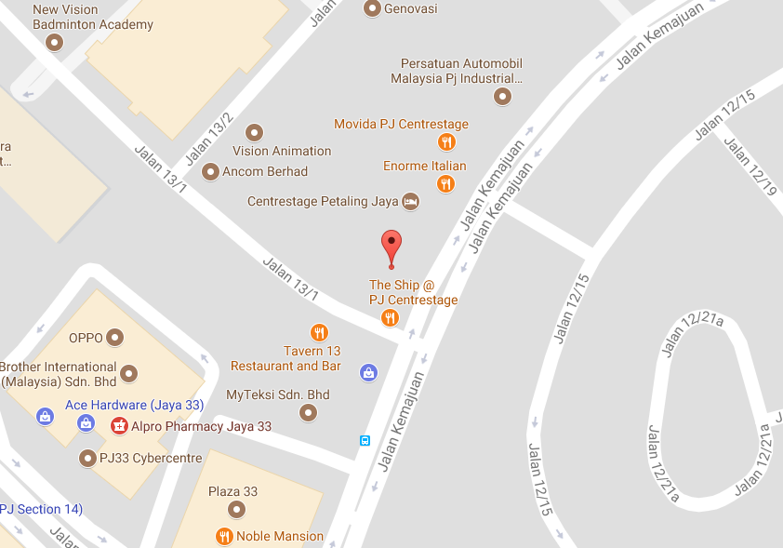
Edge Cell Location of Celcom Location : Best Western Petaling Jaya Lat: 3.1113566 Long:101.63903

Slide 11
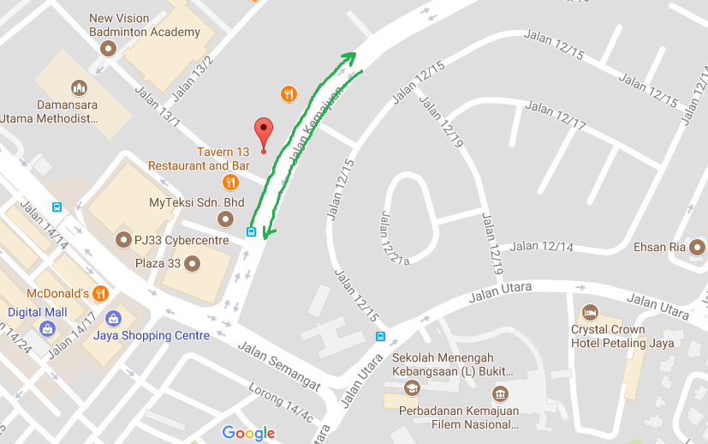
4G to 3G to 4G Reselection Location of Celcom Location : The Language House Lat: 29°59'13.16 Long:31°11'25.55

Slide 12
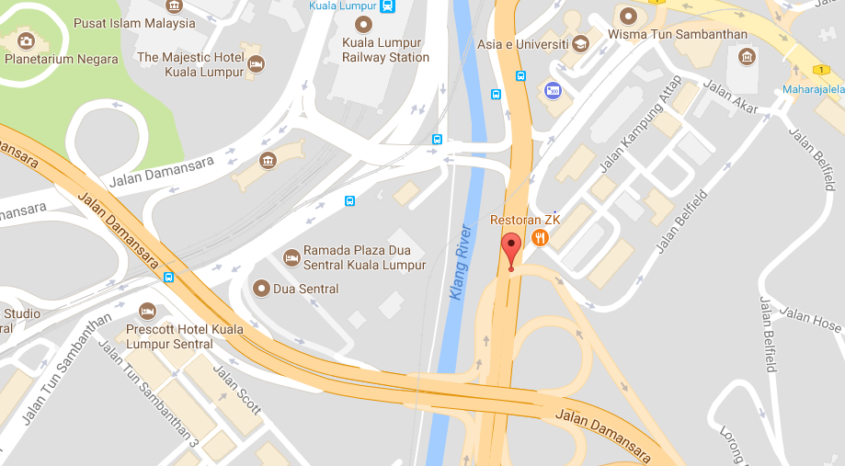
Near Cell Location of Maxis Location : Jalan Syed Putra Lat: 3.1368033 Long: 101.69521

Slide 13
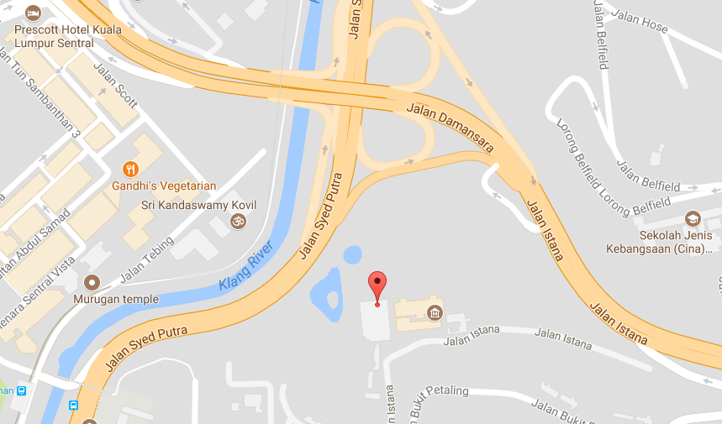
Edge Cell Location of Maxis Location :Istana Negara Lat: 3.1326016 Long: 101.695354

Slide 14
4G to 3G to 4G Reselection Location of Maxis Location : Best Western Lat: 29°59'13.16 Long:31°11'25.55

Slide 15
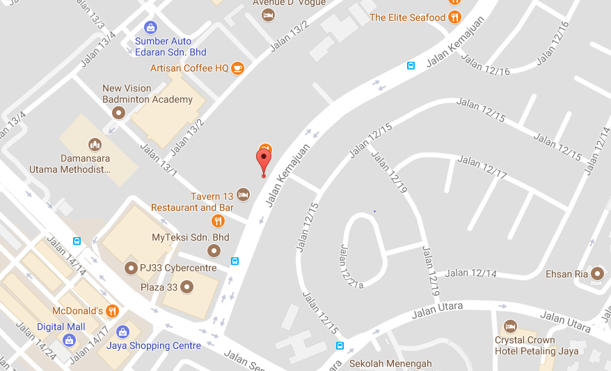
Near Cell Location of Digi Location : Widebed Short Stay @ Centrestage Hotel Lat: 3.1116716 Long: 101.63932

Slide 16
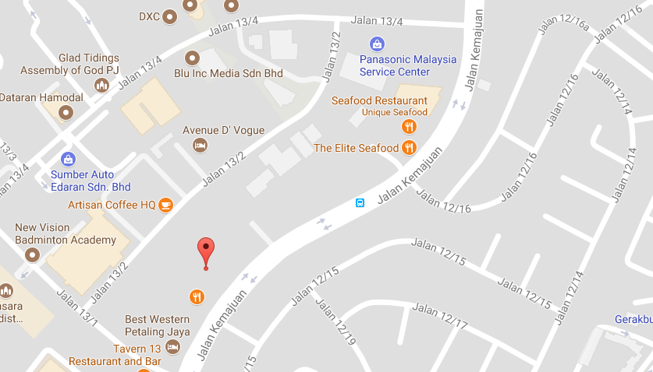
Edge Cell Location of Digi Location : Lee Electhical Trading Company Lat: 3.1124650 Long:101.63947

Slide 17
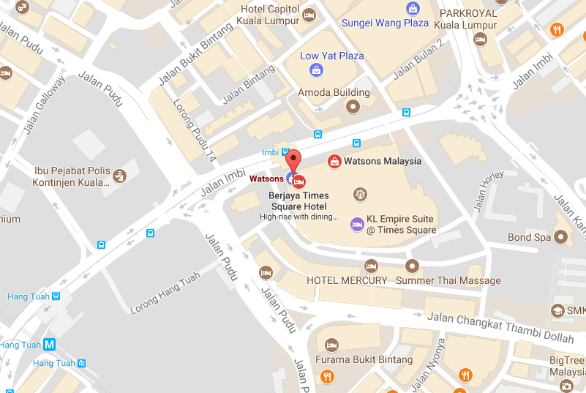
4G to 3G to 4G Reselection Location of Digi Location :Berjaya Times Square Lat: 3.142462 Long: 101.709507

Slide 18
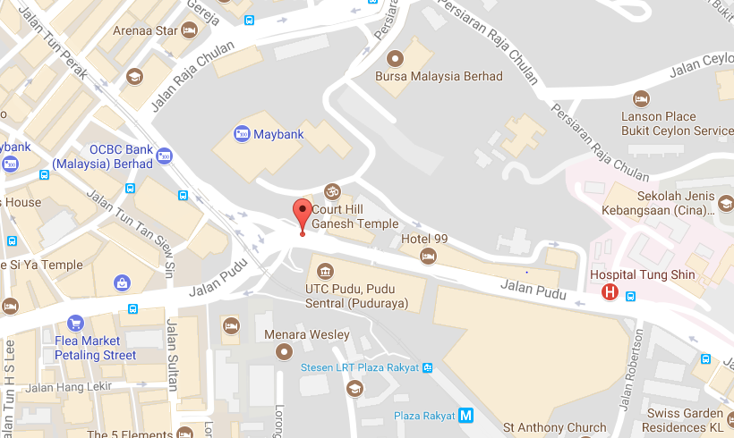
Near Cell Location of U Mobile Location : 10, Jalan Pudu Lat: 3.1462199 Long: 101.70015

Slide 19
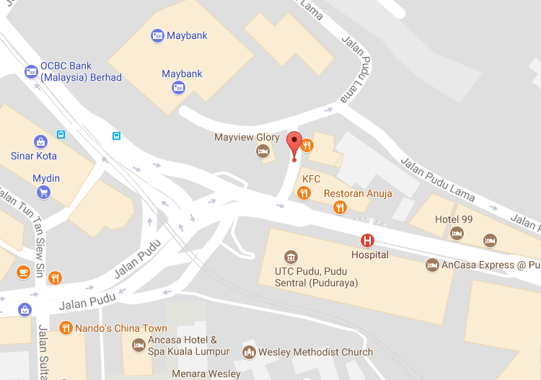
Edge Cell Location of U mobile Location : 69, Jalan Pudu Lama Lat: 3.1124650 Long:101.63947

Slide 20
4G to 3G to 4G Reselection Location of U mobile Location :Berjaya Times Square Lat: 3.142462 Long: 101.709507

Slide 21
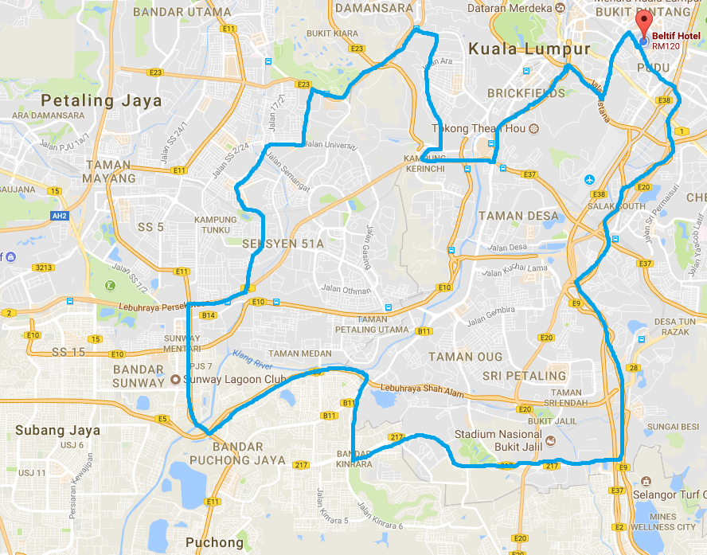
Mobility Route:4G

Slide 22
Top Most Popular Android Apps used in Malaysia
Uber
Grab
Golden Screen Cinemas (GSC)
Groupon
ASKME MALAYSIA
WhatsApp Messenger
Facebook
Share it
True caller
Bigo Live
Viber

Slide 23
Local EM number used in Kuala Lumpur
Fire Brigade Number | 994
Gas Emergency | 995
Civil Defence | 991

Slide 24
THANK YOU
MARQUIS TECHNOLOGIES
www.marquistech.com

