Slide 1
MARQUIS TECHNOLOGIES
Drive Route – Japan

Slide 2
Drive Route
Near Cell :-Stationary: RSRP: -65dbm to -85dbm
Mixed :-Mobility: RSRP : -85dbm to -100dbm
Cell Edge :-Stationary: RSRP : -100dbm to -120dbm

Slide 3
Major Japan Operators : Locations for 5G Field Test
Operator | PLMN | 5G Tested Locations | ENDC | Longitude / Latitude
NTT Docomo | 440 | Tokyo/Japan | B3 + NR B78 | lat=35.690767&lot=139.756853
Au | 440 | Tokyo/Japan | B3 + NR B78 | lat=35.690767&lot=139.756853
Rakuten | 440 | Tokyo/Japan | B3 + NR B77 | lat=35.690767&lot=139.756853

Slide 4
Major Japan Operators : Locations for 5G Field Test
Operator | PLMN | 5G Tested Locations | ENDC | Longitude / Latitude
Softbank | 440 | Tokyo/Japan | B3 + NR B77 | lat=35.690767&lot=139.756853

Slide 5
Service support by Telia Operator
Services Supported by Docomo Operator
Docomo 5G/VoLTE/4G | n77 (3700 MHz), n79 (4500 MHz), n257 (28 GHz) B1 (2100 MHz),B3 (1800 MHz),B19 (850 MHz) B21 (1500 MHz),B28 (700 MHz),B42 (3500 MHz)
OPERATOR | Features /Services | Supported(yes/No)
Docomo | MMS /SMS | NO/Yes
 | Volte | Yes
 | vowifi | NO

Slide 6
Service support by Telia Operator
Services Supported by Softbank Operator
Softbank 5G/VoLTE /4G/3G | n77 (3700 MHz),n257 (28 GHz), B1 (2100 MHz) B3 (1800 MHz),B8 (900 MHz),B11 (1500 MHz) B20 (800 MHz),B28 (700 MHz),B41 (2500 MHz) B42 (3500 MHz)
OPERATOR | Features /Services | Supported(yes/No)
Softbank | MMS /SMS | Yes/Yes
 | Volte | Yes
 | vowifi | NO

Slide 7
Service support by Telia Operator
Services Supported by AU (KDDI) Operator
AU (KDDI) 5G/VoLTE/4G | n28 (700 MHz),n77 (3700 MHz),n257 (28 GHz), B1 (2100 MHz),B3 (1800 MHz),B11 (1500 MHz) B18 (850 MHz),B28 (700 MHz),B41 (2500 MHz) B42 (3500 MHz)
OPERATOR | Features /Services | Supported(yes/No)
AU (KDDI) | MMS /SMS | No/Yes
 | Volte | Yes
 | vowifi | NO

Slide 8
Service support by Telia Operator
Services Supported by Rakuten Operator
Rakuten 5G/VoLTE/4G | n3 (1800 MHz),n77 (3700 MHz),n257 (28 GHz) B3 (1800 MHz)
OPERATOR | Features /Services | Supported(yes/No)
Rakuten | MMS /SMS | No/Yes
 | Volte | Yes
 | vowifi | NO

Slide 9
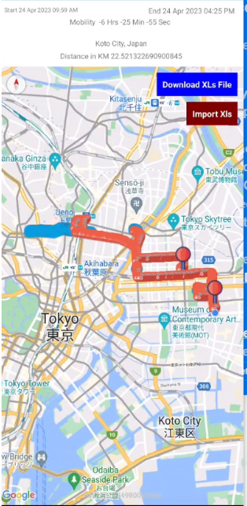
Docomo 5G Good Coverage

Slide 10
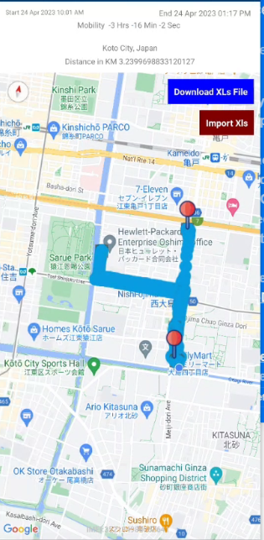
Softbank 5G Good Coverage

Slide 11
AU (KDDI) Good Coverage

Slide 12
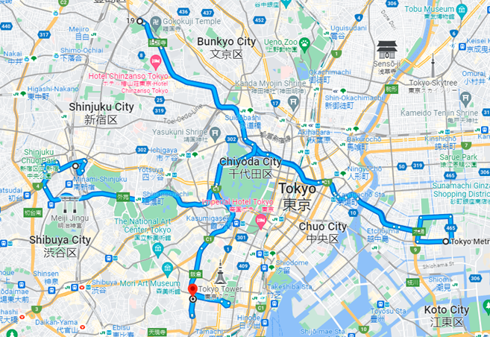
Rakuten Good Coverage

Slide 13
THANK YOU
MARQUIS TECHNOLOGIES
www.marquistech.com

