Slide 1
MARQUIS TECHNOLOGIES
Drive Route – Hyderabad(India)
MD Javeed

Slide 2
Hyderabad
Country | India
Continent | Asia
State | Telangana
City | Hyderabad
Time Zone | GMT + 5:30
International Dialing Code | +91

Slide 3
Operator Information
MCC | MNC | Operator | Bands (MHz) & E-ARFCN
405 | 854 | Reliance JIO | LTE 2300 MHz (TDD) Band 40. E-ARFCN- 39225
 |  |  | LTE 850 MHz (FDD) Band 5 E-ARFCN-2540
 |  |  | LTE 1800 MHz (FDD) Band 3
 |  |  | E-ARFCN-1454

Slide 4
Additional Information
MMS is not supported by RJIO.
L to W and W to L Redirection and reselection is not supported in Hyderabad.
Inter frequency reselection and redirection is supported.
We could not observe Volte Call Handover from Band 3 to Band 40.

Slide 5
Drive Route
Band 40 (TDD) Near Cell | Band40 (TDD) <-> Band 3 (FDD) Reselection
Band 40 (TDD) Edge Cell | Band40 (TDD) <-> Band 3 (FDD) Reselection
Band 3 (FDD) Near Cell | Mixed Mobility Route-1
Band 3 (FDD) Edge Cell | Mixed Mobility Route-2

Slide 6
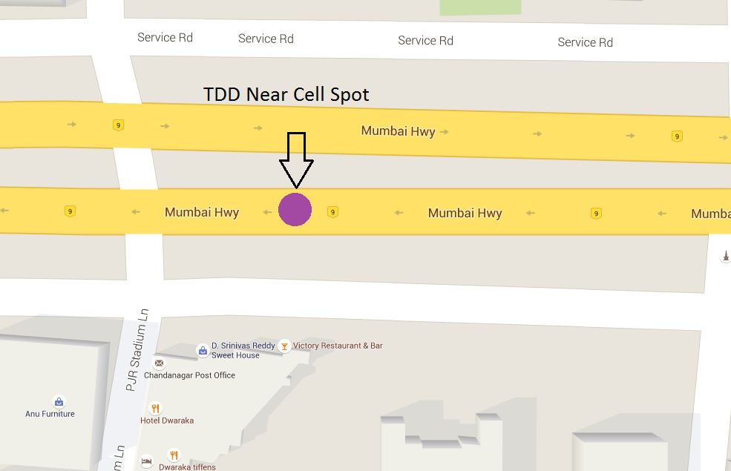
BAND40 Near Cell
Location:-Victory Restaurant, Chanda nagar, Old-Mumbai highway
Lat :-17.494973
Long :-78.325487

Slide 7
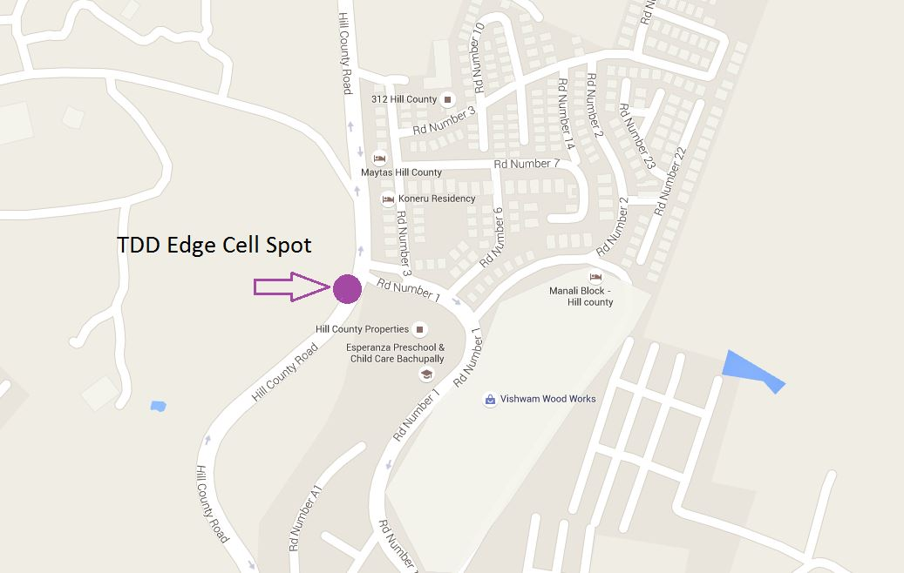
BAND40 Edge Cell
Location:-Hill Country Properties, Nizampet
Lat :-17.530295
Long :-78.375560

Slide 8
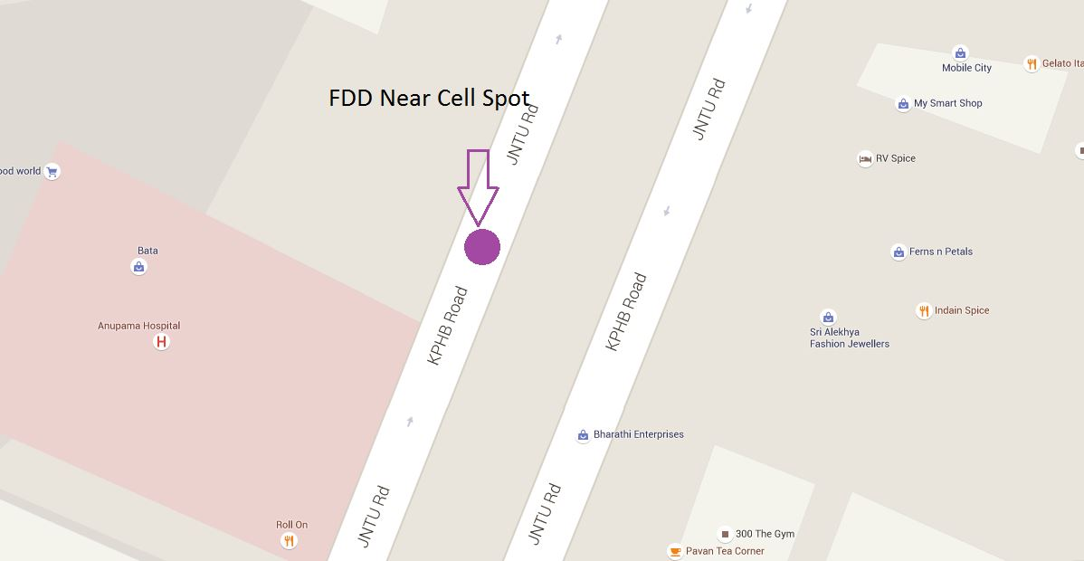
BAND5 Near Cell
Location:-
Bahar Cafe,6th Phase, KPHB
Lat :-17.485714
Long :-78.390533

Slide 9
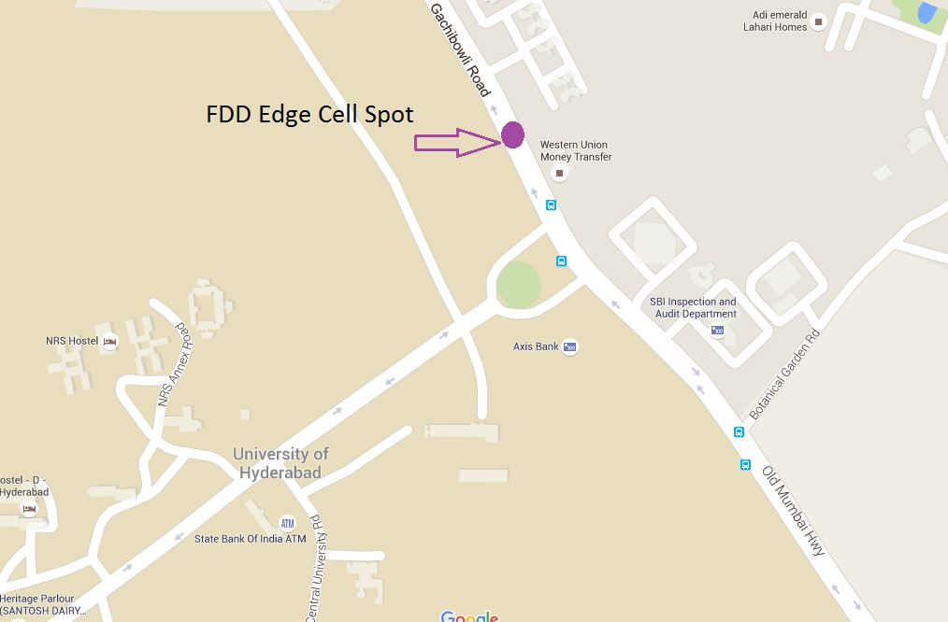
BAND5 Edge Cell
Location:- Hyderabad University, HCU road
Lat :-17.463005
Long :-78.334980

Slide 10
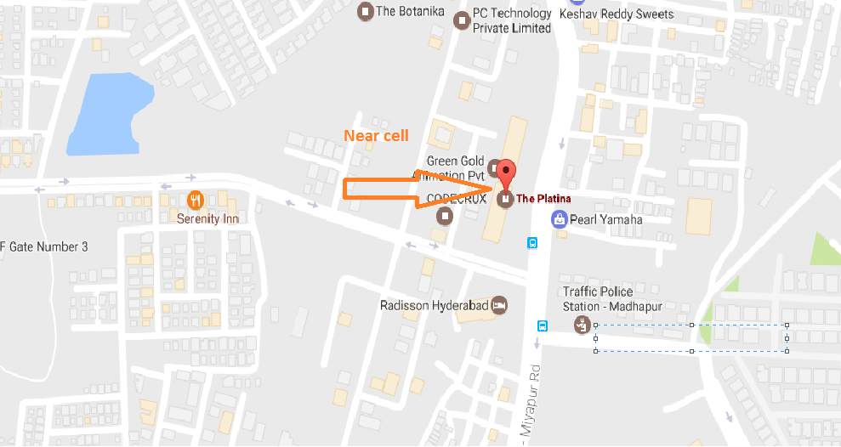
Band 3 Near Cell

Slide 11
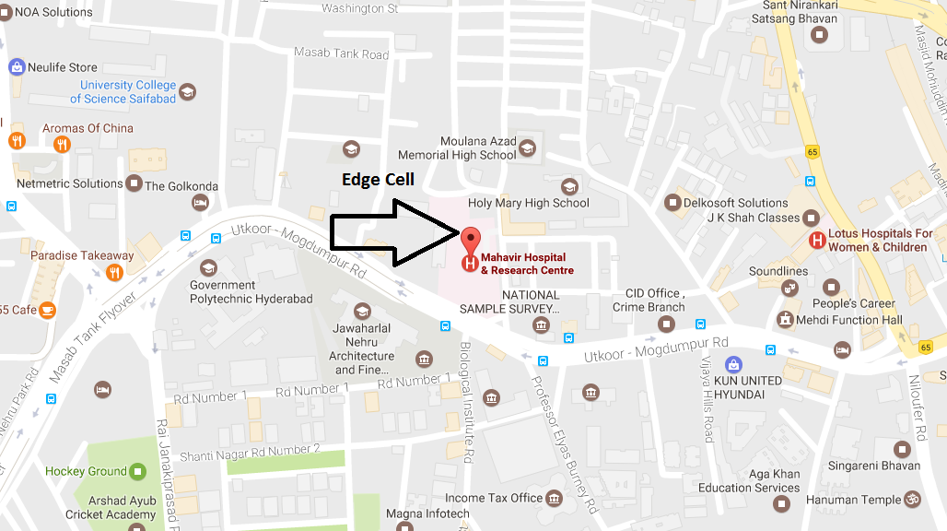
Band 3 Edge Cell

Slide 12
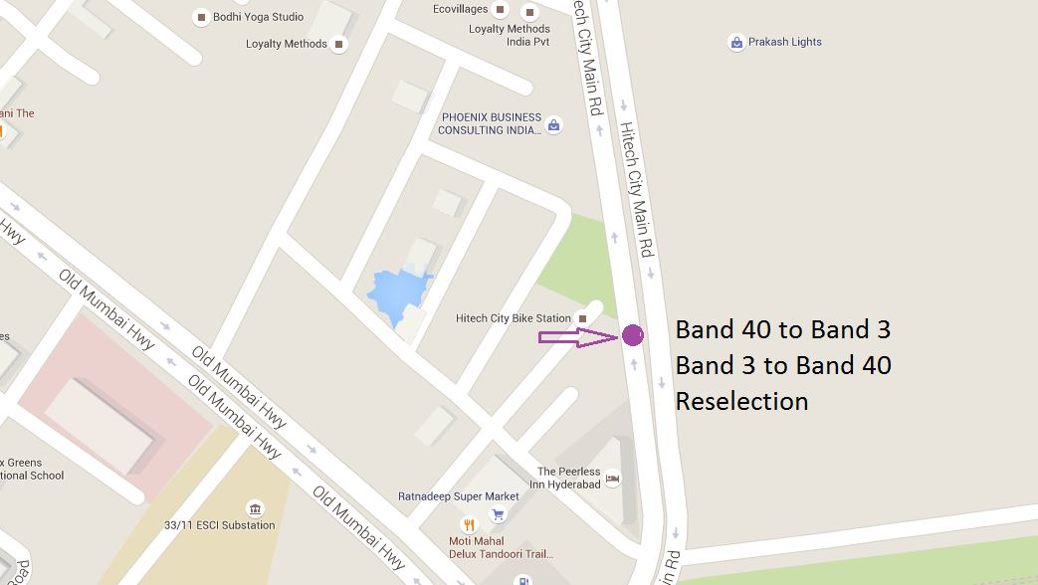
Band40<->Band3 Reselection
Location:- Quality Inn
Starting Point :-
Lat :-17.429375
Long :-78.374859
Ending Point :-
Lat :- 17.432109
Long :-78.374804

Slide 13
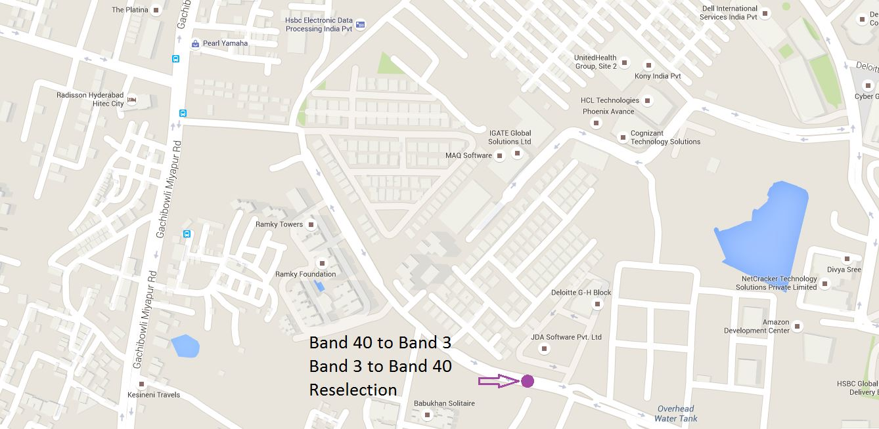
Band40<->Band3 Reselection
Location:- JDA software Pvt. Ltd., Deloitte
Starting Point :-
Lat :-17.441803
Long :-78.373140
Ending Point :-
Lat :- 17.444249
Long :- 78.367035

Slide 14
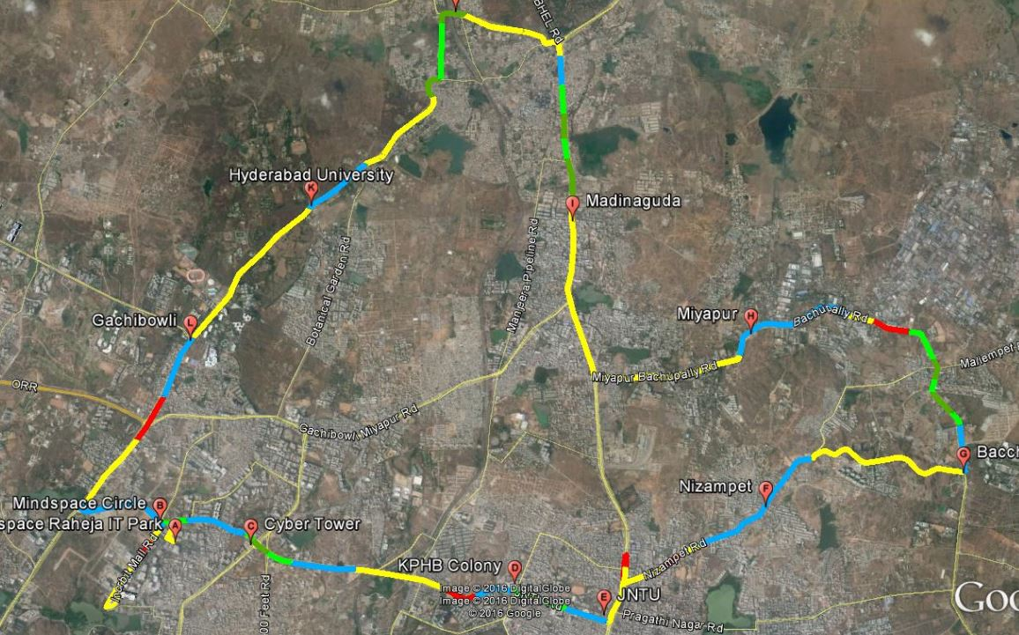
Mixed Mobility Route1
(Hitech City → JNTU →Nizampet → Bacchupally → Miyapur → Madinguda →HCU → Gachibowli → Hitech)
Starting Point :-
Lat :-17.441858
Long :-78.380164
Ending Point :-
Lat :- 17.439048
Long :- 78.376927
RSRP Level
 | -60 to -70
 | -70 to -80
 | -80 to -90
 | -90 to -100
 | Above -100

Slide 15
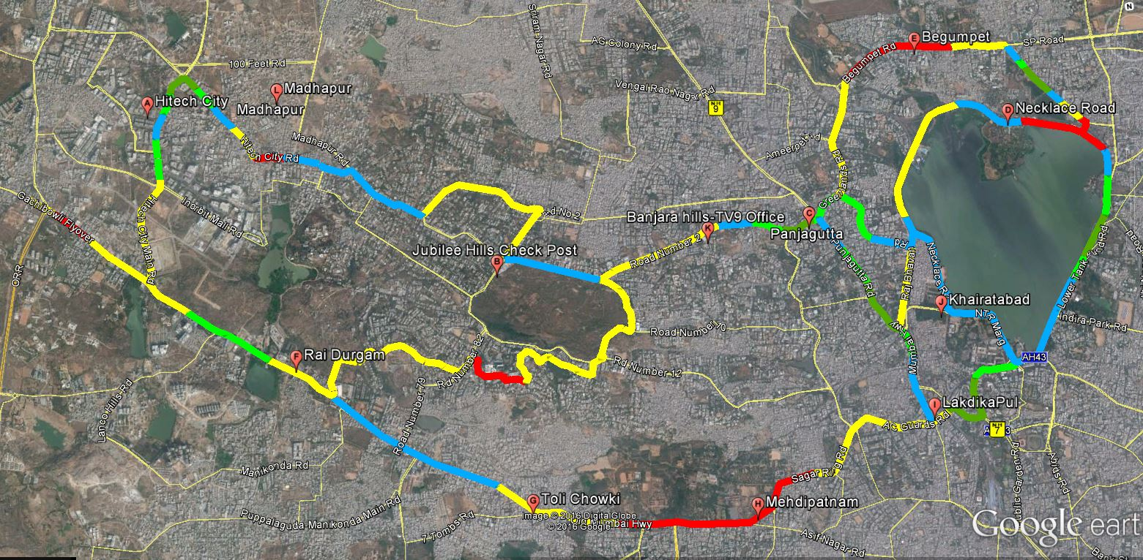
Mixed Mobility Route2
(Hitech City → Jubilee Hills →Banjara Hills →Necklace Road → Begumpet → Mehdipatnam → Raidurgam → Hitech)
Starting Point :-
Lat :-17.441858
Long :-78.380164
Ending Point :-
Lat :- 17.439048
Long :- 78.376927
RSRP Level
 | -60 to -70
 | -70 to -80
 | -80 to -90
 | -90 to -100
 | Above -100

Slide 16
Drive Route_HYD
Operator: Airtel 4G LTE
Mode: Idle & Connected

Slide 17
Introduction:
LTE BASIC SPECIFICATIONS
PARAMETER | DETAILS
Peak downlink speed (Mbps) | 31Mbps
Peak uplink speeds (Mbps) | 19Mbps
CSFB | Supported, 4G to 3G/2G
Channel bandwidths (MHz) | 5-DL Bandwidth 5-UL Bandwidth
Duplex schemes | FDD
Infra Vendor | Ericsson
Latency | Idle to active less than 100ms Small packets ~10 ms
Spectral efficiency | Downlink: 3 - 4 times Rel 6 HSDPA Uplink: 2 -3 x Rel 6 HSUPA
Access schemes | OFDMA (Downlink) SC-FDMA (Uplink)
DRX | 1280

Slide 18
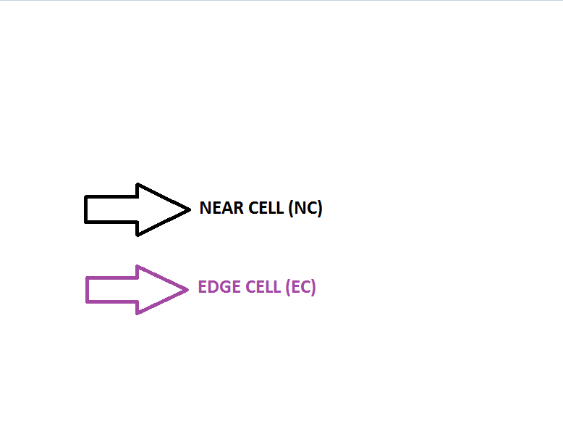
NEAR CELL & EDGE CELL SPOTS OF HYDERABAD

Slide 19
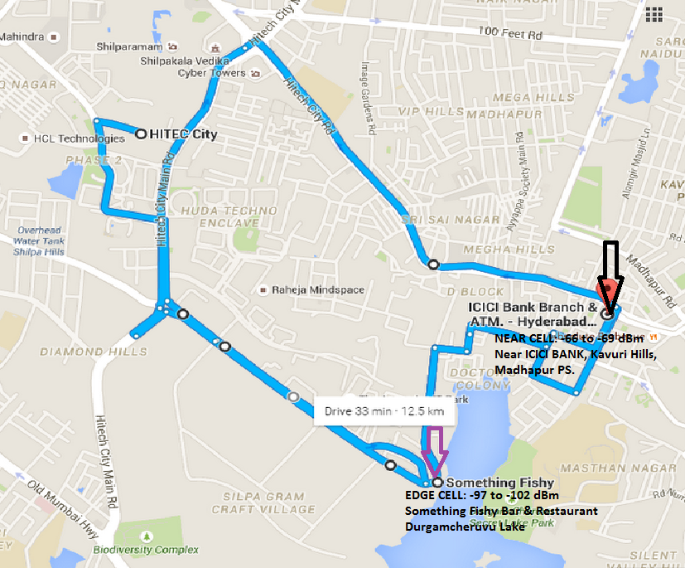
Route: Hi-Tech City, Madhapur, Durgamcheruvu Mode: Idle

Slide 20
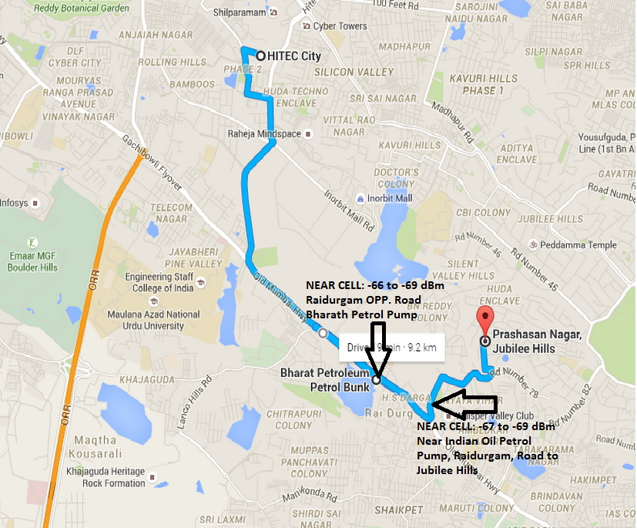
Route: Hi-tech City, Raidurgam, Jubilee Hills Mode: Idle

Slide 21
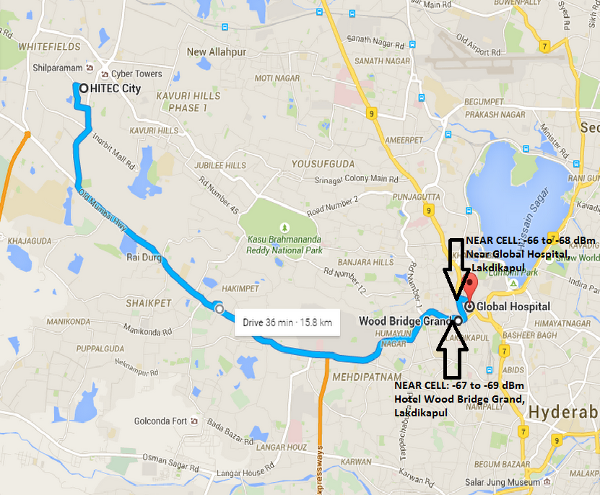
Route: Hi-tech City, Rethibowli, Masab tank, Lakdikapul Mode: Idle

Slide 22
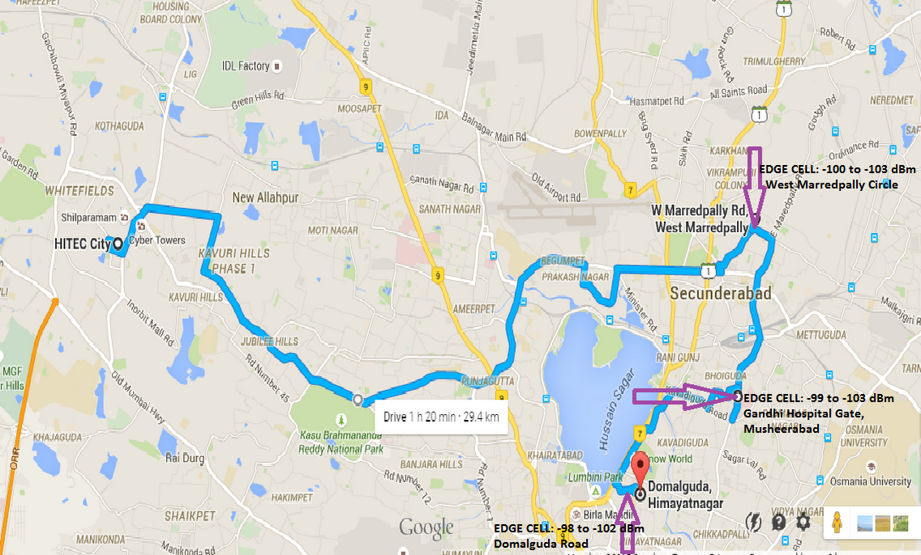
Route: Hi-tech City, Domalguda, West Marredpally, Musheerabad Gandhi Hospital Mode: Idle

Slide 23
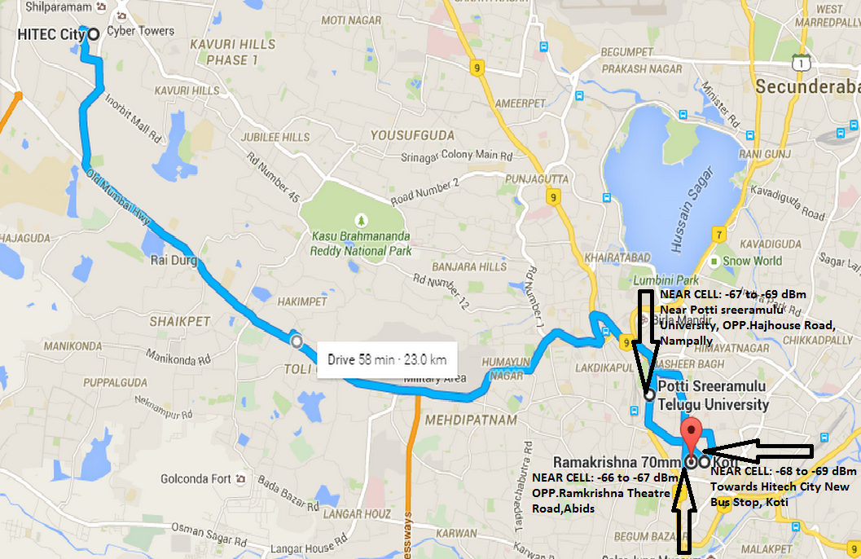
Route: Hi-tech City, Lakdikapul, Nampally, Abids, Koti Mode: Idle

Slide 24
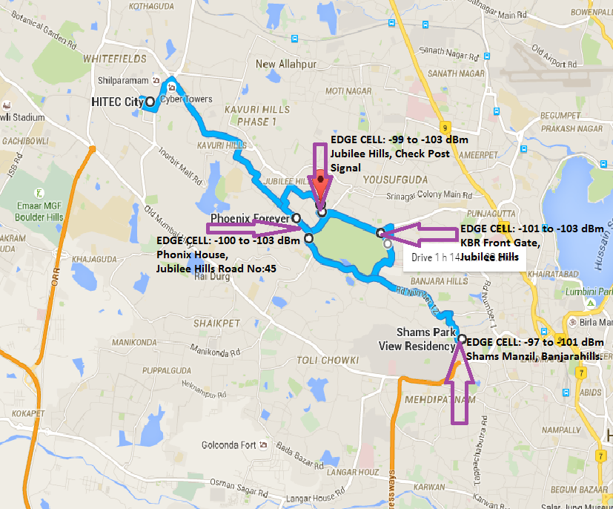
Route: Hi-Tech City, Jubilee Hills Road No-45, Banjar hills, KBR Park Mode: Idle

Slide 25
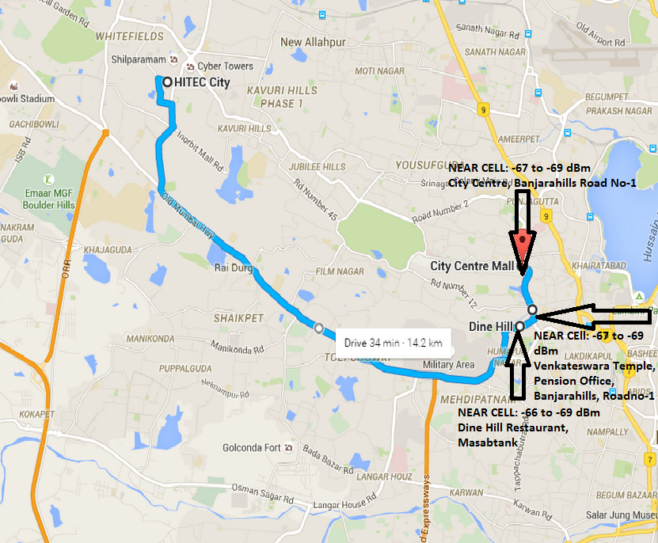
Route: Hi-tech City, Masab tank, Banjara hills Road No-1 Mode: Idle

Slide 26
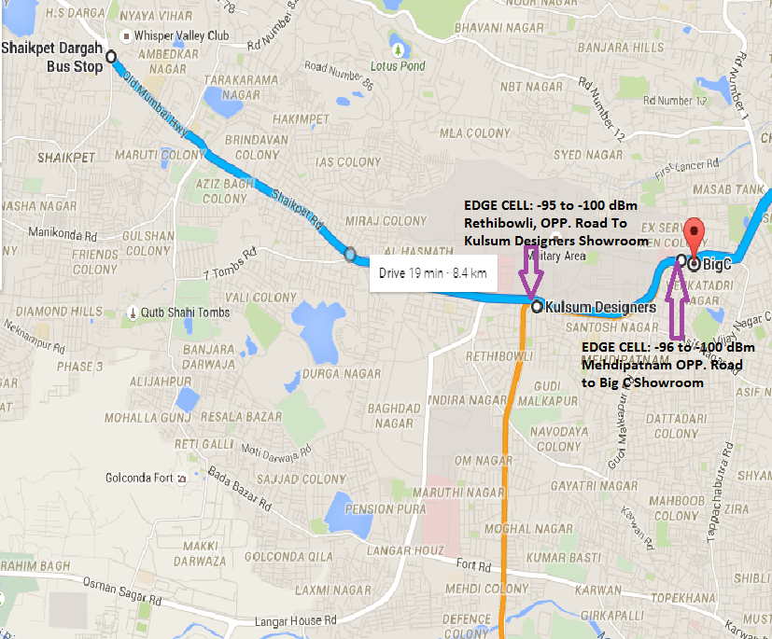
Route: Shaikpet Dargah, Rethibowli, Mehdipatnam Mode: Idle

Slide 27
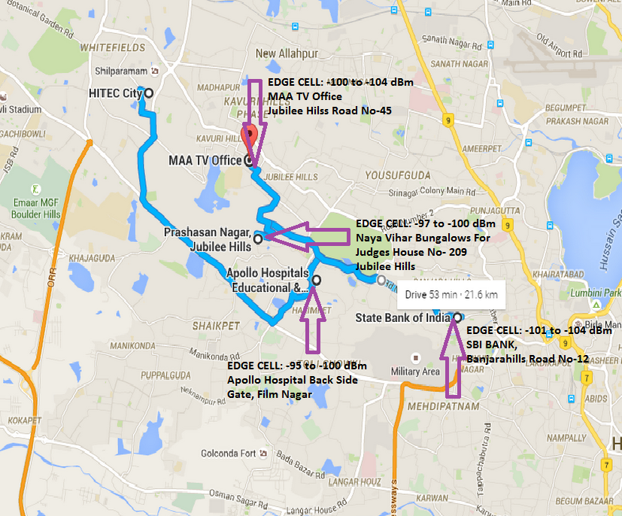
Route: Hi-tech City, Jubilee Hills, Banjara hills Road No-12, Apollo Hospital Jubilee Hills Mode: Idle

Slide 28
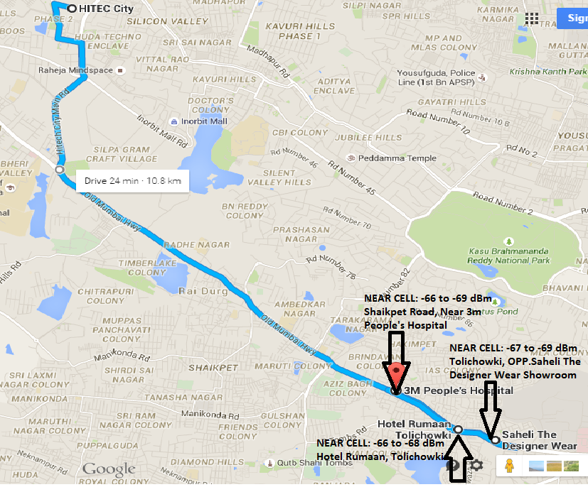
Route: Hi-Tech City, Shaikpet, Tolichowki, Raidurgam Mode: Idle

Slide 29
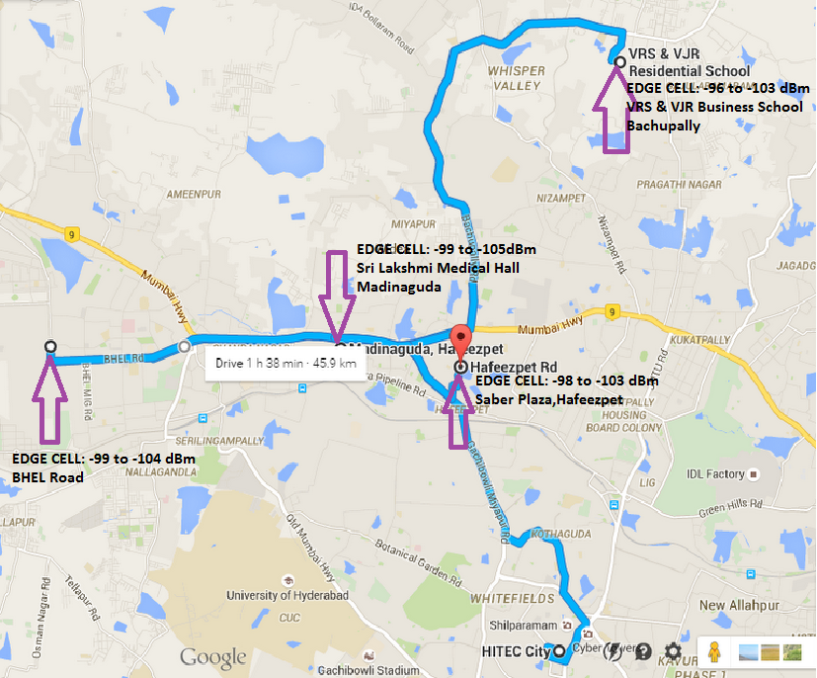
Route: BHEL, Madinaguda, Hafeezpet, Bachupally Mode: Idle

Slide 30
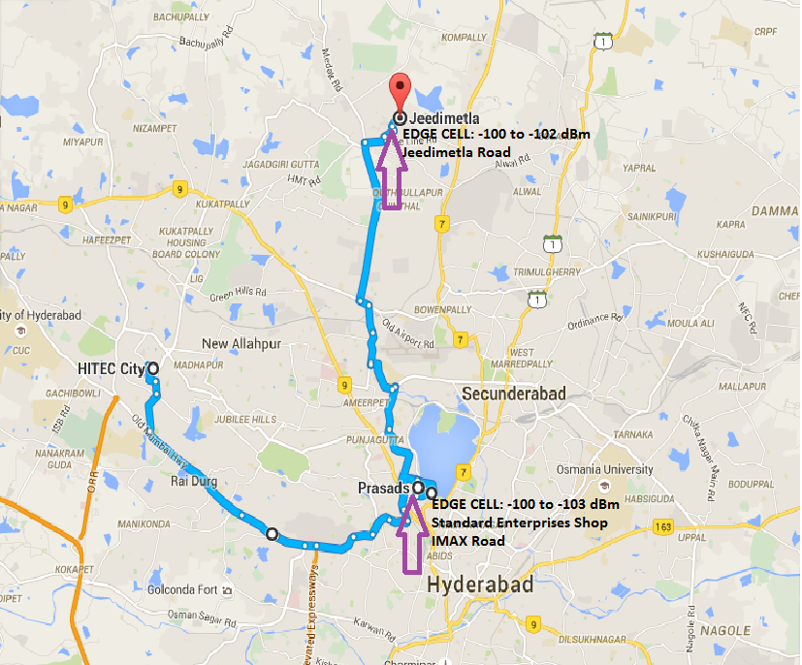
Route: Hi-tech City, Jeedimetla, IMAX Road Mode: Idle

Slide 31
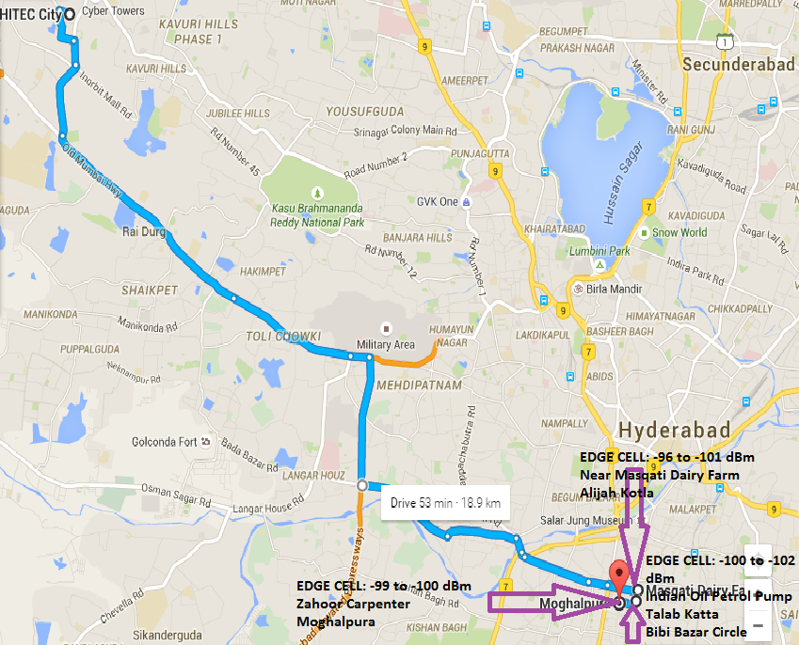
Route: Hi-tech City, Moghalpura, Alijah Kotla, Talab Katta Mode: Idle

Slide 32
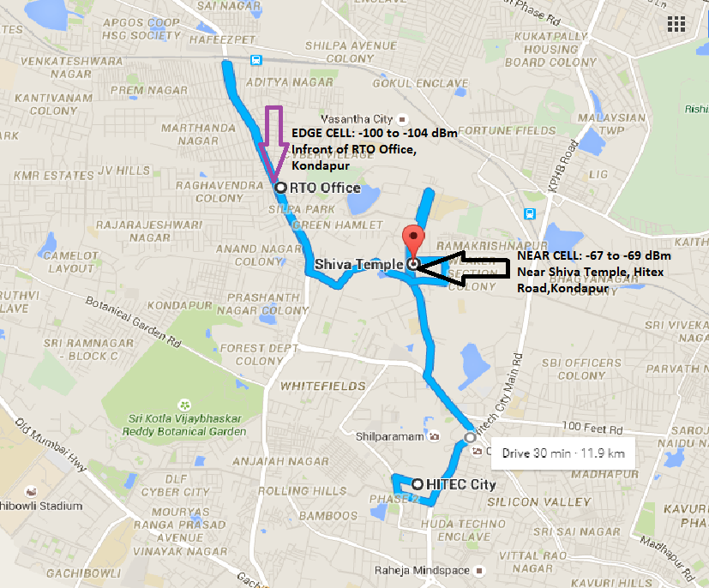
Route: Hi-tech City, Kondapur, Hi-tex Mode: Idle

Slide 33
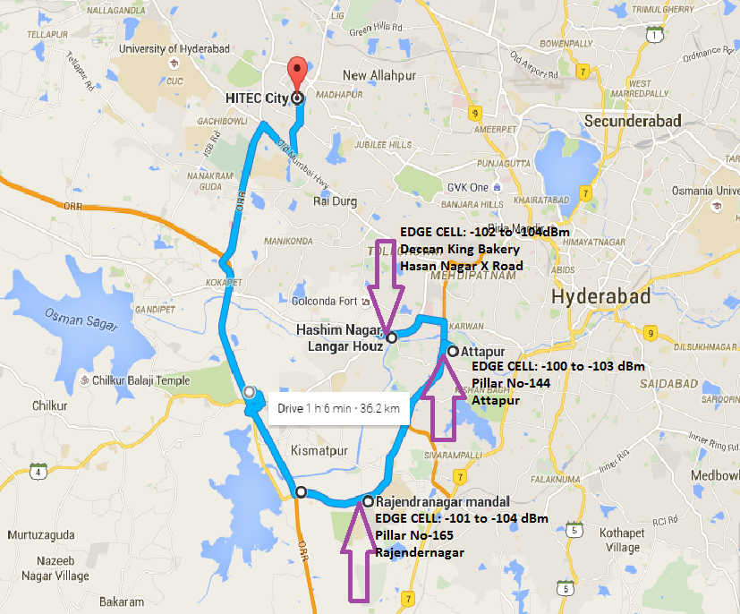
Route: Hi-tech City, Rajendernagar, Attapur, Hasan Nagar, Langer House Mode: Idle

Slide 34
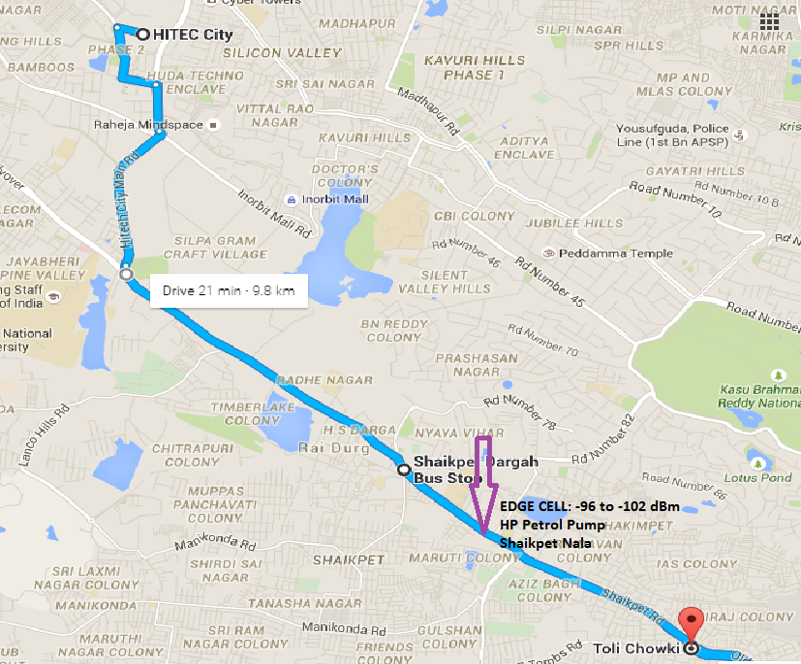
Route: Hi-tech City, Shaikpet Dargah, Tolichowki Mode: Idle

Slide 35
IRAT From 4G To 3G & 3G To 2G

Slide 36
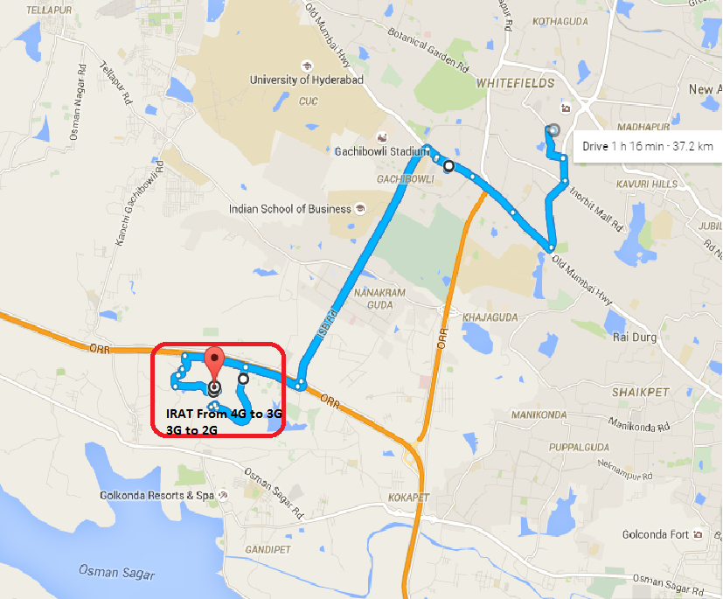
IRAT Route: Hi-tech City To Movie Towers Mode: Idle

Slide 37
Out Of Service (OOS) Mode: LTE ONLY

Slide 38
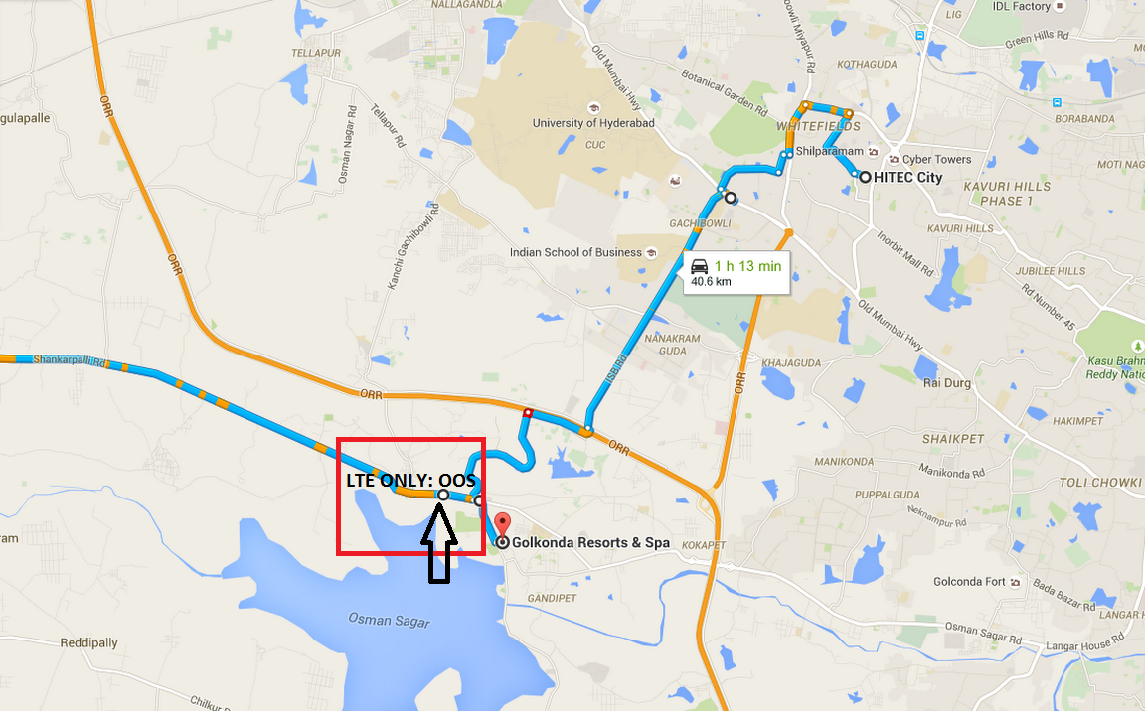
OOS Route: Hi-Tech City To Shankarpally Road Mode: LTE Only

Slide 39
Redirection From 4G To 3G Mode: Connected

Slide 40
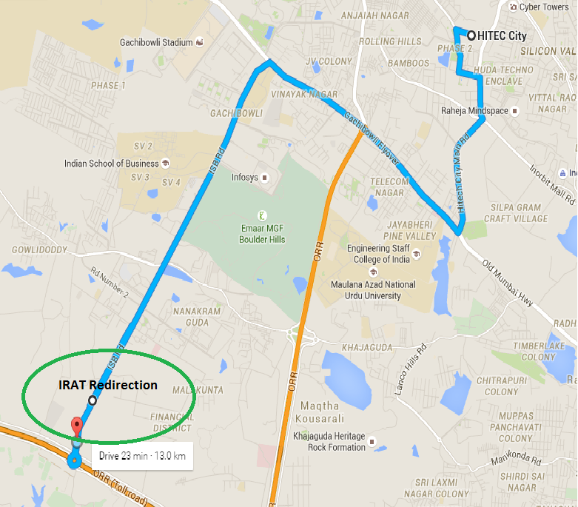
Route: Hi-Tech City To ISB Road, Financial District IRAT Redirection

Slide 41
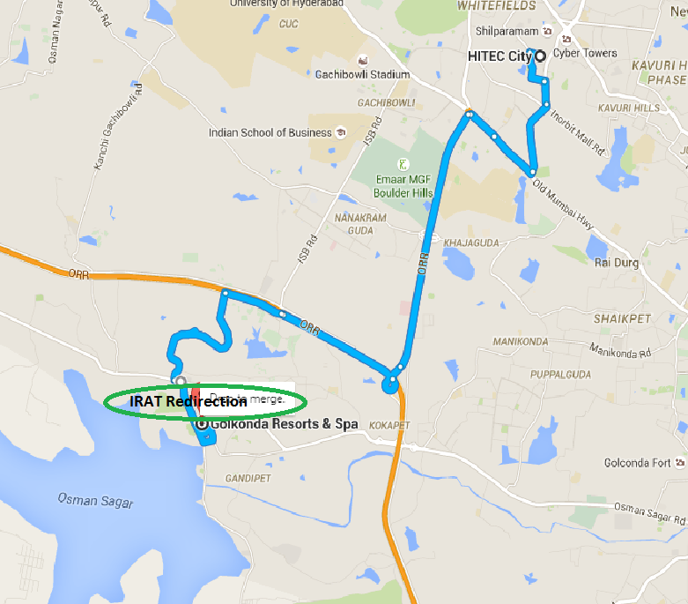
Route: Hi-Tech City To Gandipet

Slide 42
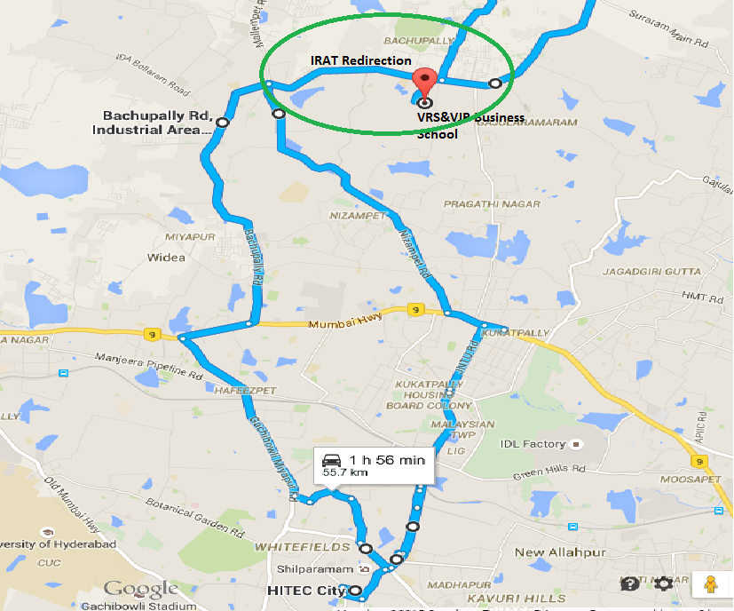
Route: Hi-Tech City To Bachupally Road

Slide 43
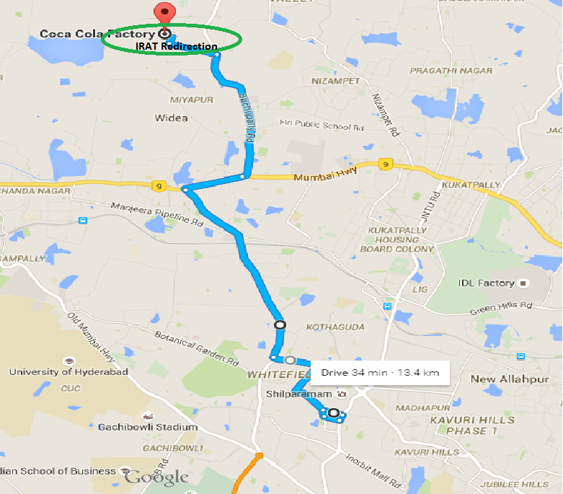
Route: Hi-Tech City To Coca-Cola Factory, Bachupally Road

Slide 44
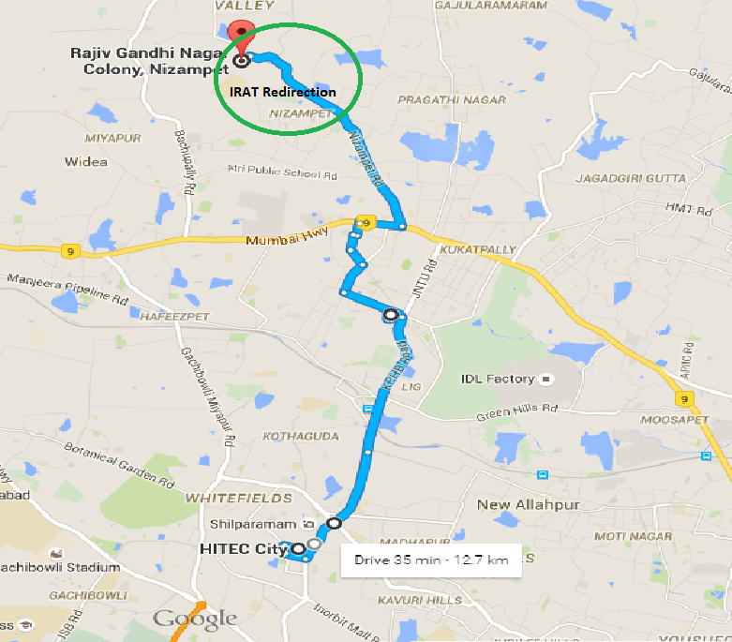
Route: Hi-Tech City To Rajiv Gandhi Nagar, Nizampet

Slide 45
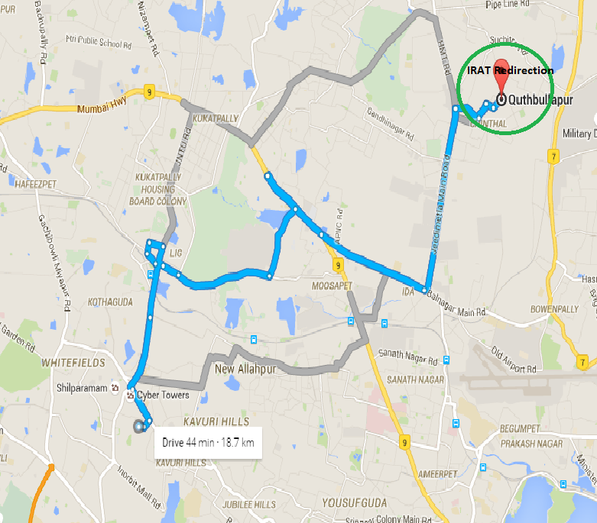
Route: Hi-Tech City To Quthbullapur

Slide 46
IRAT Reselection From 4G To 3G Mode: Idle Note:- While performing Reselection I have seen Reselection Failures at many places, because 4G is directly switching to GSM not to 3G, at only one place, I have seen Idle Reselection is happening successfully (2/10). So, at present Reselection is Blocked, till the issue gets resolved.

Slide 47
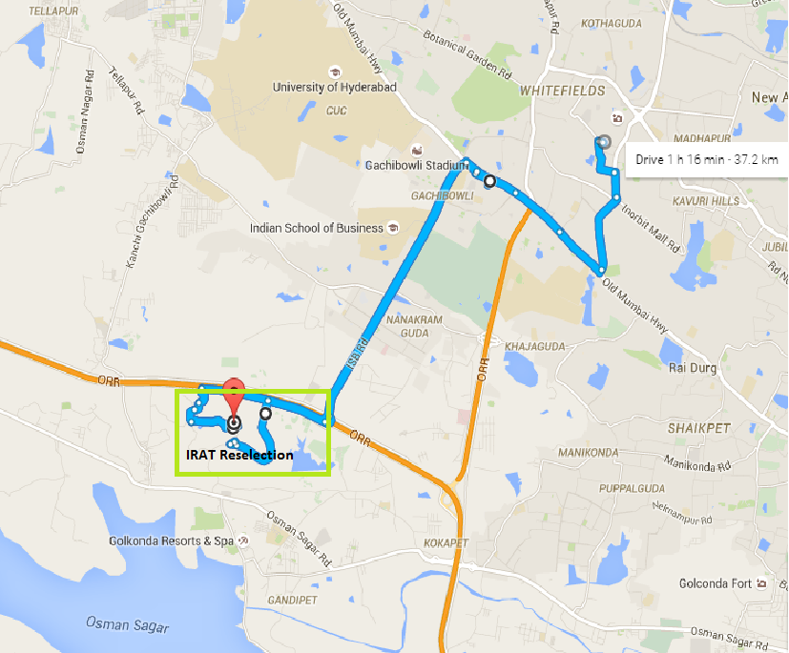
Route: Hi-Tech City To Movie Towers

Slide 48
Operator Information
Operator | MCC-MNC | Bands (MHz) | DRX value
Idea | 404-07 | 4G:- LTE (5 MHz) ARFCN: 1418 | 4G:-1280

Slide 49
Operator Information
Functionality | Idea
Website: http://www.ideacellular.com/ WAP APN: ideainternet
Customer care | 121
MNC | 07
Bands supported | EDGE/GPRS/GSM 900 MHz
 | HSDPA / UMTS 2100
 | LTE 1800 MHz –FDD(Band 3)
USSD | To check MDN:*1#
 | Balance check: *121#
 | Data Balance check: *125#
VoLTE | Not Supported
CSFB | Supported
MMS support | Not Supported

Slide 50
Drive Route
Near Cell :-Stationary: RSRP: -65dbm to -75dbm
Cell Edge :-Stationary: RSRP : -100dbm to -105dbm
Mixed :-Mobility: RSRP : -65dbm to -120dbm

Slide 51
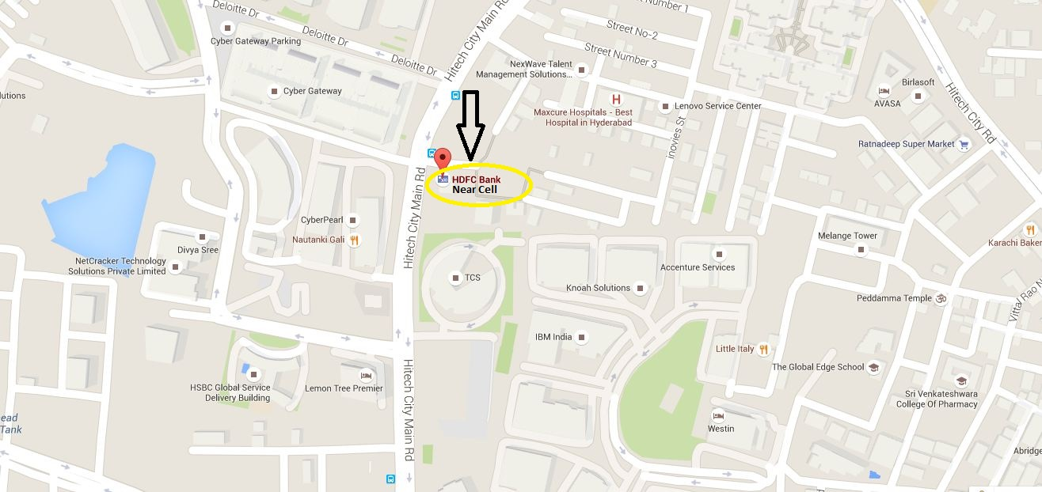
Near Cell: HDFC Bank, Hitech City
RSRP: -65dbm to -75dbm
LAT: 17.44363 LONG: 78.379956

Slide 52
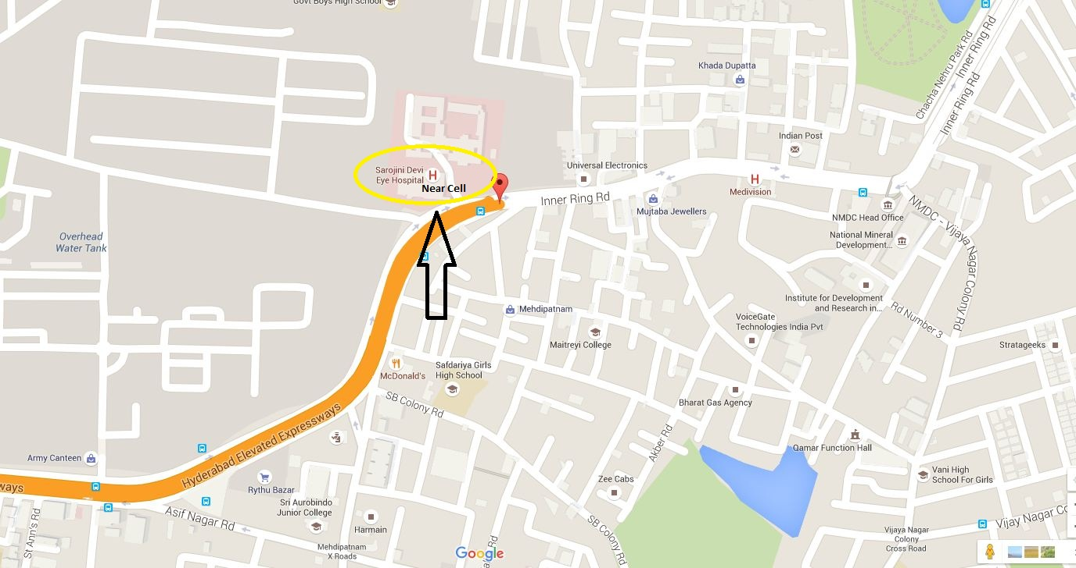
Near Cell: Sarojini Eye Hospital, Mahdipatnam
RSRP: -65dbm to -75dbm
LAT: 17.391636 LONG: 78.440065

Slide 53
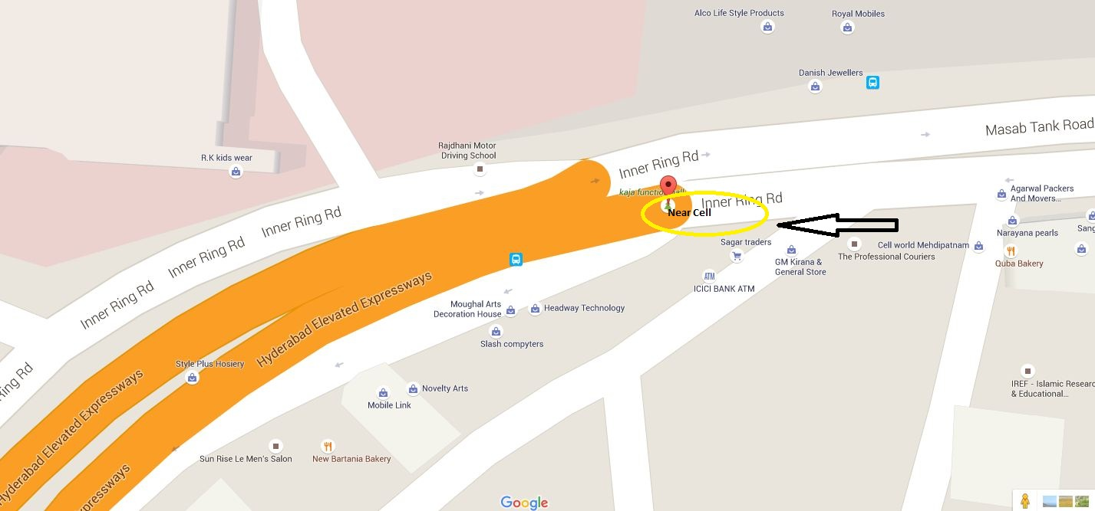
Near Cell: NMDC, Masab Tank
RSRP: -65dbm to -75dbm
LAT: 17.391636 LONG: 78.440065

Slide 54
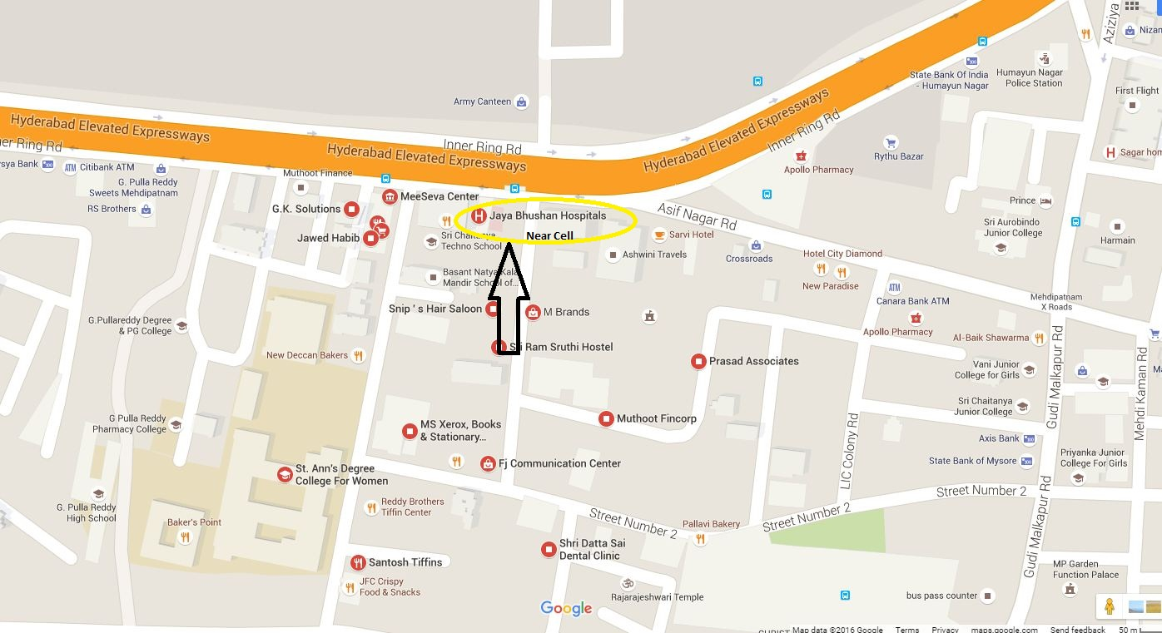
Near Cell: JayaBhusan Hospital, Mahdipatnam
RSRP: -65dbm to -75dbm
LAT: 17.393948 LONG: 78.438958

Slide 55
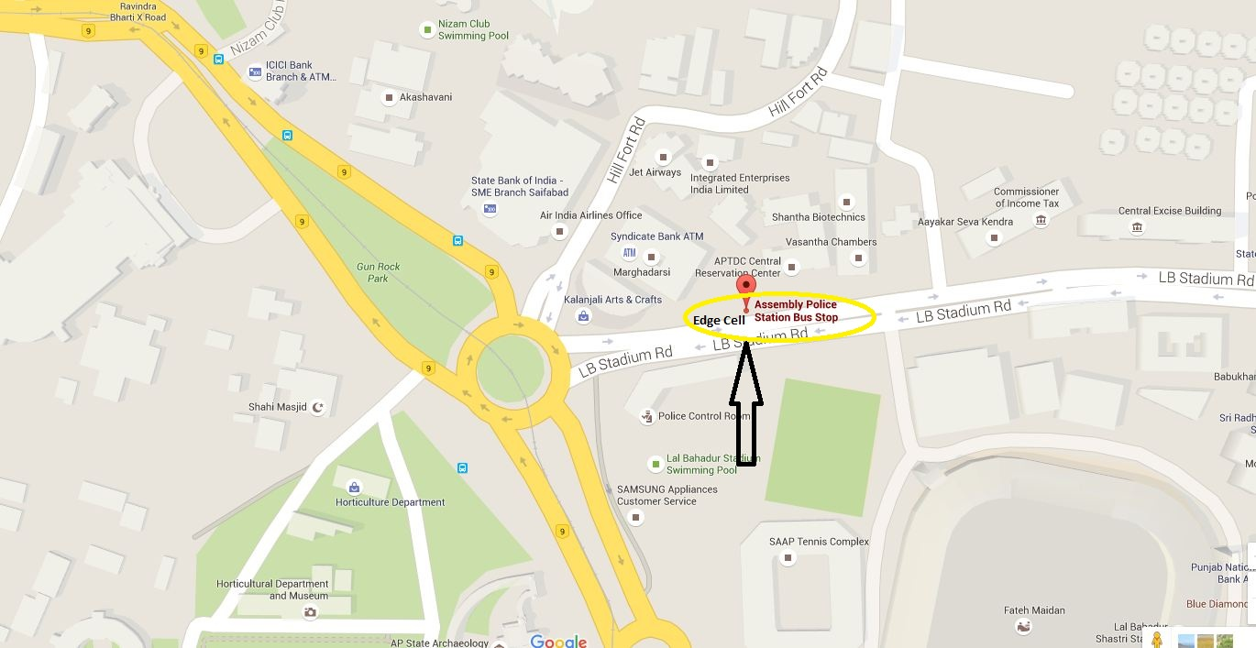
Edge Cell: LB Stadium Road, Band Colony, Adarsh Nagar
RSRP: -95dbm to -105dbm
LAT: 17.401107 LONG: 78.472396

Slide 56
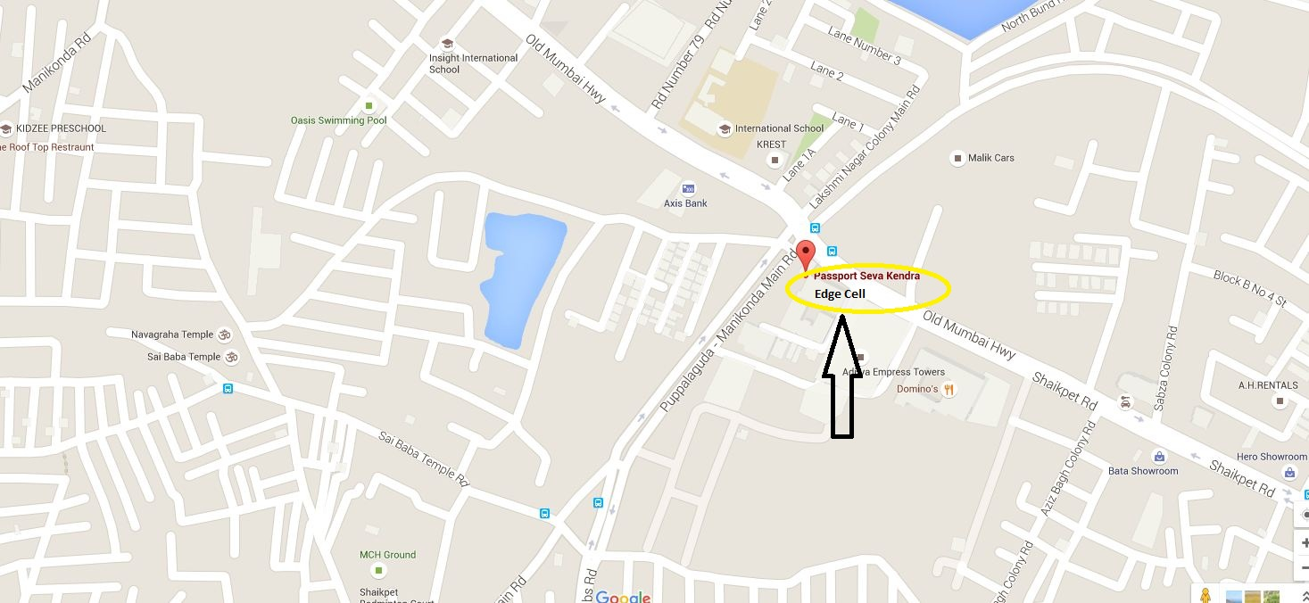
Edge Cell: Passport Office, Towlichowki
RSRP: -95dbm to -105dbm
LAT: 17.401107 LONG: 78.472396

Slide 57
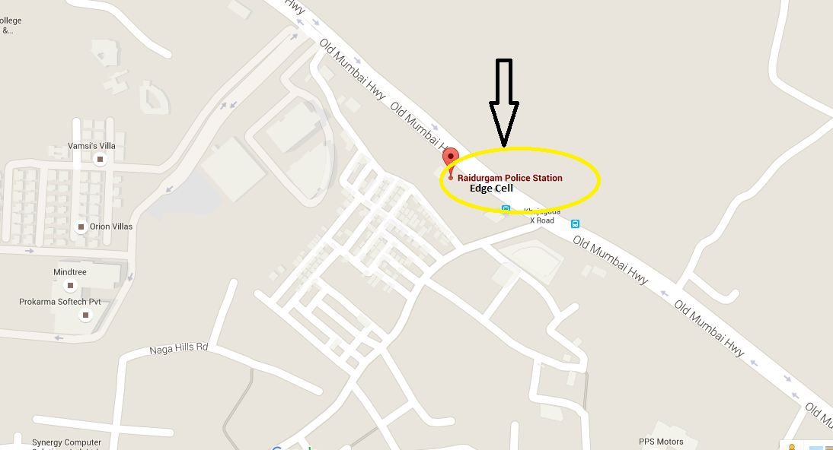
Edge Cell: Raidurgam Police Station
RSRP: -95dbm to -105dbm
LAT: 17.423079 LONG: 78.377112

Slide 58
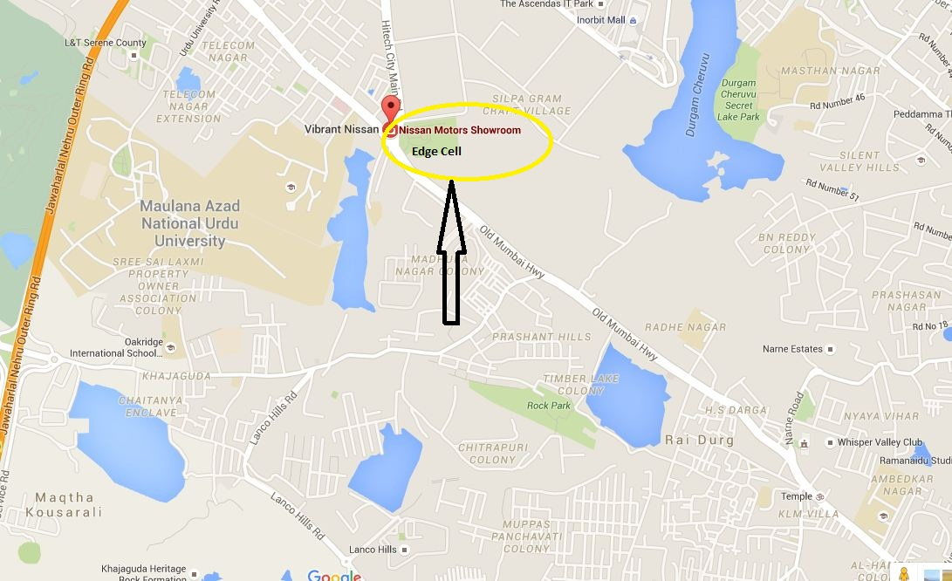
Edge Cell: Nissan Motors Showroom
RSRP: -95dbm to -105dbm
LAT: 17.437468 LONG: 78.374268

Slide 59
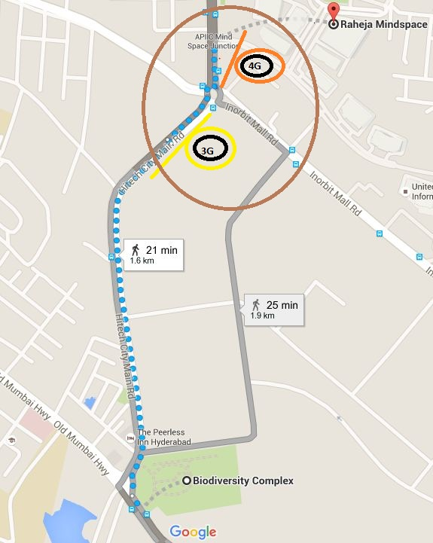
L2W Reselection/ Redirection: MindSpace Circle, Bio-Diversity

Slide 60
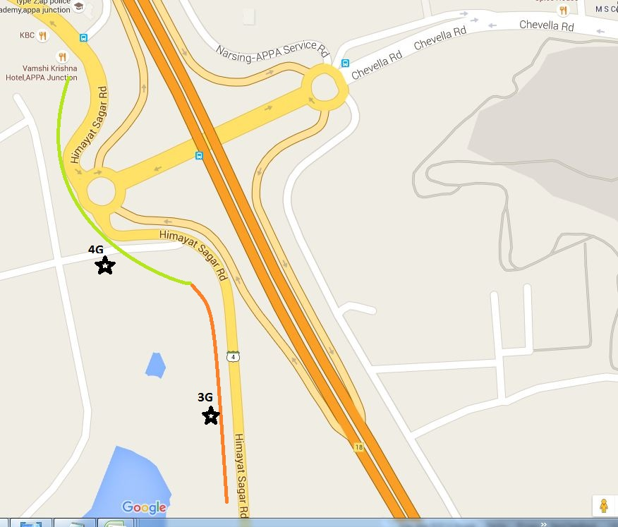
L2W Reselection/ Redirection: Himayat Sagar Road

Slide 61
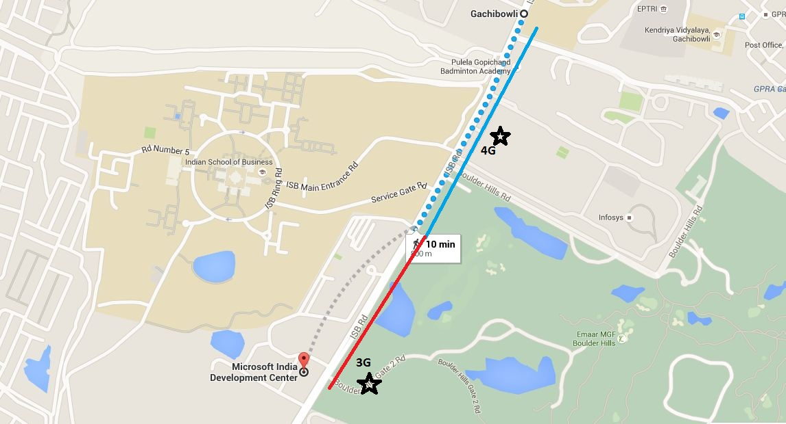
L2W Reselection/ Redirection: Microsoft Gate No.1, Gachibowli

Slide 62
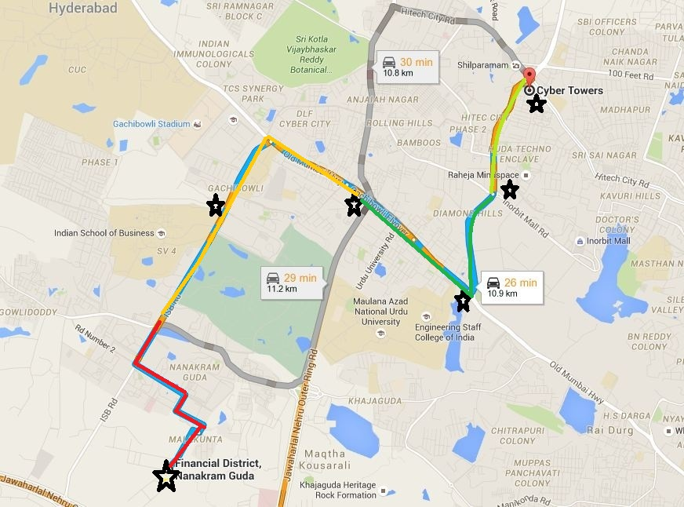
Mixed Mobility: Cyber Tower to Financial Disrtict
Starting Point :-
Lat :- 17.450368
Long :- 78.381052
Ending Point :-
Lat :- 17.410798
Long :- 78.341552
RSRP Level
 | -70 to -80
 | -80 to -90
 | -90 to -100
 | Above -100
RSRP Level
 | -70 to -80
 | -80 to -90
 | -90 to -100
 | Above -100

Slide 63
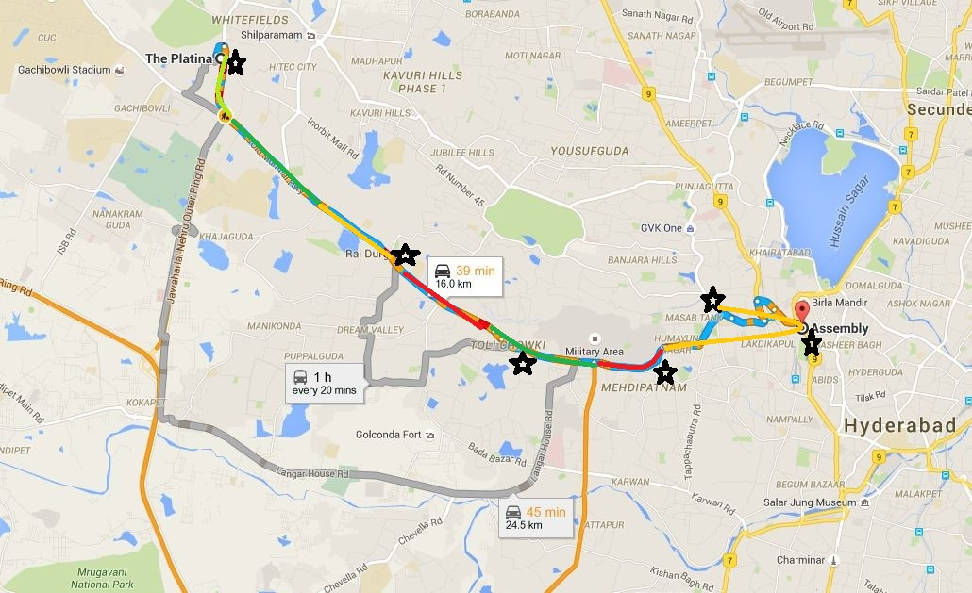
Mixed Mobility: Platina Gachibowli to Assembly Nampally
Starting Point :-
Lat :- 17.449059
Long :- 78.363290
Ending Point :-
Lat :- 17.401836
Long :- 78.469226
RSRP Level
 | -70 to -80
 | -80 to -90
 | -90 to -100
 | Above -100
RSRP Level
 | -70 to -80
 | -80 to -90
 | -90 to -100
 | Above -100

Slide 64
THANK YOU
MARQUIS TECHNOLOGIES
www.marquistech.com

