Slide 1
MARQUIS TECHNOLOGIES
Drive Routes - Hongkong/China

Slide 2
Operators in Hongkong
 |  | Operator
 |  | Smartone
 |  | CMHK(China Mobile Hongkong)
 |  | CSL
 |  | 3HK

Slide 3
Operators and Related Information
All the operators are having FDD LTE implementation
Smartone- Supports NR5G, VoLTE, VoWifi, ViLTE, LTE, WCDMA and 2G
3HK- Supports NR5G, VoLTE, VoWifi, ViLTE, LTE, WCDMA and 2G
CMHK- Supports NR5G, VoLTE, VoWifi, ViLTE, LTE, WCDMA and 2G
CSL- Supports NR5G, VoLTE, VoWifi, ViLTE, LTE, WCDMA and 2G
MMS over Vo-WiFi is supported by all three operators.

Slide 4
USSD codes for Postpaid Sim
3HK: *231, *107*3#
CSL: *101#
CMHK: #121

Slide 5

Supplementary Services
Smartone: Call forwarding and Call Waiting supported
CMHK: Call forwarding and Call Waiting supported
3HK: Call forwarding and Call Waiting supported
CSL: Call forwarding and Call Waiting supported

Slide 6
EN-DC Band Combination:-
Smartone: B1_n78
CMHK: B7_n78
3HK: B3_n78
CSL: B3_n78

Slide 7
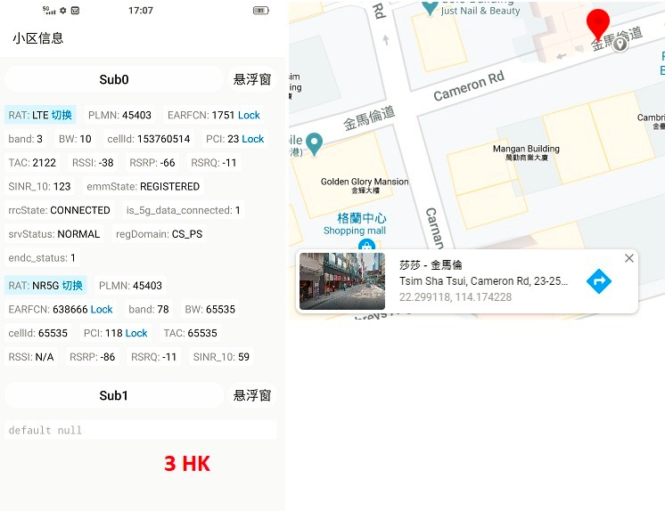
Band 3 n78 Good Coverage for 3HK Operator

Slide 8
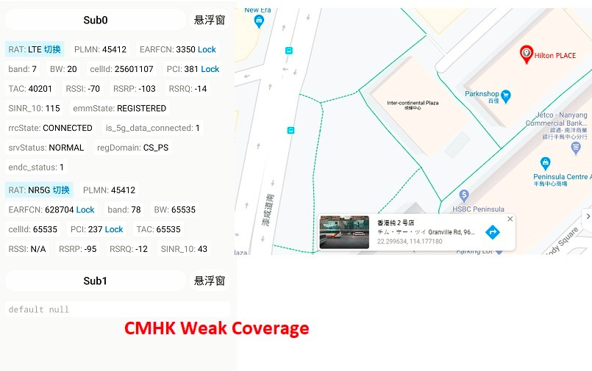
Band 7 n78 Weak Coverage for CMHK Operator

Slide 9
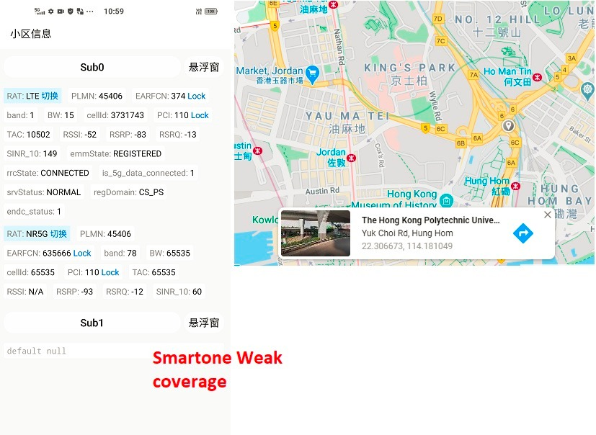
Band 1 n78 Weak Coverage for Smartone Operator

Slide 10
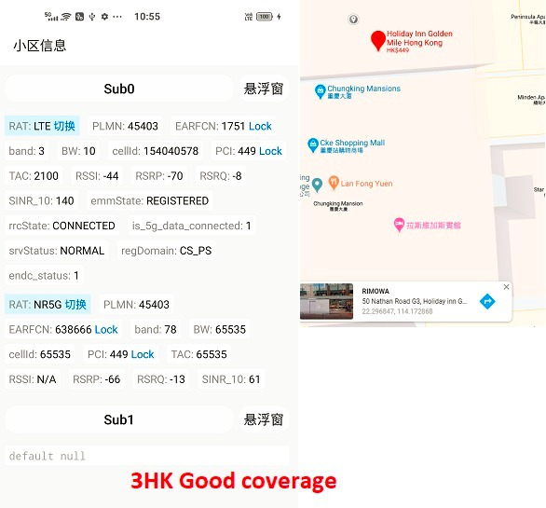
Band 3 n78 Weak Coverage for 3HK Operator

Slide 11
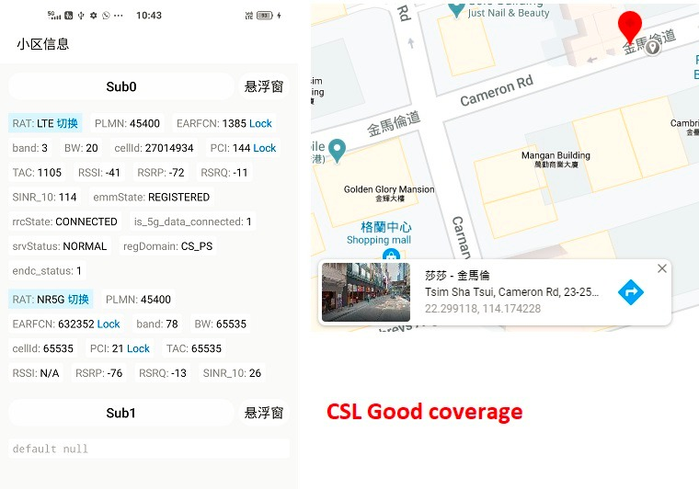
Band 3 n78 Good Coverage for CSL Operator

Slide 12
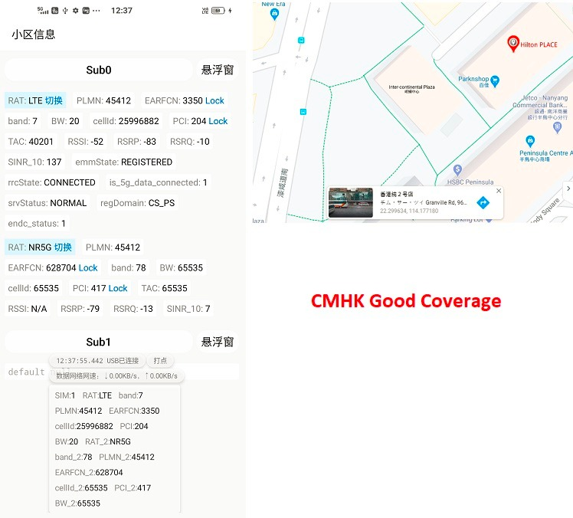
Band 7 n78 Good Coverage for CMHK Operator

Slide 13
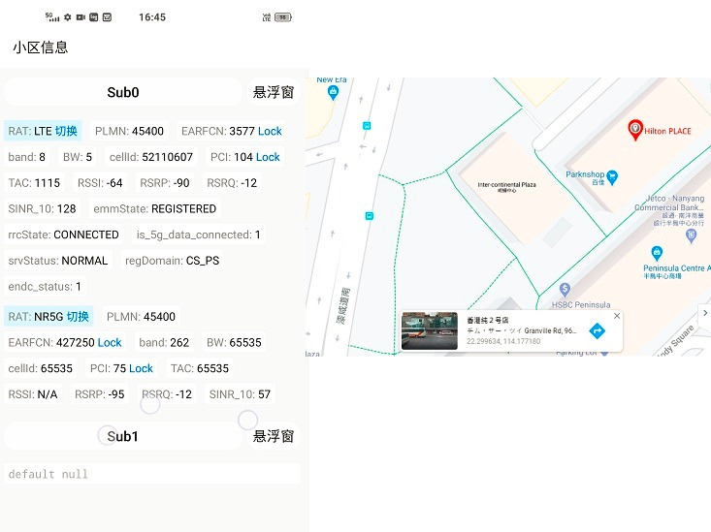
Band 8 n78 Good Coverage for Smartone Operator

Slide 14
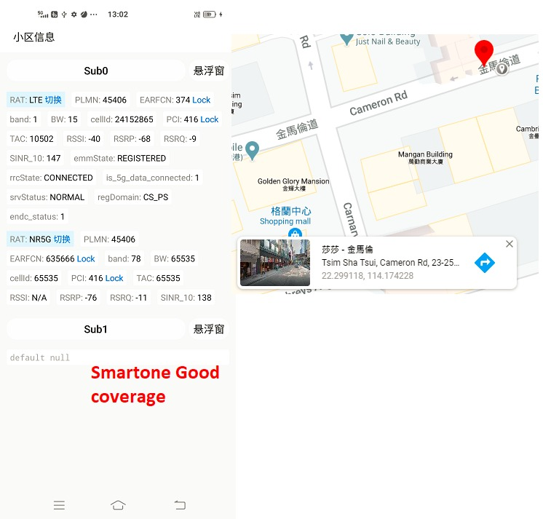
Band 1 n78 Good Coverage for Smartone Operator

Slide 15
Thank You

