Slide 1
MARQUIS TECHNOLOGIES
Drive Route – Hanoi (Vietnam)

Slide 2
Travel to Hanoi (Vietnam)
Country | Vietnam
Continent | Asia
City | Hanoi
Duration of travel from New Delhi | Approx. 7 Hrs.
Time Zone | GMT +7
International Dialing Code | +84
VISA | Business Visa
VISA Duration | 14 Days , Multiple Entry
VISA Fees | 50 $ for single person
VISA Requirements | Need to provide 2 passport size photographs, 6 month bank statement
Yellow Fever Vaccination Certificate | Not Required

Slide 3
Operator Information
MCC | MNC | Operator | Bands (MHz)
452 | 01 | MOBIFONE | GSM 900 / 1800 / UMTS 2100
452 | 04 | VIETTEL | GSM 900 / 1800 / UMTS 2100
452 | 02 | VINAFONE | GSM 900 / 1800 / UMTS 2100
452 | 05 | VIETNAMOBILE (WG) | GSM 900 / 1800 / UMTS 2100
452 | 03 | G-Mobile(G) | GSM1800

Slide 4
USSD Codes for operators
No. | Operator | Balance Check Code | Customer Care | Voice Mail No.
1 | MOBIFONE | *101# | Call 9244 for Prepaid | NA
2 | VIETTEL | *101# | Call 18008098 for Prepaid | NA
3 | VINAFONE | *101# | - | NA
4 | VIETNAMOBILE | *100# | - | NA
5 | G-Mobile | *100# | - | NA

Slide 5
Manual APN Settings
Attached is a sheet which has Manual APN Settings for all operators in Hanoi (Vietnam)

Slide 6
RSRP Criteria
Near Cell :-Stationary: RSRP : -55dbm to -85dbm
Cell Edge :-Stationary: RSRP : -95dbm to -110dbm
Mixed :-Mobility: RSRP : -55dbm to -120dbm

Slide 7
Services Supported by Operators
Operator | Features/Services | Supports(Yes/No)
Mobifone | Reselection | Yes
 | Redirection | Yes
 | MMS | Yes
 | CSFB | Yes(3G)
 | VoLTE | No
 | PS Handover | Yes
Viettel | Reselection | Yes
 | Redirection | Yes
 | MMS | Yes
 | CSFB | Yes(3G)
 | VoLTE | No
 | PS Handover | Yes
Veenafone | Reselection | Yes
 | Redirection | Yes
 | MMS | Yes
 | CSFB | Yes(3G)
 | VoLTE | No
 | PS Handover | Yes

Slide 8
Additional Information
Where to Get SIM cards?
SIM cards are available at Airport, in shops and street kiosks.
What Documents Required to Purchase SIM?
Passport ID and Colored Photographs.
Best Recharge Option for 8 days Testing?
Recharges are available in all confectionery shops and street kiosks.
Best Hotel to Stay
Hotel Tirant
Driver Details for Mobility?
Mob: +84975528326

Slide 9
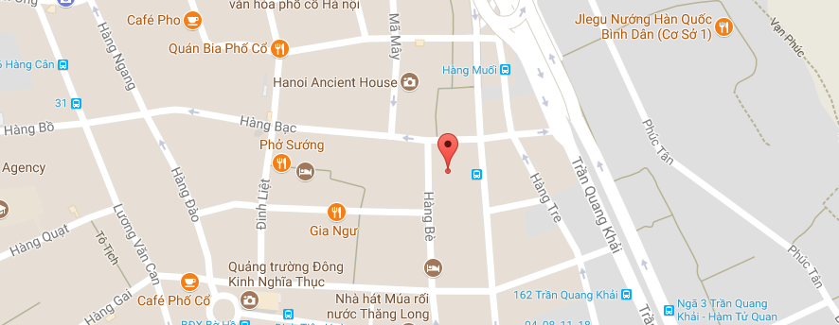
Near Cell Location of Viettel Location :Hang Mam Lat: 105.85402 Long: 21.033457

Slide 10
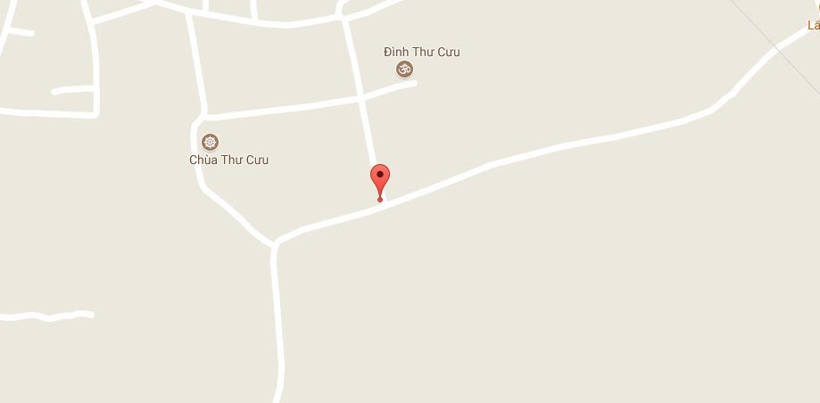
Edge Cell Location of Viettel Location :Chua Thur Curu Lat: 21.119980 Long: 105.88016

Slide 11
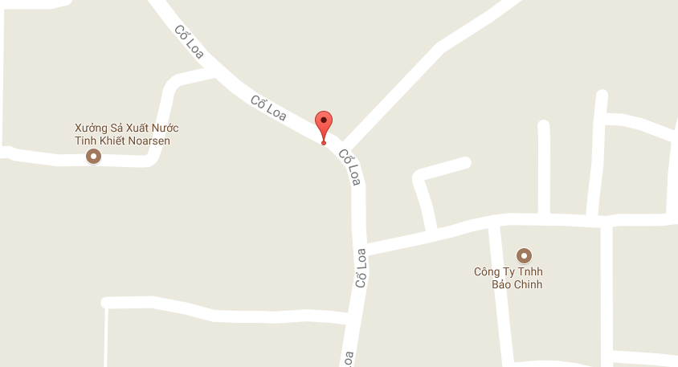
4G to 3G Reselection Location of Viettel Location :Xom Thuong Lat: 105.88016 Long: 21.119980

Slide 12
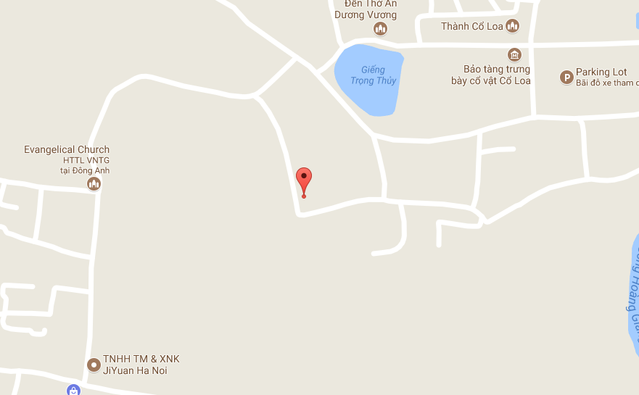
3G to 4G Reselection Location of Viettel Location :Near Gieng Trongthuy lake Lat: 105.87016 Long: 21.109980

Slide 13
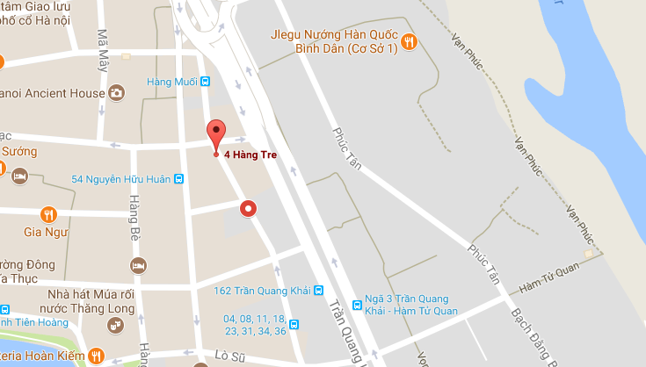
Near Cell Location of Mobifone Location :Hang tre Lat: 21.033087 Long:105.855189

Slide 14
Edge Cell Location of Mobifone Location :Chua Thur Curu Lat: 21.119980 Long: 105.88016

Slide 15
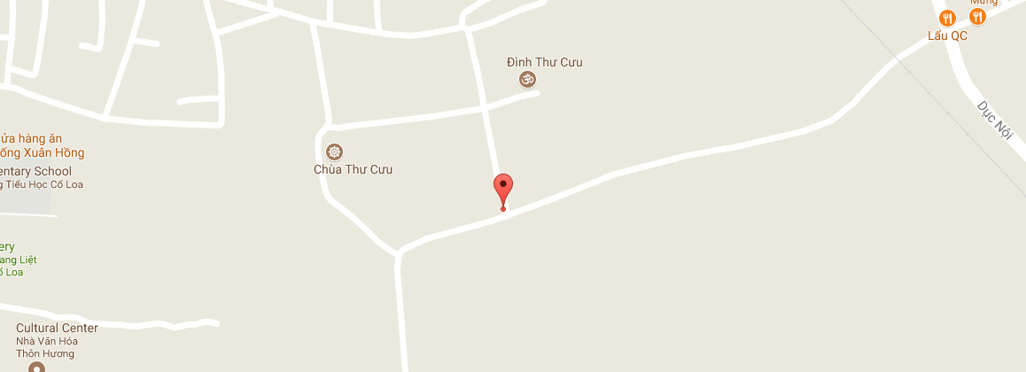
4G to 3G Reselection Location of Mobifone Location :Chua Thur Road Lat: 21.119980 Long: 105.88016

Slide 16
3G to 4G Reselection Location of Mobifone Location :Chua Thur Road Lat: 21.119980 Long: 105.88016

Slide 17
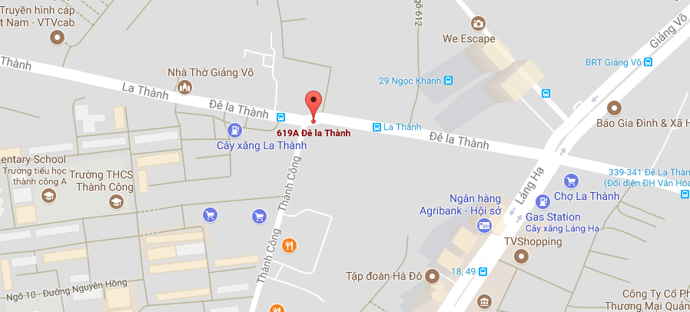
Near Cell Location of Vinafone Location : Dela Thanh Lat: 21.025779 Long: 105.810654

Slide 18
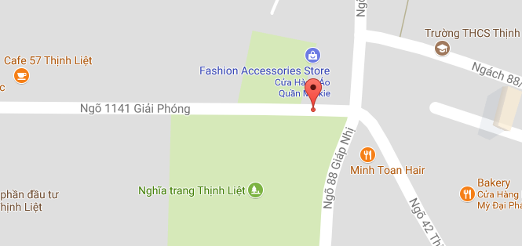
Edge Cell Location of Vinafone Location : Sakr Quresh Building Lat: 20.973960, Long:105.845136

Slide 19
4G to 3G Reselection Location of Vinafone Location :Xom Thuong Lat: 105.88016 Long: 21.119980

Slide 20
3G to 4G Reselection Location of Orange Location :Xom Thuong Lat: 105.88016 Long: 21.119980

Slide 21
Out of Service Location of All Operators Location: Not found

Slide 22
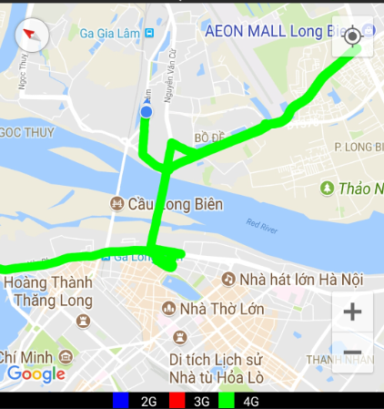
Mobility Route1:4G

Slide 23
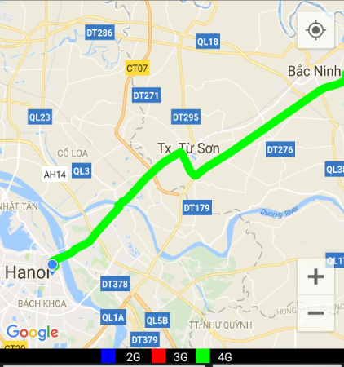
Mobility Route2:4G

Slide 24
Top Most Popular Android Apps used in Vietnam
Zalo
Facebook
Facebook Messenger
WhatsApp Messenger
Share it
Uber
Grab
True caller
Lazada

Slide 25
Local EM number used in Vietnam(Hanoi)
Police | 122
Weather Forecast | 1080
Police | 113
Ambulance | 115
Fire Bridge | 114

Slide 26
THANK YOU
MARQUIS TECHNOLOGIES
www.marquistech.com

