Slide 1
MARQUIS TECHNOLOGIES
Drive Route –Airtel, VI & Reliance JIO (FDD/TDD) LTE
Location : Goa

Slide 2
Operator Information:
Operator | JIO 4G
MCC | 405
MNC | 864
APN | jionet
Operator | Airtel 4G
MCC | 404
MNC | 90
APN | airtelgprs.com
Operator | VI
MCC | 404
MNC | 22
APN | internet

Slide 3
Operator Information 1
Functionality | Airtel
Website: https://www.airtel.in/ WAP APN: airtelgprs.com
Customer care | 121
MNC | 90
Bands supported | Both FDD and TDD
 | LTE 2300 MHz – TDD(Band 40)
 | LTE 1800 – FDD(Band 3) LTE 2100 – FDD (Band 1)
USSD | To check MDN: *282#
 | Balance check: *123#
 | To check all services: *121#
VoLTE | Supported
VoWiFi | Supported
CSFB | Supported (CSFB to 2G)

Slide 4
Operator Information 2
Functionality | RELIANCE JIO
Website: https://www.jio.com WAP APN: jionet
Customer care | 198
MNC | 864
Bands supported | Both FDD and TDD
 | LTE 2300 MHz –TDD(Band 40)
 | LTE 850 MHz – FDD(Band 5)
 | LTE 1800 MHz –FDD(Band 3)
USSD | NA
 | NA
 | NA
VoLTE | Supported
VoWiFi | Supported
CSFB | Not Supported

Slide 5
Operator Information 3
Functionality | VI
Website: https://www.myvi.in WAP APN: internet
Customer care | 198
MNC | 22
Bands supported | Both FDD and TDD
 | LTE 2300 MHz –TDD(Band 40)
 | LTE 2500 MHz –TDD(Band 41)
 | LTE 1800 MHz –FDD(Band 3)
USSD | To check MSISDN :*199#
 | Recharge : *199*5#
 | Balance check : *199*2#
VoLTE | Supported
VoWiFi | Not Supported
CSFB | Supported (CSFB to 2G/3G)

Slide 6
Drive Route
Near Cell : Stationary: RSRP : -65dbm to -75dbm
Edge Cell : Stationary: RSRP : -95dbm to -110dbm
Mixed : Mobility: RSRP : -65dbm to -110dbm

Slide 7
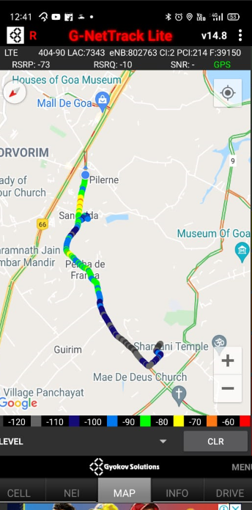
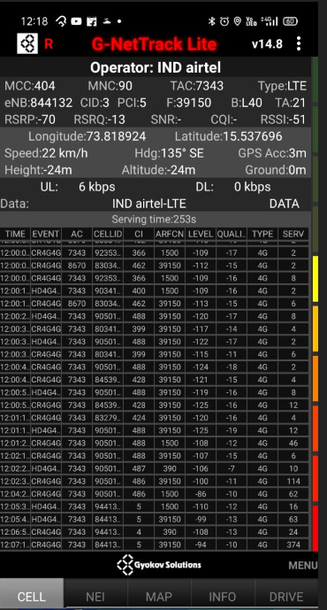
Near Cell (Airtel)
Near cell | longitude | latitude | RSRP (dbm) | Cell id | E-ARFCN
1 | 73.818924 | 15.537696 | -70 | 3 | 39150
RSRP Range for Near Cell :
-65dbm to -75dbm
Sangolda,
Pilerne Porvorim Goa

Slide 8
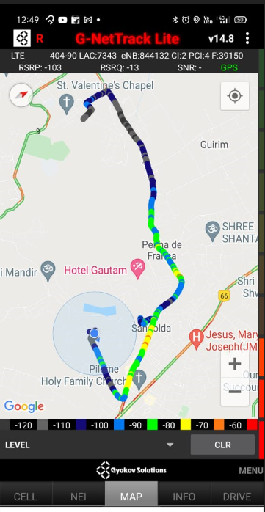
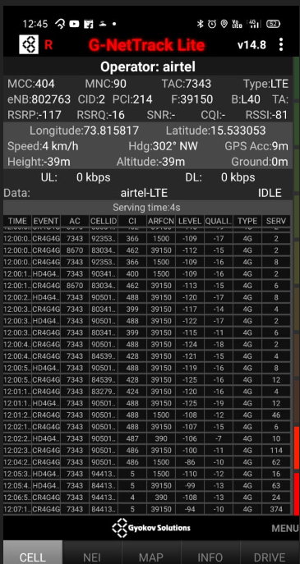
Edge Cell (Airtel)
Edge cell | longitude | latitude | RSRP (dbm) | Cell id | E-ARFCN
1 | 73.815817 | 15.533053 | -117 | 2 | 39150
RSRP Range for Edge Cell :
-95dbm to -110dbm
Sangolda,
Pilerne Porvorim Goa

Slide 9
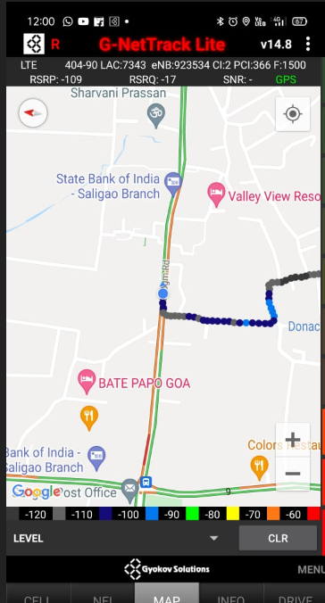
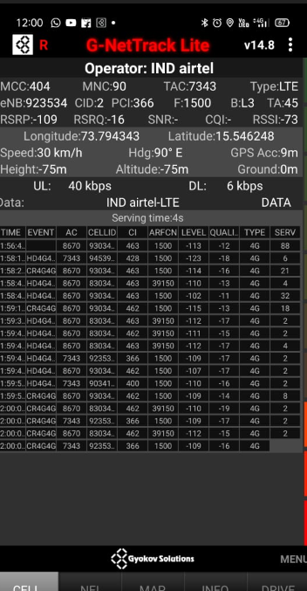
Mixed Coverage Area for Airtel

Slide 10
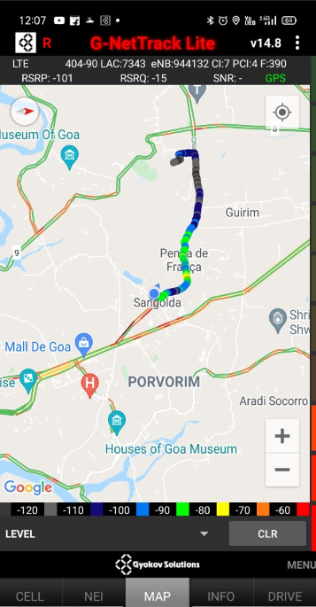
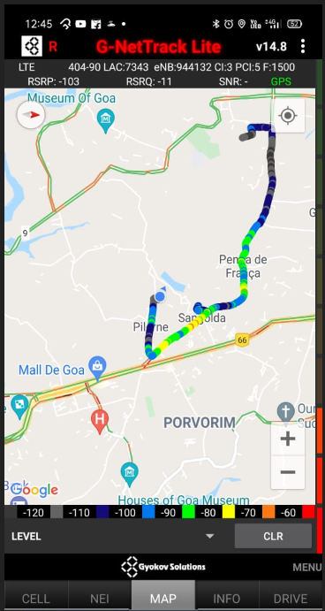
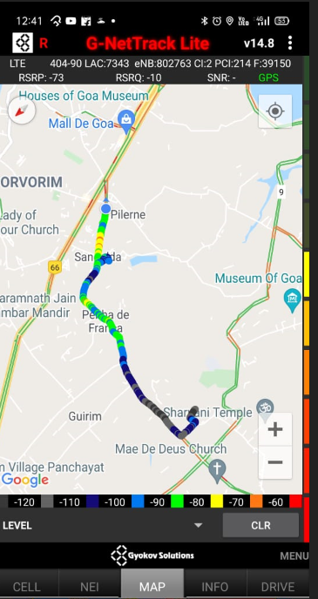
Airtel Inter Band HO
Band 1 BAND 3 BAND 40

Slide 11
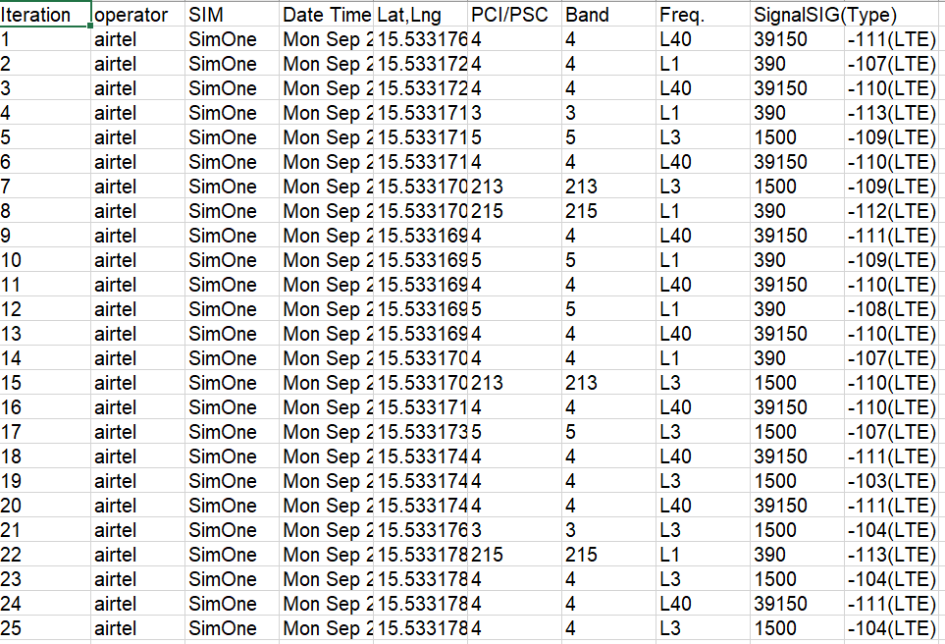
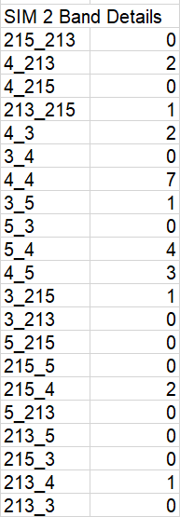
MATT Tool InterBand Handover Results for Airtel

Slide 12
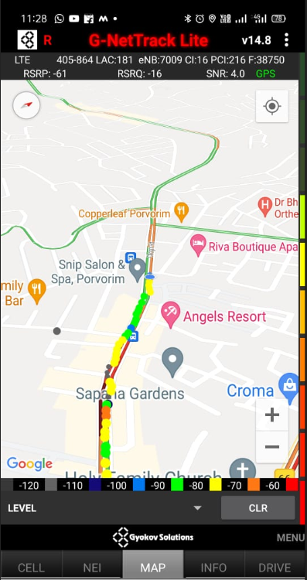
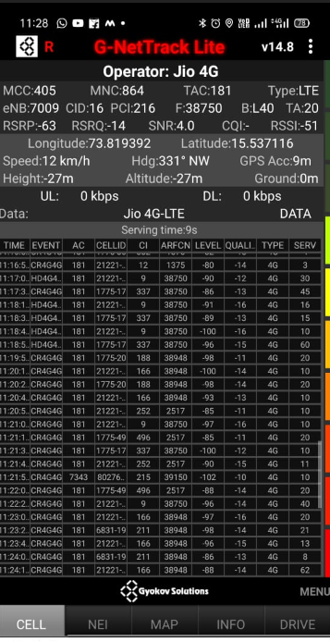
Near Cell (Reliance JIO)
Near cell | longitude | latitude | RSRP (dbm) | Cell id | E-ARFCN
1 | 73.819392 | 15.537116 | -63 | 16 | 38750
RSRP Range for Near Cell : -65dbm to -75dbm
Sangolda,
Pilerne Porvorim Goa

Slide 13
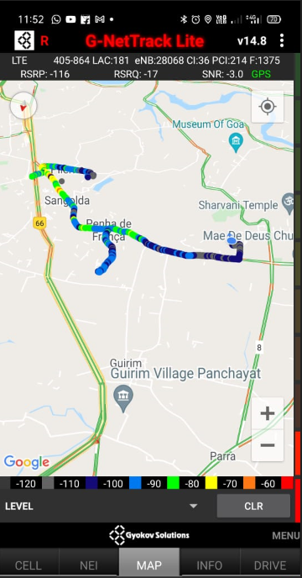
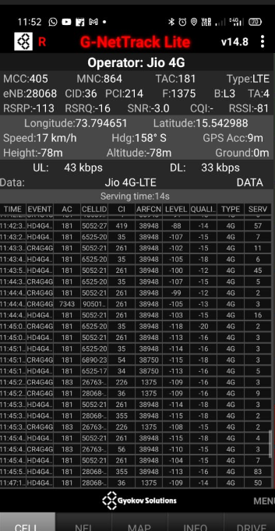
Edge Cell (Reliance JIO)
Edge Cell | longitude | latitude | RSRP (dbm) | Cell id | E-ARFCN
1 | 73.794651 | 15.542988 | -113 | 36 | 1375
RSRP Range for Edge Cell :
-95dbm to -110dbm
Sangolda,
Pilerne Porvorim Goa

Slide 14
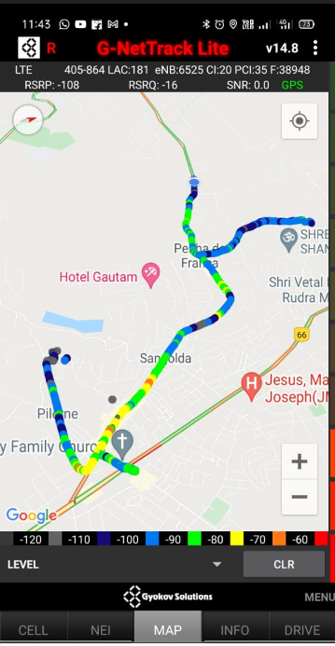
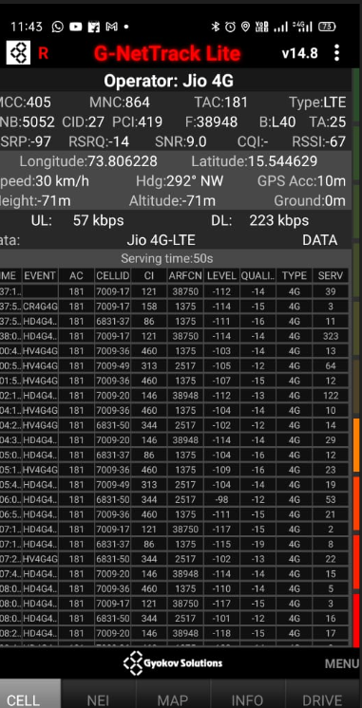
Mixed Coverage Area for Reliance JIO

Slide 15
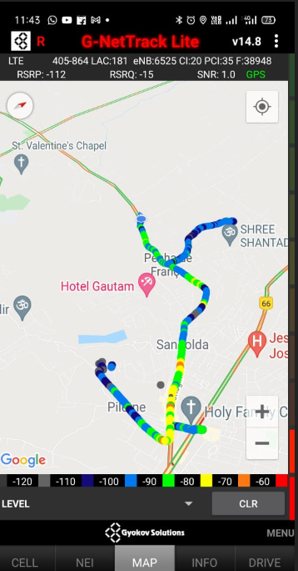
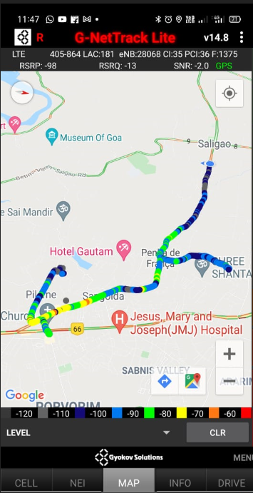
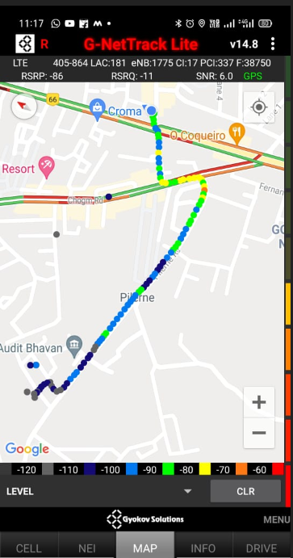
Inter Band Handover (FDD-TDD) for JIO 4G
Band 40 Band 3 Band40

Slide 16
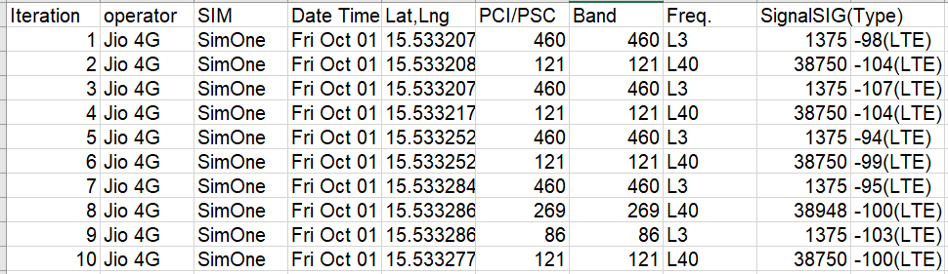
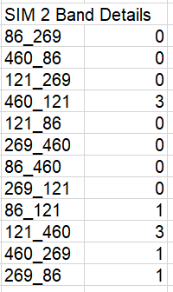
MATT Tool InterBand Handover Results for Jio

Slide 17
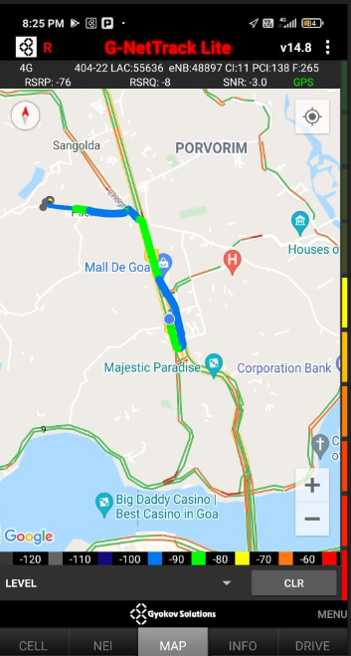
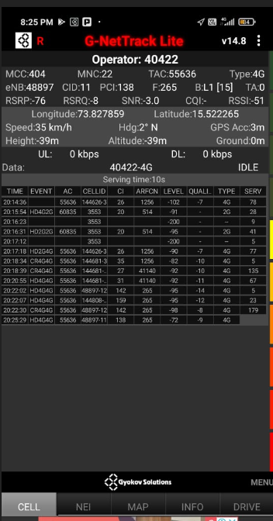
Near Cell for VI:
Near Cell | longitude | latitude | RSRP (dbm) | Cell id | E-ARFCN
1 | 73.827859 | 15.522265 | -76 | 11 | 265
RSRP Range for Near Cell :
-65dbm to -75dbm
Sangolda,
Pilerne Porvorim Goa

Slide 18
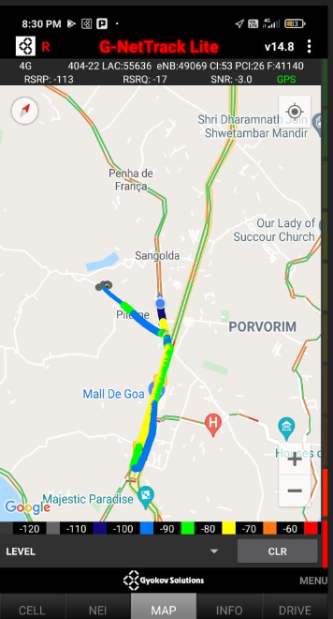
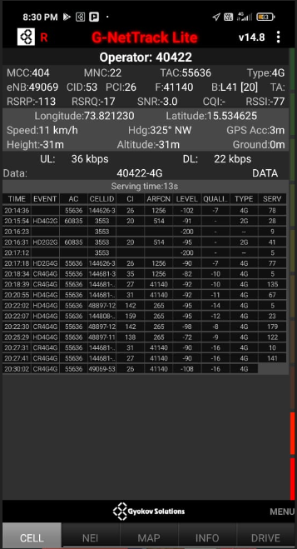
Edge Cell for VI:
Edge cell(EC) | longitude | latitude | RSRP (dbm) | Cell id | E-ARFCN
1 | 73.821230 | 15.534625 | -113 | 53 | 41140
RSRP Range for Edge Cell :
-95dbm to -110dbm
Sangolda,
Pilerne Porvorim Goa

Slide 19
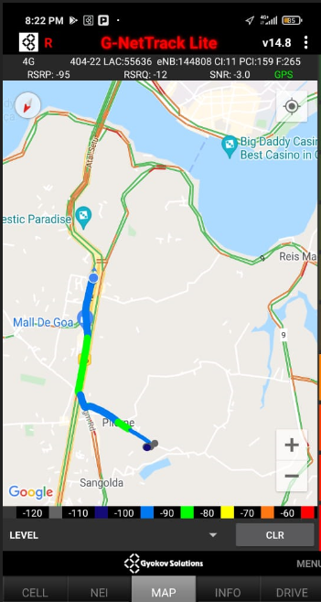
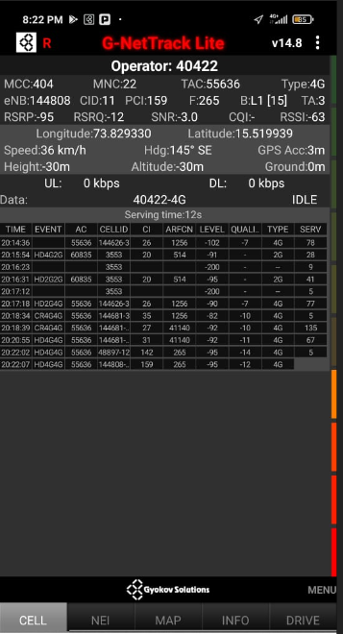
Mixed Coverage Area for VI:

Slide 20
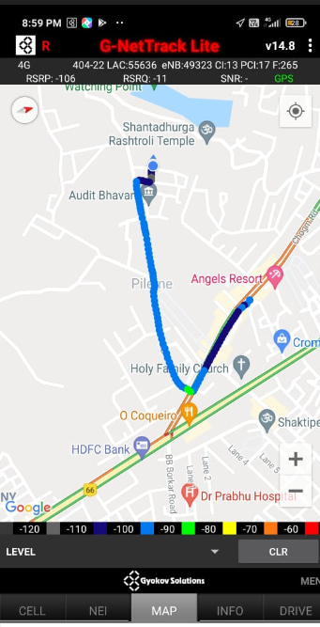
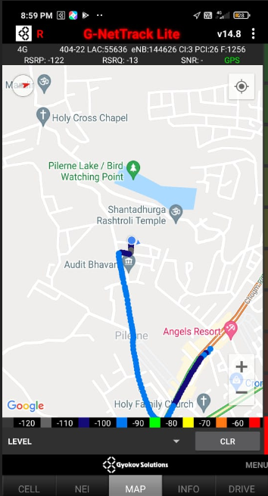
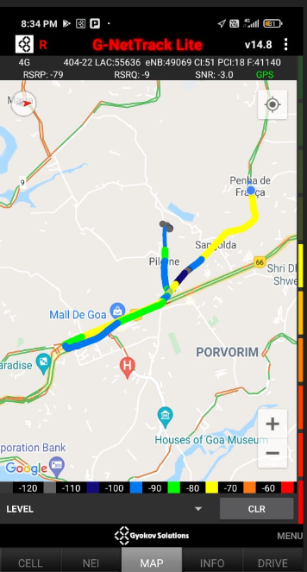
VI Band Handover
Band 1 Band 3 Band 41

Slide 21
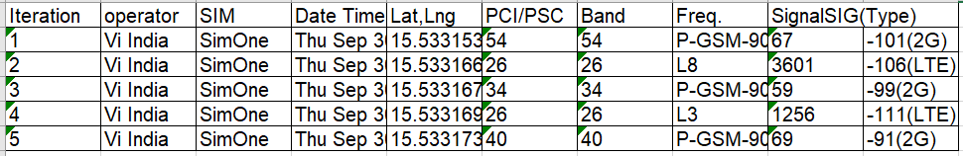
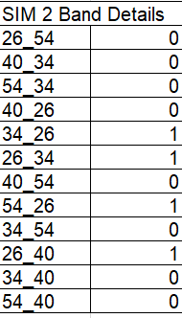
MATT Tool InterBand Handover Results for VI

Slide 22
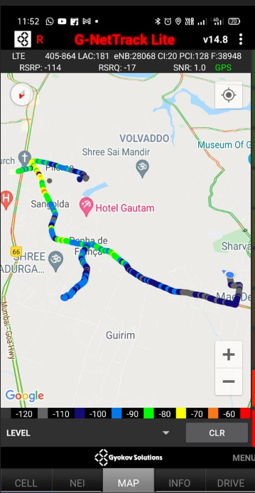
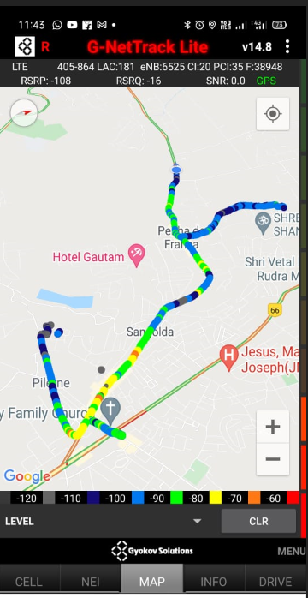
G-net Tracker Drive Route

Slide 23
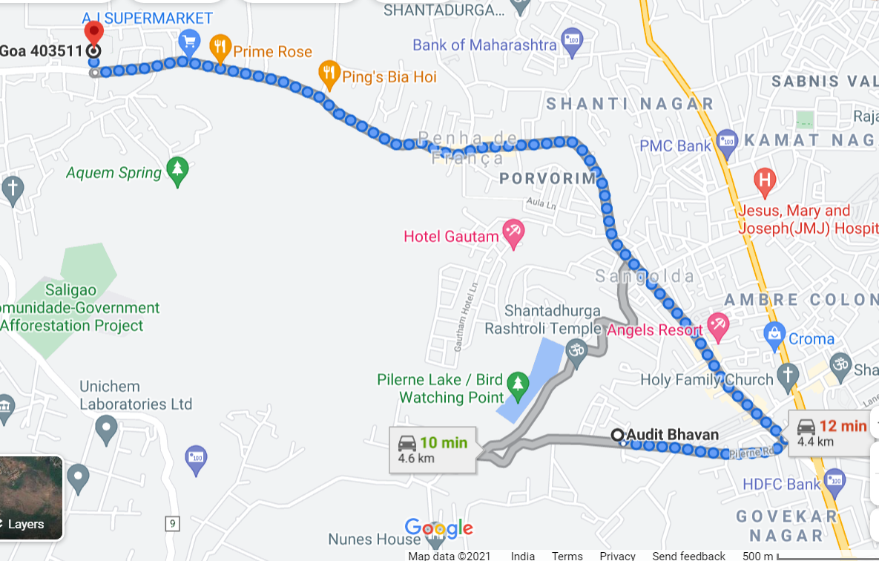
Drive Route

Slide 24
THANK YOU
MARQUIS TECHNOLOGIES

