Slide 1
MARQUIS TECHNOLOGIES
Drive Route – Paris(France)

Slide 2
Travel to Paris (FRANCE)
Country | France
Continent | Europe
City | Paris
Time Zone | GMT +2 Hour
International Dialing Code | + 33
VISA | Residence Visa
VISA Duration | 6 months
VISA Fees | -
VISA Requirements | -VISA Form: completed with you personal data; -Declaration: proving that you have conditions to live in the continent (work intention letter, bank account details, personal health security, fixed address, etc); -Bank Statement: proving that you have amount to stay in the country until your residence card to be emitted; -Local Residence Proof; -Passport: Original and Copy; -Flight booking: no need

Slide 3
Additional Information
Where to Get SIM cards?
Bouygues/SFR - PostPaid: It’s necessary to contact the local POC to provide this.
Bouygues/Orange/SFR - PrePaid: Possible to arrange PrePaid SIM Cards in any local shop, related at the operator that you are searching for.
FREE - PrePaid: It’s only possible to buy Free prepaid SIM Cards on Free shops. You need to have a credit card for this transaction (they does not accept debit cards and cash).
What Documents Required to Purchase SIM?
Passport ID and, for FREE operator, credit card.
Best Recharge Option for 8 days Testing?
Is always interesting to ask about “Holidays” plans. In these packages are included Data and Voice services. So, will be only necessary to recharge the minimum value to SMS/MMS.
Hotel to Stay
AIRBNB
Driver Details for Mobility?
Manjit: +33 7 68 61 54 27

Slide 4
Top Most Popular Android Apps used in FRANCE
Hello Stars
Tomb of the Mask
Hole.io
Tik Tok
Helix Jump
Youtube
Love Balls
Wish
Waze
Instagram

Slide 5
Local EM numbers used in FRANCE
European general emergency phone number | 112/911
Local Police | 17
Ambulance | 15/18

Slide 6
Operator’s Service Numbers
No. | Operator | Balance Check Code | Customer Care | Voice Mail No.
1 | BOUYGUES | Call the number: 630 | +33 6 60 61 46 14 | 660
2 | FREE | Call the numbers: 123 or 666 | +33 1 78 56 95 60 | +33695600011
3 | ORANGE | *124# | 0800051010 | 888
4 | SFR | Call the number: 950 | 1099 | 123

Slide 7
Operator Information
MCC | MNC | Operator | Bands (MHz)
208 | 01 | ORANGE | GSM 900(E-GSM)/1800(DCS), W-CDMA 900(GSM)/2100, LTE 700APT/800DD/1800+/2600
208 | 20 | BOUYGUES | GSM 900(E-GSM), W-CDMA 900(GSM)/2100, LTE 700APT/800DD/1800+/2100/2600
208 | 15 | FREE | GSM 900(E-GSM)/1800(DCS), W-CDMA 900(GSM)/2100, LTE 700APT/1800+/2600
208 | 10 | SFR | GSM 900(E-GSM)/1800(DCS), W-CDMA 900(GSM)2100, LTE 700APT/800DD/1800+/2100/2600

Slide 8
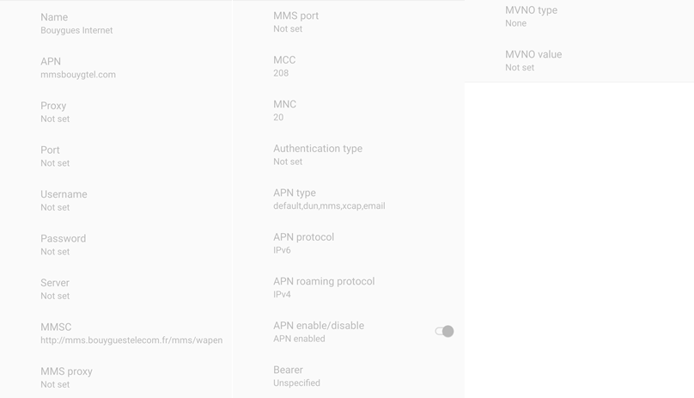
Manual APN Settings – Bouygues (Data+MMS APNs)

Slide 9
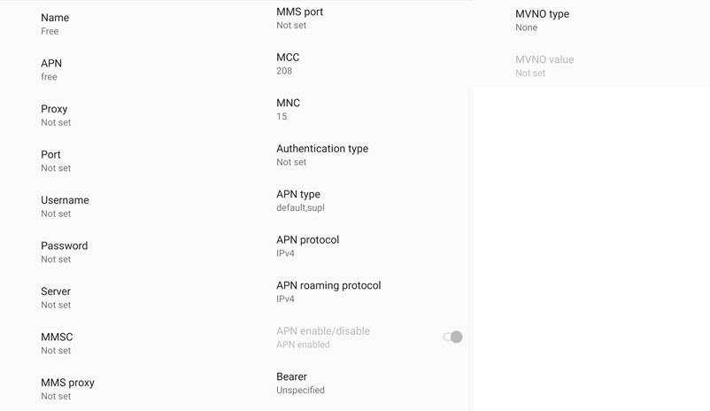
Manual APN Settings – FREE (Data APN)

Slide 10
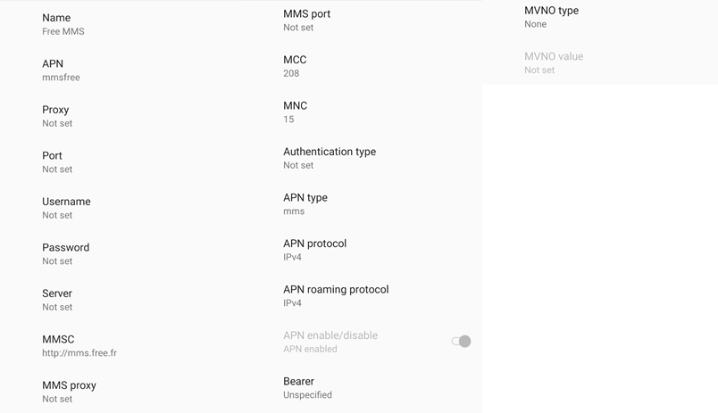
Manual APN Settings – FREE (MMS APN)

Slide 11
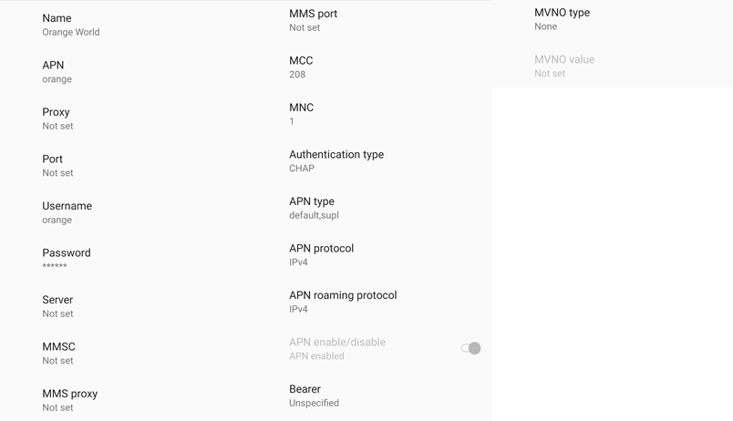
Manual APN Settings – ORANGE (Data APN)

Slide 12
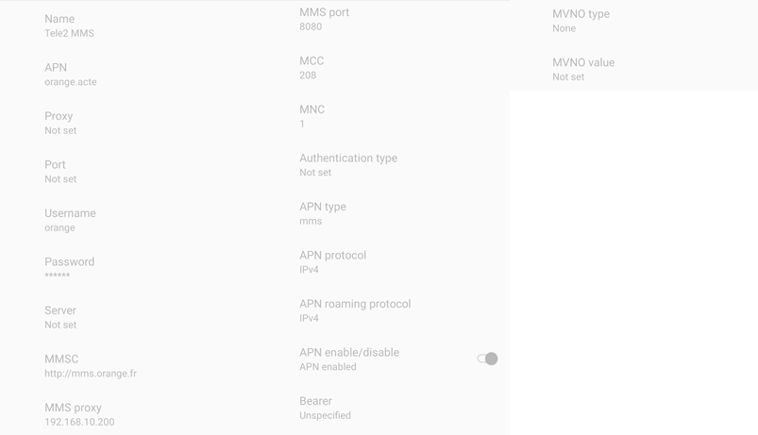
Manual APN Settings – ORANGE (MMS APN)

Slide 13
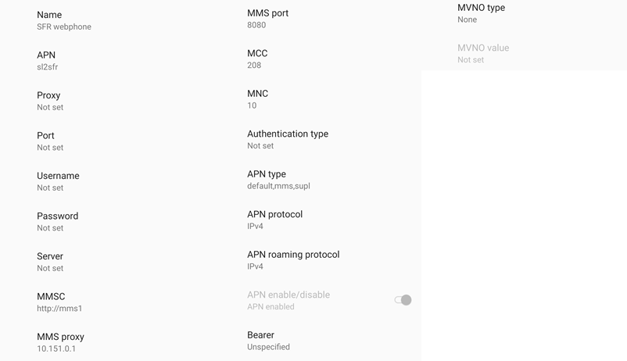
Manual APN Settings – SFR (Data+MMS APNs)

Slide 14
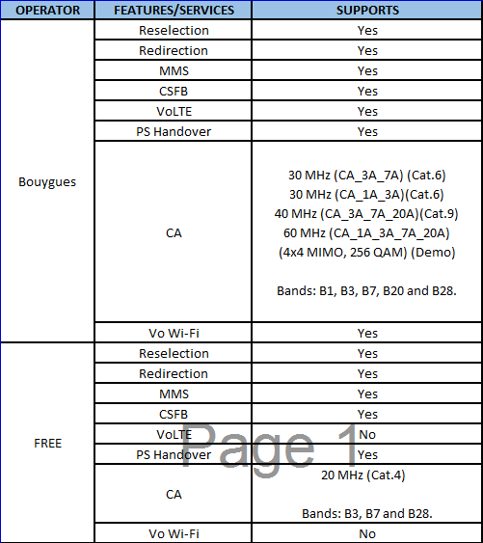
Services Supported by Operators

Slide 15
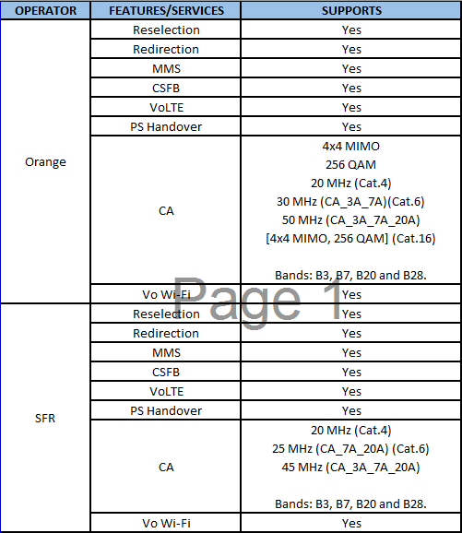
Services Supported by Operators

Slide 16
RSRP Criteria
Near Cell Stationary: RSRP : -55dbm to -85dbm
Cell Edge Stationary: RSRP : -95dbm to -110dbm
Mixed Mobility: RSRP : -55dbm to -120dbm

Slide 17
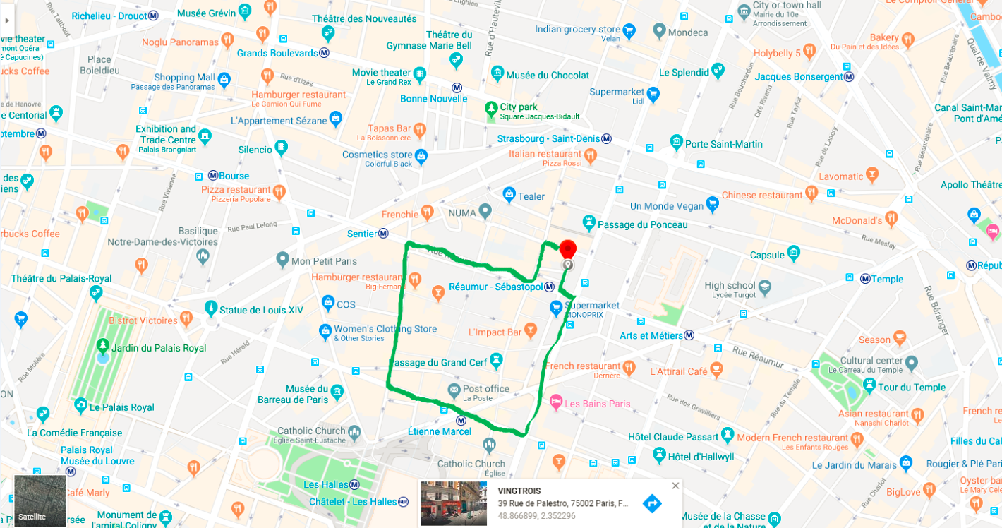
4G to 3G to 4G Reselection Location of Orange location-VINGTROIS lat-48.866899 long-2.352296

Slide 18
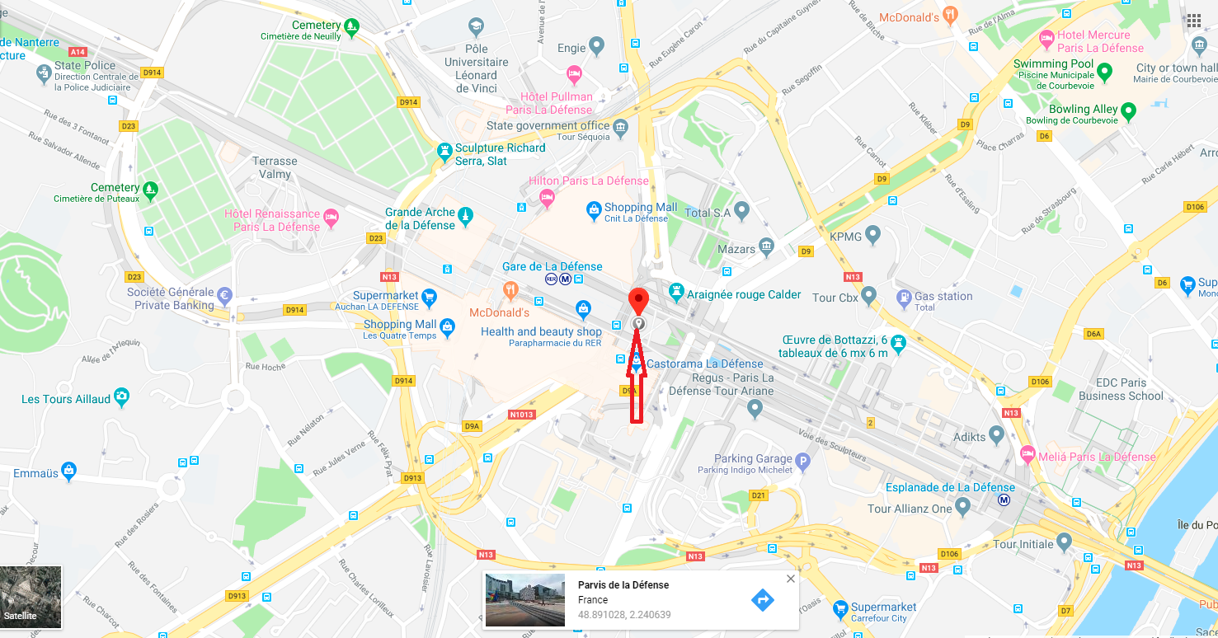
4G TO 3G IRAT BOUYGUES in L2 parking of La defense
LAT-48.891028
LONG-2.240639

Slide 19
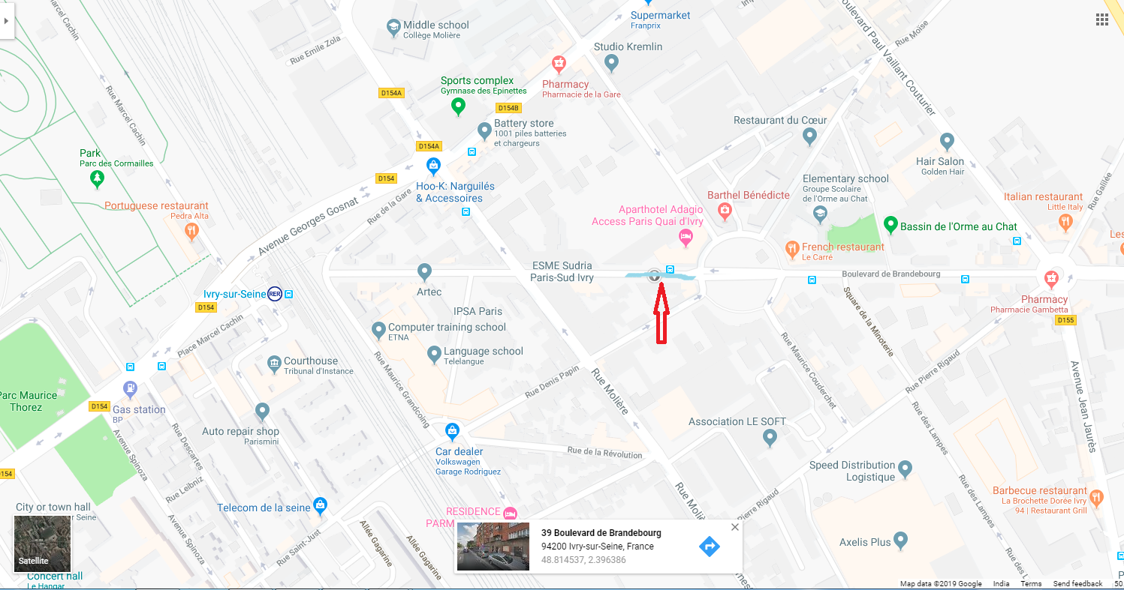
Near Cell-Orange
Road adjacent to Aparthotel Adagio,Ivry sur siene
Also this is CA location with B7+B3+B1 combination
Lat-48.814537
Long-2.396386

Slide 20
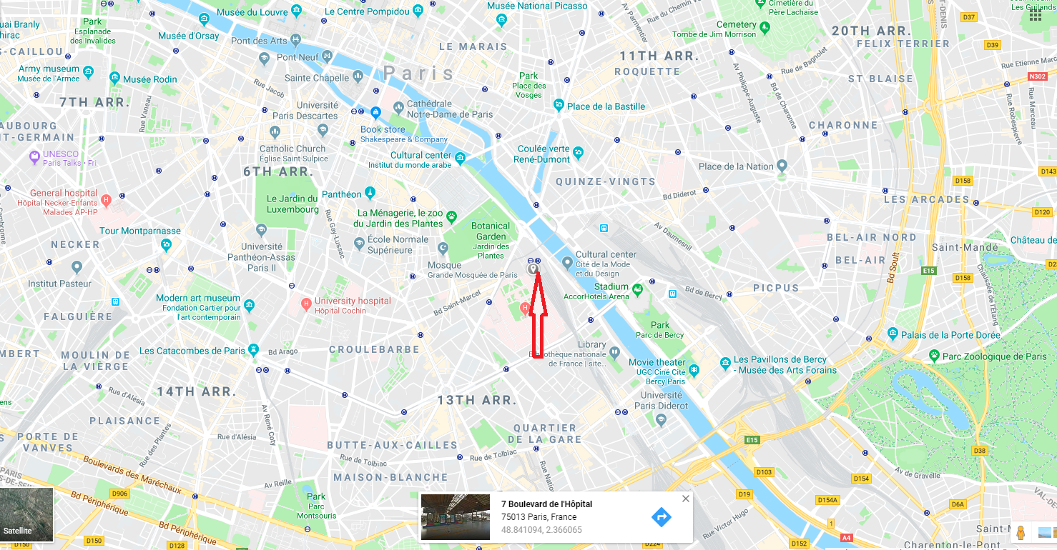
SRVCC to UTRAN-Bouygues
Gare d’Austerlitz station using Paris metro(Ivry sur siene to Paris Eiffel)
Lat-48.841094
Long-2.366065

Slide 21
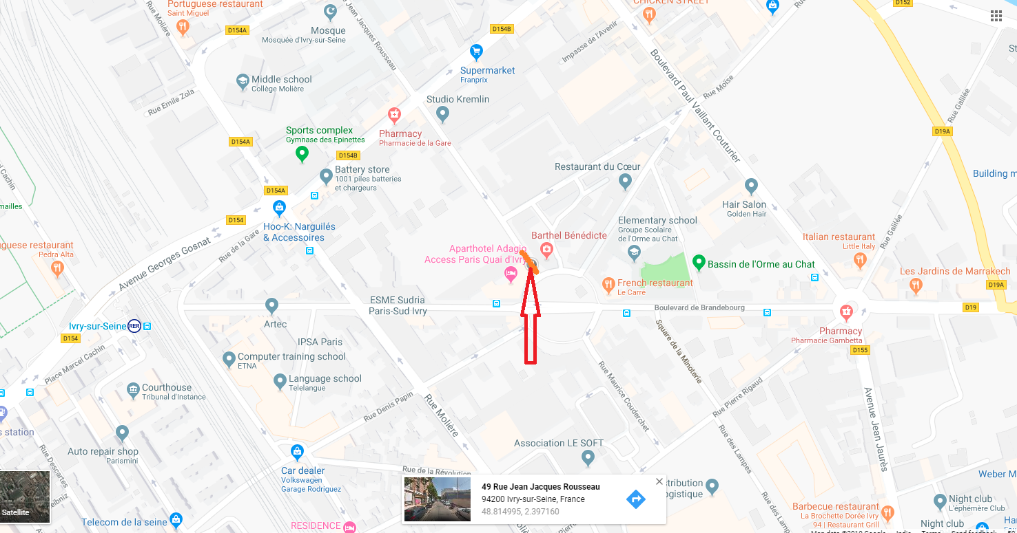
CA location-Bouygues
Band Combination-B7+B1+B3+B20
Adjacent road of Aparthotel Adagio,Ivry Sur Siene
Lat-48.814995
Long-2.397160

Slide 22
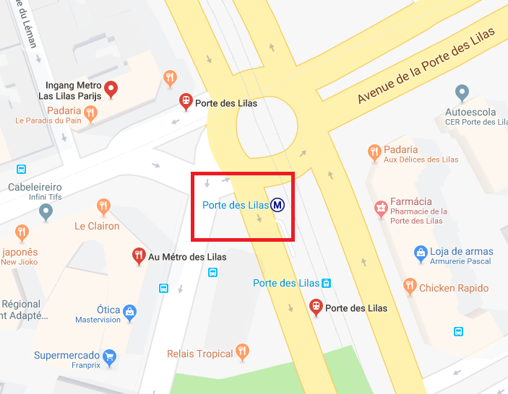
4G (VoLTE)/3G/2G
Location: Boulevards Marechaux (Near by the corner – Mc Donalds)

Slide 23
4 CA Locations in Paris for Bouygues
Bouygues: Locations marked with hotspots (Rue Gruze street)

Slide 24
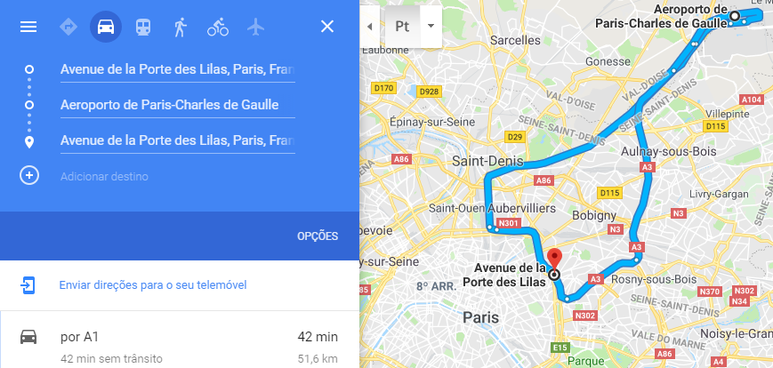
Drive Route (MO/MT Long Call)

Slide 25
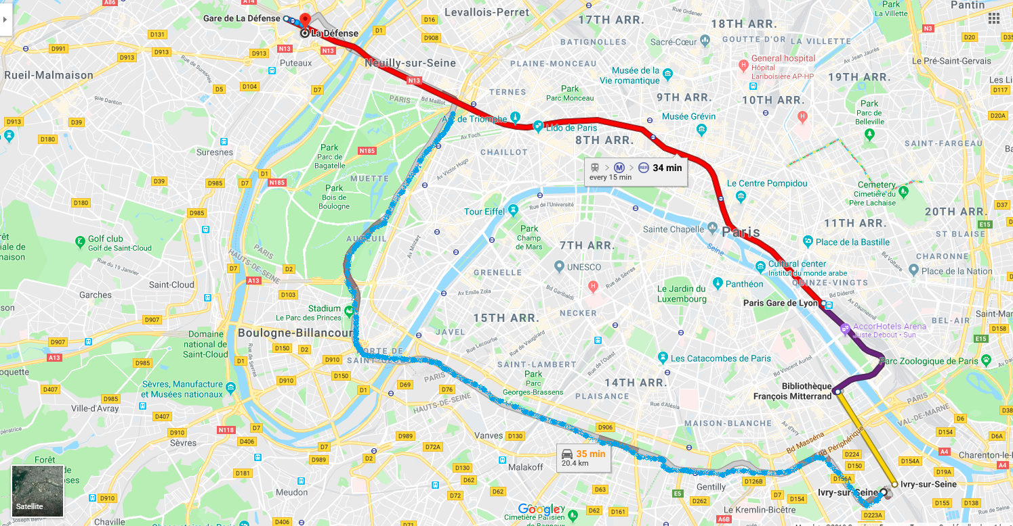
Drive Route for Volte long and short calls-Bouygues & Orange
Ivry sur siene to La Defense and return

Slide 26
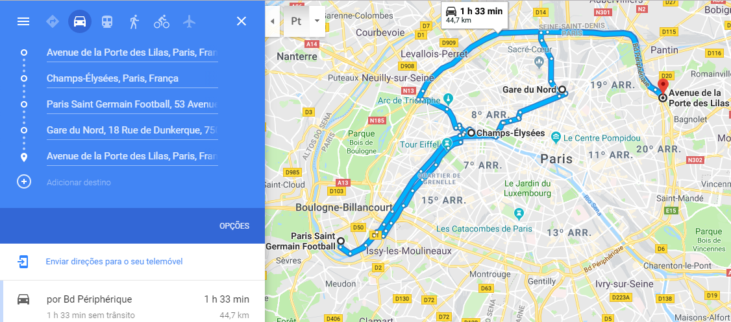
Drive Route (Data & MO/MT Short Calls)

Slide 27
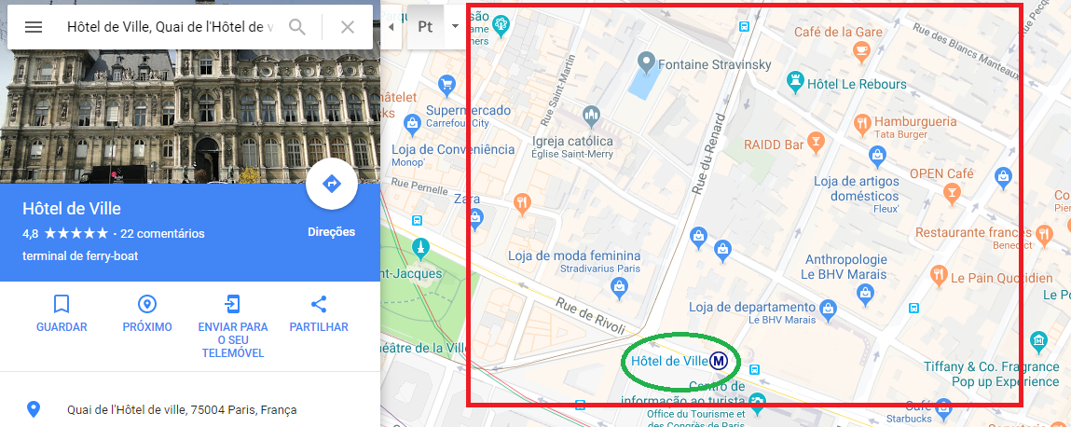
AREA OF HIGH DENSITY OF CROWD AND TALL BULIDINGS

Slide 28
THANK YOU
MARQUIS TECHNOLOGIES
www.marquistech.com

