Slide 1
MARQUIS TECHNOLOGIES
Drive Route – Paris(France)

Slide 2
Operators and Related Information
Below operators are having FDD LTE implementation
Bouygues - Supports NR5G, VoLTE, VoWifi, LTE, WCDMA and 2G

Slide 3
EN-DC Band Combination:-
Bouygues: Band 7_n78

Slide 4
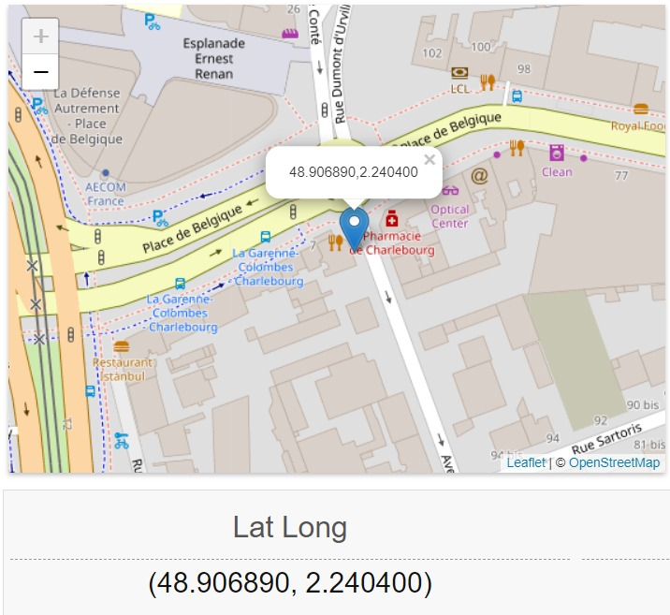
Band 7 n78 Good Coverage for Bouygues Operator

Slide 5
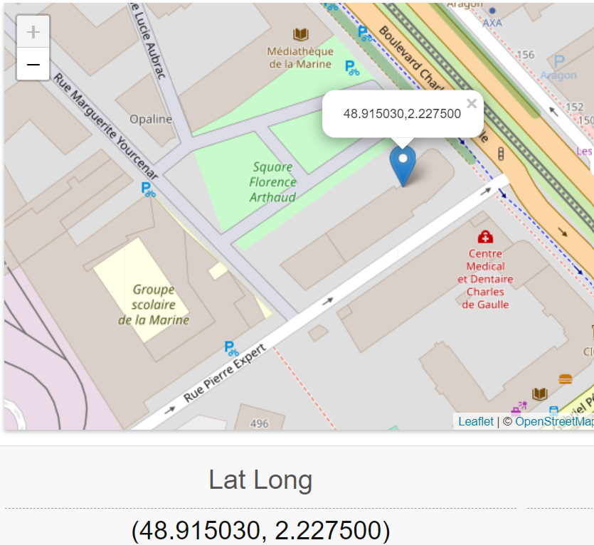
Band 7 n78 Weak Coverage for Bouygues Operator

Slide 6
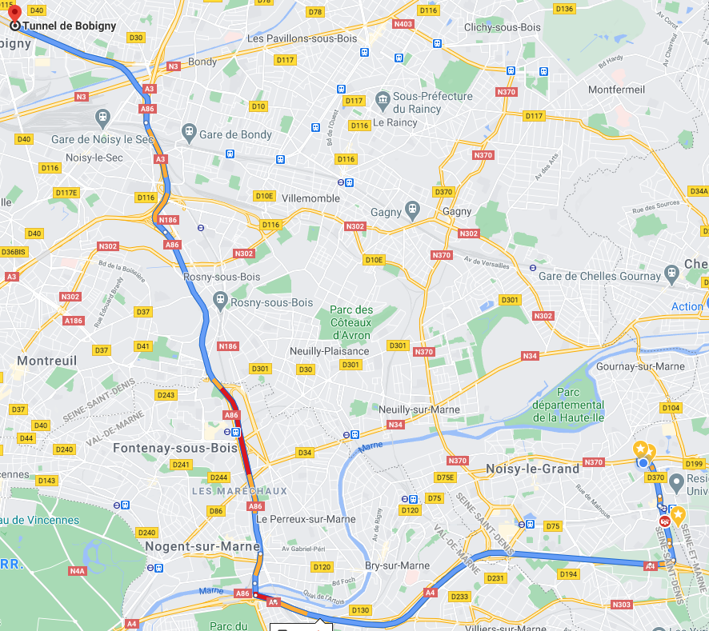
Drive route Bouygues operator

Slide 7
Travel to Paris (FRANCE)
Country | France
Continent | Europe
City | Paris
Time Zone | GMT +2 Hour
International Dialing Code | + 33
VISA | Residence Visa
VISA Duration | 6 months
VISA Fees | -
VISA Requirements | -VISA Form: completed with you personal data; -Declaration: proving that you have conditions to live in the continent (work intention letter, bank account details, personal health security, fixed address, etc); -Bank Statement: proving that you have amount to stay in the country until your residence card to be emitted; -Local Residence Proof; -Passport: Original and Copy; -Flight booking: no need

Slide 8
Additional Information
Where to Get SIM cards?
Bouygues/SFR - PostPaid: It’s necessary to contact the local POC to provide this.
Bouygues/Orange/SFR - PrePaid: Possible to arrange PrePaid SIM Cards in any local shop, related at the operator that you are searching for.
FREE - PrePaid: It’s only possible to buy Free prepaid SIM Cards on Free shops. You need to have a credit card for this transaction (they does not accept debit cards and cash).
What Documents Required to Purchase SIM?
Passport ID and, for FREE operator, credit card.
Best Recharge Option for 8 days Testing?
Is always interesting to ask about “Holidays” plans. In these packages are included Data and Voice services. So, will be only necessary to recharge the minimum value to SMS/MMS.
Hotel to Stay
AIRBNB
Driver Details for Mobility?
Manjit: +33 7 68 61 54 27

Slide 9
Top Most Popular Android Apps used in FRANCE
Hello Stars
Tomb of the Mask
Hole.io
Tik Tok
Helix Jump
Youtube
Love Balls
Wish
Waze
Instagram

Slide 10
Local EM numbers used in FRANCE
European general emergency phone number | 112/911
Local Police | 17
Ambulance | 15/18

Slide 11
Operator’s Service Numbers
No. | Operator | Balance Check Code | Customer Care | Voice Mail No.
1 | BOUYGUES | Call the number: 630 | +33 6 60 61 46 14 | 660
2 | FREE | Call the numbers: 123 or 666 | +33 1 78 56 95 60 | +33695600011
3 | ORANGE | *124# | 0800051010 | 888
4 | SFR | Call the number: 950 | 1099 | 123

Slide 12
Operator Information
MCC | MNC | Operator | Bands (MHz)
208 | 01 | ORANGE | GSM 900(E-GSM)/1800(DCS), W-CDMA 900(GSM)/2100, LTE 700APT/800DD/1800+/2600
208 | 20 | BOUYGUES | GSM 900(E-GSM), W-CDMA 900(GSM)/2100, LTE 700APT/800DD/1800+/2100/2600
208 | 15 | FREE | GSM 900(E-GSM)/1800(DCS), W-CDMA 900(GSM)/2100, LTE 700APT/1800+/2600
208 | 10 | SFR | GSM 900(E-GSM)/1800(DCS), W-CDMA 900(GSM)2100, LTE 700APT/800DD/1800+/2100/2600

Slide 13
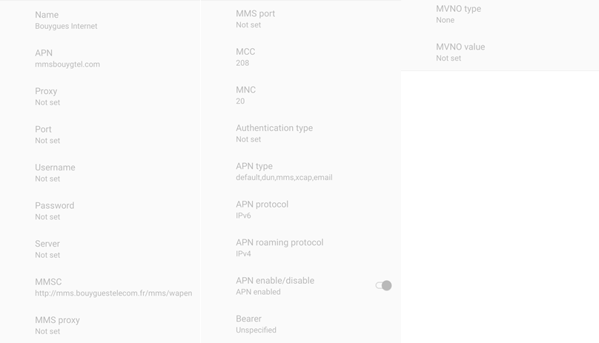
Manual APN Settings – Bouygues (Data+MMS APNs)

Slide 14
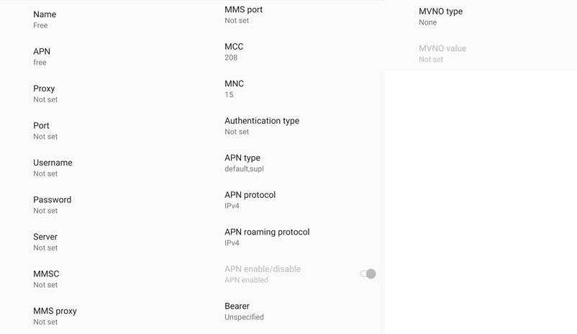
Manual APN Settings – FREE (Data APN)

Slide 15
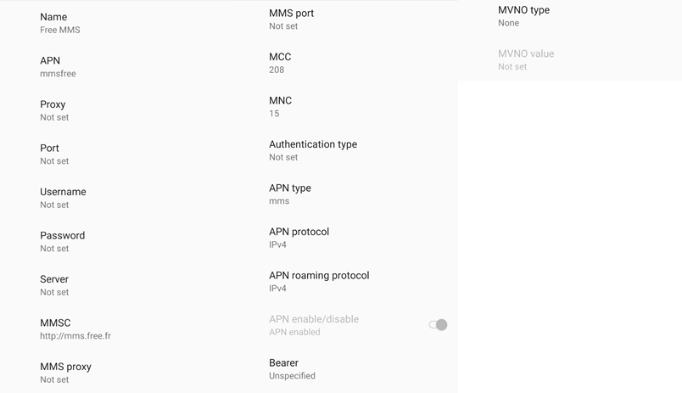
Manual APN Settings – FREE (MMS APN)

Slide 16
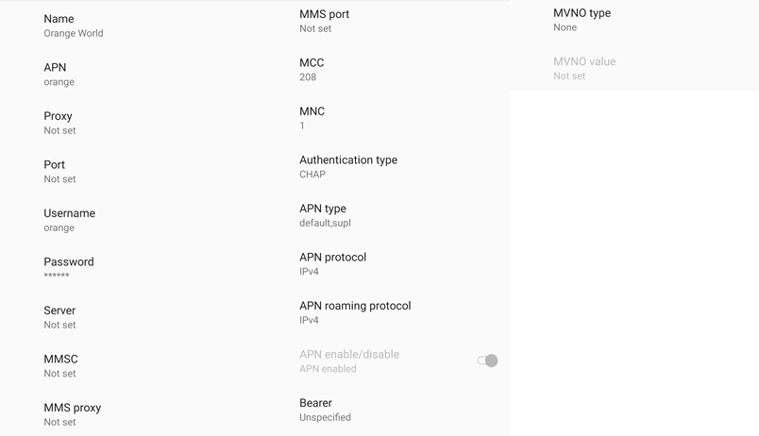
Manual APN Settings – ORANGE (Data APN)

Slide 17
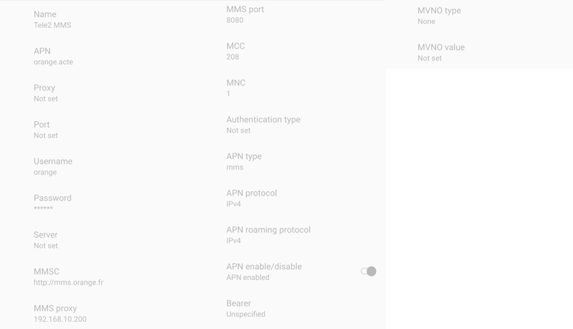
Manual APN Settings – ORANGE (MMS APN)

Slide 18
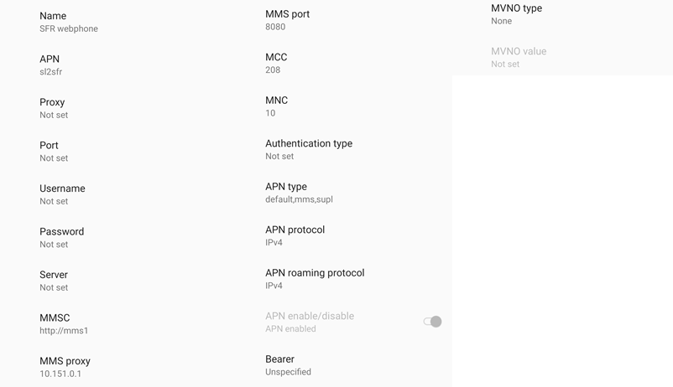
Manual APN Settings – SFR (Data+MMS APNs)

Slide 19
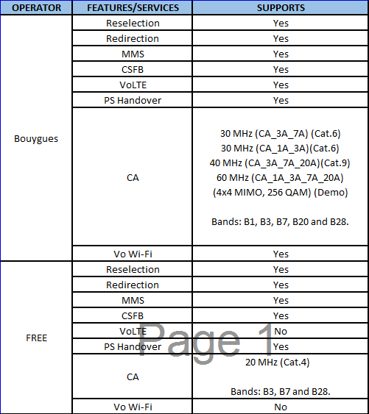
Services Supported by Operators

Slide 20
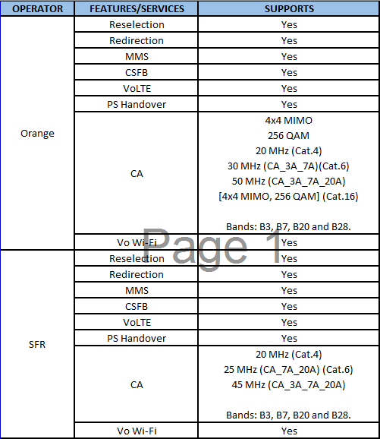
Services Supported by Operators

Slide 21
RSRP Criteria
Near Cell Stationary: RSRP : -55dbm to -85dbm
Cell Edge Stationary: RSRP : -95dbm to -110dbm
Mixed Mobility: RSRP : -55dbm to -120dbm

Slide 22
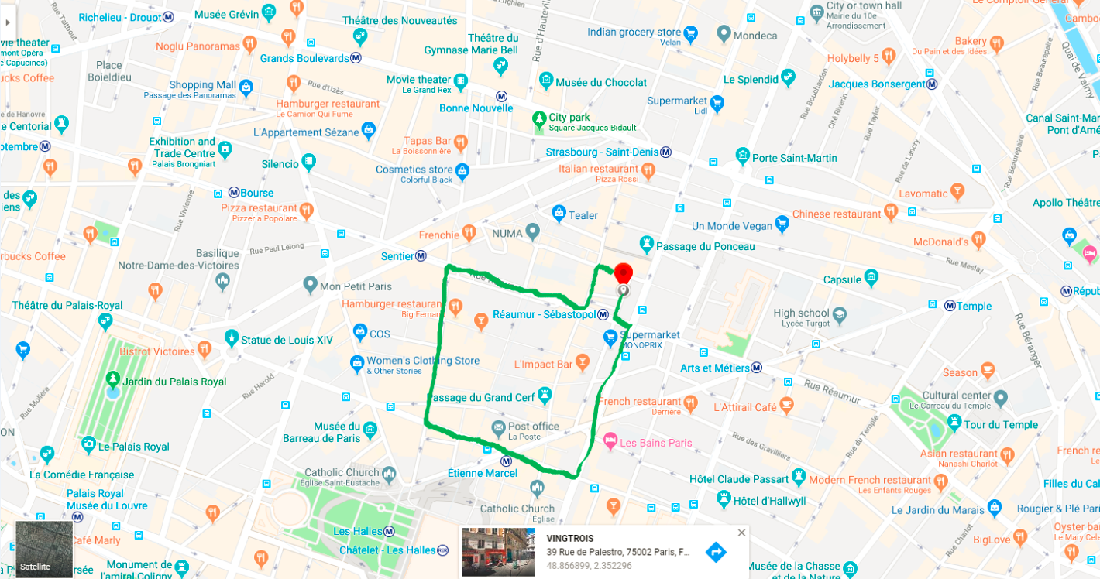
4G to 3G to 4G Reselection Location of Orange location-VINGTROIS lat-48.866899 long-2.352296

Slide 23
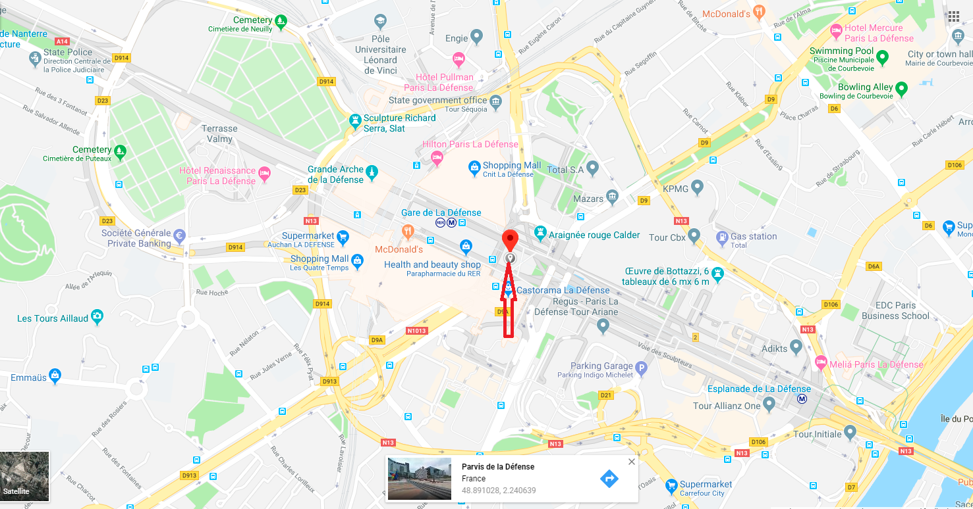
4G TO 3G IRAT BOUYGUES in L2 parking of La defense
LAT-48.891028
LONG-2.240639

Slide 24
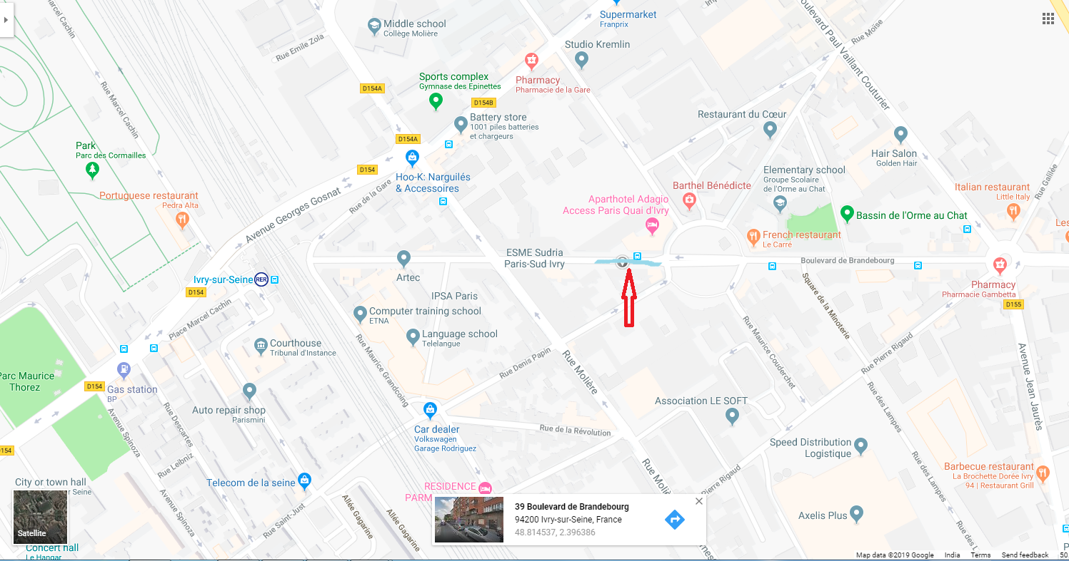
Near Cell-Orange
Road adjacent to Aparthotel Adagio,Ivry sur siene
Also this is CA location with B7+B3+B1 combination
Lat-48.814537
Long-2.396386

Slide 25
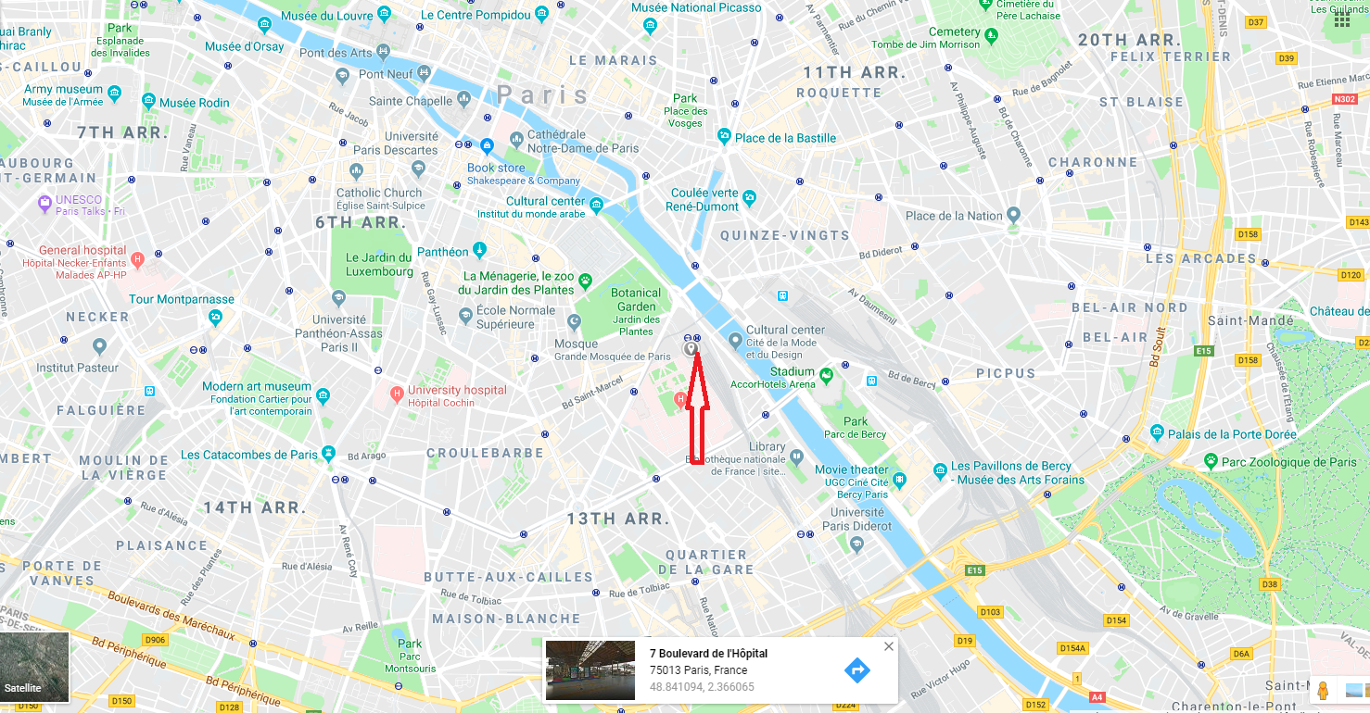
SRVCC to UTRAN-Bouygues
Gare d’Austerlitz station using Paris metro(Ivry sur siene to Paris Eiffel)
Lat-48.841094
Long-2.366065

Slide 26
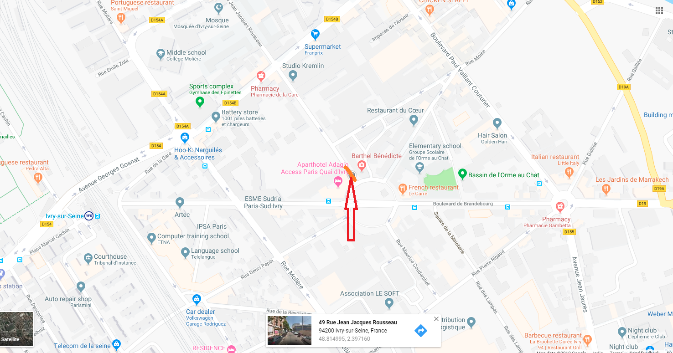
CA location-Bouygues
Band Combination-B7+B1+B3+B20
Adjacent road of Aparthotel Adagio,Ivry Sur Siene
Lat-48.814995
Long-2.397160

Slide 27
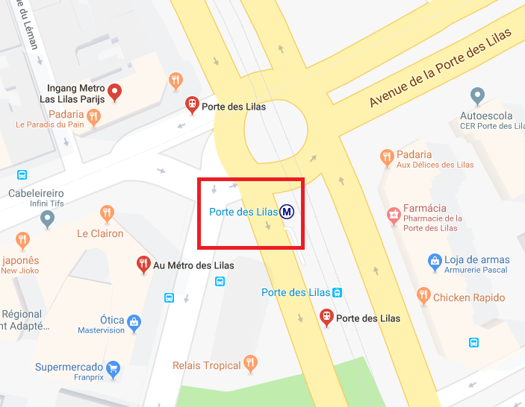
4G (VoLTE)/3G/2G
Location: Boulevards Marechaux (Near by the corner – Mc Donalds)

Slide 28
4 CA Locations in Paris for Bouygues
Bouygues: Locations marked with hotspots (Rue Gruze street)

Slide 29
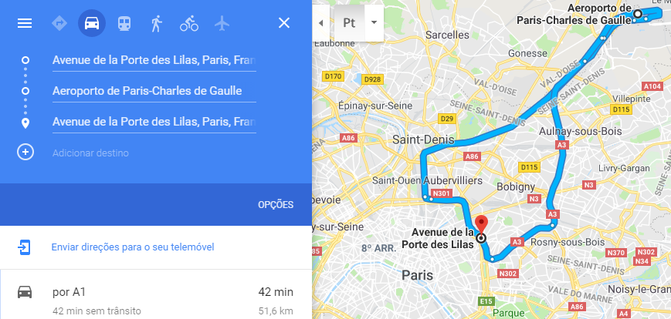
Drive Route (MO/MT Long Call)

Slide 30
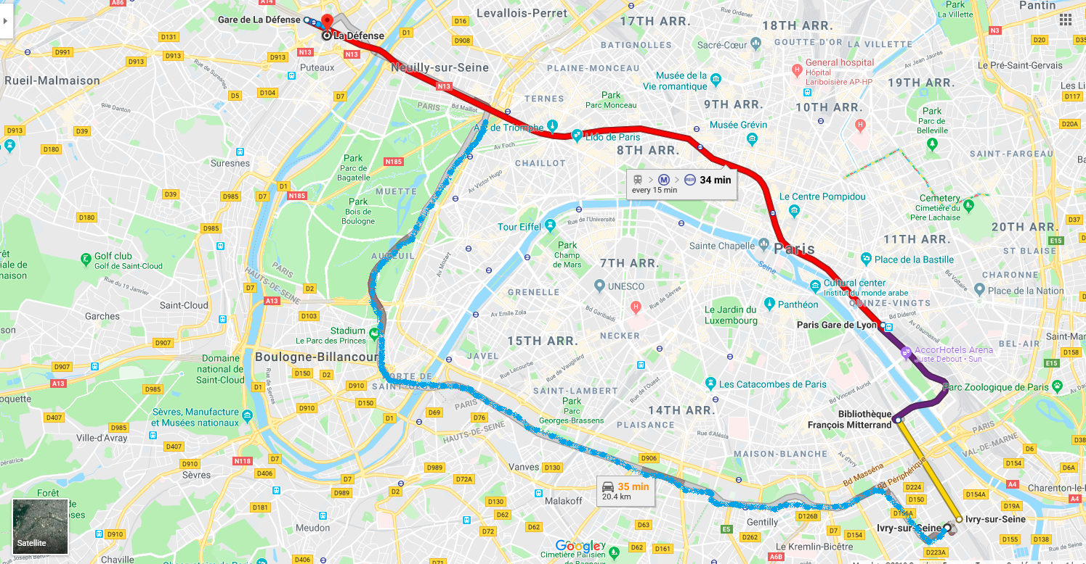
Drive Route for Volte long and short calls-Bouygues & Orange
Ivry sur siene to La Defense and return

Slide 31
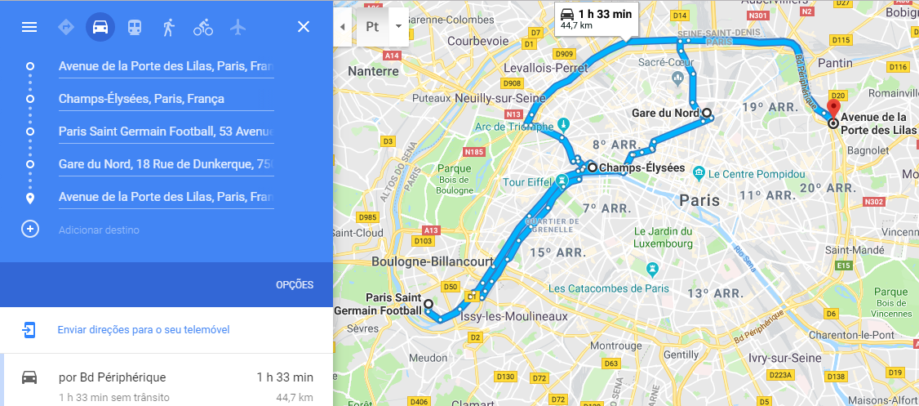
Drive Route (Data & MO/MT Short Calls)

Slide 32
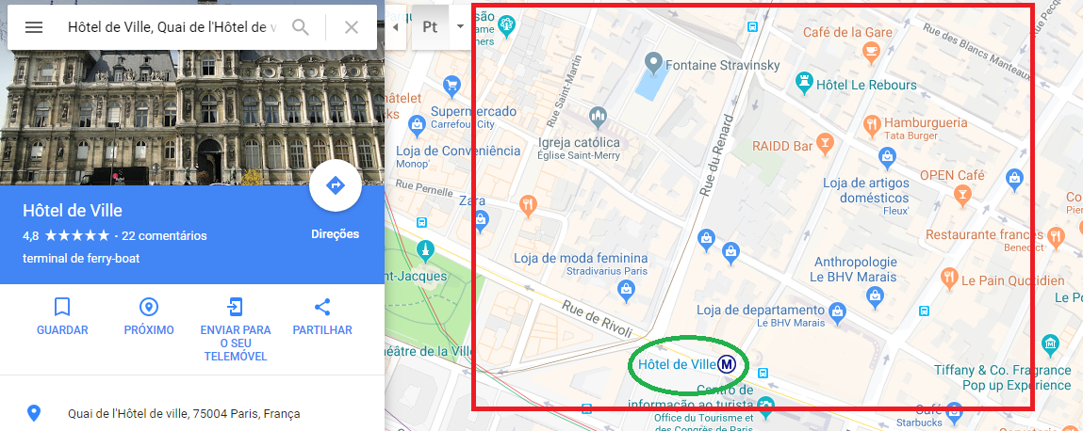
AREA OF HIGH DENSITY OF CROWD AND TALL BULIDINGS

Slide 33
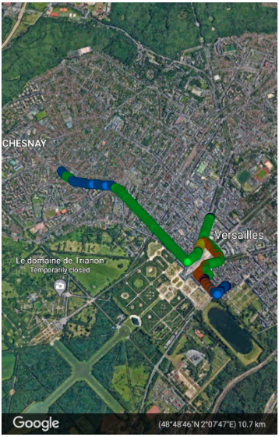
Drive route for Data Performance &Stability test:
Paris«Il de france « haute de siene « il de france « Paris

Slide 34
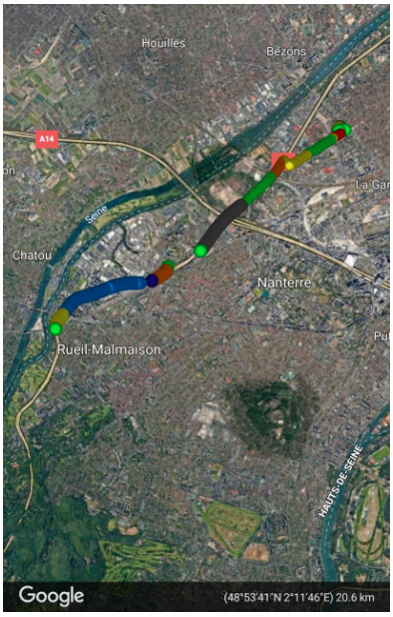
Drive route for Mobility Test :
La Courneve >> bondy>> Noisy le grand>> noisy le sac

Slide 35
THANK YOU
MARQUIS TECHNOLOGIES
www.marquistech.com

