Slide 1
MARQUIS TECHNOLOGIES
Drive Route- Finland / Helsinki

Slide 2
Travel to Finland (Helsinki)
Country | Finland
Continent | Europe
City | Helsinki
Time Zone | GMT +03 Hour Eastern European Summer Time GMT +04 Hour Eastern European Wintertime

Slide 3
Operators in Finland
MCC | MNC | Operator
358 | 05 | Elisa
358 | 36 & 91 | Telia
358 | 03, 12 & 36 | DNA
Elisa Network Info
RAT | Band | Comment
5G | n78(3500 MHz) | SA NSA
4G | B1 (2100 MHz), B3 (1800 MHz), B7 (2600 MHz), B20 (800 MHz)
3G | 900 MHz
2G | 900 (E-GSM)
DNA Network Info
RAT | Band | Comment
5G | n78(3500 MHz) | SA NSA
4G | B1 (2100 MHz), B3 (1800 MHz), B7 (2600 MHz), B20 (800 MHz), B28 (700 MHz)
3G | 900 MHz
2G | 900 (E-GSM)
Telia Network Info
RAT | Band | Comment
5G | n78(3500 MHz) | SA NSA
4G | B3 (1800 MHz), B7 (2600 MHz), B20 (800 MHz)
3G | 2100 MHz
2G | 900 (E-GSM)

Slide 4
Operators and general Information
Elisa- Supports 5G,LTE, VoLTE, VoWifi , WCDMA and 2G
Telia- Supports 5G, LTE, VoLTE ,VoWifi, WCDMA and 2G
DNA Supports 5G , LTE, VoLTE, VoWIFI, WCDMA and 2G

Slide 5
RSRP Criteria
Near Cell :-Stationary: RSRP : -65dbm to -85dbm
Cell Edge :-Stationary: RSRP : -95dbm to -110dbm
Mixed :-Mobility: RSRP : -65dbm to -120dbm

Slide 6
Operator | Mobility Scenario | Location Tested | Longitude / Latitude
Elisa | 4G-3G-4G HO SPOT | Kerava city market underground parking | 60.39932085794345, 25.100472442783154
 | SRVCC to 3G | Kerava city market underground parking | 60.39932085794345, 25.100472442783154
 | IRAT | Nikonkatu 1, 04200 Kerava | 60.39932085794345, 25.100472442783154
 | Good Coverage for Testing | Kulomäen urheilupuiston leikkialue | 60.34493714516356, 25.05787009092869
 | Poor Coverage for testing | Kotkansiipi 10 vantaa | 60.352164145238575, 25.075510521777193
 | OOS Area | Noksio national park | 60.317099462689534, 24.4829536684677
DNA | SRVCC to 2G | Nokisio national park | 60.317099462689534, 24.4829536684677
 | SRVCC to 3G | Kerava city market underground parking | 60.39932085794345, 25.100472442783154
 | 4G-3G-4G HO SPOT | Kerava city market underground parking | 60.39932085794345, 25.100472442783154
 | IRAT | Nikonkatu 1, 04200 Kerava | 60.39932085794345, 25.100472442783154
 | Good Coverage for Testing | Kulomäen urheilupuiston leikkialue | 60.34493714516356, 25.05787009092869
 | Poor Coverage for testing | Noksio National park | 60.317099462689534, 24.4829536684677
 | OOS Area | Noksio National park | 60.317099462689534, 24.4829536684677
Telia | SRVCC to 3G | Kotansiipi Underground building | 60.352164145238575, 25.075510521777193
 | SRVCC to 2G | Not supported /Location not Found
 | 4G-3G-4G HO SPOT | Kotansiipi Underground building | 60.352164145238575, 25.075510521777193
 | IRAT | Kotansiipi 10 | 60.352164145238575, 25.075510521777193
 | Good Coverage for Testing | Kulomäen urheilupuiston leikkialue | 60.34493714516356, 25.05787009092869
 | Poor Coverage for testing | Noksio nationa park | 60.317099462689534, 24.4829536684677
 | OOS Area | Noksio nationa park

Slide 7
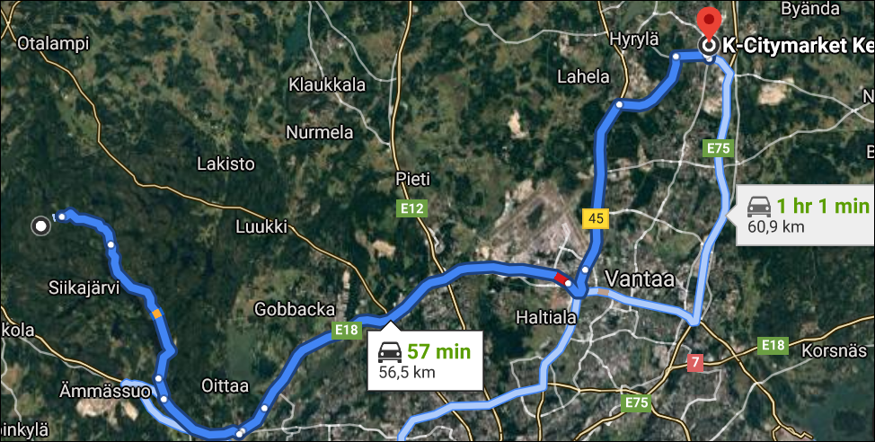
4G-3G-4G HO SPOT
SRVCC to 3G
4G-3G-4G HO SPOT
SRVCC to 3G
4G-3G-4G HO SPOT
SRVCC to 3G
4G-3G-4G HO SPOT
SRVCC-3G
to 3G

Slide 8
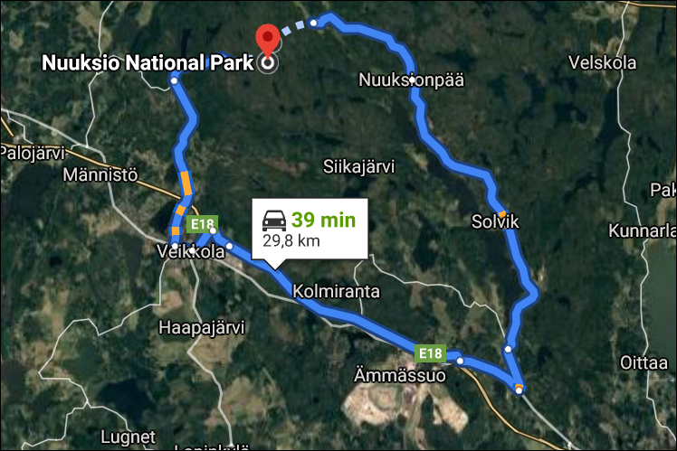
Poor Coverage for testing
SRVCC to 2G

Slide 9
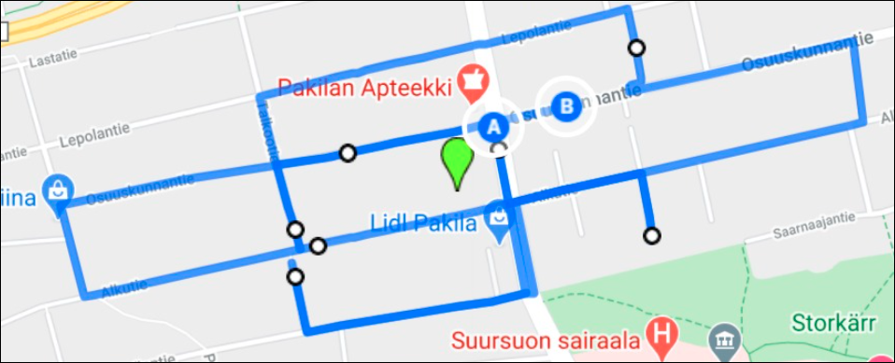
5G Elisa Drive Route
Pakilan Apteeki >>lidle pakila >> rkioski >> Sairaala>> lastatie >> lepolantie
RSRP: -65dbm to -100dbm Long/Lat: 60.24006159578787, 24.92920907874598

Slide 10
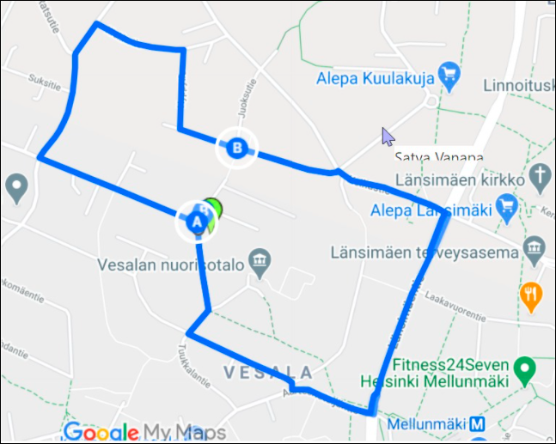
5G DNA Drive Route
Alepa >> lansimaen terveyasema >> vesalan nuorisatalo >> vesal >> fitness24seven >> mellunmaki
RSRP: -65dbm to -120dbm Long/Lat: 60.25001304633826, 25.099605933772523

Slide 11
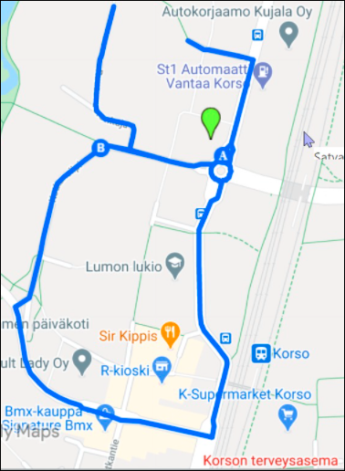
5G Telia Drive Route
Kotkansiipi 10 >> sir kippis >> supermarket >> s market >> rkioski >> korso >> bmx kaupa
RSRP: -65dbm to -100dbm Long/Lat: 60.35340012935904, 25.077490026850672

Slide 12
THANK YOU
MARQUIS TECHNOLOGIES
www.marquistech.com

