Slide 1
MARQUIS TECHNOLOGIES
5G Drive Route – Czech

Slide 2
(Location Name)
Country | Czech
Continent | Europe
City | Bruno
Time Zone | GMT + 2

Slide 3
Drive Route
Near Cell :-Stationary: RSRP: -65dbm to -90dbm
Mixed :-Mobility: RSRP : -75dbm to -100dbm
Cell Edge :-Stationary: RSRP : -95dbm to -120dbm

Slide 4
Major Czech Operators : Locations for 5G Field Test
Operator | PLMN | 5G Tested Locations | ENDC | Longitude / Latitude
Vodafone | 230-03 | Skacelova,Kralove pole | B3+N1 | 49.22229233977069, 16.587508311552288
DT | 230-01 | Ceska, Stranice | B20+N1 | 49.19698576227207, 16.60571052689412
O2 | NA | Ceska, Vankovka | B20+N1 | 49.19698576227207, 16.60571052689412

Slide 5
Service support by Telia Operator
Services Supported by DT Operator
DT 5G/4G/3G/2G | E-GSM (900), 1800(DCS), B1 (2100) B3 (1800 +),B7 (2600),B20 (800 DD), n1 (2100MHz)
OPERATOR | Features /Services | Supported(yes/No)
DT (Major) | Reselection | Yes
 | Redirection | Yes
 | MMS /SMS | Yes
 | Volte | Yes
 | vowifi | Yes
 | PS Handover | Yes

Slide 6
Service support by Telia Operator
Services Supported by Vodafone Operator
Vodafone 5G/4G/3G/2G | E-GSM (900), DCS (1800), B1 (2100) B3 (1800 +)B7(2600),B8(900),B20 (800 DD), n1 (2100MHz
OPERATOR | Features /Services | Supported(yes/No)
Vodafone (Major) | Reselection | Yes
 | Redirection | Yes
 | MMS /SMS | Yes
 | Volte | Yes
 | vowifi | Yes
 | PS Handover | Yes

Slide 7
O2 5G/4G/3G/2G | E-GSM (900), DCS (1800), B1 (2100),B7(2600), N78
OPERATOR | Features /Services | Supported(yes/No)
O2(Major) | Reselection | Yes
 | Redirection | Yes
 | MMS /SMS | Yes
 | Volte | Yes
 | vowifi | Yes
 | PS Handover | Yes

Slide 8
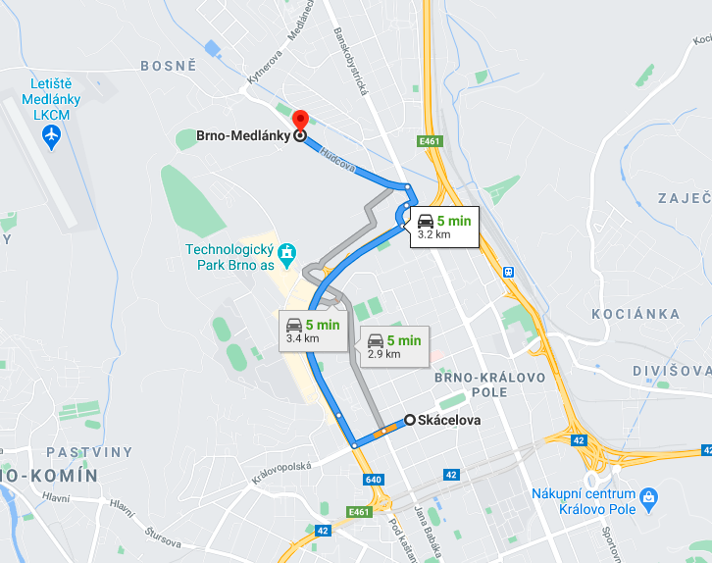
Vodafone 5G Good Coverage Area (B3+N1),RSRP=-83db Skacelova>> Medlanky

Slide 9
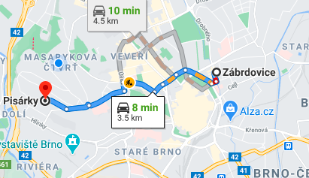
DT 5G Good Coverage Area (B20+N1),RSRP=-80db Zabrdovice>> Pisarky

Slide 10
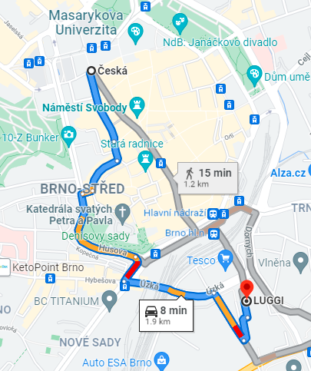
O2 5G Good Coverage Area (N78)RSRP=-82db Ceska >> Vankovka

Slide 11
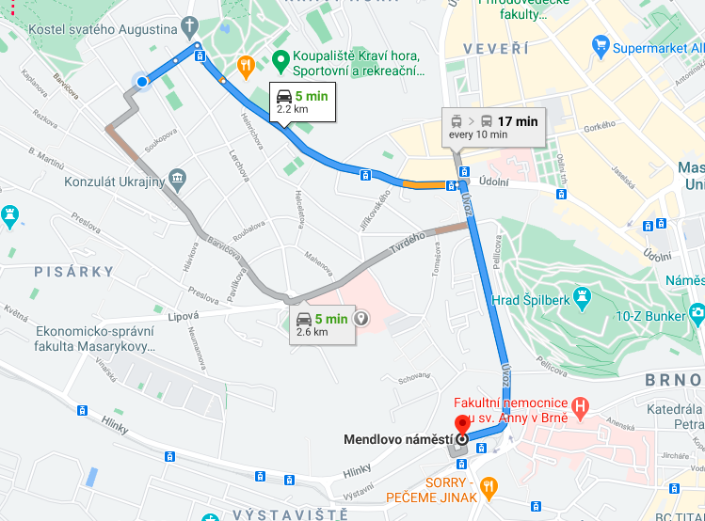
DT and Vodafone 4G Good Coverage Area Rudisova >> Menlove namesti

Slide 12
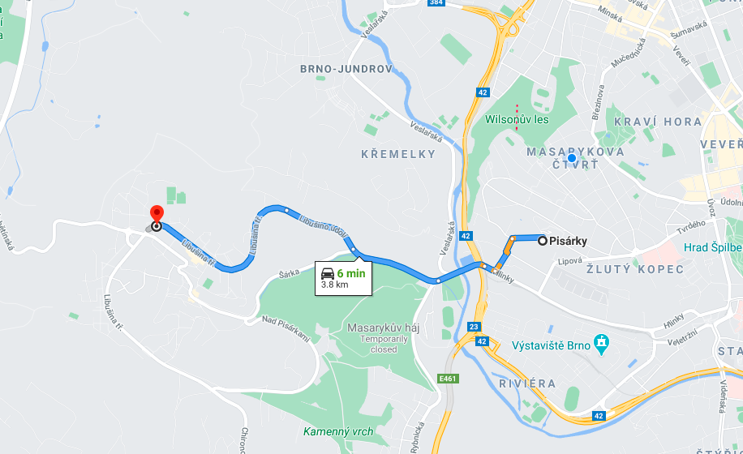
SRVCC 4G to 3G location for Vodafone Brno-Kohoutovice>> pisarky

Slide 13
THANK YOU
MARQUIS TECHNOLOGIES
www.marquistech.com

