Slide 1
MARQUIS TECHNOLOGIES
Drive Route Bucharest, Romania

Slide 2
Country | Romania
City | Bucharest
MCC | 226
Operator | Orange, DiGi, Vodafone, TMO
Near Cell | -65dbm to -80dBm
Edge Cell | -95dBm to -115dBm
Currency | RON

Slide 3
Major ROMANIA Operators : Locations for 5G /NR Field Test
Operator | PLMN | 5G Tested Locations | Longitude / Latitude | ENDC combination Tested
Vodafone | 226/1 | Piața Unirii, Bucharest, Romania | 44.42724360756836, 26.10244942624197 | LTE Band 3 + NR 78
 |  | Sala Palatului, Strada Ion Câmpineanu, Bucharest, Romania | 44.4392935665082, 26.09498979740737 | LTE Band 3 + NR 78
Orange | 226/10 | Piața Unirii, Bucharest, Romania | 44.42724360756836, 26.10244942624197 | LTE Band 3 + NR 78
 |  | Sala Palatului, Strada Ion Câmpineanu, Bucharest, Romania | 44.4392935665082, 26.09498979740737 | LTE Band 3 + NR 78
Digi Mobil | 226/5 | Biserica MAPN, Strada Izvor, Bucharest, Romania | 44.426989808067304, 26.078640141581918 | LTE Band 1 + NR 78 LTE Band 38 + NR78
 |  | Sala Palatului, Strada Ion Câmpineanu, Bucharest, Romania | 44.4392935665082, 26.09498979740737 | LTE Band 1 + NR 78 LTE Band 38 + NR78

Slide 4
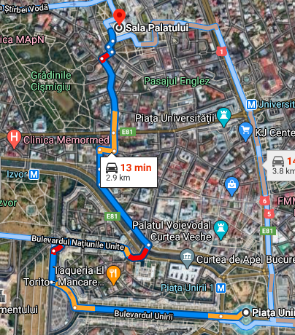
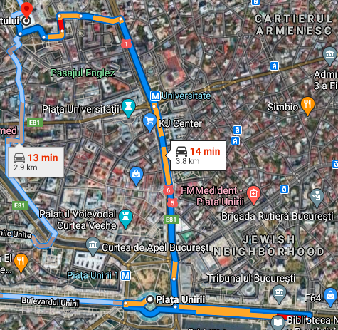
Bucharest, ROMANIA drive Routes for 5G Field Testing
Piața Unirii > Bulevardul Unirii > Strada Ion Brezoianu > Sala Palatului
Piața Unirii > E81 > Strada Demetru I. Dobrescu > Sala Palatului

Slide 5
Mobility Scenarios Execution Spots: (Bucharest, ROMANIA)
Operator | Mobility Scenario | Location Tested | Longitude / Latitude
Vodafone | 4G-3G-4G HO SPOT | Strada Vadul Moldovei, București 077190 (Baneasa Forest) | 44.524398288171554, 26.104729796192
 | SRVCC to 3G | Strada Vadul Moldovei, București 077190 (Baneasa Forest) | 44.524398288171554, 26.104729796192
 | IRAT | Piața Romană, Bucharest, Romania | 44.443576772532516, 26.098335282399805
 | Good Coverage for Testing | Sala Palatului, Sala Palatului, Strada Ion Câmpineanu, Bucharest, Romania | 44.43921696335525, 26.0949683397374
 | Poor Coverage for testing | Université Politehnica, Splaiul Independenței, Bucharest, Romania | 44.43813143235323, 26.049331564882657
 | OOS Area | NA | -
Orange | SRVCC to 2G | Strada Vadul Moldovei, București 077190 (Baneasa Forest) | 44.524398288171554, 26.104729796192
 | SRVCC to 3G | Strada Vadul Moldovei, București 077190 (Baneasa Forest) | 44.524398288171554, 26.104729796192
 | 4G-3G-4G HO SPOT | Strada Vadul Moldovei, București 077190 (Baneasa Forest) | 44.524398288171554, 26.104729796192
 | IRAT | Piața Romană, Bucharest, Romania | 44.443576772532516, 26.098335282399805
 | Good Coverage for Testing | Sala Palatului, Sala Palatului, Strada Ion Câmpineanu, Bucharest, Romania | 44.43921696335525, 26.0949683397374
 | Poor Coverage for testing | Université Politehnica, Splaiul Independenței, Bucharest, Romania | 44.43813143235323, 26.049331564882657
 | OOS Area | NA | -
Digi Mobil | SRVCC to 3G | Strada Vadul Moldovei, București 077190 (Baneasa Forest) | 44.524398288171554, 26.104729796192
 | SRVCC to 2G | Strada Vadul Moldovei, București 077190 (Baneasa Forest) | 44.524398288171554, 26.104729796192
 | 4G-3G-4G HO SPOT | Strada Vadul Moldovei, București 077190 (Baneasa Forest) | 44.524398288171554, 26.104729796192
 | IRAT | Piața Romană, Bucharest, Romania | 44.443576772532516, 26.098335282399805
 | Good Coverage for Testing | Sala Palatului, Sala Palatului, Strada Ion Câmpineanu, Bucharest, Romania | 44.43921696335525, 26.0949683397374
 | Poor Coverage for testing | Université Politehnica, Splaiul Independenței, Bucharest, Romania | 44.43813143235323, 26.049331564882657
 | OOS Area | NA | -

Slide 6
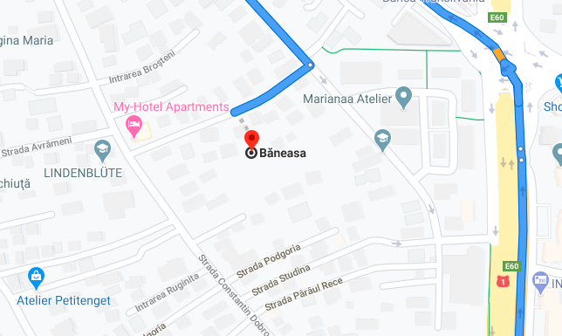
Edge Cell(All Operators)

Slide 7
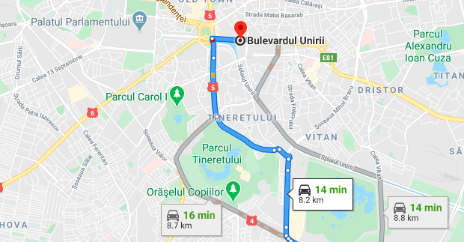
Near Cell (All Operators):

Slide 8
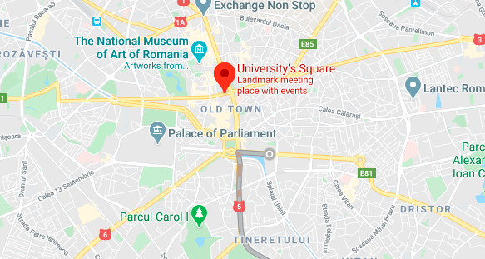
5G Coverage:

Slide 9
SRVCC Location:

Slide 10
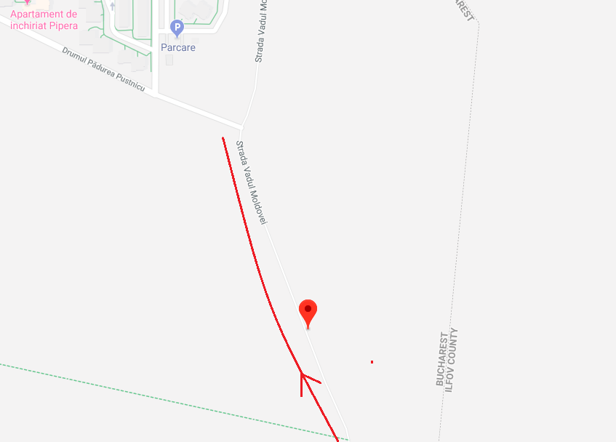
IRAT from 4G to 3G:

Slide 11
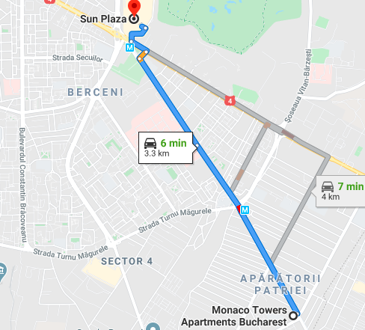
Band 3-Band 20 Handover
(Orange ,TMO, Vodafone):

Slide 12
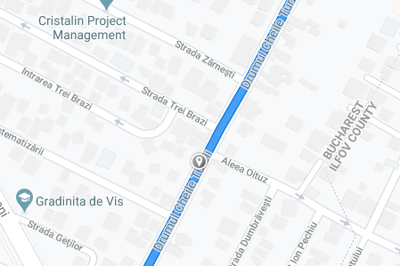
Band 3(Orange,Tmo,Vodafone & Band 8(DiGi) coverage 44.37298,26.1411202):

Slide 13
Out of Service coverage:

Slide 14
THANK YOU
MARQUIS TECHNOLOGIES
www.marquistech.com

