Slide 1
MARQUIS TECHNOLOGIES
Drive Route – Bogota(Colombia)

Slide 2
Travel to Bogota (Colombia)
Country | Colombia
Continent | South America
City | Bogota
Time Zone | GMT -5 Hour
International Dialing Code | + 57-1
VISA Requirements | Need to provide 3 passport size photographs, 6 month bank statement
Yellow Fever Vaccination Certificate | Not Required

Slide 3
Operator Information
MCC | MNC | Operator | Bands (MHz)
732 | 101 | Claro | GSM 850/1900,UMTS 850/1900, LTE Band 2(FDD-1900)/Band 7 (FDD-2600)
732 | 123 | Movistar | GSM 850/1900, UMTS 1700/2100, Band 2(FDD-1900)/Band 4(FDD-1700)
732 | 111 | Tigo | GSM 850/1900, UMTS-1900, LTE B4(FDD-1700)/Band 7 (FDD-2600)
732 | 130 | Avantel | GSM 850/1900, UMTS-1700/2100, LTE Band 4 (FDD 1700)

Slide 4
USSD Codes for operators
No. | Operator | Balance Check Code | Customer Care | Voice Mail No.
1 | Claro | *611# | *611/7441818 | *123
2 | Movistar | *611# | *611/018000930930 | 22570
3 | Tigo | *111# | 018000422222 | *123
4 | Avantel | *990 | *350/0315500500 | NA

Slide 5
Manual APN Settings
Attached is a sheet which has Manual APN Settings for all operators in (Colombia)

Slide 6
Services Supported by Operators
Operator | Features/Services | Supports(Yes/No)
Claro | Reselection | Yes
 | Redirection | Yes
 | MMS | Yes
 | CSFB | Yes(3G/2G)
 | VoLTE | Yes
 | PS Handover | Yes
 | CA | CA_4A-7A(B4+B7)
 | VoWiFi | Yes
Movistar | Reselection | Yes
 | Redirection | Yes
 | MMS | Yes
 | CSFB | Yes(3G/2G)
 | VoLTE | Yes
 | PS Handover | Yes
 | CA | No
 | VoWiFi | Yes

Slide 7
Services Supported by Operators
Operator | Features/Services | Supports(Yes/No)
Tigo | Reselection | Yes
 | Redirection | Yes
 | MMS | No
 | CSFB | Yes(3G/2G)
 | VoLTE | Yes
 | PS Handover | Yes
 | CA | CA_4A-7A(B4+B7)
 | VoWiFi | No
Avantel | Reselection | Yes
 | Redirection | Yes
 | MMS | No
 | CSFB | Yes(3G/2G)
 | VoLTE | Yes
 | PS Handover | Yes
 | CA | No
 | VoWiFi | No

Slide 8
RSRP Criteria
Near Cell :-Stationary: RSRP : -55dbm to -85dbm
Cell Edge :-Stationary: RSRP : -95dbm to -110dbm
Mixed :-Mobility: RSRP : -55dbm to -120dbm

Slide 9
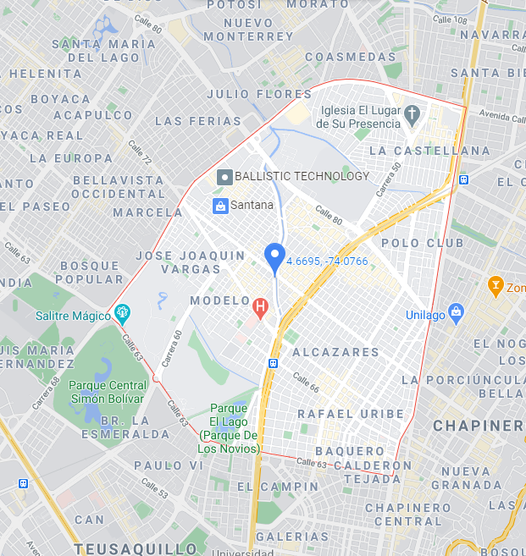
:, All operator 4G (Claro, Movistar,Tigo and Avantel )Near cell Location ( La Castellana,4.6695, -74.0766)

Slide 10
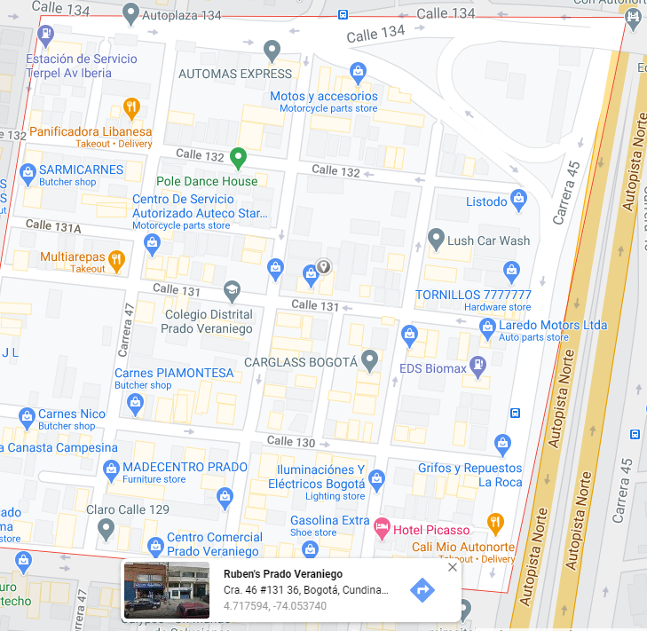
Claro 4G & Movistar 4G Near Cell Location: Ruben’s Prado Veraniego (4.717594, -74.053740)

Slide 11
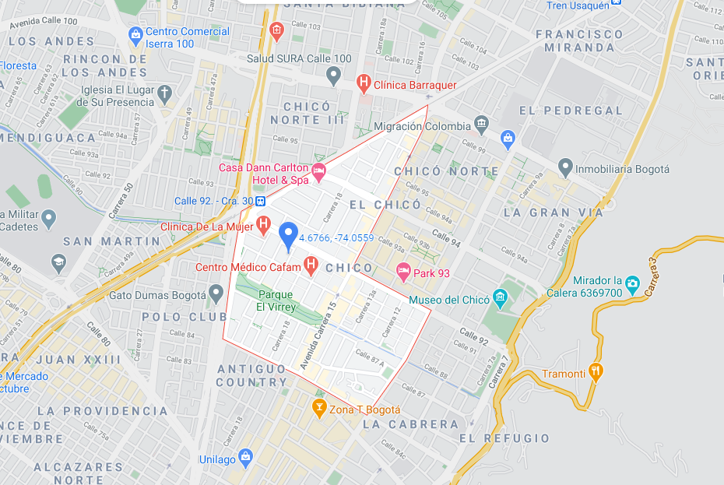
Tigo 4G & Avantel 4G Near Cell Location: Chica (4.6766, -74.0559)

Slide 12
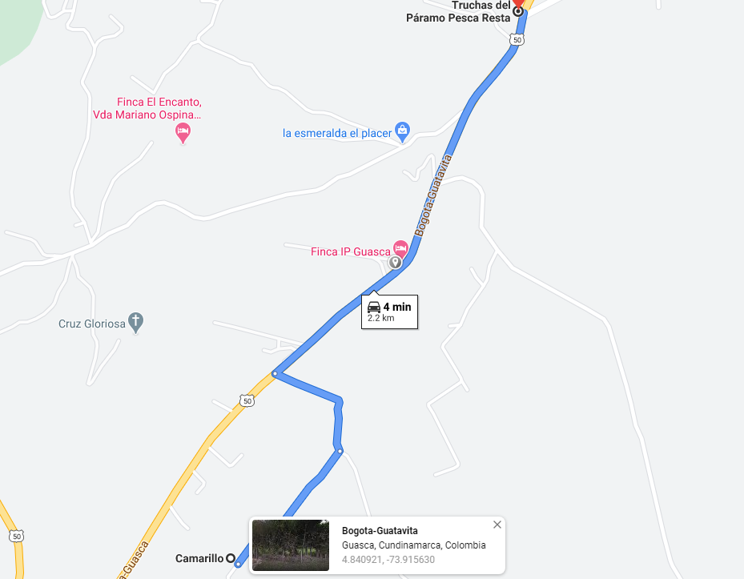
All operator 4G (Claro, Movistar,Tigo and Avantel) Edge Cell Location Bogota –Guatavita ,4.840921,-73.915630

Slide 13
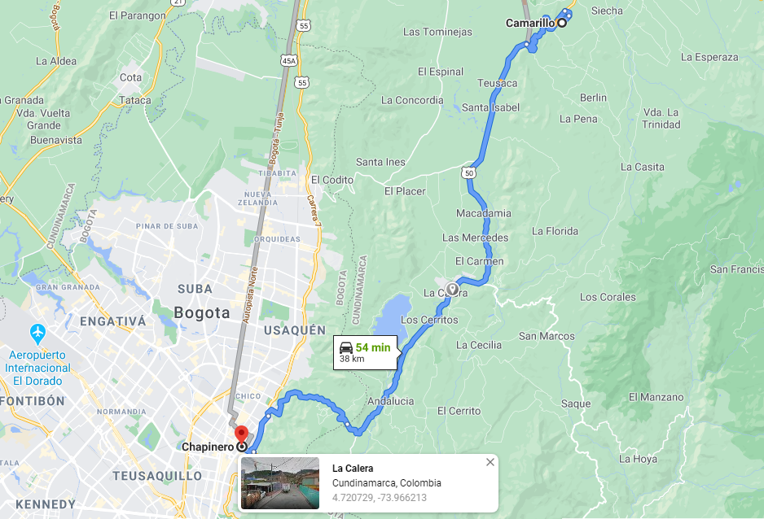
Claro and Movistar Edge Cell Location La Calera 4.720729,-73.966213

Slide 14
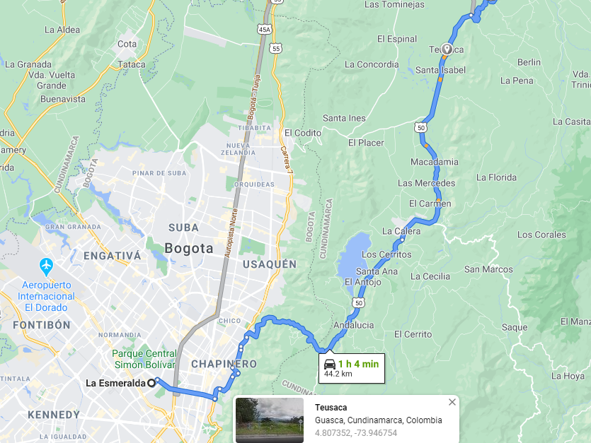
All operator Drive route for Mixed Coverage area: Teusaca 4.807352,-73.946754

Slide 15
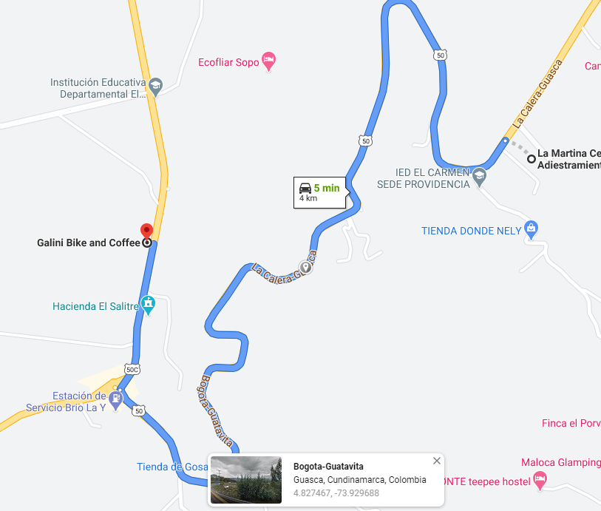
All operator IRAT Location: 4G- 3G -4G Bogota – Guatavita , 4.827467,-73.929688

Slide 16
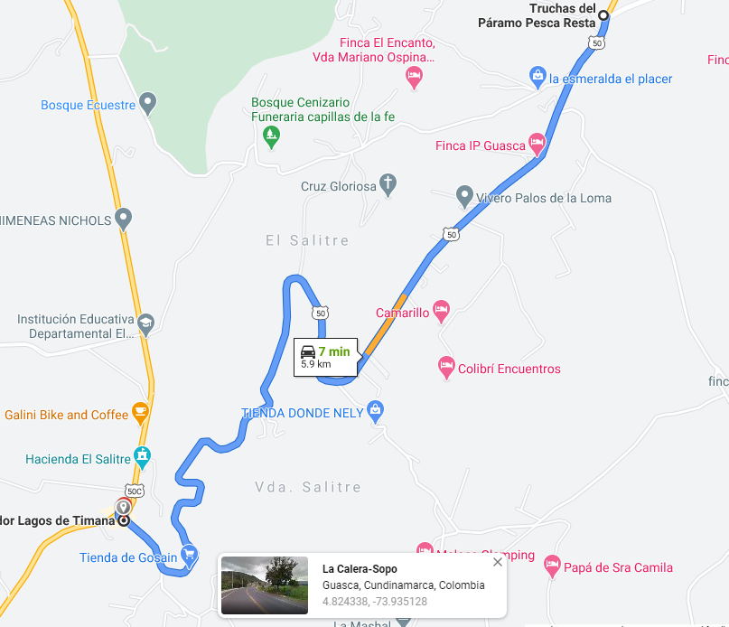
Claro & Movistar SRVCC Location: La-Calera-sopo , 4.824338,-73.935128

Slide 17
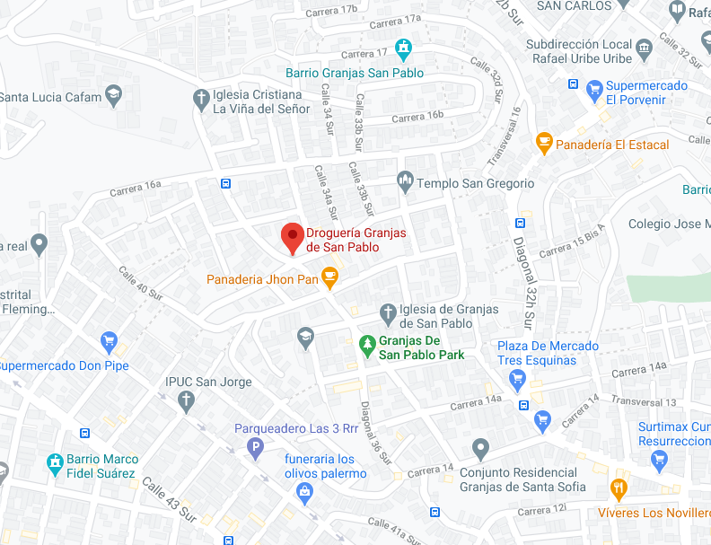
Tigo & Movistar SRVCC Location: Drogueria Granjas de San Pablo , 4.572201,-74.116382)

Slide 18
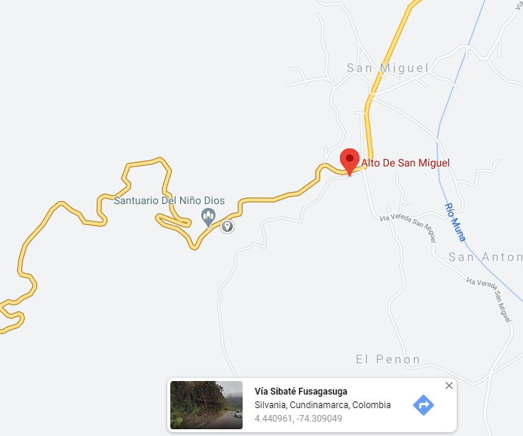
Out Of Service Location: Silvania, Cundinamarca, Colombia 4.440961, -74.309049

Slide 19
Top Most Popular Android Apps used in Colombia
Whatsapp
Facebook
Rappy
Mensajeros
Uber
Waze
Parchis
Urbanos
Hi Suite
Bancolombia

Slide 20
Local Emergency number used in Colombia:
National emergency number | 123
Local Police | 112
Ambulance | 125/132
Fire Brigade | 119
Traffic Police | 127

Slide 21
THANK YOU
MARQUIS TECHNOLOGIES
www.marquistech.com

