Slide 1
MARQUIS TECHNOLOGIES
Drive Route- Bangkok, Thailand

Slide 2
Country | Thailand
Continent | APAC
City | Bangkok
Time Zone | GMT +7 hour
Currency | THB
International Dialing Code | +66

Slide 3
Operators in Philippines
MCC | MNC | Operator
515 | 03 | AIS
515 | 02 | Truemove
515 | 66 | DTAC
 |  | NT Mobile
AIS Network Info
RAT | Band | Comment
5G | NSA, SA, N41
4G | B1 (2100 MHz) B3 (1800 MHz), B8 (900 MHz), B28(700 MHz) B41(2600 MHz)
3G | U1 (2100 MHz) U05(850 MHz)
2G | 900Mhz, 1800MHz

Slide 4
TrueMove Network Info
RAT | Band | Comment
5G | NSA, SA, n41, n28
4G | B1 (2100 MHz) B3 (1800 MHz), B8 (900 MHz), B28(700 MHz) B41(2600 MHz)
3G | U1 (2100 MHz) U05(850 MHz)
2G | 900Mhz, 1800MHz
DTAC Network Info
RAT | Band | Comment
5G | NSA, n41, n28
4G | B1 (2100 MHz) B3 (1800 MHz), B8 (900 MHz), B28(700 MHz) B41(2600 MHz)
3G | U1 (2100 MHz) U05(850 MHz)
2G | 900Mhz, 1800MHz

Slide 5
NT Mobile (MY Mobile SIM) Network Info
RAT | Band | Comment
5G | NA
4G | B1 (2100 MHz) B3 (1800 MHz)
3G | U05(850 MHz)
2G | NA

Slide 6
Operators and General Information
AIS - Supports 5G VoNR, SA/NSA, VoLTE, LTE, WCDMA and 2G
Truemove - Supports 5G SA/NSA, VoLTE, LTE, WCDMA and 2G
DTAC - Supports 5G NSA, VoLTE and LTE WCDMA and 2G
NT Mobile - Supports LTE and WCDMA only

Slide 7
USSD codes for balance check
AIS balance check: *121#
Truemove balance check: *123#
DTAC balance check: *121#
NT Mobile: *99#

Slide 8

Supplementary Services
AIS: All SS services supported on both Prepaid/Postpaid
Truemove: All SS services & ViLTE supported on Postpaid Only
DTAC: All SS services supported CSFB and supported ViLTE
NT Mobile: NO SS & NO ViLTE supported

Slide 9
RSRP Criteria
Near Cell :-Stationary: RSRP : -65dbm to -85dbm
Cell Edge :-Stationary: RSRP : -95dbm to -110dbm
Mixed :-Mobility: RSRP : -65dbm to -120dbm

Slide 10
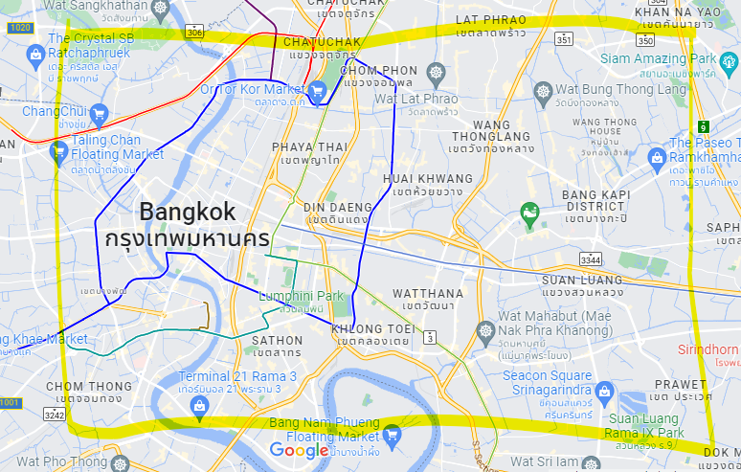
5G Near Cell (AIS, Truemove & DTAC):

Slide 11
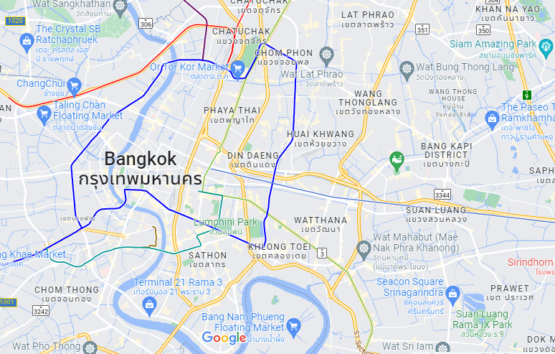
Edge Cell(AIS, Truemove, DTAC):
Inside Vista Mall Las Pinas

Slide 12
Near cell AIS 5G VoNR SA/NSA Coverage:

Slide 13
Near cell Truemove 5G NSA Coverage:

Slide 14
Near cell DTAC 5G NSA Coverage:

Slide 15
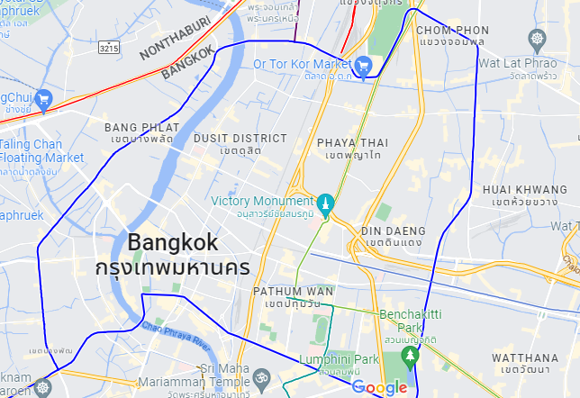
AIS, True & DTAC 5G to 4G & 4G to 5G:
Bangkok is mostly covered by 5G area, Need to check HO in Parrking spaces, Lift/Elevators or on route if there is low signal sometime

Slide 16
AIS Truemove 5G NR Handover Test Location
Bangkok is mostly covered by 5G area, Need to check HO in Parrking spaces, Lift/Elevators or on route if there is low signal sometime

Slide 17
THANK YOU
MARQUIS TECHNOLOGIES
www.marquistech.com

