Slide 1
MARQUIS TECHNOLOGIES
Drive Route- Austria /Vienna

Slide 2
Travel to Austria (vienna)
Country | Austria
Continent | Europe
City | Vienna
Time Zone | GMT +03 Hour Eastern European Summer Time GMT +04 Hour Eastern European Wintertime

Slide 3
Operators in Vienna
MCC | MNC | Operator
232 | 11, 01, 02, 08 & 09 | A1
232 | 15,07,04,03 & 13 | T- Mobile
232 | 10,14 | 3AT
A1 Network Info
RAT | Band | Comment
5G | n78 (3500 MHz) | NR
4G | B7 (2600 MHz) B20 (800 MHz)
3G | B1 (2100 MHz)
2G | -
T-Mobile Network Info
RAT | Band | Comment
5G | n78(3500 MHz) | NR
4G | B3 (1800 MHz),B7 (2600 MHz) B8 (900 MHz),B20 (800 MHz)
3G | B8 (900 MHz)
2G | -
3AT Network Info
RAT | Band | Comment
5G | n78(3500 MHz) | NR
4G | B1 (2100 MHz),B3 (1800 MHz) B7 (2600 MHz),B8 (900 MHz)
3G | B1 (2100 MHz)
2G | -

Slide 4
Operators and general Information
A1- Supports 5G,LTE, VoLTE, VoWifi , WCDMA and 2G
T –Mobile - Supports 5G, LTE, VoLTE ,VoWifi, WCDMA and 2G
3AT Supports 5G , LTE, VoLTE, VoWIFI, WCDMA and 2G

Slide 5
RSRP Criteria
Near Cell :-Stationary: RSRP : -72dbm to -85dbm
Cell Edge :-Stationary: RSRP : -95dbm to -110dbm
Mixed :-Mobility: RSRP : -65dbm to -120dbm

Slide 6
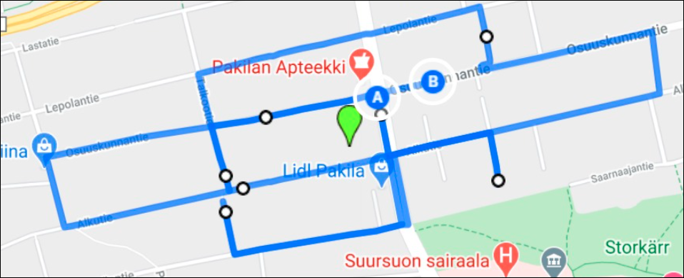
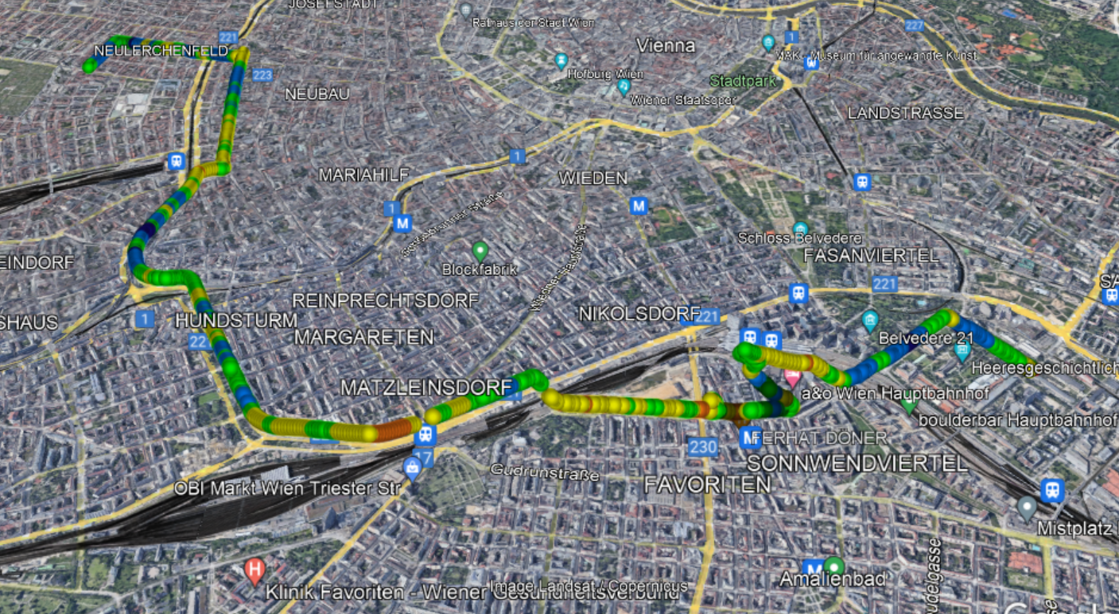
5G T-Mobile Drive Route
Alliogasse>>Westbahnhoff >> Mariahilfer strasse >>Gumpndorfer >>Friedrich Engelsplatz
RSRP: -78dbm to -100dbm Long/Lat: 16.380716 ; 48.243968

Slide 7
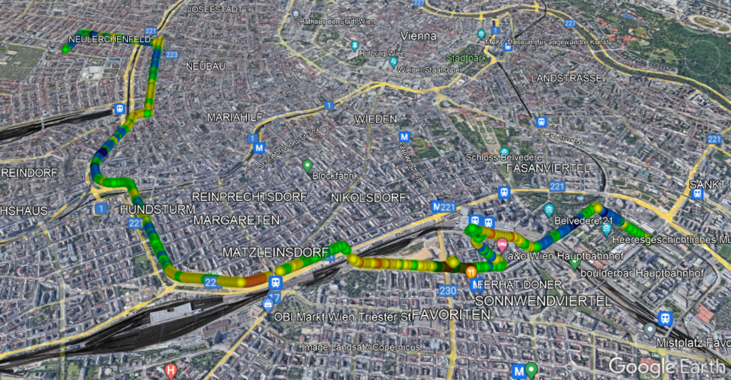
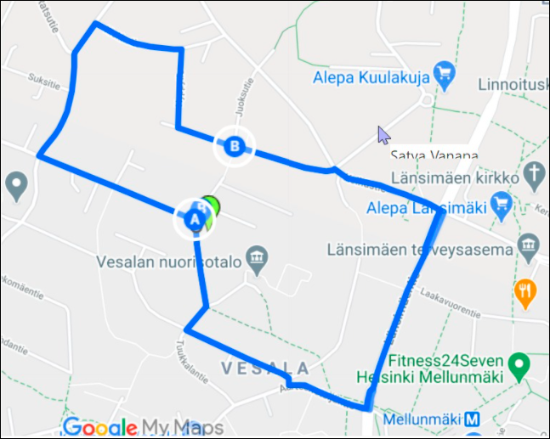
5G A1 Drive Route
Alliogasse >>Urban Loritz platz>>Westbahnhof >>Marihilfer Gurtel >> Gumpendrofer strasse>>Arbietergasse gurtel>>Arsenal
RSRP: -68dbm to -102dbm Long/Lat: 16.393115, 48.183412

Slide 8
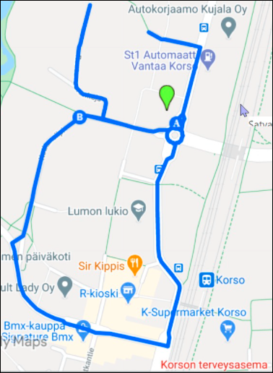
5G 3AT Drive Route
Josefstdt>>Himmelpfortgrund>>Thurygrund >> Spittelau>> Allerheiligrnplatz
RSRP: -dbm to -100dbm Long/Lat: 16.393118, 48.183417

Slide 9
THANK YOU
MARQUIS TECHNOLOGIES
www.marquistech.com

