Slide 1
MARQUIS TECHNOLOGIES
Drive Route –Airtel, Idea, VODAFONE & Reliance JIO (FDD/TDD) LTE

Slide 2
Operator Information:
Operator | JIO 4G
MCC | 405
MNC | 868
APN | Jionet
Operator | Airtel 4G
MCC | 404
MNC | 70
APN | Airtelgprs.com
Operator | VI
MCC | 404
MNC | 60
APN | www
Operator | BSNL
MCC | 404
MNC | 59
APN | Bsnlmms

Slide 3
Operator Information 1
Functionality | Airtel
Website: http://www.airtel.com/ WAP APN: airtelgprs.com
Customer care | 198
MNC | 70
Bands supported | Both FDD and TDD
 | LTE 2300 MHz – TDD(Band 40)
 | LTE 1800,2100 MHz – FDD(Band 1, 3)
USSD | To check MDN: *282#
 | Balance check: *123#
 | Data Balance check: *121*114#
VoLTE | Supported
CSFB | Supported (CSFB to 2G)

Slide 4
Operator Information 2
Functionality | RELIANCE JIO
Website: http://www.jio.com WAP APN: jionet
Customer care | 198
MNC | 868
Bands supported | Both FDD and TDD
 | LTE 2300 MHz –TDD(Band 40)
 | LTE 850 MHz – FDD(Band 5)
 | LTE 1800 MHz –FDD(Band 3)
USSD | NA
 | NA
 | NA
VoLTE | Supported
CSFB | Not Supported

Slide 5
Operator Information 3
Functionality | VI
Website: http://www. WAP APN: portalnmms
Customer care | 198
MNC | 60
Bands supported | Both FDD and TDD
 | LTE 2500 MHz –TDD(Band 41)
 | LTE 2100 MHz – FDD(Band 1)
 | LTE 1800 MHz –FDD(Band 3)
USSD | To check MDN*199#
 | Vodafone special offer 121
 | Data Balance check: *121#
VoLTE | Supported
CSFB | Supported (3G and 2G)

Slide 6
Operator Information 4
Functionality | BSNL
Website: http://Bslmms WAP APN: Bslmms
Customer care | 198
MNC | 59
Bands supported | WCDMA & GSM
 | WCDMA 2100 MHz (Band 1)
 | GSM 900 MHz – FDD(Band 5)
USSD | Balance cheak *123#
 | Data Balance *124#
 | Night Data Balance: *123*8#
VoLTE | Not Supported
CSFB | Not Supported

Slide 7
Drive Route
Near Cell :- Stationary: RSRP : -65dbm to -75dbm
Cell Edge :- Stationary: RSRP : -95dbm to -110dbm
Mixed :- Mobility: RSRP : -65dbm to -110dbm

Slide 8
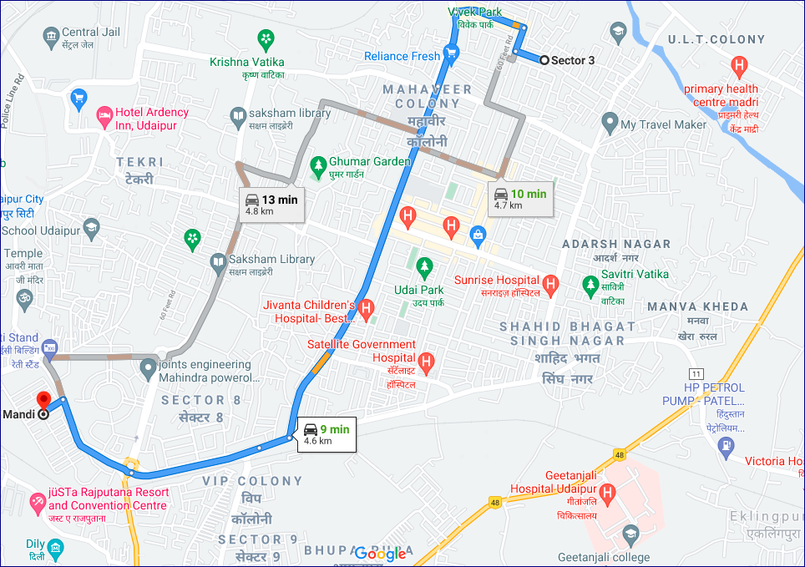
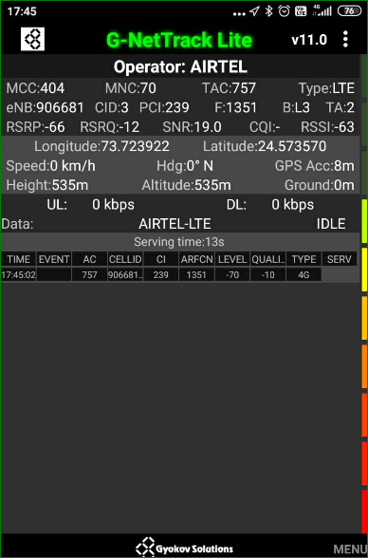
Near Cell (Airtel)
Near cell(NC) | longitude | latitude | RSRP | Cell id | FDD E-ARFCN
1 | 73.723922 | 24.573570 | -66 | 3 | 1351
Sector03,sector05,
RSRP:
-65dbm to 75dbm

Slide 9
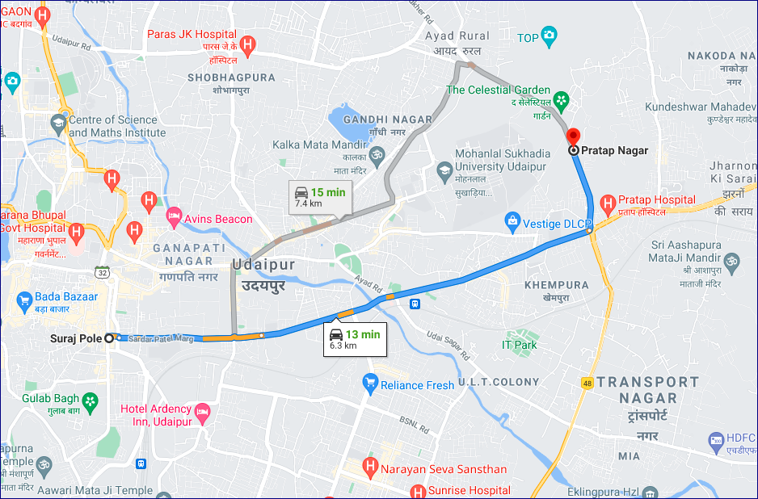
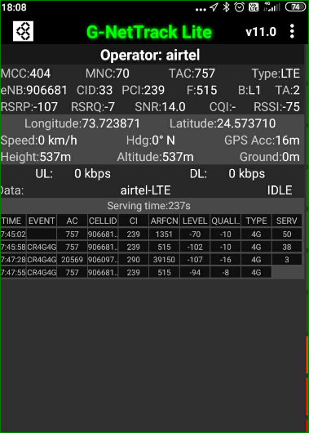
Edge Cell (Airtel)
Edge cell(EC) | longitude | latitude | RSRP | Cell id | TDD E-ARFCN
1 | 73.723871 | 24.573710 | -107 | 33 | 515
Surapole to Pratap Nagar main Road
RSRP:
-95dbm to -110dbm

Slide 10
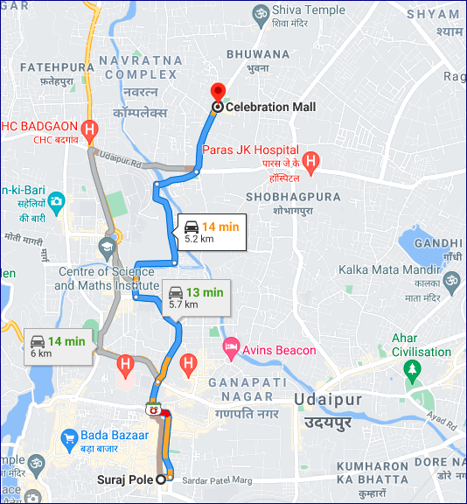
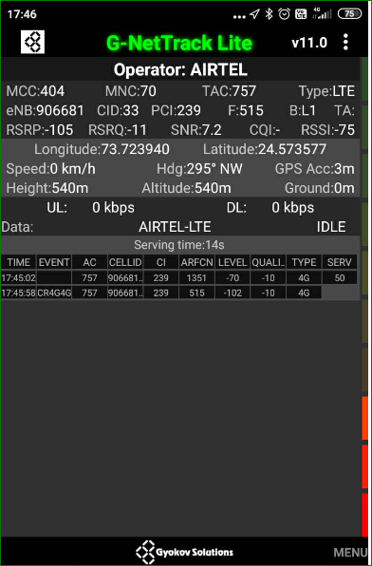
Mixed Mobility:- chetak circle uit circle celebration mall
chetak circle uit circle celebration mall
RSRP: -65dbm to -110dbm

Slide 11
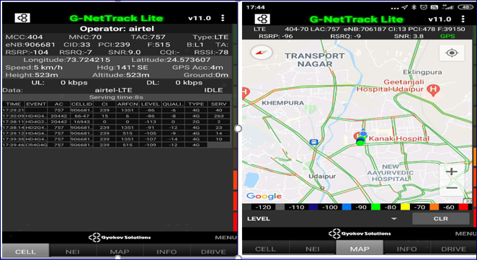
Airtel Band HO
Band Hand Over | Longitude | Latitude | RSRP
1 | 73.724215 | 24.573607 | -85 to 105 dBM
Band Hand Over | Longitude | Latitude | RSRP | Band | Freq.
1 | 73.72250379 | 24.57292594 | -85 to 105 dBM | L3 | 1351
2 | 73.72276001 | 25.38627995 | -85 to 105 dBM | L1 | 515
3 | 73.72274321 | 24.57283143 | -85 to 105 dBM | L3 | 1351
4 | 73.72276643 | 24.57283321 | -85 to 105 dBM | L40 | 39150
5 | 73.72276024 | 24.57283234 | -85 to 105 dBM | L3 | 515

Slide 12
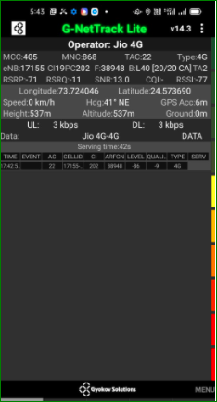
Near Cell (Reliance JIO)
Near cell(NC) | longitude | latitude | RSRP | Cell id | TDD E-ARFCN
1 | 73.724046 | 24.573690 | 70 | 19 | 38948
Sector03 to sector-11
RSRP:
-65dbm to -75dbm

Slide 13
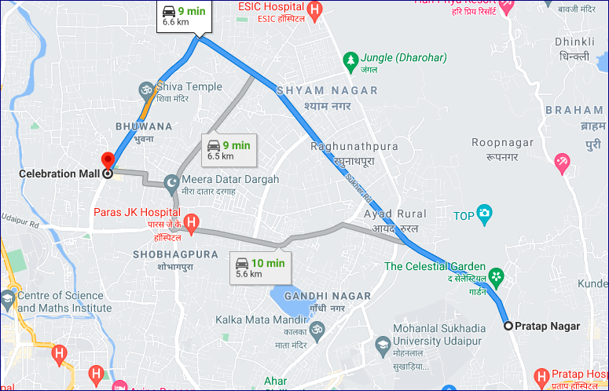
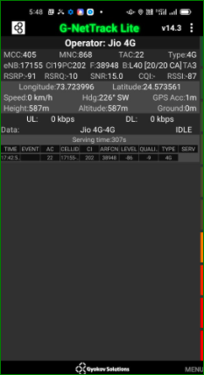
Edge Cell (Reliance JIO)
Edge cell(NC) | longitude | latitude | RSRP | Cell id | TDD E-ARFCN
1 | 73.709193 | 24.579439 | 95 | 17 | 38750
Science collage ,Pras hospital
RSRP:
-95dbm to -110dbm

Slide 14
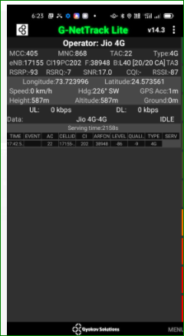
Mixed Mobility:- suraj pole to Bhuwana
RSRP: -65dbm to -110dbm

Slide 15
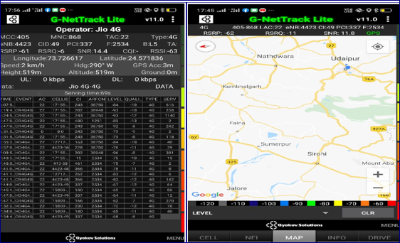
Inter Band Handover (FDD-TDD), JIO 4G
Band Handover | longitude | latitude | RSRP | PCI | TDD E-ARFCN
1 | 73.726617 | 24.571836 | -61 | 337 | 2534
Band Hand Over | Longitude | Latitude | RSRP | Band | Freq.
1 | 73.726626 | 24.5718214 | -85 to 105 dBM | L5 | 2534
2 | 73.7268765 | 24.5718521 | -85 to 105 dBM | L40 | 38948
3 | 73.726543 | 24.574831 | -85 to 105 dBM | L3 | 1251
4 | 73.7265431 | 24.5721310 | -85 to 105 dBM | L40 | 38948
5 | 73.723421 | 24.573421 | -85 to 105 dBM | L5 | 2534

Slide 16
RJIO Band 40 Near Cell:
Band-40

Slide 17
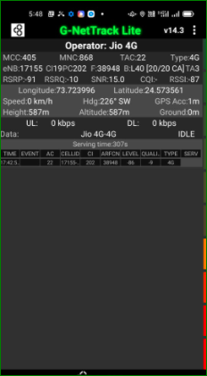
RJIO Band 40 Edge Cell:
Band-40

Slide 18
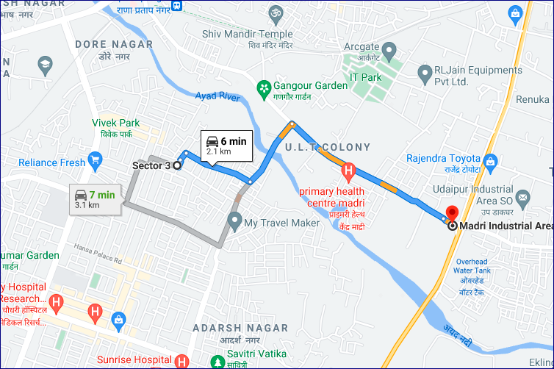
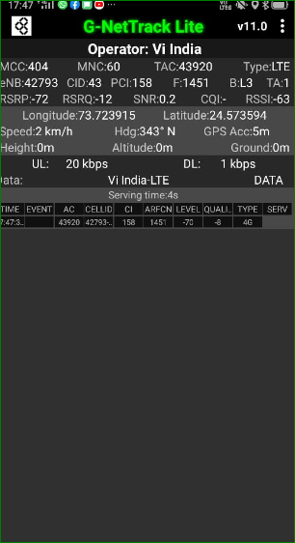
Near Cell VI:
Near cell(NC) | longitude | latitude | RSRP | Cell id | TDD E-ARFCN
1 | 73.723915 | 24.573594 | -72 | 43 | 1451
Madri industrial Area
RSRP:
-65dbm to -75dbm

Slide 19
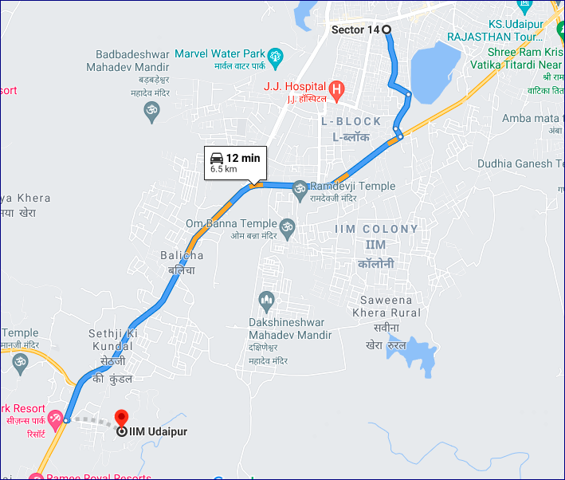
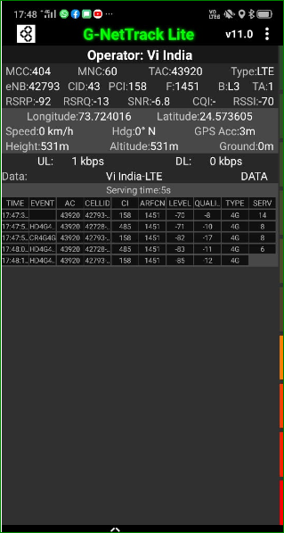
Cell Edge VI:
Edge cell(EC) | longitude | latitude | RSRP | Cell id | TDD E-ARFCN
1 | 73.724016 | 24.573605 | -92 | 41 | 1451
IIM Udaipur
RSRP:
-95dbm to -105dbm

Slide 20
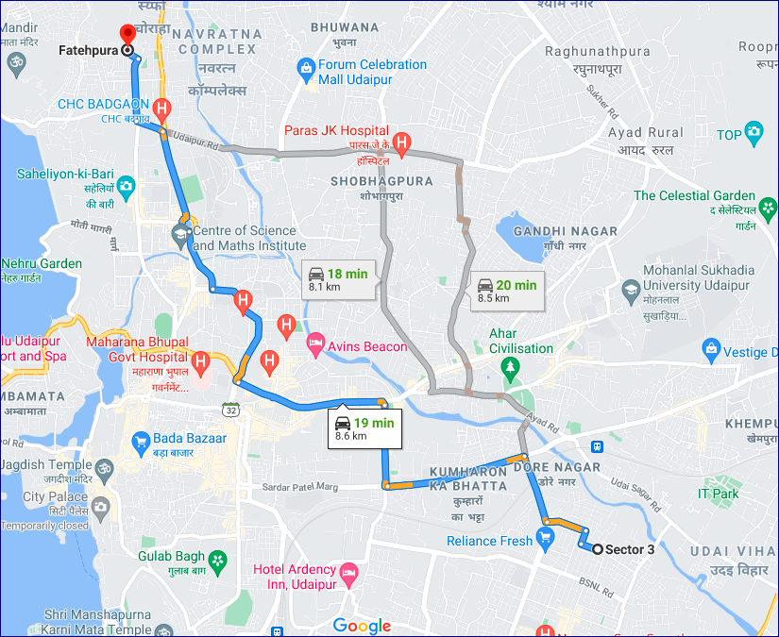
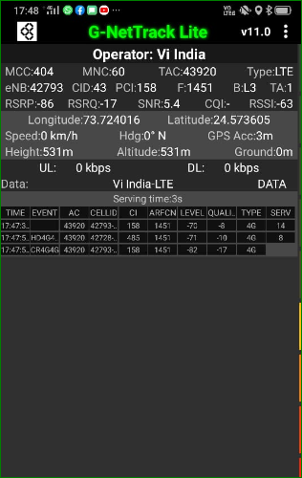
Mixed coverage area Vodafone:
-65 to -110 dbm

Slide 21
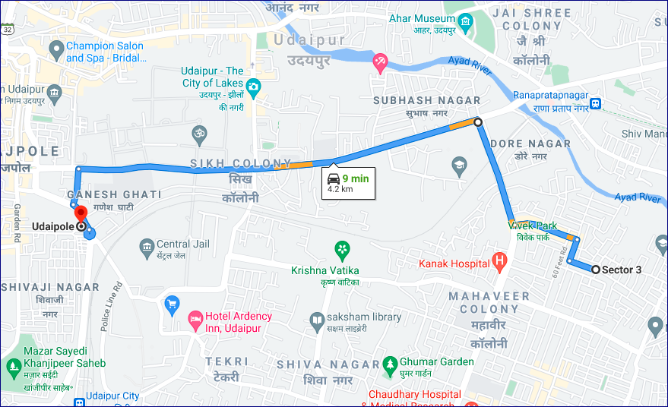
Airtel & VI SRVCC to UTRAN:
24.579429 73.707807
Longitude | Latitude
73.707807 | 24.579429
SRVCC Airtel& VI

Slide 22
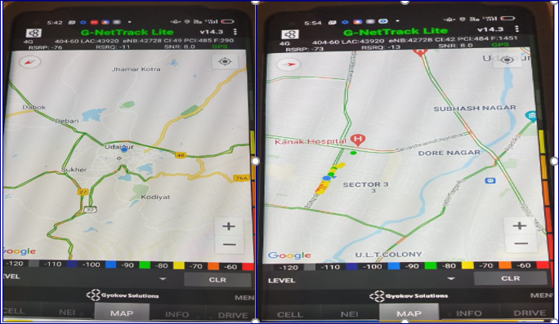
VIBand 1<>3<> Handover
Band Hand Over | Longitude | Latitude | RSRP | Band | Freq.
1 | 73.7240161 | 224.573605 | -85 to 105 dBM | L3 | 1451
2 | 73.724234 | 224.573023 | -85 to 105 dBM | L1 | 290
3 | 73.7240121 | 224.573432 | -85 to 105 dBM | L3 | 1451
4 | 73.7240523 | 224.573543 | -85 to 105 dBM | L1 | 290
5 | 73.7240132 | 224.573823 | -85 to 105 dBM | L3 | 1451

Slide 23
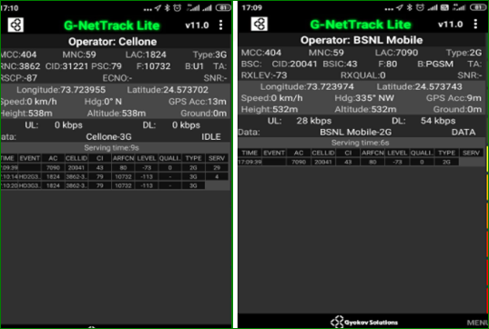
BSNL Coverage WCDMA & Gsm

Slide 24
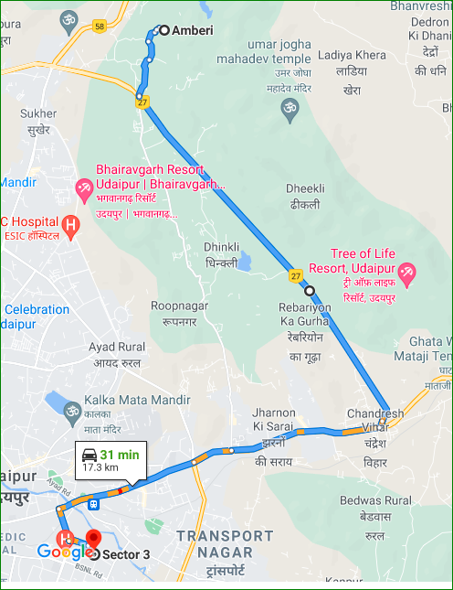
Drive Route Udaipur City

Slide 25
THANK YOU
MARQUIS TECHNOLOGIES

