Slide 1
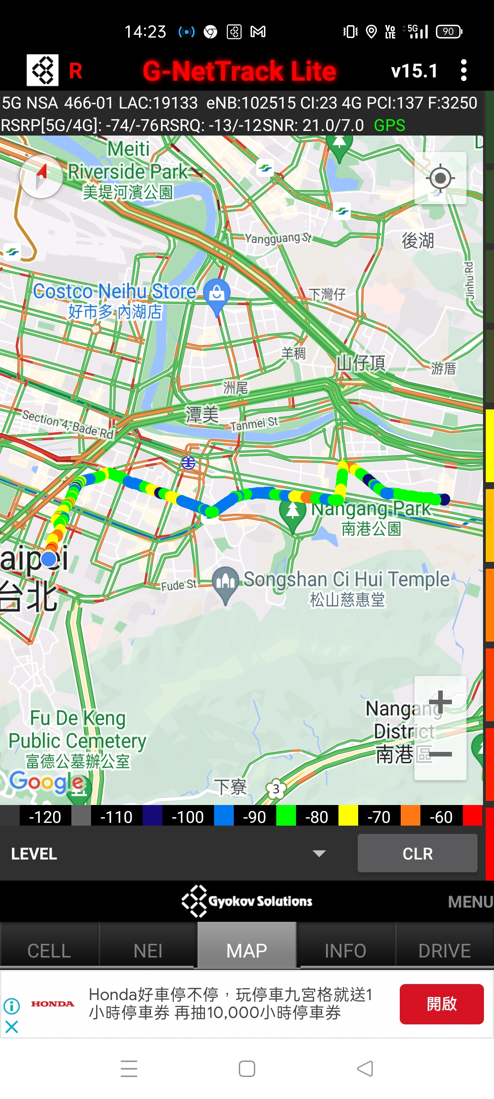
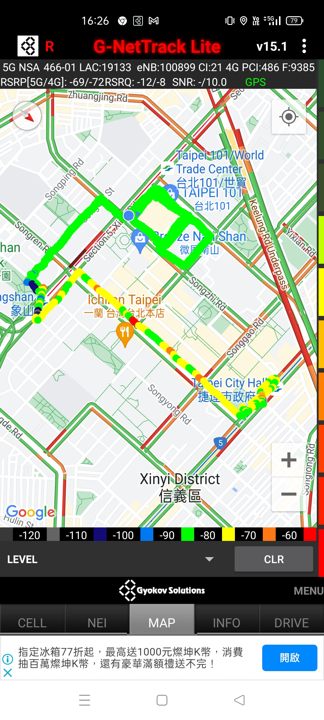
4G to 5G handover, TAC change, inter RAT and Intra RAT handover.

