Slide 1
MARQUIS TECHNOLOGIES
5G Drive Route – (Bahrain)

Slide 2
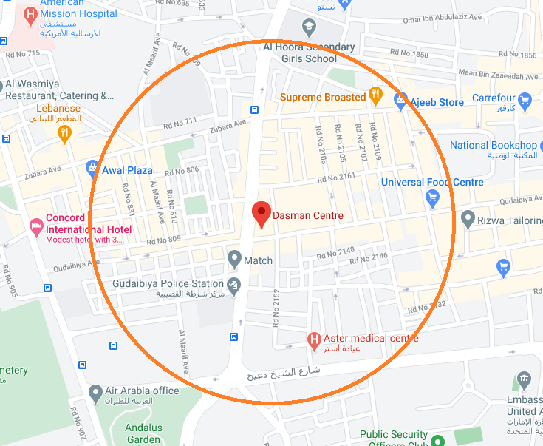
BATELCO,STC, Zain 5G Band
Lat & Long- 26.22712, 50.58829
Land Mark- Dasman center

Slide 3
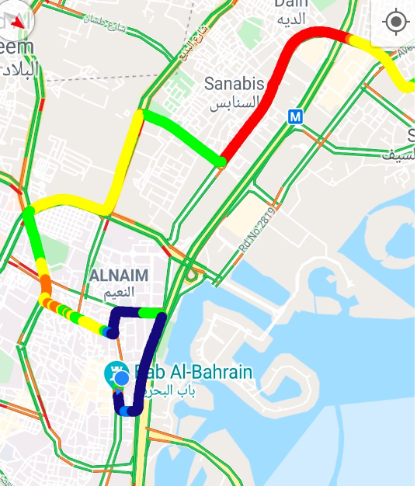
Handover
Lat & Long-26.22731,50.54550
Land mark- The Bahrain Mall

Slide 4
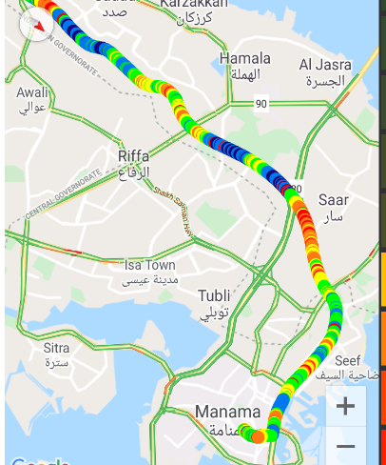
5G Band location:
Manama to A’Ali(Shaikh Khalifa Bin Salman Hwy)

Slide 5
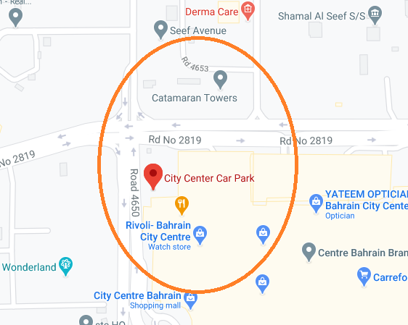
SRVCC location
City center car park -26.23437/50.55182

Slide 6
THANK YOU

