Slide 1
MARQUIS TECHNOLOGIES
Drive Route –Airtel & Reliance JIO (FDD/TDD) LTE

Slide 2
Operator Information:
Operator | JIO 4G
MCC | 405
MNC | 854
APN | Jionet
Operator | Airtel 4G
MCC | 404
MNC | 49
APN | airtelgprs.com
Operator | VI
MCC | 404
MNC | 7
APN | Internet

Slide 3
Operator Information 1
Functionality | Airtel
Website: http://www.airtel.com/ WAP APN: airtelgprs.com
Customer care | 199
MNC | 49
Bands supported | Both FDD and TDD
 | LTE 2300 MHz – TDD(Band 40)
 | LTE 1800,850 MHz – FDD(Band 3)
USSD | To check MDN: *282#
 | Balance check: *123#
 | Data Balance check: *121*114#
VoLTE | Supported
CSFB | Supported (CSFB to 2G)

Slide 4
Operator Information 2
Functionality | RELIANCE JIO
Website: http://www.jio.com WAP APN: jionet
Customer care | 198
MNC | 854
Bands supported | Both FDD and TDD
 | LTE 2300 MHz –TDD(Band 40)
 | LTE 850 MHz – FDD(Band 5)
 | LTE 1800 MHz –FDD(Band 3)
USSD | NA
 | NA
 | NA
VoLTE | Supported
CSFB | Not Supported

Slide 5
Operator Information 3
Functionality | VI
Website: http://www.myvi.in WAP APN: internet
Customer care | 198
MNC | 7
Bands supported | Both FDD and TDD
 | LTE 2300 MHz –TDD(Band 40,41)
 | LTE 850 MHz – FDD(Band 5)
 | LTE 1800 MHz –FDD(Band 3)
USSD | To check MDN*199#
 | Balance check *199#
 | Data Balance check: *199#
VoLTE | Supported
CSFB | Supported (Switched to 3G)

Slide 6
Drive Route
Near Cell :- Stationary: RSRP : -65dbm to -75dbm
Cell Edge :- Stationary: RSRP : -95dbm to -110dbm
Mixed :- Mobility: RSRP : -65dbm to -110dbm

Slide 7
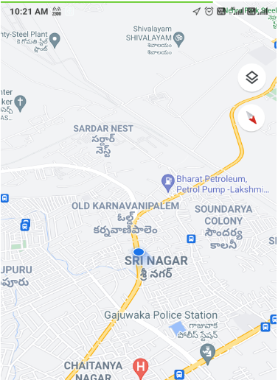
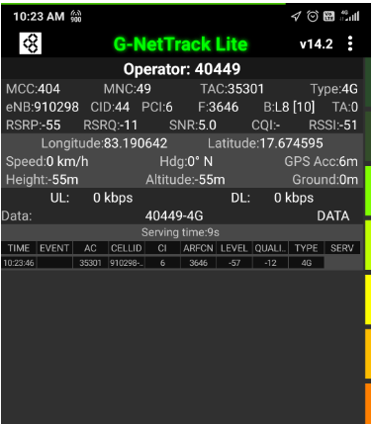
Near Cell (Airtel)
Near cell(NC) | longitude | latitude | RSRP | Cell id | FDD E-ARFCN
1 | 83.190642 | 17.674595 | 55 | 44 | 3646
Sri nagar near spencer showroom, vishakapattanam
RSRP:
-65dbm to 75dbm

Slide 8
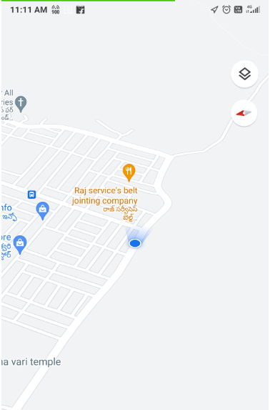
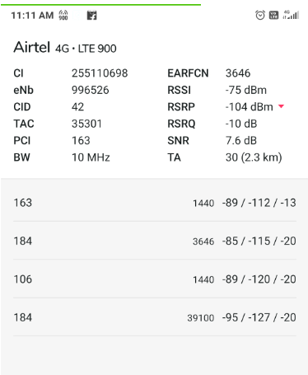
Edge Cell (Airtel)
Edge cell(EC) | longitude | Latitude | RSRP | Cell id | TDD E-ARFCN
1 | 83.2271218 | 17.6415072 | 104 | 42 | 3646
RSRP:
-95dbm to -110dbm

Slide 9
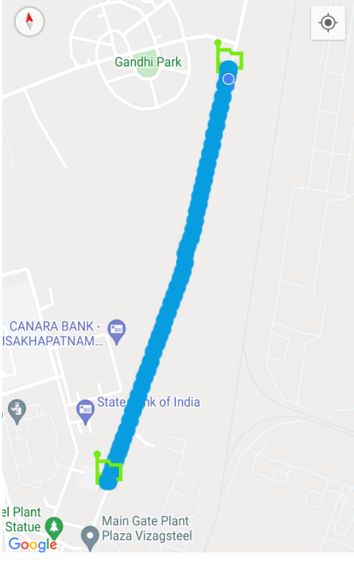
Airtel Mixed Mobility:- Steel Plant road
RSRP: -65dbm to -110dbm
Sri Nagar ,Vishakapatnam

Slide 10
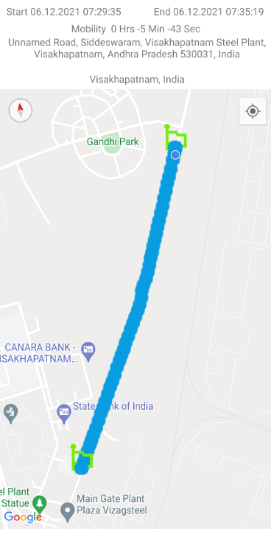
Airtel Band HO
Lat,Lng | PCI/PSC | Band | SignalSIG(Type)
17.64273702,83.17627826 | 102 | L3 | -111(LTE)
17.64345448,83.17652983 | 221 | L40 | -116(LTE)
17.64706467,83.17789037 | 220 | L3 | -112(LTE)

Slide 11
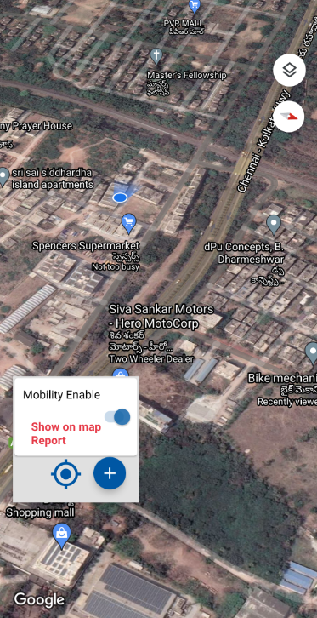
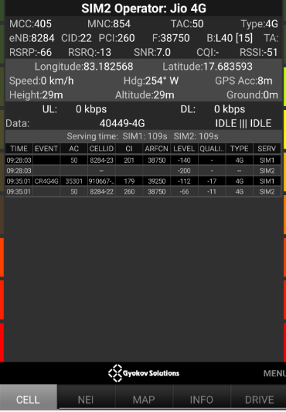
Near Cell (Reliance JIO)
Near cell(NC) | longitude | latitude | RSRP | Cell id | TDD E-ARFCN
1 | 83.182568 | 17.683593 | 66 | 22 | 38750
Near spencer super market, sri nagar ,vishkapatnam
RSRP:
-65dbm to -75dbm

Slide 12
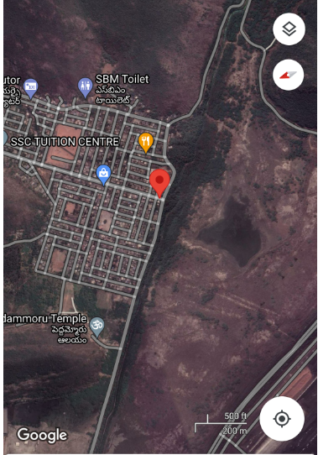
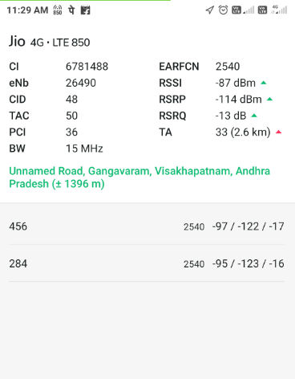
Edge Cell (Reliance JIO)
Edge cell(NC) | longitude | latitude | RSRP | Cell id | TDD E-ARFCN
1 | 83.227482 | 17.641300 | 114 | 48 | 2540
Gangavaram, vizag
RSRP:
-95dbm to -110dbm

Slide 13
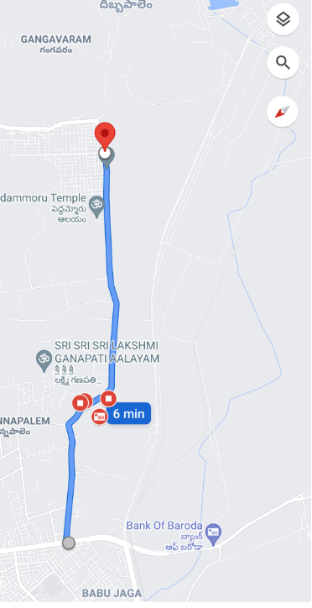
Mixed Mobility:- gangavaram,vizag
RSRP: -65dbm to -110dbm

Slide 14
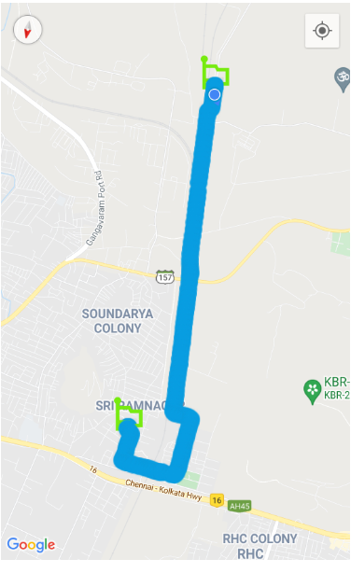
Inter Band Handover (FDD-TDD), JIO 4G
Lat,Lng | PCI/PSC | Band | Freq. | SignalSIG(Type)
17.68061333,83.17935156 | 95 | L3 | 1251 | -118(LTE)
17.68060675,83.17938794 | 334 | L40 | 38750 | -103(LTE)
17.66133469,83.18178582 | 428 | L3 | 1251 | -116(LTE)

Slide 15
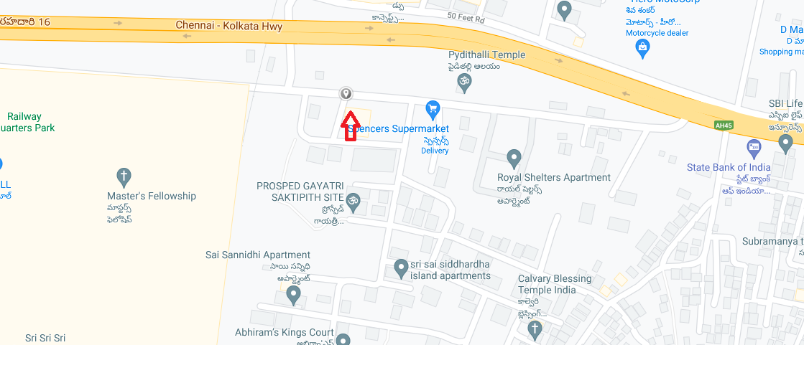
RJIO Band 40 Near Cell:

Slide 16
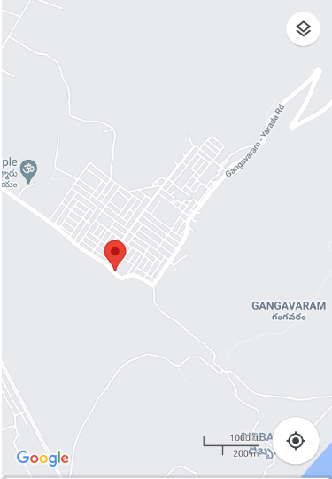
RJIO Band 40 Edge Cell:
longitude | latitude
83.1825345 | 17,6840818

Slide 17
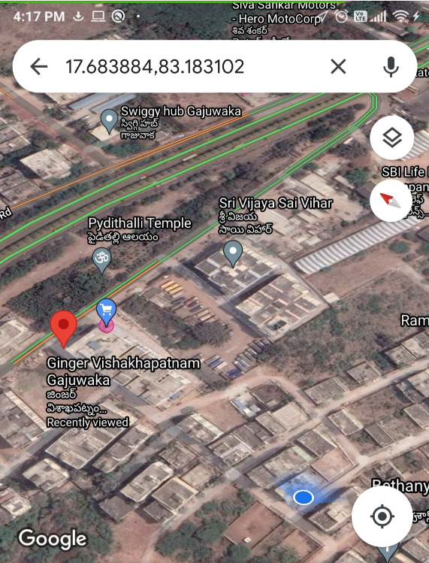
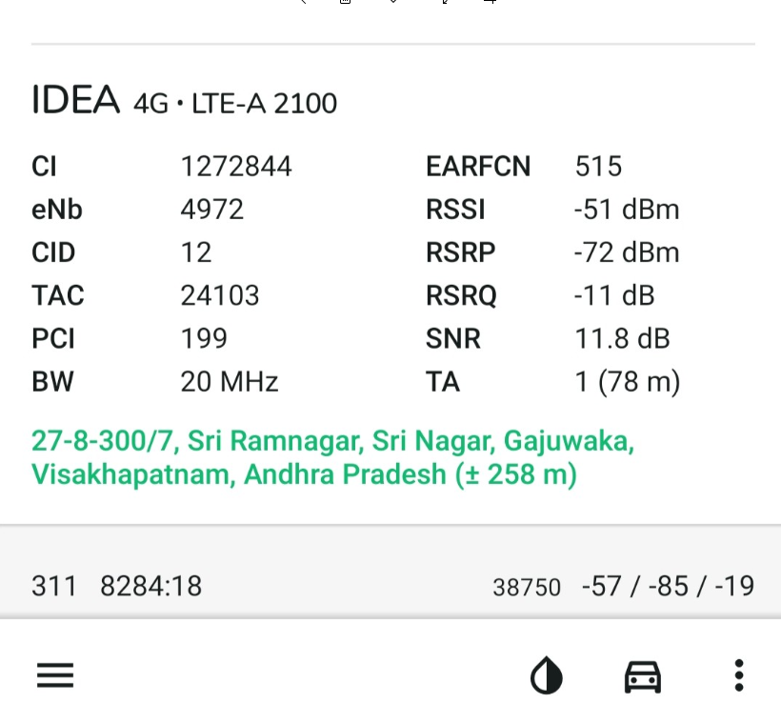
Near Cell VI:
Near cell(NC) | longitude | latitude | RSRP | Cell id | TDD E-ARFCN
1 | 83.183102 | 17.683884 | 72 | 12 | 515

Slide 18
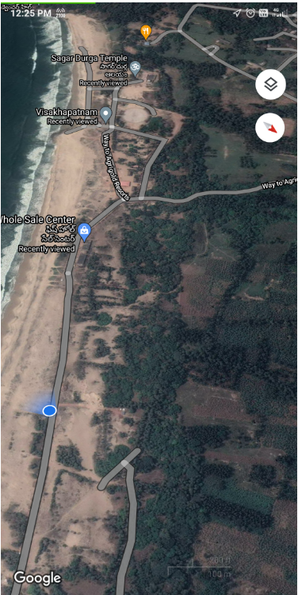
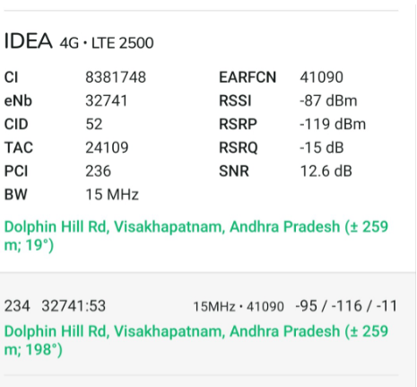
Cell Edge VI:
Edge cell(EC) | longitude | latitude | RSRP | Cell id | TDD E-ARFCN
1 | 83.2682770 | 17.6551804 | 119 | 52 | 41090
RSRP:

Slide 19
Mixed coverage area Vodafone: Near Ganagavaram port
longitude | latitude
83.219389 | 17,646860

Slide 20
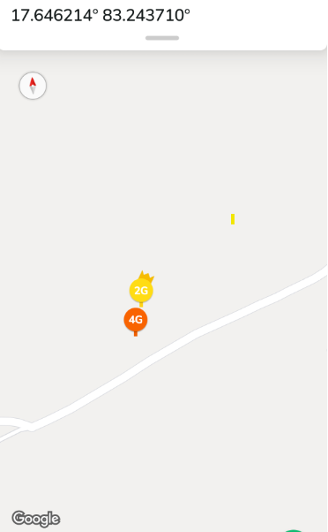
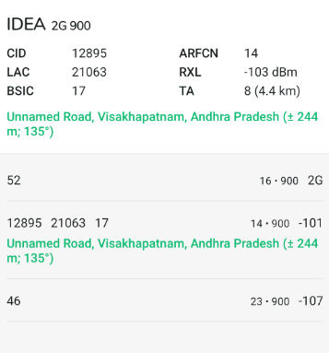
VI SRVCC to UTRAN: Gangavaram , vizag

Slide 21
VIBand 3<>41 Handover
Lat,Lng | PCI/PSC | Band | Freq. | SignalSIG(Type)
17.65239707,83.17988848 | 28 | L41 | 41090 | -117(LTE)
17.65391484,83.18045421 | 458 | L3 | 1575 | -116(LTE)
17.67006418,83.1813637 | 458 | L1 | 515 | -116(LTE)

Slide 22
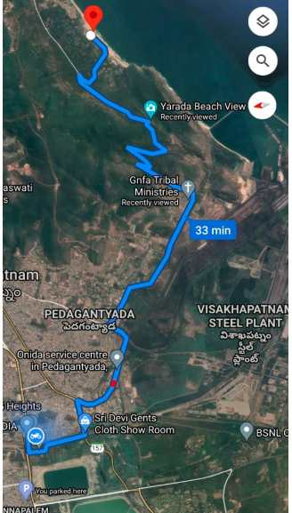
G net Tracker Drive Route

Slide 23
THANK YOU
MARQUIS TECHNOLOGIES

