Slide 1
MARQUIS TECHNOLOGIES
Drive Route & Features tested
In Troisdorf,germany.

Slide 2
Operator Details:
S. No. | Operator |  | Supported Bands | Supported Features by Network
1 | Major | TMO | N78,N28,N1 | VoWiFi/VoLTE/4G/2G/5G

Slide 3
IMPORTANT FEATURES TESTED - TMO OPERATOR
Performance test cases related to data and data for TMO OPERATOR for N78_N28_N1 – SA .
The testing Area is Pfarrer-Kenntemich-Platz 9, 53840 Troisdorf
, where the Main antenna has been installed.
Infra-Vendor used is Huawei .
Maximum speed attained was 1200/180 in RSRP< -62.

Slide 4
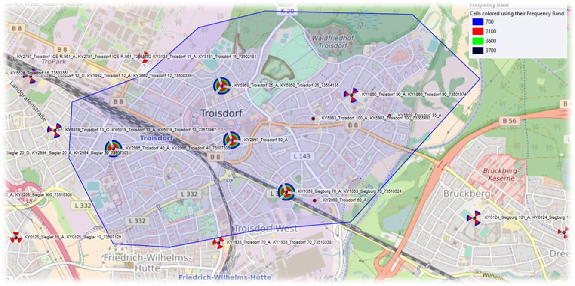
SA Near cell location with features available -
Pfarrer-Kenntemich-Platz 9, 53840 Troisdorf
Notes:
MOBILITY SITES ARE THESE

Slide 5
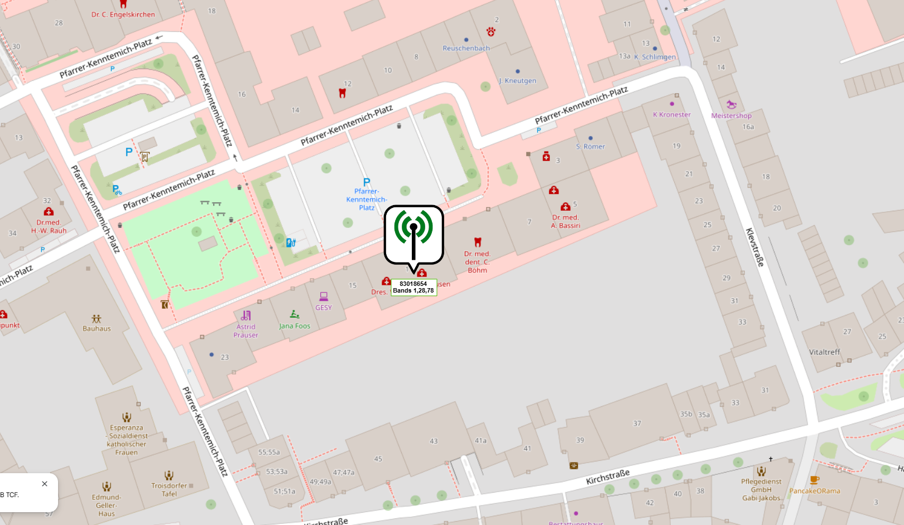
SA Near cell location with features available -

Slide 6
Information of PCI with supported Bands-
NE Name | Frequency Band | Physical Cell ID
OX831 | N78_N28_N1 | 495,434, 652

Slide 7
Testing Details – TMO Operator
The band combination present at N78+N28+N1 – SA COMBINATION.
We tested Performance Bidirectional, DL,UL,Ping,Speedtest test cases.
We tested SM8850 and our main focus was on Rel 16 SwuL and REl-15 FplusF ULCA.

Slide 8
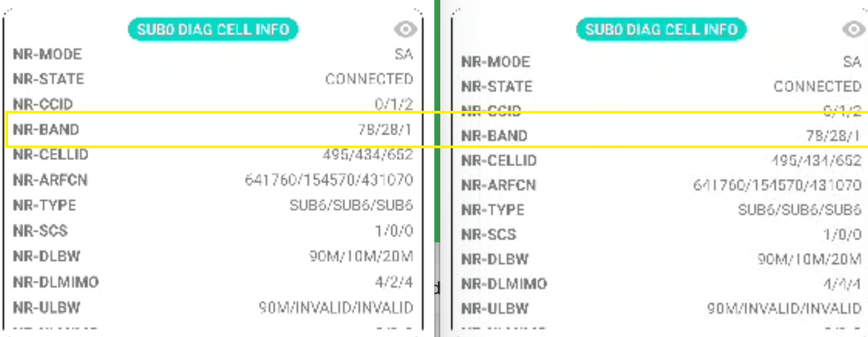
Band Details during Testing_N78+N28+N1 for REL 16 SwUL

Slide 9
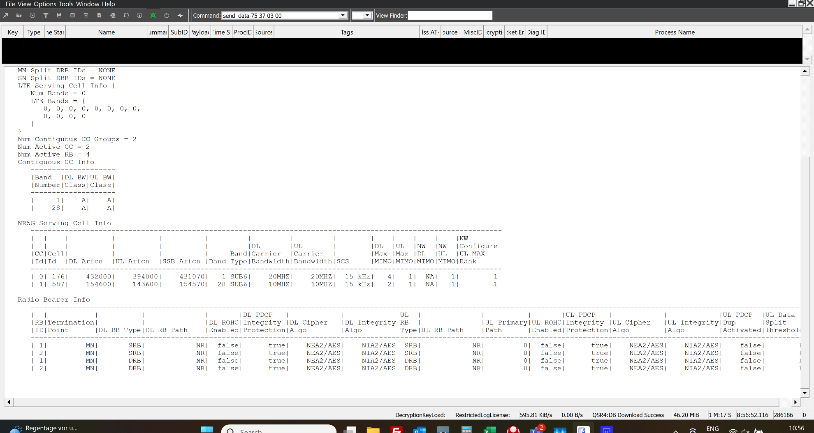
Band Details during Testing_N1+N28 for F+F ULCA

Slide 10
THANK YOU
MARQUIS TECHNOLOGIES
www.marquistech.com

