Slide 1
MARQUIS TECHNOLOGIES
Route Coverage TW Mobile/Far EasTone/Chunghwa Telecom/GT
Akash Srivastav / Syed Uddin

Slide 2
Operator Information:
Country | Taiwan
City | Taipei
Time Zone | UTC +8:00
International Dialing Code | +886
Currency | NT$
Operator | Chunghwa
MCC | 466
MNC | 92
APN | (Chunghwa) (Internet)

Slide 3
Operator Information:
Country | Taiwan
City | Taipei
Time Zone | UTC +8:00
International Dialing Code | +886
Currency | NT$
Operator | TW Mobile
MCC | 466
MNC | 97
APN | internet

Slide 4
Operator Information:
Country | Taiwan
City | Taipei
Time Zone | UTC +8:00
International Dialing Code | +886
Currency | NT$
Operator | Fareastone
MCC | 466
MNC | 01
APN | Internet or fetnet01

Slide 5
Operator Information:
Country | Taiwan
City | Taipei
Time Zone | UTC +8:00
International Dialing Code | +886
Currency | NT$
Operator | GT 4G
MCC | 466
MNC | 05
APN | gtnet

Slide 6
Operator Information:
Country | Taiwan
City | Taipei
Time Zone | UTC +8:00
International Dialing Code | +886
Currency | NT$
Operator | T-Star
MCC | 466
MNC | 89
APN | internet

Slide 7
RSRP Criteria:
Near Cell :-Stationary: RSRP : -55dbm to -85dbm
Cell Edge :-Stationary: RSRP : -95dbm to -110dbm
Mixed :-Mobility: RSRP : -65dbm to -120dbm

Slide 8
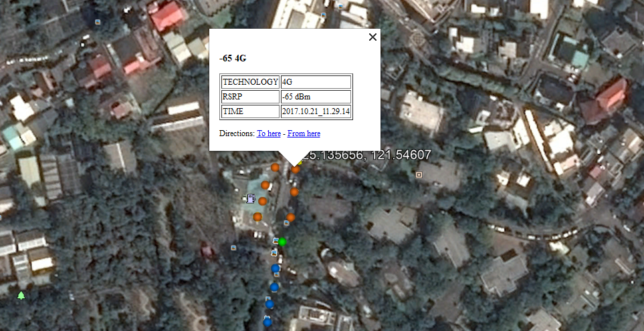
Chunghwa Telecom Near Cell: 25.135656, 121.54607

Slide 9
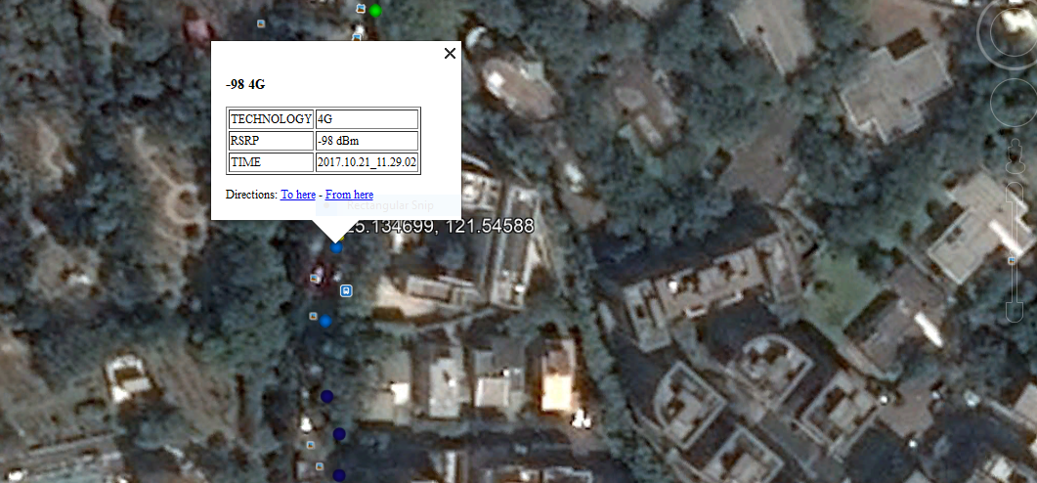
Chunghwa Telecom Edge Cell: 25.134699, 121.54588

Slide 10
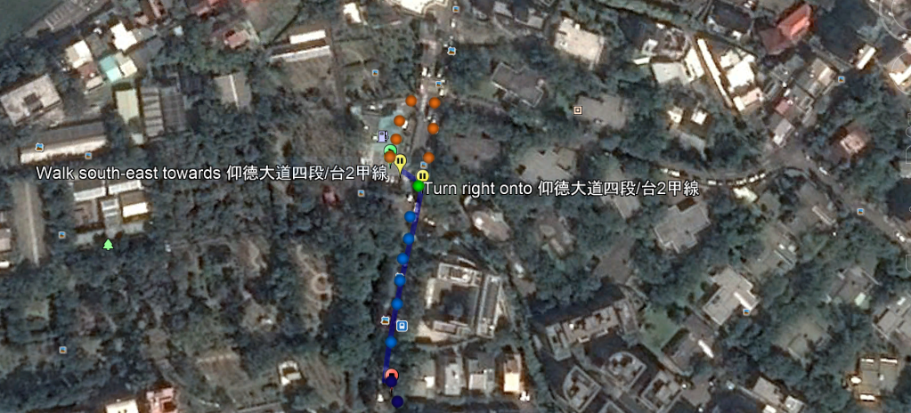
Chunghwa Telecom Mixed Mobility: from:25.13539313, 121.54584416 (-65 4G) to:25.13434539, 121.54586417 (-103 4G)

Slide 11
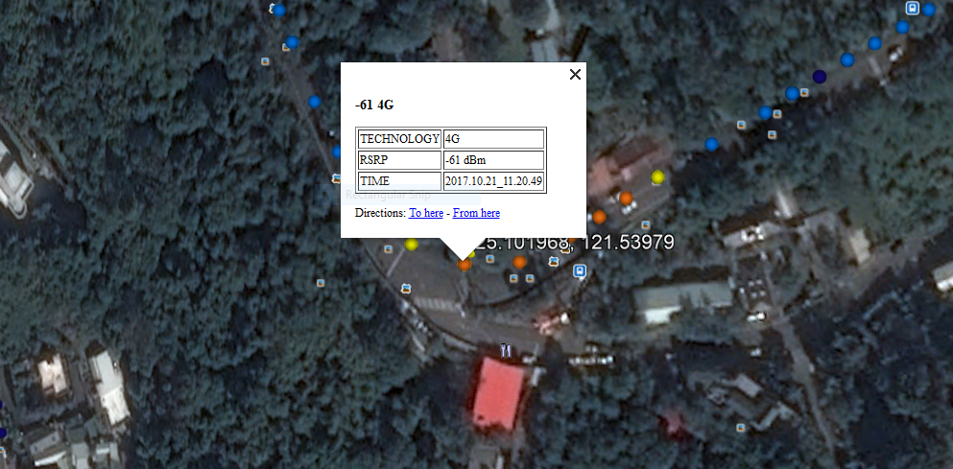
Far EasTone Near Cell: 25.101968, 121.53979

Slide 12
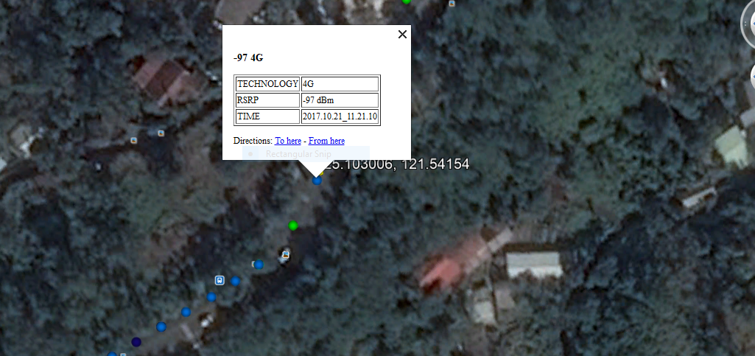
Far EasTone Edge Cell: 25.103006, 121.54154

Slide 13
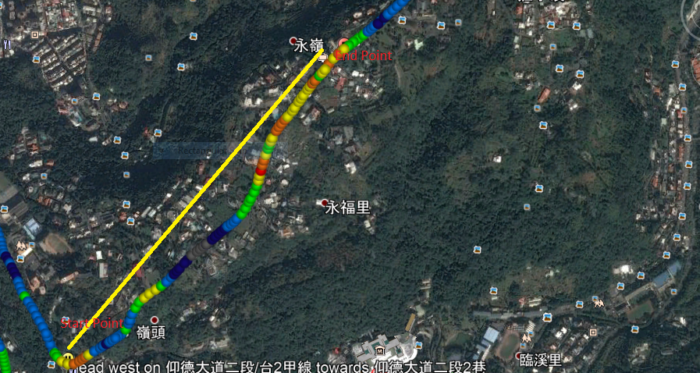
Far EasTone Mixed Mobility: from:25.1019687, 121.53979295 (-61 4G) to:25.10978797, 121.54751581 (-73 4G)

Slide 14
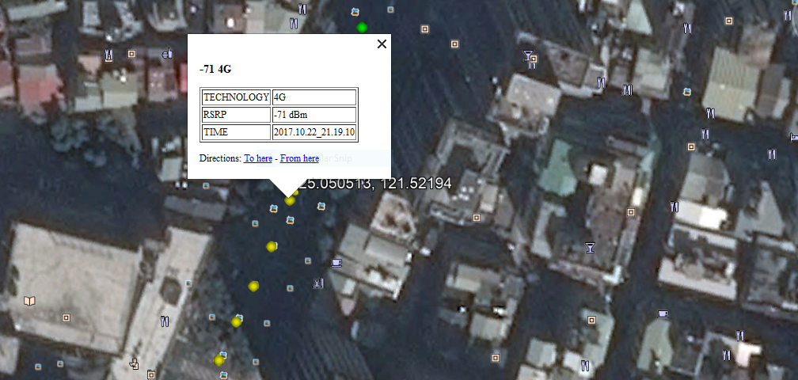
GT Near Cell: 25.050513, 121.52194

Slide 15
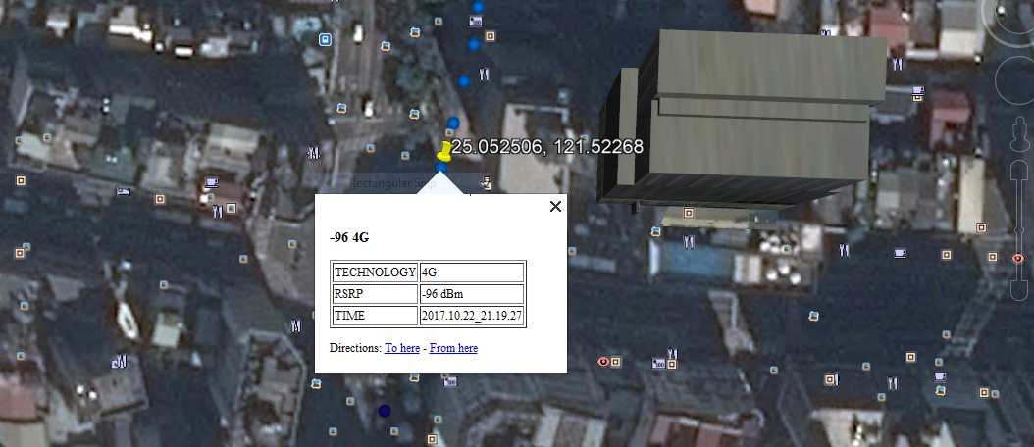
GT Edge Cell: 25.052506, 121.52268

Slide 16
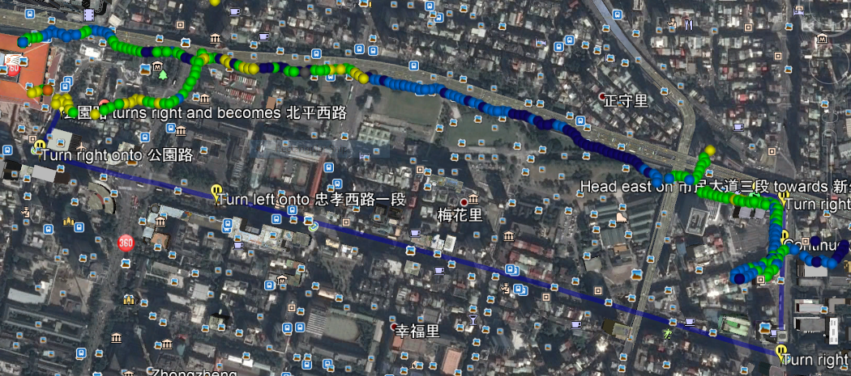
GT Mixed Mobility: from:25.0452942733, 121.532269567 (-86 4G) to:25.0469970434, 121.518915004 (-82 4G)

Slide 17
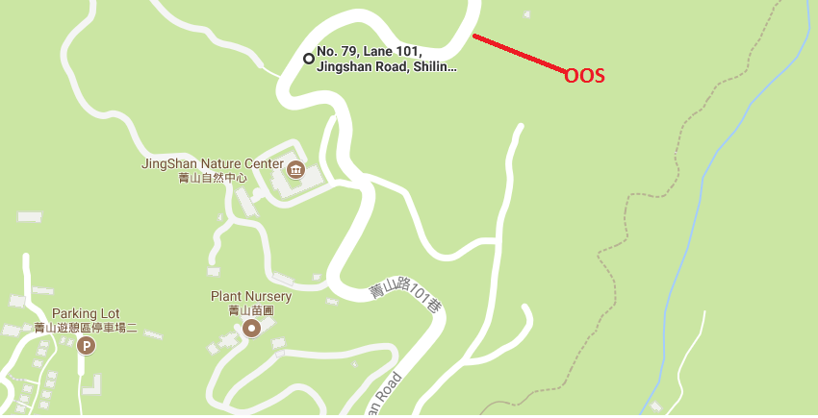
TW mobile: OOS area (No. 79, Lane 101, Jingshan Road, Shilin District, Taipei City, 111)

Slide 18
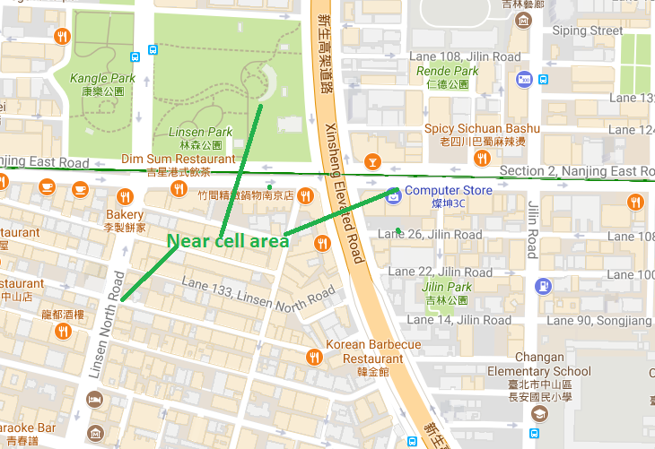
TW mobile: Near cell

Slide 19
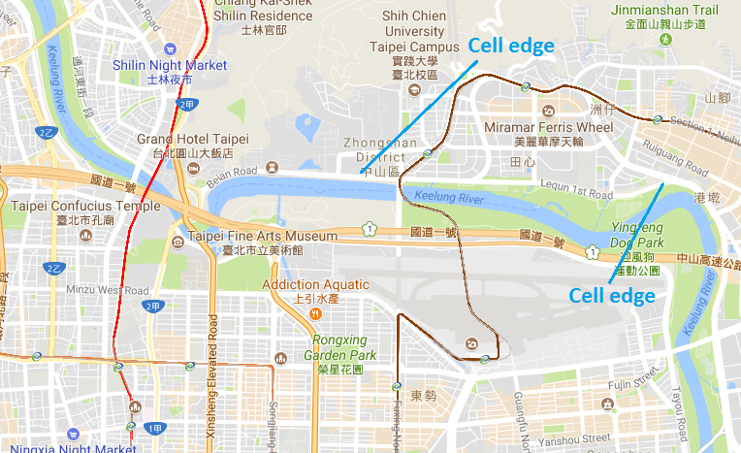
TW mobile: Edge cell

Slide 20
THANK YOU
MARQUIS TECHNOLOGIES
www.marquistech.com

